Slide 1
LAB PAPER PRESENTATION
Agentic Artificial Intelligence in Eye Care:
Is Clinical Autonomy Finally Within Reach?
Ke Zou, Jocelyn Hui Lin Goh, Gabriel Dawei Yang, Sahana Srinivasan, Qingyu Chen, Pearse A. Keane, Yih-Chung Tham*
The Lancet Digital Health, Vol 8, March 2026, 100967 (Comment)
Published online 19 Feb 2026 | doi: 10.1016/j.landig.2025.100967
National University of Singapore • Singapore Eye Research Institute • Yale • Moorfields / UCL
Presented by: Sheikh Sayed Bin Rahman
PIC Lab, Kumoh National Institute of Technology
Notes:
Good afternoon everyone. My name is Sheikh Sayed Bin Rahman from the PIC Lab. Today I will present the paper "Agentic Artificial Intelligence in Eye Care: Is Clinical Autonomy Finally Within Reach?" by Ke Zou and colleagues, with Yih-Chung Tham as the corresponding author. It was published in The Lancet Digital Health in March 2026. The authors are from the National University of Singapore, the Singapore Eye Research Institute, Yale University, and Moorfields Eye Hospital together with University College London. The paper discusses how agentic AI, meaning multiple autonomous AI agents working together, could change clinical workflows in ophthalmology.

Slide 2
About the Journal: The Lancet Digital Health
A top-tier Q1 journal at the intersection of medicine and digital technology
SCImago (SJR)
Clarivate JCR (SCIE)
Scopus CiteScore
6.838
IF 24.1 → 25.5
38.4
Q1
Q1
Q1
Q1 in every indexed category:
• Health Informatics
• Health Information Management
• Medicine (miscellaneous)
• Decision Sciences (misc.)
Latest SJR edition: Q1 (2025)
Journal Impact Factor:
• 24.1 (2024)
• 25.5 (2025)
Top ~2% of its categories
98.1st percentile — comfortably Q1
CiteScore 38.4
Ranked Q1 in Scopus
Article type: Comment (perspective / position paper) — proposes a framework rather than reporting an experiment.
Zou et al., Lancet Digital Health 2026; 8: 100967
2 / 15
Notes:
First, a quick word about the venue. The Lancet Digital Health is a Q1 journal across all major ranking systems. On SCImago it has an SJR of 6.838, and it is Q1 in every category it is indexed in: Health Informatics, Health Information Management, Medicine miscellaneous, and Decision Sciences miscellaneous. The most recent 2025 SJR edition also lists it as Q1. In Clarivate's Journal Citation Reports it is indexed in SCIE, with an impact factor of 24.1 for 2024 and 25.5 for 2025. That places it in about the top 2 percent of its categories, at the 98.1st percentile. Its Scopus CiteScore is 38.4, also Q1. One important note: this article is a Comment, which is a perspective paper. It proposes a conceptual framework and does not report experiments, so the methodology part of this talk is about the framework the authors propose.

Slide 3
Background & Motivation
Why current foundation models are not enough for the clinic
■ Foundation models — LLMs and large vision-language models (VLMs) — drive major progress in medical AI
■ But they are reactive: they only produce output in response to an explicit prompt
■ Constrained by task-specific training; little adaptability or autonomy
■ Cannot continuously perceive changes in clinical context, integrate new information, adjust reasoning, or initiate actions without a human
The clinical problem
Global shortage of ophthalmologists + ageing populations + comorbidities → rising workload and demand for personalised care.
The paper's question
Can agentic AI — autonomous, adaptive, collaborative agents — take over routine clinical tasks in eye care so clinicians focus on final decisions?
Zou et al., Lancet Digital Health 2026; 8: 100967
3 / 15
Notes:
Let me start with the motivation. Foundation models, meaning large language models and vision-language models, have pushed medical AI forward a lot. However, the authors point out that these models are reactive. They only produce an output when someone gives them an explicit prompt, and they are limited by task-specific training. They cannot keep track of changes in the clinical context, bring in new information on their own, adjust their reasoning, or take an action without a human. At the same time, ophthalmology faces a global shortage of specialists, while ageing populations and comorbidities make cases more complex. So the question of the paper is: can agentic AI take over routine clinical tasks, so that clinicians can focus on the final decisions?

Slide 4
Key Concepts: From Foundation Models to Agentic AI
Foundation model
AI agent
Agentic AI
(multi-agent)
LLM / VLM
Reactive: prompt → output
Task-specific
Foundation model
+ goal-oriented reasoning
+ tool use
Multiple specialised agents
share context, interact &
orchestrate tasks dynamically
Key attributes of agentic AI in medicine
Real-time adaptability
Contextual awareness
Autonomous decision making
Planning & tool selection
Proactive action (e.g., adjust treatment plans)
Goes beyond passive prediction: integrates history, symptoms and current condition to suggest diagnoses and personalised management.
Zou et al., Lancet Digital Health 2026; 8: 100967
4 / 15
Notes:
Here are the key concepts. On the left is a plain foundation model: you give it a prompt and it gives you an output. In the middle, an AI agent is a foundation model with two additions: goal-oriented reasoning and the ability to use tools. On the right, agentic AI is a multi-agent design. Several specialised agents interact, share context, and dynamically coordinate how tasks are carried out. The authors highlight these key attributes: real-time adaptability, contextual awareness, autonomous decision making, planning and tool selection, and proactive actions, for example adjusting a treatment plan based on the patient's response. In short, agentic AI moves from passive prediction to actively supporting the clinician through the whole decision process.

Slide 5
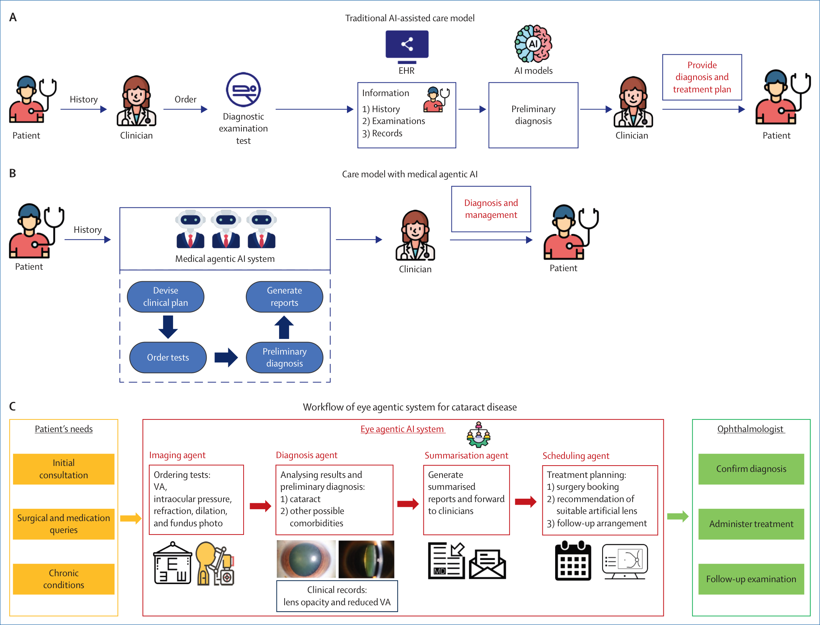
Methodology Overview: The Proposed Framework
Figure: Shift from traditional AI to agentic AI in medical workflows (extracted from the paper)
(A) Traditional AI
AI assists diagnosis only on clinician request; heavy oversight.
(B) Medical agentic AI
Agents plan, order tests, diagnose, and report; clinician makes final decision.
(C) Eye agentic system
Cataract use case: four specialised agents orchestrate the full consultation.
Zou et al., Lancet Digital Health 2026; 8: 100967
5 / 15
Notes:
This is the central figure of the paper, which I extracted directly from the PDF. It has three panels and it forms the methodology of the paper. Panel A shows today's traditional AI-assisted care model. Panel B shows the proposed care model with medical agentic AI. Panel C applies this idea to a concrete case: an eye agentic AI system for cataract disease. I will now go through each panel in detail.

Slide 6
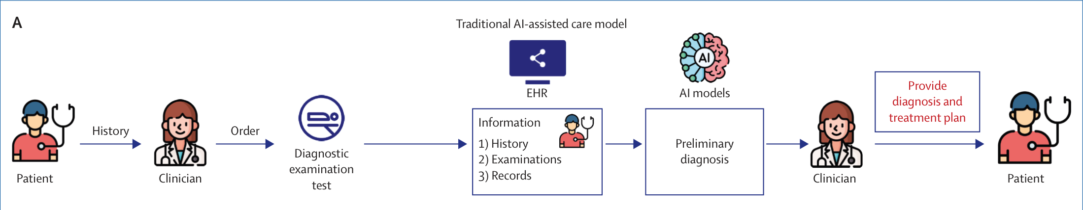
Methodology (A): Traditional AI-Assisted Care Model
The baseline the paper argues against
Workflow
Limitations
Patient history → clinician orders diagnostic tests → information (history, examinations, records) collected in the EHR → AI model gives a preliminary diagnosis → clinician provides diagnosis & treatment plan.
• AI acts only when the clinician requests it
• Limited autonomy, single isolated task
• Requires substantial clinician oversight
• Time consuming for the clinician
Zou et al., Lancet Digital Health 2026; 8: 100967
6 / 15
Notes:
Panel A is the traditional model, which is the baseline. The patient gives a history to the clinician. The clinician orders diagnostic tests. The history, examination results, and records are stored in the electronic health record. An AI model then reads this information and produces a preliminary diagnosis. Finally, the clinician makes the diagnosis and treatment plan. The key limitation is that the AI acts only when the clinician asks it to, and only for one isolated task. It has limited autonomy and needs a lot of clinician oversight, which takes up the clinician's time.

Slide 7
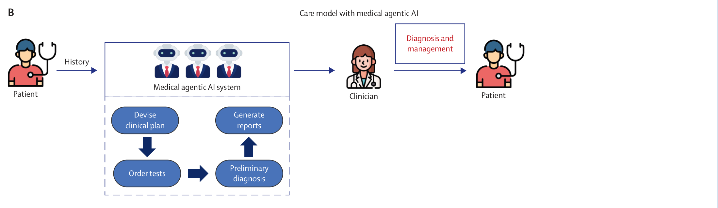
Methodology (B): Care Model with Medical Agentic AI
Agents act autonomously along the patient journey; clinician focuses on final decisions
1. Devise clinical plan
2. Order tests
3. Preliminary diagnosis
4. Generate reports
■ Multi-agent system takes the patient history, then handles test ordering, treatment planning, report drafting and preliminary interpretation
■ Routine / cognitively demanding work (history taking, note summarisation) is offloaded, which reduces workload and improves efficiency
Zou et al., Lancet Digital Health 2026; 8: 100967
7 / 15
Notes:
Panel B is the proposed care model with medical agentic AI. After the patient gives a history, a multi-agent system takes over most of the intermediate steps. As shown in the dashed box, the agents first devise a clinical plan, then order the tests, then produce a preliminary diagnosis, and finally generate reports. The clinician receives these outputs and focuses on the final diagnosis and management. The main idea is that routine or cognitively demanding tasks, such as history taking and summarising notes, are handled by the agents. This reduces the clinician's workload and improves efficiency, while the clinician stays in control of the final decision.

Slide 8
Why Ophthalmology Is a Good Fit for Agentic AI
Workforce shortage
Rising complexity
Multimodal data
Global shortage of ophthalmologists vs. growing service demand.
Ageing populations and comorbid conditions demand personalised, comprehensive care.
Rich imaging (fundus, slit-lamp, OCT) + clinical measurements — suited to VLMs + LLMs.
Protocol-driven
Bridging specialties
Resource optimisation
Standardised exam sequences (VA, IOP, refraction, dilation) map naturally onto agent tasks.
An eye-specific agent with ophthalmic + systemic knowledge can bridge subspecialty gaps.
Pre-completes consultation steps before the clinician's final review.
Zou et al., Lancet Digital Health 2026; 8: 100967
8 / 15
Notes:
Why do the authors pick ophthalmology? There are several reasons. First, there is a global shortage of ophthalmologists while demand keeps growing. Second, ageing populations and comorbidities make care more complex and personalised. Third, eye care is highly multimodal, with fundus photos, slit-lamp images, OCT and clinical measurements, which suits a combination of vision-language models and language models. Fourth, it is protocol-driven: standard examinations like visual acuity, intraocular pressure, refraction and dilation map naturally onto agent tasks. Also, an eye-specific agent that has both ophthalmic and systemic knowledge can bridge gaps between subspecialties and use resources better.

Slide 9
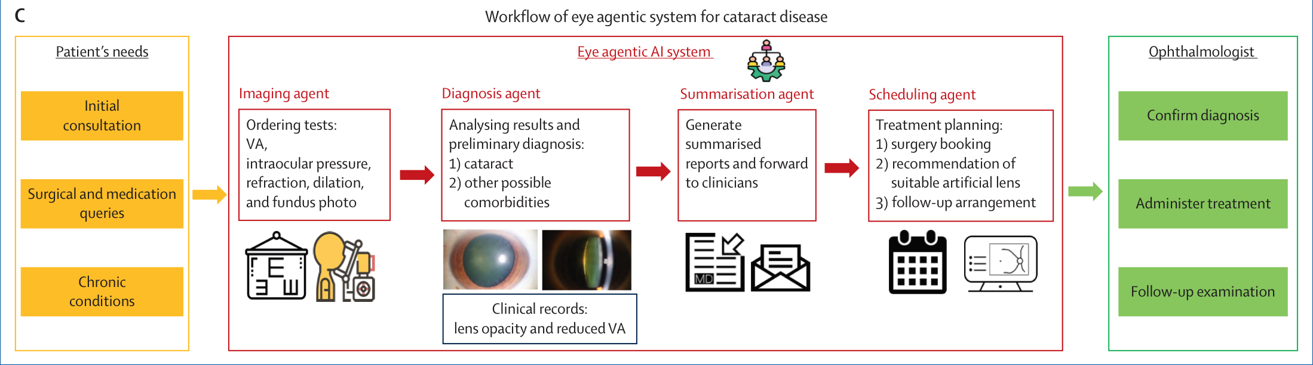
Methodology (C): Eye Agentic AI System for Cataract
Use case: patient needs → four collaborating agents → ophthalmologist
Input: patient's needs
Eye agentic AI system
Output: ophthalmologist
Initial consultation, surgical & medication queries, chronic conditions
Imaging → Diagnosis → Summarisation → Scheduling agents
Confirms diagnosis, administers treatment, follow-up examination
Zou et al., Lancet Digital Health 2026; 8: 100967
9 / 15
Notes:
Panel C is the cataract use case. On the left, in orange, are the patient's needs: an initial consultation, questions about surgery or medication, and chronic conditions. In the middle, in the red box, is the eye agentic AI system with four specialised agents working in sequence: the imaging agent, the diagnosis agent, the summarisation agent, and the scheduling agent. On the right, in green, is the ophthalmologist, who confirms the diagnosis, administers treatment, and performs the follow-up examination. So the agents prepare everything, and the human expert makes the final call.

Slide 10
Methodology (C): Agent-by-Agent Pipeline
Each agent owns one subtask; together they complete the consultation before clinician review
Imaging agent
Diagnosis agent
Summarisation agent
Scheduling agent
LLM
VLM
LLM
Triggered
Gathers eye complaints & visual demands; autonomously orders tests: VA, intraocular pressure, refraction, dilation, fundus photo
Analyses acquired ocular images; preliminary diagnosis: (1) cataract, (2) other comorbidities. Evidence: lens opacity, reduced VA
Compiles diagnostic information into summarised reports and a preliminary treatment plan; forwards to clinician
If significant cataract: books surgery, recommends a suitable artificial lens (IOL), plans tailored post-op follow-up
Result: consultation, diagnostic interpretation and follow-up preparation are done in advance → streamlined, patient-centred workflow; the clinician retains the final decision.
Zou et al., Lancet Digital Health 2026; 8: 100967
10 / 15
Notes:
Let's look at each agent. The first agent uses an LLM to collect the patient's eye complaints and visual demands, and then orders the preliminary tests by itself: visual acuity, intraocular pressure, refraction, dilation, and a fundus photo. Next, the diagnosis agent uses a vision-language model to analyse the ocular images and give a preliminary diagnosis: cataract and any other possible comorbidities, based on evidence such as lens opacity and reduced visual acuity. Then the summarisation agent, also LLM-based, compiles all diagnostic information into a report and a preliminary treatment plan, and forwards it to the clinician. Finally, if a significant cataract is detected, the scheduling agent is triggered. It books the surgery, recommends a suitable artificial lens implant, and prepares a tailored post-surgery follow-up plan. As a result, the consultation, diagnostic interpretation, and follow-up preparation are all completed before the clinician's final review.

Slide 11
Challenges of Agentic AI in Healthcare
Five real-world barriers identified by the authors
1. Computational cost
Storing/processing clinical history, imaging and inter-agent dialogue strains edge and mobile devices.
2. Fragile coordination
Without standard protocols and shared goals, agents may give inconsistent outputs or compete for resources (e.g., emergency triage).
3. Emergent behaviour
Complex interactions can be unsafe, e.g., scheduling and diagnostic agents mis-prioritising high-risk patients.
4. Debugging & traceability
Tracing decisions across asynchronous, interdependent agents is hard and erodes clinician trust.
5. Fairness, ethics & safety
Remain considerably under-explored for agentic deployments.
Zou et al., Lancet Digital Health 2026; 8: 100967
11 / 15
Notes:
Of course, there are serious challenges, and the authors list five. First, computational cost: multi-agent systems must store and process clinical history, images, and the dialogue between agents, which strains edge and mobile devices. Second, coordination is fragile. Without standard protocols and shared goals, agents might give inconsistent outputs or compete for resources, especially in complex workflows such as emergency triage. Third, emergent behaviour: for example, the scheduling and diagnosis agents might prioritise high-risk patients inconsistently, delaying urgent cases. Fourth, debugging and traceability: as the number of agents grows, it becomes hard to trace how a decision was made, which hurts transparency and clinician trust. Fifth, fairness, ethics, and patient safety are still largely unexplored for these systems.

Slide 12
Proposed Solutions & Key Enablers
Coordinated advances needed across several fronts
Human-in-the-loop
Standardised protocols & semantic planning
Expert oversight to guide agents and correct errors in time.
Better coordination, less ambiguity, outputs aligned with clinical workflow & intent.
Verifiable governance
Cross-specialty reasoning
Real-time behaviour monitoring, enforced safety limits, models predicting agent–environment interaction.
Shared causal reasoning + coherent context modelling between ophthalmic and systemic agents for interpretability.
Privacy and fairness must be safeguarded at the core to earn clinician & patient trust and ensure equitable care.
Zou et al., Lancet Digital Health 2026; 8: 100967
12 / 15
Notes:
To address these challenges, the authors propose four key enablers. First, human-in-the-loop designs, so that experts can guide the agents and correct errors in time. Second, standardised communication protocols and semantic planning frameworks to improve coordination and keep agent outputs aligned with clinical workflows and intent. Third, verifiable governance: monitoring the system's behaviour in real time, enforcing safety limits, and using models that predict how the system will interact with its environment. Fourth, for cross-specialty collaboration, for example between ophthalmic and systemic agents, shared causal reasoning and coherent context modelling are needed for interpretability. Underlying all of this, privacy and fairness must be built in from the start, otherwise clinicians and patients will not trust these systems.

Slide 13
Conclusion
■ Agentic AI moves medical AI from reactive prediction to autonomous, interactive and adaptive assistance
■ Can analyse clinical patterns, assist diagnosis, personalise treatment and support longitudinal care
■ Ophthalmology is a compelling first domain: multimodal and protocol-driven
■ The cataract case shows four agents completing the consultation pipeline before clinician review
■ Clinical autonomy is within reach, but only with human oversight, standard protocols, verifiable governance, and privacy/fairness by design
Answer to the title question: “partially” — the technology is ready for supervised autonomy on routine tasks; full autonomy awaits solutions to safety, coordination and trust.
Zou et al., Lancet Digital Health 2026; 8: 100967
13 / 15
Notes:
To conclude: agentic AI moves medical AI from reactive prediction towards autonomous, interactive, and adaptive assistance. It could analyse clinical patterns, assist diagnosis, personalise treatment, and support long-term care. Ophthalmology is a strong first domain because it is multimodal and protocol-driven, and the cataract case shows how four agents could complete the consultation pipeline before the clinician reviews it. So, to answer the title question, my reading is: partially. The technology seems ready for supervised autonomy on routine tasks, but full autonomy still depends on solving safety, coordination, and trust.

Slide 14
Critical Discussion
Our assessment for lab discussion
Strengths
Limitations
• Clear conceptual model contrasting traditional vs. agentic AI
• Concrete, end-to-end clinical use case (cataract)
• Balanced view: candid list of challenges & enablers
• Strong author team (NUS, SERI, Yale, Moorfields/UCL)
• Timely topic in a high-impact Q1 venue
• Comment article: no implementation, dataset or quantitative evaluation
• Agent architecture, models, and communication protocol not specified
• No latency, accuracy or cost measurements for the workflow
• Security / privacy of inter-agent communication only briefly mentioned
• Edge-device feasibility flagged but not analysed
Open questions: How should agents communicate securely and efficiently on resource-constrained edge devices? How do we validate and audit multi-agent decisions?
Zou et al., Lancet Digital Health 2026; 8: 100967
14 / 15
Notes:
Finally, here is my own critical assessment for our discussion. This slide is my view, not the authors'. On the strengths side, the paper gives a very clear conceptual comparison between traditional and agentic AI, a concrete end-to-end use case, and a balanced discussion of challenges. It also comes from a strong team and is published in a high-impact venue. On the limitations side, because it is a Comment, there is no implementation, no dataset, and no quantitative evaluation. The architecture, the specific models, and the communication protocol between agents are not specified, and there are no measurements of latency, accuracy, or cost. Security and privacy of the communication between agents, and feasibility on edge devices, are mentioned but not analysed. These open questions are relevant to our lab's work on secure, resource-constrained IoT communication.

Slide 15
Thank You
Questions & Discussion
Zou K, Goh JHL, Yang GD, Srinivasan S, Chen Q, Keane PA, Tham Y-C. Agentic artificial intelligence in eye care: is clinical autonomy finally within reach? Lancet Digit Health 2026; 8: 100967. doi:10.1016/j.landig.2025.100967
Sheikh Sayed Bin Rahman
PIC Lab, Kumoh National Institute of Technology
Notes:
Thank you for your attention. I'm happy to take any questions or comments, and the full citation of the paper is shown here on the slide.

