Slide 1
Analyzing and Predicting Hypertension using National Healthcare Insurance Claims Dataset
Sukyung Seo (ss13969@nyu.edu)
05/03/2022
Notes:
Hello, I am Sukyung and today I’m going to present “Analyzing and Predicting Hypertension using National Healthcare Insurance Claims Dataset” //

Slide 2
Introduction (1)
Hypertension is one of the most critical diseases in the world. It is often comorbid with other diseases such as diabetes and obesity
It can further lead to life-threatening conditions including cardiovascular diseases.
33% of US adults already have hypertension and pay nearly $2000 more per year for medical care than patients who do not have hypertension.
Thus, the identification of hypertension in its early stages is a key to preventing further, more deadly complications.
Notes:
First I will talk about why this kind of study is needed./
Hypertension is one of the most critical diseases in the world. It is often comorbid with other diseases such as diabetes and obesity and can further lead to life-threatening conditions./
thirty-three present of US adults already have hypertension and they pay nearly $2000 more per year for medical care than patients who do not have hypertension. //

Slide 3
Introduction (2)
Krishnamurthy et al., predicted the occurrence of Chronic Kidney Disease (CKD) using Taiwan’s National Health Insurance Research database.
They developed a machine-learning model using medication and comorbidity information from the database to find correlations and aggregate health data.
This study proposed a machine learning approach for the prediction and identification of hypertension by leveraging Korea’s national health insurance claim data.
Notes:
Now, I want to talk about the previous study and the objective of this study./
크리스나머띠 predicted the occurrence of Chronic Kidney Disease (CKD) and developed a machine-learning model using medication and comorbidity information from the Taiwan’s National Health Insurance Research database to find correlations and aggregate health data. /
This study proposed a machine learning approach for the prediction and identification of hypertension by leveraging Korea’s national health insurance claim data. //

Slide 4

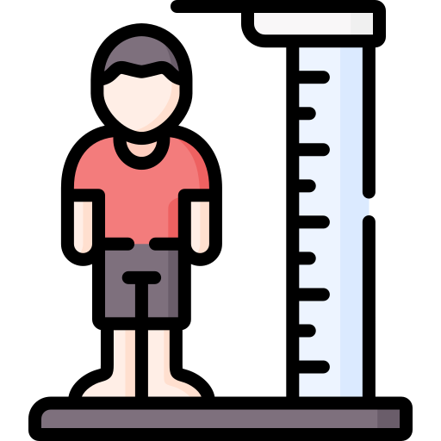

Methodology (1)
Dataset Collection
Downloaded two kinds of Korean National Healthcare Insurance Claims Database (02/2022).
Patient’s Basic Examination Data (i.e. AST/cholesterol blood test)
Patient’s Disease Data
Notes:
In this part, I want to explain how I performed this project.
First I collected datasets. I downloaded two kinds of Korean National Healthcare Insurance Claims Database in February of 2022. One dataset contains Patient’s Basic Examination Data which contains blood test results and blood pressure measurements.The other dataset contains Patient’s disease data which contains disease codes assigned based on what they were diagnosed with.

Slide 5

Methodology (2)
Dataset Preprocessing
Combined two kinds of data based on the patient’s unique code and removed missing values
If patients experienced hypertension, I excluded their other disease records.
If one patient had several records with different disease codes, I kept only one record.
Positive samples : patients who experienced high blood pressure
Negative samples : patients who experienced other diseases
Notes:
Second, I pre-processed datasets by combining two datasets based on the patient’s unique code and removing missing values. Then, I did additional pre-processing. If a patient already experienced hypertension, I only left the record of hypertension and removed other disease records. It was defined as positive samples.
If a patient didn’t experience hypertension but had several other different disease records, I only left one. I defined these as negative samples.

Slide 6


Methodology (3)
Dataset Visualization
Disease types based on sex
Average number of prescription days by age
Adopting Machine Learning Techniques
Adopted eight machine learning algorithms
Decision Tree, Random Forest, Stochastic Gradient Descent (SGD), k-Nearest Neighbor(kNN), Naive Bayes, Logistic Regression, Support Vector Machine (SVM), eXtreme Gradient Boosting (XGBoost)
Reported F1, accuracy, precision and recall.
Notes:
Third, I visualized datasets such as disease types based on sex and the average number of prescription days by age.
Finally, I adopted 8 (EIGHT not A) machine learning algorithms such as Decision Tree, Random Forest, Stochastic Gradient Descent (SGD), k-Nearest Neighbor(kNN), Naive Bayes, Logistic Regression, Support Vector Machine (SVM), eXtreme Gradient Boosting (XGBoost). And I reported F1, accuracy, precision and recall.

Slide 7
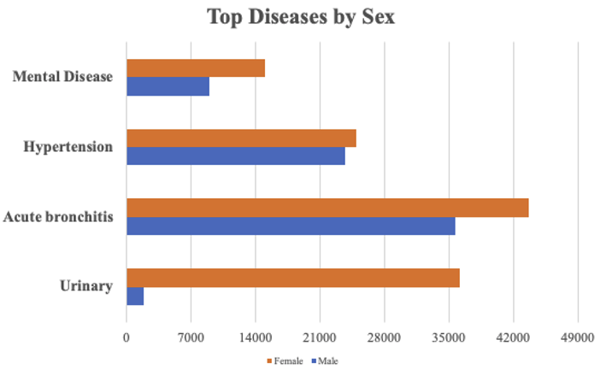
Results/Discussion - Visualization (1)
Notes:
The Next section is the result and discussion section.
In this graph, I visualized top diseases by sex. Orange indicates female and blue indicates male.
Hypertension is a common disease for both females and males. The one interesting thing is that urinary(유리내리) disease is only common in females. //

Slide 8
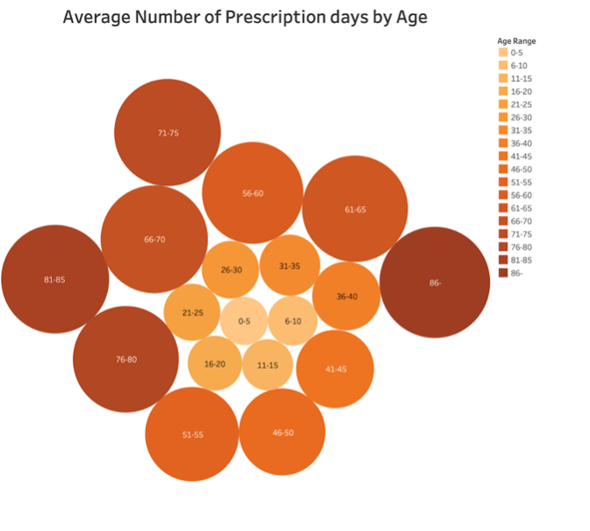
Results/Discussion - Visualization (2)
Notes:
This graph shows that as the age increases, the size of the circle increases. It clearly shows that older people are susceptible to diseases, and they take a lot of medications. //

Slide 9
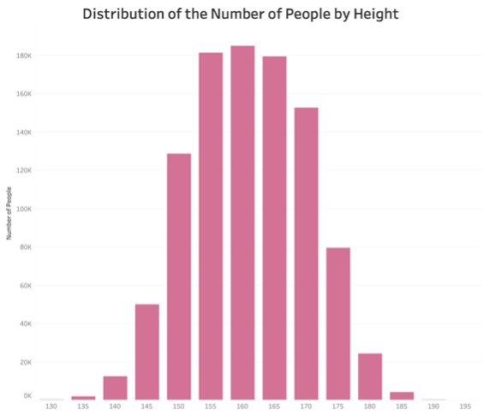
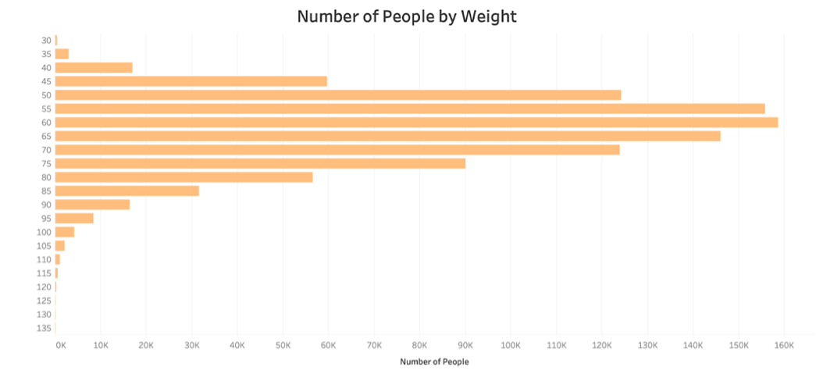
Results/Discussion - Visualization (3)
160 cm
60 kg
Notes:
These two graphs show that the median height and weight for Koreans was 60 kg and 160cm. This is consistent with previous literature. //

Slide 10
Results/Discussion - Performance Metrics (1)
Model | Accuracy | Precision | Recall | F1
SGD | 0.5559 | 0.7911 | 0.1520 | 0.2550
kNN | 0.6000 | 0.5931 | 0.6371 | 0.6143
Decision Tree | 0.6652 | 0.6690 | 0.6537 | 0.6613
Naive Bayes | 0.7515 | 0.7109 | 0.8475 | 0.7733
Logistic Regression | 0.7518 | 0.7324 | 0.7936 | 0.7618
SVM | 0.7547 | 0.7049 | 0.8762 | 0.7813
Random Forest | 0.7565 | 0.7098 | 0.8678 | 0.7809
XGBoost | 0.7621 | 0.7111 | 0.8828 | 0.7877
x1.37
Notes:
In SGD model accuracy was 0.55 and it showed poor performance on other metrics. However, after adopting XGBoost, I achieved 0.76 in accuracy which was a 37 % improvement. //

Slide 11
Results/Discussion - Performance Metrics (2)
Model | Accuracy | Precision | Recall | F1
SGD | 0.7526 | 0.6863 | 0.9305 | 0.7899
kNN | 0.6708 | 0.6465 | 0.7537 | 0.6960
Decision Tree | 0.7619 | 0.7121 | 0.8791 | 0.7869
Naive Bayes | 0.7542 | 0.7061 | 0.8708 | 0.7799
SVM | 0.6316 | 0.6535 | 0.5603 | 0.6033
Random Forest | 0.7590 | 0.7039 | 0.8941 | 0.7877
XGBoost | 0.7620 | 0.7109 | 0.8830 | 0.7877
Notes:
After hyperparameter tuning, performance improved in almost all models except some models. In most metrics it achieved over 0.6. //

Slide 12
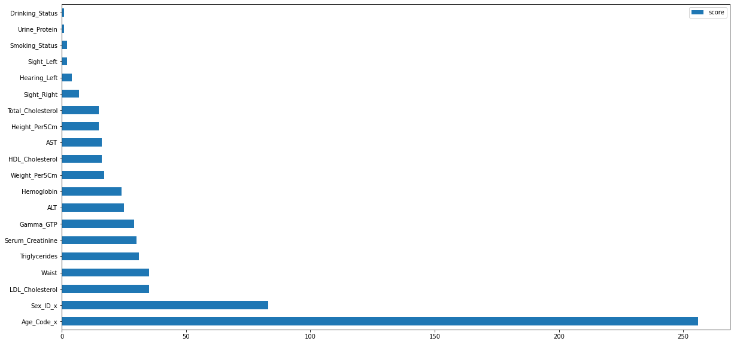
Feature importance in XGBoost
Age - Gurven et al.,
Sex - Reckelhoff et al.,
Notes:
the most influential feature was age, and it was twice as important as the next influential feature, sex. It has already been shown that age is an important risk factor of high blood pressure . Gender was also shown as a key factor according to the literature. //

Slide 13
Conclusion
The accuracy scores improved 1.37x when using the XGBoost model.
A similar approach could be taken to many different diseases.
The limitation of this method is that if there is a disease with a small number of patients, it is hard to apply machine learning algorithms because it cannot fully exploit the characteristics of machine learning.
However, since healthcare data is accumulating quickly, this limitation will likely be overcome in the near future.
Notes:
A similar approach could be applied to many different diseases. /
The limitation of this method is that if there is a disease with a small number of patients, it is hard to apply machine learning algorithms because the datasets aren’t large enough to fully exploit the characteristics of machine learning. /
However, since healthcare data is accumulating quickly, this limitation will probably be overcome in the near future. /

Slide 14

Demo
See Google colab file

Slide 15

QnA
Questions?

Slide 16
References
Mawaw, P. M., Yav, T., Mukuku, O., Lukanka, O., Kazadi, P. M., Tambwe, D., ... & Luboya, O. N. (2017). Prevalence of obesity, diabetes mellitus, hypertension and associated risk factors in a mining workforce, Democratic Republic of Congo. Pan African Medical Journal, 28(1).
Kirkland, E. B., Heincelman, M., Bishu, K. G., Schumann, S. O., Schreiner, A., Axon, R. N., ... & Moran, W. P. (2018). Trends in healthcare expenditures among US adults with hypertension: national estimates, 2003–2014. Journal of the American Heart Association, 7(11), e008731.
Lackland, D. T. (2017). Early-Life Detection of Hypertension Risks: Implications for Clinical Practice and Research. Hypertension, 70(3), 486-487.
Krishnamurthy, S., Ks, K., Dovgan, E., Luštrek, M., Gradišek Piletič, B., Srinivasan, K., ... & Syed-Abdul, S. (2021, May). Machine learning prediction models for chronic kidney disease using national health insurance claim data in Taiwan. In Healthcare (Vol. 9, No. 5, p. 546). Multidisciplinary Digital Publishing Institute.
Gurven, M., Blackwell, A. D., Rodríguez, D. E., Stieglitz, J., & Kaplan, H. (2012). Does blood pressure inevitably rise with age? Longitudinal evidence among forager-horticulturalists. Hypertension, 60(1), 25-33.
Reckelhoff, J. F. (2001). Gender differences in the regulation of blood pressure. Hypertension, 37(5), 1199-1208.

Slide 17

Thank You

