Slide 1

Design and Verification of a I2C based memory subsystem
TEAM NO : 3
Bhavani Gunda
Namratha Nadh Jammalamadugu
Shamsi Shak
Sujith Krishna Balusu
Naga sai Navaneeth Immadi
Venkat Ramana Molabanti

Slide 2
Agenda
Objective.
I2C Protocol.
Design Specifications.
Implementation.
Functional Unit.
I2C Interface.
Memory Controller.
System Verilog Constraints.
Assertions.
Coverage.
Results.
Conclusion.

Slide 3
Objective
Create a functional and efficient memory subsystem that utilizes the I2C communication protocol.
Develop the memory subsystem architecture that meets the specified requirements.
Design and implement master and slave modules considering factors like address mapping and data transfer.
Intergate the memory module with the memory subsystem to ensure proper communication between I2C slave and memory module.
Verify this design by creating a suitable verification methodology.

Slide 4
I2C Protocol
Serial Communication Protocol.
Two wired Protocol(SDA and SCL).
Based on Master-Slave Architecture.
Each device on the bus is assigned with unique address.
Master controls the data transfer, sending read/write commands to the slave.
Supports multi-master configurations.
Includes error detection mechanisms like acknowledge bits to ensure reliable data transfer.

Slide 5
Design Specifications
No of masters = 1.
No of slaves = 1.
Error detection mechanisms used = Acknowledge bit.
Memory capacity

Slide 6

Implementation
The I2C based memory subsystem consists of 3 blocks
Functional Unit.
I2C Module.
Memory Controller Module.
Build a SV-based testbench to verify the functionality.
Build a top level testbench to verify the overall functionality.
Executed and simulated in Questasim 10.4c

Slide 7
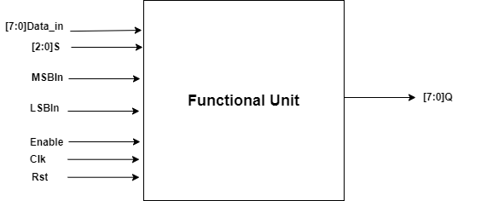
Functional Unit
This shift register allows two main operations: loading a value into the register (parallel load) and shifting the bits to the right (or left when the shift register is inverted).
If no operation is specified, the shift register retains its current value.
Shift registers also support arithmetic shift and rotate operations.
The logical shift right operation uses the serial input MSB_in, which is the Most Significant Bit.
The logical shift left operation uses the serial input LSB_in, which is the Least Significant Bit.

Slide 8
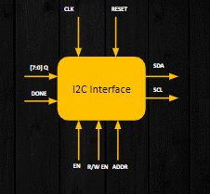
I2C Interface
Master Unit of the design.
Synchronous single master-single slave interface.
Handling Addresses.
Registers.
Bus Control.
The two lines of communication:
SDA (Serial Data Line)
SCL(Serial Clock Line)

Slide 9
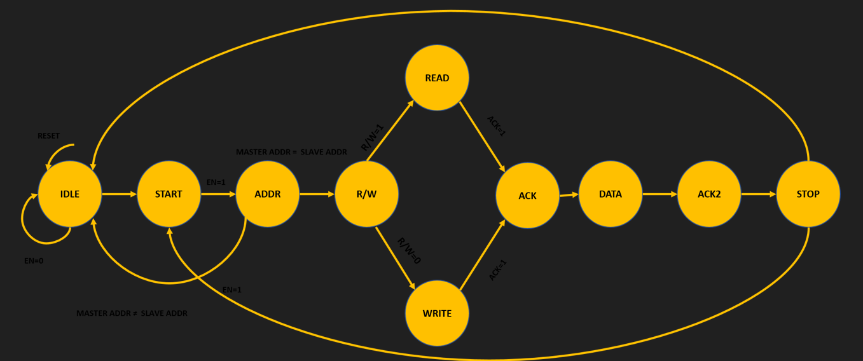
I2C Interface FSM

Slide 10
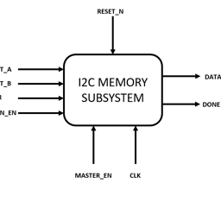
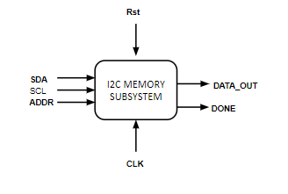
Memory Controller
Slave Unit of the design.
Peripheral Device
Respond to commands and requests from master.
Manages the addressing of memory.
Bus Arbitration.
Data Transfer Control.
Acknowledges the data.

Slide 11
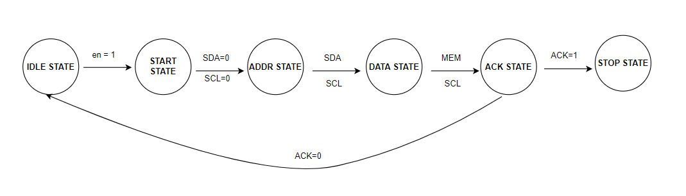
Memory Controller FSM

Slide 12
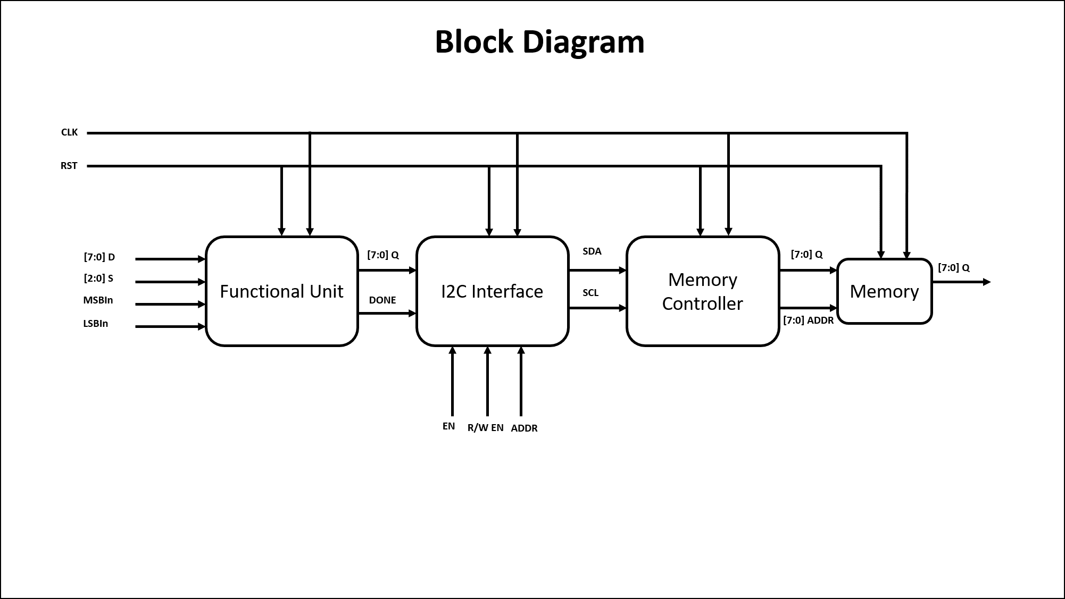
I2C based memory subsystem

Slide 13
System Verilog Constraints
Interfaces.
Packages.
Queues.
Arrays.
Assertions.
Randomization.
Classes
I2C Transactions.
Functions.
State Machines
One Hot encoding Style.
Used Enumerated type.
Used unique case.
Used reverse case statements.

Slide 14
Assertions
Clock Stretching Assertion.
Data Transfer Assertion.
Error Handling Assertion: ACK/NACK Assertion.
Data Validity Assertion.
Assertions for checking state transitions and outputs -
Reset state.
Idle state.
Start State.
Address State.
Read-Write State.
Acknowledge State.
Data State.

Slide 15
Coverage
Functional coverage is established to ensure accurate implementation of essential functionality in I2C master and slave modules by defining coverage objectives based on protocol standards and requirements encompassing communication scenarios, data transmission methods, and fault scenarios.
Interface coverage validates the correct integration and communication between I2C master and slave modules by ensuring that signals and data adhere to specified synchronization and timing requirements.

Slide 16
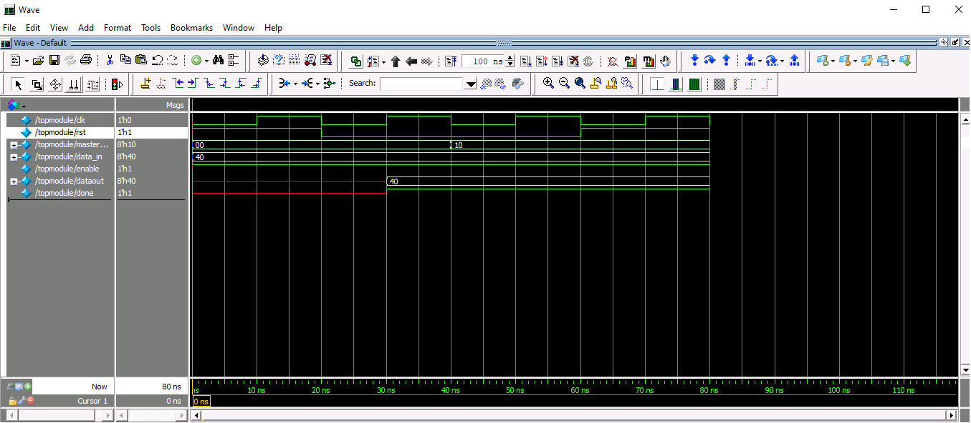
Results(Top Level Module)

Slide 17
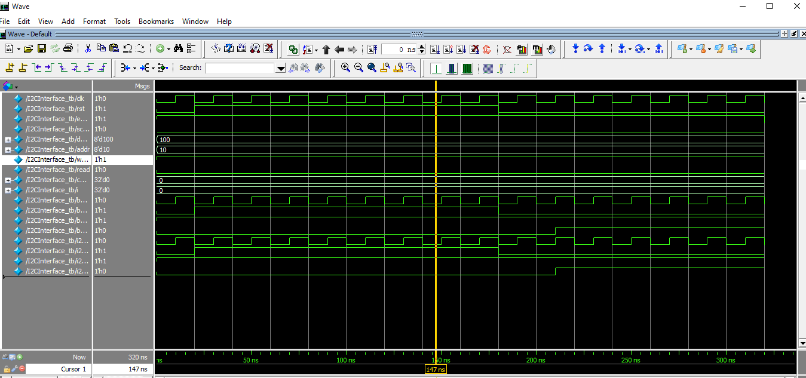
Results(I2C Module)

Slide 18
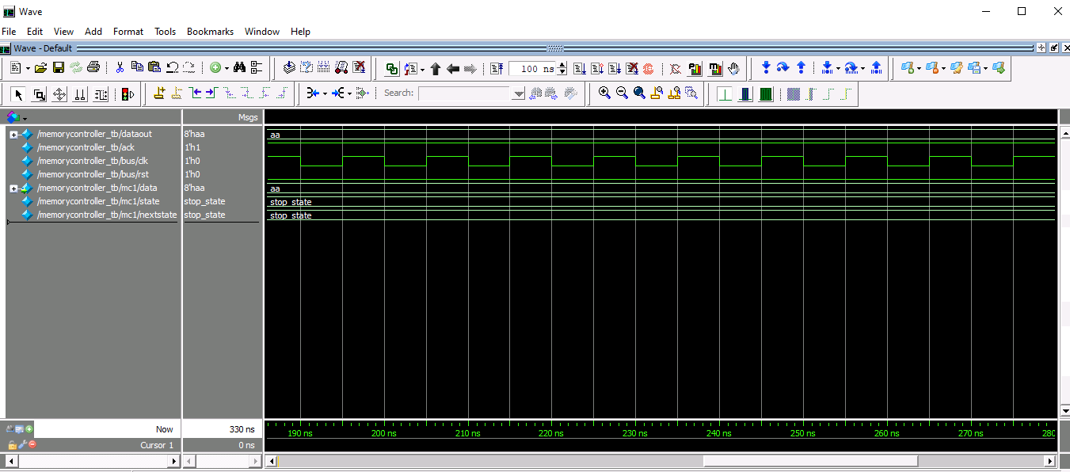
Results(Memory Controller)

Slide 19
Conclusion
Design and Verification of a I2C based memory subsystem is done properly.
Entails putting various techniques and constructs to use to enable device communication.
To manage data, configuration, and control within the I2C master and slave modules, a variety of constructs of system Verilog, including queues, arrays, interfaces, packages, coverage and classes are used.
State machines are used to model the different I2C communication states and transitions, ensuring proper protocol adherence.
Assertions are employed to verify the correctness of I2C protocol behaviors and detect violations during simulation.
Interfacing the signals for functional unit,I2C module and memory controller are done.

Slide 20
Thank you

