Slide 1
Python Beginner Document
2017

Slide 2
Table of Contents
SNo. | Description | Slide No.
1 | xxx
2 | xxx
3 | xx
4 | xxx
5 | xxx
6 | xxx

Slide 3
1 – Python: An Introduction
Introduction
Python - a high-level, interpreted, interactive and object-oriented scripting language - was developed by Guido van Rossum in the late eighties and early nineties at the National Research Institute for Mathematics and Computer Science in the Netherlands
Python is designed to be highly readable and has fewer syntactical constructions than other languages
It is processed at runtime by the interpreter, while in some other languages program needs to compiled first before executing
An interactive language where we can interact with our lines of code on the python prompt
It is also an object-oriented language, which basically encapsulates the python code with the objects
Python can be downloaded from: http://www.python.org/download/
Pros and Cons
Pros
Cons
Easy to use
Sometimes, gets a little slow because of its dynamically typed nature
Dynamically typed language
Python global interpreter lock, only a single thread can run access internals at a time
In Python, everything is object
Large community support

Slide 4



2 – Python: How to Write a Python Program?
Interactive Mode Programming
Open the Linux Terminal and type ‘python’. This will help us enter the python mode:
Now Type: >>> print "Hello, Python!“
This command will help us print the text contained within “..”. Thus, the output in case would be: Hello, Python!
Script Mode Programming
Create a file with extension .py
Type the following line to the file: print "Hello, Python!“ and save the file with the name ‘hello.py’
Once the file is created, we can run the following command to run the file on python terminal: python ./filename (the filename is hello.py in this example)
This will help run the command/script in the file and print the output accordingly

Slide 5
3 – Python Keywords
Python Keywords
and
Logical and
if
If condition
assert
Assert (ensure) that something is true
import
Import a module into this one to use
break
Stop this loop right now
in
Part of for-loops. Also a test of X in Y
class
Define a class
is
Like == to test equality
continue
Don’t process more of the loop, do it again
lambda
Create a short anonymous function
def
Define a function
not
Logical not
del
Delete from dictionary
or
Logical or
elif
Else if condition
pass
This block is empty
else
Else condition
print
Print this string
except
If an exception happens, do this
raise
Raise an exception when things go wrong
exec
Run a string as Python
return
Exit the function with a return value
finally
Assets
try
Try this block, and if exception, go to except
for
Assets
while
While loop
from
Assets
with
With an expression as a variable do
global
Assets
yield
Pause here and return to caller

Slide 6




4 – Lines & Indentation
Lines & Indentation
Python provide no braces to indicate the code blocks. Python use indentation and it is variable, but all statements must be intended with same amount.
Multiline statements
Python allows use of the line continuation character (\) to denote that the line should continue.
Statements contained within the [], {} or () brackets do not need to use the line continuation character.
Now Type: >>> print (var)
This command will help us print the output contained within the var. Thus, the output in case would be: 6
also used with the list, tuple, dictionary. Do not vary about the datatypes, we will cover those in future chapter.
Type: # This is my python script
This command will print the comments
Comments

Slide 7


5 – Lines & Indentation
Multiple statement in single line
Now Type: >>> print (a,b,c)
This command will help us print the output. Thus, the output in case would be: 1 2 3
raw_input ^{[1]}
decision = raw_input(‘Please enter your decision\n’)
After running the above statement user has to write its decision on terminal, his/her decision will be save in the variable decision
raw_input function takes user entry and its type is <str>
Input
Decision = input(‘Please enter your decision\n’)
After running the above statement user has to write its decision on terminal, his/her decision will be save in the variable decision.
Input function takes user entry and its type will depend on the user entry
Take Input from user
Notes
[1]: raw_input() does not exist in Python 3.x, while input() does. Actually, the old raw_input() has been renamed to input()

Slide 8
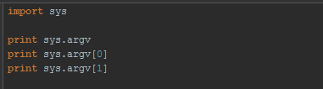
6 – Command line arguments
Command line arguments
python test.py arg1 arg2
test.py
Notes
[1]: raw_input() does not exist in Python 3.x, while input() does. Actually, the old raw_input() has been renamed to input()

Slide 9
7 – Variable
Variable
Variables are the reserved memory location, you can assign values to them
Example
a =2 ((a is the integer variable, a holds value 2)
a Memory Location (0xFFFF)
a = 100.0 (a is the float variable, a holds value 100.0)
a = ‘Cians’ (a is the string variable, a holds value Cians)
2
Data Type
Numbers
String
List
Tuple
Dictionary

Slide 10


8 – Data Type
Numbers
int
Number data types hold numeric values
Example
var = 100
complex
Python support 4 types of numerical types
long
float
String
String is the contiguous set of characters represented in quotation mark.
Example
var = ‘CiansAnalytics’

Slide 11








9 – Data Type
String
# Prints the first character of the string
# Print the last character of the string
# Print all character starting from 3rd to 5th
# Print all character starting from 3rd
# Print string two times
# Print the concatenation of both string
List
A list contains items separated by commas and enclosed within square brackets ([]). List is like arrays in C
We also can use the slice Operator on list
Example
var = ‘CiansAnalytics’
# Print the first element of the list

Slide 12



8 – Data Type
Tuple
Tuple is another sequence data type that is similar to list
Example
While in tuple this is not possible
Tuple syntax is different from list
Example

Slide 13

8 – Data Type
Dictionary
Python dictionary are kind of hash table, it consists of key-value pair. Dictionary key can be any python data type.
Dictionaries are enclosed by curly braces ({ }) and values can be assigned and accessed using square braces ([]).
Example
Data Type conversion
Int(x[,base]) | Converts x to an integer. base specifies the base if x is a string
long(x [,base] ) | Converts x to a long integer. base specifies the base if x is a string.
float(x) | Converts x to a floating-point number.
complex(real [,imag]) | Creates a complex number.
str(x) | Converts object x to a string representation.
list(s) | Converts s to a list.
tuple(s) | Converts s to a tuple.
dict(d) | Creates a dictionary. d must be a sequence of (key, value) tuples.

Slide 14
9 – Operator
Types of operator
Airthematic
Logical
comparison
Python operators
Bitwise
Assignment
Membership
Identity

Slide 15
9 – Operator
Airthematic operator
Operator | Description | Example
+ | Addition – Add two numbers | a = 5, b = 10, a+b = 15
- | Subtraction – Subtract two numbers | a = 5, b = 10, a-b = -5
/ | Division – Divide two numbers | a = 5, b =10, a/b = 0 a = 5.0, b=10.0, a/b = 0.5
* | Multiplication – Multiply two numbers | a = 5, b =10, a*b = 50
% | Modulus - divides the two numbers and return remainder | a = 5, b = 10, a%b = 5
** | Exponent – Do the exponential calculation | a = 5, b = 10, a**b = 9765625
// | Floor Division - The division of operands where the result is the quotient in which the digits after the decimal point are removed. | a = 9.9, b = 5. a//b = 1.0

Slide 16
9 – Operator
Comparison operator
Operator | Description | Example
== | Compare two values if equal then True Otherwise False | a = 5, b = 10 a == b False
!= | Compare two values if not equal then True Otherwise False | a = 5, b = 10 a != b True
> | If value of LHS greater than the RHS then True Otherwise False | a = 5, b = 10 a > b False
< | If value of LHS smaller than the RHS then True Otherwise False | a = 5, b = 10 a ><b True
>= | If value of LHS greater than or equal to the RHS then True Otherwise False | a = 5, b = 5 a >= b True
<= | If value of LHS smaller than or equal the RHS then True Otherwise False | a = 5, b = 5 a <= b False

Slide 17
9 – Operator
Assignment operator
Operator | Description | Example
= | Assigns values from right side operands to left side operand | c = a + b
+= | It adds right operand to the left operand and assign the result to left operand | c += a or c = c + a
-= | It subtracts right operand from the left operand and assign the result to left operand | c -= a or c = c – a
*= | It multiplies right operand with the left operand and assign the result to left operand | c *= a or c = c * a
/= | It divides left operand with the right operand and assign the result to left operand | c /= a or c = c/a
%= | It takes modulus using two operands and assign the result to left operand | c %= a or c = c % a
**= | Performs exponential (power) calculation on operators and assign value to the left operand | c **= a or c = c**a
//= | It performs floor division on operators and assign value to the left operand | C //= a or c = c // a

Slide 18
9 – Operator
Logical operator
Operator | Description | Example
& Binary AND | Operator copies a bit to the result if it exists in both operands. | (a & b) = 12 (means 0000 1100)
| Binary OR | It copies a bit if it exists in either operand. | (a | b) = 61 (means 0011 1101)
^ Binary XOR | It copies the bit if it is set in one operand but not both | (a ^ b) = 49 (means 0011 0001)
~ Binary Ones compliment | It is unary and has the effect of 'flipping' bits | (~a) = -61 (means 1100 0011 in 2's complement form due to a signed binary number.
and | If both the operands are True | True and True True
or | If one of the two operands are True | Ture and False True
not | Inverse operands | not True False

Slide 19
9 – Operator
Membership operator
Operator | Description | Example
in | Evaluates to True if it finds a variable in the specified sequence and false otherwise. | a = [1,2,3,4] 1 in a True
not in | Evaluates to False if it finds a variable in the specified sequence and false otherwise. | a = [1,2,3,4] 8 in a True
Identity operator
Operator | Description | Example
is | Evaluates to true if the variables on either side of the operator point to the same object and false otherwise. | a = 5, b = 5 a is b True
is not | Evaluates to false if the variables on either side of the operator point to the same object and true otherwise. | a = 5, b = 10 a is b True

Slide 20
9 – Operator
Operator precedence
1 | **
2 | ~ ,+, -
3 | * ,/, %, //
4 | +, -
5 | >>, <<
6 | &
7 | ^ ,|
8 | <=, <, >, >=,
9 | <>, ==, !=,
10 | =, %=, /=, //=, -=, +=, *=, **=
11 | is, is not
12 | in, not in
13 | not, or and

Slide 21
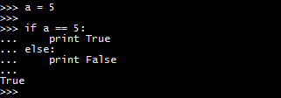
10 – Conditional Block
If Else
Note: Python programming language assumes any non-zero and non-null values as TRUE, and if it is either zero or null, then it is assumed as FALSE value
Example
Condition
If Condition block
True
Else condition block
False

Slide 22
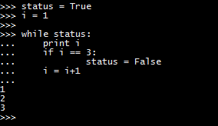
10 – Loops
While
Repeats a statement or group of statements while a given condition is TRUE. It tests the condition before executing the loop body.
Example
Note: You can also use the else statement with while loop
Condition
Conditional block
Execute until condition is True

Slide 23
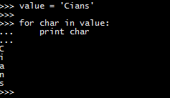
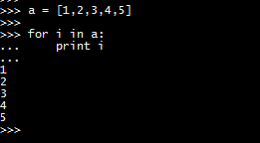
10 – Loops
For
For loop is used to iterate over a sequence like list, tuple, string.
Example
Another Example
Item from sequence
Execute the statement

Slide 24
10 – Loops
Loop control statements
break | Terminate the loop statement
pass | This statement is used when, you do not want to execute any statement
continue | Skip the current iteration and shift to next iteration

Slide 25


11 – Function
Definition
A function is a block of organized, reusable code that is used to perform a single, related action. Functions provide better modularity for your application and a high degree of code reusing.
Function blocks begin with the keyword def followed by the function name and parentheses ( ( ) ).
Any input parameters or arguments should be placed within these parentheses. You can also define parameters inside these parentheses.
The first statement of a function can be an optional statement - the documentation string of the function or docstring.
The code block within every function starts with a colon (:) and is indented.
The statement return [expression] exits a function, optionally passing back an expression to the caller. A return statement with no arguments is the same as return None.
Example
Calling a function
Rules in function definition

Slide 26



12 – Module
Definition
A module allows you to logically organize your Python code. Grouping related code into a module makes the code easier to understand and use. A module is a Python object with arbitrarily named attributes that you can bind and reference.
Simply, a module is a file consisting of Python code. A module can define functions, classes and variables. A module can also include runnable code.
Create a file with any name other than the python keyword and save that file with .py extension.
Now open the file and write some python codes.
Example
Create a file name first_module.py
Write the below code into the module
This statement will only import a single function/class from the whole module
Example
How to create a Module
How to import a module

Slide 27
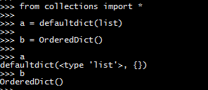
12 – Module
How to import a module
The above statement will import all the function/class to current environment

Slide 28
13 – File Operation
Open & closing file
To open a file for reading or writing, you need to create an object like this.
file = open(file_name, access_mode, buffering)
file_name – It’s a string variable contain the name of the file.
Access_mode – Access mode determines the mode in which the file will be opened, i.e. reading, writing, appending.
buffering – If buffering value is 0, means no buffering takes place, value greater than zero will indicate the buffering will be done based on defined buffered size. If value is zero or negative means buffering will not be happen.
r | Open file only in read only mode
rb | Open file in ready only mode for binary file
r+ | Open file for both reading and writing
rb+ | Open file for both reading and writing for binary file
w | Open file in write only mode, if the file does not exist, then it will create the file with the file name
wb | Open file in write only mode for binary file
w+ | Open file for both read only and write only
wb+ | Open file for both read only and write only for binary file
a | Open file in append mode, File pointer will be at end of the file
ab | Open file in append mode for binary file
a+ | Open file in appending and reading
ab+ | Open file in appending and reading for binary file.

Slide 29
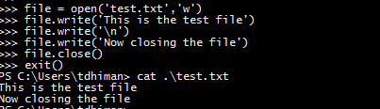
13 – File Operation
Open & closing file
Example

Slide 30
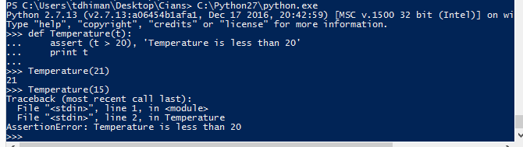
14 – Exception
Definition
Python provides two very important features to handle any unexpected error in your Python programs and to add debugging capabilities in them
Exception Handling
Assertions
An assertion is a sanity-check that you can turn on or turn off when you are done with your testing of the program. The easiest way to think of an assertion is to liken it to a raise-if statement (or to be more accurate, a raise-if-not statement). An expression is tested, and if the result comes up false, an exception is raised.
Syntax
assert (Condition check), ‘Message to print’
Example
Assertion

Slide 31
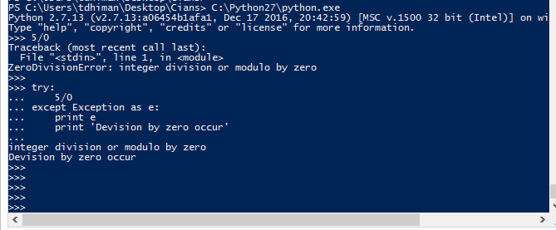
14 – Exception
Exception
When python program encounters a situation that it cannot understand, then the python code will raise the exception.
Try & catch
Sometimes code can go wrong in future, in that case we can write a block of code over the suspicious code by using try and catch.
Examples
You are opening a file name test.txt. But this file is deleted by mistake, then you code will throw the Exception. In these kinds of cases you can catch the exception and execute the necessary remedy.
How to handle exception

Slide 32
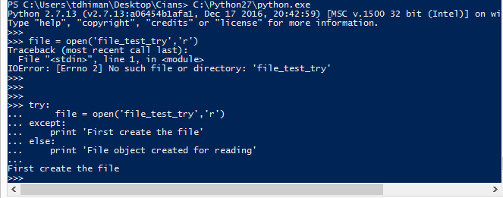
14 – Exception
How to handle exception
Try, catch & else

Slide 33
15 – OOP
Object oriented programming
There is way of organizing your program which is to combine data and functionality and wrap it inside something called an object. This is called the object-oriented programming paradigm.
Major principles of object-oriented programming system are
Object is an entity that has state and behavior. It may be anything. It may be physical and logical. For example: mouse, keyboard, chair, table, pen etc.
Everything in Python is an object, and almost everything has attributes and methods. All functions have a built-in attribute __doc__, which returns the doc string defined in the function source code.
Object
Encapsulation
Class
OOP
Data A
Method
Polymorphism
Inheritance
Object

Slide 34
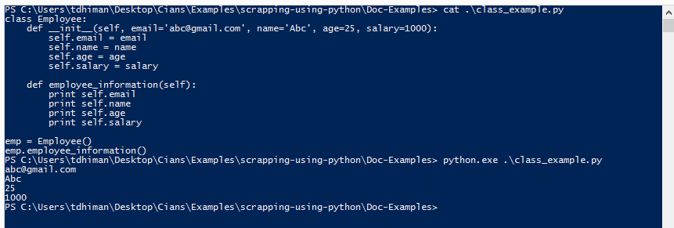
15 – OOP
Class
Class can be defined as a collection of objects. It is a logical entity that has some specific attributes and methods. For example: if you have an employee class then it should contain an attribute and method i.e. an email id, name, age, salary etc.
Syntax
Method is a function that is associated with an object. In Python, method is not unique to class instances. Any object type can have methods
Method

Slide 35
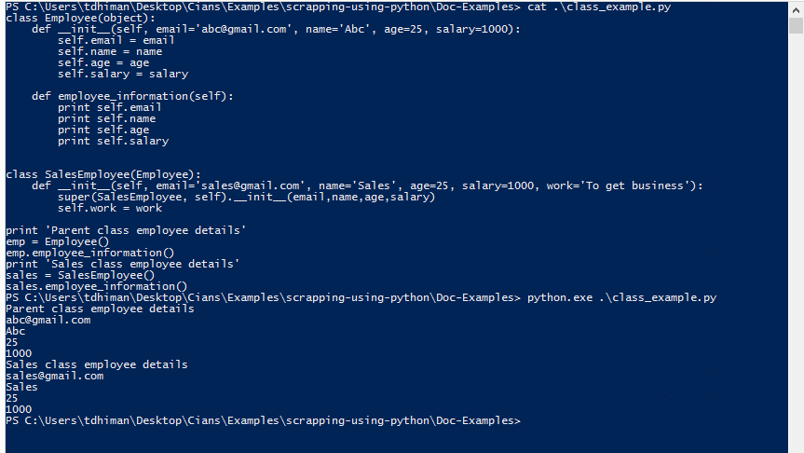
15 – OOP
Inheritance
Inheritance is a feature of object-oriented programming. It specifies that one object acquires all the properties and behaviors of parent object. By using inheritance, you can define a new class with a little or no changes to the existing class. The new class is known as derived class or child class and from which it inherits the properties is called base class or parent class.
Example
In the above example, you can see the SalesEmployee class object inherited the Employee class object. SalesEmployee class object emp also inherited the methods define in its parent class.

Slide 36
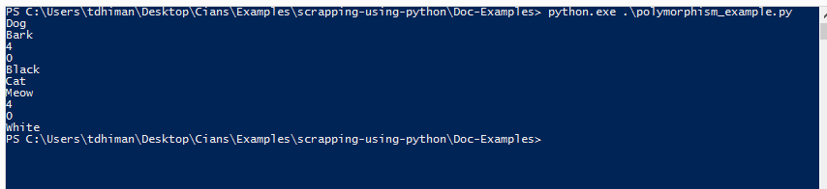
15 – OOP
Polymorphism
Polymorphism is made by two words "poly" and "morphs". Poly means many and Morphs means form, shape. It defines that one task can be performed in different ways. For example: You have a class animal and all animals talk. But they talk differently. Here, the "talk" behavior is polymorphic in the sense and totally depends on the animal. So, the abstract "animal" concept does not actually "talk", but specific animals (like dogs and cats) have a concrete implementation of the action "talk".
Example
class Animal: def __init__(self, animal_type='Animal', talk='talk', leg=4, hand=0, color='Blue'): self.animal_type = animal_type self.talk = talk self.leg = leg self.hand = hand self.color = color def animal_information(self): print self.animal_type print self.talk print self.leg print self.hand print self.color dog = Animal('Dog', 'Bark', 4, 0, 'Black') dog.animal_information() cat = Animal('Cat', 'Meow', 4, 0, 'White') cat.animal_information()

Slide 37
15 – OOP
Encapsulation
Encapsulation is also the feature of object-oriented programming. It is used to restrict access to methods and variables. In encapsulation, code and data are wrapped together within a single unit from being modified by accident.
Data abstraction and encapsulation both are often used as synonyms. Both are nearly synonym because data abstraction is achieved through encapsulation.
Abstraction is used to hide internal details and show only functionalities. Abstracting something means to give names to things, so that the name captures the core of what a function or a whole program does.
The class statement creates a new class definition.
The class has a documentation string, which can be accessed viaClassName.__doc__.
Data Abstraction
How to create class
class Abc: """ Optional class doc string """ methods and variable

Slide 38
15 – OOP
Class
Example
class Employee(object): """ This class demonstrate the class and subclass example """ employee = 0 def __init__(self, email='abc@gmail.com', name='Abc', age=25, salary=1000): self.email = email self.name = name self.age = age self.salary = salary def employee_information(self): print self.email print self.name print self.age print self.salary class SalesEmployee(Employee): def __init__(self, email='sales@gmail.com', name='Sales', age=25, salary=1000, work='To get business'): super(SalesEmployee, self).__init__(email,name,age,salary) self.work = work print 'Parent class employee details' emp = Employee() emp.employee_information() print 'Sales class employee details' sales = SalesEmployee() sales.employee_information()

Slide 39
15 – OOP
Class
In the above example employee is the class variable, its value is shared by all the class objects. This variable accessed through Employee.employee (classname.class_variable).
The quotation written after the class statement, it is the class doc string. Doc string accessed through Employee.__doc__ (classname.__doc__). Doc string is used for the documentation or to write about the class working.
__init__ method is a special method of the class called constructor. When you will initialize the instance of class called object, then the constructor will execute first from the class.
When we created the first object emp = Employee(), By this statement you created an object or instance of the class Employee, through this object emp reserved the space or memory for the variables (email, name, age, salary) initialize through the constructor.
employee_information() is the method which is printing the employee information. You can access this only through the object of the class Employee. i.e. emp, sales
emp is the class object, you can create the class object by this statement
objectname = classname(argument to send to constructor for initialization)
After creating the object, now you can call the class function using this object.
objectname.classfunction(argument to send)
How to create object
How to access variable & method using object
# Create the object of the class emp = Employee() # To access the variables print emp.email # Or you can change the value of variable using the class instance emp.email = 'noname@gmail.com' # To access the class methods emp.employee_information()

