Slide 1
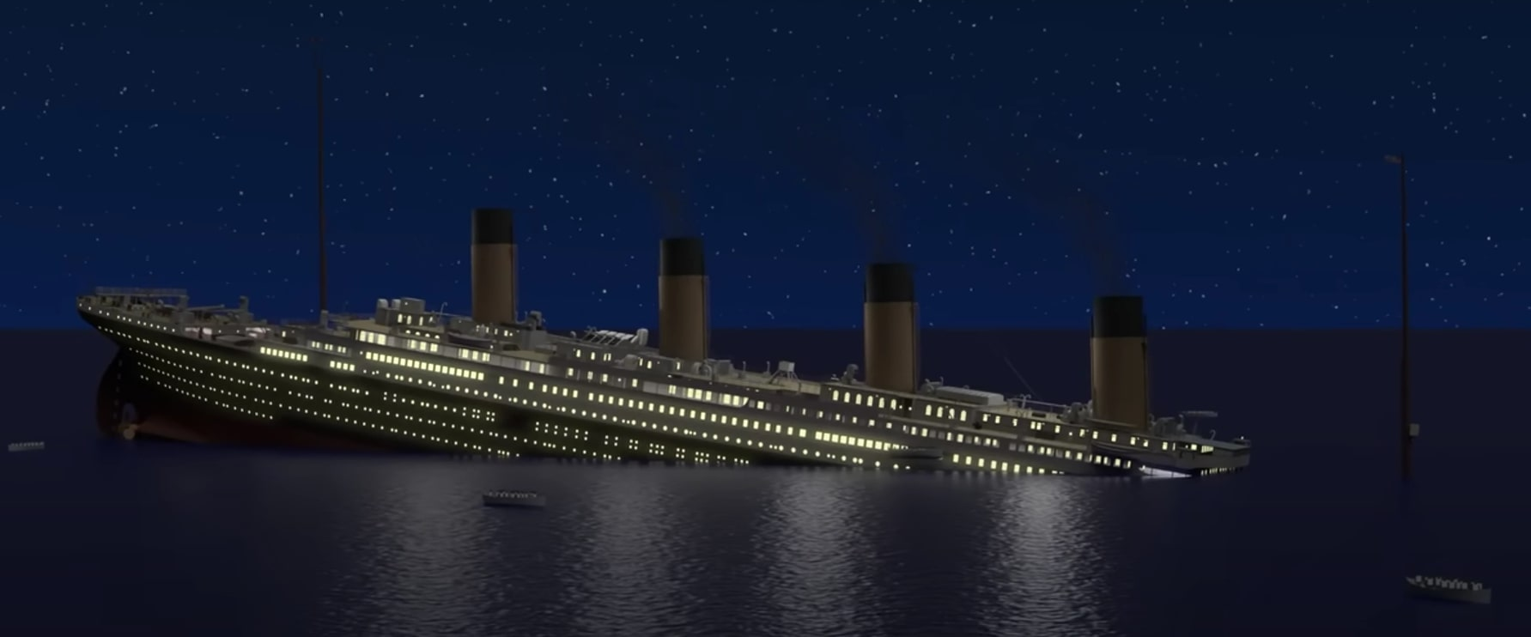
TITANIC SURVIVAL PREDICTION
Using Classification Based Models
Prepared By: Shohaib Shaikh and Sanghana Shree.
Guide: Akash Maurya.

Slide 2

INTRODUCTION
The sinking of the ocean liner RMS Titanic on April 15, 1912 was one of the most dramatic events of the twentieth century.
In this project we will understand what group of people were likely to survive the disaster.
In particular, we will be using Machine learning concepts to predict the survival chances of the passenger and building the web application for real-time prediction.

Slide 3
Objective
The project's objective is to determine the passenger's survival by using different classification algorithms.

Slide 4
Requirements
Softwares Used:
Anaconda Navigator
Jupyter Notebook
VS Code
Libraries Used:
Numpy, Pandas, Sci-Kit Learn, Matplotlib, Seaborn, Pickle

Slide 5
Algorithmns Used
We are going to use mainly 3 Classification algorithmns:
Logistic Regression
Decision Tree
K-Nearest Neighbors

Slide 6
Logistic Regression
Logistic Regression is basically a supervised classification algorithm. In a classification problem, the target variable(or output), y, can take only discrete values for a given set of features (or inputs), X.
Some examples of classification problems are Email spam or not spam, and online transactions Fraud or not Fraud.

Slide 7
Decision Tree
Decision Tree is the most powerful and popular tool for classification and prediction. A Decision tree is a flowchart-like tree structure, where each internal node denotes a test on an attribute, each branch represents an outcome of the test, and each leaf node (terminal node) holds a class label.

Slide 8
K-Nearest Neighbors
K-Nearest Neighbour is one of the simplest Machine Learning algorithms based on the Supervised Learning techniques.
K-NN algorithm can be used for Regression as well as for Classification but mostly it is used for the Classification problems.

Slide 9
Implementation
Importing the required libraries.
Exploring the dataset .
Cleaning and analyzing the data.
Building the model.
Loading the model into pickle file.
Building web application using streamlit.
Conclusion.
Business use of the project

Slide 10
Importing the Required Libraries

Slide 11
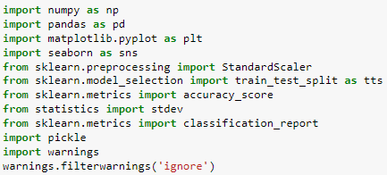
Importing necessary libraries

Slide 12
Exploring the dataset

Slide 13
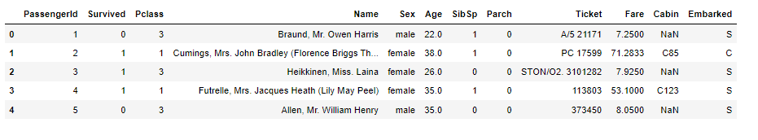
Exploring Data

Slide 14
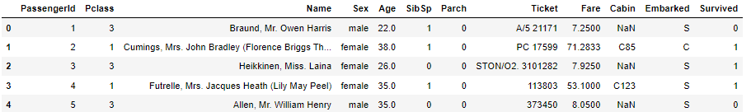
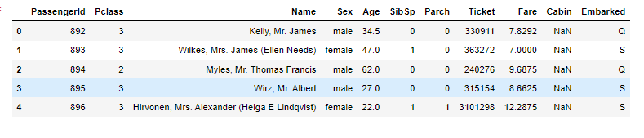
Exploring Train and Test Data
Train Data
Test Data

Slide 15
Cleaning and analyzing data

Slide 16
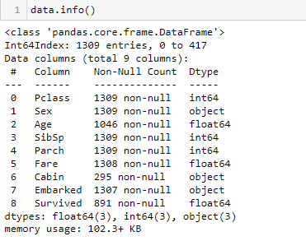

Null Values
We have maximum missing records in cabin followed by age, embarked and fare.

Slide 17
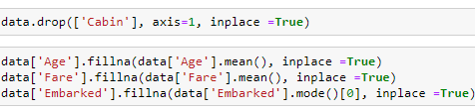
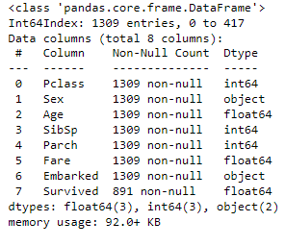
Null Values Treatment
After Treating the null values
Dropping the cabin column as it has 77.46% of missing data.
Treating the categorical columns with the mode and numerical columns with the mean.

Slide 18
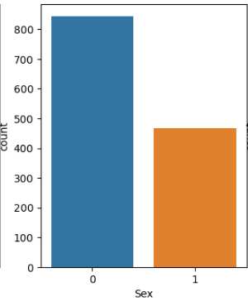
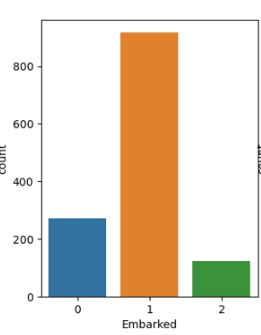
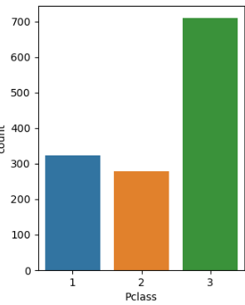
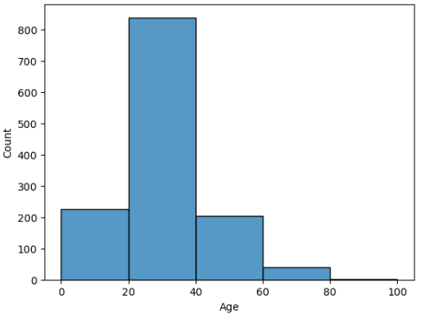
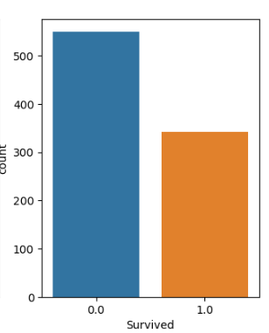
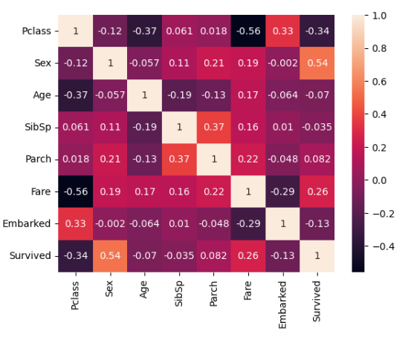
Analyzing Independent and Dependent Variables

Slide 19
Building The Model

Slide 20
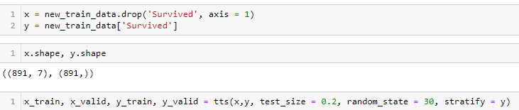
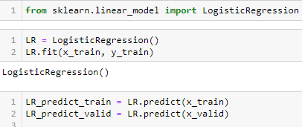
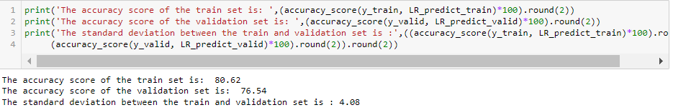
Logistic Regression
Data splitting
Fitting the data into the model
Accuracy and Standard Deviation

Slide 21
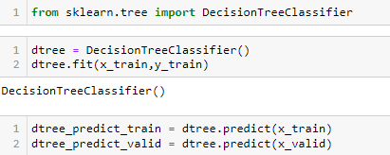
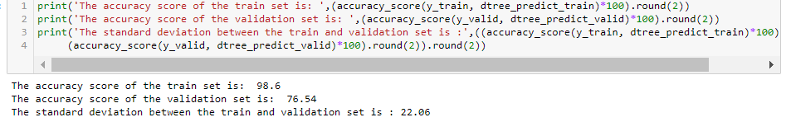
Decision Trees
Data splitting
Fitting the data into the model
Accuracy and Standard Deviation

Slide 22
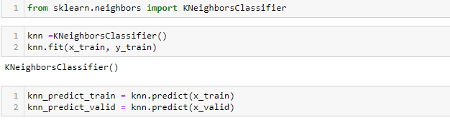
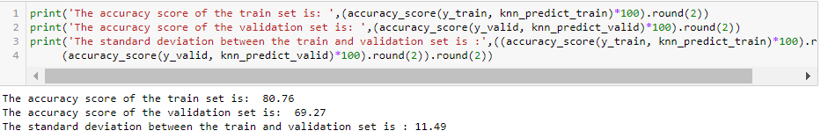
K- Nearest Neighbors
Data splitting
Fitting the data into the model
Accuracy and Standard Deviation

Slide 23

Loading The Model Into Pickle File
Loading the model into a pickle file so that we can use this file for deployment purposes

Slide 24
Building Web Application Using Streamlit

Slide 25
Libraries required for building a web application
Libraries used:
Pandas.
Pickle.
streamlit.

Slide 26
2 Main steps to built Web App
We have loaded the logistic regression pickle file.
we have created the main function and used all the UI-related functions to build the web application.

Slide 27
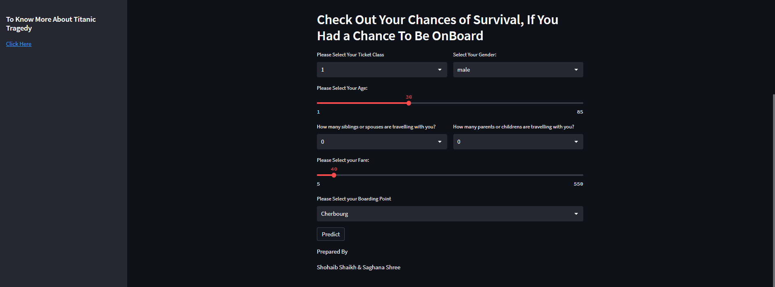
Preview of Web Application

Slide 28
Conclusion
I have removed variables like “passenger ID”, ‘Name”, “Ticket” and “Cabin” as they have no significance in our analysis and do not affect our target variable.
Passengers with no or fewer spouses, siblings and children has more survival chances.
I have used 3 models for selection with better results and found out that logistic regression has the better accuracy with 76.54% and a standard deviation of 4.08%
Hence we have 72.46% - 80.62% accuracy in predicting the survival chances of a passenger through this model.
Successfully created a web application where you can check the survival prediction of a passenger by entering the necessary inputs.

Slide 29
Business use of the Project
If in the future there is any ship that can be built with the same design and amenities as titanic we can predict the survival chances of a passenger using this model.
We can also take the necessary precautions like having multiple numbers of survival aids if the disaster happens in any unfortunate conditions.

Slide 30
References
www.stackoverflow.com
https://www.geeksforgeeks.org/
www.britannica.com/topic/Titanic

Slide 31
Thank You

