Slide 1
Credit Card Default Prediction
By Shunmukam.s.k
1

Slide 2
Problems to Resolve
Problem Statement
Purpose of Project
Financial threats are displaying a trend about the credit risk of commercial banks. The goal is to predict the probability of credit default based on credit card owner's payment history.
Conduct quantitative analysis on credit default risk by applying six interpretable machine learning models without utilizing credit score or credit history.
2

Slide 3


Who Should Care?
Credit Card Companies
Commercial Banks
* Image source: Google image
3

Slide 4
Approach Overview
Data Cleaning
Data Exploration
Predictive Modeling
Understand and Clean
Graphical and Statistical
Machine Learning
Find information on undocumented columns values
Clean data to get it ready for analysis
Exam data with visualization
Verify ﬁndings with statistical tests
Logistic Regression
Random Forest
SVM
Decision Tree
KNN
Naïve-Bayes
4

Slide 5
Data Acquisition
Dataset
Why This Dataset?
Default Payments of Credit Card Clients in Taiwan from 2005
Source: Public dataset from Kaggle.
Original Source: UCI Machine Learning Repository*
Real credit card data
Comprehensive and complete
30,000 customers
Usage of 6 months
Age from 20-79
Demographic factors
No credit score or credit history
*Lichman, M. (2013). UCI Machine Learning Repository [http://archive.ics.uci.edu/ml]. Irvine, CA: University of California, School of Information and Computer Science.
5

Slide 6
Part 1
What demographic factors impact payment default risk?
Exploratory Data Analysis

Slide 7
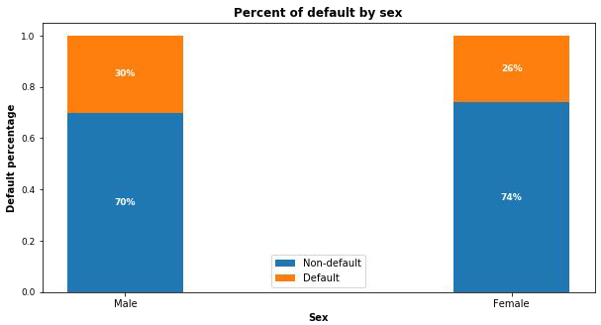
Gender Variable
30% of males and 26% of females have payment default.

Slide 8
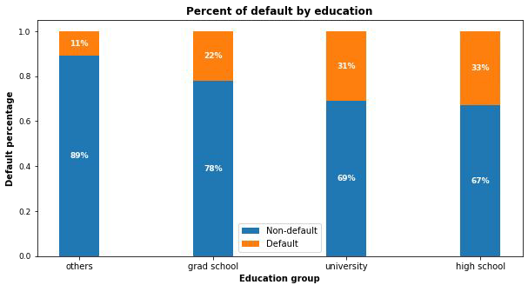
Education Variable
Higher education level, lower default risk.
“Others” only consists 1.56% of total customers even if they appear to have the least default.

Slide 9
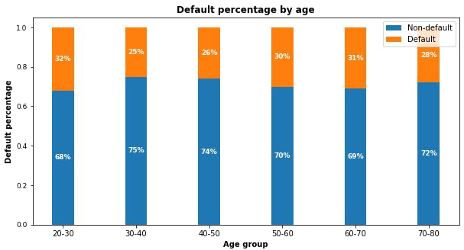
Age Variable
30-50:
Lowest risk
< 30 or >50:
Risk increases

Slide 10
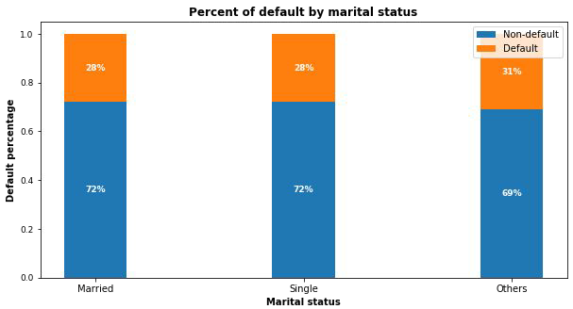
Marital Status Variable
No signiﬁcant correlations of default risk and marital status

Slide 11
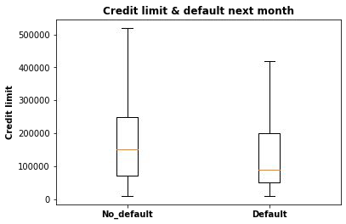
Credit Limit Variable
Higher credit limits,
lower default risk.

Slide 12
EDA Summary
Demographic factors that impact default risk are:
  Education: Higher education is associated with lower default risk.
  Age: Customers aged 30-50 have the lowest default risk.
  Sex: Females have lower default risk than males in this dataset.
  Credit limit: Higher credit limit is associated with lower default risk.

Slide 13
Part 2
What precision and recall scores can the models achieve?
Predictive Modeling

Slide 14
Modeling Overview
Deﬁne Problem:
Supervised learning / binary classiﬁcation
Imbalanced Classes:
78% non-default vs. 22% default
Tools Used:
Scikit learn library
Models Applied:
Logistic Regression / Random Forest / KNN/SVM/Decision Tree/Naïve-Bayes

Slide 15
Modeling Steps
Data Preprocessing
Fitting and Tuning
Model Evaluation
Feature selection
Feature engineering
Train-test data splitting (70%/30%)
Training data rescaling
Start with default model parameters
Hyperparameters tuning
Measure ROC_AUC on training data
Models testing
Precision_Recall score
Compare with sklearn
Compare within the 6 models

Slide 16
Hyperparameters Tuning
K-Fold Cross Validation to get average performance on the folds.
Randomized Search on Logistic Regression since C has large search space.
Grid Search on Random Forest on limited parameters combinations.
Randomized Search on XGBoost because multiple hyperparameters to tune.

Slide 17
Model Comparisons
Compare the models
SVM and Logistic regression gave the best accuracy
 | LR | KNN | SVM | DT | RF | NB
accuracy | 82.0 | 79.7 | 82.7 | 79.2 | 80.8 | 79.7
precision | 67.6 | 60.4 | 72.6 | 55.4 | 66.7 | 55.8
recall | 34.8 | 22.0 | 34.1 | 27.3 | 25.8 | 36.4
AUC | 75.5 | 71.4 | - | 63.3 | 77.0 | 71.7

Slide 18
Conclusions
Recent 2 payment status and credit limit are the strongest default predictors.
Dormant customers can also have default risk.
Random Forest has the best precision and recall balance.
Higher recall can be achieved if low precision is acceptable.
Model can be served as an aid to human decision.
Suggest output probabilities rather than predictions.
Model can be improved with more data and computational resources.

Slide 19
Thank you!

