Slide 1


PLEDGE TO PROGRESS Sustainability Hackathon
Sponsored By
Your Team Name : Sushil Sinha
Your team bio : Data Warehouse(Data Engineer)
Date : 19th Apr 23

Slide 2
Problem Statement?
Why did you decide to solve this Problem statement?
Busiess use cases-
There is a manual MVP(Mininum Valuable Product) calcuation running since long time and comsuming lots of effort to generate report.
Migrate from on premise to Azure cloud moderinzation. In order to provide cost effective and minimize maintenance resources effort. Pay as you Go (Model)

Slide 3
User Segment & Pain Points
Which user /advertiser segment would be early adopter of your product & why?
Worked in multi-customer/clients and they have differnet problem stataments and uses cases.
Experienced in to build morden Data wherehouse to stored clean and histotical data to ful fill business requirments on their Ad-hoc or instant or Known queries.

Slide 4
Pre-Requisite
What are the alternatives/competitive products for the problem you are solving?
In early time the most of traditional servies/tools being used to solve the problem .e.i. Teradata , Informatica, SQL Server and Oracle etc..
Limitation – Storage & Compuation and expensive lincencing and maintaince cost. Used to standalone data base (Relational DB)
In cloud/Big data evalution :
Distribution Data base- 1. Much faster than traditional DB/tools 2. Atomically scale up and down. 3. Modern data where house - Synapse, Redshift & Snowflake.

Slide 5
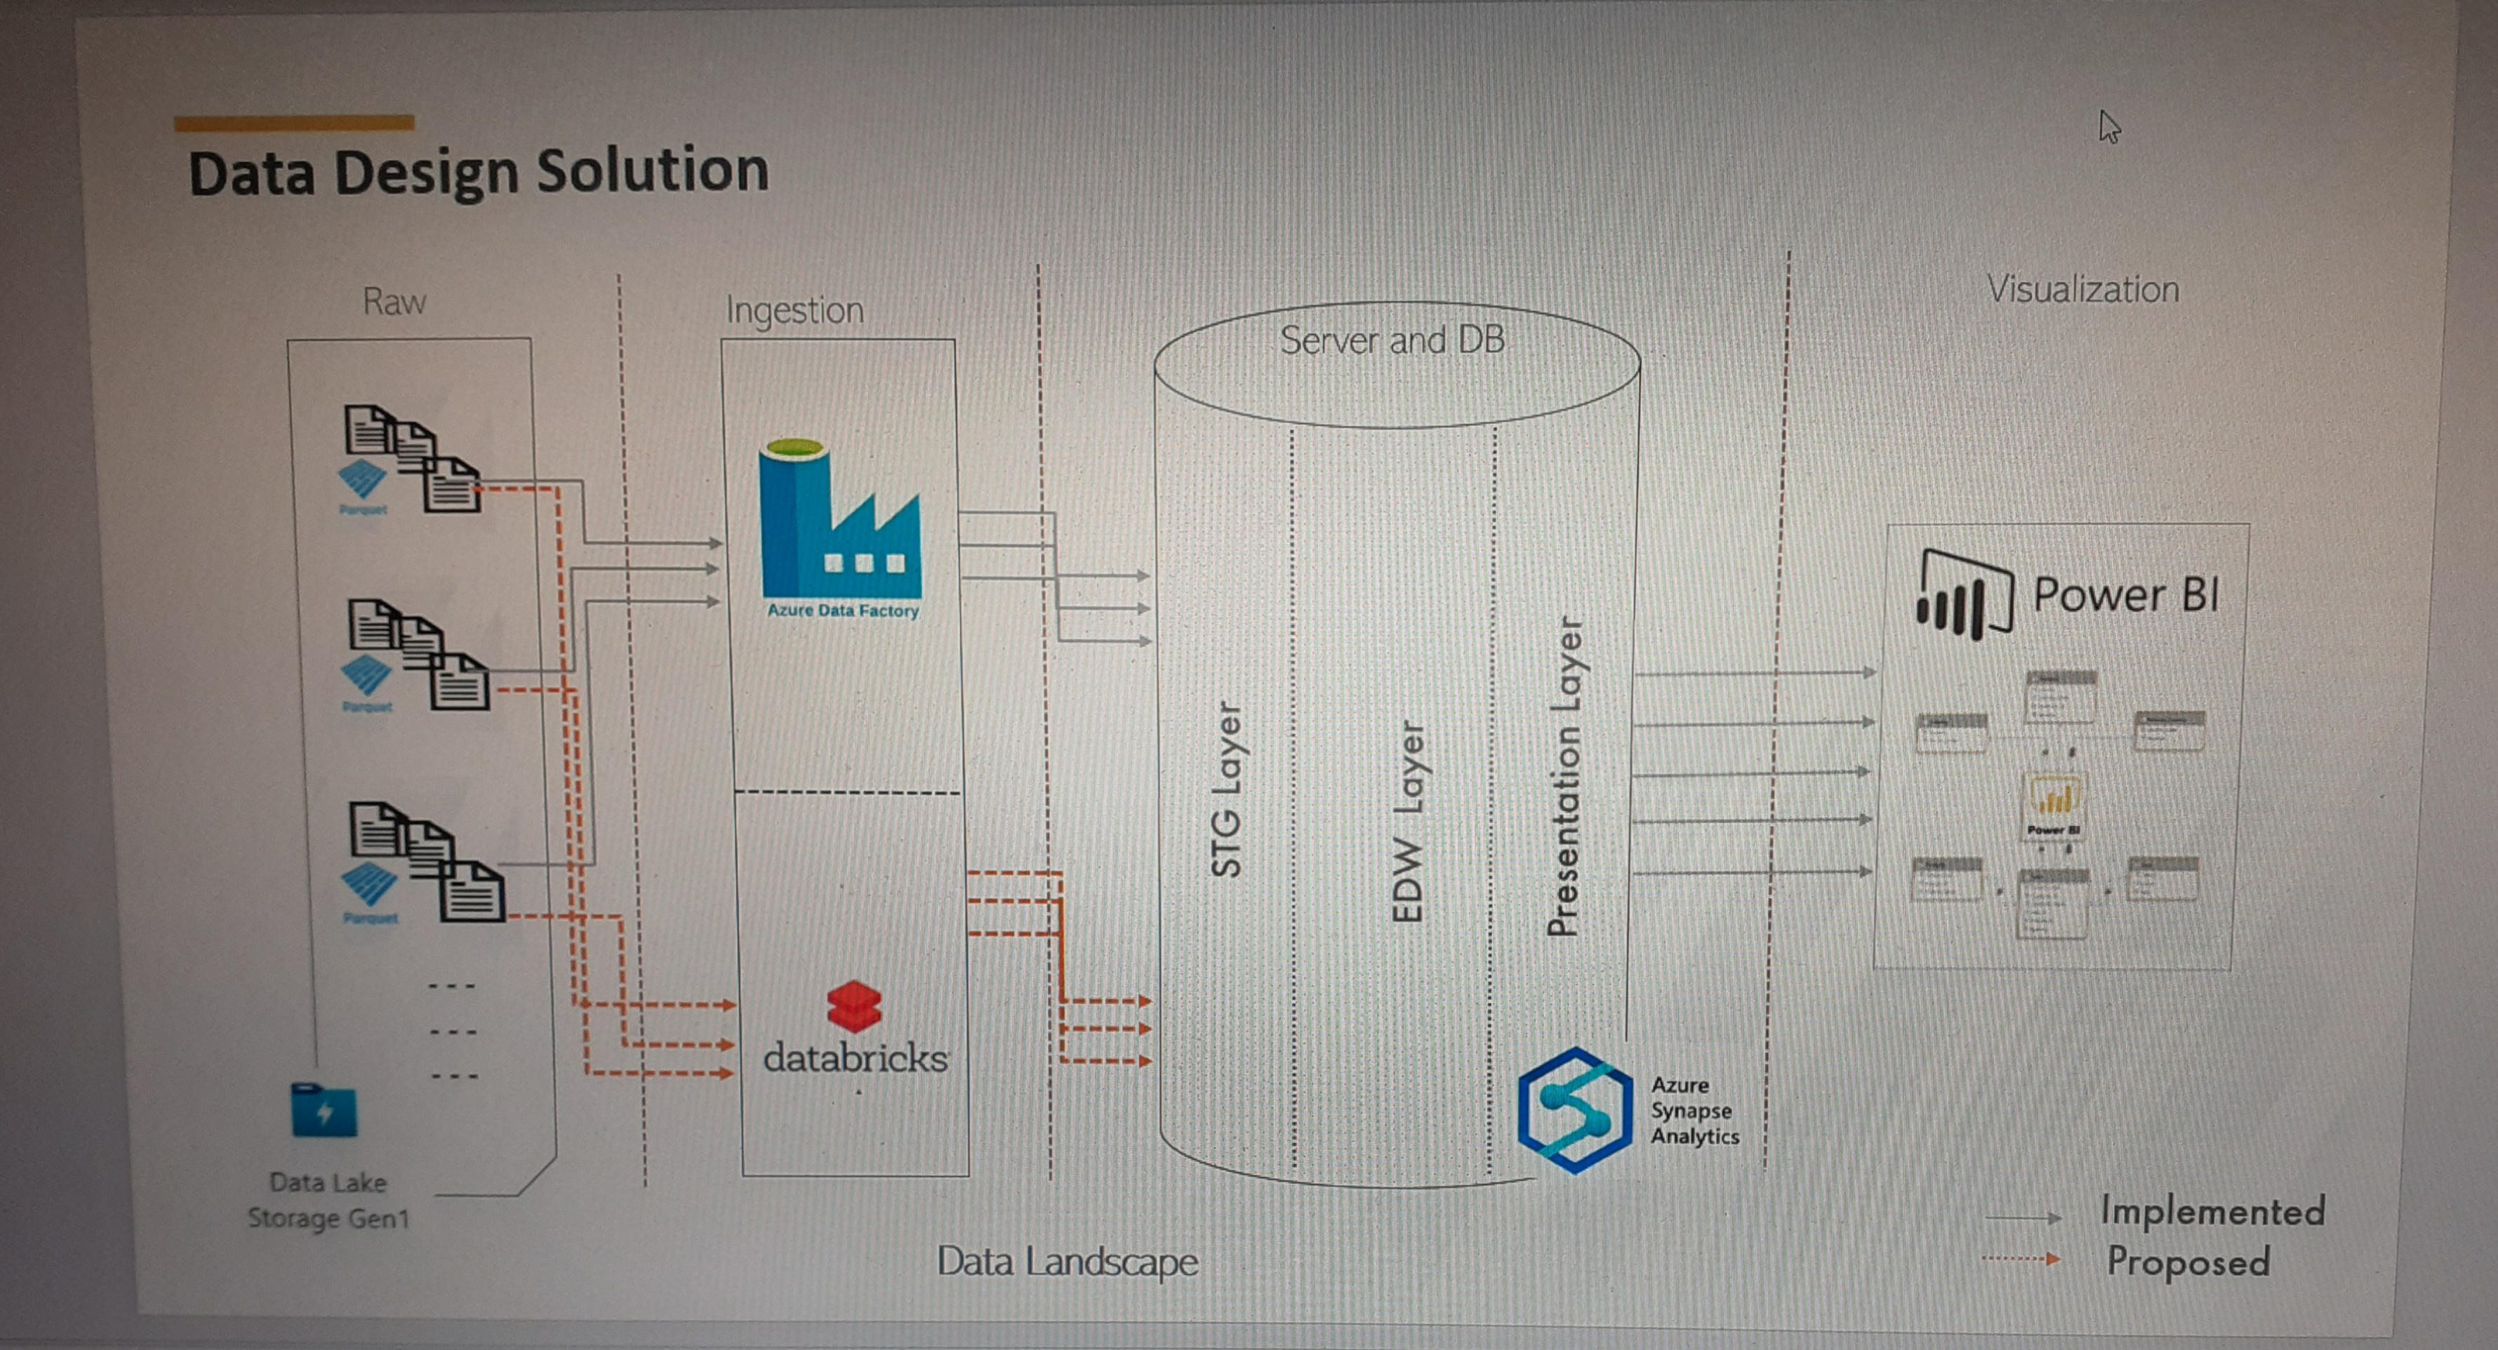
Any Supporting Functional Documents
Present your solution, talk about methodology, architecture & scalability

Slide 6
Tools or resources
Azure tools or resources which are likely to be used by you for the prototype, if your idea gets selected Recommened Azure services for business use case Azure Storage Account (Gen/Gen2) Azure Data Factory Azure Databricks Azure synapse Azure SQL DB Power BI

Slide 7
Key Differentiators & Adoption Plan
How is your solution better than alternatives and how do you plan to build adoption?
Meet the client goals and their requiriments using the best cost optimization solutions.

Slide 8
GitHub Repository Link & supporting diagrams, screenshots, if any
How far it can go?

Slide 9
Thank You
Sushil Sinha

