Slide 1
DOT NET FRAMEWORK
Kavitha Jayakumar
CUNA Mutual

Slide 2
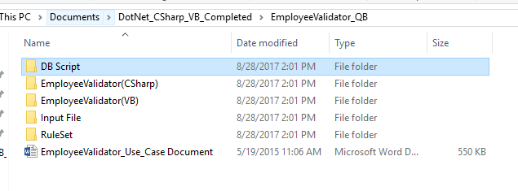
Solution Folder

Slide 3
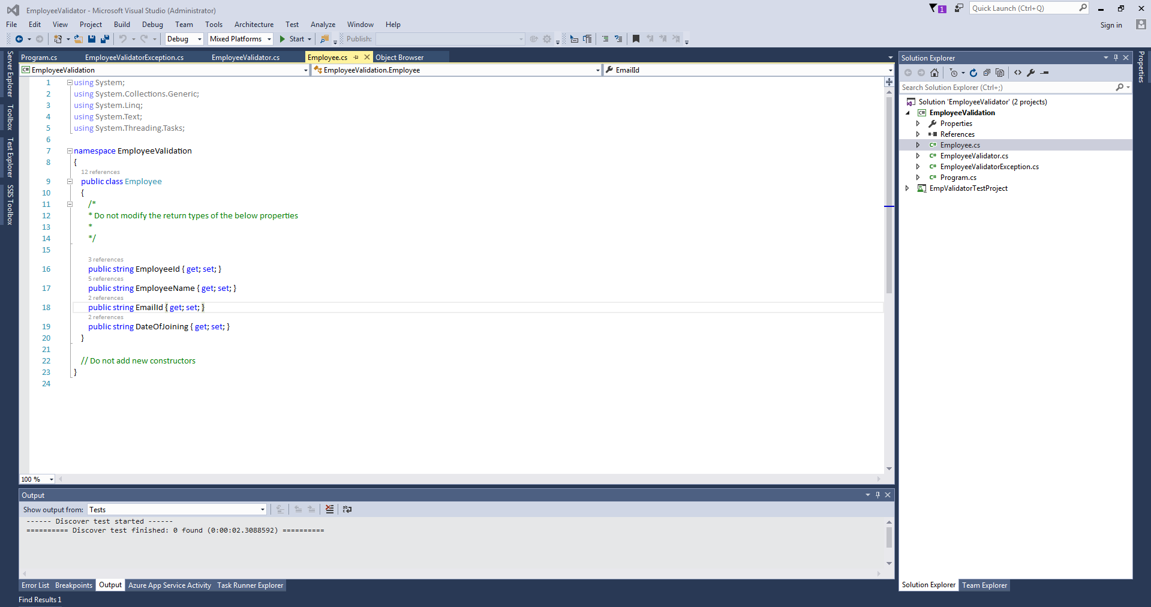

Slide 4
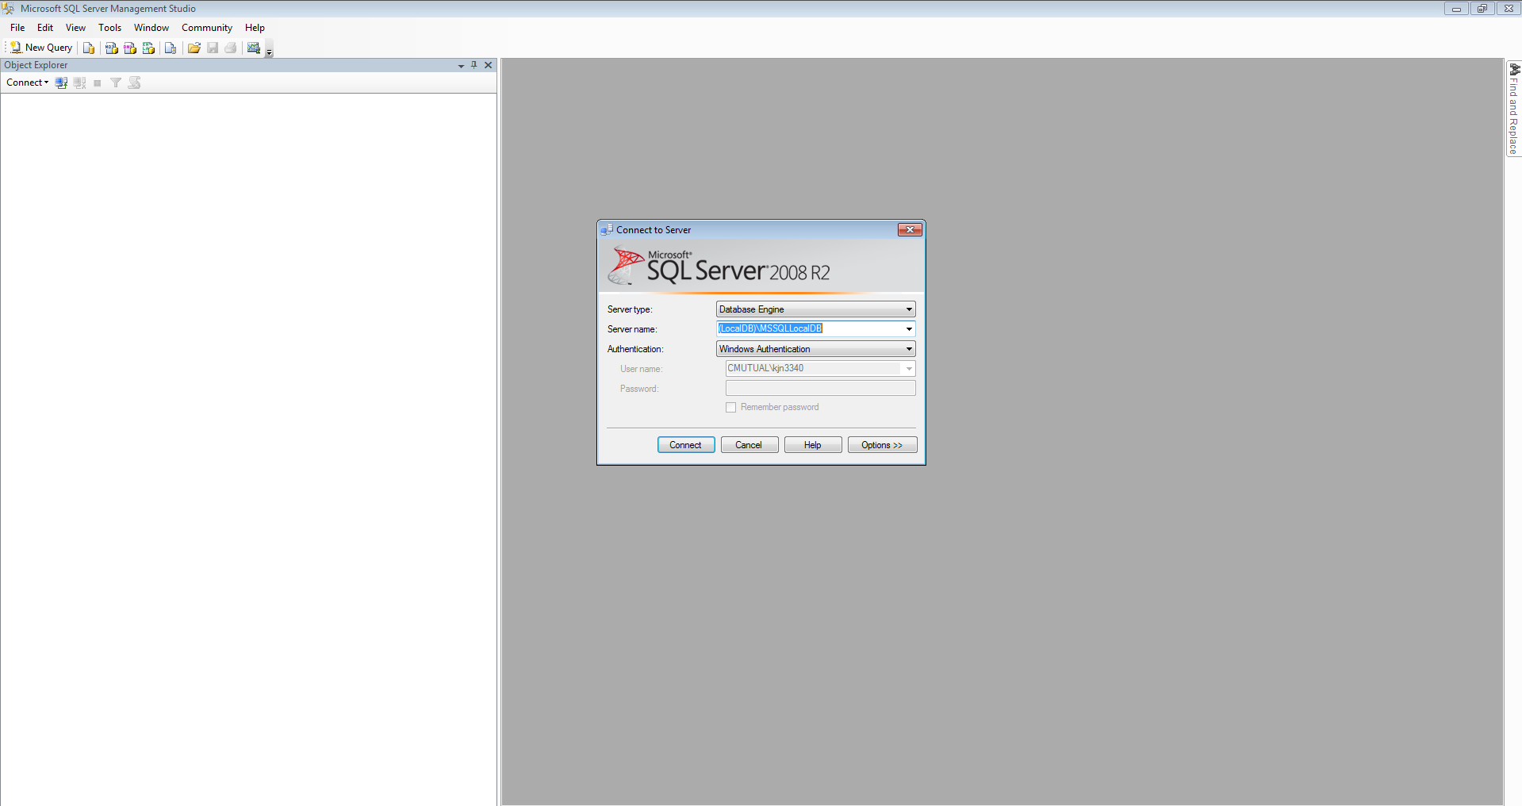

Slide 5
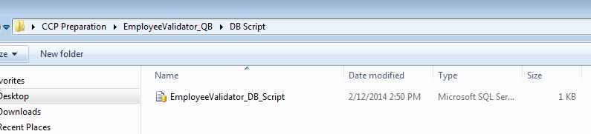
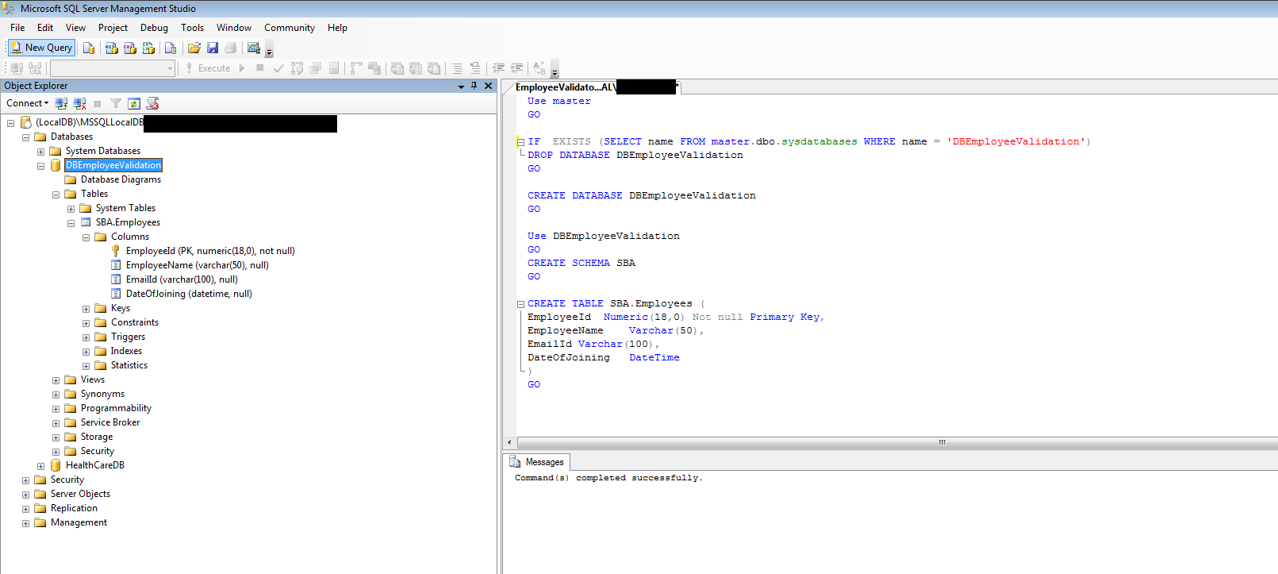

Slide 6
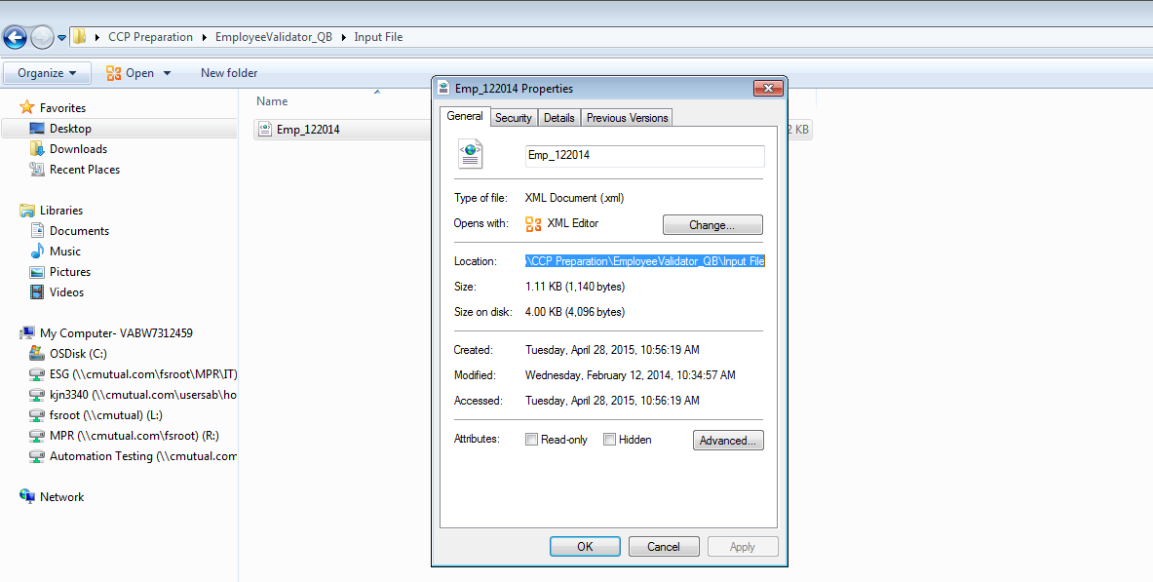

Slide 7
Must Know: Basics
How to initialize objects.
How to call another class Methods.
Loops for, while
If statements
Method Parameter Passing
Date functions
  Add Days()- DateTime answer = today.AddDays(1);
  var dateAndTime = DateTime.Now; //10/25/2017 00:00:00.0
  var date = dateAndTime.Date; // 10/25/2017
Substring – date.substring(0,10);
Try Catch Block
try { }
  catch(Exception ex)
  {
  throw new EmployeeValidatorException(ex.ToString());
  }

Slide 8
Employee.cs
using System;
using System.Collections.Generic;
using System.Linq;
using System.Text;
using System.Threading.Tasks;
namespace EmployeeValidation
{
public class Employee
{
/*
* Do not modify the return types of the below properties
*
*/
public string EmployeeId { get; set; }
public string EmployeeName { get; set; }
public string EmailId { get; set; }
public string DateOfJoining { get; set; }
}
// Do not add new constructors
}

Slide 9
Program.cs
public class Program
{
public static void Main()
{
/*
* Pass the file path, file names and connection string if any in this method alone.
* Do not hardcode in any other methods
*/
SqlConnection connection = new SqlConnection(@"Data Source=PC233649;Initial Catalog=DBEmployeeValidation;Integrated Security=True");
EmployeeValidator empValidator = new EmployeeValidator();
empValidator.ProcessData(@"C:\Users\153239\Desktop\Input File\", "Emp_122014.xml", connection);
}

Slide 10
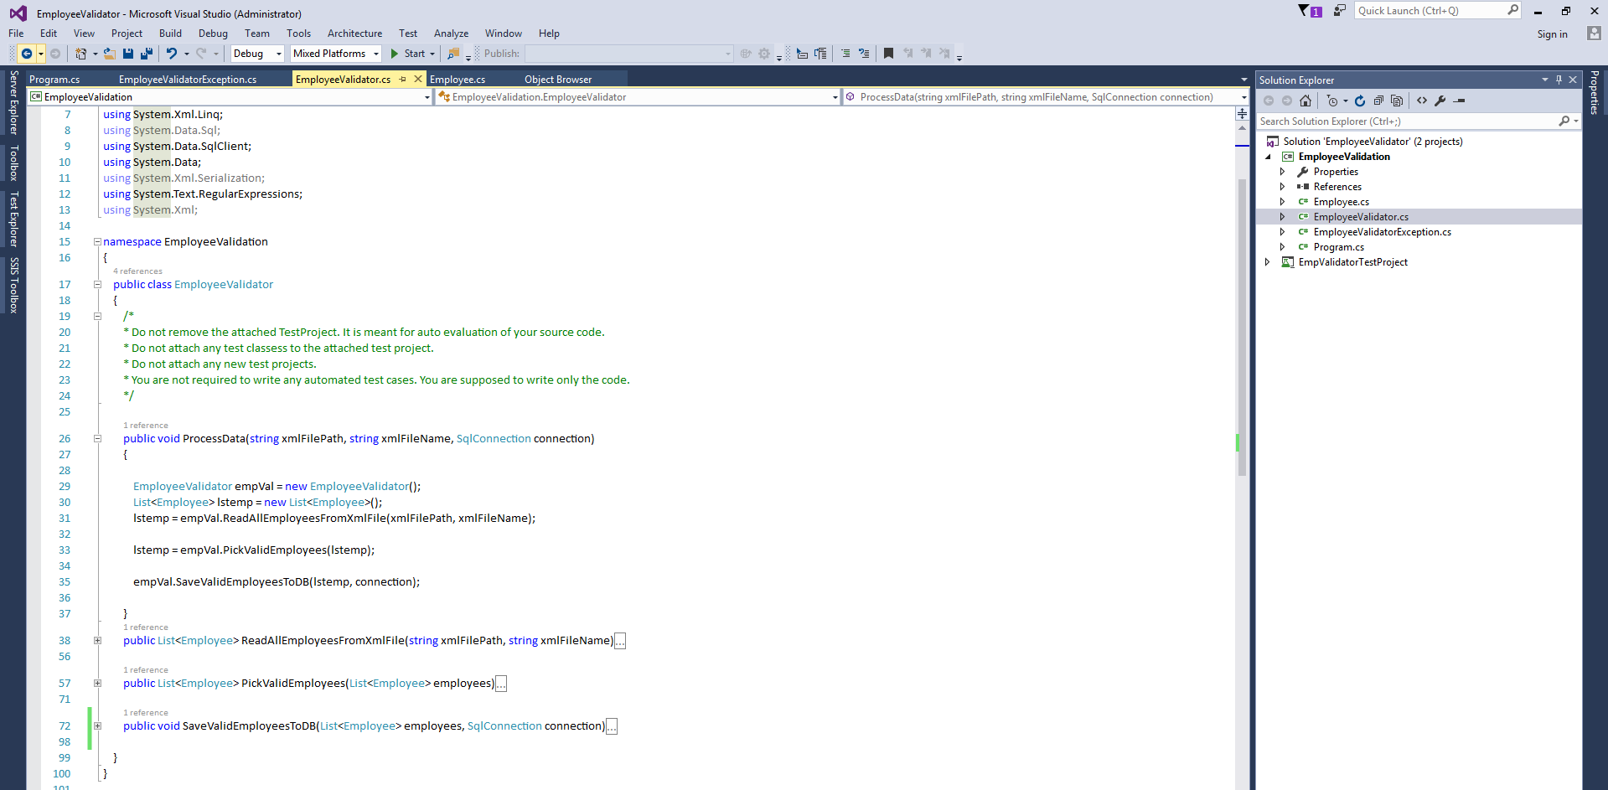

Slide 11
EmployeeValidator.cs
public class EmployeeValidator
{
public void ProcessData(string xmlFilePath, string xmlFileName, SqlConnection connection)
{
EmployeeValidator empVal = new EmployeeValidator();
List<Employee> lstemp = new List<Employee>();
lstemp = empVal.ReadAllEmployeesFromXmlFile(xmlFilePath, xmlFileName);
lstemp = empVal.PickValidEmployees(lstemp);
empVal.SaveValidEmployeesToDB(lstemp, connection);
}

Slide 12
EmployeeValidator.cs
public List<Employee> ReadAllEmployeesFromXmlFile(string xmlFilePath, string xmlFileName)
{
List<Employee> empList = new List<Employee>();
XElement xelement = XElement.Load(xmlFilePath + xmlFileName);
IEnumerable<XElement> allEmployees = xelement.Elements();
foreach (var allEmployee in allEmployees)
{
empList.Add(new Employee()
{
EmployeeId = allEmployee.Element("EmployeeId").Value,
EmployeeName = allEmployee.Element("EmployeeName").Value,
EmailId = allEmployee.Element("EmailId").Value,
DateOfJoining = allEmployee.Element("DateOfJoining").Value
});
}
return empList;
}

Slide 13
EmployeeValidator.cs
public List<Employee> PickValidEmployees(List<Employee> employees)
{
List<Employee> empList = new List<Employee>();
Regex IsNumeric = new Regex(@"^\D+$");
Regex IsAlphaNumeric = new Regex(@"\W+$");
Regex IsvalidEmail = new Regex(@"^(?("")(""[^""]+?""@)|(([0-9a-z]((\.(?!\.))|[-!#\$%&'\*\+/=\?\^`\{\}\|~\w])*)(?<=[0-9a-z])@))(?(\[)(\[(\d{1,3}\.){3}\d{1,3}\])|(([0-9a-z][-\w]*[0-9a-z]*\.)+[a-z0-9]{2,17}))$");
empList = employees.Select(x => employees.Find( m => m.EmployeeName != null && m.EmployeeName != string.Empty
&& !IsNumeric.IsMatch(m.EmployeeId.ToString()) && !IsAlphaNumeric.IsMatch(m.EmployeeName)
)).Distinct().ToList();
return empList;
}
(or)
extractuniquelist = employees.GroupBy(x => x.EmployeeId).Select(y => y.First()).ToList();
foreach (var emp in extractuniquelist)
{
if ((IsNumeric.IsMatch(emp.EmployeeName)) && (emp.EmployeeId != "") && (IsAlphaNumeric.IsMatch(emp.EmployeeName)) && (emp.EmployeeName != "") && (email.IsMatch(emp.EmailId)))
{
empList.Add(new Employee
{
EmployeeId = emp.EmployeeId,
EmployeeName = emp.EmployeeName,
EmailId = emp.EmailId,
DateOfJoining = emp.DateOfJoining
});
}
}

Slide 14
EmployeeValidator.cs
public void SaveValidEmployeesToDB(List<Employee> employees, SqlConnection connection)
{
string query = @"Insert into SBA.Employees(EmployeeId,EmployeeName,DateOfJoining,EmailId) Values(@EmployeeId,@EmployeeName,@DateOfJoining,@EmailId)";
connection.Open();
using (SqlCommand cmd = new SqlCommand(query, connection))
{
foreach (Employee emp in employees)
{
cmd.Parameters.AddWithValue("@EmployeeId", emp.EmployeeId);
cmd.Parameters.AddWithValue("@EmployeeName", emp.EmployeeName);
cmd.Parameters.AddWithValue("@EmailId", emp.EmailId);
cmd.Parameters.AddWithValue("@DateOfJoining", emp.DateOfJoining);
int i = cmd.ExecuteNonQuery();
}
}
connection.Close();
}

Slide 15
Must Know
Read & write from Database
Read & Write from Text File
Read & write from XML file
Read & write from Excel file

Slide 16
Read from TEXT file
public List<Employee> ReadValuesfromTextfile(string fpath, string fname)
{
List<Employee> readedValues = new List<Employee>();
if (Directory.Exists(fpath))
{
if (File.Exists(fpath + fname))
{
using (StreamReader sr = new StreamReader(fpath + fname))
{
while (!sr.EndOfStream)
{
string readline = sr.ReadLine();
if (readline != null && readline != "")
{
readedValues.Add(new Employee
{
EmployeeId = readline.Split(',')[0],
EmployeeName = readline.Split(',')[1],
EmailId = readline.Split(',')[2],
DateOfJoining = readline.Split(',')[3]
});
}
}
}
}
}
return readedValues;
}

Slide 17
Read From XML file
public List<Employee> ReadFromXmlFile(string FilePath, string FileName)
{
List<Employee> emplist = new List<Employee>();
if (Directory.Exists(FilePath))
{
if (File.Exists(FilePath + FileName))
{
StreamReader sr = new StreamReader(FilePath + FileName);
XmlSerializer xSerializer = new XmlSerializer(typeof(List<Employee>), new XmlRootAttribute("Employees"));
emplist = (List<Employee>)xSerializer.Deserialize(sr);
}
}
return emplist;
}

Slide 18
Read From Database
public List<Employee> savefromDBtoTextfile(SqlConnection connetion)
{
DataTable dt = new DataTable();
List<Employee> selectlist = new List<Employee>();
string query = "select * from SBA.Employees";
connetion.Open();
using (SqlCommand cmd = new SqlCommand(query, connetion))
{
SqlDataAdapter adp = new SqlDataAdapter(cmd);
adp.Fill(dt);
}
connetion.Close();
foreach (DataRow emp in dt.Rows)
{
selectlist.Add(new Employee
{
EmployeeId = emp["EmployeeId"].ToString(),
EmployeeName = emp["EmployeeName"].ToString(),
EmailId = emp["EmailId"].ToString(),
DateOfJoining = emp["DateOfJoining"].ToString()
});
}
return selectlist;
}

Slide 19
Write to Text File
public void WritetoTextFile(List<Employee> writelist, string FilePath)
{
using (StreamWriter sw = File.CreateText(FilePath + "newtxtfile.txt"))
{
foreach (var emp in writelist)
{
sw.WriteLine(emp.EmployeeId + " " + emp.EmployeeName + " " + emp.EmailId + " " + emp.DateOfJoining + " ");
}
}
}

Slide 20
Write to XML File
public void writeXmlfile(List<Employee> epmlist)
{
var fileName = @"K:\redir\Desktop\TestDotnet\Input File\TestFile.xml";
using (StreamWriter sw = new StreamWriter(fileName))
{
XmlSerializer xmlsr = new XmlSerializer(typeof(List<Employee>), new XmlRootAttribute("Employees"));
xmlsr.Serialize(sw, epmlist);
sw.Flush();
sw.Close();
}
}

Slide 21
Insert into Database
public void SaveValidEmployeesToDB(List<Employee> employees, SqlConnection connection)
{
string query = @"Insert into SBA.Employees(EmployeeId,EmployeeName,DateOfJoining,EmailId) Values(@EmployeeId,@EmployeeName,@DateOfJoining,@EmailId)";
connection.Open();
using (SqlCommand cmd = new SqlCommand(query, connection))
{
foreach (Employee emp in employees)
{
cmd.Parameters.AddWithValue("@EmployeeId", emp.EmployeeId);
cmd.Parameters.AddWithValue("@EmployeeName", emp.EmployeeName);
cmd.Parameters.AddWithValue("@EmailId", emp.EmailId);
cmd.Parameters.AddWithValue("@DateOfJoining", emp.DateOfJoining);
int i = cmd.ExecuteNonQuery();
}
}
connection.Close();
}

Slide 22
THANK YOU

