Slide 1
DEUTSCHE BAHN
Train Delay
Analysis
Final Data Visualization Project
SHAIK KHAJA SOHAIL HUSSAIN
Matriculation No. 82022509
Subject: DATA VISUALIZATION
Summer 2026

Slide 2
SCOPE
Project at a glance
A compact summary of the cleaned dataset, analytical focus and overall reliability picture.
76,476
20
8
44.4%
3.0 min
cleaned service records
major German stations
sampled dates
overall delay rate
median actual delay
Core research question
What the project delivers
How do train delays differ by station, train category, time, sampled date and recorded disruption reason across major German railway stations?
10 analytical questions
10 explanatory Plotly visualisations
Interactive Streamlit dashboard
Public GitHub repository
Notebook export and presentation
The analysis separates delay frequency from delay severity, so high-volume stations are not automatically treated as the least reliable.
Source: final_analysis.ipynb and project README

Slide 3
METHOD
From raw train records to decision-ready insights
The workflow preserves the original data, creates interpretable features and then tests multiple reliability dimensions.
01
02
03
04
05
Raw data
Cleaning
Feature engineering
Analysis
Delivery
77,146 rows
9 original fields
670 exact duplicates
removed
delay minutes, hour,
day type, train group
10 multidimensional
questions
dashboard, GitHub,
HTML & PPT
Key engineered variables
actual_delay_minutes
train_group
hour
day_type
platform_change
delay_reason
The original CSV remains unchanged in data/raw; the cleaned file is saved separately in data/processed.
Dataset: Trains and Delays Deutsche Bahn (Kaggle, CC0); underlying Deutsche Bahn station-board information

Slide 4
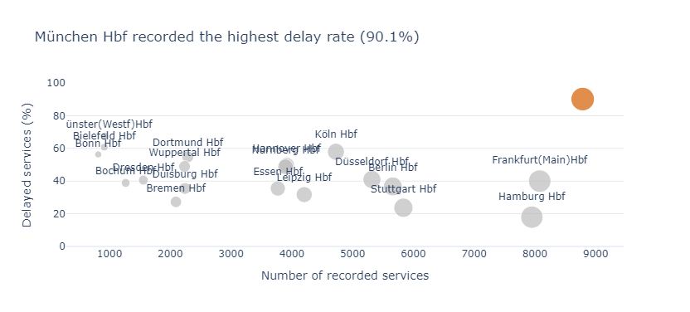
FINDING 1
Station reliability varies far more than service volume alone can explain
München Hbf combines one of the highest service volumes with the highest recorded delay rate.
Key takeaways
90.1%
München Hbf delay rate
67.6%
Münster (Westf) Hbf
17.9%
Hamburg Hbf despite high volume
Interpretation
Delay rate gives a fairer comparison than delayed-service counts alone.
Question 1 - station delay rate versus recorded service volume

Slide 5
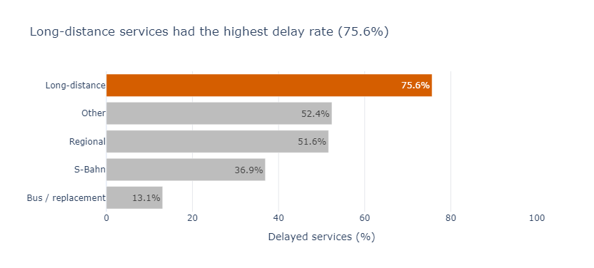
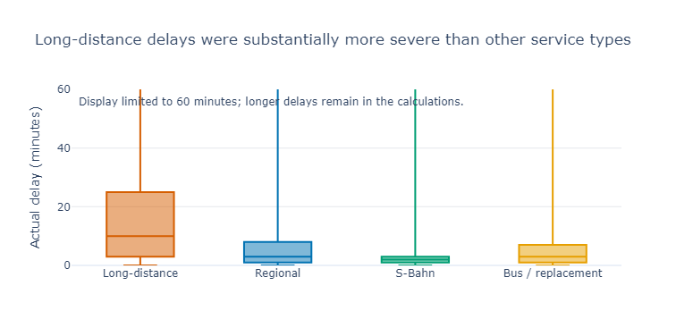
FINDING 2
Long-distance services are the core reliability issue
They are delayed most often and, when delayed, typically remain late for longer.
Frequency: 75.6% of long-distance records were delayed. Severity: median actual delay was about 10 minutes, versus 2-3 minutes for the other main groups.
Questions 2 and 6 - delay rate and actual delay severity by train group

Slide 6
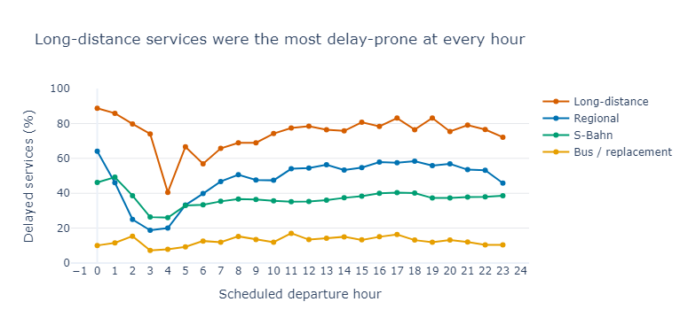
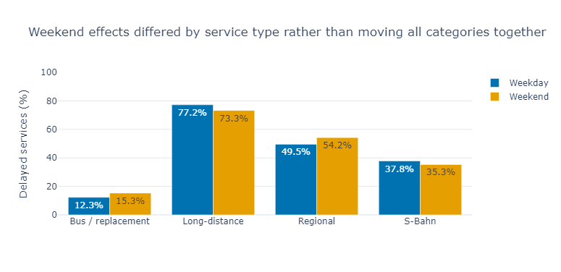
FINDING 3
Long-distance services remain the most delay-prone throughout the day
The gap between service types is more persistent than any single peak-hour effect.
Weekday vs weekend
What changes?
Long-distance: slightly worse on weekdays
Regional: higher delay rate on weekends
S-Bahn: small weekend improvement
Questions 3 and 5 - hourly and weekday/weekend delay-rate patterns

Slide 7
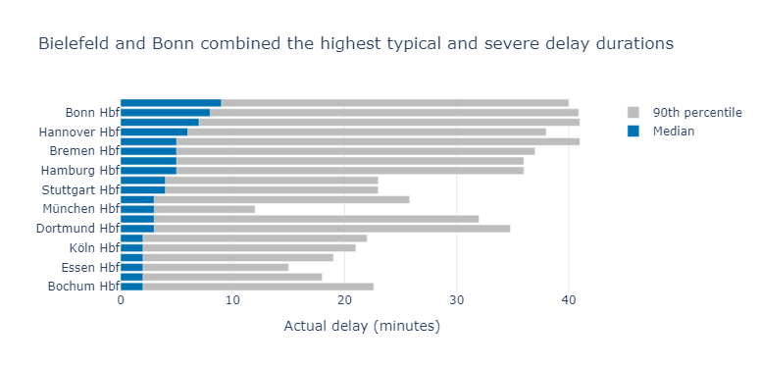
FINDING 4
The “worst” station changes when delay severity is considered
München leads on delay rate, but Bielefeld and Bonn show longer typical delays.
Median delay
Bielefeld Hbf
9 min
Bonn Hbf
8 min
Münster (Westf) Hbf
7 min
90th-percentile delays
~40-41 minutes at Bielefeld, Bonn and Münster.
Therefore, delay rate and delay duration should be reported separately.
Question 7 - median and 90th-percentile actual delay by station

Slide 8
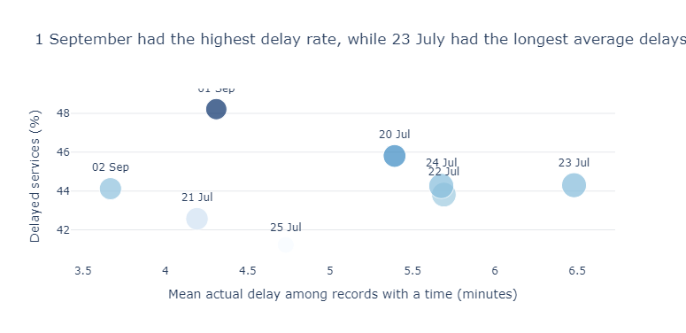
FINDING 5
Delay frequency and delay duration peak on different days
No single date was worst on every reliability measure.
1 September
48.2%
highest delay rate
23 July
6.5 min
longest average actual delay
This is why the project uses both frequency and severity metrics.
Question 8 - sampled dates compared by delay rate, average delay and service volume

Slide 9
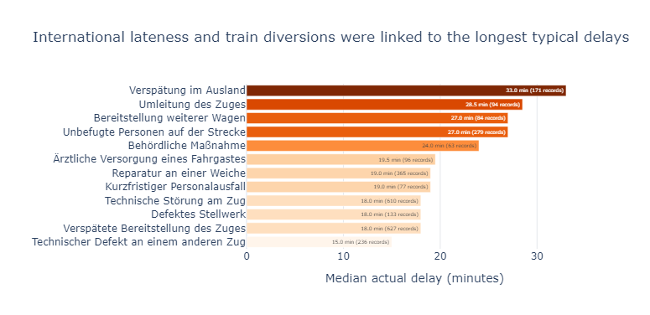
FINDING 6
Less-common disruptions can produce the most severe delays
The most frequent operational issue is not necessarily the most damaging.
Highest median delays
33.0 min
Delay originating abroad
28.5 min
Train diversion
Platform changes
Münster recorded the highest platform-change rate (10.9%), while München changes carried a median delay of about 11 minutes.
Questions 9 and 10 - disruption reasons and recorded platform changes

Slide 10
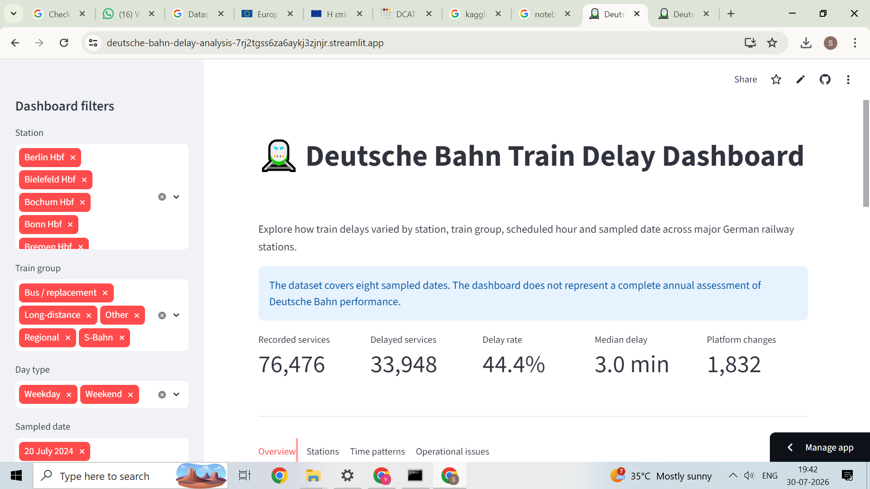
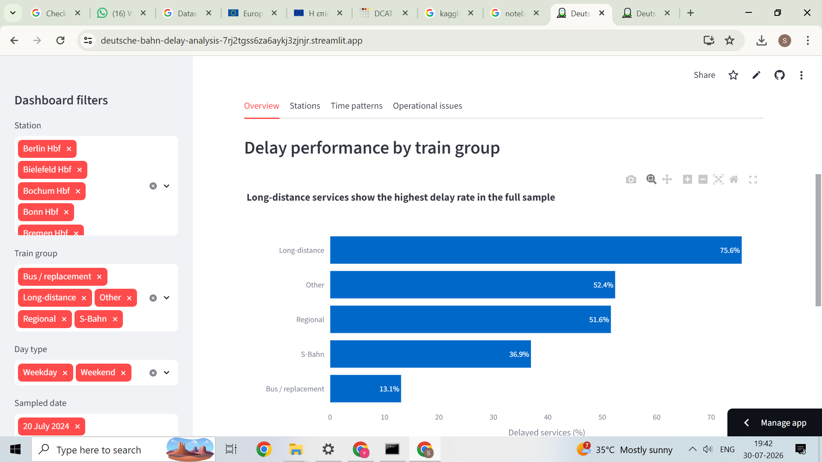
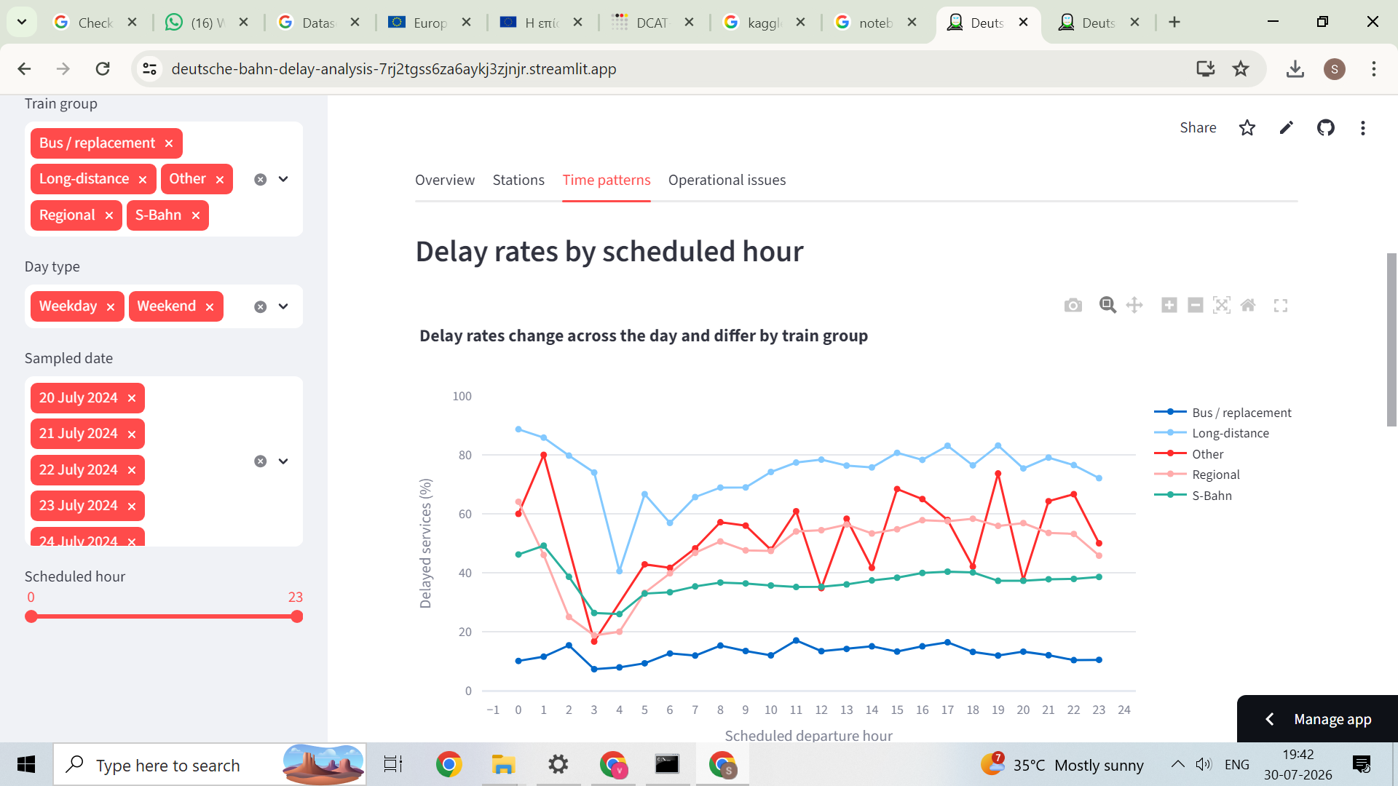
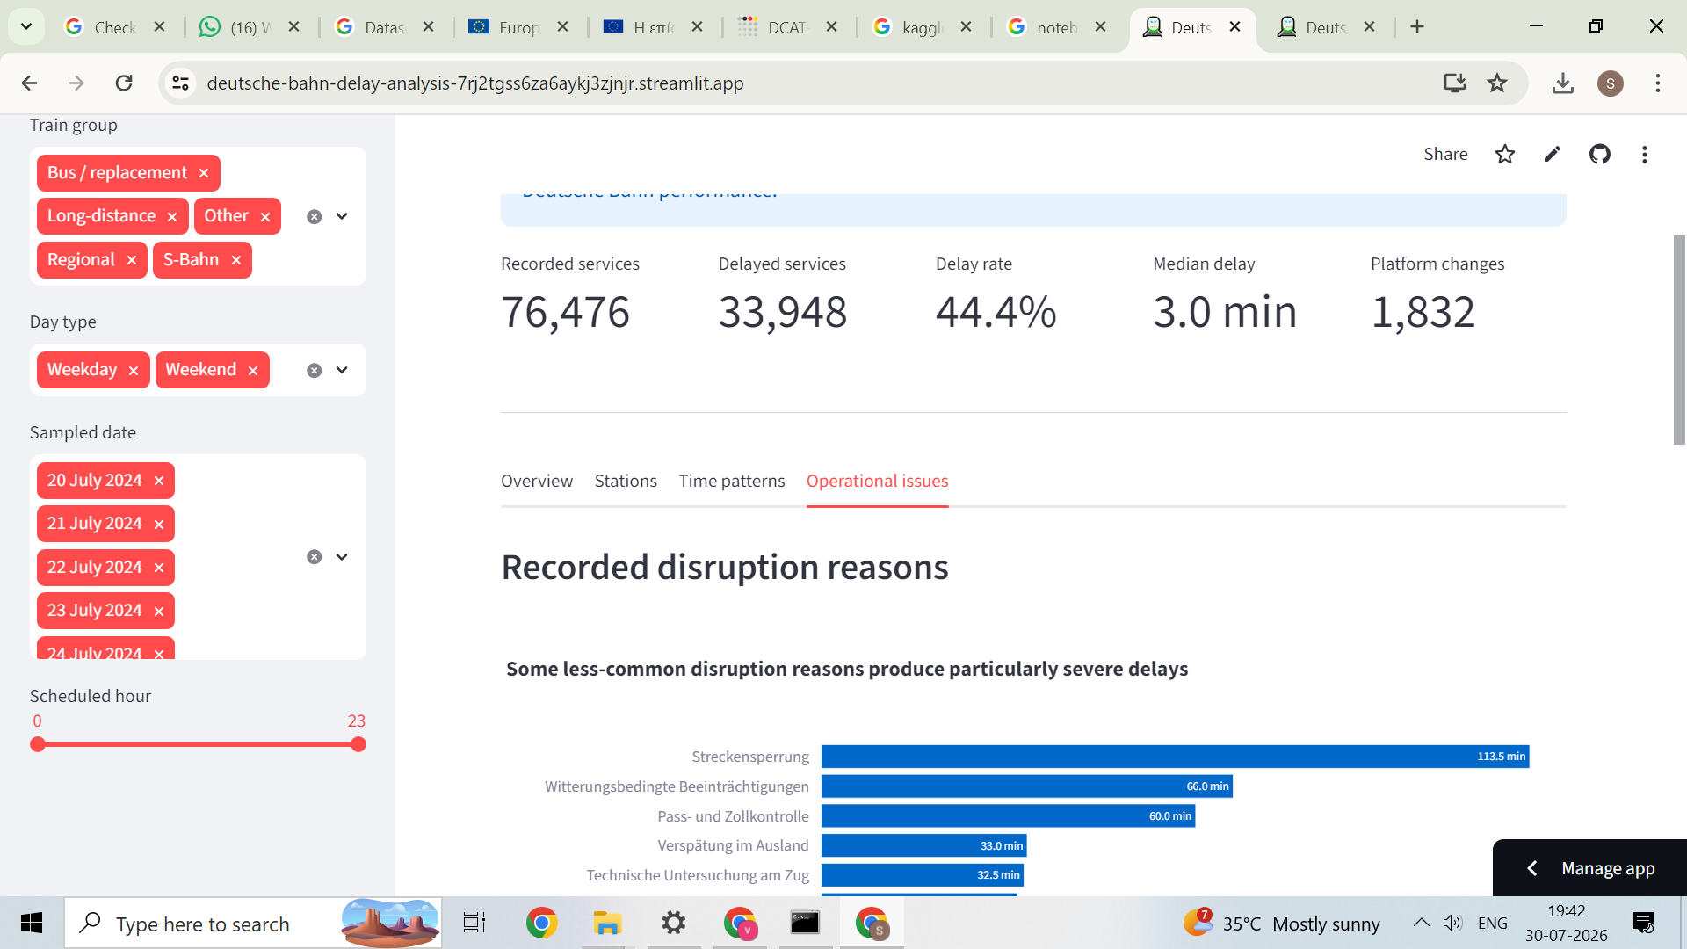
DELIVERY
Interactive dashboard: from static findings to guided exploration
Users can filter by station, train group, day type, sampled date and scheduled hour.
Live dashboard: deutsche-bahn-delay-analysis-7rj2tgss6za6aykj3zjnjr.streamlit.app

Slide 11


CLOSE
Conclusions, limitations and project access
The analysis is strongest when frequency, severity, station context and operational causes are considered together.
Main conclusions
Open the project
Long-distance services were the weakest-performing category.
München had the highest delay rate, while Bielefeld and Bonn had longer typical delays.
Delay frequency and delay severity identify different problem areas.
Operational causes have unequal effects; international lateness and train diversions were especially severe.
GitHub repository
Live dashboard
Student
SHAIK KHAJA SOHAIL HUSSAIN
Matriculation
82022509
Key limitation
Subject
DATA VISUALIZATION
The dataset covers only eight sampled dates, so the findings should not be treated as a full annual assessment of Deutsche Bahn performance.
Thank you
Prepared from final_analysis.ipynb, notebook_export.html and the deployed Streamlit dashboard

