Slide 1
How unique is your .onion?
An Analysis of the Fingerprintability of Tor Onion Services

Slide 2
CS 6350 Project Fall 2017 Big Data Management and Analytics Project Report by:
Shashank Kumar Som, sxs168033
Divya Kishore, dxk164430
Archana Gummadavelly, axg162330
Nithin Vasireddy, nxv160230

Slide 3
Introduction
Website fingerprinting attacks apply supervised classifiers to network traffic traces to identify patterns that are unique to a web page.
To carry out the attack the adversary first visits the websites, records the network traffic of his own visits, and extracts from it a template or fingerprint for each site.
Later, when the victim user connects to the site (possibly through Tor), the adversary observes the victim’s traffic and compares it to the previously recorded templates, trying to find a match.
In this work, we study what we call the fingerprintability of websites and investigate what makes a page more vulnerable to website fingerprinting.

Slide 4
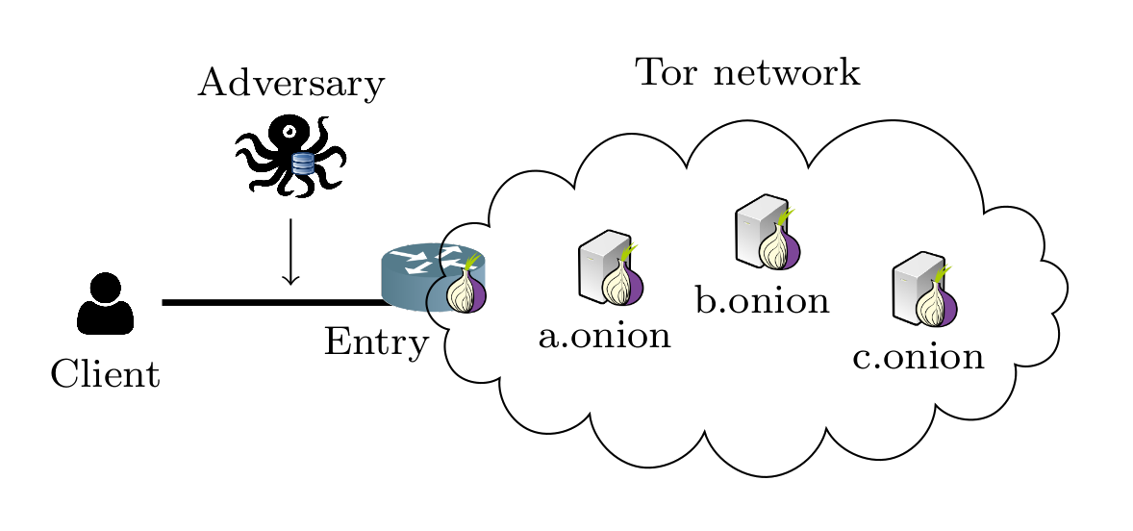
Scenario

Slide 5
Approach and Process Involved
Data Downloaded from : https://cosic.esat.kuleuven.be/fingerprintability/ -- This is the sample data link given by the authors of paper. It contains the crawled data obtained by the web crawlers employed by the authors of the paper over which our project is developed upon. This data is clean and already processed to remove pages with errors and pages that are duplicates of other sites, thus we were left with a sanitized dataset of 482 out of the 1,363 onion services that were crawled.
Data pre-processing : The downloaded data was further pre-processed using the ‘.pig’ script written by us to convert the above data into a format that we can use to perform Big-Data analytics.

Slide 6
Findings : We used several of the website fingerprinting state-of-the-art attacks (i.e., Naive Bayes , Logistic Regression, Multilayer Perceptron) and even tried unsupervised Machine learning techniques (i.e. Clustering) across different onion websites to determine how easy it was for a .onion to be predicted correctly thus making it vulnerable to the website fingerprinting attacks.
Naïve Bayes : When the Naïve Bayes attack was used over the data collected it showed that 4% accuracy in the prediction of the .onion of the website which made us to reach to a conclusion that 4% of the 432 onion services are vulnerable to the website fingerprinting attack in the dataset that we have. Further the model created using the dataset available can be used to predict the vulnerability of any specific website if the model is trained on sufficient amount of data. Time elapsed : 2 hours (approx.)

Slide 7
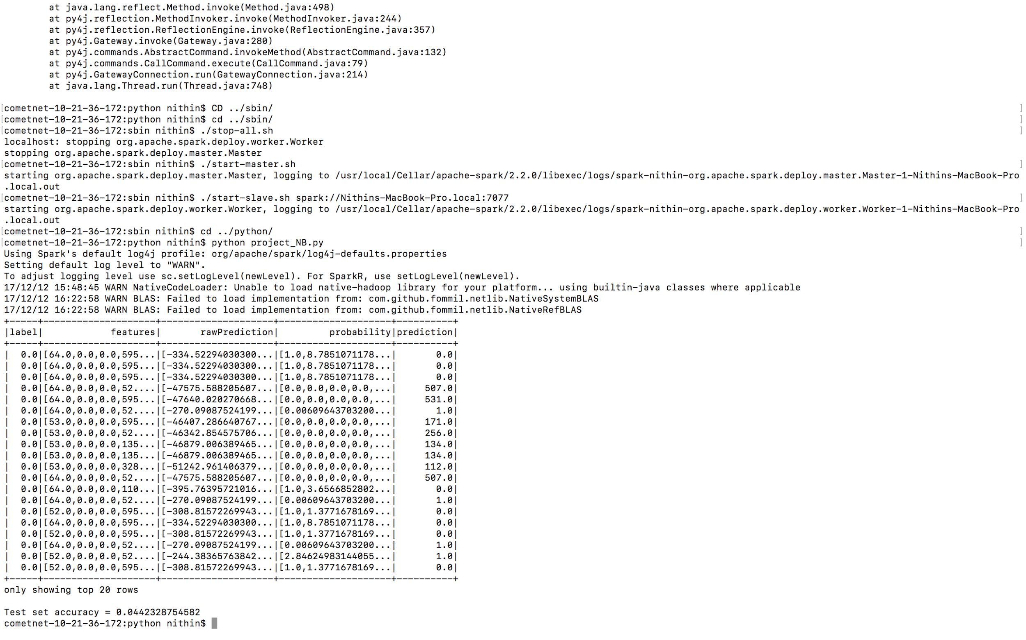

Slide 8
Logistic Regression : Logistic regression though runs successfully on one file but gives timeout (after running for more than 24 hours) when applied on the complete dataset due to the size of the dataset. Time Elapsed : 24 hours and ongoing.
K-means || : K-means parallel though did not prove to be very useful in this scenario but helps to give a bit of intuition about the data when classified into two classes, Vulnerable(cluster1) and Immune(cluster0) that one cluster proves to be considerably bigger than another but at the same time the within class error is very high. Hence, the outcome of the experiment is that unsupervised Machine Learning attacks prove to be futile as website fingerprinting attacks. Time Elapsed : 15 minutes(approx.)

Slide 9
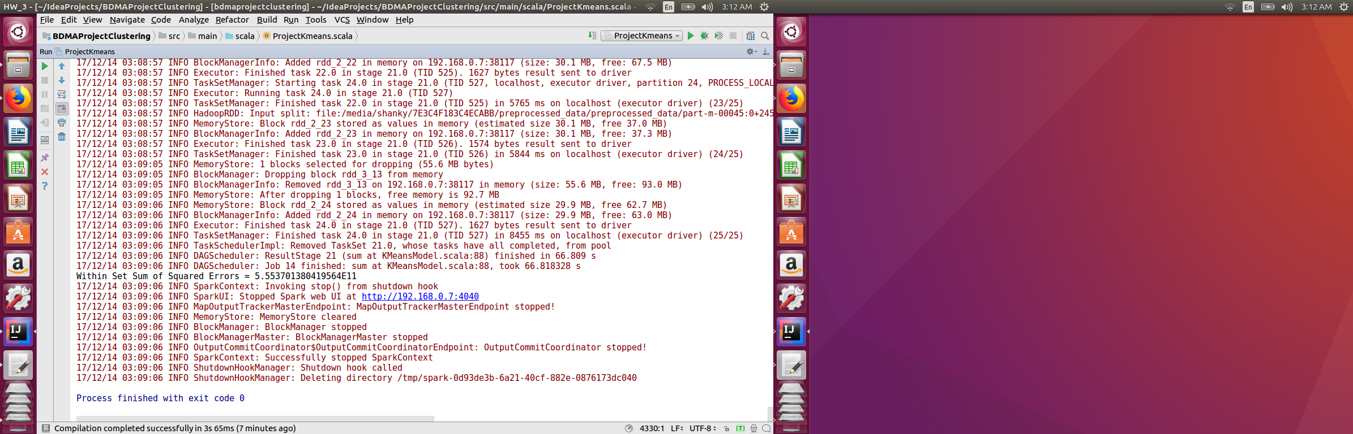

Slide 10
Multilayer Perceptron Classifier:
A Multilayer Perceptron is highly efficient for multinomial classification of big data sets with high number of features. However, with limited computational capacity of our laptops, this model would exceed the time limits in classifying dataset of 2.2gbs. However, running it on subsets of the data was successful.

Slide 11
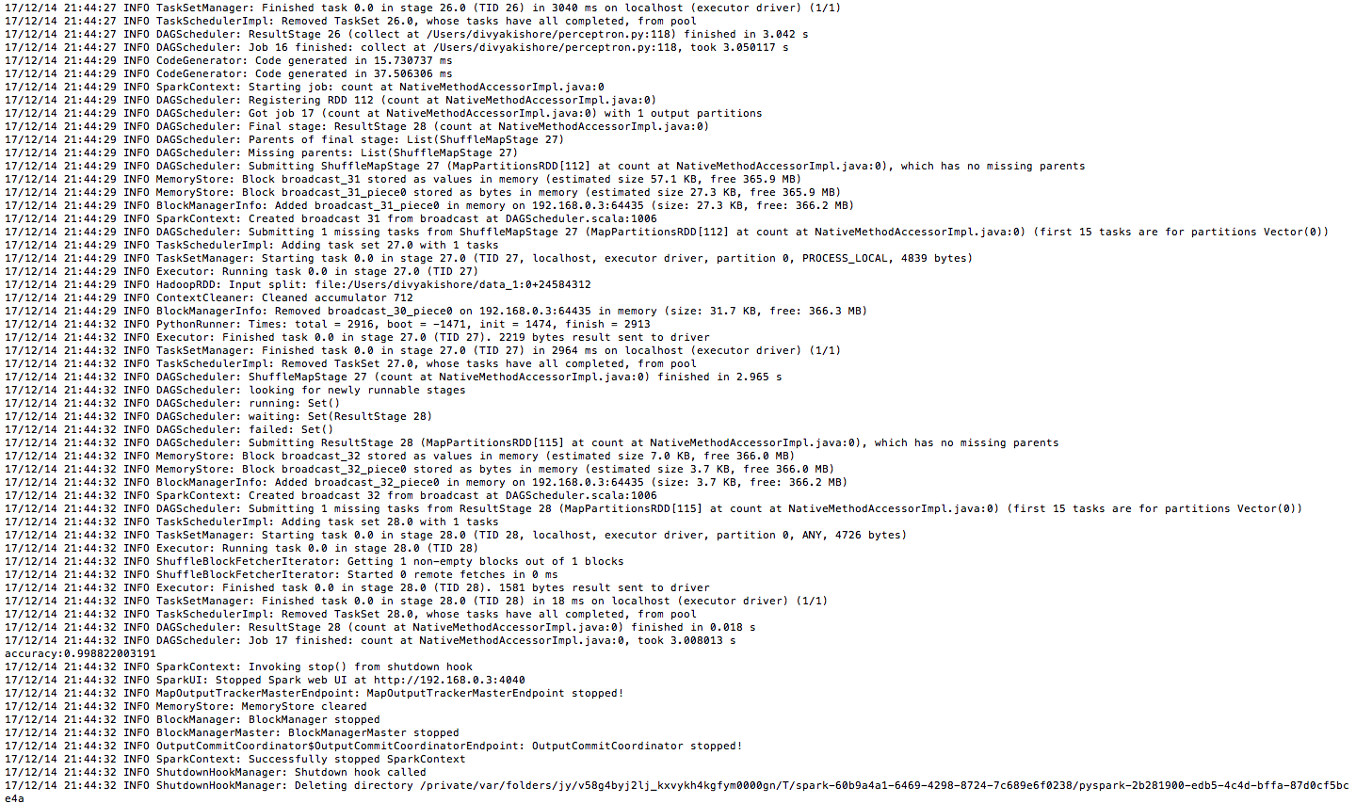

Slide 12
Citation(s)
How Unique is Your .onion? An Analysis of the Fingerprintability of Tor Onion Services★
Rebekah Overdorf (Drexel University); Marc Juarez and Gunes Acar (KU Leuven); Rachel Greenstadt (Drexel University); Claudia Diaz (KU Leuven), ACM CCS 2017, Dallas, TX
https://arxiv.org/pdf/1708.08475.pdf

Slide 13
Vote of Thanks
We are thankful to the authors of the paper, “How Unique is Your .onion? An Analysis of the Fingerprintability of Tor Onion Services”★ which served as the foundation of our project. Also, we thank them for their help in providing the dataset which otherwise would have been a very tedious task to attain.
https://arxiv.org/pdf/1708.08475.pdf

