Slide 1
Netflix Movie Clustering
Case Study

Slide 2
Overview:
Problem Statement
Data Cleaning and Transformation
Metrics for Baseline Models
Feature Engineering
Topic Modelling
Hyperparameter Tuning
Clustering Models
Model selection
Hyperparameter Tuning
Results
Classification Model
Metrics for Baseline Models
Hyperparameter Tuning
Results
Summary

Slide 3
Problem statement
Build Model(s)
· Group different movies using text and clustering algorithm.
· Use the clusters as labels to build a classification model (either Deep learning or Sequence models).

Slide 4
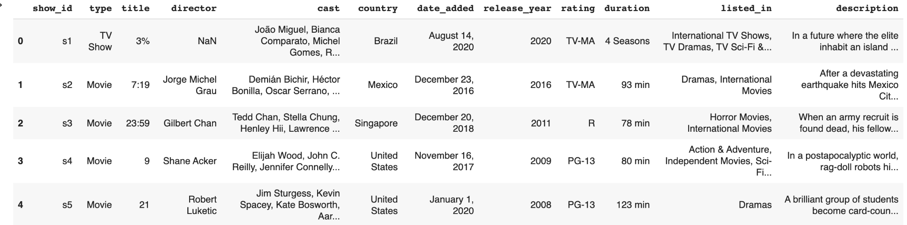
Data set
Metadata of TV Shows and Movies (12 features and 7787 rows)

Slide 5
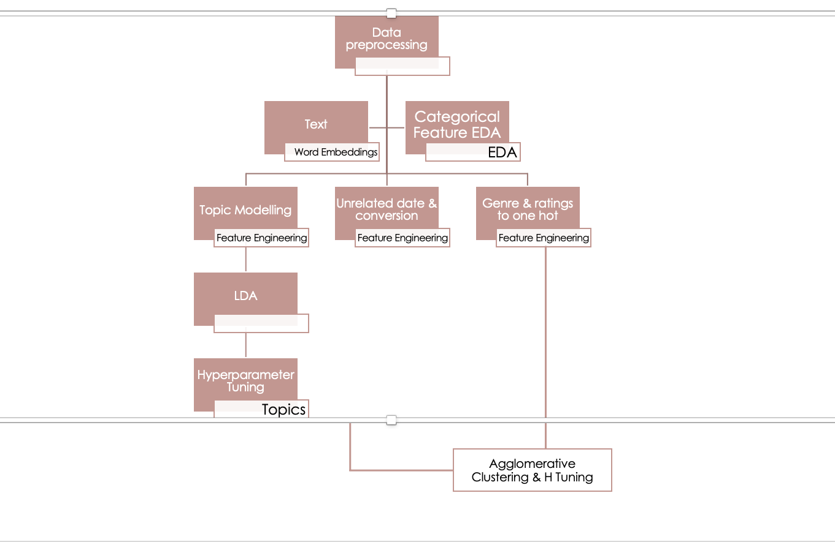
Approach

Slide 6
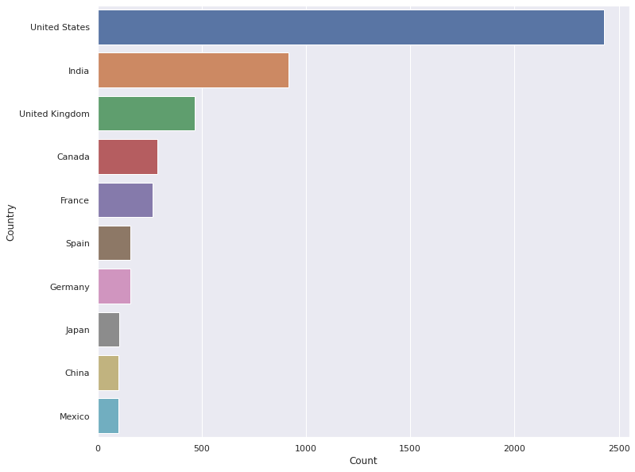
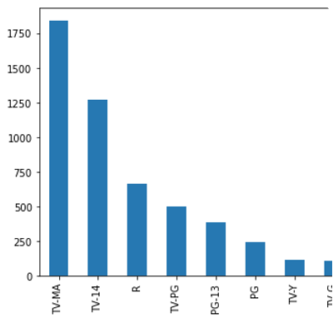
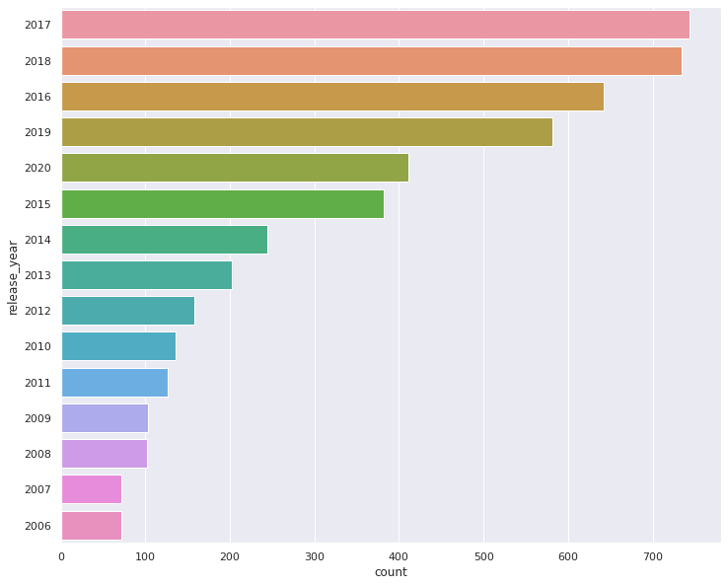
Data Pre-processing and EDA
Filter Movies
Missing values
Data Transformation

Slide 7
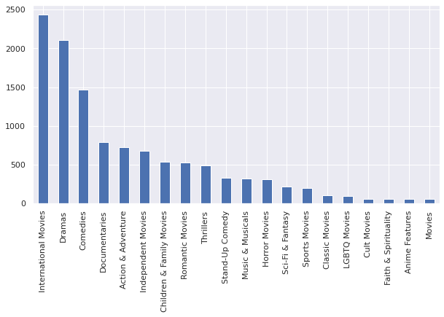
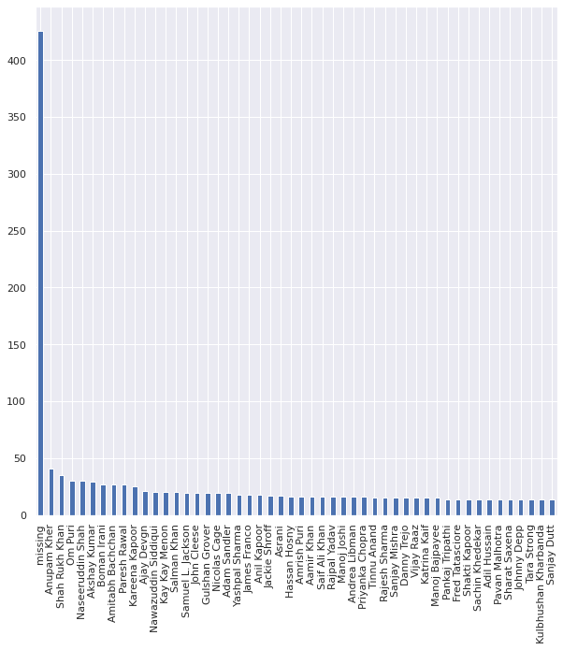
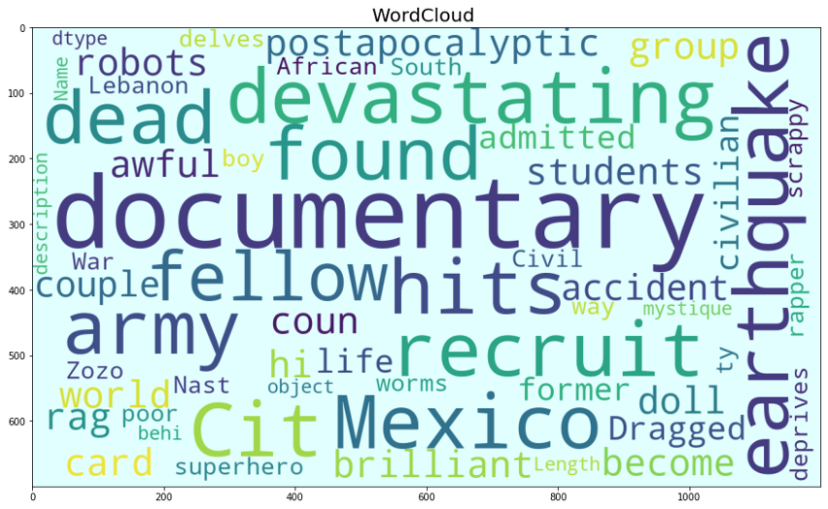
Contd

Slide 8
Text Processing
Preprocess String
Replace special characters, contractions
Tokenize
Remove stop words
Lemmatization & Stemming - Stemming with WordNet POS
Word Frequency by Review Matrix using Custom Analyzer
CoutVectorizer and Tf-IDF

Slide 9
Feature Engineering
Country, release_date features are removed
Categorical features are transformed using one hot encoding
Top frequent terms are added as features to the dataset
Topics as features

Slide 10
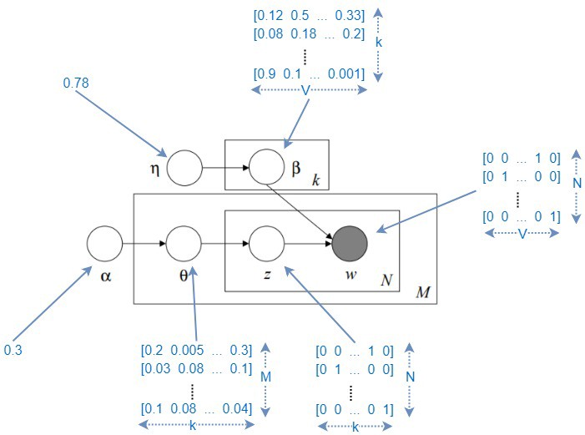
Topic Modelling - LDA
Hyperparameters:
Num of Topics
Alpha
Beta
Eta
Metrics:
Coherence
Jaccard Similarity
Improvement : 64 percent from base model
Final Model : 10 Topics

Slide 11
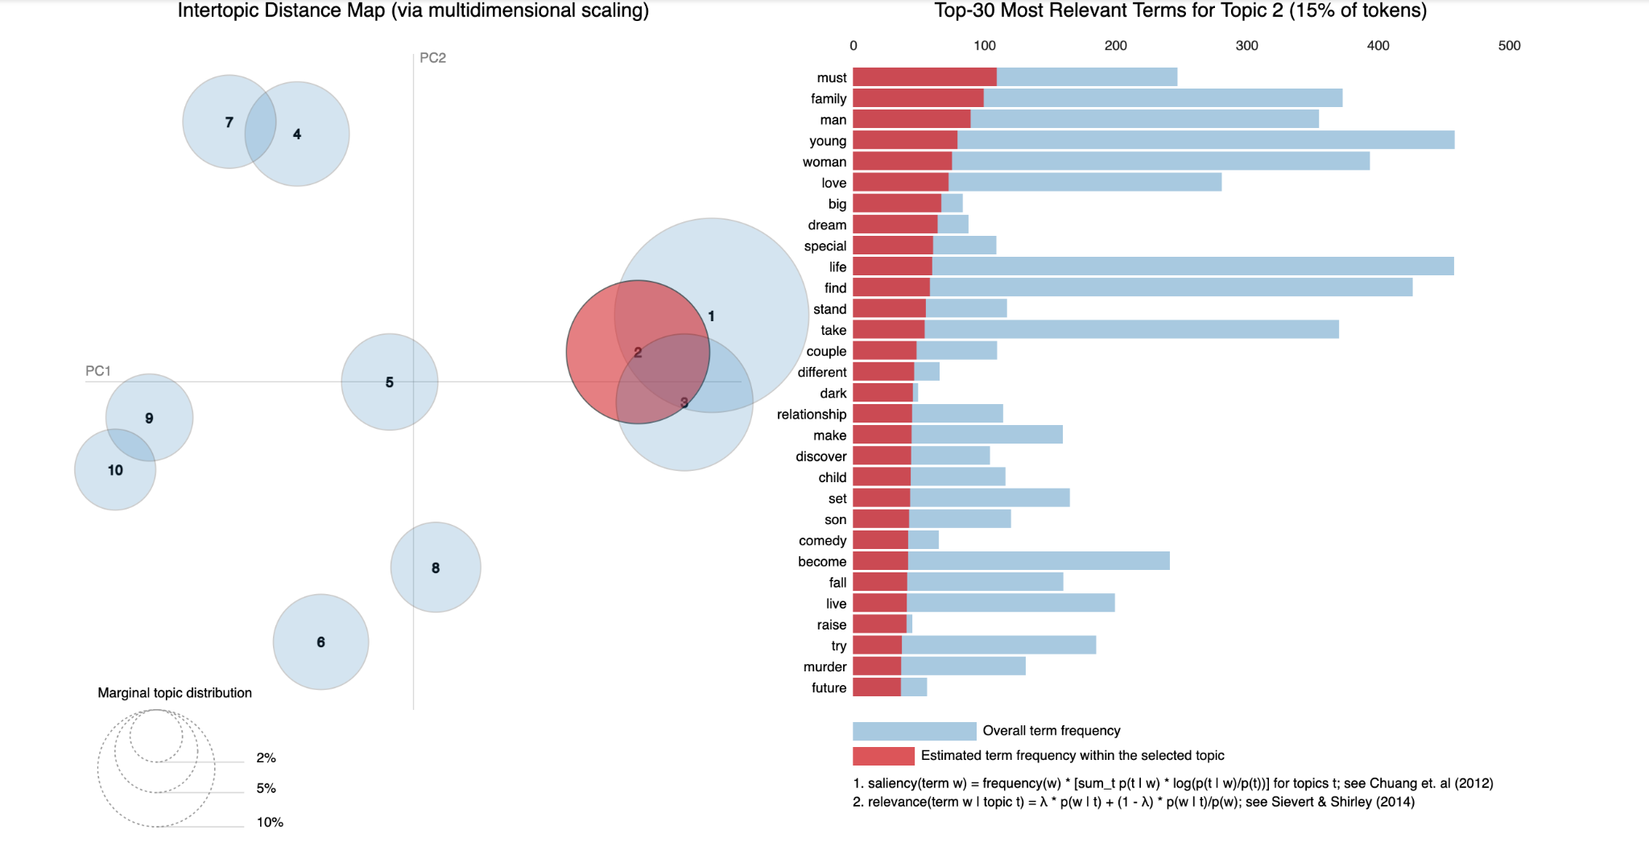
Topics Analysis

Slide 12
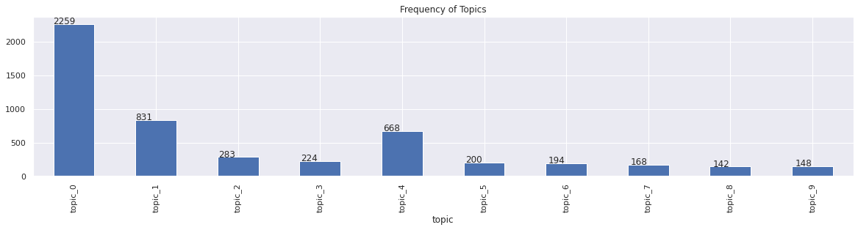
Topics Distribution

Slide 13
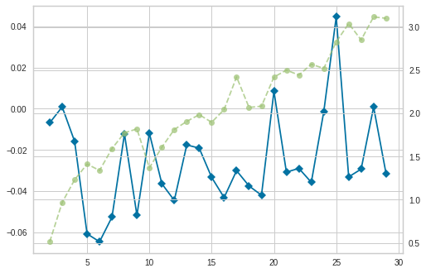
Clustering Models
Standardized data
PCA (As the data is sparse(no major reduction in dimensions)
K Means
Hyperparameters:
Num of clusters
Metrics:
Silhouette and Elbow Method

Slide 14
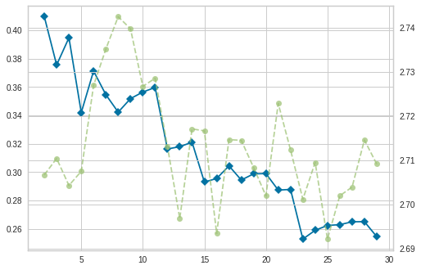
Contd
Agglomerative Clustering Model
Hyperparameters:
N_clusters
Linkage
Affinity
Metrics
Silhouette
Final Model - 4 clusters
Improvement :
9 times better than kmeans
15 percent improved from base model

Slide 15
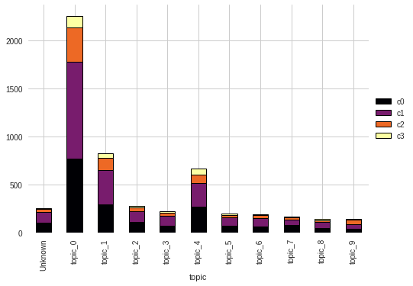
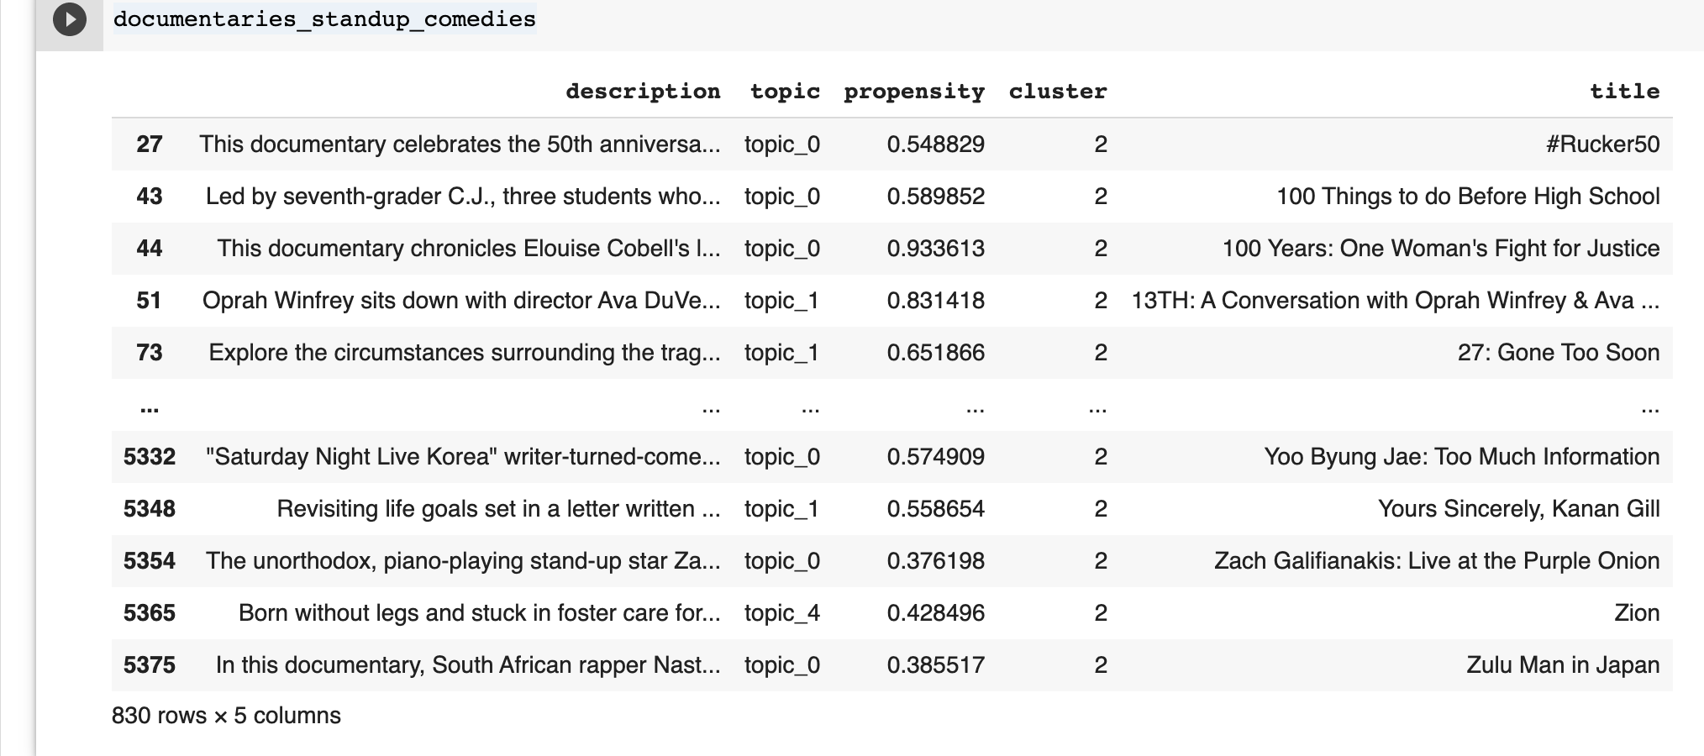
Results

Slide 16
Other Approaches
As we have sparse data eliminating few features based on the domain knowledge may help to cluster the movies more efficiently.
A better clustering algorithm for sparse data like sparse kmeans or converting them to categorical and trying kmodes may help to increase the performance.

Slide 17
Classification
We can notice that the data is imbalanced.
To treat the imbalance in text data:
One approach is to oversample data by generating new samples through the similar terms( through similarity index in the dict)
Train-Test-Val data split

Slide 18
Metrics
As the data is imbalanced:
Better metrics would be precision and recall.
We can measure F1 as a harmonic mean
For our study we need to minimize false positives as we don’t want to predict a wrong cluster for a movie - Precision should be high for our model.
Precision-recall curve

Slide 19
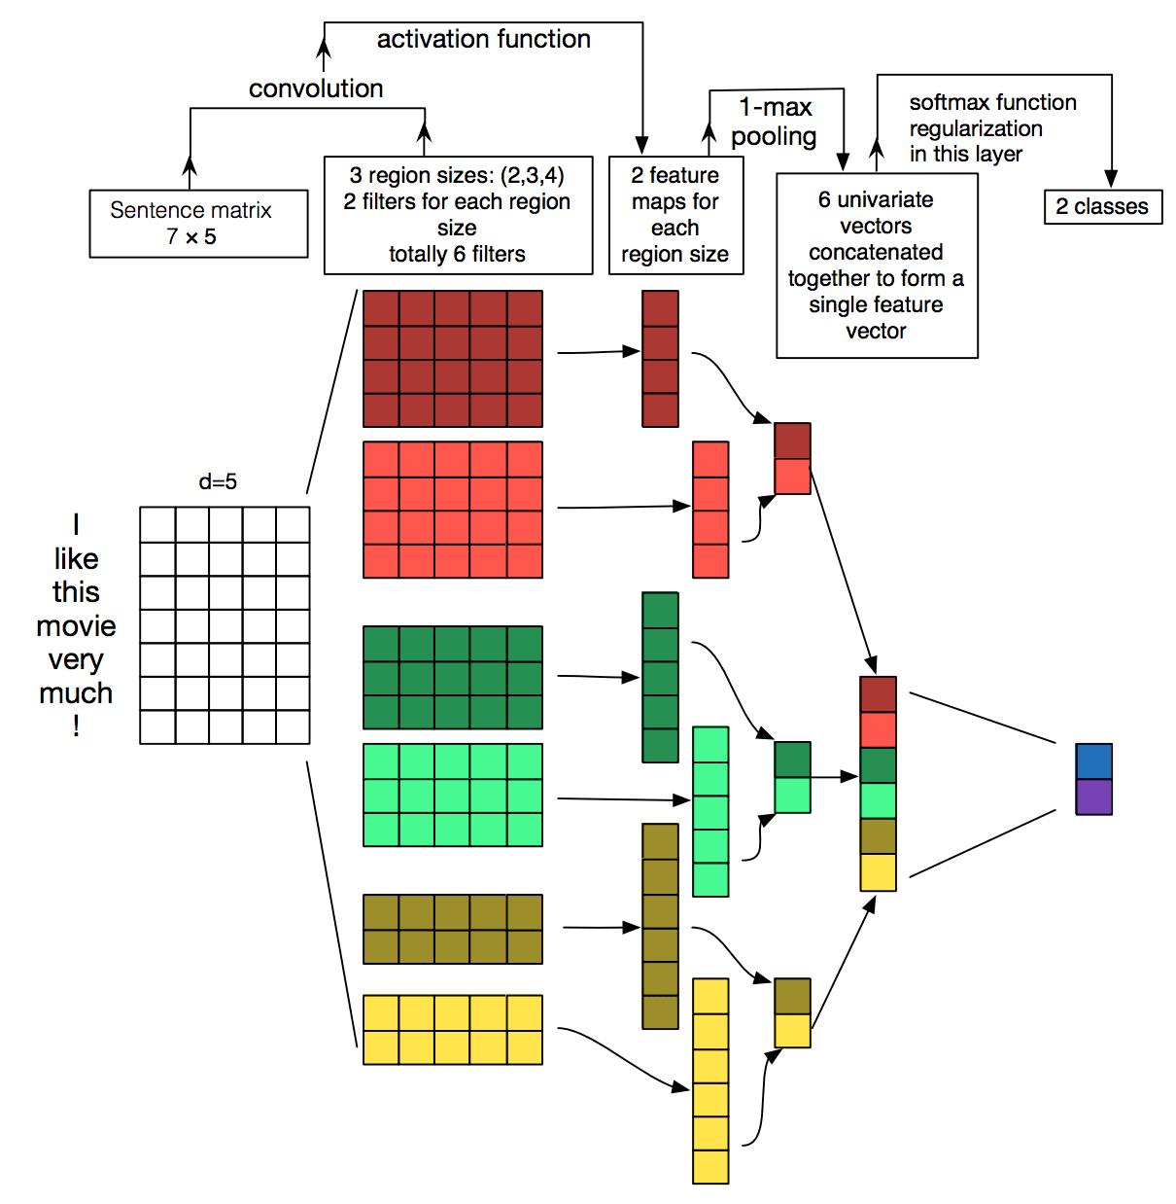
Text CNN
Hyperparameters:
Drop out
Filter sizes
pooling (max, min,avg)

Slide 20
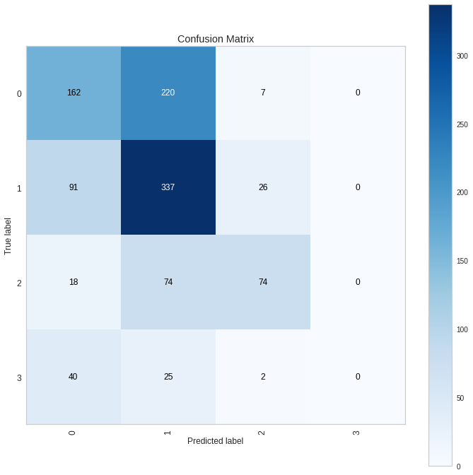
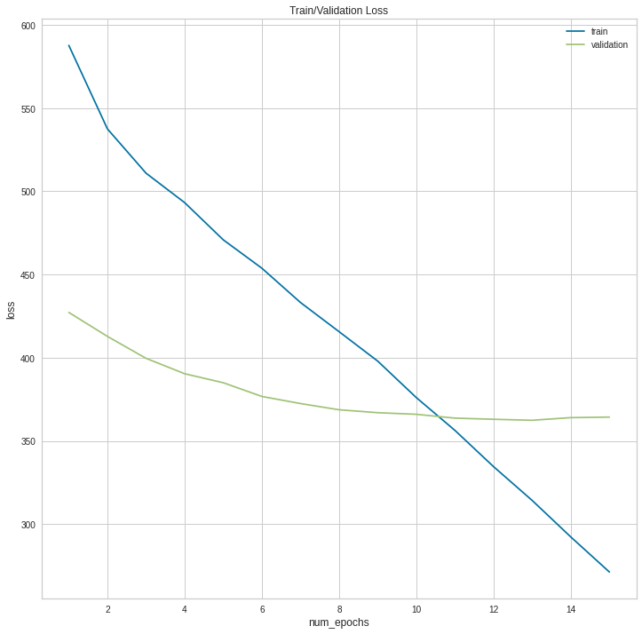
Results

Slide 21
Other Approaches
For classification Model, I developed a baseline model for the word embeddings, the next steps should be using the other feature and building a separate model and stacking both for final prediction may result for better precision.
I started with Text CNN for the text classification, a few other models can be tried for the same.(LSTM, BERT)

Slide 22
Summary
Derived topics from topic modelling(LDA) and added them as features along with frequent terms and other features.
For clustering using the metrics silhouette value(0.57) we were able to decide the cluster value as 4 with Hierarchical clustering.
TextCNN classification model with only input of word embeddings has been developed and for imbalanced data oversampling technique for text generation has been discussed.
Precision is considered as a key metric for this case study and improvement in the classification model is necessary.

Slide 23
References
https://arxiv.org/abs/1408.5882
https://machinelearningmastery.com/
https://en.wikipedia.org/wiki/Latent_Dirichlet_allocation

