Slide 1
Distributor Operational Assessment
User Training — Area Sales Supervisor Role
SKINTIFIC

Slide 2
Introduction
What this app does and who it's for
• What it is:
‣ A multi-role scoring tool that assesses each distributor across 10 operational metrics every month.
• Who's involved:
‣ Area Sales Supervisor — people, infrastructure, delivery & inventory (7 metrics, 34 pts)
‣ Distributor Manager — bulk allocation uploads (NPD, SKU Focus) + user admin
‣ Admin RSA — operational scoring inputs
‣ Account Receivable — AR performance + data reporting compliance
• This guide covers:
‣ The Area Sales Supervisor workflow end-to-end, from login to submission.
Distributor Operational Assessment — User Training

Slide 3
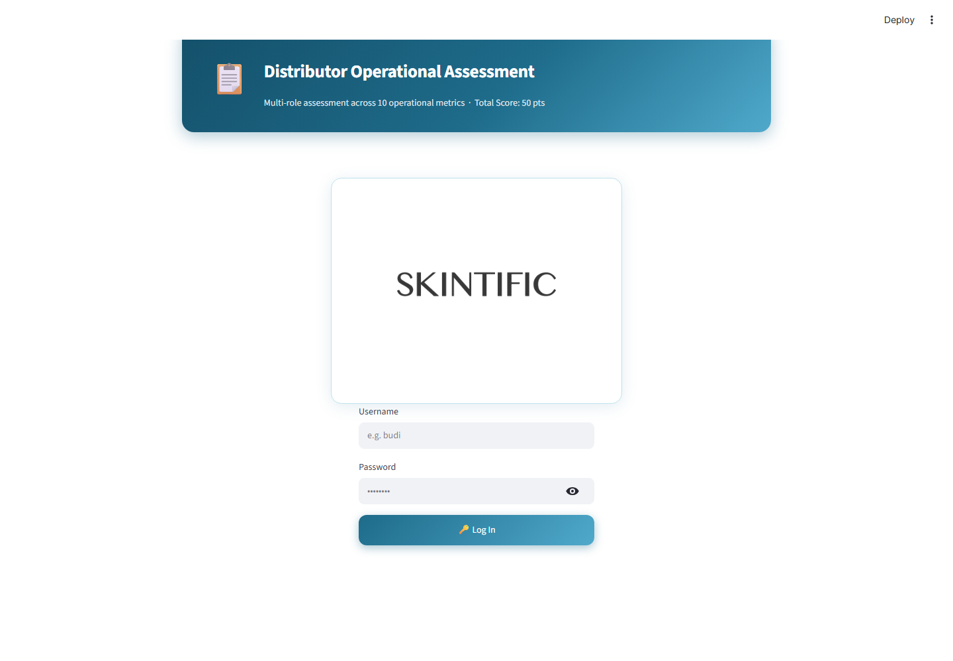
2. Login
Authenticate and reach your role's dashboard
• Purpose:
‣ Your account determines what you see — there is no manual role picker.
• Fields:
‣ Username (not case-sensitive)
‣ Password
• Validation:
‣ Wrong credentials show one generic error — doesn't reveal which field was wrong.
‣ No retry/lockout limit is enforced.
Distributor Operational Assessment — User Training

Slide 4
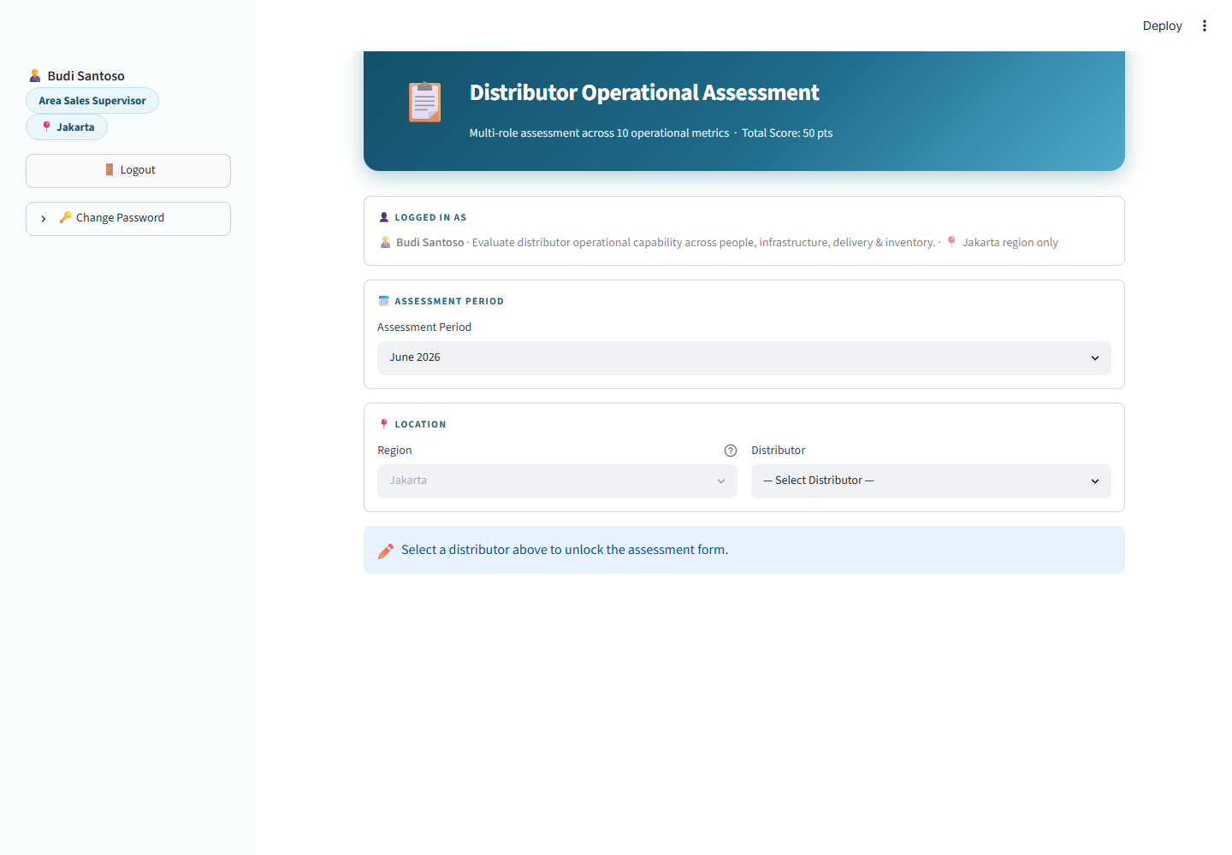
3. Dashboard Overview
What you see right after logging in
• Sidebar:
‣ Your name, role, region, Logout, Change Password
‣ Live Score and per-metric breakdown (updates as you fill the form)
‣ Assessment Progress — all 4 roles' status for this distributor+period
• Main area:
‣ Logged In As card — confirms identity & scope
‣ Assessment Period selector
‣ Location: Region (locked) + Distributor (required to unlock the form)
Distributor Operational Assessment — User Training

Slide 5
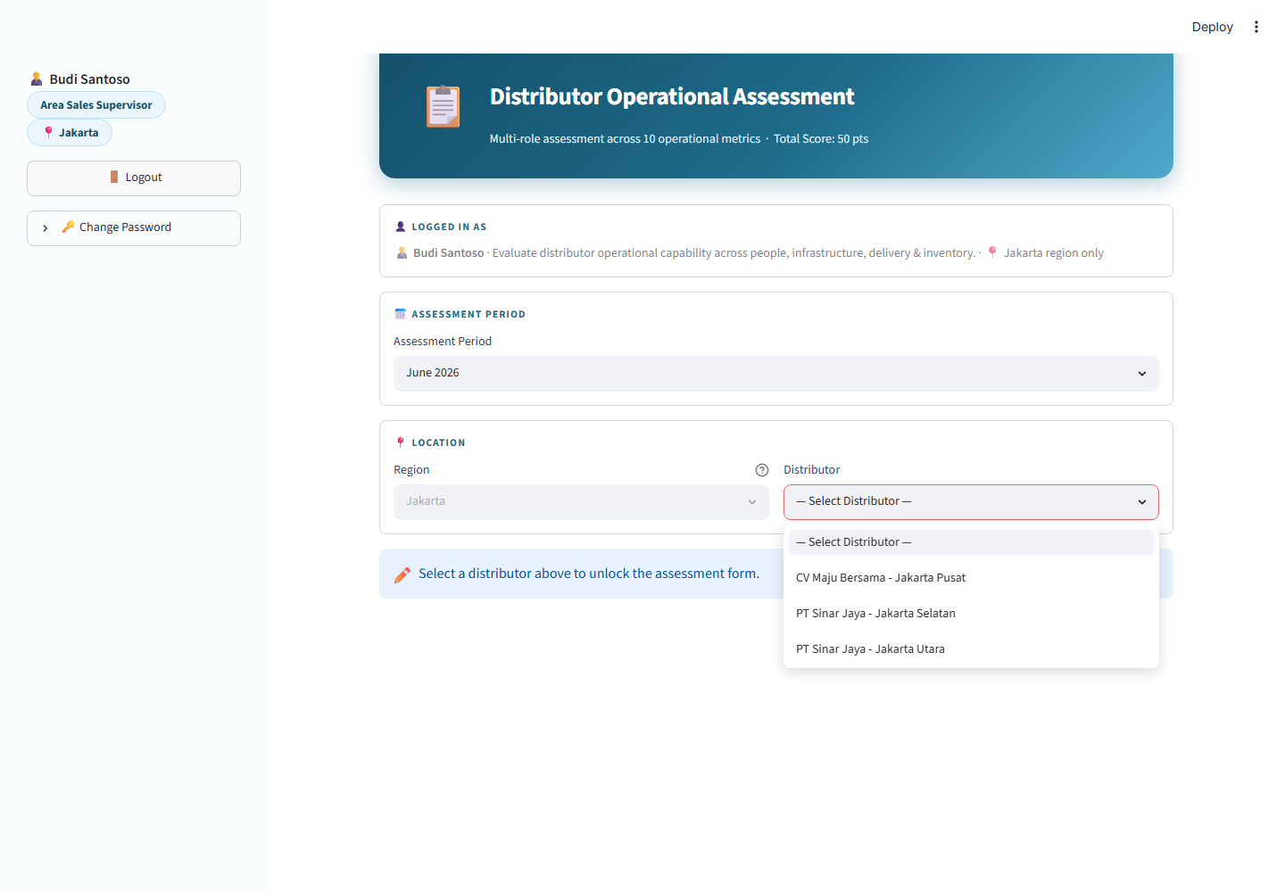
4. Assessment Workflow
Step 1 — choose period and distributor
• Assessment Period:
‣ Area Sales Supervisor sees only the current month + 2 prior months.
• Distributor:
‣ List is filtered to distributors mapped to YOU specifically, not the whole region.
‣ Empty list = nothing mapped to your account yet — contact an Admin.
Distributor Operational Assessment — User Training

Slide 6
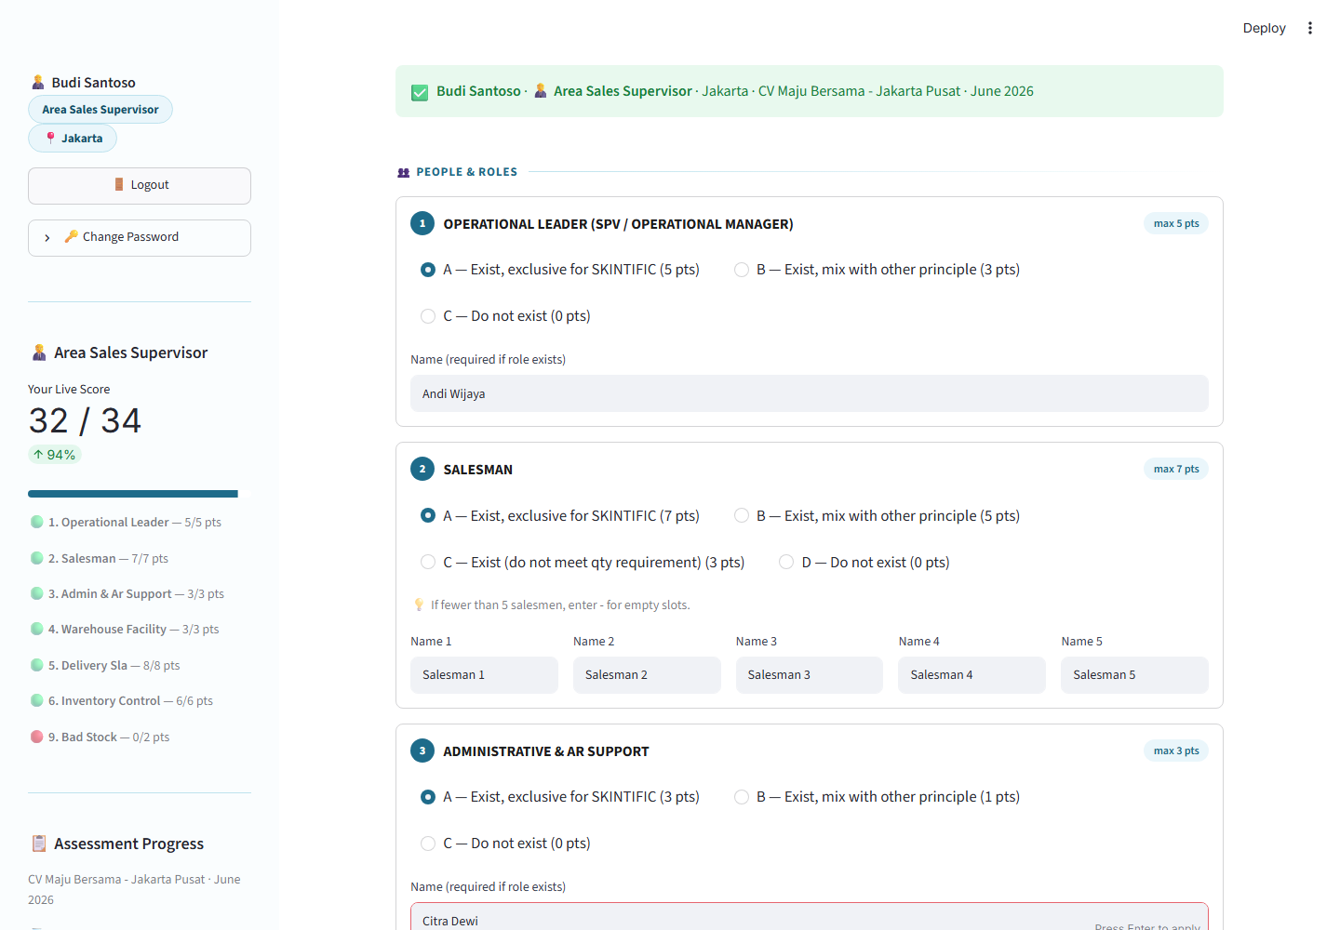
4. Assessment Workflow
Step 2 — People & Roles (metrics 1–3)
• Operational Leader — max 5 pts
• Salesman — max 7 pts, requires exactly 5 names
• Administrative & AR Support — max 3 pts
• Validation:
‣ Grade ≠ 'Do not exist' → a name is required.
‣ Grade = 'Do not exist' → no name should be entered.
Distributor Operational Assessment — User Training

Slide 7
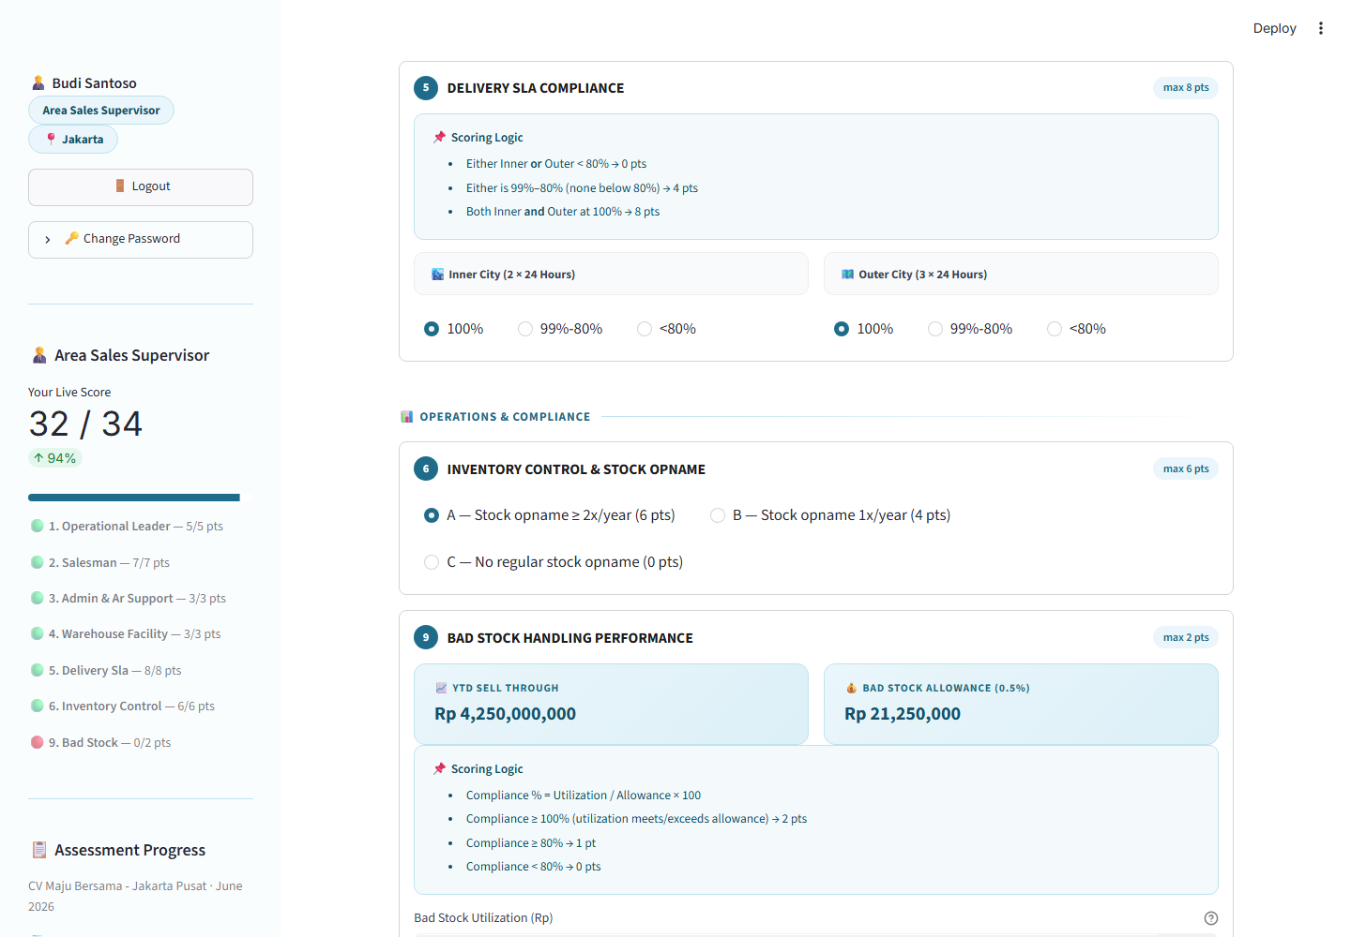
4. Assessment Workflow
Step 3 — Infrastructure, Delivery & Operations (metrics 4–6, 9)
• Warehouse Facility Standard — max 3 pts (direct grade)
• Delivery SLA Compliance — max 8 pts (calculated)
‣ Inner/Outer City bands; both at 100% = 8 pts, any <80% = 0 pts
• Inventory Control & Stock Opname — max 6 pts (direct grade)
• Bad Stock Handling Performance — max 2 pts (calculated)
‣ Compliance % = Utilization ÷ (0.5% of YTD Sell Through) × 100
‣ Card hides + auto-scores max if YTD Sell Through is zero/unavailable
Distributor Operational Assessment — User Training

Slide 8
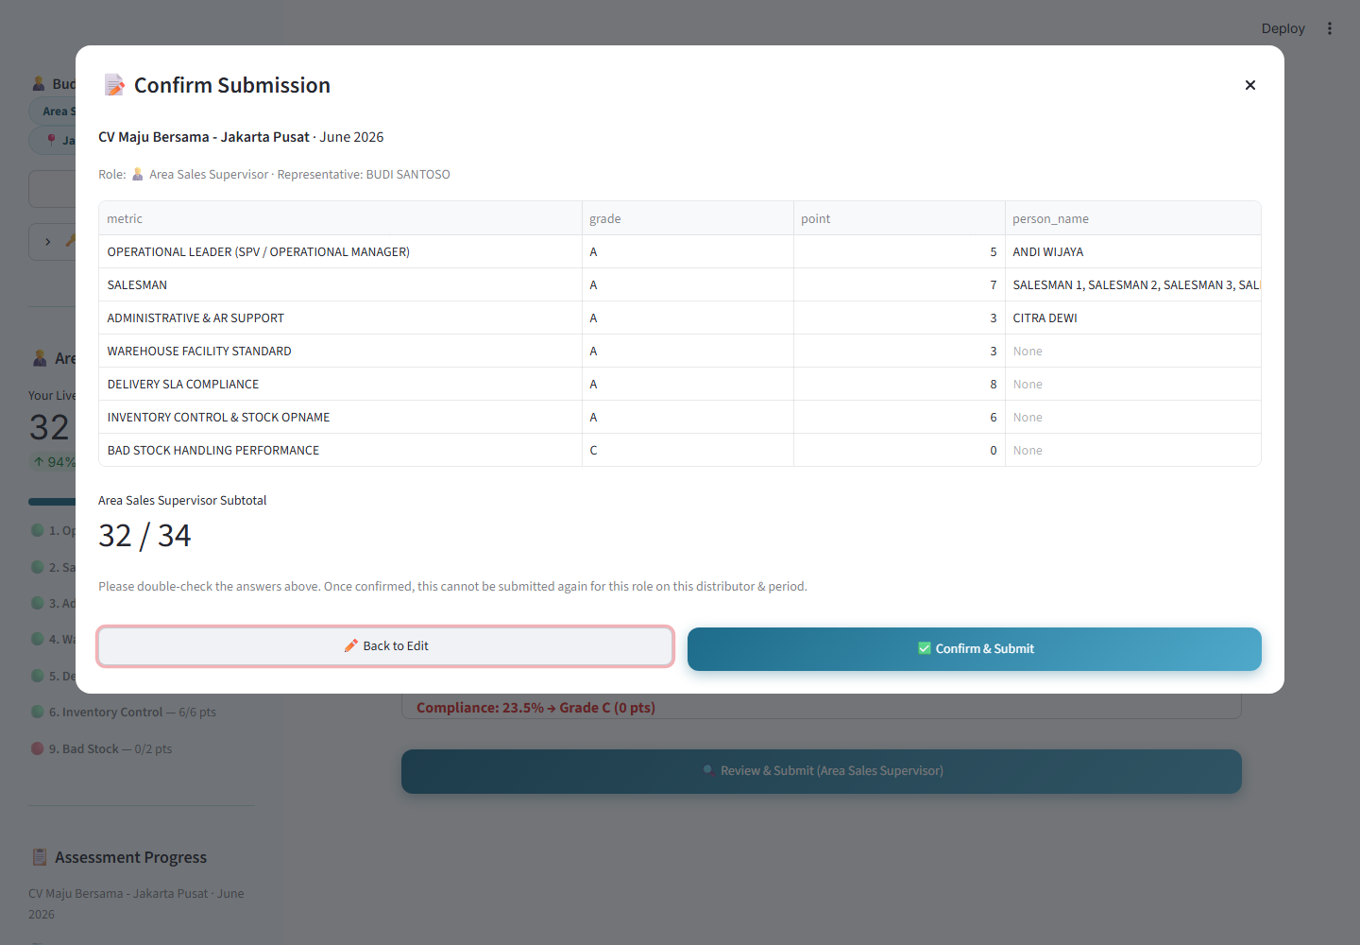
5. Score Submission
Live tracking, review, and final confirmation
• Live Score Tracker (sidebar):
‣ Updates instantly as you answer — running total out of 34.
‣ Shows other roles' progress on the same distributor+period.
• Review & Submit:
‣ Validates the form, then opens a confirmation popup with the full breakdown.
‣ One submission per role, per distributor, per assessment period — final once confirmed.
Distributor Operational Assessment — User Training

Slide 9
6. Distributor Mapping
Why you only see certain distributors
• How the list is built:
‣ Matched against the master distributor list using YOUR region and full name
‣ Specifically: your name must match the assigned supervisor field for SKINTIFIC or Timephoria on that distributor
• Why this matters:
‣ Prevents assessing distributors that aren't actually yours — keeps accountability clean.
• If something's missing:
‣ Contact an Admin to check/update the master distributor mapping — this app doesn't let you self-add distributors.
Distributor Operational Assessment — User Training

Slide 10
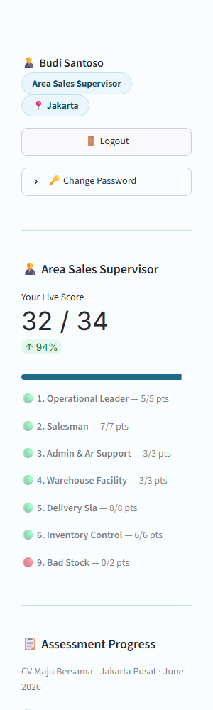
7. Reports
Where to see scores today (and what's not built yet)
• Available now:
‣ Sidebar 'Assessment Progress' — live status of all 10 metrics across all 4 roles for the distributor+period you're viewing.
‣ 'Combined Score So Far' — running total out of 50 as roles submit.
‣ Confirmation popup — your own role's full point breakdown at submission time.
• Not available yet:
‣ There is no dedicated multi-distributor or historical reporting screen inside this app — that would be a future enhancement, not a current feature.
Distributor Operational Assessment — User Training

Slide 11
8. FAQ
• Q: I can't find a distributor I expect to see.
‣ A: Your list is filtered to distributors mapped to you. Contact an Admin if one's missing.
• Q: The Bad Stock card disappeared — bug?
‣ A: No — happens when YTD sell-through is zero. Full marks are auto-awarded.
• Q: I made a mistake after confirming — can I fix it?
‣ A: No. Submissions are final per role/distributor/period. Contact an Admin.
• Q: Why does the sidebar show other roles' progress?
‣ A: All 4 roles roll up into one combined assessment per distributor+period.
Distributor Operational Assessment — User Training

Slide 12
9. Troubleshooting
Symptom | Likely Cause | Fix
"Invalid username or password" | Typo or wrong account | Re-check credentials (password is case-sensitive)
Distributor dropdown is empty | No distributors mapped to you | Contact an Admin
Review & Submit is disabled | Already submitted this period | Pick a different distributor/period, or ask an Admin
Bad Stock card missing | Zero YTD sell-through | Expected — not an error
Logged out unexpectedly | You just changed your password | Log back in with the new password
Distributor Operational Assessment — User Training

