Slide 1
Decremental Tree Connectivity
Sarah Tollman, Zack Swafford, and Alex Barron
Stanford University | CS166 | Keith Schwarz

Slide 2
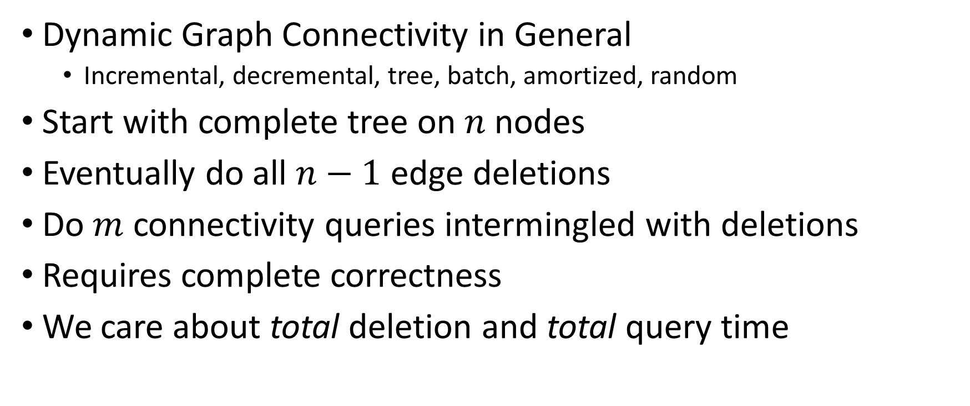
Problem Summary
Dynamic Graph Connectivity in General
Incremental, decremental, tree, batch, amortized, random
Start with complete tree on $n$ nodes
Eventually do all $n−1$ edge deletions
Do $m$ connectivity queries intermingled with deletions
Requires complete correctness
We care about total deletion and total query time

Slide 3
Motivation
Applications to other problems
Subproblem in more general dynamic connectivity problems
Applications in UNION-FIND and leaf tracking
Little interest since 1999
Practical results
Benchmarking tests
Visualizations to aid understanding
Synthesis of state of the art solutions

Slide 4
Method Overview
Unstructured
DFS Labeling
Even-Shiloach
Alstrup-Secher-Spork

Slide 5

Unstructured Model
No information stored
DFS for query
Preprocessing in $O(1)$
Total Delete in $O(n)$
Total Query in $O\left(m∙n\right)$

Slide 6
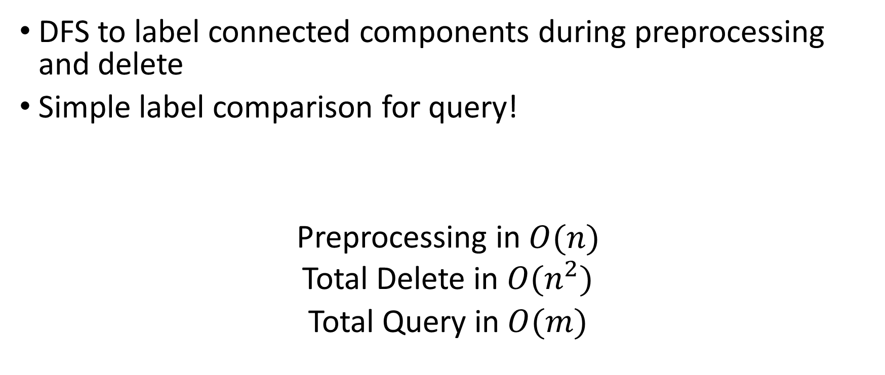
DFS Labeling Model
DFS to label connected components during preprocessing and delete
Simple label comparison for query!
Preprocessing in $O(n)$
Total Delete in $O(n^{2})$
Total Query in $O(m)$

Slide 7
Can we do better?

Slide 8
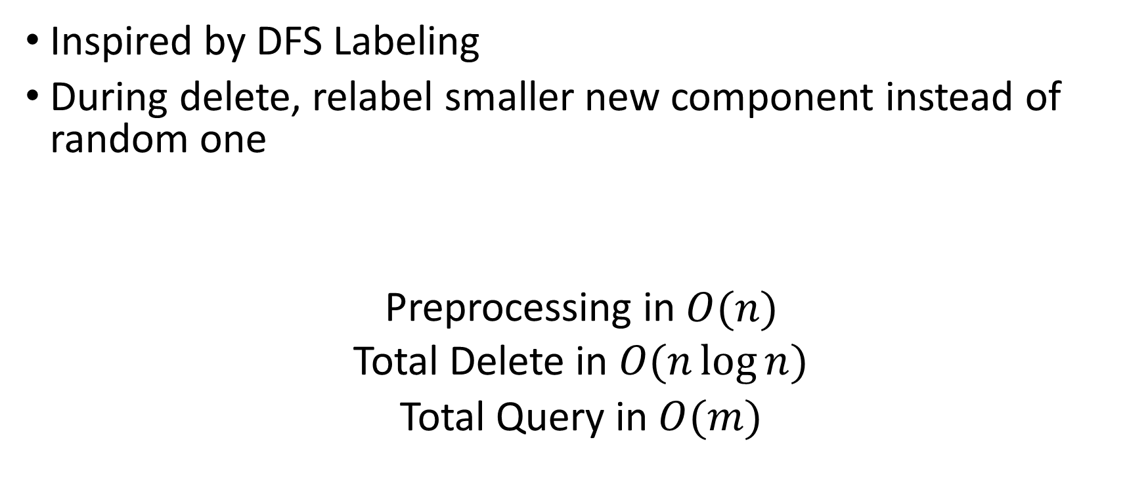
Even-Shiloach Model
Inspired by DFS Labeling
During delete, relabel smaller new component instead of random one
Preprocessing in $O(n)$
Total Delete in $O(n\log{n})$
Total Query in $O(m)$

Slide 9
Can we do better?

Slide 10
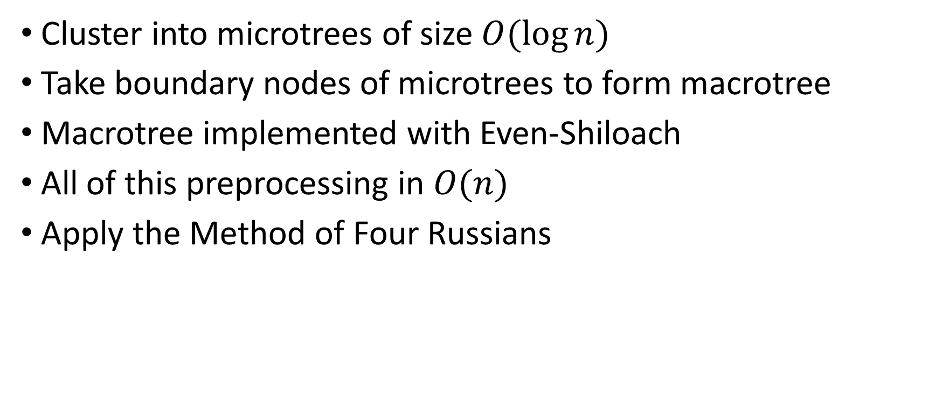
Alstrup-Secher-Spork Model
Cluster into microtrees of size $O(\log{n)}$
Take boundary nodes of microtrees to form macrotree
Macrotree implemented with Even-Shiloach
All of this preprocessing in $O(n)$
Apply the Method of Four Russians

Slide 11
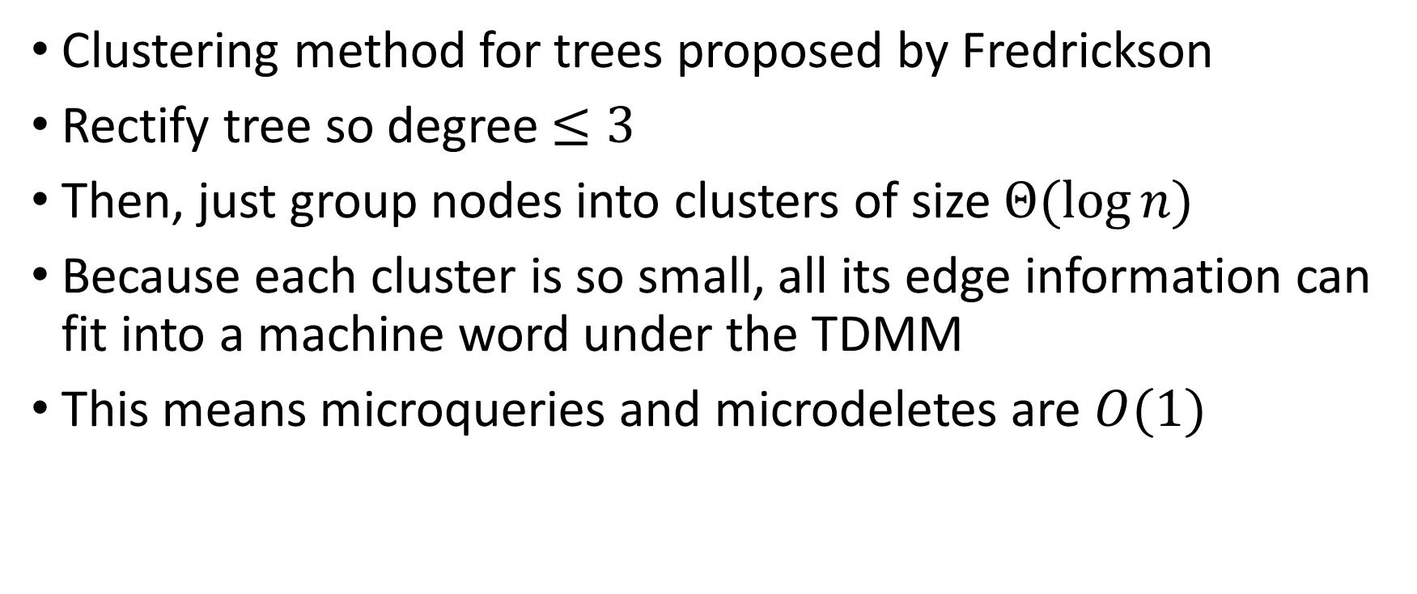
Alstrup-Secher-Spork Model
Clustering method for trees proposed by Fredrickson
Rectify tree so degree $≤3$
Then, just group nodes into clusters of size $Θ(\log{n)}$
Because each cluster is so small, all its edge information can fit into a machine word under the TDMM
This means microqueries and microdeletes are $O(1)$

Slide 12
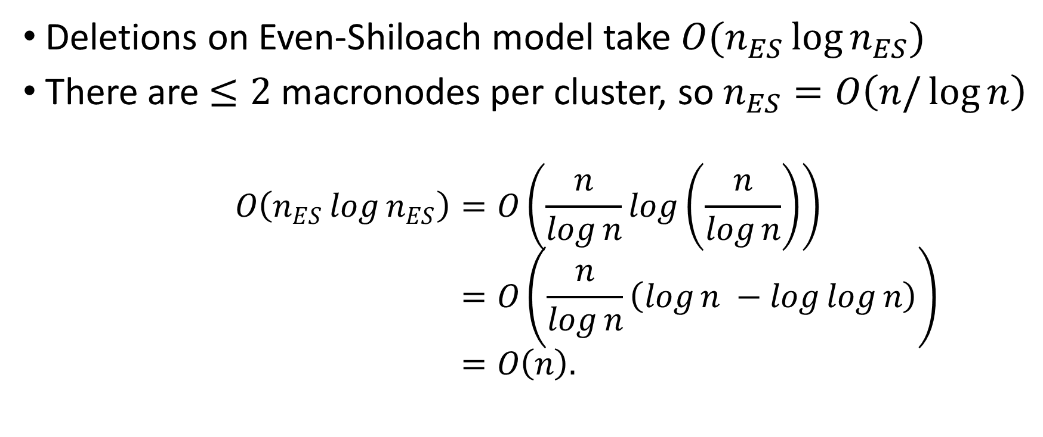
Alstrup-Secher-Spork Model
Deletions on Even-Shiloach model take $O(n_{ES}\log{n_{ES})}$
There are $≤2$ macronodes per cluster, so $n_{ES}=O\left(n/\log{n}\right)$
$$O\left(n_{ES}\log{n_{ES}}\right)=O\left(\frac{n}{\log{n}}\log\left(\frac{n}{\log{n}}\right)\right)=O\left(\frac{n}{\log{n}}\left(\log{n −\log{\log{n}}}\right)\right)=O\left(n\right).$$

Slide 13
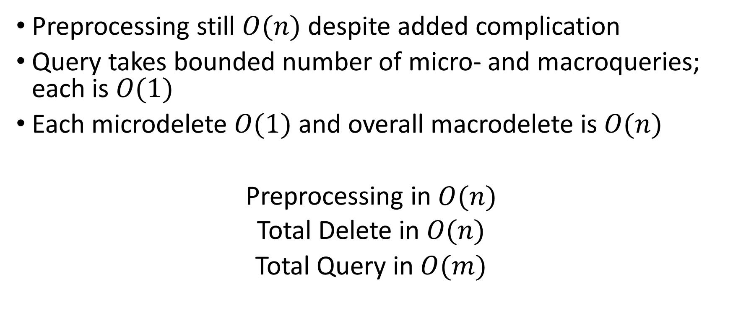
Alstrup-Secher-Spork Model
Preprocessing still $O(n)$ despite added complication
Query takes bounded number of micro- and macroqueries; each is $O(1)$
Each microdelete $O(1)$ and overall macrodelete is $O(n)$
Preprocessing in $O(n)$
Total Delete in $O(n)$
Total Query in $O(m)$

Slide 14
Can we do better?

Slide 15

No. This is big-$O$ optimal.

Slide 16
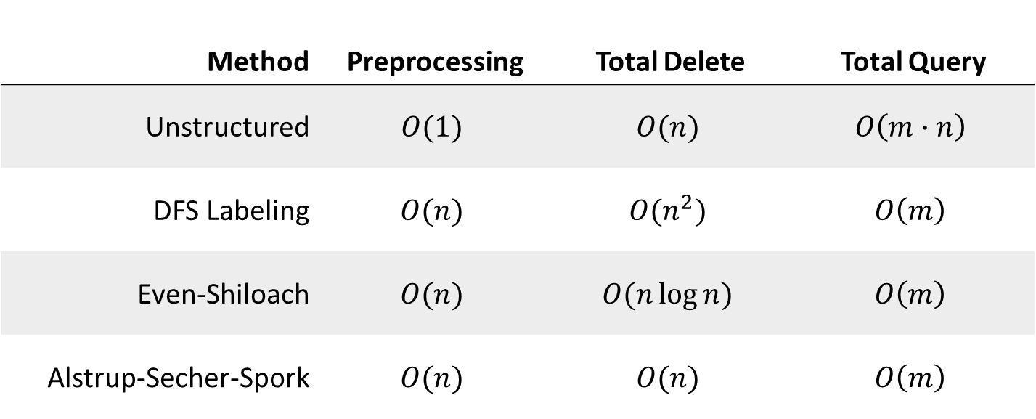
Model Summary
Method | Preprocessing | Total Delete | Total Query
Unstructured | $$O(1)$$ | $$O(n)$$ | $$O\left(m∙n\right)$$
DFS Labeling | $$O(n)$$ | $$O(n^{2})$$ | $$O\left(m\right)$$
Even-Shiloach | $$O(n)$$ | $$O(n\log{n})$$ | $$O\left(m\right)$$
Alstrup-Secher-Spork | $$O(n)$$ | $$O(n)$$ | $$O\left(m\right)$$

Slide 17
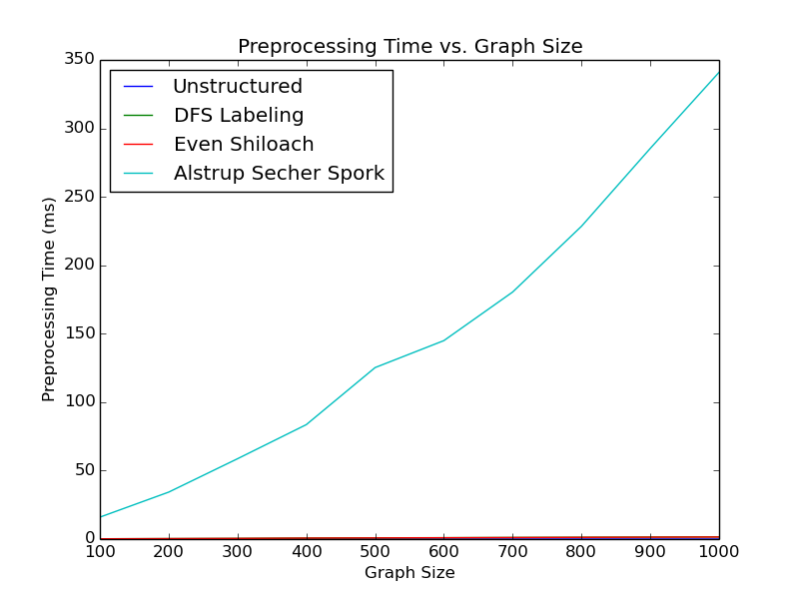
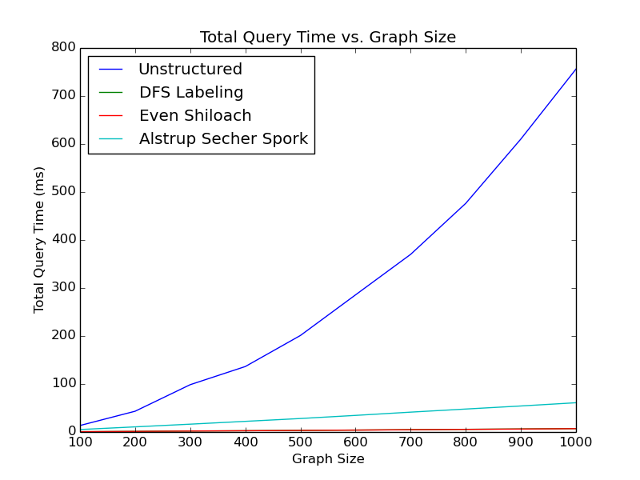
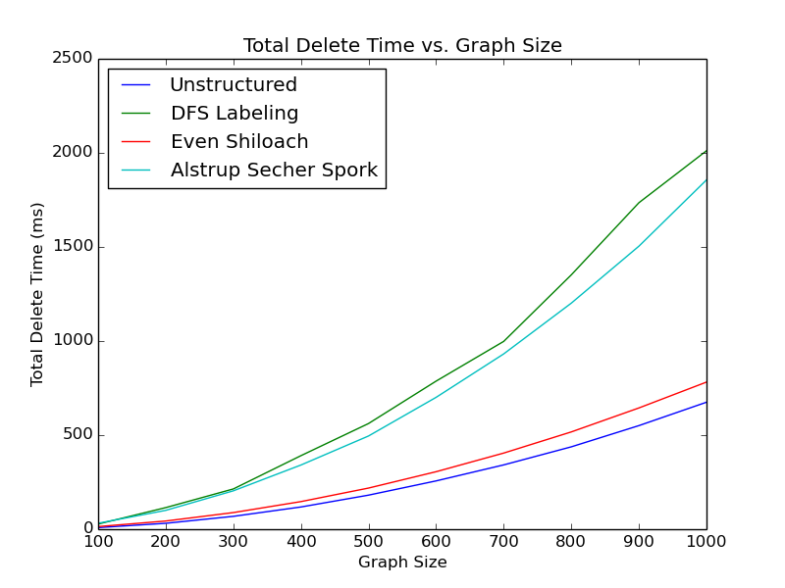
Practical Runtime Results

Slide 18
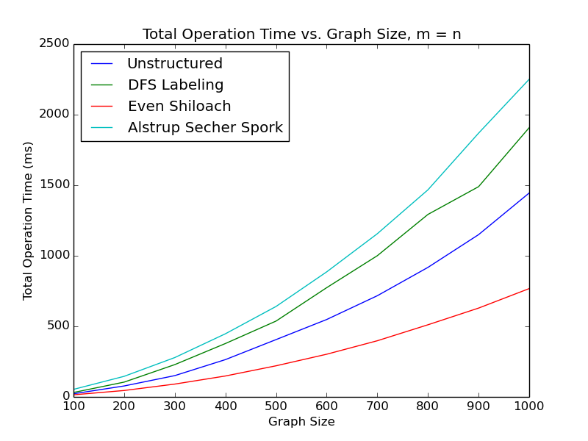
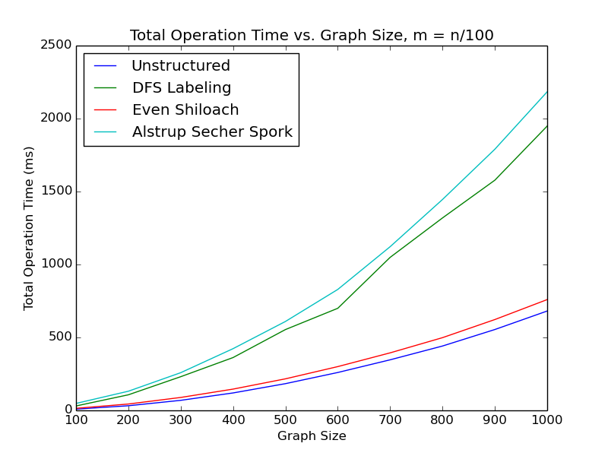
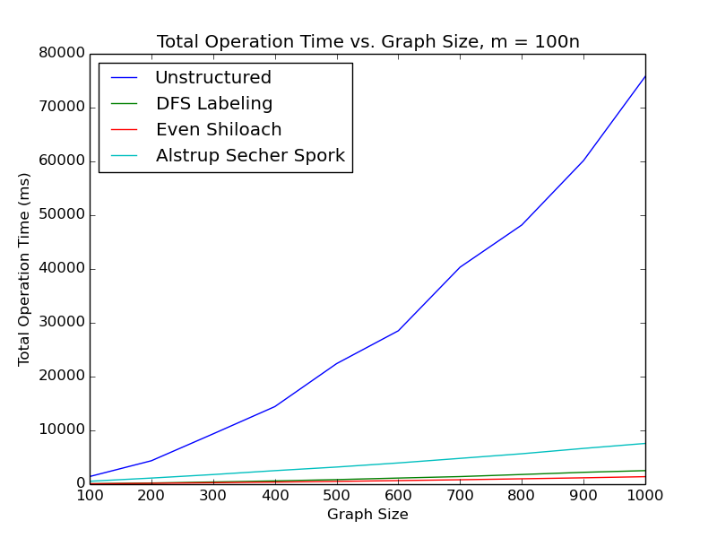
Practical Runtime Results

Slide 19
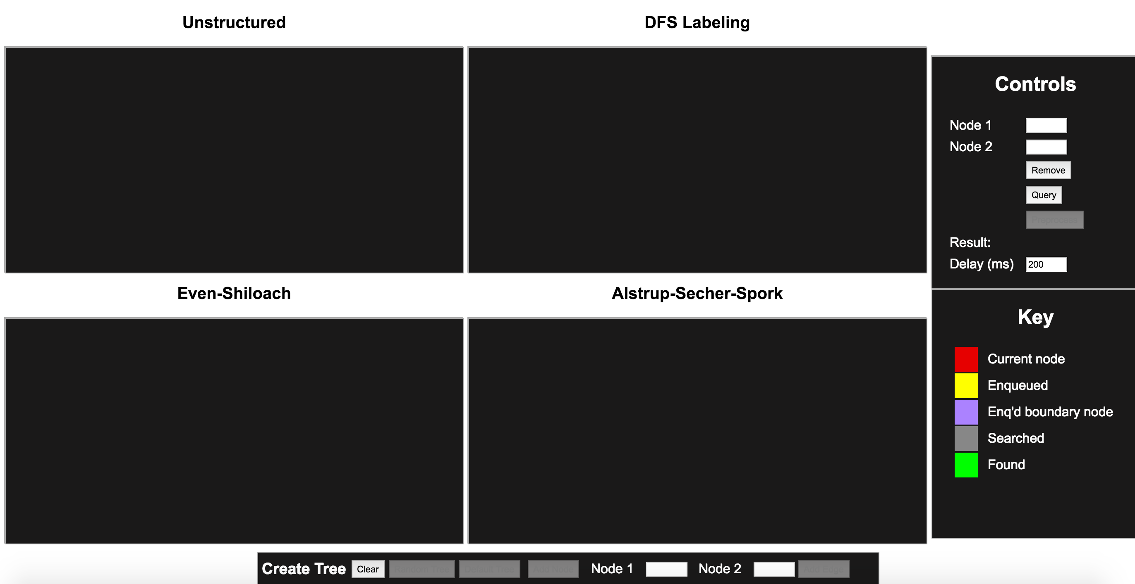
Visual Modeling

Slide 20
Further Work
Benchmarking code available to try for specific application!
Practically, we see that Even-Shiloach is preferable for any non-ginormous tree
The biggest surprise was that E-S was so much better than DFS labeling in total delete time
Summary paper and visualization designed to help future work

