Slide 1
Nginx
https://www.youtube.com/watch?v=1ndlRiaYiWQ

Slide 2
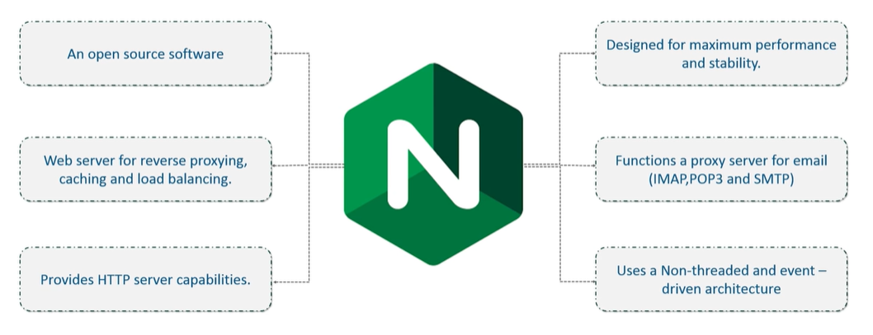
Nginx

Slide 3
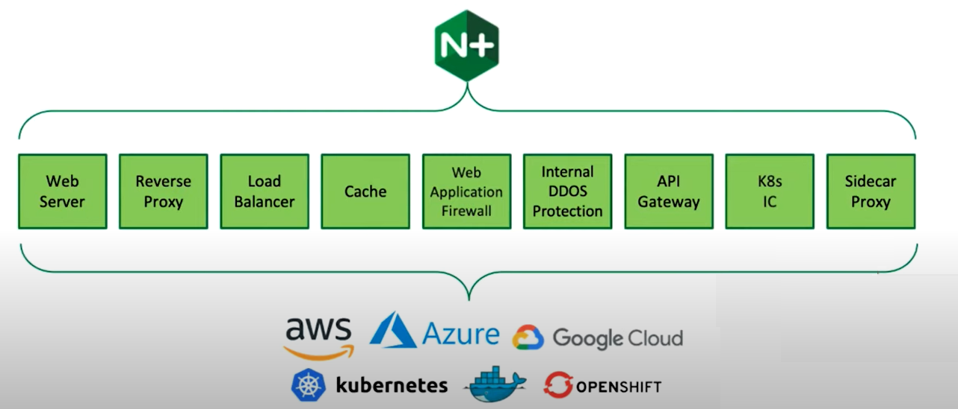
Nginx - Usecase

Slide 4
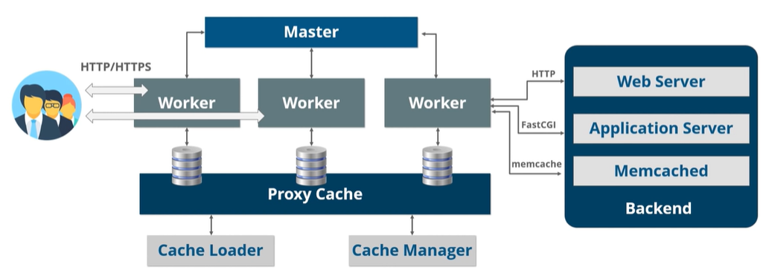
Nginx Architecture
Ngnix usages Master-Slave architecture by supporting event-driven, asynchronous and non-blocking model.

Slide 5
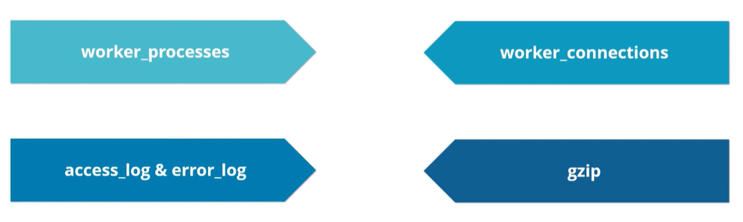
Nginx Configuration
The core setting of NGINX are mainly configured in the nginx.conf.
The configuration file is mainly structured into contexts.

Slide 6
Reverse Proxy using Nginx
https://www.youtube.com/watch?v=lZVAI3PqgHc

Slide 7
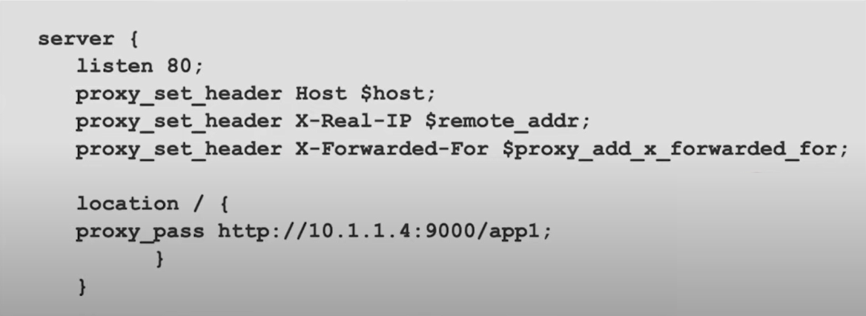
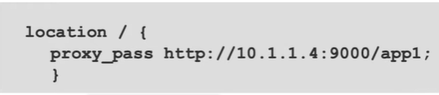
proxy_pass Directive
Terminate connection @reverse proxy
Need to set some information of the host who is
calling.

Slide 8
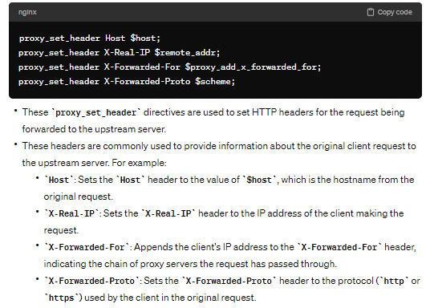
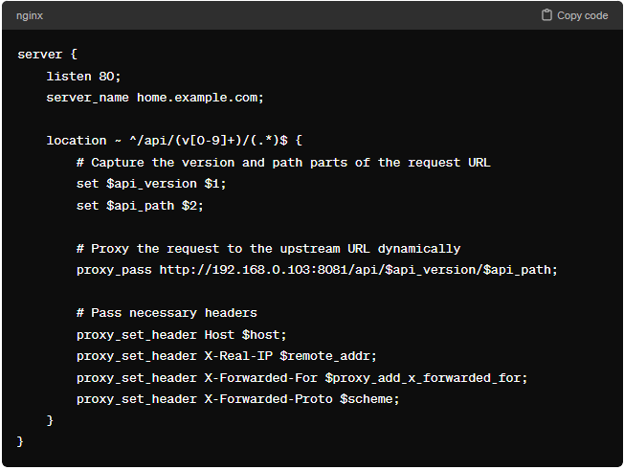
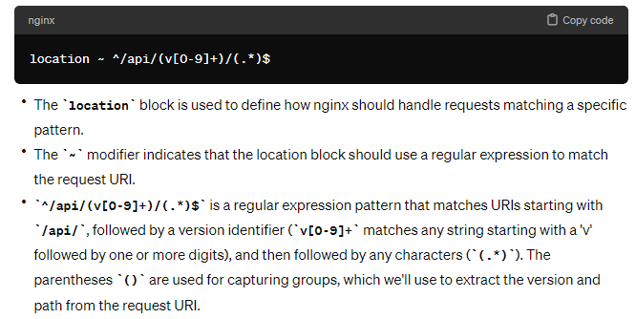
Other Directives
Example

