Slide 1
Square Lattice
Hexagonal Lattice
a
a
a
120 °
a

Slide 2
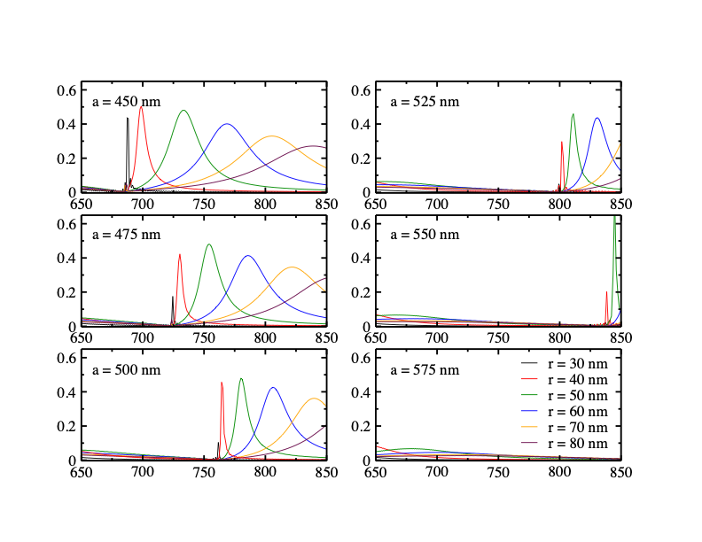
Square Lattice Absorption Relevant for a< 550 nm

Slide 3

Temperature Change
absorption cross section
power of illumination
average thermal conductivity
diameter of heated area
unit cell area of NP lattice
Confinement
interparticle distance
beam diameter
NP radius

Slide 4
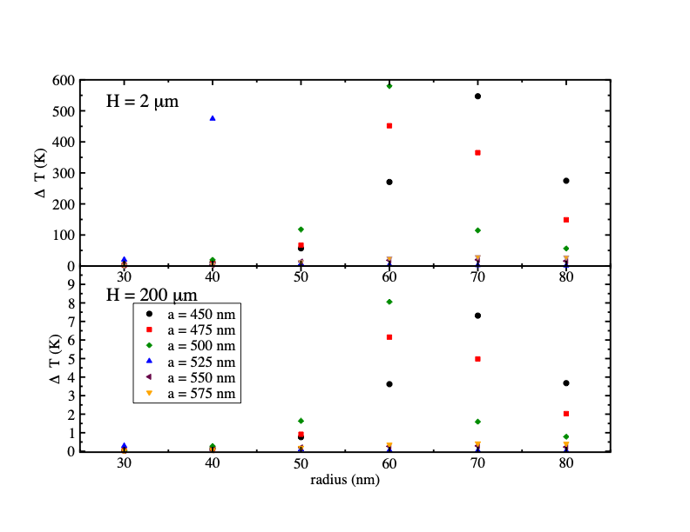
Heated Area Greatly Influences Temperature Change in the Lattice

Slide 5
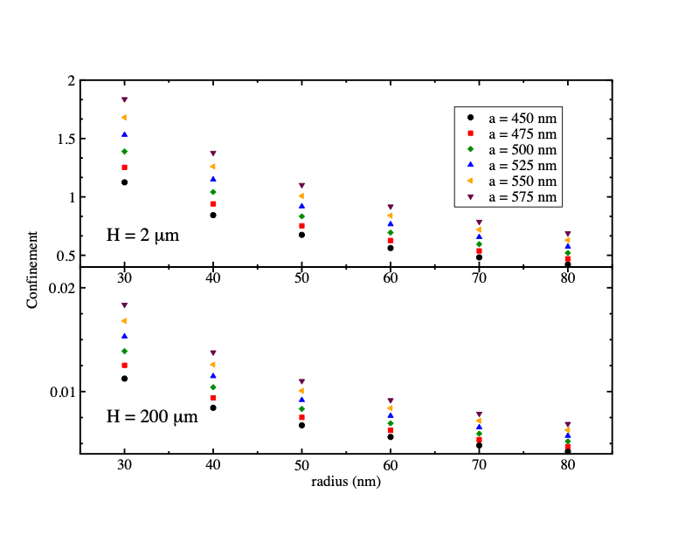
Confinement Occurs with Reduced H

Slide 6
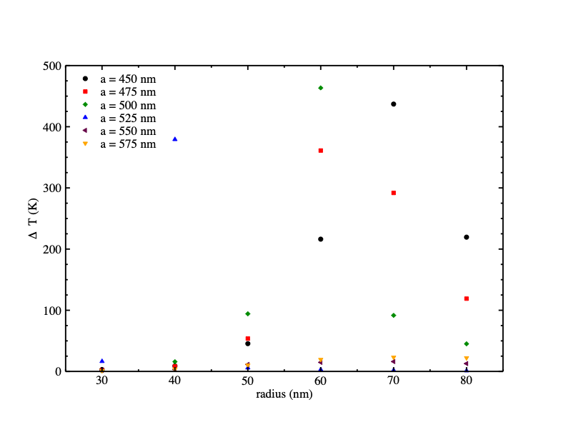
PAM Reduces the Temperature Change

Slide 7
Square Lattice
Hexagonal Lattice
a
a
a
120 °
a

Slide 8
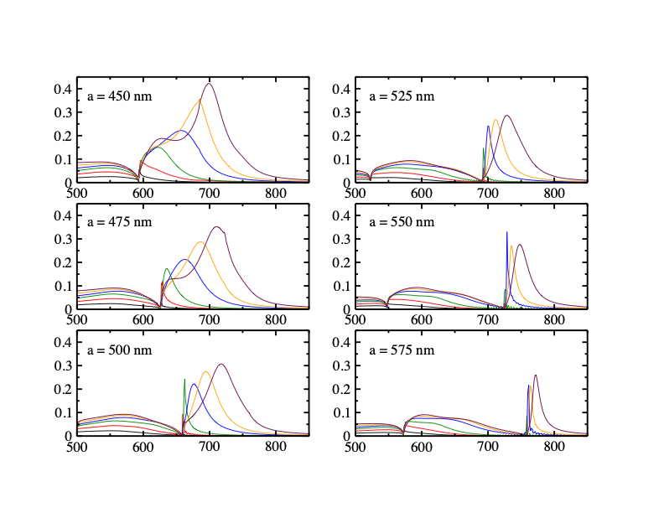
Hexagonal Absorption Also Shifts with Lattice Spacing

Slide 9
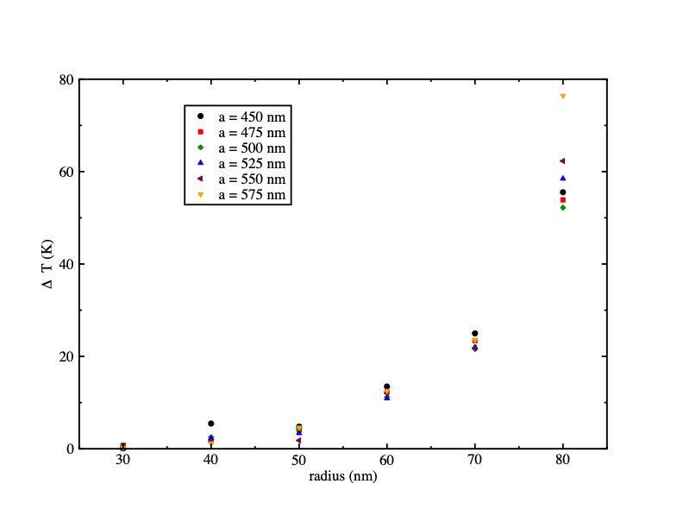
PAM Hexagonal Arrays have Lower Temperature Even with small H

