Slide 1

Statistics Based Word Correction
A reevaluation of our approach to word correction based on evolving matrices of bigram/trigram probability.
David Skufca^{1,2}, Dr. Sean Banerjee³
¹Department of Mathematics, Clarkson University
²Department of Computer Science, Clarkson University
³Department of Electrical and Computer Engineering, Clarkson University
skufcadj@clarkson.edu

Slide 2
Motivation and Problem
Represent abstract systems through mathematics.
Develop a better understanding of human language.
Current methods in word correction are:
  Impersonal to the user.
  Unable to adapt to changing language.

Slide 3

Data
Thomson Reuters Text Research Corpus
Signed NDA with NIST to obtain access to the research corpus of news articles from 1996/1997 created by the REUTERS News Agency.
Before parsing – 806,774 xml files totaling 2.5 GB
After parsing and exclusion – 531,765 files.

Slide 4
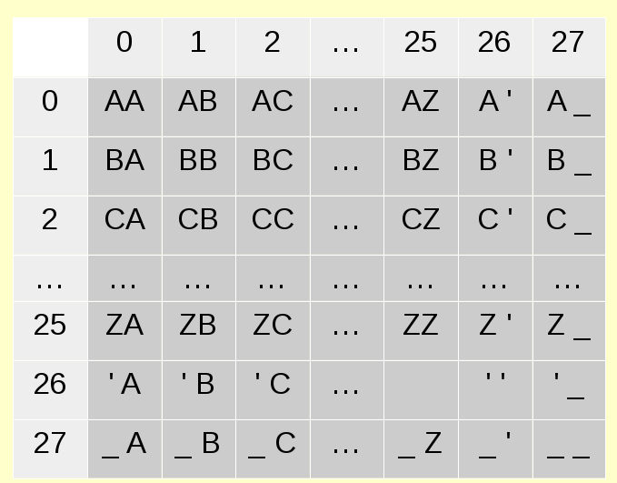
Basis
Idea is that language is not some random collection of characters. A mathematical generalization can be made using a bigram frequency table.

Slide 5

Populating the Bigram Matrix
Analyzing “FIREFOX”
  Bigram Breakup:
  Matrix positions incremented:
  [ 27 ][ 5 ], [ 5 ][ 8 ], [ 8 ][ 17 ], [ 17 ][ 4 ], [ 4 ][ 5 ], [ 5 ][ 14 ], [ 14 ][ 23 ], [ 23 ][ 27 ]
This is done for each word in our training set in order to generate our bigram frequency table.

Slide 6
Word Probability
Using bigram probabilities, a word's probability found as a product of it's bigram breakup.
P_{FIREFOX} = p_{_F} * p_{FI} * p_{IR}* p_{RE} * p_{EF} * p_{FO}* p_{OX} * p_{X_}

Slide 7
Levenshtein Distance
By comparing our root word's probability (the one being tested for validity) with the probability of words of close Levenshtein distance, a basic understanding of correctness can be deduced.
cat <=> ca Levenshtein distance: 1
cat <=> cats Levenshtein distance: 1
cat <=> cap Levenshtein distance: 1
cat <=> caps Levenshtein distance: 2

Slide 8
Why It Works
If “FIREFX” was our root word and it was compared with “FIREFOX” (1 LD away), we would be able to realize that “FIREFOX” is a proper correction since,
the FX bigram has a lower probability.
P_{FIREFX} < P_{FIREFOX}

Slide 9
Where It Falls Short
Correct words made of irregular bigrams.
Comparing words of different lengths.
Words of higher than average length.

Slide 10
Adjustments
In order to fix these, we can factor in a few more statistics we have recorded.
Weighting by word frequency, the number of times the specific word has occurred in our training set.
Scaling by a word's “best probability,” the highest probability based on a word's first 2 characters.

Slide 11
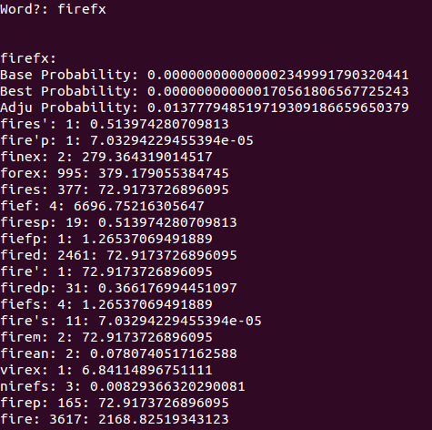
Results
As you can tell, the program has not been able to even offer “FIREFOX” as a suitable correction.
Why is this?

Slide 12
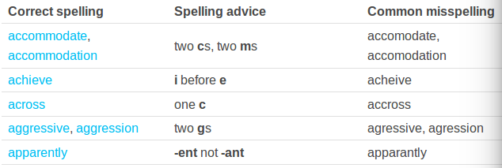
More Conclusive Results
From OxfordDictionaries.com

Slide 13
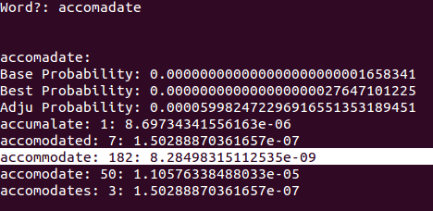
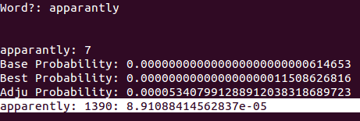
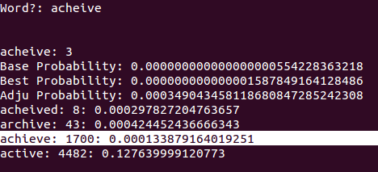
Accomodate
Accommodate
Apparantly
Apparently
Achieve
Acheive

Slide 14
Conclusions
My method is able to find common misspellings in language, just as the dictionary method.
Since it is constantly learning and evolving based on what the user types, it will change with language and stay personal to the user.
A method has been created that can be applied to any language similar to English, therefore, no need for multiple dictionaries.

Slide 15
Future Work
Application to languages other than English as a proof of concept.
Factoring the layout of a keyboard into the equation.
Analyzing aural perceptions of spellings.

