Slide 1
C++ Concepts

Slide 2
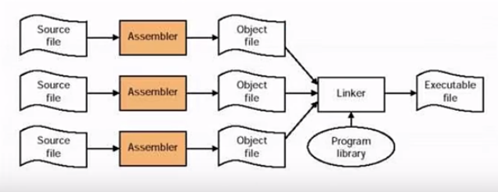
Compilation Process

Slide 3
C++ Source
Pre-Processing
Inclusion of header file code.
Compilation
Assembler
Replace MACRO name with value.
Linking
Object File Header
Debugging Information
Removal of comment's.
Text Segment
Data Segment
Relocation Information
Symbol Table
gcc -E <file_name.c>
High Level Language Source
gcc -S <file_name.c>
Assembly Source
gcc -c <file_name.c>
Object File (Binary)
gcc <file_name.c> -o ExeName
Executable

Slide 4
Allocate Memory
Copy text and data segment
Copy arguments off the stack and jump to main
Copy program arguments onto the stack
Clear register, set stack pointer
OS Runs LOADER to begin execution

Slide 5
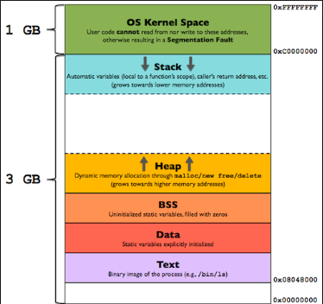
Memory Layout

Slide 6
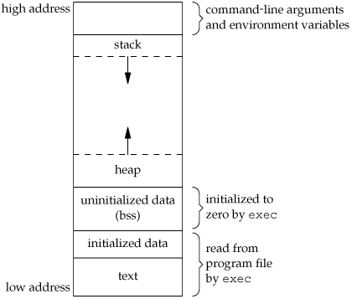
A typical memory representation of C program consists of following sections.
1. Text segment
2. Initialized data segment
3. Uninitialized data segment
4. Stack
5. Heap

Slide 7
1. Text Segment:
A text segment , also known as a code segment or simply as text, is one of the sections of a program in an object file or in memory, which contains executable instructions.
As a memory region, a text segment may be placed below the heap or stack in order to prevent heaps and stack overflows from overwriting it.
Usually, the text segment is sharable so that only a single copy needs to be in memory for frequently executed programs, such as text editors, the C compiler, the shells, and so on. Also, the text segment is often read-only, to prevent a program from accidentally modifying its instructions.
2. Initialized Data Segment:
Initialized data segment, usually called simply the Data Segment. A data segment is a portion of virtual address space of a program, which contains the global variables and static variables that are initialized by the programmer.
Note that, data segment is not read-only, since the values of the variables can be altered at run time.
This segment can be further classified into initialized read-only area and initialized read-write area.
For instance the global string defined by char s[] = “hello world” in C and a C statement like int debug=1 outside the main (i.e. global) would be stored in initialized read-write area. And a global C statement like const char* string = “hello world” makes the string literal “hello world” to be stored in initialized read-only area and the character pointer variable string in initialized read-write area.
Ex: static int i = 10 will be stored in data segment and global int i = 10 will also be stored in data segment

Slide 8
3. Uninitialized Data Segment:
Uninitialized data segment, often called the “bss” segment, named after an ancient assembler operator that stood for “block started by symbol.” Data in this segment is initialized by the kernel to arithmetic 0 before the program starts executing
uninitialized data starts at the end of the data segment and contains all global variables and static variables that are initialized to zero or do not have explicit initialization in source code.
For instance a variable declared static int i; would be contained in the BSS segment.
For instance a global variable declared int j; would be contained in the BSS segment.
4. Stack:
The stack area traditionally adjoined the heap area and grew the opposite direction; when the stack pointer met the heap pointer, free memory was exhausted. (With modern large address spaces and virtual memory techniques they may be placed almost anywhere, but they still typically grow opposite directions.)
The stack area contains the program stack, a LIFO structure, typically located in the higher parts of memory. On the standard PC x86 computer architecture it grows toward address zero; on some other architectures it grows the opposite direction. A “stack pointer” register tracks the top of the stack; it is adjusted each time a value is “pushed” onto the stack. The set of values pushed for one function call is termed a “stack frame”; A stack frame consists at minimum of a return address.
Stack, where automatic variables are stored, along with information that is saved each time a function is called. Each time a function is called, the address of where to return to and certain information about the caller’s environment, such as some of the machine registers, are saved on the stack. The newly called function then allocates room on the stack for its automatic and temporary variables. This is how recursive functions in C can work. Each time a recursive function calls itself, a new stack frame is used, so one set of variables doesn’t interfere with the variables from another instance of the function.

Slide 9
5. Heap:
Heap is the segment where dynamic memory allocation usually takes place.
The heap area begins at the end of the BSS segment and grows to larger addresses from there.The Heap area is managed by malloc, realloc, and free, which may use the brk and sbrk system calls to adjust its size (note that the use of brk/sbrk and a single “heap area” is not required to fulfill the contract of malloc/realloc/free; they may also be implemented using mmap to reserve potentially non-contiguous regions of virtual memory into the process’ virtual address space). The Heap area is shared by all shared libraries and dynamically loaded modules in a process.
Example:
#include <stdio.h>
int main(void)
{
return 0;
}
gcc sample.c -o sample
size sample.exe
text data bss dec hex filename
10752 1616 1096 13464 3498 sample.exe
For the above mentioned program sample.c (which finds whether the underlying architecture is little endian or big endian) the size of text, data, .bss segments, and the total size is examined as follows with help of the size command. The fourth and fifth columns are the total of the three sizes, displayed in decimal and hexadecimal, respectively.

Slide 10
Normal Member Variable Vs Pointer Member Variable

Slide 11
There are advantages and disadvantages to both:
Using a pointer:
Pros:
Class will be smaller in memory
You only need a forward declaration to the other class - no need to include the other header in your header
Can use derived objects from B as members
Cons:
Memory Management - this is a pretty big one. Do you want the memory to be managed by the class (override destructor, assignment operator and copy constructor)?
Using an object:
Pros:
No need to worry about memory management
Cons:
Can only use objects of the base class. What if you want to derive from B?
More memory for each instance
Constructor of B will be called on construction of A
You need the full definition of B inside the header

Slide 12
Question:
class* obj; //No call to constructor.
When we allocate dynamic memory to a pointer, new operator automatically calls the constructor. But what if we don't allocate memory?
Answer:
Because when we are creating a pointer, you are NOT creating an actual object. If you don't initialize it, it will be pointing to garbage and dereferencing it will be an error.
Remember that just because you make a pointer does not mean it is pointing to anything.

Slide 13
Copy Constructor Vs Move Constructor

Slide 14
A Copy Constructor, is to make a copy of an object---a new object that contains the same data or holds the same resource as the source object.
A copy constructor usually takes const X& so it won't mutate its argument and so it can also copy const objects as well as rvalues (in the case where you don't intend to write a separate move constructor). A copy constructor taking X& would not be able to copy const objects or rvalues.
A Move Constructor is used to transfer data or resources from a source object into a new object being created. The source object may or may not retain a copy; it is assumed to be unimportant because the source object will be destroyed soon or reset to a known state before being used again. The important thing is that the new object now holds the logical state originally held by the source object.
A move constructor usually takes X&& because it needs to mutate its argument in order to transfer ownership.
The difference is that a copy constructor takes its argument by lvalue reference and a move constructor by rvalue reference.

Slide 15
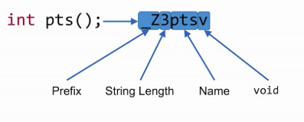
Name Mangling

Slide 16
C++ supports function overloading, i.e., there can be more than one functions with same name and differences in parameters.
How does C++ compiler distinguishes between different functions when it generates object code?
It changes names by adding information about arguments.
This technique of adding additional information to function names is called Name Mangling. Use command nm to see the more information on object file (Ex: g++ -c file.cpp & nm file.o)

Slide 17
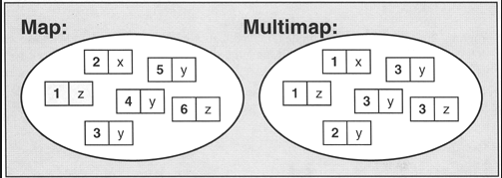
Difference Between map/multimap

Slide 18
The STL map and multimap Containers. The map and the multimap are both containers that manage key/value pairs as single components.
Maps are associative containers that store elements formed by a combination of a key value and a mapped value, following a specific order.
Multimaps are associative containers that store elements formed by a combination of a key value and a mapped value, following a specific order, and where multiple elements can have equivalent keys.
The essential difference between the two is that in a map the keys must be unique, while a multimap permits duplicate keys.

