Slide 1


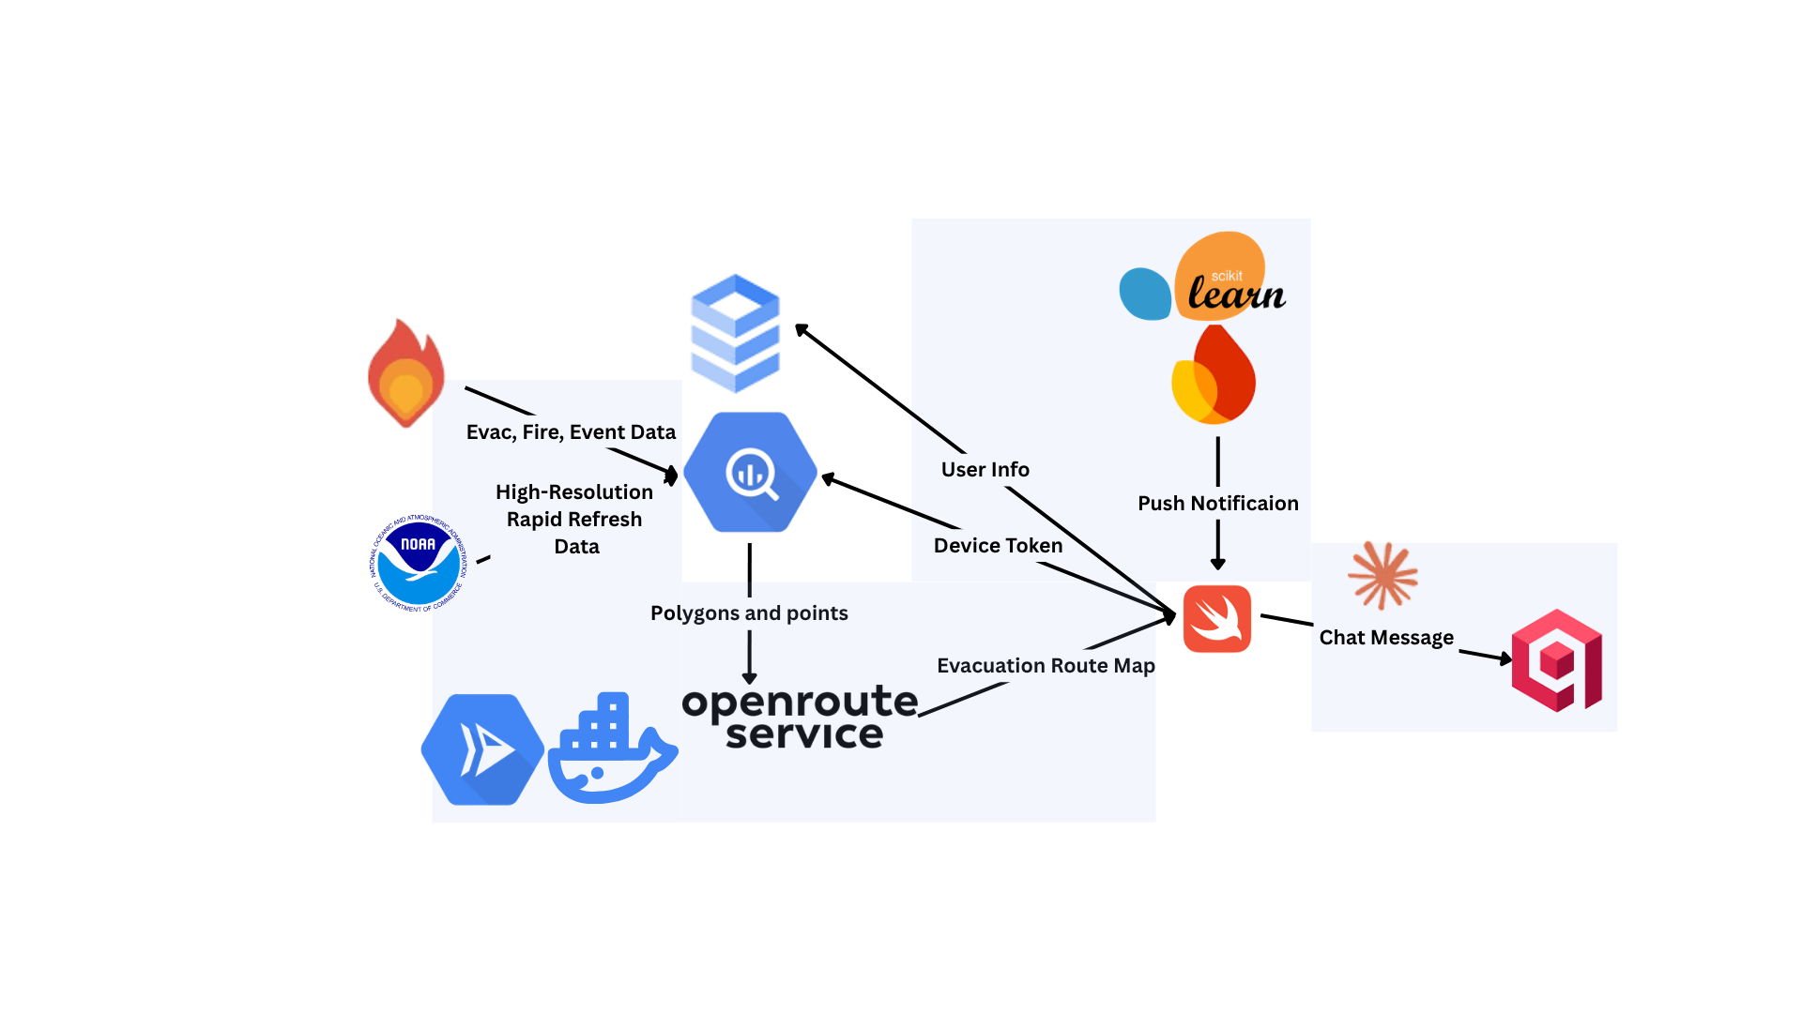
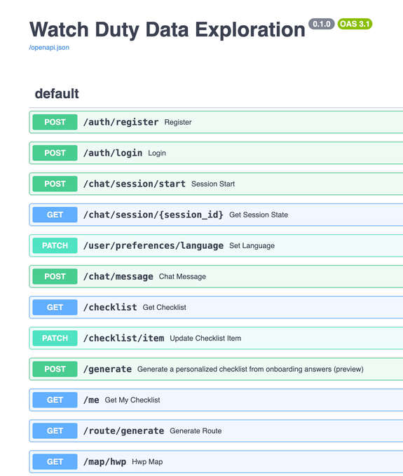
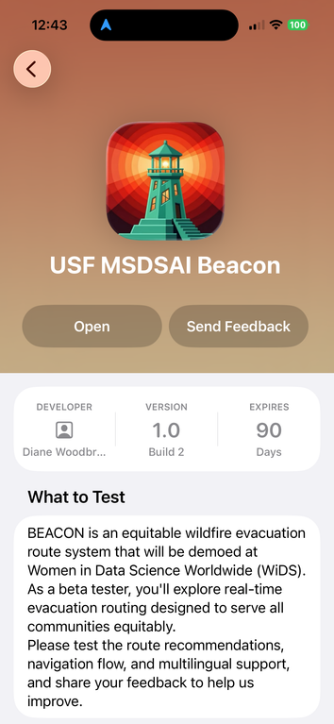
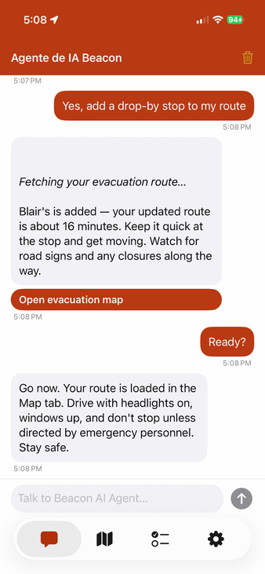
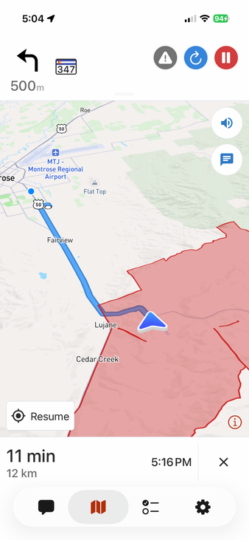
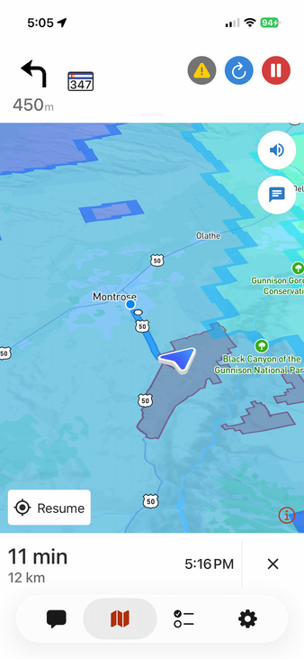
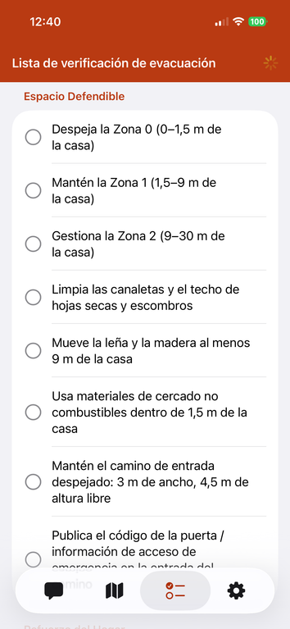
BEACON
Broadscale Evacuation Agentic Coordination, Outreach & Navigation
A Multilingual AI-Powered Wildfire Evacuation Assistant
Shruti Kulkarni · Helen Lin · Chelyah Miller · Aditi Namboodiripad · Lynn Tong
ABSTRACT
The United States is experiencing a significant increase in the duration and intensity of wildfires, posing a severe threat to millions of residents in fire-prone states. One critical yet under-addressed aspect of emergency preparedness is language accessibility. Approximately 26 million U.S. residents have limited English proficiency, and 9.5 million speak neither English nor Spanish. Despite these challenges, over 80% of emergency alerts are issued exclusively in English.
BEACON, a multilingual AI-powered mobile app, bridges the gap in emergency evacuation guidance. It integrates real-time fire and evacuation perimeter data, meteorological wind modeling, and polygon-avoidant routing to provide language-inclusive evacuation instructions. The app’s AI agent automatically detects the user’s language and responds in the same language, eliminating the need for manual selection. It offers danger assessments, turn-by-turn evacuation routing, and provides a personalized evacuation checklist in the user’s native language.
INTRODUCTION
Climate change has significantly extended wildfire seasons in the United States by an average of 84 days compared to the 1970s, while wildfire smoke now contributes to an estimated 40,000 deaths annually. Despite these escalating risks, emergency alert infrastructure has not kept pace — the vast majority of alerts are broadcast in English only, leaving residents with limited English proficiency systematically underserved during life-threatening events.
Existing tools such as Google Maps were evaluated for evacuation routing but repeatedly ignored fire polygon constraints, routing users through active fire perimeters — a critical failure when seconds matter.
BEACON was built to change that. It is a fully agentic evacuation platform that puts a powerful, personalized assistant in every resident's pocket — in their own language. BEACON combines a real-time AI chatbot agent with a live GPS navigation system that reflects current fire danger and an hourly fire prediction model, ensuring users always have the most up-to-date situational awareness. Every alert, message, and UI component is rendered automatically in the user's native language — with no configuration required. In addition, users receive a personalized evacuation checklist tailored to their household — accounting for pets, medications, mobility needs, and family size. The navigation engine supports customized routing that can include essential stops along the way, such as pharmacies and medical facilities, while intelligently avoiding hazards. Routes are recalculated in real time around active fire perimeters using WatchDuty polygon data and OpenRouteService (ORS), guaranteeing that no path leads through danger.
RESULT
BEACON was successfully deployed end-to-end as a production-ready system. The Python FastAPI backend is containerized with Docker and deployed on Google Cloud Run, enabling fully managed, auto-scaling serverless execution without infrastructure overhead. The native Swift iOS application was submitted to and approved on Apple TestFlight, making BEACON available for live beta testing on iPhone. Testers can access the full application — including the AI chatbot agent, PS evacuation routing, multilingual interface, and personalized checklist — directly from their devices. The system demonstrated reliable end-to-end performance across all core features: automatic language detection, polygon-avoidant route generation via ORS, HWP-driven danger bin classification, and household-personalized checklist generation.
SYSTEM WORKFLOW
DATA
WatchDuty - active fire perimeter polygons, evacuation status, evacuation facility NOAA High Resolution Rapid Refresh (HRRR) - hourly surface wind gust, 2-meter temperature, dewpoint, soil moisture, and snow water equivalent at ~3 km resolution across the CONUS grid
OverPass - pharmacies, groceries, shelters, fairgrounds, and hotels — are queried on-demand from the OverPass API, as they are commonly used as a shelter
User GPS coordinates - captured at session start and reverse-geocoded
User Information - household and language information during the onboarding
Chat Messages - system, user and agent messages are stored in Qdrant vector DB for semantic search and message chains
METHODS
At session start, the user's GPS coordinates are reverse-geocoded and the Haversine distance to the nearest active WatchDuty fire perimeter is computed. This danger score is wind-adjusted using a Hourly Wildfire Potential (HWP) index derived from HRRR fields and spatially smoothed over a ~27 km neighborhood. A scikit-learn classification model then assigns one of four danger bins (LOW, MEDIUM, HIGH, CRITICAL) based on distance, HWP score, and the user's location danger history. For routing, the user's GPS and WatchDuty fire polygons are passed to OpenRouteService (ORS), which generates a GeoJSON route avoiding all active fire perimeters; users may add waypoints such as pharmacies, or designate zones to avoid. The AI agent receives a structured prompt as a system message containing the user's location, danger bin, evacuation zone status, route, and household profile. It auto-detects language, adjusts tone to danger severity, and generates a personalized evacuation checklist. Conversation history is stored in Qdrant vector DB, enabling semantic search and coherent multi-turn message chains across sessions.
DISCUSSION
For future work, integrating IBM Weather Company data as a secondary meteorological source will add redundancy and resilience to the danger assessment pipeline, ensuring continuous fire risk prediction. An Android expansion is planned to extend BEACON's reach to the significant portion of LEP communities. Rigorous user testing with diverse LEP communities will guide improvements to language accuracy, UI accessibility, and checklist personalization. Human-in-the-loop review for critical translation outputs and live shelter availability integration are also on the roadmap.
REFERENCES
[1] Theo Stein. "An Experimental NOAA Tool That Predicts Hourly Wildfire Hazards Across the U.S." National Oceanic and Atmospheric Administration.
[2] Vieira, Laura. "Limited English proficiency individuals: Assessing the inclusion of risk communication aimed at LEP populations in emergency and disaster management plans across the United States." Georgetown University (2022)
[3] Villarreal, Melissa, Carson MacPherson-Krutsky, and Mary Angelica Painter. "Barriers and best practices for inclusive emergency alerts and warnings." International Journal of Disaster Risk Reduction 125 (2025)
SPATIAL User GPS → nearest fire perimeter
TEMPORAL Per session, refreshed on open
BASELINE Distance only, no wind adj.
User GPS
Live coordinates at session start
WatchDuty Polygons
Active fire perimeters + polygons
Haversine Distance
User → newest perimeter (km)
Danger Bin
LOW/MEDIUM/HIGH/CRITICAL
Agent Response
Tone + checklist severity
User Location
GPS coordinates
Fire Polygons
WatchDuty perimeters
GPS Location
Danger Bin
Safe Route
User Profile
LOW
General preparedness tips
MEDIUM
Prepare a go bag, stay alert
HIGH
Evacuate now, evacuation zones nearby
CRITICAL
Call 911, no safe routes available
OpenRouteService (ORS)
Polygon-avoidant routing engine
Injected at session start via prompt
Claude
Detecs language - Adjusts tone - Generates Checklist
GeoJSON Route
Avoids all active fire perimeters
Mapbox
Turn-by-turn navigation
Localized Response
Turn-by-Turn Steps
Packing Checklist
Equitable Wildfire Collective | University of San Francisco, MS in Data Science & AI | WiDS AI Forum 2026
HWP LAYER
HRRR wind speed, direction & humidity overlaid on distance score; adjusts bin upward when wind is blowing toward user. Refresh cadence driven by fire activity patterns.
Danger Assessment
Our classification ML model dynamically calculates the hourly danger level based on the user location’s danger level history.
Navigation Route Generation
AI Agent

