Slide 1
Solution Overview
Proactive Server/Device Failure Detection Dashboard
Real-time monitoring, anomaly detection, prediction, and alerting
Covers all MVP and advanced requirements

Slide 2
Data Ingestion & Asset Scope
Ingests event logs, server issue data, and ticket dumps
Simulates metrics (CPU, Memory, Disk I/O, Network) for 5+ servers
Supports real and synthetic data

Slide 3
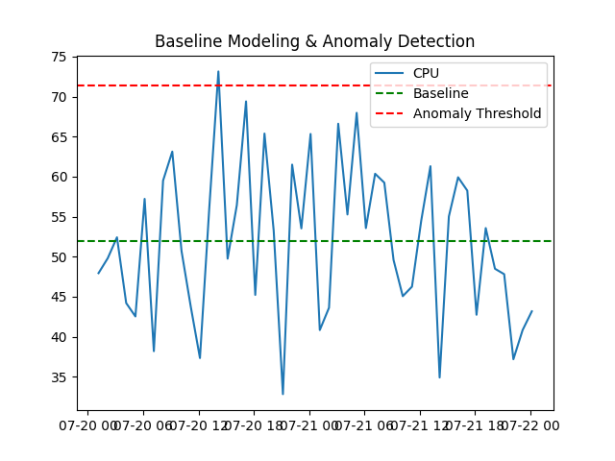
Baseline Modeling & Anomaly Detection
Establishes statistical baselines for each metric per server
Detects anomalies using thresholds
Highlights deviations from normal behavior

Slide 4
Time-to-Failure (TTF) Prediction
Predicts TTF for hardware and metrics using historical patterns
Displays TTF estimates for each server and metric
Enables proactive maintenance

Slide 5
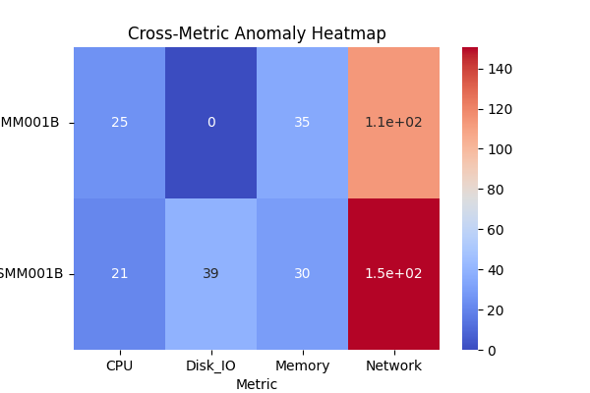
Cross-Metric & Cross-Device Analysis
Visualizes anomalies across metrics and servers
Detects cascading failures and correlated events
Heatmaps and tables for root cause analysis

Slide 6
Alerting & Notification
Sends alerts via Outlook email and Microsoft Teams
Includes server, metric, deviation, timestamp
Supports routing, deduplication, and history

Slide 7
Interactive Visualization & Customization
Interactive dashboards with Plotly and Seaborn
Custom thresholds and alert settings
Multi-server comparison and forecasts

Slide 8
User Experience & Roles
Role-based views: Viewer, Operator, Admin
Export/download anomaly data
Simulated remediation playbooks

Slide 9
MVP & Beyond
MVP fully covered: ingestion, detection, TTF, alerting
Advanced features: thresholds, plots, history, heatmaps
Scalable and extensible for AI/ML

Slide 10
Business Value
Enables proactive, data-driven IT operations
Reduces downtime and improves reliability
Optimizes maintenance and enhances customer satisfaction

