Slide 1
PMIS– Cycle-1

Slide 2
Data Collection

Slide 3
Data for PMIS– Cycle 1 (Till September 2015)
Sprint Name | Size | Total Planned effort | Actual Start Date | Actual End Date | RA | RA Review | Design | Design review | CUT(Code and Unit Testing) | Code Review | TC Prep | Testing | Total Actual Effort
Admin-Menu mapping | 8 | 76.16 | 21 April 2016 | 12 May 2016 | 6 | 3 | 12.25 | 3 | 29 | 6 | 2.5 | 16 | 90.25
Admin-Role Management | 5.5 | 52.36 | 22 April 2016 | 05 May 2016 | 4 | 2 | 6 | 2.25 | 21 | 2 | 2.5 | 10.5 | 60.25
Admin-View Management | 3 | 28.59 | 29 April 2016 | 06 May 2016 | 2 | 1.5 | 4.25 | 1 | 9.5 | 2 | 1.5 | 6 | 35.25
Authentication & Authorization | 4 | 76.16 | 25 April 2016 | 02 May 2016 | 5.6 | 1.55 | 8 | 3.5 | 17 | 4 | 3 | 17 | 80
Email Component and Email Queue | 1 | 9.531429 | 27 April 2016 | 28 April 2016 | 0.5 | 0.1 | 1.5 | 0.5 | 5.75 | 1 | 0.75 | 2.4 | 12.75
User Management | 13 | 95 | 27 April 2016 | 12 May 2016 | 10 | 4.5 | 10 | 1 | 71 | 2 | 8 | 12 | 107
Super Admin Role Management | 6 | 66.66 | 28 April 2016 | 06 May 2016 | 4 | 1 | 8 | 3 | 30 | 8 | 4 | 14 | 86.5
Super Admin-Menu Mapping | 6 | 57.11 | 29 April 2016 | 10 May 2016 | 3.6 | 2.6 | 6 | 2 | 25 | 5.25 | 5 | 9 | 69.25
Super Admin-User Management | 6.5 | 61.92 | 29 April 2016 | 09 May 2016 | 4 | 2.5 | 4 | 2 | 32 | 7 | 7 | 14 | 77
Admin- Menu Mapping | 8 | 76.15 | 28 April 2016 | 12 May 2016 | 8.3 | 3 | 6 | 3 | 38 | 8 | 4 | 9 | 87
Site Map Implementing | 1 | 9.531429 | 02 May 2016 | 03 May 2016 | 0.6 | 0 | 1 | 0.5 | 4.5 | 0.75 | 0.75 | 3 | 13.35
Manage Circle Rate | 3 | 28.56 | 02 May 2016 | 06 May 2016 | 2 | 0.8 | 3 | 1 | 13 | 1 | 2.2 | 8.5 | 34.5
Manage Master Data | 8 | 57.13 | 04 May 2016 | 13 May 2016 | 4.5 | 2 | 4 | 1 | 35 | 2.25 | 6 | 23 | 72
Manage Notification | 5.5 | 52.39 | 05 May 2016 | 12 May 2016 | 4 | 2 | 5 | 2 | 26.5 | 2 | 2.5 | 7 | 60
Manage Refund | 5.5 | 52.39 | 02 May 2016 | 10 May 2016 | 5 | 1 | 8 | 4 | 20 | 1.75 | 4 | 7 | 66.25
Property Management | 5.5 | 52.39 | 03 May 2016 | 11 May 2016 | 5.5 | 1.25 | 13.5 | 1 | 22 | 2 | 4 | 11.5 | 65
Scheme Management | 16 | 152.32 | 15 April 2016 | 12 May 2016 | 17 | 7 | 13 | 2 | 73 | 8 | 12 | 24 | 173.5

Slide 4
Data Analysis

Slide 5
Y factors –PMIS Cycle 1
Sprint Name | EV | Cycle Time(Hours) per FP
Admin-Menu mapping | 0.1850 | 13.5
Admin-Role Management | 0.1507 | 12
Admin-View Management | 0.2329 | 13.3333
Authentication & Authorization | 0.0504 | 10
Email Component and Email Queue | 0.3377 | 8
User Management | 0.1263 | 6.3846
Super Admin Role Management | 0.2976 | 8
Super Admin-Menu Mapping | 0.2126 | 9.3333
Super Admin-User Management | 0.2435 | 7.3846
Admin- Menu Mapping | 0.1425 | 9.25
Site Map Implementing | 0.4006 | 8
Manage Circle Rate | 0.2080 | 10.6667
Manage Master Data | 0.2603 | 7
Manage Notification | 0.1453 | 7.2727
Manage Refund | 0.2646 | 8.7273
Property Management | 0.2407 | 8.7273
Scheme Management | 0.1390 | 8.5625
Average | 0.2140 | 9.1848
Stander Deviation | 0.0861 | 2.1091
UCL | 0.4723 | 15.5121
LCL | -0.0443 | 2.8575
Notes:
Cycle time to have equation with review rate ( review defects / time taken for review ) and RA effort. EV ((Actual Effort - Plan Effort)/Plan Effort)*100

Slide 6
X Factors – PMIS Cycle 1
Sprint Name | RA effort Per FP(RA/Size) | RA review effort Per FP(RAR/Size) | Coiding effort /Per FP (Code/size) | Test Preparation effort /Per FP (TP+TCR)/Size
Admin-Menu mapping | 0.75 | 0.375 | 3.625 | 0.375
Admin-Role Management | 0.727272727 | 0.363636364 | 3.81818 | 0.63636
Admin-View Management | 0.666666667 | 0.333333333 | 3.16667 | 0.66667
Authentication & Authorization | 1.4 | 0.3875 | 4.25 | 0.9375
Email Component and Email Queue | 0.5 | 0.1 | 5.75 | 0.75
User Management | 0.769230769 | 0.346153846 | 5.46154 | 0.76923
Super Admin Role Management | 0.666666667 | 0.166666667 | 5 | 0.75
Super Admin-Menu Mapping | 0.6 | 0.433333333 | 4.16667 | 1.08333
Super Admin-User Management | 0.615384615 | 0.384615385 | 4.92308 | 1.30769
Admin- Menu Mapping | 1.0375 | 0.375 | 4.75 | 0.75
Site Map Implementing | 0.6 | 0 | 4.5 | 1.25
Manage Circle Rate | 0.666666667 | 0.266666667 | 4.33333 | 0.81667
Manage Master Data | 0.5625 | 0.25 | 4.375 | 1
Manage Notification | 0.727272727 | 0.363636364 | 4.81818 | 0.63636
Manage Refund | 0.909090909 | 0.181818182 | 3.63636 | 0.90909
Property Management | 1 | 0.227272727 | 4 | 0.90909
Scheme Management | 1.0625 | 0.4375 | 4.5625 | 0.90625
Average | 0.7800 | 0.2937 | 4.4198 | 0.8502
Stander Deviation | 0.2316 | 0.1235 | 0.6706 | 0.2308
UCL | 1.4748 | 0.6642 | 6.4316 | 1.5426
LCL | 0.0852 | -0.0768 | 2.408 | 0.1578

Slide 7
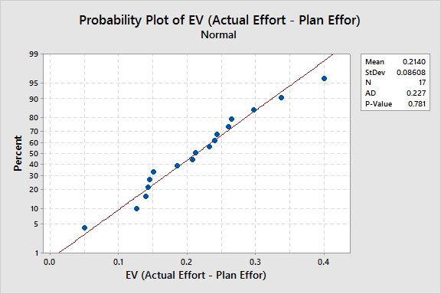
Y Factor – Effort Variance Normality Curve (Cycle -I)
Mean -0.2140
St Dev -0.0861
P Value -0.781
P value is >.05
Hence Data is Normal
Notes:
Normal Probability Plots and Tests for Normality. Normal probability plots are often used as an informal means of assessing the non-normality of a set of data.

Slide 8
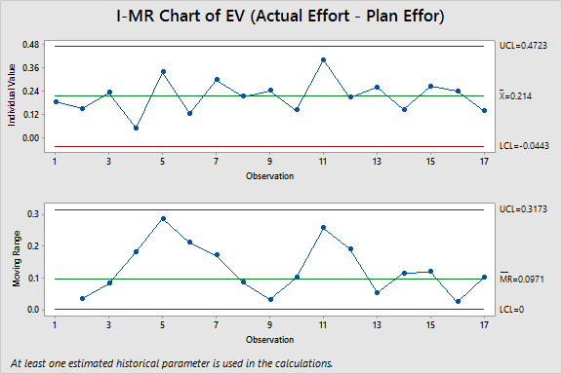
Y Factor – Effort Variance Control chart (Cycle -1)
Mean - 0.214
UCL = 0.4723
LCL = (-0.0443)
St Dev – 0.0861
As no points are outside UCL and LCL, the Process is stable.

Slide 9
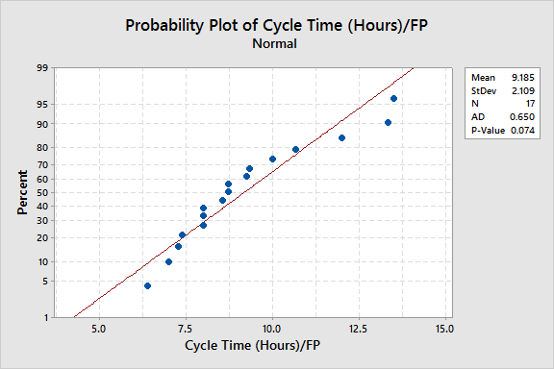
Y Factor – Cycle Time Per FP Normality Curve (Cycle -1)
Mean -9.185
St Dev -2.109
P Value -0.074
P value is >.05
Hence Data is Normal

Slide 10
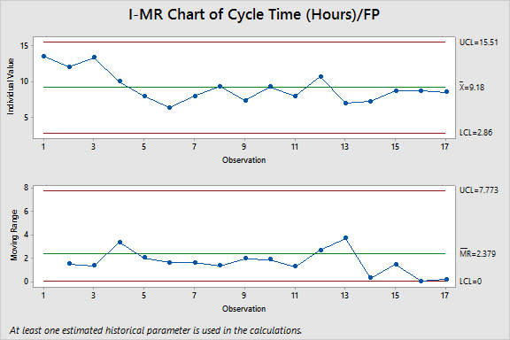
Y Factor – Cycle Time Per FP Control chart (Cycle -1)
Mean = 9.185
UCL =15.51
LCL =2.86
St Dev = 2.109
As no points are outside UCL and LCL, the Process is stable.

Slide 11
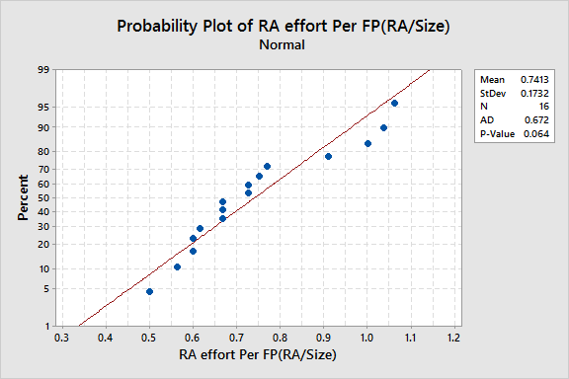
X Factor –RA effort per FP Normality Curve (Cycle -1)
Mean – 0.7413
St Dev –0.1732
P Value -0.064
P value is >.05
Hence Data is Normal

Slide 12
X Factor – RA effort per FP Control chart (Cycle -I)
Mean - 0.7413
UCL =1.1374
LCL = 0.3451
St Dev = 0.1732
As no points are outside UCL and LCL, the Process is stable.

Slide 13
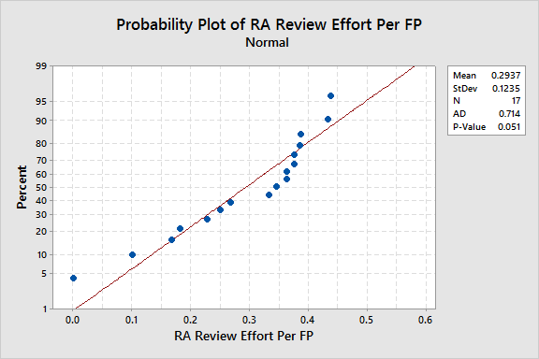
X Factor – RA review effort per FP Normality Curve (Cycle -1)
Mean – 0.2937
St Dev -0.1235
P Value -0.051
P value is >.05
Hence Data is Normal

Slide 14
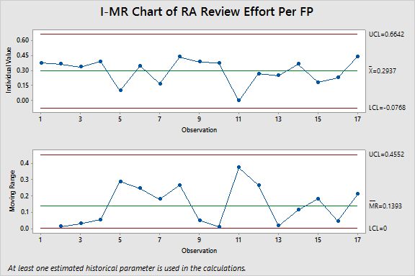
X Factor – RA review effort per FP Control Chart (Cycle -I)
Mean - 0.2937
UCL =0.6642
LCL = 0.0768
St Dev= 0.1235
As no points are outside UCL and LCL, the Process is stable.

Slide 15
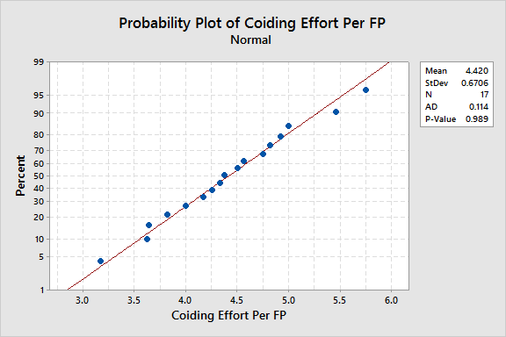
X Factor –Coding Effort Per FP Normality Curve (Cycle -I)
Mean -4.420
St Dev- 0.6706
P-Value –0.989
P value is >.05
Hence Data is Normal

Slide 16
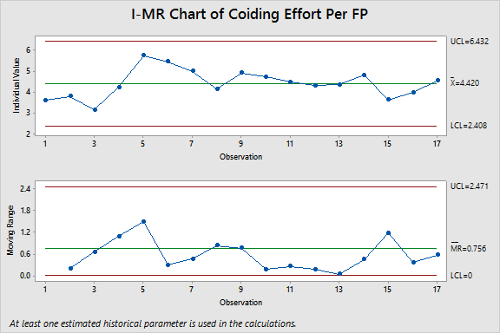
X Factor –Coding Effort Per FP Control chart (Cycle -1)
Mean – 4.420
UCL – 6.432
LCL – 2.408
St Dev - 0.6706
As no points are outside UCL and LCL, the Process is stable.

Slide 17
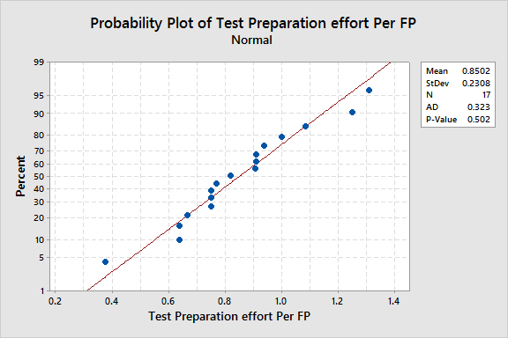
X Factor – Test Preparation Effort Per FP Normality Curve (Cycle-I)
Mean -0.8502
St Dev -0.2308
P Value -0.502
P value is >.05
Hence Data is Normal

Slide 18
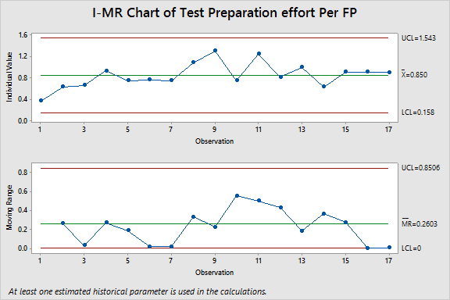
X Factor – Test Preparation Effort Per FP Control Chart (Cycle-1)
Mean – 0.850
UCL – 1.543
LCL – 0.158
St Dev - 0.2308
As no points are outside UCL and LCL, the Process is stable.

Slide 19
Target Setting Exercise for EV and Cycle Time

Slide 20
Data of EV (Y) and its X Factors
Sprint Name | EV | RA effort Per FP(RA/Size) | RA review effort Per FP (RAR/Size)
Admin-Menu mapping | 0.1850 | 0.75 | 0.375
Admin-Role Management | 0.1507 | 0.727272727 | 0.363636364
Admin-View Management | 0.2329 | 0.666666667 | 0.333333333
Authentication & Authorization | 0.0504 | 1.4 | 0.3875
Email Component and Email Queue | 0.3377 | 0.5 | 0.1
User Management | 0.1263 | 0.769230769 | 0.346153846
Super Admin Role Management | 0.2976 | 0.666666667 | 0.166666667
Super Admin-Menu Mapping | 0.2126 | 0.6 | 0.433333333
Super Admin-User Management | 0.2435 | 0.615384615 | 0.384615385
Admin- Menu Mapping | 0.1425 | 1.0375 | 0.375
Site Map Implementing | 0.4006 | 0.6 | 0
Manage Circle Rate | 0.2080 | 0.666666667 | 0.266666667
Manage Master Data | 0.2603 | 0.5625 | 0.25
Manage Notification | 0.1453 | 0.727272727 | 0.363636364
Manage Refund | 0.2646 | 0.909090909 | 0.181818182
Property Management | 0.2407 | 1 | 0.227272727
Scheme Management | 0.1390 | 1.0625 | 0.4375
Average | 0.214 | 0.78 | 0.2937
Stander Deviation | 0.0861 | 0.2316 | 0.1235
UCL | 0.4723 | 1.4748 | 0.6642
LCL | -0.0443 | 0.0852 | -0.0768
EV and its X factors at organization level in Cycle-2(DEC)
 | EV | RA Effort / FP | RA Review effort / FP
Average | 0.068919 | 2.219713 | 0.645304
Standard Deviation | 0.069156 | 0.790629 | 0.215455
Notes:
EV ((Actual Effort - Plan Effort)/Plan Effort)*100

Slide 21
Regression Equation For Cycle 1 -Effort Variance
The regression equation is provided by SEPG Team
EV_Cycle1 = 0.475 - 0.154 RA/FP_Cycle1 - 0.481 RA Review/FP_Cycle1

Slide 22
What if Analysis (Target of Effort variance Average is 15% and ST. Dev is 5%)
EV = 0.475 - 0.154 RA/FP - 0.481 RA Review/FP
Effort Variance | RA Effort/FP | RA Review Effort/FP | Target | Target for SD | Probability
21% | 0.7800 | 0.2937 | 15% | 7 | 23%
20% | 0.85 | 0.3000 |  |  | 28%
17% | 0.9 | 0.3500 |  |  | 42%
11% | 1.1 | 0.4 |  |  | 67%
Formula for calculating Probability =NORM.DIST(x, mean, standard_dev, cumulative)
Here:
X is target
Mean is your EV Average
Std. Deviation of Y Factor
Cumulative is 1

Slide 23
Effort variance reduction methodology
To reduce effort variance from 21% to 15% with standard deviation 9% to 7%
RA Effort to increase from .78 Hrs/FP to 1.1 Hrs/FP with standard deviation from 0.232 to .20 by
  Introduce subject matter expert in requirement analysis at Onsite
  By micro level analysis of requirement through smaller releases and their req. analysis
RA review effort to increase from .292 hrs/FP to .4 Hr/FP with standard deviation From .123 to .10 by
  By doing sprint meeting with Manager including stakeholder for requirement review
  Involving customer feedback in requirement review and document & revise requirements as needed.
  Requirements details clarified and validate with customer.

Slide 24
Data of Cycle Time(Y) and its X Factors
Sprint Name | Cycle Time(Hours) Per FP | Coding effort Per FP | Test Preparation effort Per FP
Admin-Menu mapping | 13.5 | 3.625 | 0.375
Admin-Role Management | 12 | 3.81818 | 0.63636
Admin-View Management | 13.3333 | 3.16667 | 0.66667
Authentication & Authorization | 10 | 4.25 | 0.9375
Email Component and Email Queue | 8 | 5.75 | 0.75
User Management | 6.3846 | 5.46154 | 0.76923
Super Admin Role Management | 8 | 5 | 0.75
Super Admin-Menu Mapping | 9.3333 | 4.16667 | 1.08333
Super Admin-User Management | 7.3846 | 4.92308 | 1.30769
Admin- Menu Mapping | 9.25 | 4.75 | 0.75
Site Map Implementing | 8 | 4.5 | 1.25
Manage Circle Rate | 10.6667 | 4.33333 | 0.81667
Manage Master Data | 7 | 4.375 | 1
Manage Notification | 7.2727 | 4.81818 | 0.63636
Manage Refund | 8.7273 | 3.63636 | 0.90909
Property Management | 8.7273 | 4 | 0.90909
Scheme Management | 8.5625 | 4.5625 | 0.90625
Average | 9.1848 | 4.4198 | 0.8502
Stander Deviation | 2.1091 | 0.6706 | 0.2308
UCL | 15.5121 | 6.4316 | 1.5426
LCL | 2.8575 | 2.408 | 0.1578
Notes:
Coding effort=(Code/size) Tp=(TP+TCR)/Size

Slide 25
Regression Equation For Cycle 1 – Cycle Time
The regression equation for Cycle time is Provided by SEPG Team
Cycle Time(Hours)/FP = 21.8 - 2.12 Coding - 3.78 Test Preparation per FP

Slide 26
What if Analysis (Target of Cycle Time 7)
Cycle Time(Hours)/FP = 21.8 - 2.12 Coding - 3.78 Test Preparation
Cycle Time | Coding Effort/FP | Test Preparation Effort/FP | Target from Mean | Target from St. Dev | Probability
9.216315 | 4.4198 | 0.8502 | 7 | 1.84 | 15%
8.646 | 4.6 | 0.9 |  |  | 22%
7.3 | 4.7 | 1.2 |  |  | 44%
6.332 | 4.8 | 1.4 |  |  | 62%

Slide 27
Cycle Time Reduction Methodology
To reduce Cycle Time from 9.18 Hrs./FP to 7 Hrs./FP with standard deviation 2.10 to 1.84
Coding efforts to Improved from 4.41Hrs/FP to 4.8Hrs/FP with standard deviation From .67 to 0.62 by
  Create a reusable code.
  By using root cause analysis of bugs
  By including sprint information in deigned document.
Test Preparation efforts to Improved from 0.85hrs/FP to 1.4 Hr/FP with standard deviation By .23 to .20 by
  Preparing more test cases
  Break user requirements into use cases in the SRS
  By adopting previous project knowledge which help them to reduce test case preparation effort and reduced time on testing.

Slide 29
PMIS – Cycle II

Slide 30
Data for PMIS – Cycle II
Sprint Name | Size | Total Planned effort | Actual Start Date | Actual End Date | RA | RA Review | Design | Design review | CUT(Code and Unit Testing) | Code Review | TC Prep | Testing | Total Actual Effort
Add Application Details | 2 | 19.03285714 | 06 May 2016 | 10 May 2016 | 1.5 | 0.675 | 1.25 | 0.75 | 9.4 | 0.5 | 1.75 | 1.5 | 20
Add Bulk Application Entries | 4 | 38.07571429 | 16 June 2016 | 21 June 2016 | 1.6 | 0.625 | 0.625 | 0.5 | 20 | 0.5 | 3.25 | 4 | 40.5
Allotment of Property | 2 | 19.03285714 | 28 June 2016 | 30 June 2016 | 1.1 | 0.5 | 0.75 | 0.25 | 9.5 | 0.5 | 2.25 | 2.5 | 20.5
Approve/Reject request | 2 | 19.03285714 | 21 June 2016 | 23 June 2016 | 1 | 0.45 | 1 | 0.5 | 8.75 | 0.75 | 1.25 | 3 | 21.65
Create Allotee List of a Scheme | 2 | 19.03285714 | 20 June 2016 | 28 June 2016 | 1.1 | 0.5 | 1 | 0.5 | 10.25 | 0.75 | 1.5 | 2 | 21.25
Create unsuccessful applicant list | 2 | 19.03285714 | 20 June 2016 | 24 June 2016 | 1.5 | 0.7 | 1 | 0.25 | 8.75 | 0.3 | 1.75 | 2.75 | 19.6
Edit Allotted Property | 2 | 19.03285714 | 21 June 2016 | 30 June 2016 | 1.2 | 0.4 | 1 | 0.25 | 11.75 | 1 | 1.25 | 1.5 | 22.25
Edit Application Details | 2 | 19.03285714 | 20 June 2016 | 22 June 2016 | 1.3 | 0.55 | 1 | 0.25 | 9 | 0.4 | 2 | 2 | 20
Generate a Payment Schedule | 1 | 9.531428571 | 20 June 2016 | 24 June 2016 | 1 | 0.4 | 0.75 | 0.5 | 4.35 | 0.5 | 0.75 | 2 | 10.9
Generate allotment letters | 6 | 57.12857143 | 20 June 2016 | 27 June 2016 | 1.2 | 0.3 | 1 | 0.5 | 33 | 1.75 | 5.25 | 4.75 | 61.5
View Allotment | 6 | 47.59714286 | 14 June 2016 | 20 June 2016 | 1.2 | 0.45 | 0.3333 | 0.2917 | 31 | 0 | 4 | 5 | 50.85
View Application Details | 2 | 19.03285714 | 20 June 2016 | 22 June 2016 | 1.1 | 0.65 | 0.75 | 0.75 | 9.25 | 0.5 | 2 | 2.5 | 20.35
View comments | 2 | 19.06285714 | 20 June 2016 | 22 June 2016 | 1.1 | 0.425 | 0.875 | 0.875 | 11.25 | 1.25 | 1.75 | 2 | 22.55
View Unsuccessful Applicant List | 4 | 28.56285714 | 20 June 2016 | 24 June 2016 | 1.1 | 0.5625 | 0.25 | 0.125 | 16 | 0.4 | 3.5 | 2.5 | 31.6
Submit Allotee list for approval | 2 | 19.03285714 | 20 June 2016 | 28 June 2016 | 1.4 | 0.575 | 0.5 | 0.25 | 9.5 | 2.1 | 0.75 | 2 | 21
Generate Bulk Payment Schedule | 2 | 19.03285714 | 20 June 2016 | 27 June 2016 | 1.3 | 0.6 | 1 | 0.5 | 9.8 | 1 | 1 | 2 | 21.5
Initiate Refund for Unsuccessful Applicants | 2 | 19.03285714 | 20 June 2016 | 23 June 2016 | 1.1 | 0.65 | 0.5 | 0.5 | 9 | 1.5 | 1.25 | 2 | 20.75
Manage Allotment | 2 | 19.03285714 | 20 June 2016 | 22 June 2016 | 1.2 | 0.5 | 0.75 | 0.25 | 6.25 | 0.5 | 1.5 | 3.5 | 20
Manage Applicants | 2 | 19.03285714 | 20 June 2016 | 22 June 2016 | 1.3 | 0.5 | 1 | 0.5 | 9.5 | 1 | 1.5 | 1.5 | 19.5
Submit unsuccessful candidate list for approval | 2 | 19.03285714 | 20 June 2016 | 23 June 2016 | 1.3 | 0.5 | 0 | 0 | 10.5 | 1 | 2 | 3.5 | 20.25
Update Personal Information | 1 | 9.53 | 20 June 2016 | 22 June 2016 | 1.3 | 0.4 | 0 | 0 | 5.3 | 0.5 | 1 | 1 | 10.75

Slide 31
Data Analysis

Slide 32
Y factors –PMIS Cycle II
Sprint Name | EV | Cycle Time(Hours)/FP
Add Application Details | 0.050814381 | 5
Add Bulk Application Entries | 0.063670131 | 5.25
Allotment of Property | 0.077084741 | 6.25
Approve/Reject request | 0.137506568 | 7.75
Create Allotee List of a Scheme | 0.11649028 | 6.5
Create unsuccessful applicant list | 0.029798094 | 6.25
Edit Allotted Property | 0.169030999 | 7.5
Edit Application Details | 0.050814381 | 6.75
Generate a Payment Schedule | 0.143585132 | 7
Generate allotment letters | 0.07651913 | 4.8333
View Allotment | 0.068341437 | 3.3333
View Application Details | 0.069203633 | 5.75
View comments | 0.182928657 | 6.25
View Unsuccessful Applicant List | 0.1063319 | 5.5
Submit Allotee list for approval | 0.1033551 | 8
Generate Bulk Payment Schedule | 0.12962546 | 6.5
Initiate Refund for Unsuccessful Applicants | 0.09021992 | 7
Manage Allotment | 0.050814381 | 8
Manage Applicants | 0.024544022 | 6.75
Submit unsuccessful candidate list for approval | 0.063949561 | 4.5
Update Personal Information | 0.128016789 | 5
Average | 0.0920 | 6.1746
Stander Deviation | 0.0443 | 1.2264
UCL | 0.2249 | 9.8538
LCL | -0.0409 | 2.4954
Notes:
Cycle time to have equation with review rate ( review defects / time taken for review ) and RA effort. EV ((Actual Effort - Plan Effort)/Plan Effort)*100

Slide 33
X Factors – PMIS Cycle II
Sprint Name | RA effort Per FP(RA/Size) | RA review effort Per FP(RAR/Size) | Coiding effort /Per FP (Code/size) | Test Preparation effort /Per FP (TP+TCR)/Size
Add Application Details | 1.5 | 0.675 | 4.7 | 1.25
Add Bulk Application Entries | 1.625 | 0.625 | 5 | 1.0625
Allotment of Property | 1.1 | 0.5 | 4.75 | 1.375
Approve/Reject request | 0.95 | 0.45 | 4.375 | 0.875
Create Allotee List of a Scheme | 1.125 | 0.5 | 5.125 | 1
Create unsuccessful applicant list | 1.45 | 0.7 | 4.375 | 1.125
Edit Allotted Property | 1.2 | 0.4 | 5.875 | 0.875
Edit Application Details | 1.25 | 0.55 | 4.5 | 1.25
Generate a Payment Schedule | 1 | 0.4 | 4.35 | 1
Generate allotment letters | 1.383333333 | 0.566666667 | 5.5 | 1.29167
View Allotment | 1.166666667 | 0.45 | 5.16667 | 0.91667
View Application Details | 1.05 | 0.65 | 4.625 | 1.25
View comments | 1.1 | 0.425 | 5.625 | 1.125
View Unsuccessful Applicant List | 1.125 | 0.5625 | 4 | 1.125
Submit Allotee list for approval | 1.375 | 0.575 | 4.75 | 0.5
Generate Bulk Payment Schedule | 1.25 | 0.6 | 4.9 | 0.75
Initiate Refund for Unsuccessful Applicants | 1.125 | 0.65 | 4.5 | 1.025
Manage Allotment | 1.175 | 0.5 | 3.125 | 1
Manage Applicants | 1.325 | 0.5 | 4.75 | 0.875
Submit unsuccessful candidate list for approval | 1.3 | 0.5 | 5.25 | 1.375
Update Personal Information | 1.3 | 0.4 | 5.3 | 1.25
Average | 1.2321 | 0.5323 | 4.7877 | 1.0617
Stander Deviation | 0.1703 | 0.0939 | 0.6043 | 0.2184
UCL | 1.743 | 0.814 | 6.6006 | 1.7169
LCL | 0.7212 | 0.2506 | 2.9748 | 0.4065

Slide 34
Data of EV (Y) and its X Factors for Cycle-II
Sprint Name | EV | RA effort Per FP | RA review effort Per FP
Add Application Details | 0.050814381 | 1.5 | 0.675
Add Bulk Application Entries | 0.063670131 | 1.625 | 0.625
Allotment of Property | 0.077084741 | 1.1 | 0.5
Approve/Reject request | 0.137506568 | 0.95 | 0.45
Create Allotee List of a Scheme | 0.11649028 | 1.125 | 0.5
Create unsuccessful applicant list | 0.029798094 | 1.45 | 0.7
Edit Allotted Property | 0.169030999 | 1.2 | 0.4
Edit Application Details | 0.050814381 | 1.25 | 0.55
Generate a Payment Schedule | 0.143585132 | 1 | 0.4
Generate allotment letters | 0.07651913 | 1.383333333 | 0.566666667
View Allotment | 0.068341437 | 1.166666667 | 0.45
View Application Details | 0.069203633 | 1.05 | 0.65
View comments | 0.182928657 | 1.1 | 0.425
View Unsuccessful Applicant List | 0.1063319 | 1.125 | 0.5625
Submit Allotee list for approval | 0.1033551 | 1.375 | 0.575
Generate Bulk Payment Schedule | 0.12962546 | 1.25 | 0.6
Initiate Refund for Unsuccessful Applicants | 0.09021992 | 1.125 | 0.65
Manage Allotment | 0.050814381 | 1.175 | 0.5
Manage Applicants | 0.024544022 | 1.325 | 0.5
Submit unsuccessful candidate list for approval | 0.063949561 | 1.3 | 0.5
Update Personal Information | 0.128016789 | 1.3 | 0.4
Average | 0.0920 | 1.2321 | 0.5323
Stander Deviation | 0.0443 | 0.1703 | 0.0939
UCL | 0.2249 | 1.743 | 0.814
LCL | -0.0409 | 0.7212 | 0.2506
Notes:
EV=((Actual Effort - Plan Effort)/Plan Effort)*100

Slide 35
Data of Cycle Time(Y) and its X Factors
Sprint Name | Cycle Time(Hours)/FP | Coiding effort /Per FP (Code/size) | Test Preparation effort /Per FP (TP+TCR)/Size
Add Application Details | 5 | 4.7 | 1.25
Add Bulk Application Entries | 5.25 | 5 | 1.0625
Allotment of Property | 6.25 | 4.75 | 1.375
Approve/Reject request | 7.75 | 4.375 | 0.875
Create Allotee List of a Scheme | 6.5 | 5.125 | 1
Create unsuccessful applicant list | 6.25 | 4.375 | 1.125
Edit Allotted Property | 7.5 | 5.875 | 0.875
Edit Application Details | 6.75 | 4.5 | 1.25
Generate a Payment Schedule | 7 | 4.35 | 1
Generate allotment letters | 4.8333 | 5.5 | 1.29167
View Allotment | 3.3333 | 5.16667 | 0.91667
View Application Details | 5.75 | 4.625 | 1.25
View comments | 6.25 | 5.625 | 1.125
View Unsuccessful Applicant List | 5.5 | 4 | 1.125
Submit Allotee list for approval | 8 | 4.75 | 0.5
Generate Bulk Payment Schedule | 6.5 | 4.9 | 0.75
Initiate Refund for Unsuccessful Applicants | 7 | 4.5 | 1.025
Manage Allotment | 8 | 3.125 | 1
Manage Applicants | 6.75 | 4.75 | 0.875
Submit unsuccessful candidate list for approval | 4.5 | 5.25 | 1.375
Update Personal Information | 5 | 5.3 | 1.25
Average | 6.1746 | 4.7877 | 1.0617
Stander Deviation | 1.2264 | 0.6043 | 0.2184
UCL | 9.8538 | 6.6006 | 1.7169
LCL | 2.4954 | 2.9748 | 0.4065

Slide 36
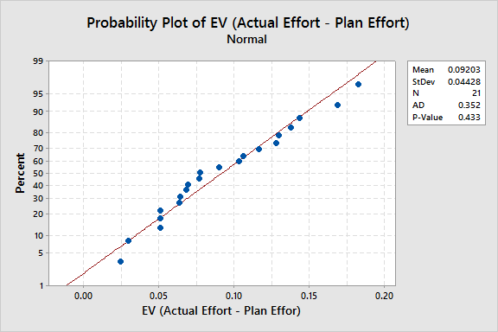
Cycle II- Y Factor – Effort Variance Normality Curve
Mean -0.09203
St Dev - .04428
P Value -0.433
P value is >.05
Hence Data is Not Normal

Slide 37
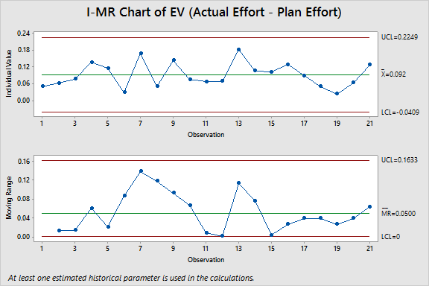
Cycle II- Y Factor – Effort Variance Control chart
Mean – 0.092
UCL = 0.2249
LCL = (-0.0409)
St Dev =.0443
As no points are outside UCL and LCL, the Process is stable.

Slide 38
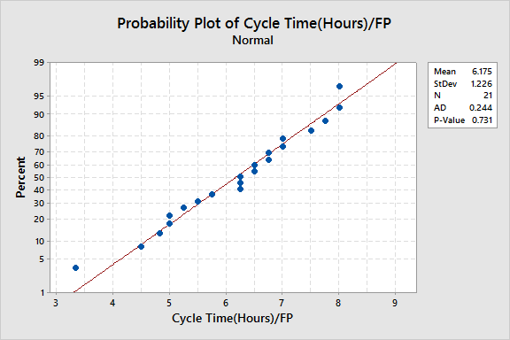
Cycle II- Y Factor – Cycle Time Per FP Normality Curve
Mean -6.175
St Dev –1.226
P Value -0.731
P value is <.05
Hence Data is Normal

Slide 39
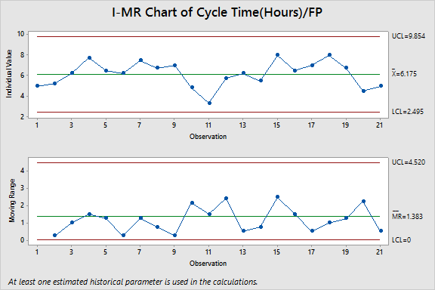
Cycle II- Y Factor – Cycle Time Per FP Control Chart
Mean – 6.175
UCL = 9.854
LCL = 2.495
St Dev =1.226
As no points are outside UCL and LCL, the Process is stable.

Slide 40
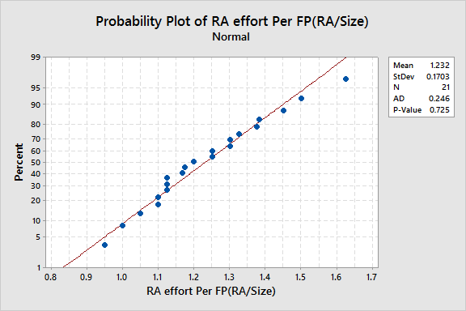
Cycle II- X Factor – RA effort Normality Curve
Mean – 1.232
St Dev –0.1703
P Value –0.725
P value is >.05
Hence Data is Normal

Slide 41
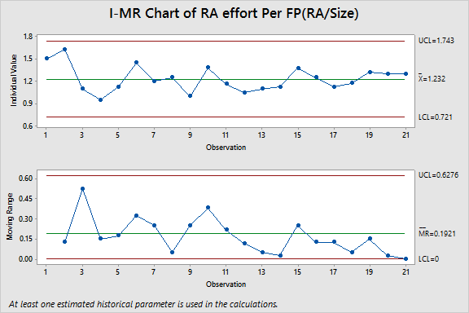
Cycle II- X Factor – RA effort Control Chart
Mean=1.232
UCL =1.743
LCL =0.721
St Dev =0.1703
As no points are outside UCL and LCL, the Process is stable.

Slide 42
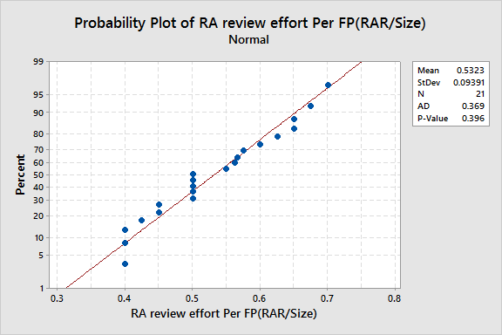
Cycle II- X Factor – RA Review effort Normality Curve
Mean -0.5323
St Dev –0.09391
P Value –0.396
P value is >.05
Hence Data is Normal

Slide 43
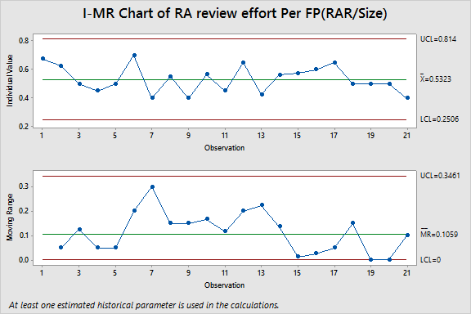
Cycle II- X Factor – RA Review control chart
Mean – 0.5323
UCL = 0.814
LCL =0.2506
St Dev = 0.09391
As no points are outside UCL and LCL, the Process is stable.

Slide 44
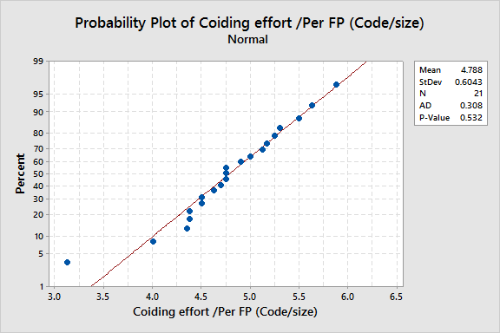
Cycle II- X Factor – Coding Effort Per FP Normality Curve
Mean -4.788
St Dev –0.6043
P Value –0.532
P value is >.05
Hence Data is Normal

Slide 45
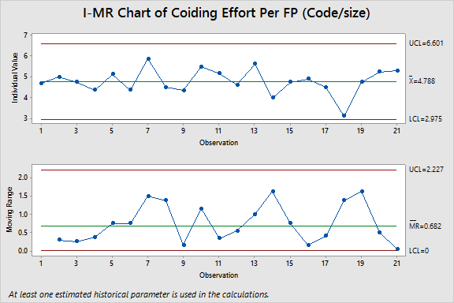
Cycle II- X Factor – Coding Effort per FP control chart
Mean – 4.788
UCL = 6.601
LCL =2.975
St Dev = 0.6043
As no points are outside UCL and LCL, the Process is stable.

Slide 46
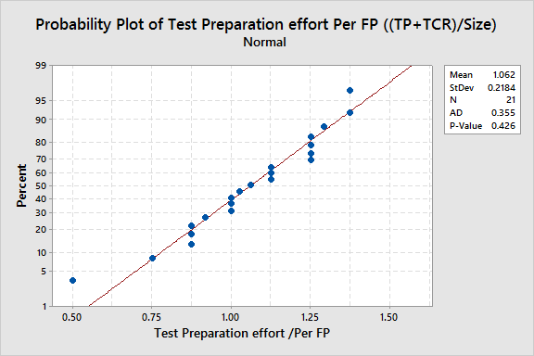
Cycle II- X Factor – Test Preparation Effort Per FP Normality Curve
Mean -1.062
St Dev –0.2184
P Value –0.426
P value is >.05
Hence Data is Normal

Slide 47
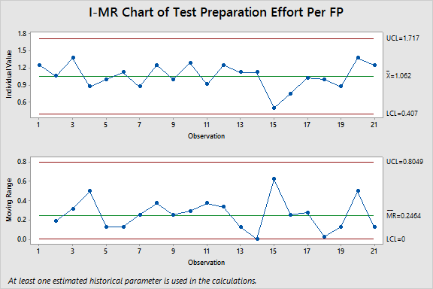
Cycle II- X Factor – Test Preparation Effort Per FP control chart
Mean – 1.062
UCL = 1.717
LCL =0.407
St Dev = 0.2184
As no points are outside UCL and LCL, the Process is stable.

Slide 48
Effort Variance 2T test

Slide 49
Data comparison For EV Cycle I and Cycle II
Modules | Cycle I |  |  | Cycle II
 | EV | RA Effort Per FP | RA Review Effort Per FP | EV | RA Effort Per FP | RA Review Effort Per FP
Admin-Menu mapping | 0.1850 | 0.75 | 0.375
Admin-Role Management | 0.1507 | 0.727272727 | 0.363636364
Admin-View Management | 0.2329 | 0.666666667 | 0.333333333
Authentication & Authorization | 0.0504 | 1.4 | 0.3875
Email Component and Email Queue | 0.3377 | 0.5 | 0.1
User Management | 0.1263 | 0.769230769 | 0.346153846
Super Admin Role Management | 0.2976 | 0.666666667 | 0.166666667
Super Admin-Menu Mapping | 0.2126 | 0.6 | 0.433333333
Super Admin-User Management | 0.2435 | 0.615384615 | 0.384615385
Admin- Menu Mapping | 0.1425 | 1.0375 | 0.375
Site Map Implementing | 0.4006 | 0.6 | 0
Manage Circle Rate | 0.2080 | 0.666666667 | 0.266666667
Manage Master Data | 0.2603 | 0.5625 | 0.25
Manage Notification | 0.1453 | 0.727272727 | 0.363636364
Manage Refund | 0.2646 | 0.909090909 | 0.181818182
Property Management | 0.2407 | 1 | 0.227272727
Scheme Management | 0.1390 | 1.0625 | 0.4375
Add Application Details |  |  |  | 0.050814381 | 1.5 | 0.675
Add Bulk Application Entries |  |  |  | 0.063670131 | 1.625 | 0.625
Allotment of Property |  |  |  | 0.077084741 | 1.1 | 0.5
Approve/Reject request |  |  |  | 0.137506568 | 0.95 | 0.45
Create Allotee List of a Scheme |  |  |  | 0.11649028 | 1.125 | 0.5
Create unsuccessful applicant list |  |  |  | 0.029798094 | 1.45 | 0.7
Edit Allotted Property |  |  |  | 0.169030999 | 1.2 | 0.4
Edit Application Details |  |  |  | 0.050814381 | 1.25 | 0.55
Generate a Payment Schedule |  |  |  | 0.143585132 | 1 | 0.4
Generate allotment letters |  |  |  | 0.07651913 | 1.383333333 | 0.566666667
View Allotment |  |  |  | 0.068341437 | 1.166666667 | 0.45
View Application Details |  |  |  | 0.069203633 | 1.05 | 0.65
View comments |  |  |  | 0.182928657 | 1.1 | 0.425
View Unsuccessful Applicant List |  |  |  | 0.1063319 | 1.125 | 0.5625
Submit Allotee list for approval |  |  |  | 0.1033551 | 1.375 | 0.575
Generate Bulk Payment Schedule |  |  |  | 0.12962546 | 1.25 | 0.6
Initiate Refund for Unsuccessful Applicants |  |  |  | 0.09021992 | 1.125 | 0.65
Manage Allotment |  |  |  | 0.050814381 | 1.175 | 0.5
Manage Applicants |  |  |  | 0.024544022 | 1.325 | 0.5
Submit unsuccessful candidate list for approval |  |  |  | 0.063949561 | 1.3 | 0.5
Update Personal Information |  |  |  | 0.128016789 | 1.3 | 0.4
Average | 0.2140 | 0.7800 | 0.2937 | 0.0920 | 1.2321 | 0.5323
Stander Deviation | 0.0861 | 0.2316 | 0.1235 | 0.0443 | 0.1703 | 0.0939
UCL | 0.4723 | 1.4748 | 0.6642 | 0.2249 | 1.743 | 0.814
LCL | -0.0443 | 0.0852 | -0.0768 | -0.0409 | 0.7212 | 0.2506

Slide 50
Result of Effort variance and its X factors
Effort Variance improved
  From 21% to 9%
  Standard deviation reduced from 0.0861 to 0.0443
RA effort increased
  From 0.7800 hr/FP to 1.2321 hr/FP as
  Standard deviation Reduced from 0.2316 to 0.1703
RA review effort increased
  From 0.2937 hr/FP to 0.5323 hr/FP
  Standard deviation reduced from 0.1235 to 0.0939

Slide 51
2 sample T test for Effort Variance
Two-Sample T-Test and CI: EV_Cycle1, EV_Cycle2
Two-sample T for EV_Cycle1 vs EV_Cycle2
N Mean StDev SE Mean
EV_Cycle1 17 0.2140 0.0861 0.021
EV_Cycle2 21 0.0920 0.0443 0.0097
Difference = mu (EV_Cycle1) - mu (EV_Cycle2)
Estimate for difference: 0.121952
95% CI for difference: (0.074241, 0.169662)
T-Test of difference = 0 (vs not =): T-Value = 5.30 P-Value = 0.000 DF = 22
2T Test is Passed as P value is <.05(0.000) indicating that the two data, which are compared are significantly different

Slide 52
2 sample T test for RA Effort
Two-Sample T-Test and CI: RA/FP_Cycle1, RA/FP_Cycle2
Two-sample T for RA/FP_Cycle1 vs RA/FP_Cycle2
N Mean StDev SE Mean
RA/FP_Cycle1 17 0.780 0.232 0.056
RA/FP_Cycle2 21 1.232 0.170 0.037
Difference = mu (RA/FP_Cycle1) - mu (RA/FP_Cycle2)
Estimate for difference: -0.452099
95% CI for difference: (-0.590062, -0.314136)
T-Test of difference = 0 (vs not =): T-Value = -6.71 P-Value = 0.000 DF = 28
2T Test is Passed as P value is <.05(0.000) indicating that the two data, which are compared are significantly different

Slide 53
2 sample T test for RA Review Effort
Two-Sample T-Test and CI: RA Review/FP_Cycle1, RA Review/FP_Cycle2
Two-sample T for RA Review/FP_Cycle1 vs RA Review/FP_Cycle2
N Mean StDev SE Mean
RA Review/FP_Cyc 17 0.294 0.124 0.030
RA Review/FP_Cyc 21 0.5323 0.0939 0.020
Difference = mu (RA Review/FP_Cycle1) - mu (RA Review/FP_Cycle2)
Estimate for difference: -0.238686
95% CI for difference: (-0.312915, -0.164458)
T-Test of difference = 0 (vs not =): T-Value = -6.58 P-Value = 0.000 DF = 29
2T Test is Passed as P value is <.05(0.000) indicating that the two data, which are compared are significantly different

Slide 54
Cycle Time 2T test

Slide 55
Data comparison for Cycle Time Cycle I and Cycle II
Modules | Cycle I |  |  | Cycle II
 | Cycle Time | Coiding Effort Per FP | Test Preparation Effort Per FP | Cycle Time | Coiding Effort Per FP | Test Preparation Effort Per FP
Admin-Menu mapping | 13.5000 | 3.625 | 0.375
Admin-Role Management | 12.0000 | 3.81818 | 0.63636
Admin-View Management | 13.3333 | 3.16667 | 0.66667
Authentication & Authorization | 10.0000 | 4.25 | 0.9375
Email Component and Email Queue | 8.0000 | 5.75 | 0.75
User Management | 6.3846 | 5.46154 | 0.76923
Super Admin Role Management | 8.0000 | 5 | 0.75
Super Admin-Menu Mapping | 9.3333 | 4.16667 | 1.08333
Super Admin-User Management | 7.3846 | 4.92308 | 1.30769
Admin- Menu Mapping | 9.2500 | 4.75 | 0.75
Site Map Implementing | 8.0000 | 4.5 | 1.25
Manage Circle Rate | 10.6667 | 4.33333 | 0.81667
Manage Master Data | 7.0000 | 4.375 | 1
Manage Notification | 7.2727 | 4.81818 | 0.63636
Manage Refund | 8.7273 | 3.63636 | 0.90909
Property Management | 8.7273 | 4 | 0.90909
Scheme Management | 8.5625 | 4.5625 | 0.90625
Add Application Details |  |  |  | 5 | 4.7 | 1.25
Add Bulk Application Entries |  |  |  | 5.25 | 5 | 1.0625
Allotment of Property |  |  |  | 6.25 | 4.75 | 1.375
Approve/Reject request |  |  |  | 7.75 | 4.375 | 0.875
Create Allotee List of a Scheme |  |  |  | 6.5 | 5.125 | 1
Create unsuccessful applicant list |  |  |  | 6.25 | 4.375 | 1.125
Edit Allotted Property |  |  |  | 7.5 | 5.875 | 0.875
Edit Application Details |  |  |  | 6.75 | 4.5 | 1.25
Generate a Payment Schedule |  |  |  | 7 | 4.35 | 1
Generate allotment letters |  |  |  | 4.8333 | 5.5 | 1.29167
View Allotment |  |  |  | 3.3333 | 5.16667 | 0.91667
View Application Details |  |  |  | 5.75 | 4.625 | 1.25
View comments |  |  |  | 6.25 | 5.625 | 1.125
View Unsuccessful Applicant List |  |  |  | 5.5 | 4 | 1.125
Submit Allotee list for approval |  |  |  | 8 | 4.75 | 0.5
Generate Bulk Payment Schedule |  |  |  | 6.5 | 4.9 | 0.75
Initiate Refund for Unsuccessful Applicants |  |  |  | 7 | 4.5 | 1.025
Manage Allotment |  |  |  | 8 | 3.125 | 1
Manage Applicants |  |  |  | 6.75 | 4.75 | 0.875
Submit unsuccessful candidate list for approval |  |  |  | 4.5 | 5.25 | 1.375
Update Personal Information |  |  |  | 5 | 5.3 | 1.25
Average | 9.1848 | 4.4198 | 0.8502 | 6.1746 | 4.7877 | 1.0617
Stander Deviation | 2.1091 | 0.6706 | 0.2308 | 1.2264 | 0.6043 | 0.2184
UCL | 15.5121 | 6.4316 | 1.5426 | 9.8538 | 6.6006 | 1.7169
LCL | 2.8575 | 2.408 | 0.1578 | 2.4954 | 2.9748 | 0.4065

Slide 56
Result of Cycle Time and its X factors
Cycle Time improved
  From 9.1848 /FP to 6.1746 /FP
  Standard deviation reduced from 2.1091 to 1.2264
Coding Effort increased
  From 4.4198 hr/FP to 4.7877 hr/FP.
  Standard deviation reduced from 0.6706 to 0.6043
Test Preparation Effort increased
  From 0.8502 hr/FP to 1.0617 hr/FP
  Standard deviation reduced from 0.2308 to 0.2184

Slide 57
2 sample T test for Cycle Time Per FP
Two-Sample T-Test and CI: Cycle Time(Hours)/FP_B1, Cycle Time(Hours)/FP_B2
Two-sample T for Cycle Time(Hours)/FP_B1 vs Cycle Time(Hours)/FP_B2
N Mean StDev SE Mean
Cycle Time(Hours 17 9.18 2.11 0.51
Cycle Time(Hours 21 6.17 1.23 0.27
Difference = mu (Cycle Time(Hours)/FP_B1) - mu (Cycle Time(Hours)/FP_B2)
Estimate for difference: 3.01024
95% CI for difference: (1.81874, 4.20175)
T-Test of difference = 0 (vs not =): T-Value = 5.21 P-Value = 0.000 DF = 24
2T Test is Passed as P value is <.05(0.000) indicating that the two data, which are compared are significantly different

Slide 58
2 sample T test for Coding Effort
Two-Sample T-Test and CI: Coding_B1, Coding Rate_B2
Two-sample T for Coding_B1 vs Coding Rate_B2
N Mean StDev SE Mean
Coding_B1 17 4.420 0.671 0.16
Coding Rate_B2 21 4.788 0.604 0.13
Difference = mu (Coding_B1) - mu (Coding Rate_B2)
Estimate for difference: -0.367904
95% CI for difference: (-0.794409, 0.058601)
T-Test of difference = 0 (vs not =): T-Value = -1.76 P-Value = 0.088 DF = 32
2T Test is Passed as P value is <.05(0.088) indicating that the two data, which are compared are significantly different

Slide 59
2 sample T test for Test Preparation Effort
Two-Sample T-Test and CI: Test Preparation_B1, Test Preparation/FP_B2
Two-sample T for Test Preparation_B1 vs Test Preparation/FP_B2
N Mean StDev SE Mean
Test Preparation 17 0.850 0.231 0.056
Test Preparation 21 1.062 0.218 0.048
Difference = mu (Test Preparation_B1) - mu (Test Preparation/FP_B2)
Estimate for difference: -0.211516
95% CI for difference: (-0.361096, -0.061936)
T-Test of difference = 0 (vs not =): T-Value = -2.88 P-Value = 0.007 DF = 33
2T Test is Passed as P value is <.05(0.000) indicating that the two data, which are compared are significantly different

Slide 60
Capability Analysis For EV (Cycle-II)
CP and CPK is > 1 hence process is capable

Slide 61
Capability Analysis For RA Effort (Cycle-II)
CP and CPK is > 1 hence process is capable

Slide 62
Capability Analysis For RA Review Effort (Cycle-II)
CP and CPK is > 1 hence process is capable

Slide 63
Capability Analysis For Cycle Time (Cycle-II)
CP and CPK is > 1 hence process is capable

Slide 64
Capability Analysis For Coding Efforts (Cycle-II)
CP and CPK is > 1 hence process is capable

Slide 65
Target Setting Exercise For Cycle-III

Slide 66
Data of EV (Y) and its X Factors for Cycle-II
Sprint Name | EV | RA effort Per FP(RA/Size) | RA review effort Per FP(RAR/Size)
Add Application Details | 0.050814381 | 1.5 | 0.675
Add Bulk Application Entries | 0.063670131 | 1.625 | 0.625
Allotment of Property | 0.077084741 | 1.1 | 0.5
Approve/Reject request | 0.137506568 | 0.95 | 0.45
Create Allotee List of a Scheme | 0.11649028 | 1.125 | 0.5
Create unsuccessful applicant list | 0.029798094 | 1.45 | 0.7
Edit Allotted Property | 0.169030999 | 1.2 | 0.4
Edit Application Details | 0.050814381 | 1.25 | 0.55
Generate a Payment Schedule | 0.143585132 | 1 | 0.4
Generate allotment letters | 0.07651913 | 1.383333333 | 0.566666667
View Allotment | 0.068341437 | 1.166666667 | 0.45
View Application Details | 0.069203633 | 1.05 | 0.65
View comments | 0.182928657 | 1.1 | 0.425
View Unsuccessful Applicant List | 0.1063319 | 1.125 | 0.5625
Submit Allotee list for approval | 0.1033551 | 1.375 | 0.575
Generate Bulk Payment Schedule | 0.12962546 | 1.25 | 0.6
Initiate Refund for Unsuccessful Applicants | 0.09021992 | 1.125 | 0.65
Manage Allotment | 0.050814381 | 1.175 | 0.5
Manage Applicants | 0.024544022 | 1.325 | 0.5
Submit unsuccessful candidate list for approval | 0.063949561 | 1.3 | 0.5
Update Personal Information | 0.128016789 | 1.3 | 0.4
Average | 0.0920 | 1.2321 | 0.5323
Stander Deviation | 0.0443 | 0.1703 | 0.0939
UCL | 0.2249 | 1.743 | 0.814
LCL | -0.0409 | 0.7212 | 0.2506
EV and its X factors at organization level in Cycle-2
Notes:
Ev=((Actual Effort - Plan Effort)/Plan Effort)*100

Slide 67
Regression Equation For Cycle II – Effort Variance
The regression equation is provided by SEPG Team
EV_Cycle12 = 0.399 - 0.104 RA/FP_Cycle12 - 0.342 RA Review/FP_Cycle12

Slide 68
What if Analysis (Target of Effort variance 5% and target of St.Dev is 3%)
EV_Cycle12 = 0.399 - 0.104 RA/FP_Cycle12 - 0.342 RA Review/FP_Cycle12
Effort Variance | RA Effort/FP | RA Review Effort/FP | Target | Target for SD | Probability
9% | 1.2321 | 0.5323 | 5% | 3% | 19%
1% | 1.3 | 0.5423 |  |  | 79%

Slide 69
Effort variance reduction methodology
To reduce effort variance from 9% to 5% and St Dev reduced from 4% to 3%
RA Effort to improved from 1.2321 Hrs/FP to 1.3Hrs/FP with SD from 0.170279 to 0.15 reduced by
  Using subject matter expert in requirement analysis
  By micro level analysis of requirement through smaller releases and their req. analysis
RA review effort to increase from 0.5323 hrs/FP to 0.5423 Hr/FP With standard deviation from .093 to 0.091 by
  By introducing checklist in requirement review
  By Add, Modify, delete and track requirements and maintain documents
  Involving customer feedback in requirement review and document & revise requirements as needed.
  Requirements details clarified and validate with customer.

Slide 70
Data of Cycle Time(Y) and its X Factors For Cycle-II
Sprint Name | Cycle Time(Hours)/FP | Coiding effort /Per FP (Code/size) | Test Preparation effort /Per FP (TP+TCR)/Size
Add Application Details | 5 | 4.7 | 1.25
Add Bulk Application Entries | 5.25 | 5 | 1.0625
Allotment of Property | 6.25 | 4.75 | 1.375
Approve/Reject request | 7.75 | 4.375 | 0.875
Create Allotee List of a Scheme | 6.5 | 5.125 | 1
Create unsuccessful applicant list | 6.25 | 4.375 | 1.125
Edit Allotted Property | 7.5 | 5.875 | 0.875
Edit Application Details | 6.75 | 4.5 | 1.25
Generate a Payment Schedule | 7 | 4.35 | 1
Generate allotment letters | 4.8333 | 5.5 | 1.29167
View Allotment | 3.3333 | 5.16667 | 0.91667
View Application Details | 5.75 | 4.625 | 1.25
View comments | 6.25 | 5.625 | 1.125
View Unsuccessful Applicant List | 5.5 | 4 | 1.125
Submit Allotee list for approval | 8 | 4.75 | 0.5
Generate Bulk Payment Schedule | 6.5 | 4.9 | 0.75
Initiate Refund for Unsuccessful Applicants | 7 | 4.5 | 1.025
Manage Allotment | 8 | 3.125 | 1
Manage Applicants | 6.75 | 4.75 | 0.875
Submit unsuccessful candidate list for approval | 4.5 | 5.25 | 1.375
Update Personal Information | 5 | 5.3 | 1.25
Average | 6.1746 | 4.7877 | 1.0617
Stander Deviation | 1.2264 | 0.6043 | 0.2184
UCL | 9.8538 | 6.6006 | 1.7169
LCL | 2.4954 | 2.9748 | 0.4065

Slide 71
Regression Equation For Cycle - II Cycle Time
The regression equation for Cycle Time is Provided by SEPG Team
Cycle Time(Hours)/FP = 19.9 - 1.68 Coding - 4.79 Test Preparation

Slide 72
What if Analysis (Target of Cycle Time)
Cycle Time(Hours)/FP = 19.9 - 1.68 Coding - 4.79 Test Preparation
Cycle Time | Coding Effort/FP | Test Preparation Effort/FP | Target from Mean | Target from St. Dev | Probability
6.771091 | 4.7877 | 1.0617 | 4 | 1 | 1%
 |  |  |  |  | 67%
6.088 | 4.8 | 1.2

Slide 73
Cycle Time Reduction Methodology
To reduce Cycle Time from 6.1746 defects/FP to 4 defects /FP with St dev from 1.226423 To 1.0
Test Preparation efforts Improved from 1.061707 Hrs/FP to 1.2Hrs/FP with St Dev from 0.218413 to.10 by
  Preparing more test cases
  By using root cause analysis of bugs
  By adopting previous project knowledge which help them to reduce test case preparation effort and spend more time on testing
Coding efforts Improved from 4.787699 hrs/FP to 4.8 Hr/FP with St Dev from 0.604282 to .5
  Break user requirements into use cases in the SRS
  By using effective estimation
  Start planning of Code Review Effort in Project Schedule
  Use code review checklist

Slide 74
Capability Analysis for DDD(Cycle2)

Slide 75
Capability Analysis for Test Planning Effort(Cycle2)

Slide 76
Capability Analysis for Code Review Effort (Cycle2)

Slide 77
PMIS – Cycle III

Slide 78
Data for PMIS – Cycle -III
Sprint Name | Size | Total Planned effort | Actual Start Date | Actual End Date | RA | RA Review | Design | Design review | CUT(Code and Unit Testing) | Code Review | TC Prep | Testing | Total Actual Effort | # internal defects
Approve/Reject/Cancel and resubmit Mutation approval Request | 3 | 28.59 | 04 July 2016 | 08 July 2016 | 4.9 | 2.4 | 1.25 | 0.5 | 14 | 0.5 | 2.75 | 2.5 | 28.85
Generate lease challan and add lease deed | 3 | 28.56285714 | 04 July 2016 | 06 July 2016 | 4.4 | 2 | 2.75 | 1.75 | 15.5 | 0.75 | 1 | 2 | 30.4
View comment and request department user | 1 | 9.54 | 06 July 2016 | 07 July 2016 | 1.5 | 0.7 | 0.8 | 0.5 | 4.6 | 0.25 | 1.1 | 1.2 | 10.3
View requests -approver and deartment user | 3 | 28.59285714 | 07 July 2016 | 08 July 2016 | 4.6 | 2.25 | 1.25 | 1 | 13.5 | 0.5 | 2.5 | 4.45 | 29.9
Allottee Details view | 2 | 19.03285714 | 08 July 2016 | 11 July 2016 | 3.3 | 1.25 | 1 | 0.75 | 8.75 | 0.5 | 1.25 | 2 | 19.75
Add bulk Possession Order | 2 | 19.03285714 | 06 July 2016 | 08 July 2016 | 3.2 | 1.25 | 0.75 | 0.25 | 9.2 | 0.25 | 1.5 | 1.5 | 18.5
Add Mutation/Substitution SMS/Email Notifications to requestor | 1 | 9.531428571 | 08 July 2016 | 11 July 2016 | 1.8 | 0.9 | 0.5 | 0 | 4.45 | 0 | 0.55 | 0.8 | 9.75
Business Rule Engine | 4 | 38.07571429 | 11 July 2016 | 14 July 2016 | 5.8 | 2.3 | 2 | 1 | 18.2 | 0.5 | 4 | 5 | 40.75
Generate Mutation Letter | 2 | 19.03285714 | 12 July 2016 | 14 July 2016 | 2.6 | 1.2 | 1.5 | 0.5 | 10 | 0.5 | 1 | 3 | 20.75
Generate letters | 2 | 19.06285714 | 13 July 2016 | 18 July 2016 | 3.6 | 1.6 | 1 | 0.5 | 9 | 0.25 | 1.25 | 1.75 | 19.9
Lease deed + Checklist - Letter just after allotment is done | 2 | 19.03285714 | 14 July 2016 | 15 July 2016 | 2.7 | 1.25 | 1 | 0.5 | 11 | 0.75 | 1 | 2 | 20.75
Payment Schedule History view | 2 | 19.03285714 | 15 July 2016 | 18 July 2016 | 2.9 | 1.5 | 1.5 | 0.5 | 10.5 | 0.5 | 1.9 | 2 | 18.5
Property Master page(BA) | 2 | 19.03285714 | 11 July 2016 | 15 July 2016 | 2.8 | 1.65 | 1 | 0.5 | 9.5 | 0 | 2 | 3 | 19.5
Property Details Subsitution Transfer | 2 | 19.03285714 | 18 July 2016 | 20 July 2016 | 2.7 | 1.3 | 1 | 0.5 | 10.5 | 0.5 | 2 | 2 | 20
View Lease Deed Details | 1 | 9.531428571 | 18 July 2016 | 19 July 2016 | 1.5 | 0.75 | 1 | 0.4 | 4 | 0.5 | 0.75 | 1 | 9.9
Webserives | 4 | 38.06571429 | 19 July 2016 | 22 July 2016 | 5.3 | 3.2 | 1 | 0.5 | 20.5 | 0.5 | 2.5 | 4 | 39.5
Webservices - Post document to PMS,Receive document from PMS (based on RID) | 2 | 19.03285714 | 20 July 2016 | 21 July 2016 | 3.5 | 1.75 | 0.5 |  | 8.75 |  | 2 | 2 | 19
BA Meta Data for document | 2 | 19.03285714 | 21 July 2016 | 22 July 2016 | 3.5 | 1.5 |  | 2 | 9.25 | 0.25 | 0.5 | 1 | 18.5
View possesion entry ,letter generation,db preparation | 5 | 47.59714286 | 18 July 2016 | 22 July 2016 | 7.9 | 3.7 | 1.5 | 1 | 28 | 2 | 1.75 | 3 | 49.3
Account database understanding for BA | 2 | 19.03285714 | 21 July 2016 | 22 July 2016 | 2.5 | 1.25 | 1 | 0.5 | 11 | 0.5 | 2 | 1 | 20.5

Slide 79
Data Analysis

Slide 80
Y Factors –PMIS Cycle III
Sprint Name | EV | Cycle Time(Hours)/FP
Approve/Reject/Cancel and resubmit Mutation approval Request | 0.0091 | 2.667
Generate lease challan and add lease deed | 0.0643 | 2.667
View comment and request department user | 0.0797 | 2.500
View requests -approver and deartment user | 0.0457 | 2.167
Allottee Details view | 0.0377 | 3.000
Add bulk Possession Order | -0.0280 | 2.750
Add Mutation/Substitution SMS/Email Notifications to requestor | 0.0229 | 2.500
Business Rule Engine | 0.0702 | 2.750
Generate Mutation Letter | 0.0902 | 3.250
Generate letters | 0.0439 | 2.500
Lease deed + Checklist - Letter just after allotment is done | 0.0902 | 3.250
Payment Schedule History view | -0.0280 | 3.500
Property Master page(BA) | 0.0245 | 3.000
Property Details Subsitution Transfer | 0.0508 | 3.250
View Lease Deed Details | 0.0387 | 3.000
Webserives | 0.0377 | 2.750
Webservices - Post document to PMS,Receive document from PMS (based on RID) | -0.0017 | 2.000
BA Meta Data for document | -0.0280 | 2.500
View possesion entry ,letter generation,db preparation | 0.0358 | 1.700
Account database understanding for BA | 0.0771 | 1.500
Average | 0.0366 | 2.6600
Stander Deviation | 0.0374 | 0.5216
UCL | 0.1488 | 4.2248
LCL | -0.0756 | 1.0952

Slide 81
X Factors – PMIS Cycle III
Sprint Name | RA effort Per FP | RA review effort Per FP | Coding effort Per FP | Test Preparation effort Per FP
Approve/Reject/Cancel and resubmit Mutation approval Request | 1.616666667 | 0.8 | 4.666666667 | 1.166666667
Generate lease challan and add lease deed | 1.466666667 | 0.666666667 | 5.166666667 | 0.883333333
View comment and request department user | 1.5 | 0.7 | 4.6 | 1.1
View requests -approver and deartment user | 1.516666667 | 0.75 | 4.5 | 1.083333333
Allottee Details view | 1.625 | 0.625 | 4.375 | 1.125
Add bulk Possession Order | 1.6 | 0.625 | 4.6 | 1.125
Add Mutation/Substitution SMS/Email Notifications to requestor | 1.8 | 0.9 | 4.45 | 1.3
Business Rule Engine | 1.4375 | 0.575 | 4.55 | 1.5
Generate Mutation Letter | 1.3 | 0.6 | 5 | 1
Generate letters | 1.8 | 0.8 | 4.5 | 1.375
Lease deed + Checklist - Letter just after allotment is done | 1.325 | 0.625 | 5.5 | 1
Payment Schedule History view | 1.45 | 0.75 | 5.25 | 0.95
Property Master page(BA) | 1.375 | 0.825 | 4.75 | 1.5
Property Details Subsitution Transfer | 1.35 | 0.65 | 5.25 | 1.25
View Lease Deed Details | 1.5 | 0.75 | 4 | 0.9
Webserives | 1.325 | 0.8 | 5.125 | 1.125
Webservices - Post document to PMS,Receive document from PMS (based on RID) | 1.75 | 0.875 | 4.375 | 1.5
BA Meta Data for document | 1.75 | 0.75 | 4.625 | 1.25
View possesion entry ,letter generation,db preparation | 1.57 | 0.74 | 5.6 | 1.25
Account database understanding for BA | 1.25 | 0.625 | 5.5 | 1.375
Average | 1.5154 | 0.7216 | 4.8192 | 1.1879
Stander Deviation | 0.1708 | 0.0947 | 0.4469 | 0.1947
UCL | 2.0278 | 1.0057 | 6.1599 | 1.772
LCL | 1.003 | 0.4375 | 3.4785 | 0.6038
Notes:
RA Effort /FP =(RA/Size) RAR=RAR/Size perfp= Code/Size Tpeffort=TP+TCR/size

Slide 82
Data of EV (Y) and its X Factors for Cycle-III
Sprint Name | EV | RA effort Per FP | RA review effort Per FP
Approve/Reject/Cancel and resubmit Mutation approval Request | 0.0091 | 1.616666667 | 0.8
Generate lease challan and add lease deed | 0.0643 | 1.466666667 | 0.666666667
View comment and request department user | 0.0797 | 1.5 | 0.7
View requests -approver and deartment user | 0.0457 | 1.516666667 | 0.75
Allottee Details view | 0.0377 | 1.625 | 0.625
Add bulk Possession Order | -0.0280 | 1.6 | 0.625
Add Mutation/Substitution SMS/Email Notifications to requestor | 0.0229 | 1.8 | 0.9
Business Rule Engine | 0.0702 | 1.4375 | 0.575
Generate Mutation Letter | 0.0902 | 1.3 | 0.6
Generate letters | 0.0439 | 1.8 | 0.8
Lease deed + Checklist - Letter just after allotment is done | 0.0902 | 1.325 | 0.625
Payment Schedule History view | -0.0280 | 1.45 | 0.75
Property Master page(BA) | 0.0245 | 1.375 | 0.825
Property Details Subsitution Transfer | 0.0508 | 1.35 | 0.65
View Lease Deed Details | 0.0387 | 1.5 | 0.75
Webserives | 0.0377 | 1.325 | 0.8
Webservices - Post document to PMS,Receive document from PMS (based on RID) | -0.0017 | 1.75 | 0.875
BA Meta Data for document | -0.0280 | 1.75 | 0.75
View possesion entry ,letter generation,db preparation | 0.0358 | 1.57 | 0.74
Account database understanding for BA | 0.0771 | 1.25 | 0.625
Average | 0.0366 | 1.5154 | 0.7216
Stander Deviation | 0.0374 | 0.1708 | 0.0947
UCL | 0.1488 | 2.0278 | 1.0057
LCL | -0.0756 | 1.003 | 0.4375
Notes:
EV ((Actual Effort - Plan Effort)/Plan Effort)*100

Slide 83
Data of Cycle Time(Y) and its X Factors For Cycle-III
Sprint Name | Cycle Time(Hours) Per FP | Coiding effort Per FP | Test Preparation effort per FP
Approve/Reject/Cancel and resubmit Mutation approval Request | 2.667 | 4.67 | 1.17
Generate lease challan and add lease deed | 2.667 | 5.17 | 0.88
View comment and request department user | 2.500 | 4.60 | 1.10
View requests -approver and deartment user | 2.167 | 4.50 | 1.08
Allottee Details view | 3.000 | 4.38 | 1.13
Add bulk Possession Order | 2.750 | 4.60 | 1.13
Add Mutation/Substitution SMS/Email Notifications to requestor | 2.500 | 4.45 | 1.30
Business Rule Engine | 2.750 | 4.55 | 1.50
Generate Mutation Letter | 3.250 | 5.00 | 1.00
Generate letters | 2.500 | 4.50 | 1.38
Lease deed + Checklist - Letter just after allotment is done | 3.250 | 5.50 | 1.00
Payment Schedule History view | 3.500 | 5.25 | 0.95
Property Master page(BA) | 3.000 | 4.75 | 1.50
Property Details Subsitution Transfer | 3.250 | 5.25 | 1.25
View Lease Deed Details | 3.000 | 4.00 | 0.90
Webserives | 2.750 | 5.13 | 1.13
Webservices - Post document to PMS,Receive document from PMS (based on RID) | 2.000 | 4.38 | 1.50
BA Meta Data for document | 2.500 | 4.63 | 1.25
View possesion entry ,letter generation,db preparation | 1.700 | 5.60 | 1.25
Account database understanding for BA | 1.500 | 5.50 | 1.38
Average | 2.6600 | 4.8192 | 1.1879
Stander Deviation | 0.5216 | 0.4469 | 0.1947
UCL | 4.2248 | 6.1599 | 1.772
LCL | 1.0952 | 3.4785 | 0.6038

Slide 84
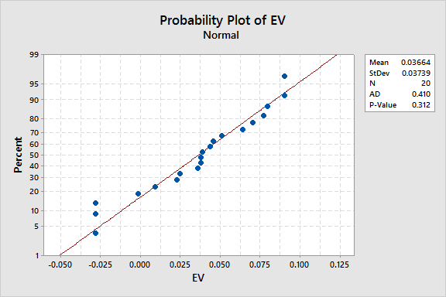
Cycle III- Y Factor – Effort Variance Normality Curve
Mean -0.03664
St Dev - .03739
P Value -0.312
P value is >.05
Hence Data is Not Normal

Slide 85
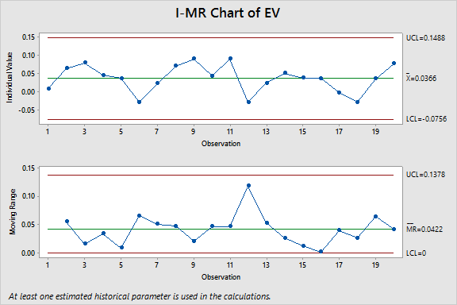
Cycle III- Y Factor – Effort Variance Control chart
Mean – 0.0366
UCL = 0.1488
LCL = (-0.0756)
St Dev =.0374
As no points are outside UCL and LCL, the Process is stable.

Slide 86
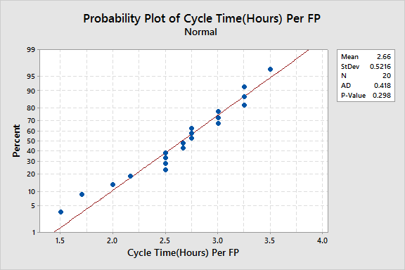
Cycle III- Y Factor – Cycle Time Per FP Normality Curve
Mean -2.66
St Dev –0.5216
P Value -0.298
P value is >.05
Hence Data is Normal

Slide 87
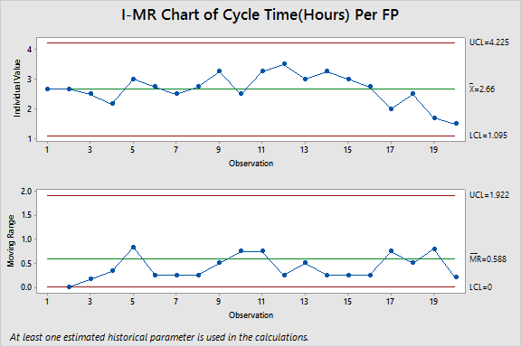
Cycle III- Y Factor – Cycle Time Per FP Control Chart
Mean – 2.66
UCL = 4.225
LCL = 1.095
St Dev =0.5216
As no points are outside UCL and LCL, the Process is stable.

Slide 88
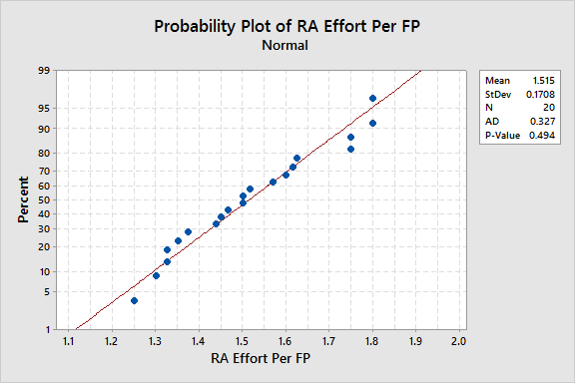
Cycle III- X Factor – RA effort Normality Curve
Mean – 1.515
St Dev –0.1708
P Value –0.494
P value is >.05
Hence Data is Normal

Slide 89
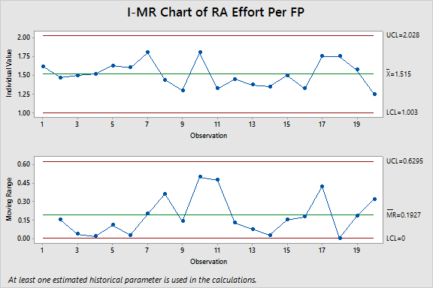
Cycle III- X Factor – RA effort Control Chart
Mean=1.515
UCL =2.028
LCL =1.003
St Dev =0.1708
As no points are outside UCL and LCL, the Process is stable.

Slide 90
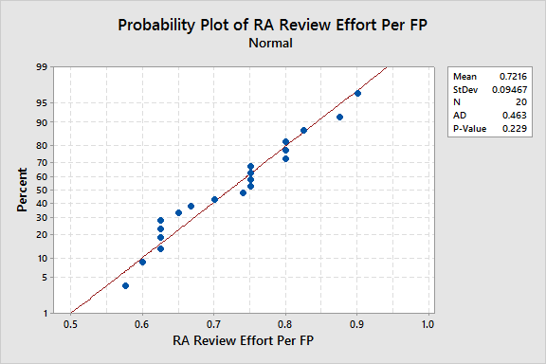
Cycle III- X Factor – RA Review effort Normality Curve
Mean -0.7216
St Dev –0.09467
P Value –.229
P value is >.05
Hence Data is Normal

Slide 91
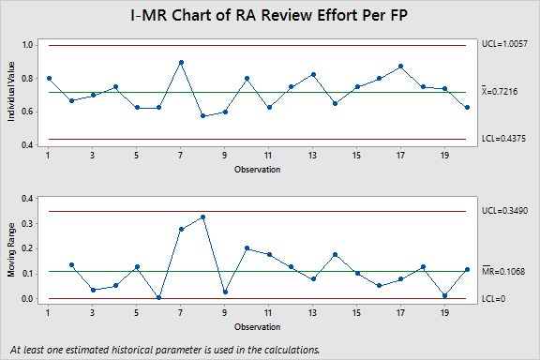
Cycle III- X Factor – RA Review control chart
Mean – 0.7216
UCL = 1.0057
LCL =0.4375
St Dev = 0.09467
As no points are outside UCL and LCL, the Process is stable.

Slide 92
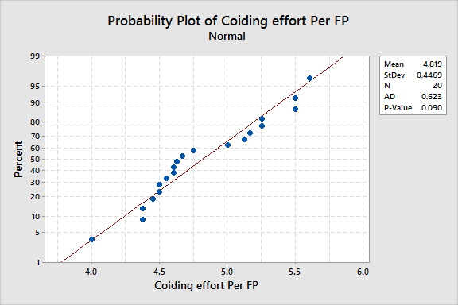
Cycle III- X Factor – Coding Effort Per FP Normality Curve
Mean -4.819
St Dev –0.4469
P Value –0.090
P value is >.05
Hence Data is Normal

Slide 93
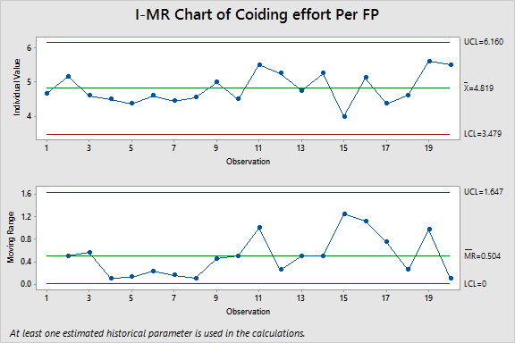
Cycle III- X Factor – Coding Effort per FP control chart
Mean – 4.819
UCL = 6.160
LCL =3.479
St Dev = 0.4469
As no points are outside UCL and LCL, the Process is stable.

Slide 94
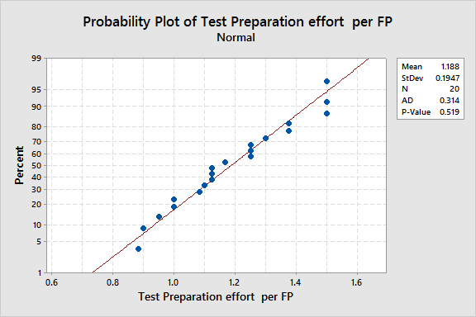
Cycle III- X Factor – Test Preparation Effort Per FP Normality Curve
Mean -1.188
St Dev –0.1947
P Value –0.519
P value is >.05
Hence Data is Normal

Slide 95
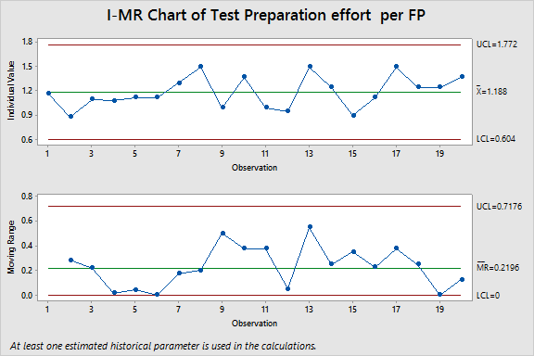
Cycle III- X Factor – Test Preparation Effort Per FP control chart
Mean – 1.188
UCL = 1.772
LCL =0.604
St Dev = 0.1947
As no points are outside UCL and LCL, the Process is stable.

Slide 96
Effort Variance 2T test

Slide 97
Data comparison For EV Cycle-I and Cycle-III
Modules | Cycle I |  |  | Cycle III
 | EV | RA Effort Per FP | RA Review Effort Per FP | EV | RA Effort Per FP | RA Review Effort Per FP
Admin-Menu mapping | 0.1850 | 0.75 | 0.375
Admin-Role Management | 0.1507 | 0.727272727 | 0.363636364
Admin-View Management | 0.2329 | 0.666666667 | 0.333333333
Authentication & Authorization | 0.0504 | 1.4 | 0.3875
Email Component and Email Queue | 0.3377 | 0.5 | 0.1
User Management | 0.1263 | 0.769230769 | 0.346153846
Super Admin Role Management | 0.2976 | 0.666666667 | 0.166666667
Super Admin-Menu Mapping | 0.2126 | 0.6 | 0.433333333
Super Admin-User Management | 0.2435 | 0.615384615 | 0.384615385
Admin- Menu Mapping | 0.1425 | 1.0375 | 0.375
Site Map Implementing | 0.4006 | 0.6 | 0
Manage Circle Rate | 0.2080 | 0.666666667 | 0.266666667
Manage Master Data | 0.2603 | 0.5625 | 0.25
Manage Notification | 0.1453 | 0.727272727 | 0.363636364
Manage Refund | 0.2646 | 0.909090909 | 0.181818182
Property Management | 0.2407 | 1 | 0.227272727
Scheme Management | 0.1390 | 1.0625 | 0.4375
Approve/Reject/Cancel and resubmit Mutation approval Request |  |  |  | 0.009094089 | 1.616666667 | 0.8
Generate lease challan and add lease deed |  |  |  | 0.064319296 | 1.466666667 | 0.666666667
View comment and request department user |  |  |  | 0.07966457 | 1.5 | 0.7
View requests -approver and deartment user |  |  |  | 0.045715713 | 1.516666667 | 0.75
Allottee Details view |  |  |  | 0.037679201 | 1.625 | 0.625
Add bulk Possession Order |  |  |  | -0.027996697 | 1.6 | 0.625
Add Mutation/Substitution SMS/Email Notifications to requestor |  |  |  | 0.022931655 | 1.8 | 0.9
Business Rule Engine |  |  |  | 0.070235996 | 1.4375 | 0.575
Generate Mutation Letter |  |  |  | 0.09021992 | 1.3 | 0.6
Generate letters |  |  |  | 0.043914868 | 1.8 | 0.8
Lease deed + Checklist - Letter just after allotment is done |  |  |  | 0.09021992 | 1.325 | 0.625
Payment Schedule History view |  |  |  | -0.027996697 | 1.45 | 0.75
Property Master page(BA) |  |  |  | 0.024544022 | 1.375 | 0.825
Property Details Subsitution Transfer |  |  |  | 0.050814381 | 1.35 | 0.65
View Lease Deed Details |  |  |  | 0.038669065 | 1.5 | 0.75
Webserives |  |  |  | 0.037679201 | 1.325 | 0.8
Webservices - Post document to PMS,Receive document from PMS (based on RID) |  |  |  | -0.001726338 | 1.75 | 0.875
BA Meta Data for document |  |  |  | -0.027996697 | 1.75 | 0.75
View possesion entry ,letter generation,db preparation |  |  |  | 0.035776457 | 1.57 | 0.74
Account database understanding for BA |  |  |  | 0.077084741 | 1.25 | 0.625
Average | 0.214 | 0.7800 | 0.2937 | 0.0366 | 1.5154 | 0.7216
Stander Deviation | 0.0861 | 0.2316 | 0.1235 | 0.0374 | 0.1708 | 0.0947
UCL | 0.4723 | 1.4748 | 0.6642 | 0.1488 | 2.0278 | 1.0057
LCL | -0.0443 | 0.0852 | -0.0768 | -0.0756 | 1.003 | 0.4375

Slide 98
Result of Effort variance and its X factors
Effort Variance improved
  From 21% to 4%
  Standard deviation reduced from 0.0861 to 0.0374
RA effort increased
  From 0.7800 hr/FP to 1.5154 hr/FP as
  Standard deviation Reduced from 0.2316 to 0.1708
RA review effort increased
  From 0.2937 hr/FP to 0.7216 hr/FP
  Standard deviation reduced from 0.1235 to 0.0947

Slide 99
2 sample T test for Effort Variance
Two-Sample T-Test and CI: EV_Cycle1, EV_Cycle3
Two-sample T for EV_Cycle1 vs EV_Cycle3
N Mean StDev SE Mean
EV_Cycle1 17 0.2140 0.0861 0.021
EV_Cycle3 20 0.0366 0.0374 0.0084
Difference = mu (EV_Cycle1) - mu (EV_Cycle3)
Estimate for difference: 0.177342
95% CI for difference: (0.130574, 0.224111)
T-Test of difference = 0 (vs not =): T-Value = 7.89 P-Value = 0.000 DF = 21
2T Test is Passed as P value is <.05(0.000) indicating that the two data, which are compared are significantly different

Slide 100
2 sample T test for RA Effort
Two-Sample T-Test and CI: RA/FP_Cycle1, RA/FP_Cycle3
Two-sample T for RA/FP_Cycle1 vs RA/FP_Cycle3
N Mean StDev SE Mean
RA/FP_Cycle1 17 0.780 0.232 0.056
RA/FP_Cycle3 20 1.515 0.171 0.038
Difference = mu (RA/FP_Cycle1) - mu (RA/FP_Cycle3)
Estimate for difference: -0.735331
95% CI for difference: (-0.874466, -0.596197)
T-Test of difference = 0 (vs not =): T-Value = -10.83 P-Value = 0.000 DF = 28
2T Test is Passed as P value is <.05(0.000) indicating that the two data, which are compared are significantly different

Slide 101
2 sample T test for RA Review Effort
Two-Sample T-Test and CI: RA Review/FP_Cycle1, RA Review/FP_Cycle3
Two-sample T for RA Review/FP_Cycle1 vs RA Review/FP_Cycle3
N Mean StDev SE Mean
RA Review/FP_Cyc 17 0.294 0.124 0.030
RA Review/FP_Cyc 20 0.7216 0.0947 0.021
Difference = mu (RA Review/FP_Cycle1) - mu (RA Review/FP_Cycle3)
Estimate for difference: -0.427928
95% CI for difference: (-0.502945, -0.352912)
T-Test of difference = 0 (vs not =): T-Value = -11.67 P-Value = 0.000 DF = 29
2T Test is Passed as P value is <.05(0.000) indicating that the two data, which are compared are significantly different

Slide 102
Cycle Time 2T test

Slide 103
Data comparison for Cycle Time Cycle I and Cycle III
Modules | Cycle I |  |  | Cycle III
 | Cycle Time | Coiding Effort Per FP | Test Preparation Effort Per FP | Cycle Time | Coiding Effort Per FP | Test Preparation Effort Per FP
Admin-Menu mapping | 13.5000 | 3.625 | 0.375
Admin-Role Management | 12.0000 | 3.81818 | 0.63636
Admin-View Management | 13.3333 | 3.16667 | 0.66667
Authentication & Authorization | 10.0000 | 4.25 | 0.9375
Email Component and Email Queue | 8.0000 | 5.75 | 0.75
User Management | 6.3846 | 5.46154 | 0.76923
Super Admin Role Management | 8.0000 | 5 | 0.75
Super Admin-Menu Mapping | 9.3333 | 4.16667 | 1.08333
Super Admin-User Management | 7.3846 | 4.92308 | 1.30769
Admin- Menu Mapping | 9.2500 | 4.75 | 0.75
Site Map Implementing | 8.0000 | 4.5 | 1.25
Manage Circle Rate | 10.6667 | 4.33333 | 0.81667
Manage Master Data | 7.0000 | 4.375 | 1
Manage Notification | 7.2727 | 4.81818 | 0.63636
Manage Refund | 8.7273 | 3.63636 | 0.90909
Property Management | 8.7273 | 4 | 0.90909
Scheme Management | 8.5625 | 4.5625 | 0.90625
Approve/Reject/Cancel and resubmit Mutation approval Request |  |  |  | 2.666666667 | 4.666666667 | 1.166666667
Generate lease challan and add lease deed |  |  |  | 2.666666667 | 5.166666667 | 0.883333333
View comment and request department user |  |  |  | 2.5 | 4.6 | 1.1
View requests -approver and deartment user |  |  |  | 2.166666667 | 4.5 | 1.083333333
Allottee Details view |  |  |  | 3 | 4.375 | 1.125
Add bulk Possession Order |  |  |  | 2.75 | 4.6 | 1.125
Add Mutation/Substitution SMS/Email Notifications to requestor |  |  |  | 2.5 | 4.45 | 1.3
Business Rule Engine |  |  |  | 2.75 | 4.55 | 1.5
Generate Mutation Letter |  |  |  | 3.25 | 5 | 1
Generate letters |  |  |  | 2.5 | 4.5 | 1.375
Lease deed + Checklist - Letter just after allotment is done |  |  |  | 3.25 | 5.5 | 1
Payment Schedule History view |  |  |  | 3.5 | 5.25 | 0.95
Property Master page(BA) |  |  |  | 3 | 4.75 | 1.5
Property Details Subsitution Transfer |  |  |  | 3.25 | 5.25 | 1.25
View Lease Deed Details |  |  |  | 3 | 4 | 0.9
Webserives |  |  |  | 2.75 | 5.125 | 1.125
Webservices - Post document to PMS,Receive document from PMS (based on RID) |  |  |  | 2 | 4.375 | 1.5
BA Meta Data for document |  |  |  | 2.5 | 4.625 | 1.25
View possesion entry ,letter generation,db preparation |  |  |  | 1.7 | 5.6 | 1.25
Account database understanding for BA |  |  |  | 1.5 | 5.5 | 1.375
Average | 9.1848 | 4.4198 | 0.8502 | 2.6600 | 4.8192 | 1.1879
Stander Deviation | 2.1091 | 0.6706 | 0.2308 | 0.5216 | 0.4469 | 0.1947
UCL | 15.5121 | 6.4316 | 1.5426 | 4.2248 | 6.1599 | 1.772
LCL | 2.8575 | 2.408 | 0.1578 | 1.0952 | 3.4785 | 0.6038

Slide 104
Result of Cycle Time and its X factors
Cycle Time improved
  From 9.1848 /FP to 2.6600 /FP
  Standard deviation reduced from 2.1091 to 0.5216
Coding Effort increased
  From 4.4198 hr/FP to 4.8192 hr/FP.
  Standard deviation reduced from 0.6706 to 0.4469
Test Preparation Effort increased
  From 0.8502 hr/FP to 1.1879 hr/FP
  Standard deviation reduced from 0.2308 to 0.1947

Slide 105
2 sample T test for Cycle Time Per FP
Two-Sample T-Test and CI: Cycle Time(Hours)/FP_B1, Cycle Time(Hours)/FP_B3
Two-sample T for Cycle Time(Hours)/FP_B1 vs Cycle Time(Hours)/FP_B3
N Mean StDev SE Mean
Cycle Time(Hours 17 9.18 2.11 0.51
Cycle Time(Hours 20 2.660 0.522 0.12
Difference = mu (Cycle Time(Hours)/FP_B1) - mu (Cycle Time(Hours)/FP_B3)
Estimate for difference: 6.52484
95% CI for difference: (5.41791, 7.63177)
T-Test of difference = 0 (vs not =): T-Value = 12.44 P-Value = 0.000 DF = 17
2T Test is Passed as P value is <.05(0.000) indicating that the two data, which are compared are significantly different

Slide 106
2 sample T test for Coding Effort
Two-Sample T-Test and CI: Coding_B1, Coding Rate_B3
Two-sample T for Coding_B1 vs Coding Rate_B3
N Mean StDev SE Mean
Coding_B1 17 4.420 0.671 0.16
Coding Rate_B3 20 4.819 0.447 0.10
Difference = mu (Coding_B1) - mu (Coding Rate_B3)
Estimate for difference: -0.399372
95% CI for difference: (-0.791054, -0.007690)
T-Test of difference = 0 (vs not =): T-Value = -2.09 P-Value = 0.046 DF = 27
2T Test is Passed as P value is <.05(0.046) indicating that the two data, which are compared are significantly different

Slide 107
2 sample T test for Test Preparation Effort
Two-Sample T-Test and CI: Test Preparation_B1, Test Preparation/FP_B3
Two-sample T for Test Preparation_B1 vs Test Preparation/FP_B3
N Mean StDev SE Mean
Test Preparation 17 0.850 0.231 0.056
Test Preparation 20 1.188 0.195 0.044
Difference = mu (Test Preparation_B1) - mu (Test Preparation/FP_B3)
Estimate for difference: -0.337726
95% CI for difference: (-0.482359, -0.193093)
T-Test of difference = 0 (vs not =): T-Value = -4.76 P-Value = 0.000 DF = 31
2T Test is Passed as P value is <.05(0.000) indicating that the two data, which are compared are significantly different

Slide 108
Target Setting Exercise For Cycle-IV

Slide 109
Data of EV (Y) and its X Factors for Cycle-III
Sprint Name | EV | RA effort Per FP | RA review effort Per FP
Approve/Reject/Cancel and resubmit Mutation approval Request | 0.0091 | 1.616666667 | 0.8
Generate lease challan and add lease deed | 0.0643 | 1.466666667 | 0.666666667
View comment and request department user | 0.0797 | 1.5 | 0.7
View requests -approver and deartment user | 0.0457 | 1.516666667 | 0.75
Allottee Details view | 0.0377 | 1.625 | 0.625
Add bulk Possession Order | -0.0280 | 1.6 | 0.625
Add Mutation/Substitution SMS/Email Notifications to requestor | 0.0229 | 1.8 | 0.9
Business Rule Engine | 0.0702 | 1.4375 | 0.575
Generate Mutation Letter | 0.0902 | 1.3 | 0.6
Generate letters | 0.0439 | 1.8 | 0.8
Lease deed + Checklist - Letter just after allotment is done | 0.0902 | 1.325 | 0.625
Payment Schedule History view | -0.0280 | 1.45 | 0.75
Property Master page(BA) | 0.0245 | 1.375 | 0.825
Property Details Subsitution Transfer | 0.0508 | 1.35 | 0.65
View Lease Deed Details | 0.0387 | 1.5 | 0.75
Webserives | 0.0377 | 1.325 | 0.8
Webservices - Post document to PMS,Receive document from PMS (based on RID) | -0.0017 | 1.75 | 0.875
BA Meta Data for document | -0.0280 | 1.75 | 0.75
View possesion entry ,letter generation,db preparation | 0.0358 | 1.57 | 0.74
Account database understanding for BA | 0.0771 | 1.25 | 0.625
Average | 0.0366 | 1.5154 | 0.7216
Stander Deviation | 0.0374 | 0.1708 | 0.0947
UCL | 0.1488 | 2.0278 | 1.0057
LCL | -0.0756 | 1.003 | 0.4375
EV and its X factors at organization level in Cycle-2

Slide 110
Regression Equation For Cycle-III Effort Variance
The regression equation is provided by SEPG Team
EV_Cycle123 = 0.364 - 0.100 RA/FP_Cycle123 - 0.257 RA Review/FP_Cycle123

Slide 111
What if Analysis (Target of Effort variance 5% and target of St. Dev is 3%)
EV_Cycle123 = 0.364 - 0.100 RA/FP_Cycle123 - 0.257 RA Review/FP_Cycle123
Effort Variance | RA Effort/FP | RA Review Effort/FP | Target | Target for SD | Probability
3% | 1.5154 | 0.7216 | 2% | 2% | 42%
-1% | 1.666913 | 0.793742 |  |  | 77%

Slide 112
Effort variance reduction methodology
To reduce effort variance from 3% to 2% and St Dev reduced from 3% to 2%
RA Effort to improved from 1.5154 Hrs/FP to 1.666 Hrs/FP with SD from 0.1664 to 0.1 reduced by
  Using subject matter expert in requirement analysis
  By micro level analysis of requirement through smaller releases and their req. analysis
RA review effort to increase from 0.7216 hrs/FP to 0.7937 Hr/FP With standard deviation from 0.09226 to 0.083 by
  By introducing checklist in requirement review
  By Add, Modify, delete and track requirements and maintain documents
  Involving customer feedback in requirement review and document & revise requirements as needed.
  Requirements details clarified and validate with customer.

Slide 113
Data of Cycle Time(Y) and its X Factors For Cycle-III
Sprint Name | Cycle Time(Hours) Per FP | Coiding effort Per FP | Test Preparation effort per FP
Approve/Reject/Cancel and resubmit Mutation approval Request | 2.667 | 4.67 | 1.17
Generate lease challan and add lease deed | 2.667 | 5.17 | 0.88
View comment and request department user | 2.500 | 4.60 | 1.10
View requests -approver and deartment user | 2.167 | 4.50 | 1.08
Allottee Details view | 3.000 | 4.38 | 1.13
Add bulk Possession Order | 2.750 | 4.60 | 1.13
Add Mutation/Substitution SMS/Email Notifications to requestor | 2.500 | 4.45 | 1.30
Business Rule Engine | 2.750 | 4.55 | 1.50
Generate Mutation Letter | 3.250 | 5.00 | 1.00
Generate letters | 2.500 | 4.50 | 1.38
Lease deed + Checklist - Letter just after allotment is done | 3.250 | 5.50 | 1.00
Payment Schedule History view | 3.500 | 5.25 | 0.95
Property Master page(BA) | 3.000 | 4.75 | 1.50
Property Details Subsitution Transfer | 3.250 | 5.25 | 1.25
View Lease Deed Details | 3.000 | 4.00 | 0.90
Webserives | 2.750 | 5.13 | 1.13
Webservices - Post document to PMS,Receive document from PMS (based on RID) | 2.000 | 4.38 | 1.50
BA Meta Data for document | 2.500 | 4.63 | 1.25
View possesion entry ,letter generation,db preparation | 1.700 | 5.60 | 1.25
Account database understanding for BA | 1.500 | 5.50 | 1.38
Average | 2.6600 | 4.8192 | 1.1879
Stander Deviation | 0.5216 | 0.4469 | 0.1947
UCL | 4.2248 | 6.1599 | 1.772
LCL | 1.0952 | 3.4785 | 0.6038

Slide 114
Regression Equation For Cycle-III Cycle Time
The regression equation for Cycle Time is Provided by SEPG Team
Cycle Time(Hours)/FP_B123 = 21.0 - 1.68 Coding Rate_B123 - 6.97 Test Preparation/FP_B123

Slide 115
What if Analysis (Target of Cycle Time)
Cycle Time(Hours)/FP_B123 = 21.0 - 1.68 Coding Rate_B123 - 6.97 Test Preparation/FP_B123
Cycle Time | Coding Effort/FP | Test Preparation Effort/FP | Target from Mean | Target from St. Dev | Probability
4.624021 | 4.8192 | 1.1879 | 2 | 0.42 | 0%
2.986423 | 5.301083 | 1.306708 |  |  | 3%
1.840104 | 5.638425 | 1.389863 |  |  | 62%

Slide 116
Cycle Time Reduction Methodology
To reduce Cycle Time from 2.6600 Per FP to 2 Per FP with St dev from 0.5216 To 0.42
Test Preparation efforts Improved from 1.1879 Hrs/FP to 1.389863 Hrs/FP with St Dev from 0.1947 to .10 by
  Preparing more test cases
  By using root cause analysis of bugs
  By adopting previous project knowledge which help them to reduce test case preparation effort and spend more time on testing
Coding efforts Improved from 4.8192 hrs/FP to 5.638425 Hr/FP with St Dev from 0.4469 to 0.34
  Break user requirements into use cases in the SRS
  By using effective estimation
  Start planning of Code Review Effort in Project Schedule
  Use code review checklist

