Slide 1
OO Principles

Slide 2
Encapsulation
Encapsulation is defined 'as the process of enclosing one or more items within a physical or logical package'.
Encapsulation, in object oriented programming methodology, prevents access to implementation details.

Slide 3
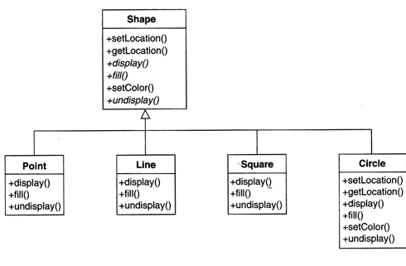
Encapsulation

Slide 4
Specialization - Generalization
In an inheritance relationship the superclass is Generalization
Deriving subclasses with a specialized characteristic is Specialization

Slide 5
Abstraction
Abstraction is the process where you "throw-away" unnecessary details from an entity you plan to capture/represent in your design and keep only the properties of the entity that are relevant to your domain.

Slide 6
Polymorphism
Polymorphism means “many forms”. Polymorphic operations have many implementations.
Polymorphism means objects of different classes have operations with the same signature but different implementations.

Slide 7
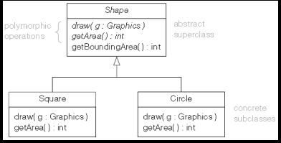
Polymorphism

