Slide 1
Internet Concepts

Slide 2
Introduction
Over the past century and a half, important technological developments have created a global environment that is drawing the people of the world closer and closer together.
Currently, we are in the information Age, where magnifying the computation power is an essential Goal.

Slide 3
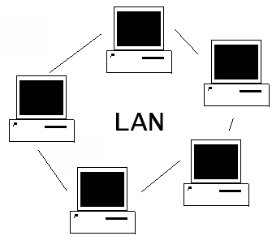
Computer Network
LAN

Slide 4
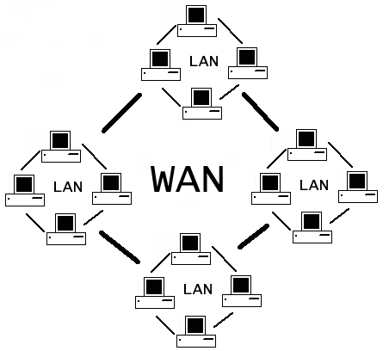
Computer Network
WAN

Slide 5
Computer Network
Allow us to generate exchange, share and manipulate information in an uncountable number of ways.

Slide 6
What is the Internet?
Internet is a specific interconnected network that connects computers all over the world using a common set of interconnection standards or protocols.

Slide 7
Connecting to a Network Vs Communicating over a network
When Connect to the Internet requires special hardware such as:
Modem – short for modulator / demodulator - which connects computers using a standard telephone line
Network interface card (NIC) – which connects computers using a special type of network cabling.

Slide 8
Connecting to a Network Vs Communicating over a network
In order to communicate with another computer over a network, you must do two things:
1- Use the set of rules governing communication over the network, called a protocol. Your computer will generally handle this.
2- Know the address of the computer you want to communicate with. There are two types of network addresses:
  Medium access control (MAC) address which is used inside a single network
  Internet protocol (IP) address which is used on the Internet

Slide 9
World Wide Web
The World Wide Web (web for short or www) is a collection of interlinked multimedia documents that are stored on the Internet and accessed using a common protocol (HTTP).
So, what is the relation between the internet and the World Wide Web?
  World Wide Web (WWW) is an Internet based software application.
Other Internet applications are:
  Email
  ftp (file transfer protocol)
  Messenger

Slide 10
web server
is a computer programs that delivers (serves) content web pages, using the Hypertext Transfer Protocol HTTP.
The term web server can also refer to a computer connected to the Internet that contains files their owners have made available publicly through their Internet connections.

Slide 11
Web Client
When you use your Internet connection to become part of the Web, your computer becomes a Web client in a worldwide network called a client/server network.
Web browsers are software that you run on your computer to make it work as a Web client

Slide 12
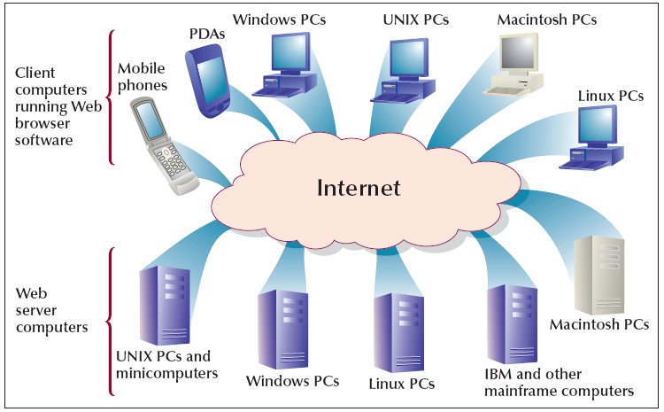
web server

Slide 13
Web servers
Apache HTTP Server which occupies (69.01%) of the general use. It is developed in 1994 by Rob McCool.
It is Available for free charge.
It Runs on operating systems including FreeBSD-UNIX, HP-UX, Linux, Microsoft Windows, SCO-UNIX and Solaris

Slide 14
Web servers
Microsoft Internet Information Server (IIS) which occupies (23.26%) of the general use.
It comes bundled with Microsoft Windows Server operating system.
It runs on Windows Server and Windows 10

Slide 15
Web servers
Sun Java System Web Server (JSWS) (former names are Sun One, iPlanet Enterprise Server and Netscape Enterprise Server) (0.86%)

Slide 16
HTML
HTML is a standard language used on the Web to format documents.
HTML uses codes (tags) to tell the Web browser software how to display text.
HTML document is defined as a text file that contains HTML tags.
When a Web browser displays an HTML document, it is referred to as a Web page.

Slide 17
HTML
One of the most important features of html is HTML anchor tag
create Hypertext links.
Hypertext links can connect HTML documents together or can connect one part of HTML document to another part.
When hyperlinks connect to Multimedia files , it is called Hypermedia links.

Slide 18
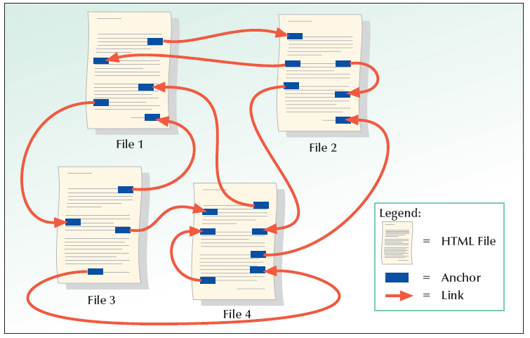
HTML

Slide 19
HTML
Having a collection of linked Web pages with a common theme or focus is called a website.
Each website should have a main or home page to start the web site from.

Slide 20
Domain Name Addressing
Each computer on the Web is given a unique identification number called Internet Protocol Address or (IP).
Remembering IP addresses are hard to remember
IP address may also be assigned a host or domain name.

Slide 21
Domain Name Addressing
Domain name are unique name associated with specific IP address by a program that runs on an Internet host computer.
This program is called DNS (Domain Name System ) software.
Domain Name Software or (DNS) is an Internet service that translates domain names into IP addresses.

Slide 22
Domain Name Addressing
Every time you use a domain name, a DNS service must translate the name into the corresponding IP address.
For example, the domain name www.example.com might translate to 198.105.232.4.
The host computer that runs the DNS service or software is called Domain name server or DNS server.

Slide 23
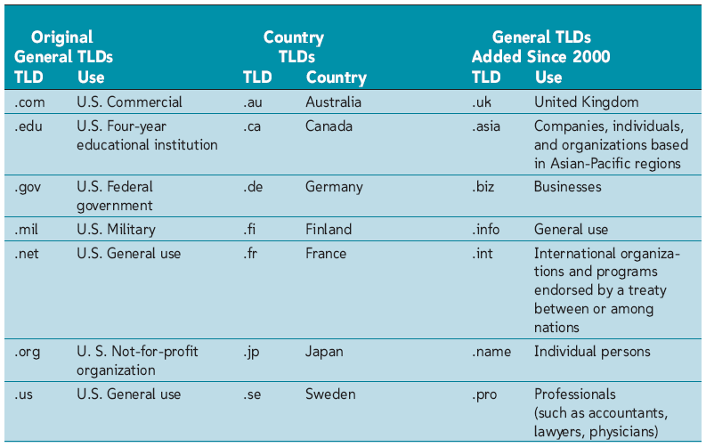
Domain Name Addressing
The last part of domain name is called its top-level domain (TLD).

Slide 24
Addressing Schema
How to tell the browser the needed information to allocate the wanted web site to be displayed.
The Addressing schema = uniform resource allocator (URL)
URLs, or Uniform Resource Locators, are the schema by which documents or data are addressed in the World Wide Web.

Slide 25
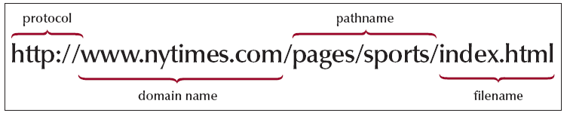
Addressing Schema
URL contains the following information:
  Transfer protocol to use when transporting the file
  Domain name of computer on which file resides
  Pathname of folder or directory on computer on which file resides
  Name of the file

Slide 26
Internet Service Providers (ISPs)
ISP is a company that offers its customer access to the Internet.
The ISP connects to its customers using a data transmission technology appropriate for delivering Internet Protocol datagrams
  dial-up
  DSL
  cable modem
  wireless
  dedicated high-speed interconnects.

Slide 27
Internet Service Providers (ISPs)
ISPs charge persons for a fee and provide the following services:
  Adding your computer to the ISP’s network, allowing you to communicate with other computers on the Internet
  Giving your computer an IP address, allowing other computers on the Internet to communicate with you
  Providing you access to a DNS server.

Slide 28
The Structure of the Internet
To understand how to get an IP address from a URL, we need to understand the basic structure of the Internet.
root
com
org
net
edu
bellsouth
yahoo
w3c
hypercon
kctcs
uky
www
www
mail
www

Slide 29
Who Structuring the Internet?
Networks from corporations, commercial firms, and other companies
Telephone companies
Cable companies
Satellite companies
Government

Slide 30
who is controlling the internet?
generally speaking there is no single entity controls or owns the Internet.
The Internet is a public, cooperative, and independent network.

Slide 31
who is controlling the internet?
Internet Corporation for Assigned Names and Numbers (ICANN). Its task is to manage the logistics of Internet Protocol (IP) addresses and domain names.
World Wide Web Consortium (W3C): Its task is to develop and tests advanced Internet technologies.

Slide 32
steps followed to retrieve a certain page through the internet
http://www.abc.ben.edu/staff/josh/index.html
http stands for hypertext transfer protocol, the protocol for retrieving web pages
www is the name of the server (with a specific IP address)
abc is a subdomain of benha
ben is the subdomain of edu
edu is the top level domain
/staff/josh/ is the name of the folder (or directory) on the server where the page is stored. This part of the URL is called the path.
index.html is the name of the file we want to see

Slide 33
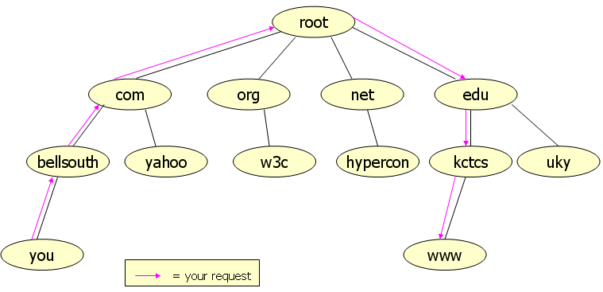
Example
ISP is BellSouth (www.bellsouth.com
If you try to reach www.kctcs.edu

Slide 34
The Client-Server Relationship
Now you located the computer you wish to communicate (remote host or server)
Your machine is a local host or client
Client request web pages from the server
Web pages are written in HTML (text + multimedia)
Received web pages are read by web browsers (IE, FireFox…)

Slide 35
HTML Example
  <HTML>
  <BODY>
  <CENTER>
  <B> Hello, World! </B>
  </CENTER>
  <BR>
  <FONT COLOR=“RED”>
  This text is red.
  </FONT>
  <BR>
  <A HREF=“www.kctcs.edu”> Go to kctcs.edu. </A>
  </BODY>
  </HTML>

Slide 36
HTML Example
  Hello, World!
  This text is red.
  Go to kctcs.edu.

Slide 37
More on Browsers
The World Wide Web Consortium (W3C) has tried to establish standards for HTML that all browsers should support.
A good web page designer will test his or her page in several browsers before publishing it.

Slide 38
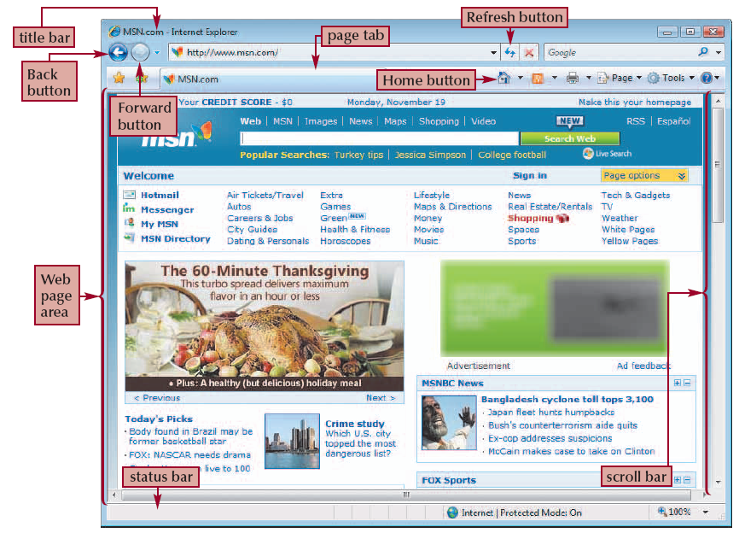
Main Elements of Web Browsers

Slide 39
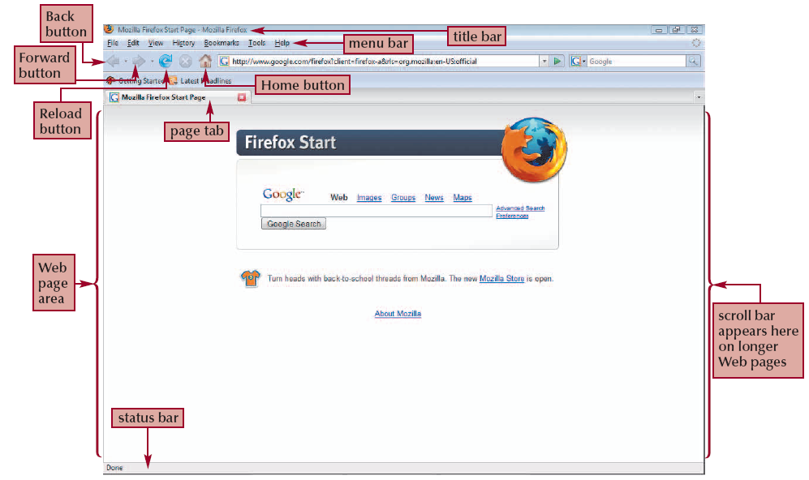
Main Elements of Web Browsers
History

Slide 40
Hyperlinks:
  The true power of HTML lies in the use of hyperlinks.
  Most browsers render hyperlinked text in blue and underline it.
  Hyperlinked graphics have a blue border.
  The browser’s status bar shows the URL of the resource linked to by the hyperlink.
  The browser changes the cursor, usually to a hand.

Slide 41
Browser cache
In the interest of speed, most browsers will cache web pages the first time they are visited.
On subsequent visits, it displays the cached copy instead of requesting the page from the server.
If you do not believe you are seeing the most up-to-date information, click your browser’s Refresh or Reload button to force the browser to request the page from the server.

Slide 42
Browser Cookies
Some web sites appear to “remember” your preferences on subsequent visits.
This is accomplished in one of two ways:
  A server-side database stores your preferences. When you visit the site, you enter a username and password, and your preferences are loaded from the database.
  On your first visit, the site silently places a small text file (called a cookie) on your hard drive. This file contains your preferences and is automatically loaded by the site when you visit it again.

Slide 43
Search Engines
Allows the user to type in a word or phrase to search for, then returns results that it determines most closely match the user’s request.
The user’s request is called a query. Each individual result is called a hit.
Some popular search engines are Google, Bing etc

Slide 44
Search Engines
Search engines are constantly updating their “knowledge” of information on the Internet using spiders.
Spiders are programs that crawl the Internet (i.e. follow all possible links and reporting the information found there back to the search engine.).
Some search engines do not use spiders. Instead, they query many other search engines and combine the list of hits. These engines are called meta-search engines.

Slide 45
Email
To send and receive email, you need an email account.
An email address of the form username@domainname.tld.
Mail storage where your incoming messages are stored. (ISP “10M”- and web mails “2G”)

Slide 46
File Transfer
Files can be transferred from one computer to another over the Internet using the file transfer protocol (FTP).
The process of transferring a file from a remote host to your local machine is called downloading.
The process of transferring a file from your local machine is called uploading.
Most browsers natively support downloading, but uploading often requires a special utility called an FTP client.

Slide 47
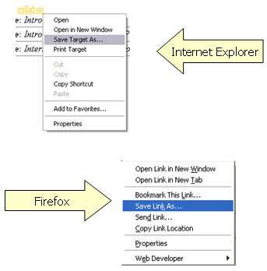
File Transfer
To download with an Internet browser,

Slide 48
Client-Server Architecture
is a way to structure a distributed application so that it consists client (multiple) and server (single).
key characteristic → central point for communication.
Server app → more complex
Client app is simpler. (web browser)

Slide 49
Client-Server Architecture
The server runs on a port (standard=80) and network IP address (need to be known) that is known to the client module.
The server need not be configured with any information about the clients. (many->one)
The clients only need to know the IP address of the computer on which the server is running

Slide 50
Client server → simplicity and ease of maintenance
It has one drawback — It does not utilize the computing power of the client computers.

Slide 51
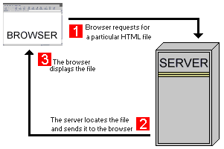
client-server inter-communication models
Model #1 of the Static HTML pages

Slide 52
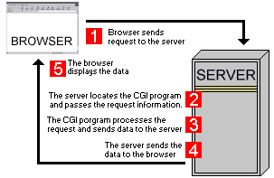
client-server inter-communication models
Model #2 CGI Scripts: The Common Gateway Interface (CGI) is a standard method for web server software to delegate the generation of web content
Thus the CGI program generates a dynamic HTML page.

Slide 53
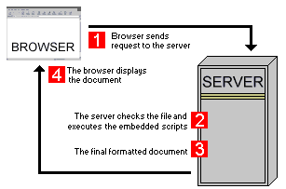
client-server inter-communication models
Server side scripting technologies
dynamic response generated by the use of server side technologies.

Slide 54
Server side scripting technologies
There are many server side technologies today:
Active Server Pages.Net (ASP).Net: A Microsoft technology.
ASP pages typically have the extension .aspx.
Personal Home Pages (PHP): An open source technology.
PHP pages typically have .php, .phtml or .php3 file name extensions.
Java Server Pages: .jsp pages contain Java code.
With these server technologies it has become easier to maintain Web pages especially helpful for a large web site.
The developer needs to embed the server-side language code inside the HTML page.
This code is passed to the appropriate interpreter which processes these instructions and generates the final HTML displayed by the browser

Slide 55
Peer-to-Peer Architecture
More complex
Each computer need to know the network addresses others.
propagating changes to the different software modules is harder.
result in much more scalable applications.

Slide 56
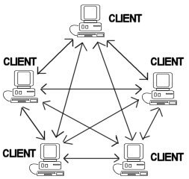
Peer-to-Peer Architecture

Slide 57
Instant Messaging
Instant Messaging (IM) where software applications, such as MSN Messenger or AOL Instant Messenger
While most vendors offer a free version of their IM software others have begun to focus on enterprise versions of IM software as business and corporations have moved towards implementing IM as a standard communications tool for business.

Slide 58
Affinity Communities
تقارب المجتمعات
based around file-sharing
Napster. Affinity Communities are based on users collaborating and searching other user's computers for information and files.

Slide 59

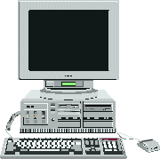
Static vs. Dynamic pages
In Static pages, the contents (text/ links/ images) are the same each time it is delivered by the web server.
1
3
Web server locates .htm file
Author writes
HTML
4
WebServer
HTML stream returned to browser
2
5
Client requests page
Browser processes page
Client

Slide 60
Static vs. Dynamic pages
Server-side Dynamic Page Delivery
1
3
Web server locates instructions file
Author writes
instructions
4
Web server processes instructions to create HTML
5
HTML stream returned to browser
Web Server
6
2
Client requests page
Browser processes page
Client-side Dynamic Page Delivery
Client

