Slide 1
CSS – Part2

Slide 2
CSS Box Model
The CSS box model is essentially a box that wraps around every HTML element. It consists of: margins, borders, padding, and the actual content

Slide 3
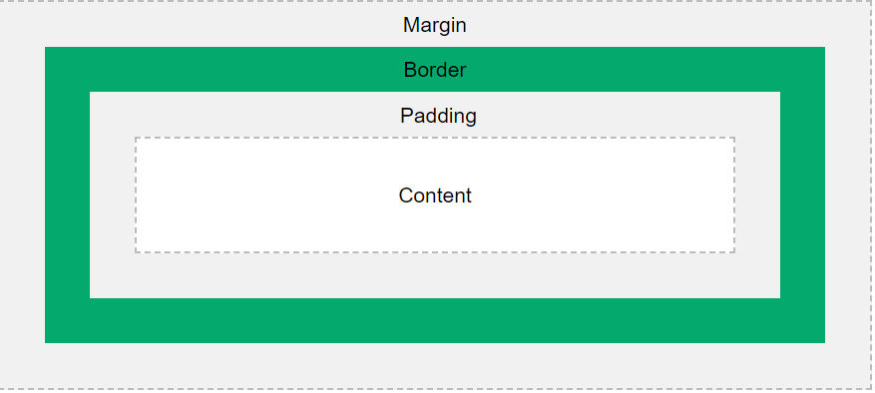
Box Model

Slide 4
Box Model
Content - The content of the box, where text and images appear
Padding - Clears an area around the content. The padding is transparent
Border - A border that goes around the padding and content
Margin - Clears an area outside the border. The margin is transparent

Slide 5
Background
https://www.w3schools.com/cssref/css3_pr_background.asp

Slide 6
Text Effects
CSS Text Overflow, Word Wrap, Line Breaking Rules, and Writing Modes
text-overflow
word-wrap
word-break
writing-mode

Slide 7
CSS 2D Transforms
CSS transforms allow you to move, rotate, scale, and skew elements.
https://www.w3schools.com/css/css3_2dtransforms.asp

Slide 8
CSS 3D Transforms
CSS also supports 3D transformations.
https://www.w3schools.com/css/css3_3dtransforms.asp

Slide 9
CSS Multiple Columns
The CSS multi-column layout allows easy definition of multiple columns of text - just like in newspapers
https://www.w3schools.com/css/css3_multiple_columns.asp

Slide 10
CSS User Interface
https://www.w3schools.com/css/css3_user_interface.asp
resize
outline-offset

Slide 11
CSS Selector
https://www.w3schools.com/cssref/css_selectors.asp
https://www.w3schools.com/cssref/trysel.asp

Slide 12
CSS Border Image
https://www.w3schools.com/css/css3_border_images.asp

Slide 13
CSS Box Shadow
The CSS box-shadow property applies shadow to elements.

Slide 14
CSS Background-size
https://www.w3schools.com/cssref/css3_pr_background-size.asp

Slide 15
CSS Background-origin
https://www.w3schools.com/cssref/css3_pr_background-origin.asp

Slide 16
Bootstrap
Bootstrap is the most popular HTML, CSS, and JavaScript framework for developing responsive, mobile-first websites.
Bootstrap is completely free to download and use!

Slide 17
Container
Containers are the most basic layout element in Bootstrap and are required when using our default grid system. Containers are used to contain, pad, and (sometimes) center the content within them.

Slide 18
Container
https://getbootstrap.com/docs/5.0/layout/containers/

Slide 19
Buttons
https://getbootstrap.com/docs/5.0/components/buttons/

Slide 20
Bootstrap Typography
https://getbootstrap.com/docs/5.0/content/typography/

Slide 21
Bootstrap Utilities
https://getbootstrap.com/docs/5.0/utilities/colors/
https://getbootstrap.com/docs/5.0/utilities/background/

Slide 22
Bootstrap Badges
https://getbootstrap.com/docs/5.0/components/badge/

Slide 23
Button Group
https://getbootstrap.com/docs/5.0/components/button-group/

Slide 24
Grid
Use our powerful mobile-first flexbox grid to build layouts of all shapes and sizes thanks to a twelve column system, six default responsive tiers, Sass variables and mixins, and dozens of predefined classes.
https://getbootstrap.com/docs/5.0/layout/grid/

Slide 25
Grid
Bootstrap’s grid system uses a series of containers, rows, and columns to layout and align content. It’s built with flexbox and is fully responsive. Below is an example and an in-depth explanation for how the grid system comes together.

Slide 26
Forms
https://getbootstrap.com/docs/5.0/forms/overview/

