Slide 1
Javascript

Slide 2
JavaScript
JavaScript is the world's most popular programming language.
https://developer.mozilla.org/en-US/docs/Web/JavaScript/Reference
JavaScript is the programming language of the Web.
REPL – Read , Evaluate, Print, Loop

Slide 3
JavaScript Primitive Types
Number
String
Boolean
Null
Undefined
PEMDAS
Parentheses
Exponents
Multiplication/Division
Addition/Subtraction

Slide 4
Numbers
JS has one number type
Positive numbers
Negative Numbers
Whole Numbers
Decimal Numbers

Slide 5
Math Operations
Addition
Subtraction
Multiplication
Division
Remainder

Slide 6
NaN – Not a number
0/0
1 + NaN

Slide 7
typeof
typeof 4
typeof 4.23456
0/0
typeof NaN

Slide 8
Numbers Quiz
4 + 3 * 4 / 2
(13 % 5) ** 2
200 + 0/0

Slide 9
Variables
Variables are like Labels for Values
We can store a value and give it a name so that we can
Refer back to it later
Use that value to do stuff
Or change it

Slide 10
Variables
let someName = value;
let year = 1975;

Slide 11
Demo of let
Please see the demo in console
numVirtualCourses = 2
numLiveCourses = 4
totalCourses = numVirtualCourses + numLiveCourses;
totalCourses is a just in time snapShot

Slide 12
Variables
const and var
Before let and const var was the only way of making variables

Slide 13
Variables can change types
let num = 23;
num = false;
num = 100;

Slide 14
Variable naming conventions
Cannot start with a digit
Variables are camel cased

Slide 15
Strings
Strings are another primitive type in JavaScript
They represent text and must be wrapped in quotes

Slide 16
Strings –Indices and Length
let a= “Hello”
a[2]
a.length

Slide 17
Strings - Methods
toUpperCase()
toLowerCase()
trim()

Slide 18
Strings – Method chaining
let whisper="taste the rainbow!";
whisper.trim().
tolowercase();

Slide 19
String methods
indexOf
Slice
Template literals
`I counted ${3 +4} sheep`

Slide 20
Math
Math is a built-in object that has properties and methods for mathematical constants and functions. It’s not a function object.
https://developer.mozilla.org/en-US/docs/Web/JavaScript/Reference/Global_Objects/Math

Slide 21
How to generate random numbers
Math.floor(Math.random() * 10)

Slide 22
Equality
>=
<=
==
===
== Vs ===

Slide 23
Console, Alert and Prompt
console.log()
alert(“Hello World”)
prompt(“Please enter a number”)

Slide 24
Truthy and Falsy values
All JS values have inherent truthyness or falsyness about them.
Falsy values
false
0
“” (empty string)
null
undefined
NaN
Everything else is truthy

Slide 25
Logical Operators
&& - AND
|| - OR
!- NOT

Slide 26
JavaScript Switch statements
The switch statement is used to perform different actions based on different conditions.
switch(expression) { case x: // code block break; case y: // code block break; default: // code block }

Slide 27
JavaScript switch statements
The switch expression is evaluated once.
The value of the expression is compared with the values of each case.
If there is a match, the associated block of code is executed.
If there is no match, the default code block is executed.

Slide 28
JavaScript Arrays
JavaScript arrays are used to store multiple values in a single variable.
var cars = ["Saab", "Volvo", "BMW"];
var fruits = [“Apple”, “Mango”, “Orange”]
var luckyNums = [41,23,32]

Slide 29
JavaScript Array
var cars = [ "Saab", "Volvo", "BMW" ];
Spaces and line breaks are not important

Slide 30
JavaScript keyword new
var cars = new Array("Saab", "Volvo", "BMW");

Slide 31
Array methods
toString()
join()
pop() and push()
shift()
unshift()
delete()
splice()

Slide 32
Array methods
concat()

Slide 33
Reference Types and Equality
1 == 1
[1] === [1]
var luckyNums = [41, 32, 23]
Var luckyNumsCopy = luckyNums

Slide 34
Arrays + Const
const nums = [1,2,3]
What operations are possible with this array?

Slide 35
Multidimensional array
Array inside an array

Slide 36
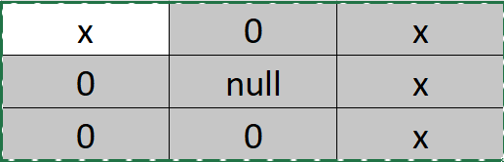
Gameboard exercise

Slide 37
Airplane exercise
const airplaneSeats = [ ['Ruth', 'Anthony', 'Stevie'],
['Amelia', 'Pedro', 'Maya'],
['Xavier', 'Ananya', 'Luis'],
['Luke', null, 'Deniz'],
['Rin', 'Sakura', 'Francisco']];
Please access the null element.

Slide 38
Objects
Objects are collection of properties
Properties are key-value pair
Rather than accessing data using an index, we use custom keys.

Slide 39
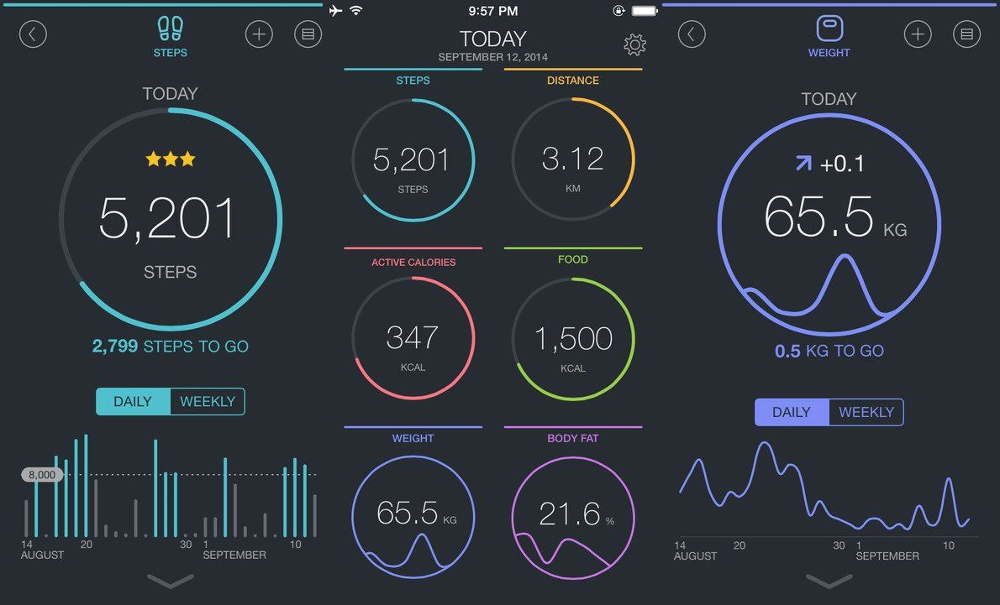
Example

Slide 40
Object
const fitnessData = {
noOfSteps : 5201,
distance : 3.12,
food: 1500,
Weight: 65.5
}

Slide 41
Create your own Objects
Create an object Teacher
Create an object Student
Create an object Course

Slide 42
Exercise
const restaurant = {
name: 'Ichiran Ramen',
address: `${Math.floor(Math.random() * 100) + 1} Johnson Ave`,
city: 'Brooklyn',
state: 'NY',
zipcode: '11206',};
Print the address, city and state

Slide 43
Exercise
Can you have object inside objects?
Can you have an array of Objects?

Slide 44
Loops
Loops can execute a block of code a number of times.
for - loops through a block of code a number of times
for/in - loops through the properties of an object
for/of - loops through the values of an iteratable object
while - loops through a block of code while a specified condition is true
do/while - also loops through a block of code while a specified condition is true

Slide 45
Exercises
Display contents of the teacher object
Display the array of objects

