Slide 1
Lakebridge
Free, Open Data Migration to Databricks SQL
Jun 2025
Confidential
03-10-2024
Somanath Sankaran

Slide 2
AGENDA
Lakebridge Overview
Evolution of Lakebridge
Lakebridge Supported Source platform/ SQL dialects
Lakebridge components/features
Lakebridge Setup & Installation
Snowflake to Databricks
Datastage to Databricks

Slide 3
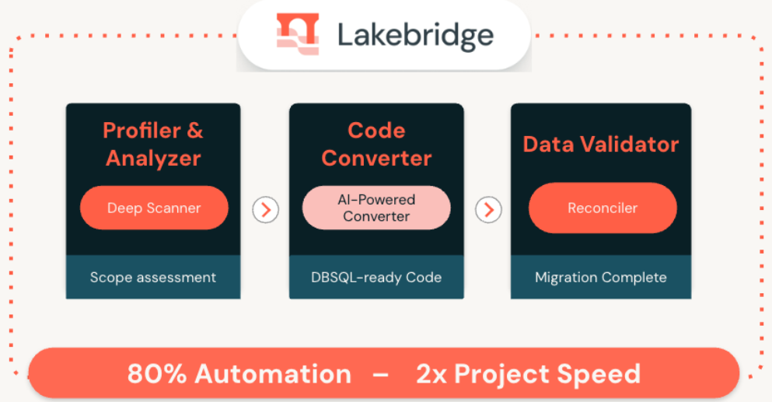
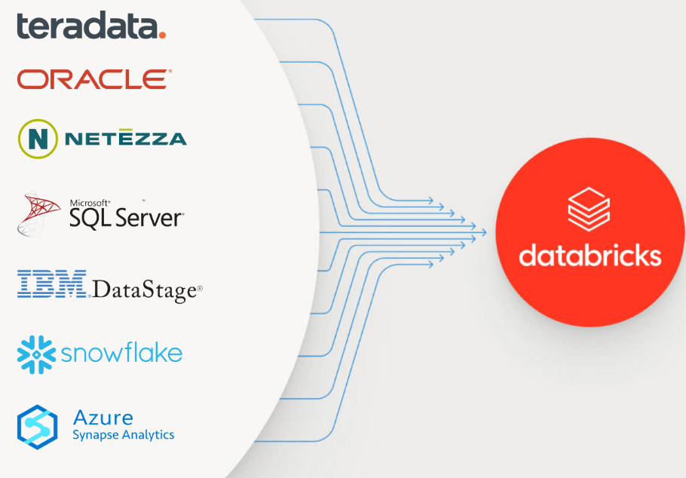
Lakebridge Overview
Accelerates EDW migrations to Databricks SQL – it’s free tool
It provides end-end support for migration – profiling, assessment, conversion, validation and reconciliation.
Automates up to 80% of migration tasks, expected to accelerate implementation speed by up to 2X.
Converts multiple SQL dialects like BTEQ(Teradata), T-SQL(Microsoft), PL/SQL Oracle into ANSI compliant Databricks SQL. Supports Snowflake, Synapse Analytics as well to Databricks SQL
Also supports ETL based tool conversions like Datastage, Informatica with help of bladebridge transpilers.
Evolved & enhanced from the Remorph / Bladebridge transpiler/analyzer with more Lakebridge built-in features. Fully extensible/customized as per project requirements.
Currently Lakebridge foundation package available for use, soon in next phase it will incorporate GenAI - Mosaic AI powered reinforcement learning to improve translation accuracy and GUI for intuitive navigation, tracking & insights
*Source: Databricks blog

Slide 4

Evolution of Lakebridge
Analyzer
Scans and interprets metadata from SQL and ETL assets. Evolved from Remorph with influence from Bladebridge insights.
Profiler
Estimates migration complexity and effort across assets. A newly added module, still in early stages of development.
Converter (transpilers)
Combines Remorph’s SQL migration engine with BladeBridge’s enterprise transpilers. Supports pluggable transpilers like Morpheus for extensibility.
Validator (reconcile)
Performs data reconciliation between legacy and Databricks outputs. Evolved from Remorph’s reconcile module with improved automation.
Pluggable Framework
Lakebridge is designed to integrate third-party plugins across modules. Supports flexible, scalable, and enterprise-grade migrations.
Lakebridge Core
Bladebridge Core
Analyzer
Profiler
Lakebridge-transpilers
Remorph
Base framework
Bladebridge
transpilers
Morpheus
transpilers
3rd Party Pluggable transpilers
Reconcile
https://github.com/databrickslabs/lakebridge/releases
Source code: https://github.com/databrickslabs/lakebridge/
databricks-labs-remorph (Sunset) → databricks-labs-lakebridge
databricks-bb-analyzer # Lakebridge’s bladebridge analyzer plugin
databricks-bb-plugin # Lakebridge’s bladebridge transpiler plugin
Lakebridge documentation

Slide 5
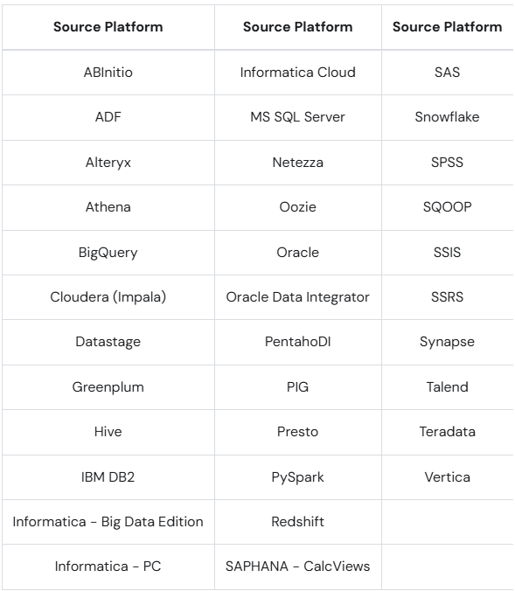
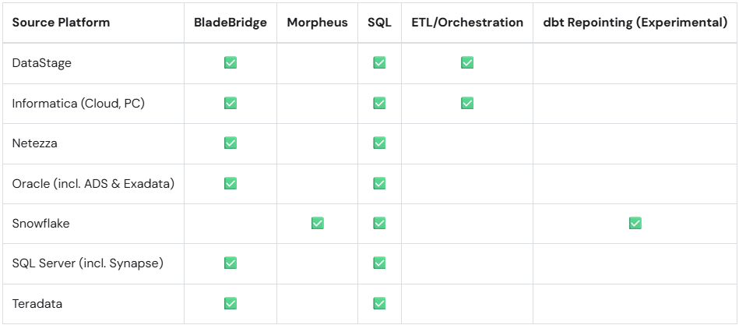
Lakebridge Supported Source platform / SQL Dialects (Current State)
Analyzer
Transpile

Slide 6
Profiler
Upcoming release**
Lakebridge Components / Features
Analyzer
Transpile
Reconcile
ETL & SQL Metadata Scanning
Analyzer scans metadata from ETL pipelines and SQL assets to understand the structure and design of legacy systems.
Job Complexity Assessment
It calculates the complexity of jobs, feeding into the Conversion Calculator to estimate migration cost and effort.
Comprehensive Job Inventory
Generates a full inventory of mappings, transformations, functions, and other components in your environment.
Cross-System Interdependency Mapping
Identifies dependencies between jobs and systems to guide migration sequencing and minimize risk.
Migration Planning Support
Enables better cutover planning by providing a complete view of asset relationships and technical depth.
Plugin Architecture
LakeBridge supports pluggable transpilers; it comes bundled with Morpheus and BladeBridge, each offering distinct capabilities and guarantees, 3rd party transpilers are pluggable & extensible
Morpheus: Conservative & Safe
Focuses on high-fidelity SQL translation with strong equivalence guarantees. Emits warnings/errors when it cannot ensure output correctness on Databricks.
Morpheus Internals
Built using a custom ANTLR-based parser and IR tree transformations. It handles dialect-to-Databricks conversion carefully, continuing even in the presence of non-fatal issues.
BladeBridge: Flexible & Extensible
Designed for large-scale modernization, BladeBridge supports legacy ETL tools (Informatica, Teradata, Oracle) and outputs Databricks-ready notebooks, PySpark, and workflows.
BladeBridge Configurability
Driven by config files, BladeBridge allows mapping customizations, naming conventions, and format control—scaling across thousands of workloads with repeatable precision.
Purpose & Scope
Automates comparison between source vs. target results, validating row counts, aggregated metrics, and value-level differences to ensure migrated logic matches original outputs
Flexible Configuration
Users can configure reconciliation rules via YAML/JSON files specifying tables, views, columns, comparison metrics, and tolerance levels to tailor validation to their migration scenarios .
CLI-Driven Workflow
The lakebridge reconcile CLI command executes the configured comparisons, generating clear success/failure statuses and exporting detailed results for analysis .
Designed for Scale
Suitable for both simple checks (e.g., row count) and complex validations (e.g., individual row diffing), making it effective for large-scale migration efforts.
Streamlines Migration Trust
By automating data validation and discrepancy detection, Reconcile builds confidence in migrated assets, reducing manual QA effort and accelerating cutover.

Slide 7
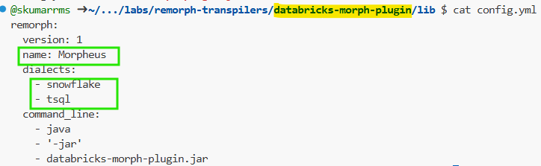
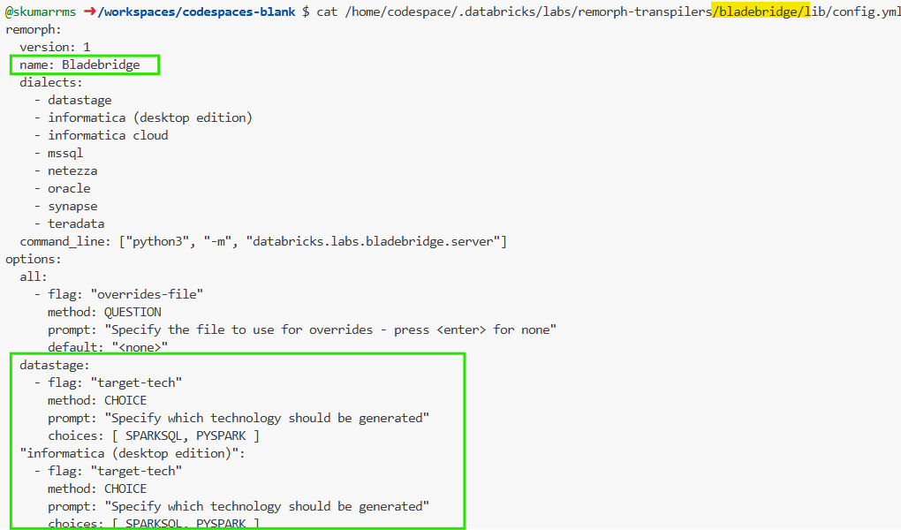
Lakebridge Transpiler Configurations

Slide 8
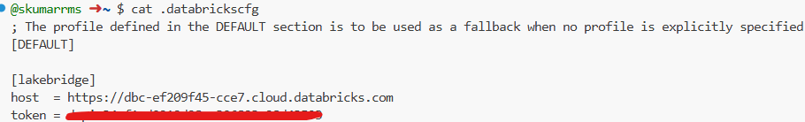
Lakebridge Setup & Installation
Ensure latest Databricks CLI installed on your machine Databricks CLI .It require Databricks Workspace profile with Cluster
Supported in Windows, Linux and MacOS
Machine should at least have Python 3.10. No other version supported
Verify that Java 11 or above is required to install & use the Morpheus transpiler
Link the Databricks workspace profile as usual like below,
Install Lakebridge
databricks labs install lakebridge # install lakebridge base package with analysers & other components as whole
databricks labs lakebridge install-transpile # install bladebridge & morpheus transpilers for efficient conversion
databricks labs lakebridge configure-reconcile # install reconcile utility for source to target validation
Verify installation
databricks labs lakebridge –help
databricks labs lakebridge transpile –help
databricks labs lakebridge reconcile –help

Slide 9
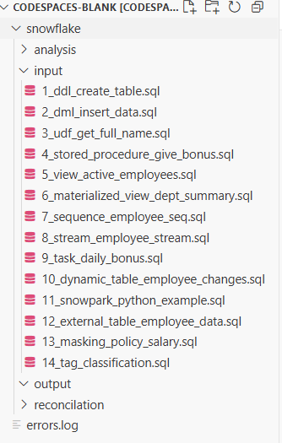
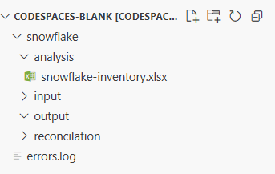
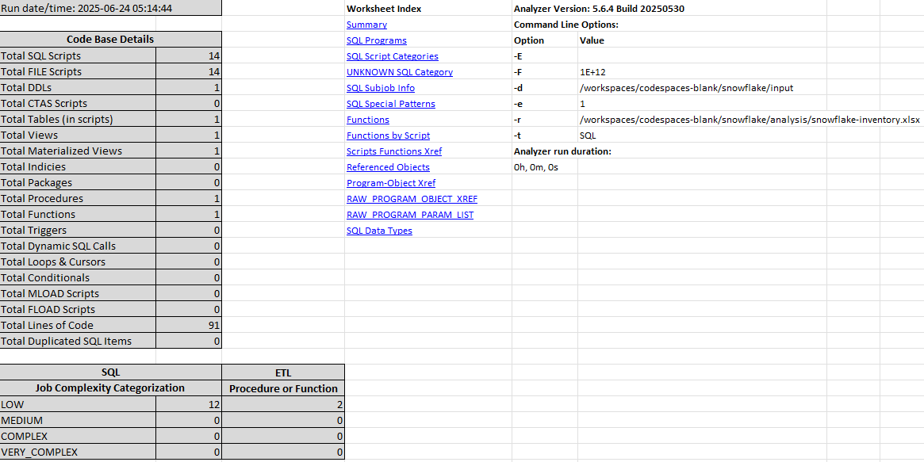
Lakebridge – Snowflake to Databricks
Analyzer
Run this in CLI before starting, since lakebridge is continuously evolving - > databricks labs upgrade lakebridge
Create the necessary folder structure for snowflake assets for analysis, here input folder will hold all snowflake assets & analysis folder
will produce the snowflake-inventory.xlsx by running the lakebridge analyze command
>$
databricks labs lakebridge analyze
--source-directory
/workspaces/codespaces-blank/snowflake/input
--report-file
/workspaces/codespaces-blank/snowflake/analysis/snowflake-inventory.xlsx
Follow the instruction on the screen once you execute above command:
Choose number 25 for Snowflake

Slide 10
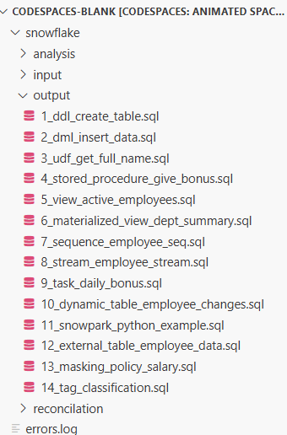
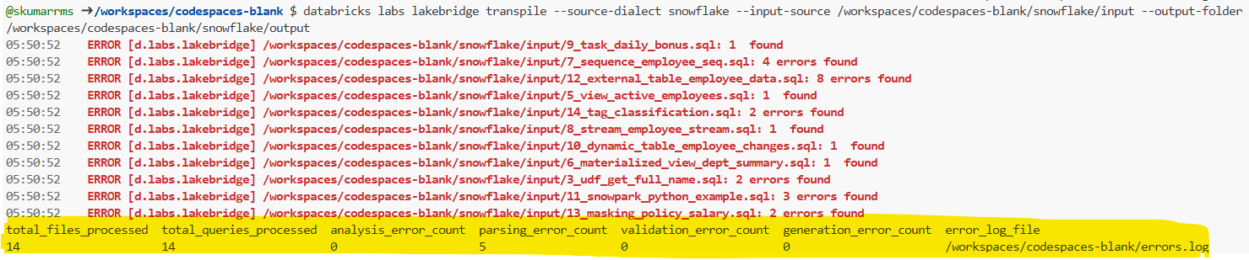
Lakebridge – Snowflake to Databricks
Transpile (Converter)
Run this in CLI before starting, since lakebridge is continuously evolving - > databricks labs upgrade lakebridge
Create the necessary folder structure for snowflake assets for analysis, here input folder will hold all snowflake assets & output folder
will produce the converted Databricks SQL assets by running the lakebridge transpile command
>$
databricks labs lakebridge transpile
--source-dialect snowflake
--input-source
/workspaces/codespaces-blank/snowflake/input
--output-folder
/workspaces/codespaces-blank/snowflake/output

Slide 11
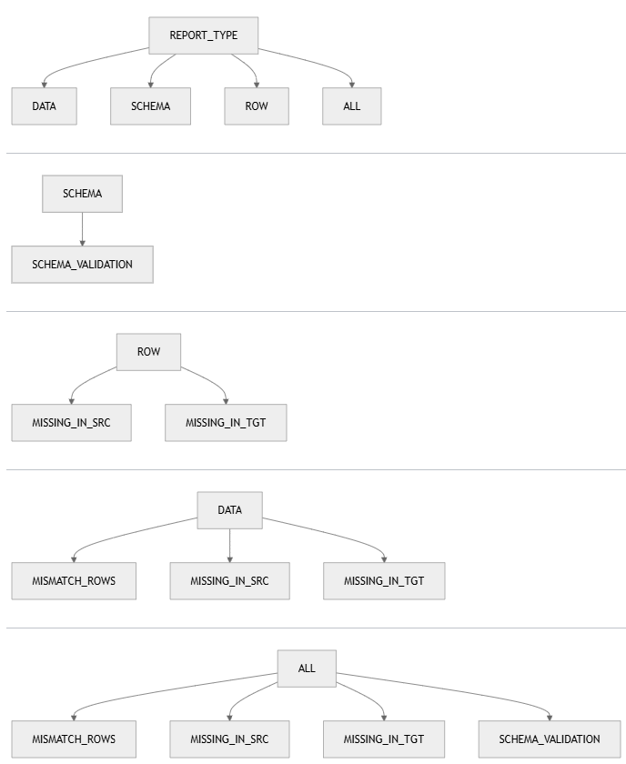
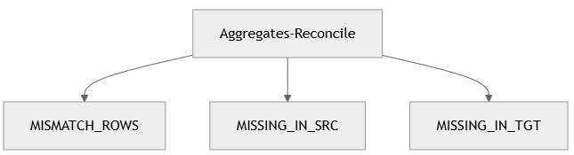
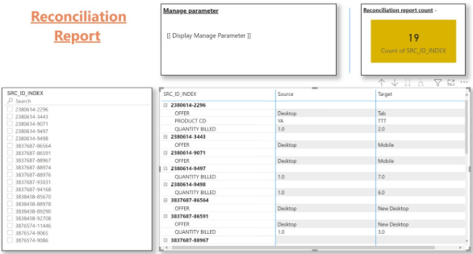
Lakebridge – Snowflake to Databricks
Reconcile
Not tested fully**
Reconcile Dataflow example
Run this in CLI before starting, since lakebridge is continuously evolving - > databricks labs upgrade lakebridge
Run this in CLI to configure& follow steps > databricks labs lakebridge configure-reconcile # Note it needs cluster with 2X-small or less
Create the recon config JSON file & run using CLI
> databricks labs lakebridge reconcile
or
Databricks notebook using databricks.labs.lakebridge.reconcile
During installation of Lakebridge, it deploys an AI/BI Dashboard on your workspace
After every reconciliation run, you get a recon_id. You can use this recon_id to drill down into the details of that particular reconciliation run on the dashboard.
Place the below JSON config file of all source/target needed info in ~/.lakebridge folder, for e.g.:-
recon_config_${DATA_SOURCE}_${SOURCE_CATALOG_OR_SCHEMA}_${REPORT_TYPE}.json

Slide 12
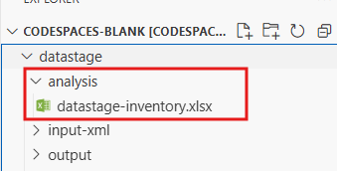
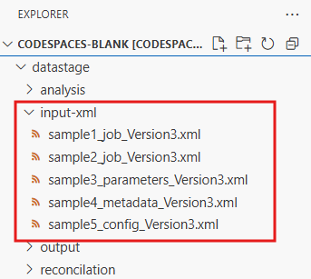
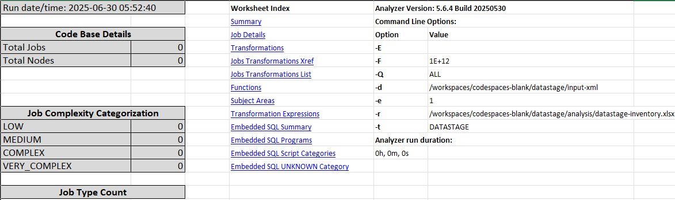
Lakebridge – ETL DataStage to Databricks
Analyzer
Run this in CLI before starting, since lakebridge is continuously evolving - > databricks labs upgrade lakebridge
Create the necessary folder structure for DataStage assets for analysis, here input folder will hold all ETL DataStage assets & analysis folder
will produce the datastage-inventory.xlsx by running the lakebridge analyze command
>$
databricks labs lakebridge analyze
--source-directory
/workspaces/codespaces-blank/datastage/input-xml --report-file
/workspaces/codespaces-blank/datastage/analysis/datastage-inventory.xlsx
Follow the instruction on the screen once you execute above command:
Choose number 7 for DataStage

Slide 13
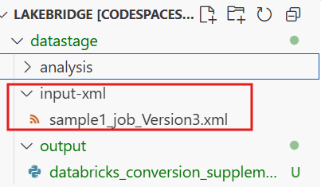
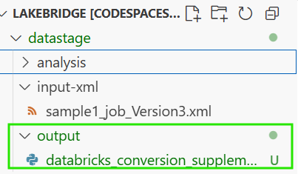
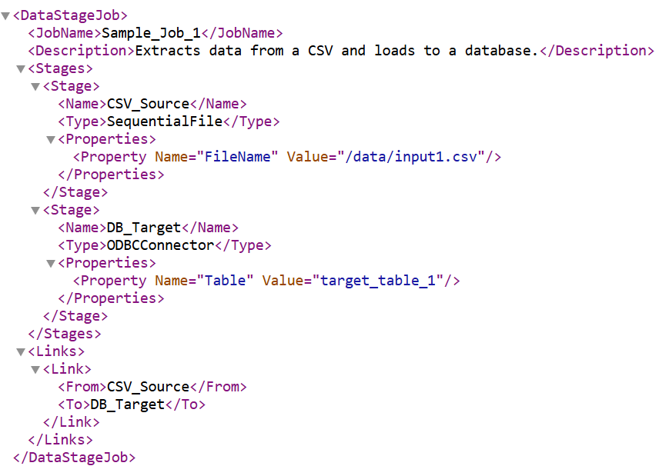
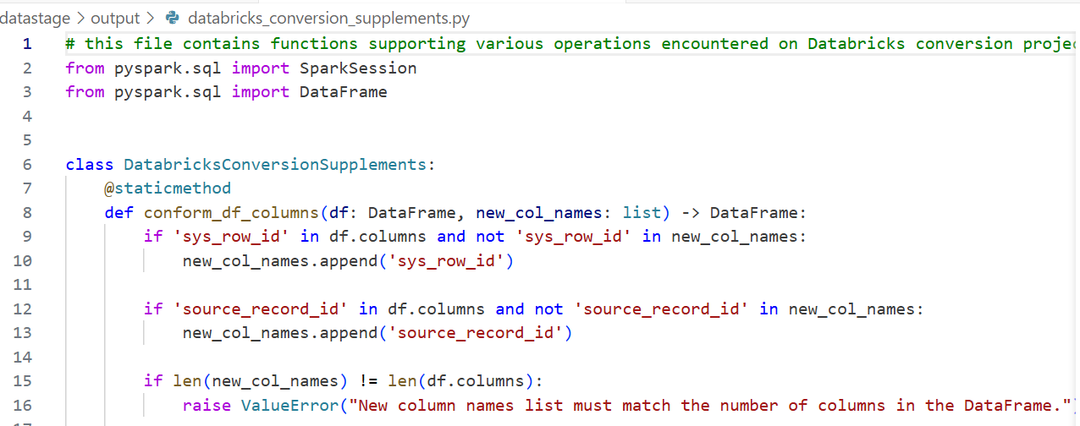
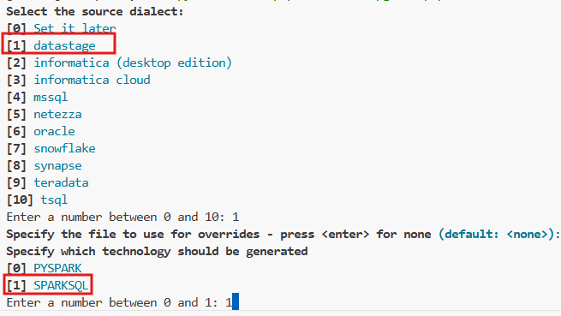
Lakebridge – ETL DataStage to Databricks
Transpile (Converter)
Run this in CLI before starting, since lakebridge is continuously evolving - > databricks labs upgrade lakebridge
Create the necessary folder structure for snowflake assets for analysis, here input folder will hold all snowflake assets & output folder
will produce the converted Databricks SQL assets by running the lakebridge transpile command
>$
databricks labs lakebridge transpile
--source-dialect datastage
--input-source
/workspaces/lakebridge/datastage/input-xml
--output-folder
/workspaces/lakebridge/datastage/output

Slide 14
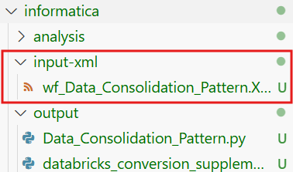
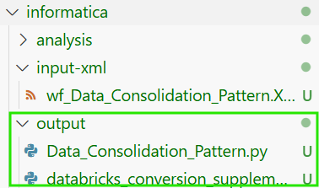
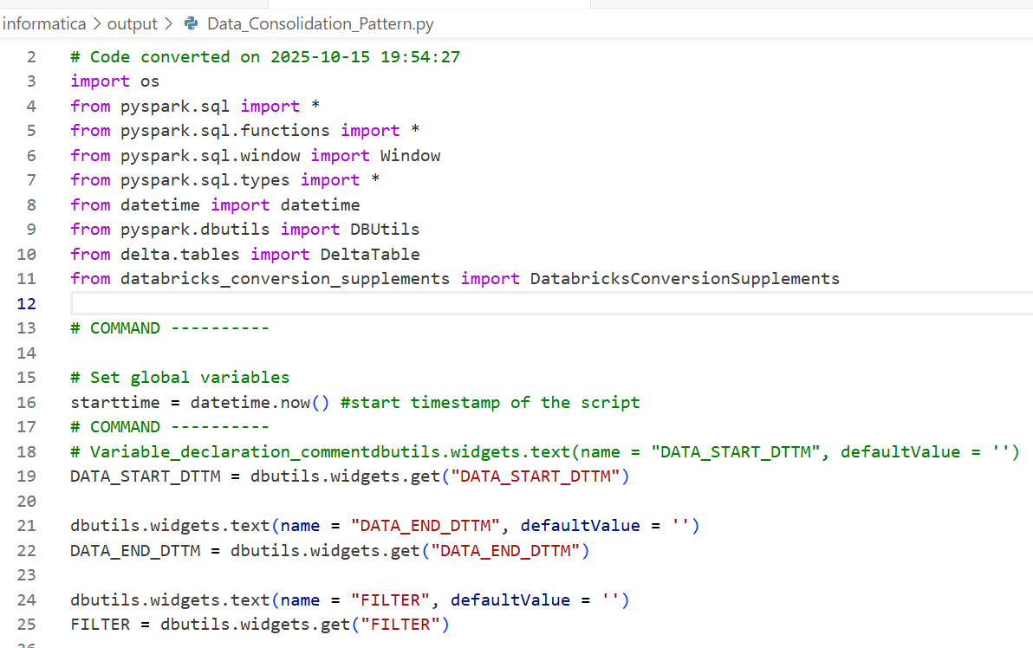
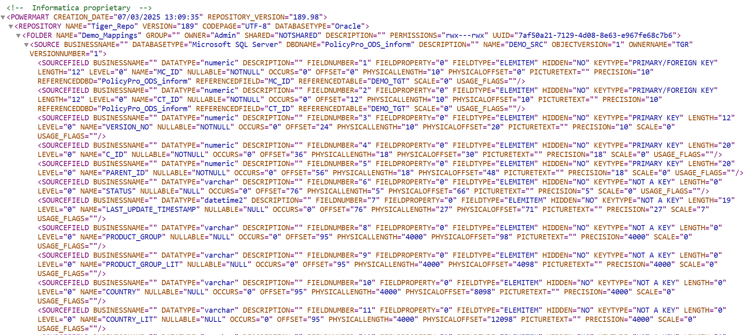
Lakebridge – ETL Informatica to Databricks
Transpile (Converter)
Run this in CLI before starting, since lakebridge is continuously evolving - > databricks labs upgrade lakebridge
Create the necessary folder structure for snowflake assets for analysis, here input folder will hold all snowflake assets & output folder
will produce the converted Databricks SQL assets by running the lakebridge transpile command
>$
databricks labs lakebridge transpile
--source-dialect “informatica (desktop edition)
--input-source
/workspaces/lakebridge/datastage/input-xml
--output-folder
/workspaces/lakebridge/datastage/output

Slide 15
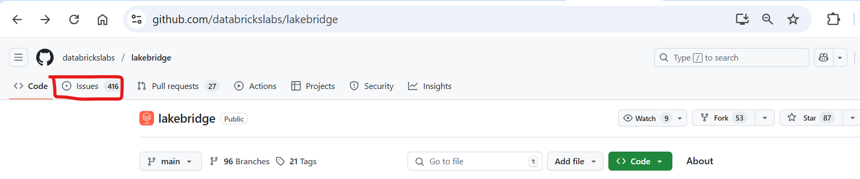
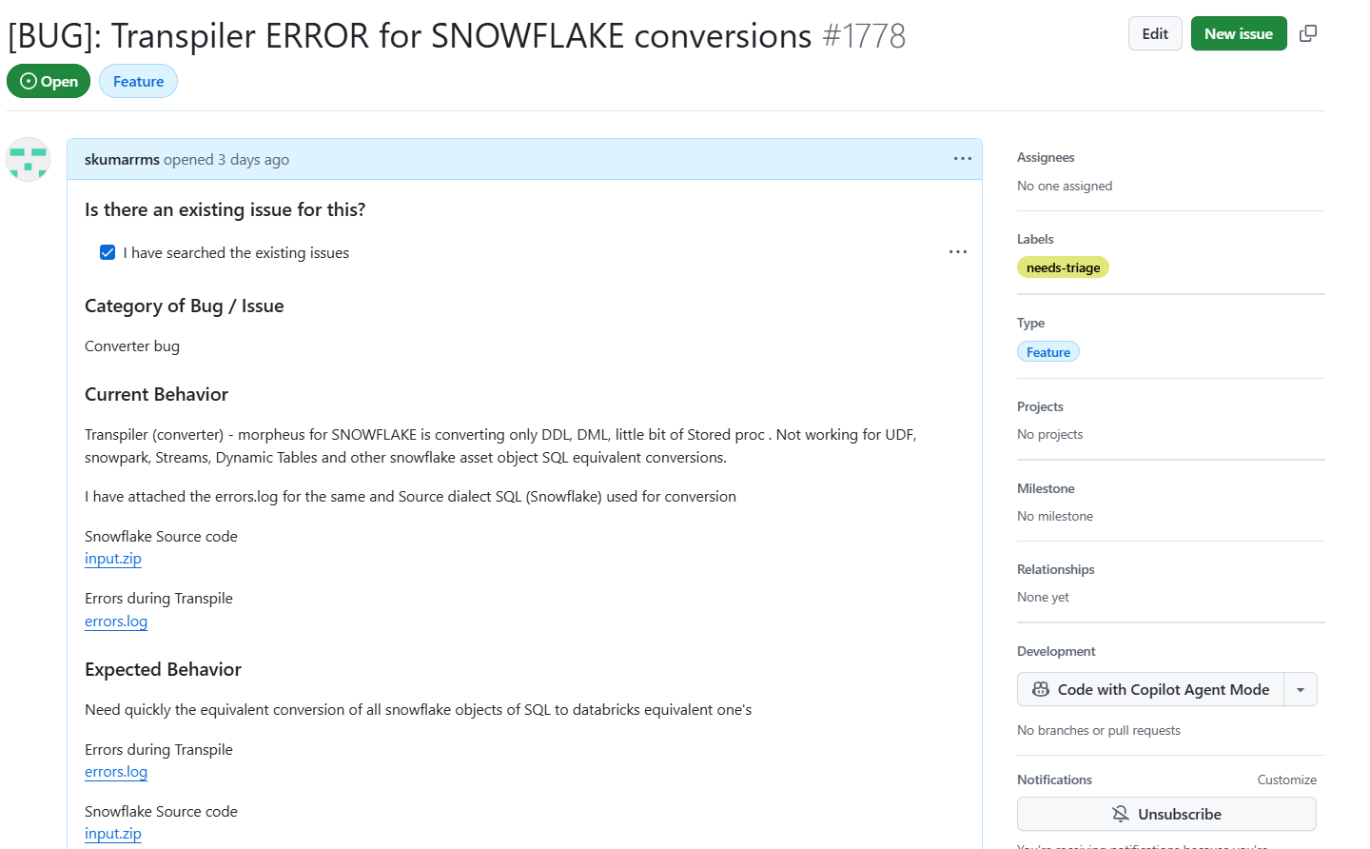
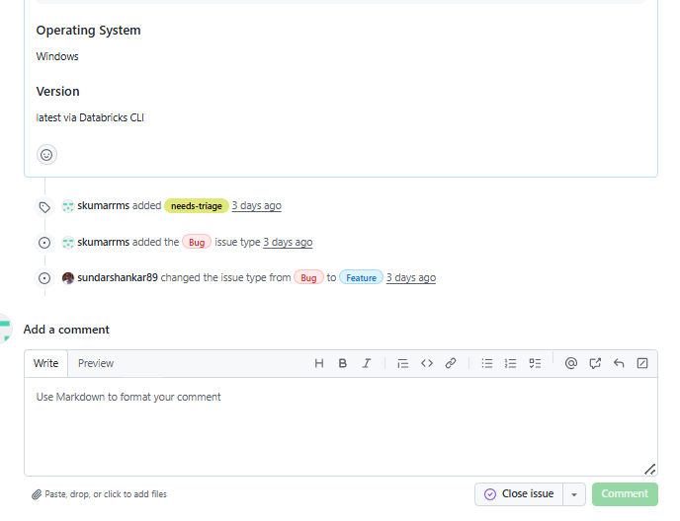
Lakebridge Support – Raise GitHub Issue
Go to https://github.com/databrickslabs/lakebridge for raising the BUG or FEATURE for lakebridge support
**Note:
Reached out to the Databricks Partner SA
They reached out to their engineering teams
The instruction is provided to raise and follow up by raising GITHUB
issue under lakebridge ,since this is the databricks labs project.

Slide 16
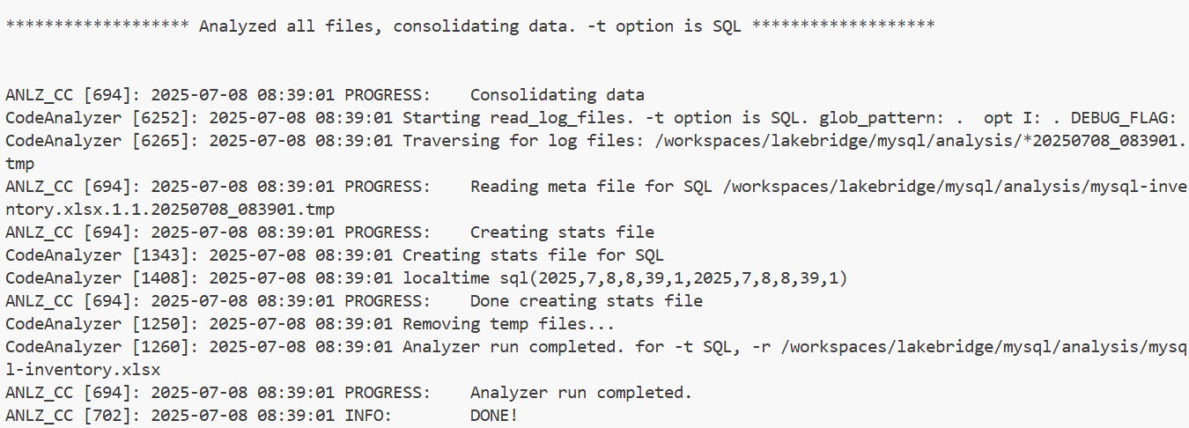
Lakebridge – MySQL to Databricks
Analyzer
Run this in CLI before starting, since lakebridge is continuously evolving - > databricks labs upgrade lakebridge
Create the necessary folder structure for mysql assets for analysis, here input folder will hold all source technologies & analysis folder
will produce the mysql-inventory.xlsx by running the lakebridge analyze command
>$
databricks labs lakebridge analyze
--source-directory /workspaces/lakebridge/mysql/input --report-file /workspaces/lakebridge/mysql/analysis/mysql-inventory.xlsx

Slide 17
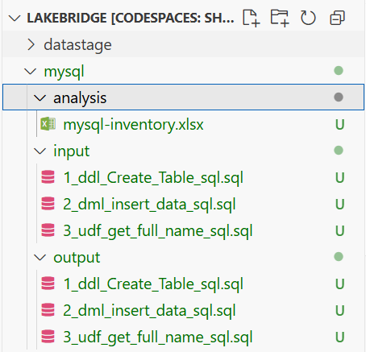
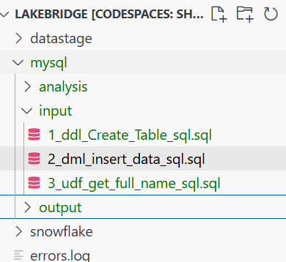
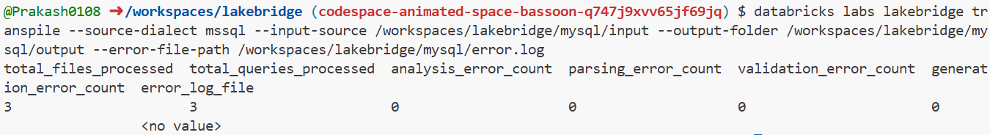
Lakebridge – MySQL to Databricks
Transpile (Converter)
Run this in CLI before starting, since lakebridge is continuously evolving - > databricks labs upgrade lakebridge
Create the necessary folder structure for mysql assets for analysis, here input folder will hold all mysql assets & output folder
will produce the converted Databricks SQL assets by running the lakebridge transpile command
>$
databricks labs lakebridge transpile --source-dialect mssql --input-source /workspaces/lakebridge/mysql/input --output-folder /workspaces/lakebridge/mysql/output --error-file-path /workspaces/lakebridge/mysql/error.log

Slide 18
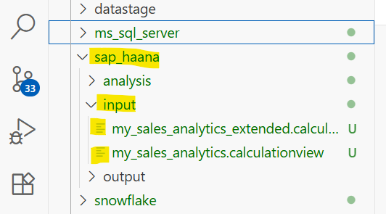
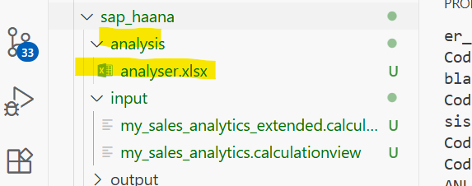
Lakebridge – SAP to Databricks
Analyzer
Run this in CLI before starting, since lakebridge is continuously evolving - > databricks labs upgrade lakebridge
Create the necessary folder structure for SAP assets for analysis, here input folder will hold all SAP assets & analysis folder
will produce the analyser.xlsx by running the lakebridge analyze command
>$
databricks labs lakebridge analyze
--source-directory /workspaces/codespaces-blank/lakebridge/sap_haana/input --report-file /workspaces/codespaces-blank/lakebridge/sap_haana/analysis/analyser.xlsx

Slide 19
Lakebridge – SAP to Databricks
Transpile (Converter)
In Lakebridge for SAP HAANA Transpiler was not yet configured

Slide 20
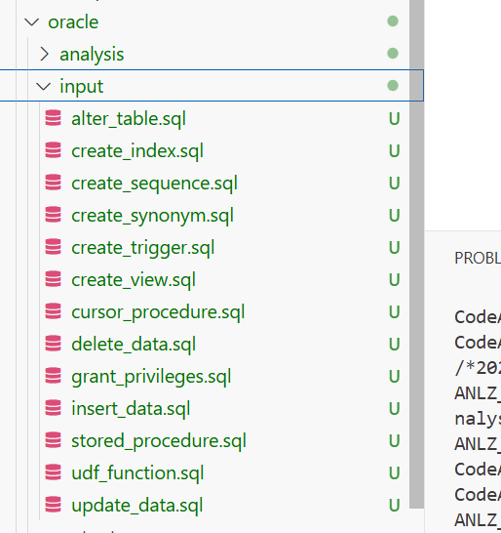
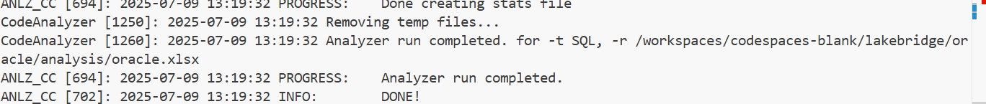

Lakebridge – Oracle to Databricks
Analyzer
Run this in CLI before starting, since lakebridge is continuously evolving - > databricks labs upgrade lakebridge
Create the necessary folder structure for oracle assets for analysis, here input folder will hold all oracle assets & analysis folder
will produce the oracle-inventory.xlsx by running the lakebridge analyze command
>$
databricks labs lakebridge analyze --source-directory /workspaces/codespaces-blank/lakebridge/oracle/input --report-file /workspaces/codespaces-blank/lakebridge/oracle/analysis/oracle.xlsx
Follow the instruction on the screen once you execute above command:

Slide 21
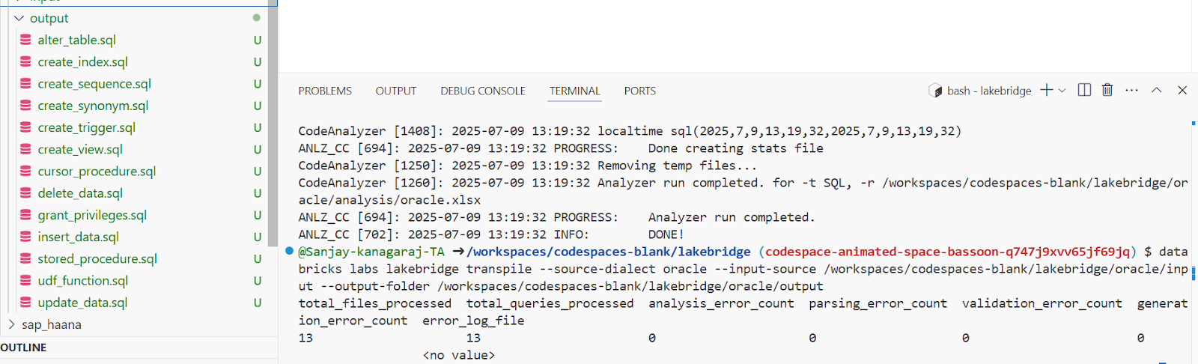
Lakebridge – Oracle to Databricks
Transpile (Converter)
Run this in CLI before starting, since lakebridge is continuously evolving - > databricks labs upgrade lakebridge
Create the necessary folder structure for oracle assets for analysis, here input folder will hold all oracle assets & output folder
will produce the converted Databricks SQL assets by running the lakebridge transpile command
>$
databricks labs lakebridge transpile
--source-dialect snowflake
--input-source
/workspaces/codespaces-blank/snowflake/input
--output-folder /workspaces/codespaces-blank/snowflake/output

Slide 22
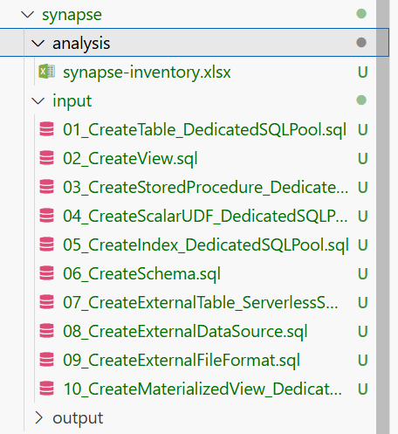
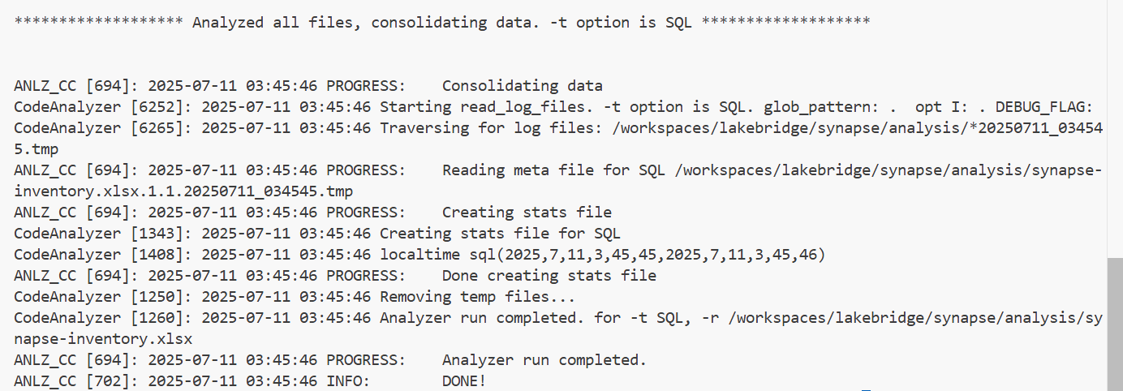
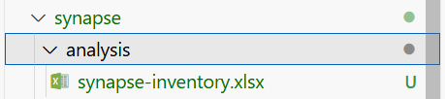
Lakebridge – Synapse to Databricks
Analyzer
Run this in CLI before starting, since lakebridge is continuously evolving - > databricks labs upgrade lakebridge
Create the necessary folder structure for synapse assets for analysis, here input folder will hold all synapse assets & analysis folder
will produce the synapse-inventory.xlsx by running the lakebridge analyze command
>$
databricks labs lakebridge analyze --source-directory /workspaces/lakebridge/synapse/input --report-file /workspaces/lakebridge/synapse/analysis/synapse-inventory.xlsx

Slide 23
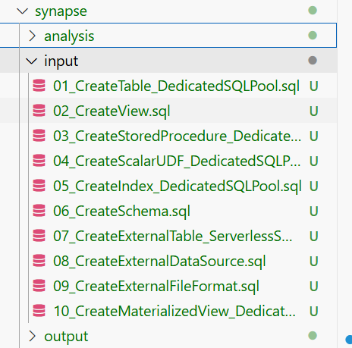
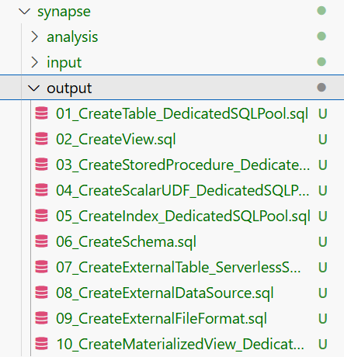
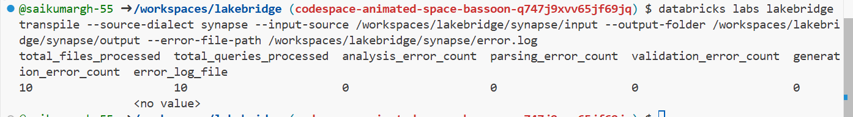
Lakebridge – Synapse to Databricks
Transpile (Converter)
Run this in CLI before starting, since lakebridge is continuously evolving - > databricks labs upgrade lakebridge
Create the necessary folder structure for synapse assets for analysis, here input folder will hold all synapse assets & output folder
will produce the converted Databricks SQL assets by running the lakebridge transpile command
>$
databricks labs lakebridge transpile --source-dialect synapse --input-source /workspaces/lakebridge/synapse/input --output-folder /workspaces/lakebridge/synapse/output --error-file-path /workspaces/lakebridge/synapse/error.log

Slide 24
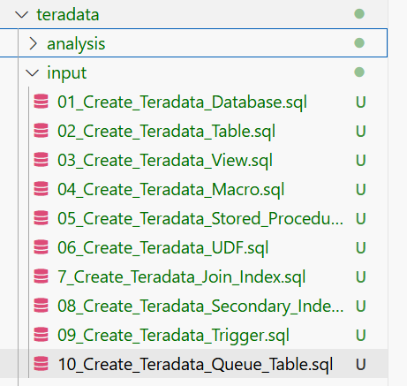
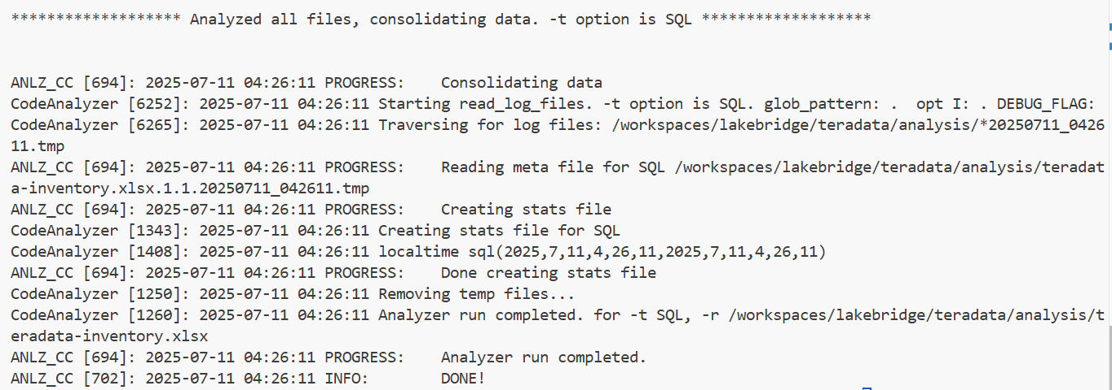
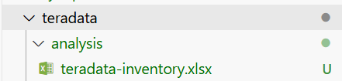
Lakebridge – Teradata to Databricks
Analyzer
Run this in CLI before starting, since lakebridge is continuously evolving - > databricks labs upgrade lakebridge
Create the necessary folder structure for teradata assets for analysis, here input folder will hold all teradata assets & analysis folder
will produce the teradata-inventory.xlsx by running the lakebridge analyze command
>$
databricks labs lakebridge analyze --source-directory /workspaces/lakebridge/teradata/input --report-file /workspaces/lakebridge/teradata/analysis/teradata-inventory.xlsx

Slide 25
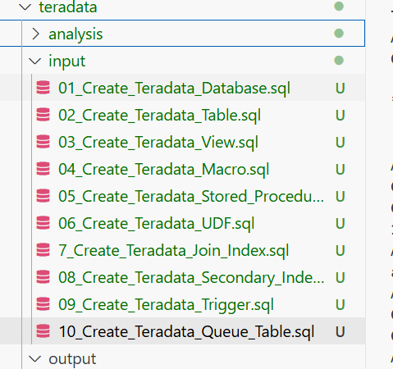
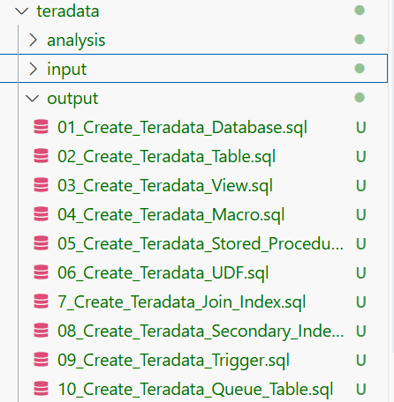

Lakebridge – Snowflake to Databricks
Transpile (Converter)
Run this in CLI before starting, since lakebridge is continuously evolving - > databricks labs upgrade lakebridge
Create the necessary folder structure for teradata assets for analysis, here input folder will hold all teradata assets & output folder
will produce the converted Databricks SQL assets by running the lakebridge transpile command
>$
databricks labs lakebridge transpile
--source-dialect snowflake
--input-source
/workspaces/codespaces-blank/snowflake/input
--output-folder
/workspaces/codespaces-blank/snowflake/output

Slide 26



Lakebridge –Informatica to Databricks
Analyzer
Run this in CLI before starting, since lakebridge is continuously evolving - > databricks labs upgrade lakebridge
Create the necessary folder structure for informatica assets for analysis, here input folder will hold all informatica assets & analysis folder
will produce the informatica-inventory.xlsx by running the lakebridge analyze command
>$
databricks labs lakebridge analyze --source-directory /workspaces/lakebridge/informatica/input --report-file /workspaces/lakebridge/ informatica/analysis/ informatica-inventory.xlsx

Slide 27



Lakebridge – Informatica to Databricks
Transpile (Converter)
Run this in CLI before starting, since lakebridge is continuously evolving - > databricks labs upgrade lakebridge
Create the necessary folder structure for informatica assets for analysis, here input folder will hold all informatica assets & output folder
will produce the converted Databricks SQL assets by running the lakebridge transpile command
>$
databricks labs lakebridge transpile
--source-dialect 'informatica (desktop edition)'
--input-source
/workspaces/lakebridge/informatica/input
--output-folder
/workspaces/lakebridge/informatica/output

