Slide 1
Long the Grid, Short the Bottleneck
Hong Kong Track | Energy Transition | From Clean-Tech Growth to Grid-Backbone Value | Long Dongfang Electric (1072.HK) / Short Sungrow (300274.SZ)
Serkan Kumyol | Kirill Shatilov | Hong Kong University of Science and Technology

Slide 2
Executive Summary
• Thesis: Own grid integration leader capturing State Grid RMB 4T capex + synchronous condenser breakthrough
• Long Dongfang Electric @ target upside: 44.9%
• Short Sungrow @ target downside: -67.5%
• Pair spread expected return: 112.4%
• 3 pillars: (1) Structural electricity demand (2) Grid capex visibility (3) Earnings-quality divergence
• Key catalysts: State Grid 4T RMB capex, Dongfang synchronous condenser orders, Sungrow margin scrutiny

Slide 3
Variant View: The Real Energy-Security Trade Is Grid Resilience
• Consensus treats energy-transition equipment winners as interchangeable
• Variant view: energy security is no longer just securing barrels — it is reliable electricity
• Data centers, EVs, industrial electrification, and cooling all stress the power system
• Governments treat grid hardening as national security infrastructure
• → Oil disruption is the symptom. Grid investment is the solution.

Slide 4
Electricity Continuity Is Becoming Strategic Infrastructure
• China's 15th FYP shifts the bottleneck from generation buildout to system reliability and grid integration
• State Grid plans RMB 4 trillion of fixed-asset investment across 2026-2030, a step-up versus the prior cycle
• New-type power system priorities include source-grid-load-storage coordination and grid flexibility
• Dongfang is directly exposed to synchronous condensers, transmission equipment, and grid-supporting power equipment
• This makes China grid capex, not generic global clean-tech beta, the key macro driver for the pair

Slide 5
Why Now: The Regime Shift
• ⚠️ 2Y backtest can be unfavorable because broad energy-transition winners often rerated together
• This is NOT a historically validated spread — it is a forward-looking variant view on regime shift
• Past regime (2021-2024): Broad clean-tech beta lifted inverter and equipment winners together
• New regime (2025-2030): Grid infrastructure durability beats high-growth clean-tech valuation risk
• Stock-pool compliance: Dongfang is the pool anchor; Sungrow is the non-pool same-sector short
• We are betting on the BREAKDOWN of historical correlation, not its continuation

Slide 6
Dongfang Electric: Grid Tech Leader with RMB 140B Backlog
• Integrated power equipment and grid-integration leader with clean-energy equipment exposure
• Strong domestic grid orders from State Grid Corp + overseas expansion (Middle East, SE Asia)
• Revenue growth trajectory supported by multi-year order backlog
• Gross margins stable/improving vs peers; R&D investment in digital grid
• Variant gap: Market prices it as cyclical China equipment — we price it as global grid-resilience compounder

Slide 7
Sungrow: High-Expectation Inverter Leader Facing Demand Normalization
• High-expectation inverter and storage leader facing demand normalization
• 2025 strong results (Revenue RMB 89.2bn, +14.6%; Net Profit RMB 13.5bn, +22.0%)
• Q1 2026 shows clear slowdown: Revenue -18.3% YoY, Net Profit -40.1% YoY
• Premium multiple vulnerable to inverter/storage price compression and margin pressure
• Short thesis is valuation de-rating as growth expectations normalize, not business failure

Slide 8
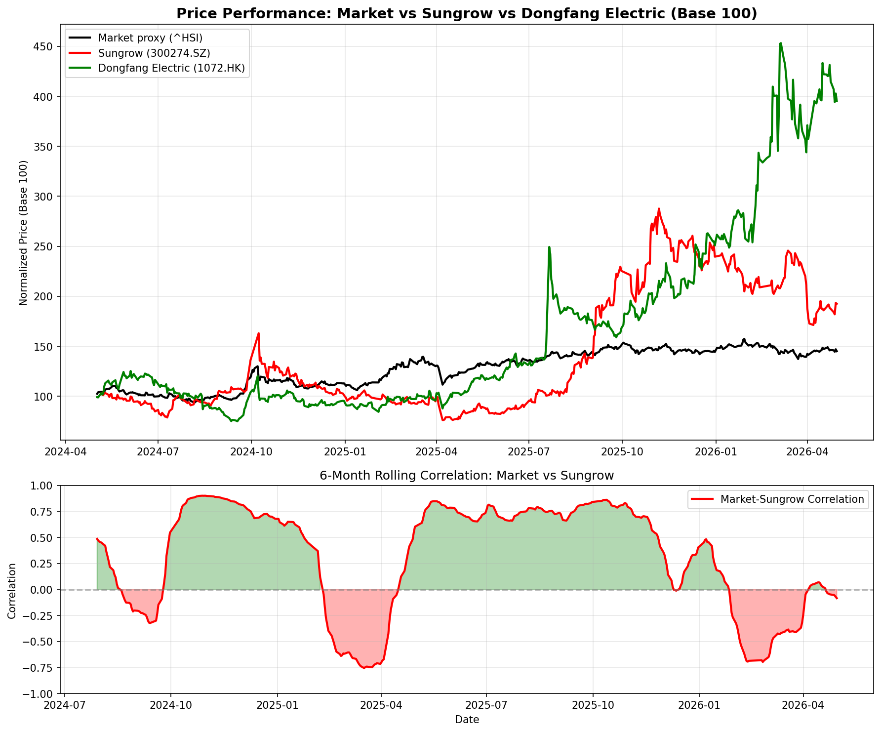
Historical Divergence: Market vs Dongfang Electric vs Sungrow (2Y)
Historical result is a risk check, not proof. Forward case depends on grid infrastructure durability outperforming high-growth clean-tech valuation risk.

Slide 9
Empirical Setup: Forward Predictive Scorecard
Pillar | Evidence | Signal
Historical spread test | 2Y simulated pair P&L was 101.4%; Dongfang Electric 2Y return 295.4% vs Sungrow 92.5%. | Risk / contradiction
Earnings durability | Dongfang Electric delivered 2025 net profit growth of 31.1% on 12.8% revenue growth, backed by order visibility, while Sungrow moved from +22.0% full-year profit growth to -40.1% YoY in Q1 2026. | Supports long Dongfang Electric / short Sungrow
Valuation stretch | Sungrow trades at a 8.9x P/E premium and 5.4x P/B gap to Dongfang Electric (45.0x/8.5x vs 36.1x/3.1x). | Supports short Sungrow if margin recovery disappoints
Technical setup | Sungrow is at 66.9% of its 52-week high with RSI 59.3, while Dongfang Electric is at 87.2% with RSI 50.9. | Supports timing discipline
Scenario valuation | Probability-weighted modeled pair spread is 112.4%. | Forward prediction
Separates adverse historical backtest from current empirical setup and forward catalysts.

Slide 10
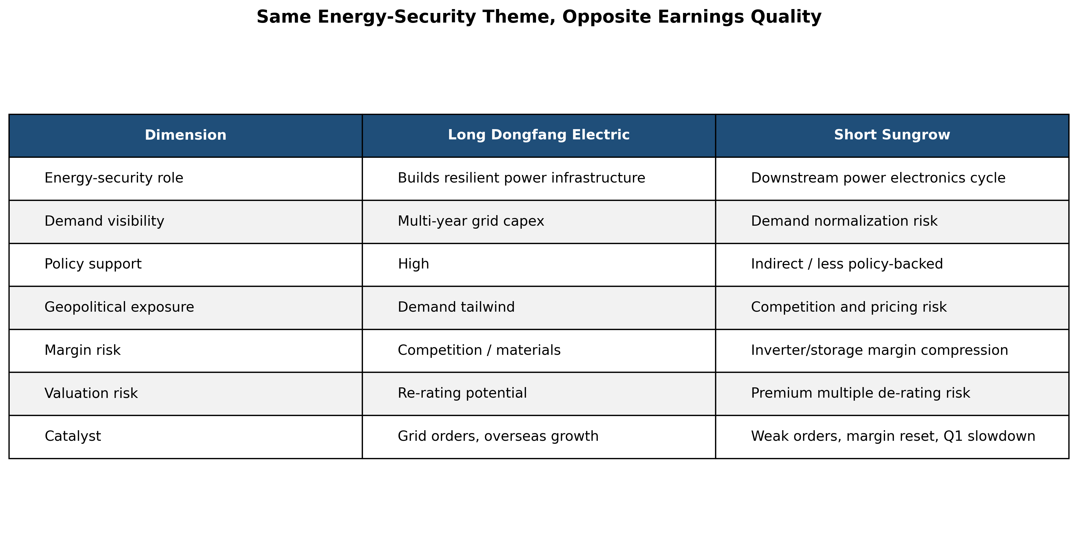
Same Energy-Transition Theme, Opposite Cycle Position
Long Dongfang Electric captures grid capex tailwind. Short Sungrow carries high-expectation inverter and storage de-rating risk.

Slide 11
Thematic Evidence Tracker: Text-Based Signal Compilation
Signal Cluster | Grid Equipment | Inverter & Storage Equipment
Grid upgrade | Low | Medium
Electricity demand | Low | High
Policy-backed capex | Low | Low
Logistics disruption | Low | Low
Margin pressure | Low | Low
Thesis support score: 0.244 | Moderate support for variant thesis | Grid signal share: 60%

Slide 12
Valuation: Peer Comparables
Company | Ticker | Sector | P/E | EV/EBITDA | ROIC | Revenue Growth | Profit Margin
DONGFANG ELEC | 1072.HK | Grid / Power Equipment | 29.6x | 34.0x | N/A | 5.9% | 4.9%
GE Vernova Inc. | GEV | Grid / Power Equipment | 31.7x | 82.2x | N/A | 16.3% | 23.8%
Quanta Services, Inc. | PWR | Grid / Power Equipment | 104.1x | 40.1x | N/A | 19.7% | 3.6%
Eaton Corporation, PLC | ETN | Grid / Power Equipment | 40.6x | 26.8x | N/A | 13.1% | 14.9%
ABB | ABB | Grid / Power Equipment | N/A | N/A | N/A | N/A | N/A
SCHNEIDER ELECTRIC SE | SU.PA | Grid / Power Equipment | 33.4x | 21.2x | N/A | 4.2% | 10.4%
SUNGROW POWER SUPPLY CO LTD | 300274.SZ | Inverter / Storage Equipment | 23.7x | 16.9x | N/A | -18.3% | 13.9%
Comps compare Dongfang's grid-backbone exposure against premium downstream inverter/storage valuation risk.

Slide 13
Valuation: DCF Cross-Check
Company | Fcf0 Rmb Bn | Growth Rate Pct | Terminal Growth Pct | Wacc Pct | Years | Enterprise Value Rmb Bn | Implied Value Per Share Rmb
Dongfang Electric | 2.8 | 17.0 | 4.0 | 8.5 | 5 | 112.009 | 33.64
Sungrow | 8.0 | 8.0 | 3.0 | 9.5 | 5 | 156.707 | 106.6
Simple normalized FCF DCF used as a consistency check against the scenario framework

Slide 14
Long Scenarios: Dongfang Electric
scenario | eps_growth | target_pe | target_eps | target_price | upside_pct | probability
Bear | +15% | 32.0x | 1.32 | 42.32 | +8% | 20%
Base | +25% | 38.0x | 1.44 | 54.62 | +40% | 55%
Bull | +40% | 45.0x | 1.61 | 72.45 | +85% | 25%
Probability-weighted upside driven by overseas revenue mix and grid re-rating

Slide 15
Short Scenarios: Sungrow
scenario | eps_growth | target_pe | target_eps | target_price | upside_pct | probability
Bear | +0% | 36.0x | 0.92 | 33.12 | -76% | 35%
Base | +8% | 44.0x | 0.99 | 43.72 | -68% | 45%
Bull | +25% | 58.0x | 1.15 | 66.7 | -51% | 20%
Probability-weighted downside driven by thin margins and multiple compression

Slide 16
Catalysts Over Next 6-12 Months
• LONG CATALYSTS (Dongfang):
• • Quarterly overseas order wins (Middle East, SE Asia)
• • China State Grid capex announcements
• • Gross margin expansion on overseas mix shift
• SHORT CATALYSTS (Sungrow):
• • Margin recovery falls short of expectations
• • Inverter/storage pricing pressure persists
• • Investors de-rate premium clean-tech expectations vs backlog-backed grid exposure

Slide 17
Risks and Mitigants
• Broad power-equipment rally may lift Sungrow temporarily → position sizing limits risk
• Dongfang China beta/multiple compression → offset by 140B RMB backlog visibility
• Grid capex delays → multi-year policy demand reduces single-year risk
• FX risk on RMB → monitored; sensitivity table in appendix
• SHORT SQUEEZE / BORROW COST: Sungrow borrow cost assumed ~2.5-7%; position sizing limits risk
• Thesis kill switch: Sungrow margin expansion + Dongfang backlog decline → exit pair

Slide 18
Execution: Position Sizing, Carry & Liquidity
• POSITION SIZING (Risk-Based):
• • Portfolio: $100M example | Max risk per trade: 2% ($2M)
• • Pair volatility: 80.3% annual | Position size: 1.2% of portfolio ($1.2M notional)
• • Allocation: $0.6M long Dongfang / $0.6M short Sungrow (dollar-neutral)
•
• CARRY COST (6-month hold):
• • Sungrow borrow cost: 2.5-7% annually
• • Sungrow dividend/carry checked before execution
• • Dongfang dividend (long receives): 1.5% → ~$9K income
• • Net carry: ~$13K-27K based on current trader analysis
•
• LIQUIDITY & EXECUTION:
• • Dongfang (HK): ~$148M daily volume | Execute in <1 day | HKEX access
• • Sungrow: highly liquid A-share leg; execute in slices after borrow is confirmed
• • Dongfang trades on HKEX (1072.HK) - no Stock Connect needed
•
• TECHNICAL TIMING:
• • Sungrow: RSI 59.3 | 66.9% of 52-week high
• • Dongfang: RSI 50.9 | 87.2% of 52-week high

Slide 19
Text Analysis: Scope and Limitations
• WHAT THIS MODULE DOES:
• • Compiles text evidence from 59 documents / 455 paragraphs into structured categories
• • Surfaces specific quotes and management language for manual review
• • Feeds a predictive scorecard with fundamentals, valuation, technicals, and catalysts
• CLAIM BOUNDARY:
• • Predictive input, not autonomous forecast — text signals do not trade themselves
• • Corpus is useful for thesis discovery, but still too small for standalone statistical alpha claims
• • Classification relies on keyword patterns, not deep semantic understanding
• • Source bias: RSS feeds overweight news vs. operational 8-K filings
• • Every output requires human verification before investment decisions

Slide 20
Recommendation
Long Dongfang (+45%) / Short Sungrow (-68%) = Pair spread +112%

