Slide 1

Configure your Microsoft 365 tenant
Learning Path Overview
Set up your organisation’s profile, manage subscriptions and services, and configure connectivity to guarantee a seamless Microsoft 365 experience.
[1]
Notes:
Slide 1: Learning Path Overview
Microsoft 365 tenant setup is crucial for a seamless organisational experience.
Key tasks: Set up organisation profile, manage subscriptions and services, and configure connectivity.
The goal: Ensure your Microsoft 365 environment is ready for users and workloads.
https://learn.microsoft.com/en-us/training/modules/configure-microsoft-365-experience/#:~:text=Learning%20objectives

Slide 2
Learning Objectives
Microsoft 365 Tenant Management Tasks
Configure organization profile, subscriptions, services
Prepare tenant checklist
Create and manage user accounts
Assign and recover licenses
Manage guest users and contacts
Establish and maintain collaboration groups
Plan and add custom domains with DNS
Configure client connectivity and troubleshoot issues
Notes:
Slide 2: Learning Objectives
Tenant Management Tasks: Understand the main responsibilities for managing a Microsoft 365 tenant.
Configure organisation profile, subscriptions, and services.
Prepare a checklist for tenant setup.
Create and manage user accounts.
Assign and recover licenses for users.
Manage guest users and contacts.
Establish and maintain collaboration groups.
Plan and add custom domains using DNS.
Configure client connectivity and troubleshoot issues.

Slide 3
Modules Overview
[7] [8] [9] [10] [11]
Module | Key topics
Configure your Microsoft 365 experience | Tenant profile, subscriptions, services, checklist
Manage users, licenses & contacts | User provisioning, license assignment, recovery, guests
Manage groups in Microsoft 365 | Group types, creation & management, Exchange & SharePoint
Add a custom domain | DNS planning, domain addition, verification
Configure client connectivity | Autodiscover, protocols, troubleshooting tools
Notes:
Slide 3: Modules Overview
Configure your Microsoft 365 experience: Focus on tenant profile, subscriptions, services, and checklist.
Manage users, licenses & contacts: Learn user provisioning, license assignment and recovery, and guest management.
Manage groups in Microsoft 365: Explore group types, creation, management, and integration with Exchange & SharePoint.
Add a custom domain: Plan DNS, add domains, and verify them.
Configure client connectivity: Use Autodiscover, protocols, and troubleshooting tools.
https://learn.microsoft.com/en-us/training/modules/configure-microsoft-365-experience/#:~:text=Learning%20objectives

Slide 4
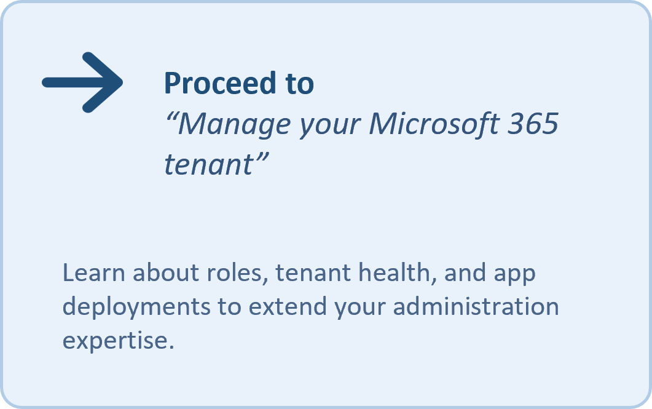
Summary & Next Steps
Set up a robust foundation by configuring your tenant profile, subscriptions, and services.
Manage identities efficiently through user provisioning, license assignment, and group organisation.
Integrate custom domains and maintain seamless client connectivity across all devices and workloads.
[12] [13] [14]
Notes:
Slide 4: Summary & Next Steps
Start by configuring your tenant profile, subscriptions, and services for a strong foundation.
Manage identities: Provision users, assign licenses, and organise groups.
Integrate custom domains and ensure client connectivity across devices and workloads.
Next: Proceed to “Manage your Microsoft 365 tenant” to learn about roles, tenant health, and app deployments.
https://learn.microsoft.com/en-us/training/modules/configure-microsoft-365-experience/#:~:text=Learning%20objectives

