Slide 1
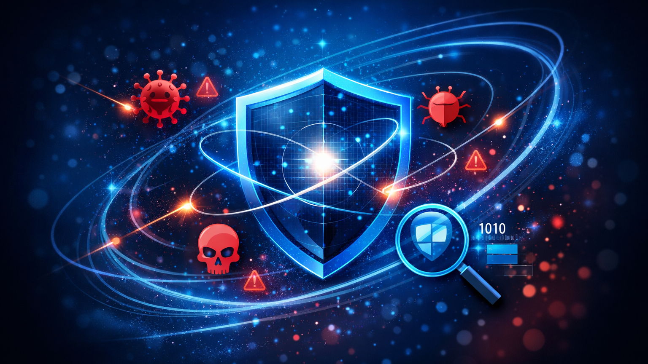
Implement threat protection
using Microsoft Defender XDR
Learning Path Overview
Explore threat intelligence and implement app, endpoint and email protection to defend against modern threats.
[1]
Notes:
Slide 1: Implement threat protection using Microsoft Defender XDR – Learning Path Overview
1. Slide Intent
Learners must understand the scope of threat protection in Microsoft 365 and why integrating intelligence across apps, endpoints, and email is essential for defending against modern threats.
This concept is critical because today’s threats are multi-vector and require a unified, proactive defence strategy.
2. Key Talking Points
Microsoft Defender XDR combines threat intelligence and automation to protect against malware, phishing, and advanced attacks.
The “security shield” visual represents layered defence; orbiting icons (virus, skull, alert) illustrate diverse threat types.
The learning path covers app, endpoint, and email protection, all powered by Microsoft’s security graph.
3. Technical Depth / Behind the Scenes
Defender XDR leverages the Microsoft Intelligent Security Graph, aggregating signals from billions of devices and cloud services.
Automated investigation and response (AIR) reduce manual workload and speed up threat mitigation.
Integration across Defender for Endpoint, Cloud Apps, and Office 365 enables correlated detection and response.
4. Real-World Example or Scenario
A ransomware campaign targets both endpoints and email; Defender XDR detects lateral movement and blocks malicious attachments before data is exfiltrated.
5. Common Mistakes & Misconceptions
Assuming traditional antivirus is sufficient for cloud and hybrid environments.
Believing that threat protection is “set and forget”—it requires ongoing tuning and monitoring.
6. Best Practices & Recommendations
Enable all relevant Defender modules for comprehensive coverage.
Regularly review threat analytics and update policies based on emerging risks.
7. Exam & Assessment Notes
Expect questions on the role of the security graph and the integration of Defender components.
8. Instructor Prompts / Engagement Cues
Ask: “What types of threats have you seen target both endpoints and cloud apps in your environment?”
9. References & Further Reading
Microsoft Learn: https://learn.microsoft.com/en-us/training/modules/explore-threat-intelligence-microsoft-365-defender/#:~:text=,the%20Microsoft%20Intelligent%20Security%20Graph
%20365

Slide 2
Learning Objectives
Describe how Microsoft threat intelligence and the security graph power Defender XDR.
Protect cloud applications with Defender for Cloud Apps, including deployment, policies and alerts.
Implement endpoint protection with Defender for Endpoint: onboard devices, reduce attack surfaces, remediate vulnerabilities.
Enhance email protection with Defender for Office 365: use Threat Explorer, Threat Tracker and Attack Simulation.
[2] [3] [4] [5]
Notes:
Slide 2: Learning Objectives
1. Slide Intent
Learners should know the specific skills and knowledge they will gain: understanding threat intelligence, and implementing protection for apps, endpoints, and email.
2. Key Talking Points
Microsoft threat intelligence and the security graph underpin all Defender XDR capabilities.
Defender for Cloud Apps: deployment, policy creation, and alert management.
Defender for Endpoint: onboarding, attack surface reduction, vulnerability remediation.
Defender for Office 365: Threat Explorer, Threat Tracker, and attack simulation.
3. Technical Depth / Behind the Scenes
Security graph correlates signals from multiple sources for holistic detection.
Defender for Cloud Apps uses API connectors and discovery tools to monitor sanctioned and unsanctioned apps.
Endpoint protection includes EDR, AV, and vulnerability management.
Office 365 protection leverages real-time scanning, sandboxing, and user simulation.
4. Real-World Example or Scenario
An organisation uses Threat Explorer to trace a phishing campaign from email to endpoint infection, then remediates affected devices.
5. Common Mistakes & Misconceptions
Overlooking the need to onboard all devices for full endpoint visibility.
Not customising policies for specific app or user risk profiles.
6. Best Practices & Recommendations
Use attack simulation to train users and test defences.
Continuously monitor and adjust policies as threats evolve.
7. Exam & Assessment Notes
Focus on deployment steps, policy configuration, and the role of threat intelligence.
8. Instructor Prompts / Engagement Cues
Quick check: “Who can explain how Defender for Cloud Apps discovers Shadow IT?”
9. References & Further Reading
Microsoft Learn:
https://learn.microsoft.com/en-us/training/modules/explore-threat-intelligence-microsoft-365-defender/#:~:text=,the%20Microsoft%20Intelligent%20Security%20Graph
https://learn.microsoft.com/en-us/training/modules/implement-app-protection-use-microsoft-defender-cloud-apps/#:~:text=,critical%20data%20across%20cloud%20applications
https://learn.microsoft.com/en-us/training/modules/implement-endpoint-protection-use-microsoft-defender-endpoint/#:~:text=,and%20respond%20to%20advanced%20threats
https://learn.microsoft.com/en-us/training/modules/implement-threat-protection-use-microsoft-defender-office-365/#:~:text=,Microsoft%20Defender%20for%20Office

Slide 3
Modules Overview
[6] [7] [8] [9]
Module | Key topics
Threat intelligence in Defender XDR | Security graph, automated investigation & response, threat hunting
App protection with Defender for Cloud Apps | Visibility, file & app policies, alert management, Cloud Discovery
Endpoint protection with Defender for Endpoint | Device onboarding, threat & vulnerability management, remediation
Email threat protection in Defender for Office 365 | Protection stack, Threat Explorer & Tracker, Attack Simulation
Notes:
Slide 3: Modules Overview
1. Slide Intent
Learners must see the course structure and how each module builds towards comprehensive threat protection.
2. Key Talking Points
Four modules: Threat intelligence, App protection, Endpoint protection, Email threat protection.
Each module addresses specific topics: security graph, policies, onboarding, remediation, simulation.
The table clarifies which skills and concepts are addressed in each module.
3. Technical Depth / Behind the Scenes
Security graph powers automated investigation and threat hunting.
Cloud App policies use activity logs and anomaly detection.
Endpoint onboarding supports Windows, macOS, Linux, and mobile.
Email protection includes multi-layered filtering and user education.
4. Real-World Example or Scenario
A multinational company uses Cloud Discovery to identify unsanctioned SaaS apps, then applies policies to block risky usage.
5. Common Mistakes & Misconceptions
Treating modules as siloed; effective defence requires integration across all areas.
6. Best Practices & Recommendations
Map each module to specific organisational roles and responsibilities.
Encourage cross-team collaboration during implementation.
7. Exam & Assessment Notes
Scenario-based questions may require linking concepts from multiple modules.
8. Instructor Prompts / Engagement Cues
Discussion: “Which module do you anticipate will be most challenging for your team?”
9. References & Further Reading
Microsoft Learn:
https://learn.microsoft.com/en-us/training/modules/explore-threat-intelligence-microsoft-365-defender/#:~:text=,the%20Microsoft%20Intelligent%20Security%20Graph
https://learn.microsoft.com/en-us/training/modules/implement-app-protection-use-microsoft-defender-cloud-apps/#:~:text=,critical%20data%20across%20cloud%20applications
https://learn.microsoft.com/en-us/training/modules/implement-endpoint-protection-use-microsoft-defender-endpoint/#:~:text=,and%20respond%20to%20advanced%20threats
https://learn.microsoft.com/en-us/training/modules/implement-threat-protection-use-microsoft-defender-office-365/#:~:text=,Microsoft%20Defender%20for%20Office%20365

Slide 4

Summary & Next Steps
Harness Microsoft threat intelligence to detect and hunt threats proactively.
Secure your cloud apps with policies and alerts that address Shadow IT and sensitive data.
Protect endpoints by onboarding devices and remediating vulnerabilities based on prioritised recommendations.
Use Defender for Office 365 to investigate threats and educate users through realistic attack simulations.
Proceed to
“Explore data governance”
Up next: learn about archiving, retention, information protection and insider risk management within Microsoft 365.
[10] [11] [12] [13]
Notes:
Slide 4: Summary & Next Steps
1. Slide Intent
Learners should consolidate their understanding and know the next steps: proactive threat hunting, securing cloud apps, protecting endpoints, and using attack simulation.
2. Key Talking Points
Use Microsoft threat intelligence for proactive detection and hunting.
Secure cloud apps with policies and alerts to address Shadow IT and sensitive data.
Onboard devices and remediate vulnerabilities for endpoint protection.
Use Defender for Office 365 to investigate threats and educate users.
3. Technical Depth / Behind the Scenes
Threat intelligence is continuously updated from global telemetry.
Policies and alerts are enforced in real time across cloud and endpoint workloads.
Attack simulation provides metrics for user readiness and policy effectiveness.
4. Real-World Example or Scenario
After a phishing simulation, an organisation identifies users who need additional training and updates policies to block similar threats.
5. Common Mistakes & Misconceptions
Neglecting ongoing monitoring and review of threat protection controls.
Failing to update policies as new threats emerge.
6. Best Practices & Recommendations
Schedule regular reviews of threat analytics and policy effectiveness.
Use adaptive protection to respond to emerging threats.
7. Exam & Assessment Notes
Look for questions on threat hunting, policy management, and incident response.
8. Instructor Prompts / Engagement Cues
Ask: “What’s your next step in improving threat protection at your organisation?”
9. References & Further Reading
Microsoft Learn:
https://learn.microsoft.com/en-us/training/modules/explore-threat-intelligence-microsoft-365-defender/#:~:text=,the%20Microsoft%20Intelligent%20Security%20Graph
https://learn.microsoft.com/en-us/training/modules/implement-app-protection-use-microsoft-defender-cloud-apps/#:~:text=,critical%20data%20across%20cloud%20applications
https://learn.microsoft.com/en-us/training/modules/implement-endpoint-protection-use-microsoft-defender-endpoint/#:~:text=,and%20respond%20to%20advanced%20threats
https://learn.microsoft.com/en-us/training/modules/implement-threat-protection-use-microsoft-defender-office-365/#:~:text=,Microsoft%20Defender%20for%20Office%20365

