Slide 1
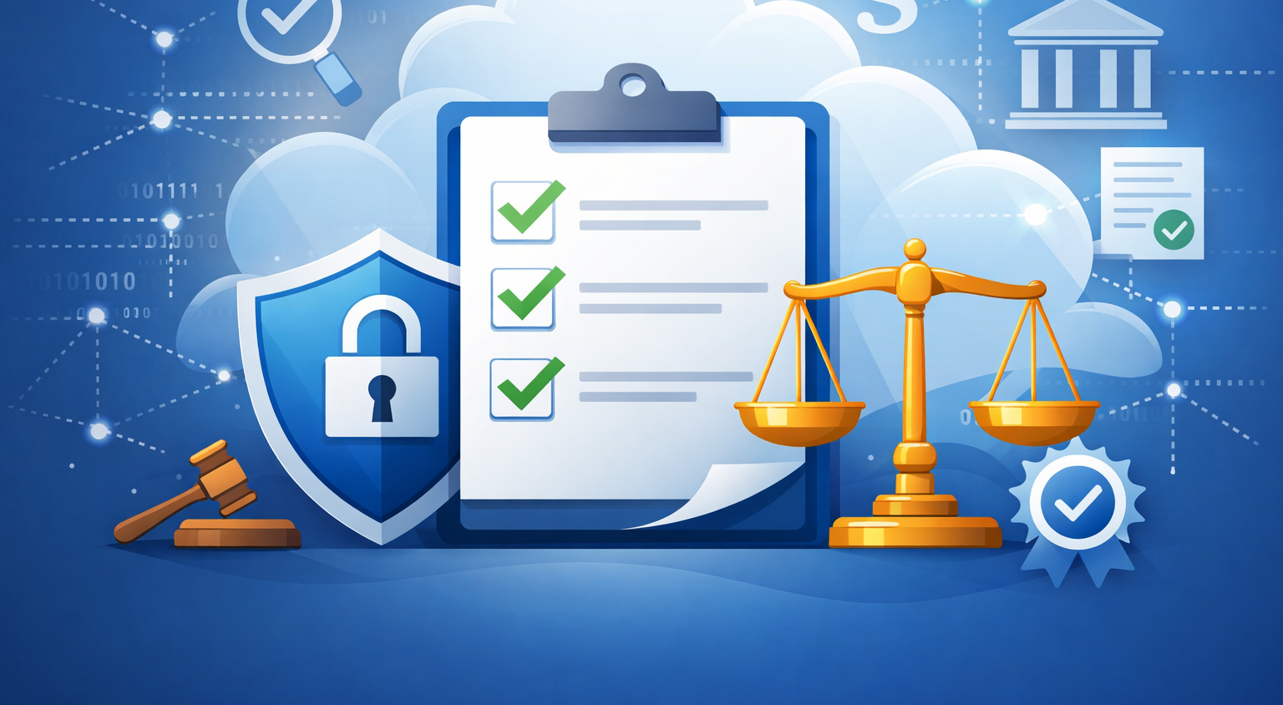
Implement compliance
in Microsoft 365
Learning Path Overview
Build a robust compliance program using Microsoft Purview to manage risks, insider activities, communications boundaries and data loss.
[1]
Notes:
Implement compliance in Microsoft 365 – Learning Path Overview
1. Slide Intent
Learners must grasp the scope and importance of building a compliance programme in Microsoft 365 using Purview.
Understanding compliance is critical for protecting organisational data, managing risks, and meeting regulatory standards in real-world environments. [8_implemen...compliance | PowerPoint]
2. Key Talking Points
Microsoft Purview provides tools for risk management, insider activity monitoring, communication boundaries, and data loss prevention.
Compliance is not just about ticking boxes—it’s about operational resilience and trust.
The visual elements (cloud, shield, checklist) represent layered security and governance.
3. Technical Depth / Behind the Scenes
Purview integrates with Microsoft 365 services, leveraging unified dashboards and policy engines.
Compliance controls are enforced across Exchange, Teams, SharePoint, and OneDrive.
Backend processes include continuous risk assessment and automated alerting.
4. Real-World Example or Scenario
A financial services firm uses Purview to detect insider trading risks and prevent unauthorised data sharing between departments.
5. Common Mistakes & Misconceptions
Assuming compliance is a one-time setup rather than an ongoing process.
Overlooking insider risks or failing to monitor communication boundaries.
6. Best Practices & Recommendations
Regularly review compliance posture using Purview dashboards.
Engage stakeholders from legal, IT, and business units in compliance planning.
7. Exam & Assessment Notes
Expect questions on Purview’s role in risk management and regulatory compliance.
8. Instructor Prompts / Engagement Cues
Ask: “What compliance risks are most relevant to your organisation?”
9. References & Further Reading
https://learn.microsoft.com/en-us/training/modules/explore-plan-compliance-microsoft-365/ [8_implemen...compliance | PowerPoint]

Slide 2
Learning Objectives
Plan and manage your compliance posture using Microsoft Purview’s Compliance Manager and compliance score.
Implement Insider Risk Management: develop plans, create policies and manage alerts and cases.
Enforce boundaries with Information Barriers across Teams, SharePoint and OneDrive.
Understand Data Loss Prevention concepts: sensitive info types, endpoint DLP, policy results and adaptive protection.
Design and implement DLP policies – from planning to custom templates and notifications.
[2] [3] [4] [5] [6]
Notes:
Learning Objectives
1. Slide Intent
Learners should understand the specific skills and tools they’ll master in this course, including planning, managing, and enforcing compliance in Microsoft 365. [8_implemen...compliance | PowerPoint]
2. Key Talking Points
Compliance Manager and score: central to tracking and improving compliance posture.
Insider Risk Management: policies, alerts, and case management.
Information Barriers: restricting communication across Teams, SharePoint, OneDrive.
Data Loss Prevention (DLP): concepts, sensitive info types, endpoint protection, adaptive policies.
3. Technical Depth / Behind the Scenes
Compliance Manager uses control mapping and automated assessments.
Insider Risk Management leverages signals from user activity and integrates with case management workflows.
Information Barriers are enforced via directory segmentation and policy rules.
DLP policies use pattern matching and endpoint telemetry.
4. Real-World Example or Scenario
A healthcare provider uses DLP to prevent patient data from leaving the organisation via email or Teams.
5. Common Mistakes & Misconceptions
Believing default policies are sufficient for all scenarios.
Not customising DLP templates for specific business needs.
6. Best Practices & Recommendations
Customise policies to fit organisational risk profiles.
Monitor compliance score and address gaps proactively.
7. Exam & Assessment Notes
Focus on policy creation, management, and enforcement.
8. Instructor Prompts / Engagement Cues
Quick check: “Who can describe a scenario where Information Barriers would be essential?”
9. References & Further Reading
https://learn.microsoft.com/en-us/training/modules/explore-plan-compliance-microsoft-365/
https://learn.microsoft.com/en-us/training/modules/implement-insider-risk-management/
https://learn.microsoft.com/en-us/training/modules/create-information-barriers/
https://learn.microsoft.com/en-us/training/modules/explore-examine-data-loss-prevention-microsoft-365/ [8_implemen...compliance | PowerPoint]

Slide 3
Modules Overview
[7] [8] [9] [10] [11]
Module | Key topics
Explore compliance in Microsoft 365 | Risk management, beginning compliance tasks, Compliance Manager & score
Implement Insider Risk Management | Insider risk functionality, planning, policy creation, alerts & cases
Implement Information Barriers | Restrict communications, components, enable barriers, manage user scopes
Explore Data Loss Prevention | DLP management, sensitive info types, endpoint DLP, adaptive protection, reporting
Implement Data Loss Prevention | Plan DLP, default policies, custom policies, notifications & tips
Notes:
Modules Overview
1. Slide Intent
Learners must see the structure of the course and how each module builds towards comprehensive compliance management. [8_implemen...compliance | PowerPoint]
2. Key Talking Points
Five modules: Explore compliance, Insider Risk Management, Information Barriers, Data Loss Prevention (explore and implement).
Each module covers distinct but interrelated topics.
The table clarifies which skills and concepts are addressed in each module.
3. Technical Depth / Behind the Scenes
Modules are sequenced to build foundational knowledge before tackling advanced scenarios.
Integration points between modules (e.g., DLP policies rely on correct Information Barrier setup).
4. Real-World Example or Scenario
In a multinational company, different modules are assigned to specialised teams (e.g., IT handles DLP, HR manages Insider Risk).
5. Common Mistakes & Misconceptions
Treating modules as siloed; in reality, compliance requires cross-functional collaboration.
6. Best Practices & Recommendations
Encourage learners to map modules to their own organisational roles and responsibilities.
7. Exam & Assessment Notes
Expect scenario-based questions linking multiple modules.
8. Instructor Prompts / Engagement Cues
Discussion: “Which module do you think will be most challenging for your team?”
9. References & Further Reading
https://learn.microsoft.com/en-us/training/modules/explore-plan-compliance-microsoft-365/
https://learn.microsoft.com/en-us/training/modules/implement-insider-risk-management/
https://learn.microsoft.com/en-us/training/modules/create-information-barriers/
https://learn.microsoft.com/en-us/training/modules/explore-examine-data-loss-prevention-microsoft-365/
https://learn.microsoft.com/en-us/training/modules/implement-data-loss-prevention-policies-microsoft-365/ [8_implemen...compliance | PowerPoint]

Slide 4

Summary & Next Steps
• Map your organisation’s compliance journey with Purview’s dashboards and management tools.
• Mitigate insider threats through proactive policies and responsive case management.
• Ensure ethical communications by enforcing information barriers across collaboration platforms.
• Protect sensitive information through robust DLP programs, from discovery through policy enforcement and notification.
Proceed to
“Manage compliance”
Next, learn how to maintain your compliance posture with retention, labels and insider risk responses.
[12] [13] [14] [15] [16]
Notes:
Summary & Next Steps
1. Slide Intent
Learners should consolidate their understanding and prepare for the next phase: maintaining compliance posture with retention, labels, and insider risk responses. [8_implemen...compliance | PowerPoint]
2. Key Talking Points
Map compliance journey using Purview dashboards.
Mitigate insider threats with proactive policies.
Enforce ethical communications via Information Barriers.
Protect sensitive information with robust DLP programmes.
3. Technical Depth / Behind the Scenes
Retention and labelling are managed via Microsoft 365 compliance centre.
Insider risk responses involve automated and manual interventions.
4. Real-World Example or Scenario
After a data leak, an organisation uses Purview to trace the incident and update retention policies.
5. Common Mistakes & Misconceptions
Neglecting ongoing monitoring and review of compliance controls.
Failing to update policies as business needs evolve.
6. Best Practices & Recommendations
Schedule regular compliance reviews.
Use adaptive protection to respond to emerging threats.
7. Exam & Assessment Notes
Look for questions on retention, labelling, and incident response.
8. Instructor Prompts / Engagement Cues
Ask: “What’s your next step in improving compliance at your organisation?”
9. References & Further Reading
https://learn.microsoft.com/en-us/training/modules/explore-plan-compliance-microsoft-365/
https://learn.microsoft.com/en-us/training/modules/implement-insider-risk-management/
https://learn.microsoft.com/en-us/training/modules/create-information-barriers/
https://learn.microsoft.com/en-us/training/modules/explore-examine-data-loss-prevention-microsoft-365/
https://learn.microsoft.com/en-us/training/modules/implement-data-loss-prevention-policies-microsoft-365/ [8_implemen...compliance | PowerPoint]

