Slide 1
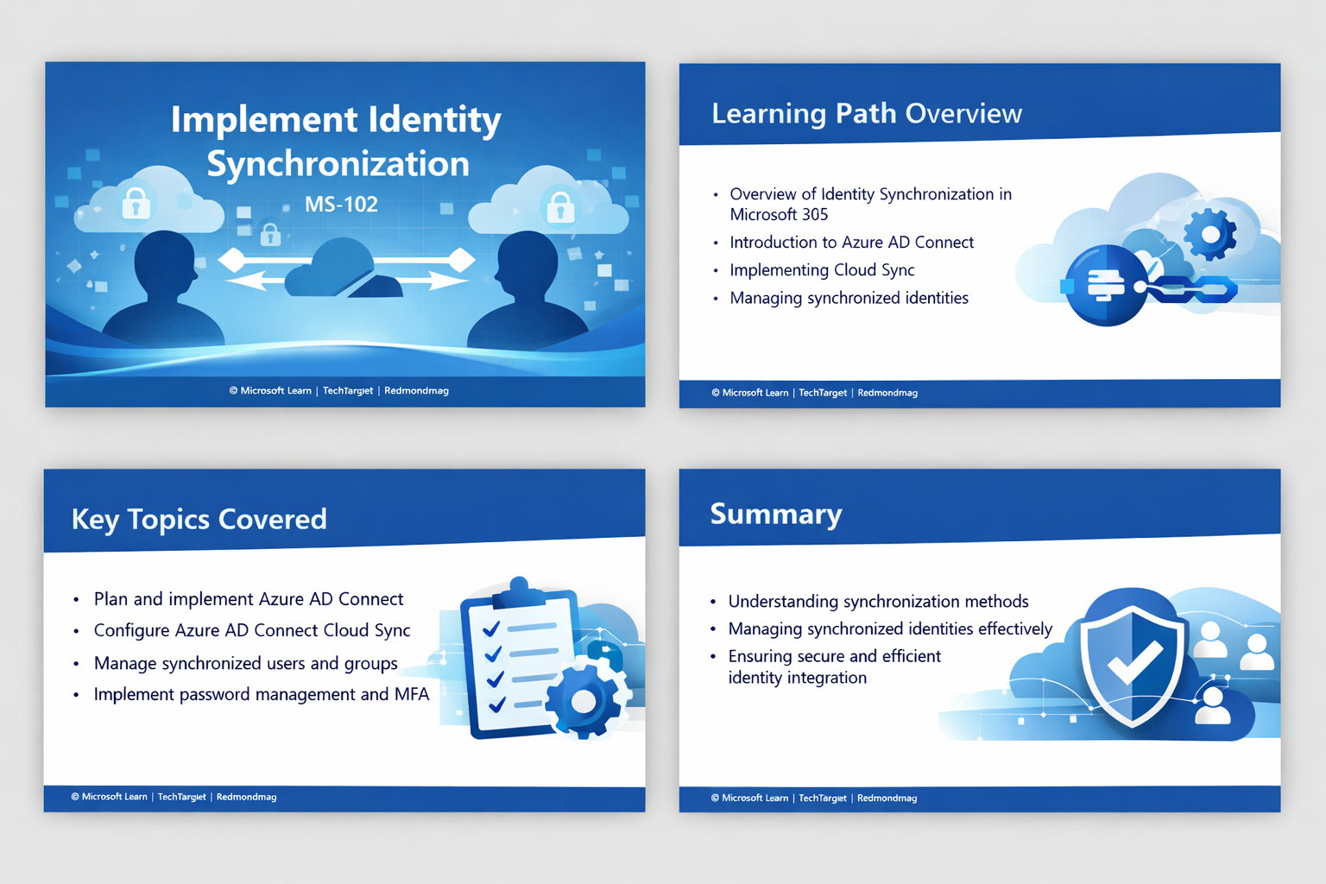
Manage compliance
in Microsoft 365
Learning Path Overview
Classify your organization’s data and implement sensitivity labels to maintain a secure and compliant environment.
[1]
Notes:
Slide 1: Manage compliance in Microsoft 365 – Learning Path Overview
1. Slide Intent
Learners should understand the overall goal: to classify organisational data and apply sensitivity labels for a secure, compliant Microsoft 365 environment.
This concept is vital because regulatory compliance and data protection are foundational to trust and operational resilience in any enterprise.
2. Key Talking Points
Microsoft 365 provides built-in tools for data classification and labelling.
Sensitivity labels help enforce security policies and compliance requirements.
The slide’s visuals (clouds, locks, checklists) represent layered security and governance.
The learning path covers both conceptual understanding and practical implementation.
3. Technical Depth / Behind the Scenes
Data classification frameworks are implemented using Microsoft Purview.
Sensitivity labels are enforced across Exchange, SharePoint, OneDrive, and Teams.
Policies are evaluated in real time, with enforcement at the document and email level.
4. Real-World Example or Scenario
A law firm uses sensitivity labels to restrict access to confidential case files, ensuring only authorised staff can view or share them.
5. Common Mistakes & Misconceptions
Believing that labelling data is a one-time task rather than an ongoing process.
Assuming default labels are sufficient for all business needs.
6. Best Practices & Recommendations
Regularly review and update classification policies.
Involve compliance, IT, and business stakeholders in framework design.
7. Exam & Assessment Notes
Expect questions on the purpose and scope of sensitivity labels and data classification frameworks.
8. Instructor Prompts / Engagement Cues
Ask: “What types of sensitive data exist in your organisation, and how are they currently protected?”
9. References & Further Reading
https://learn.microsoft.com/en-us/training/modules/implement-data-classification-sensitive-information/#:~:text=,creating%20a%20data%20classification%20framework

Slide 2
Learning Objectives
Develop a data classification framework and leverage trainable classifiers and document fingerprinting.
Describe the purpose and scope of sensitivity labels and understand their policies and ordering.Implement sensitivity labels: plan deployment, enable encrypted files in SharePoint/OneDrive, create and publish labels.
[2] [3] [4]
Notes:
Slide 2: Learning Objectives
1. Slide Intent
Learners must know what skills and knowledge they will gain, including developing a data classification framework and implementing sensitivity labels.
These objectives are crucial for building a compliant and secure Microsoft 365 environment.
2. Key Talking Points
Data classification frameworks: what they are and why they matter.
Trainable classifiers and document fingerprinting: advanced tools for identifying sensitive data.
Sensitivity labels: purpose, scope, policies, and ordering.
Steps to implement sensitivity labels: planning, enabling encryption, creating, and publishing labels.
3. Technical Depth / Behind the Scenes
Trainable classifiers use machine learning to identify custom data patterns.
Document fingerprinting allows detection of unique document types.
Sensitivity label policies determine how and where labels are applied, including encryption and access controls.
4. Real-World Example or Scenario
A healthcare provider uses document fingerprinting to identify and protect patient records across SharePoint and OneDrive.
5. Common Mistakes & Misconceptions
Not enabling encryption for sensitive files in SharePoint/OneDrive.
Overlooking the importance of label policy ordering.
6. Best Practices & Recommendations
Test label deployment in a pilot group before organisation-wide rollout.
Document and communicate label policies to all users.
7. Exam & Assessment Notes
Focus on label policy configuration, deployment steps, and technical capabilities.
8. Instructor Prompts / Engagement Cues
Quick check: “Who can explain the difference between a sensitivity label and a label policy?”
9. References & Further Reading
https://learn.microsoft.com/en-us/training/modules/implement-data-classification-sensitive-information/#:~:text=,creating%20a%20data%20classification%20framework
https://learn.microsoft.com/en-us/training/modules/explore-sensitivity-labels-microsoft-365/#:~:text=,what%20label%20policies%20can%20do
https://learn.microsoft.com/en-us/training/modules/implement-sensitivity-labels-microsoft-365/#:~:text=,that%20satisfies%20your%20organization%27s%20requirements

Slide 3
Modules Overview
[5] [6] [7]
Module | Key topics
Data classification of sensitive information | Benefits & pain points, trainable classifiers, Content/Activity explorer, Document Fingerprinting
Explore sensitivity labels | Label concepts, reasons for use, scope configuration, label ordering, label policies
Implement sensitivity labels | Deployment strategy, enablement in SharePoint & OneDrive, creation, publishing & removal
Notes:
Slide 3: Modules Overview
1. Slide Intent
Learners should see the structure of the course and how each module contributes to comprehensive compliance management.
2. Key Talking Points
Three main modules: Data classification, Explore sensitivity labels, Implement sensitivity labels.
Each module addresses specific topics: benefits, pain points, classifiers, label concepts, deployment strategies.
The table clarifies which skills are developed in each module.
3. Technical Depth / Behind the Scenes
Data classification uses Content/Activity Explorer and trainable classifiers for deep data discovery.
Sensitivity label ordering and policy scope affect how protections are applied across workloads.
Deployment strategies must account for SharePoint/OneDrive encryption and lifecycle management.
4. Real-World Example or Scenario
An enterprise rolling out sensitivity labels must coordinate between IT, compliance, and business units to ensure effective adoption.
5. Common Mistakes & Misconceptions
Treating modules as isolated; in practice, effective compliance requires integration across all areas.
6. Best Practices & Recommendations
Map each module to specific organisational roles and responsibilities.
Encourage cross-team collaboration during implementation.
7. Exam & Assessment Notes
Scenario-based questions may require linking concepts from multiple modules.
8. Instructor Prompts / Engagement Cues
Discussion: “Which module do you anticipate will be most challenging for your team?”
9. References & Further Reading
https://learn.microsoft.com/en-us/training/modules/implement-data-classification-sensitive-information/#:~:text=,creating%20a%20data%20classification%20framework
https://learn.microsoft.com/en-us/training/modules/explore-sensitivity-labels-microsoft-365/#:~:text=,what%20label%20policies%20can%20do
https://learn.microsoft.com/en-us/training/modules/implement-sensitivity-labels-microsoft-365/#:~:text=,that%20satisfies%20your%20organization%27s%20requirements

Slide 4

Summary & Wrap‑Up
• Establish a clear classification strategy and leverage advanced classifiers and fingerprinting to protect sensitive items.
• Use sensitivity labels to enforce consistent protection across data while maintaining productivity.
• Develop and execute a deployment plan for sensitivity labels, ensuring encryption support and lifecycle management.
Next Steps
Review previous modules and prepare for the MS‑102 exam.
Join the community for ongoing updates.
[8] [9] [10]
Notes:
Slide 4: Summary & Wrap-Up
1. Slide Intent
Learners should consolidate their understanding and know the next steps for maintaining compliance and preparing for the MS-102 exam.
2. Key Talking Points
Establish a clear classification strategy using advanced classifiers and fingerprinting.
Sensitivity labels enforce consistent protection and support productivity.
Deployment plans must include encryption and lifecycle management.
Encourage review of previous modules and ongoing community engagement.
3. Technical Depth / Behind the Scenes
Encryption support is managed via label policies and integrated with Microsoft 365 services.
Lifecycle management includes label publishing, updating, and removal.
4. Real-World Example or Scenario
After a compliance audit, an organisation updates its sensitivity labels and retrains classifiers to address new regulatory requirements.
5. Common Mistakes & Misconceptions
Failing to update labels and policies as business needs evolve.
Overlooking the importance of ongoing monitoring and review.
6. Best Practices & Recommendations
Schedule regular compliance reviews and policy updates.
Join professional communities for the latest updates and best practices.
7. Exam & Assessment Notes
Expect questions on label lifecycle, encryption, and compliance strategy.
8. Instructor Prompts / Engagement Cues
Ask: “What is your organisation’s next step in improving compliance?”
9. References & Further Reading
https://learn.microsoft.com/en-us/training/modules/implement-data-classification-sensitive-information/#:~:text=,creating%20a%20data%20classification%20framework
https://learn.microsoft.com/en-us/training/modules/explore-sensitivity-labels-microsoft-365/#:~:text=,what%20label%20policies%20can%20do
https://learn.microsoft.com/en-us/training/modules/implement-sensitivity-labels-microsoft-365/#:~:text=,that%20satisfies%20your%20organization%27s%20requirements

