Slide 1
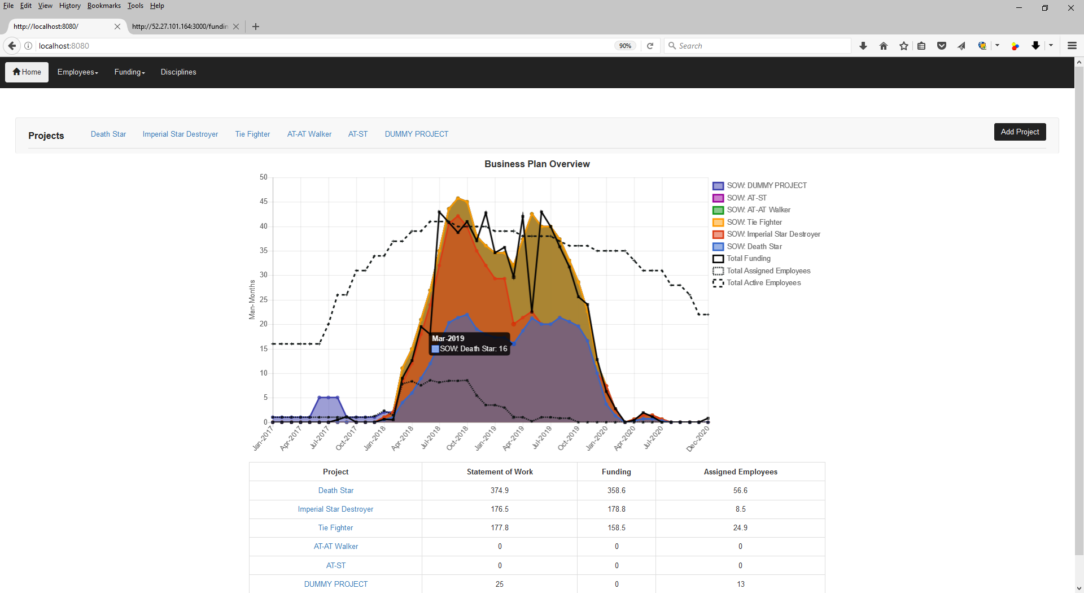
Index / Landing Page
OSU / Spring 2017 / CS467 / Team Cassiopeia (Guthrie, Kuretski, Stramel) Page 1
Description
This is the home screen for the entire application. From here the user can view a summary of the entire business plan including the estimated statement of work (by project), the total funding allocation, total available (active) employees, and total assigned employees.
The navigation bar across the top provides the user access to a number of maintenance and summary pages such as employee list and utilization, funding by project or type, and disciplines.
The Projects navigation bar allows the user to select or drill down into a particular project. The “Add Project” button on the right hand side of the Projects navigation bar allows the user to do just that.
Important Notes
The application can be accessed at http://34.210.131.245
Supported browsers include Chrome and Firefox at a minimum.
Internet Explorer is not supported.
Support for Safari, Opera, and Edge has not been verified.
Time constraints necessitated the construction of this demo document prior to project completion. Therefore you may see some minor differences between this document and the final deliverable.
Demonstration Steps
With your mouse hover over any data point on any curve.
You should see the numerical value and the associate date for that data point.
In the chart legend, click on “SOW: Death Star”.
You should see the statement of work associated with the project disappear from the chart. Click it again to bring it back.
This is a good tool for scenario planning such as taking on new projects or cancellations of existing projects.
Note that projects are displayed in a stacked area format.
The total area under all of the shaded curves represents the total statement of work for all projects.
The area under any one shaded curve represents the total statement of work for an individual project.
Note that the employee and funding curves are simple line format.
The total areas under each of these curves represent business level totals.
Click on the “Add Project” button.
In the pop-up window, enter a title and a short description for the project.
Click “Add New Project” and you should see your new project page.
Click on the link titled “Death Star” in the Projects navigation bar.
Proceed to page 2 of this demonstration.
1
2
4
3
2
5
1
4
3
5

Slide 2
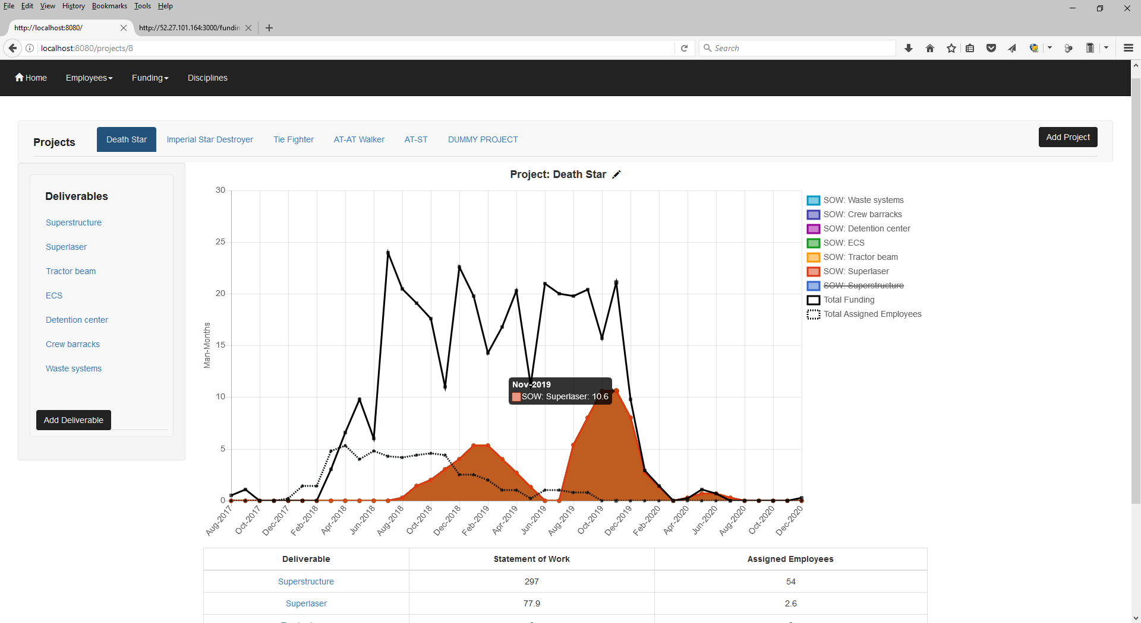
Project Page
OSU / Spring 2017 / CS467 / Team Cassiopeia (Guthrie, Kuretski, Stramel) Page 2
Description
This is the project summary screen. From here the user can view an overview of the entire project plan including the estimated statement of work (by deliverable), the total funding allocation, and total of employees currently assigned.
The view is visually and functionally similar to the index / landing page but provides more specific data for an individual project.
The Deliverables navigation bar allows the user to select or drill down into a particular project deliverable. The “Add Deliverable” button on the bottom of the Deliverables navigation bar allows the user to do just that.
Demonstration Steps
Note that “Death Star” is highlighted on the Projects Navigation bar and the title above the chart has also changed.
Note the appearance of the new Deliverables navigation bar. The Deliverables are specific to this project.
With your mouse hover over any data point on any curve.
You should see the numerical value and the associate date for that data point.
This is a good tool for understanding the alignment of employees, funding, and statement of work over time.
In the chart legend, click on “SOW: Superstructure”.
You should see the statement of work associated with the project disappear from the chart. Click it again to bring it back.
Note that deliverables are displayed in a stacked area format.
The total area under all of the shaded curves represents the total statement of work for all deliverables (for the project as a whole) and matches that shown on the Index / Landing page.
The area under any one shaded curve represents the total statement of work for an individual deliverable.
Note that the employee and funding curves are simple line format.
The total areas under each of these curves represent project level totals.
Click on the pencil next to the Project Title.
In the pop-up window, update the title from “Death Star” to “Death Star #2” and update the description from “DS-1” to “DS-2” (for unfortunate reasons).
Click “Update Project” and you should see the updated project name in various locations.
Click on the “Add Deliverable” button.
In the pop-up window, enter a title such as “Thermal Exhaust Protection” and a short description for the deliverable.
Click “Add New Deliverable to Death Star #2” and you should see your new project on the Deliverables navigation bar.
Click on the link titled “Superstructure” in the Deliverables navigation bar.
Proceed to page 3 of this demonstration.
1
2
1
3
2
3
4
4
5
5

Slide 3
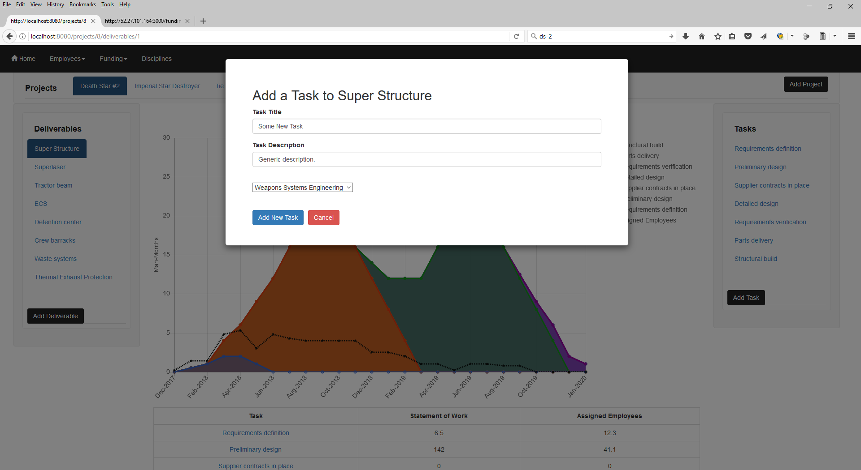
Deliverable Page
OSU / Spring 2017 / CS467 / Team Cassiopeia (Guthrie, Kuretski, Stramel) Page 3
Description
This is the deliverable summary screen. From here the user can view an overview of the entire deliverable plan including the estimated statement of work (by task) and total of employees currently assigned.
The view is visually and functionally similar to the project page but provides more specific data for an individual project deliverable.
The Tasks navigation bar allows the user to select or drill down into a particular task that supports this project deliverable. The “Add Task” button on the bottom of the Tasks navigation bar allows the user to do just that.
Demonstration Steps
Note that “Death Star #2” is highlighted on the Projects Navigation bar, “Superstructure” is highlighted on the Deliverables Navigation bar, and the title above the chart has also changed.
Note the appearance of the new Tasks navigation bar. The Tasks are specific to this project deliverable.
You may optionally note similar functionality to other pages already presented in prior pages.
Mouse hover over any data point on any curve.
In the chart legend, click on “SOW: Detailed Design” several times.
Tasks are displayed in a stacked area format.
The total area under all of the shaded curves represents the total statement of work for all tasks (for the project deliverable as a whole).
The assigned employee curve is simple line format.
The total area under this curve represents a deliverable level total.
Click on the pencil next to the Deliverable Title.
In the pop-up window, update the title from “Superstructure” to “Super Structure”.
Click “Update Deliverable” and you should see the updated deliverable name in various locations.
Click on the “Add Task” button.
In the pop-up window, enter a title and a short description for the task.
Click “Add New Task” and you should see your new project on the Deliverables navigation bar.
You’ll also need to select a Discipline from the drop down list for this task. This represents the skill set required to complete this task.
Click on one of the two links titled “Preliminary Design”.
The first link is in the Tasks navigation bar.
The second link is in the summary table below the chart.
Both links will take you to the task summary page.
Proceed to page 4 of this demonstration.
1
2
2
1
3
4
3
4

Slide 4
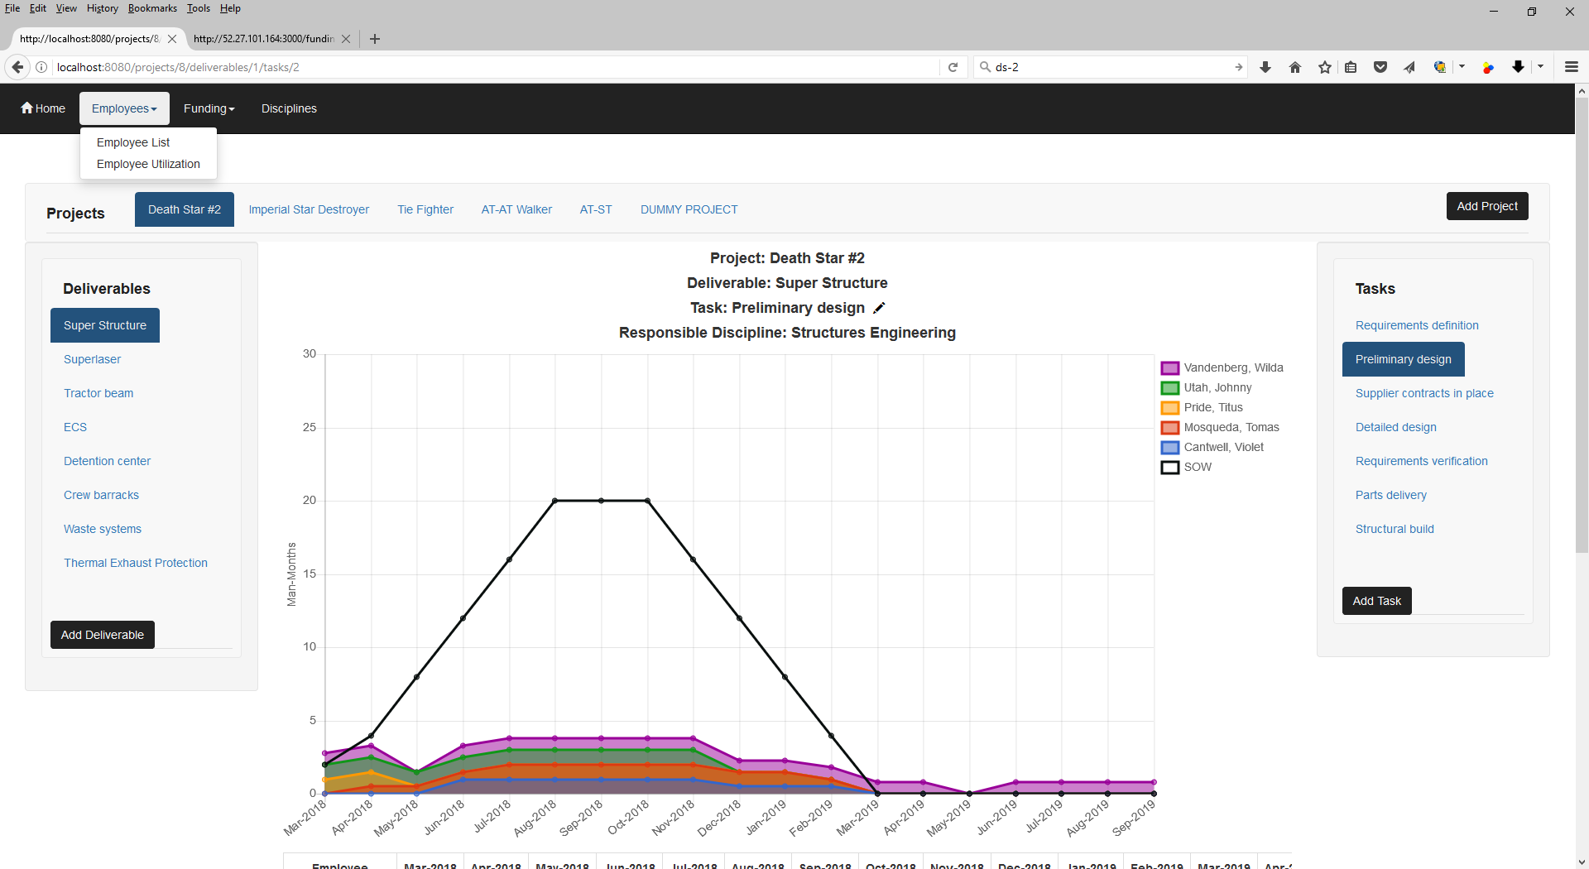
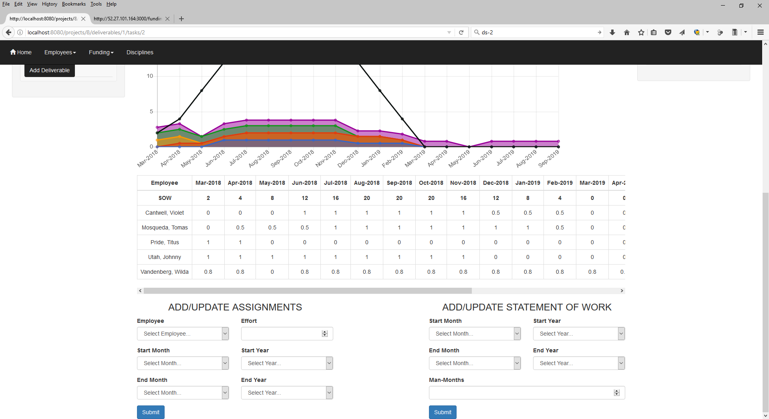
Task Page
OSU / Spring 2017 / CS467 / Team Cassiopeia (Guthrie, Kuretski, Stramel) Page 4
Description
This is the task summary screen. From here the user can input the estimated statement of work and assigned individual employees to a particular task. The user can also see visual representations of the same data which are updated in real time as the user makes updates.
The chart portion of the view is visually and functionally similar to the deliverable page but provides more specific data for an individual task that supports a project deliverable.
Demonstration Steps
Note that “Death Star #2” is highlighted on the Projects Navigation bar, “Super Structure” is highlighted on the Deliverables Navigation bar, “Preliminary design” is highlighted on the Tasks Navigation and the title above the chart has also changed.
Note the appearance of the new summary table (relative to the other views). Whereas the other views show totals, the Task view shows by month statement of work and employee assignments.
You may optionally note similar functionality to other pages already presented in prior pages.
Mouse hover over any data point on any curve.
In the chart legend, click on “Cantwell, Violet” several times.
Employee assignments are displayed in a stacked area format.
The total area under all of the shaded curves represents the total of assigned employees for this particular task.
The statement of work curve is simple line format.
The total area under this curve represents a task level total.
Click on the pencil next to the Task Title.
In the pop-up window, add a description.
Click “Update Task”.
Under “ADD/UPDATE ASSIGNMENTS”, fill in each field and click submit. This will assign a portion of an employees time to this task for a period of time.
Employee: “Amin, Shane”
Effort: 0.8
Start: April/2018
End: March/2019
You should see that both the chart and the table are updated.
Under “ADD/UPDATE STATEMENT OF WORK”, fill in each field and click submit. This will update the estimate statement of work for this task for a period of time.
Start: Aug/2018
End: Oct/2018
Man-months: 18
You should see that both the chart and the table are updated.
On the upper left of the screen, click on the “Employees” drop-down and then click “Employee List”.
Proceed to page 5 of this demonstration.
1
2
6
3
1
3
4
2
5
4
5
6

Slide 5
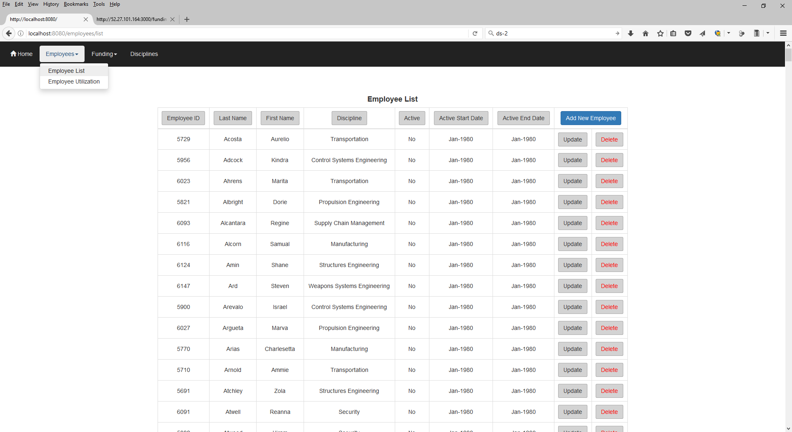
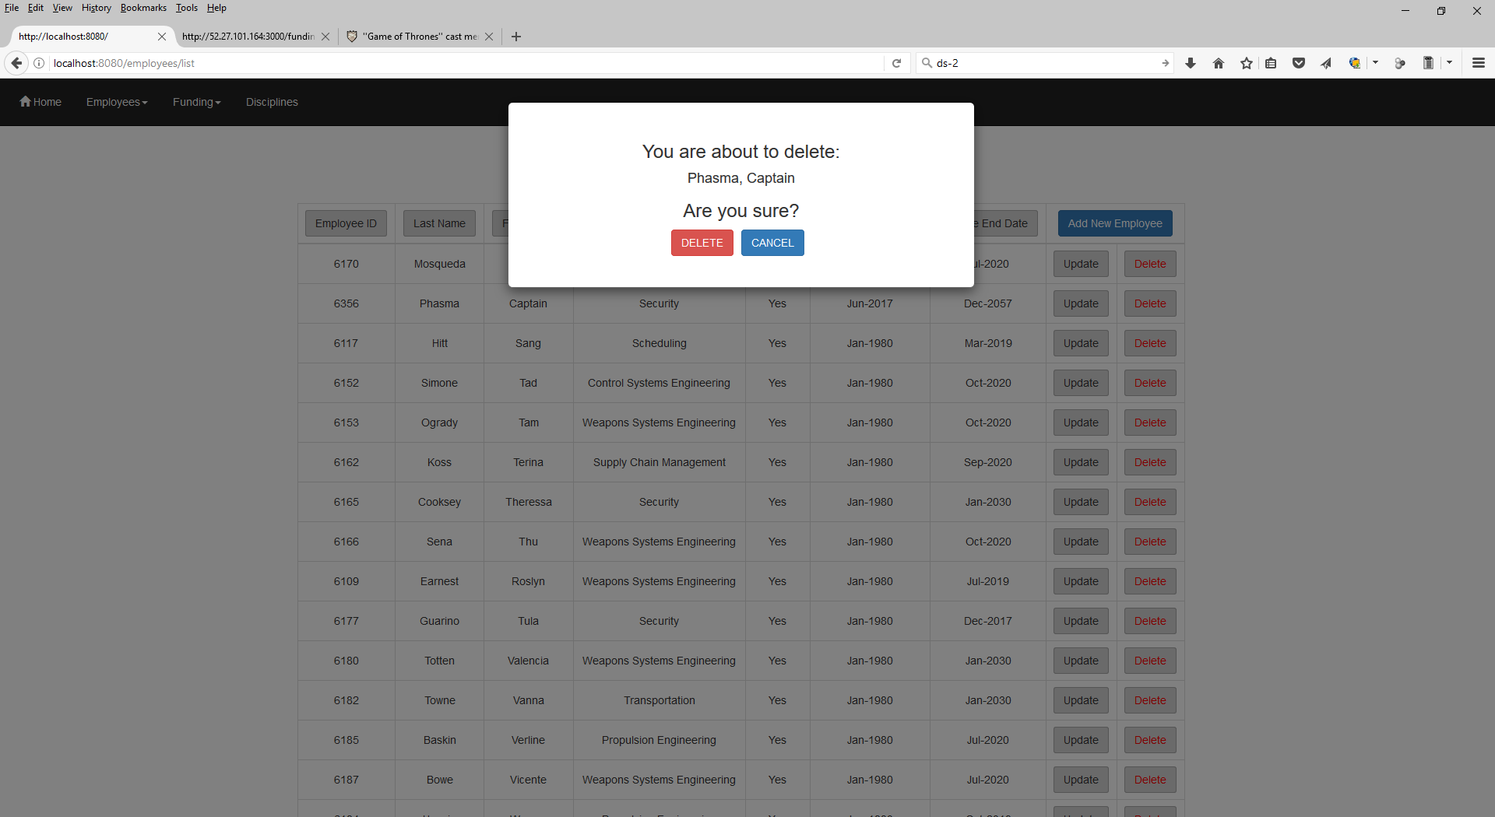
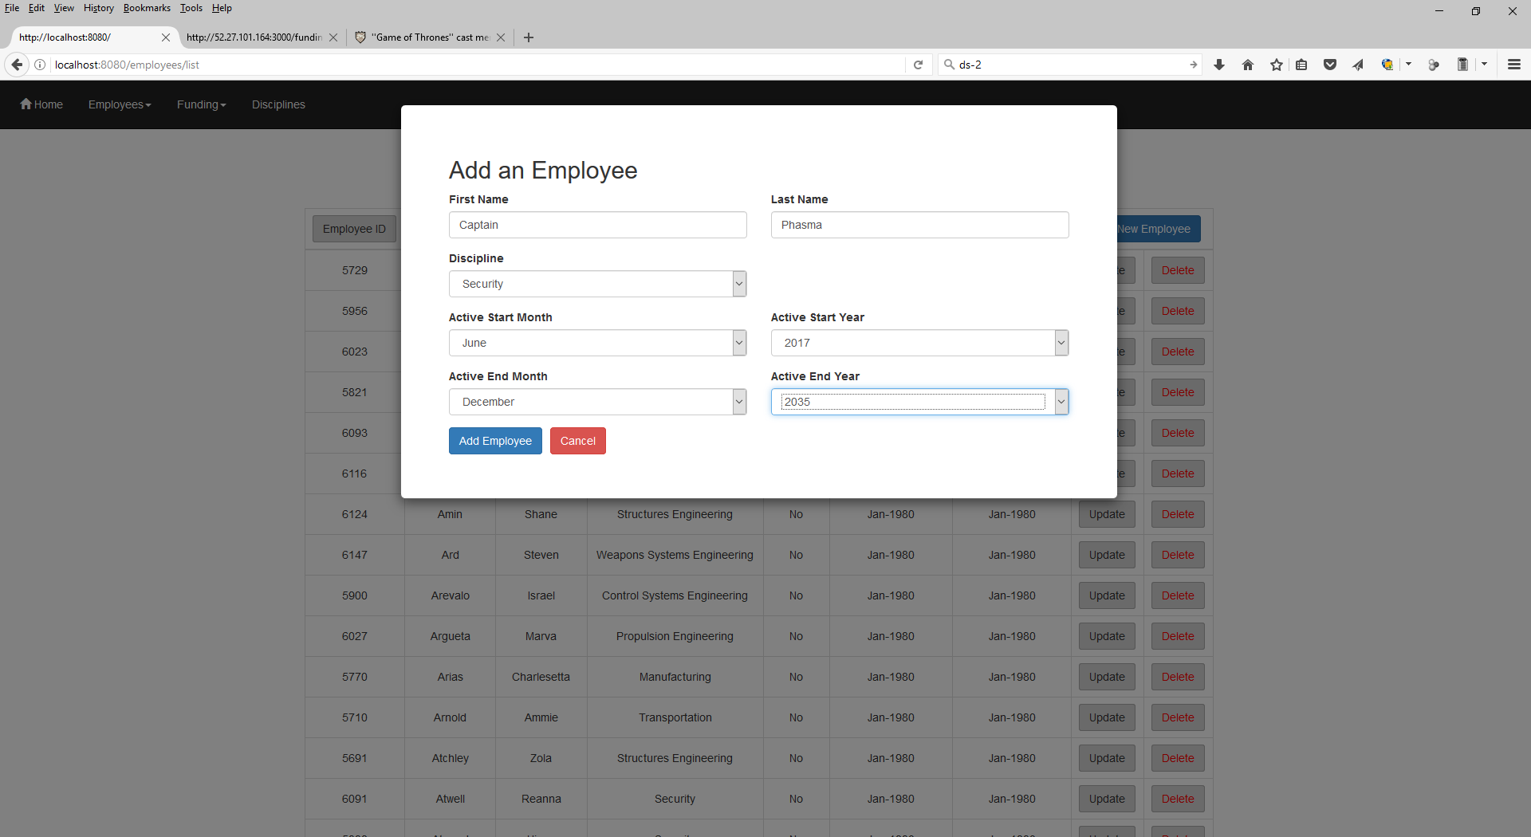
Employee List Page
OSU / Spring 2017 / CS467 / Team Cassiopeia (Guthrie, Kuretski, Stramel) Page 5
Description
This is a maintenance page where users can see the employees that do or have worked for the company over time. Employees can also be added, updated, or deleted from this page.
Demonstration Steps
Click the “Employee ID” button to sort the employee list based on employee ID. You can also sort by Last Name, First Name, Discipline, Active, and Start/End dates.
Click the “Add New Employee” button, fill in each field and click submit.
First Name: “Captain”
Last Name: “Phasma”
Discipline: “Security”
Active Start: June/2017
Active End: Dec/2057 (meaning unknown at the moment)
After clicking “Add Employee” you should be able to find the new employee in the list.
Click the “Update” button next to “Captain Phasma”.
Change “Active End Year” to 2017 (we can’t be sure she’ll be available after The Last Jedi).
After clicking “Update Employee” you should be able to see the updates in the list.
Take note of the Employee ID for “Captain Phasma” in the list.
Click the “Delete” button next to “Captain Phasma”.
You will get a warning.
Go ahead and click “Delete”.
Search for her Employee ID to verify deletion. She should not appear in the list.
On the upper left of the screen, click on the “Employees” drop-down and then click “Employee Utilization”.
Proceed to page 6 of this demonstration.
1
1
2
4
2
3
3
4

Slide 6
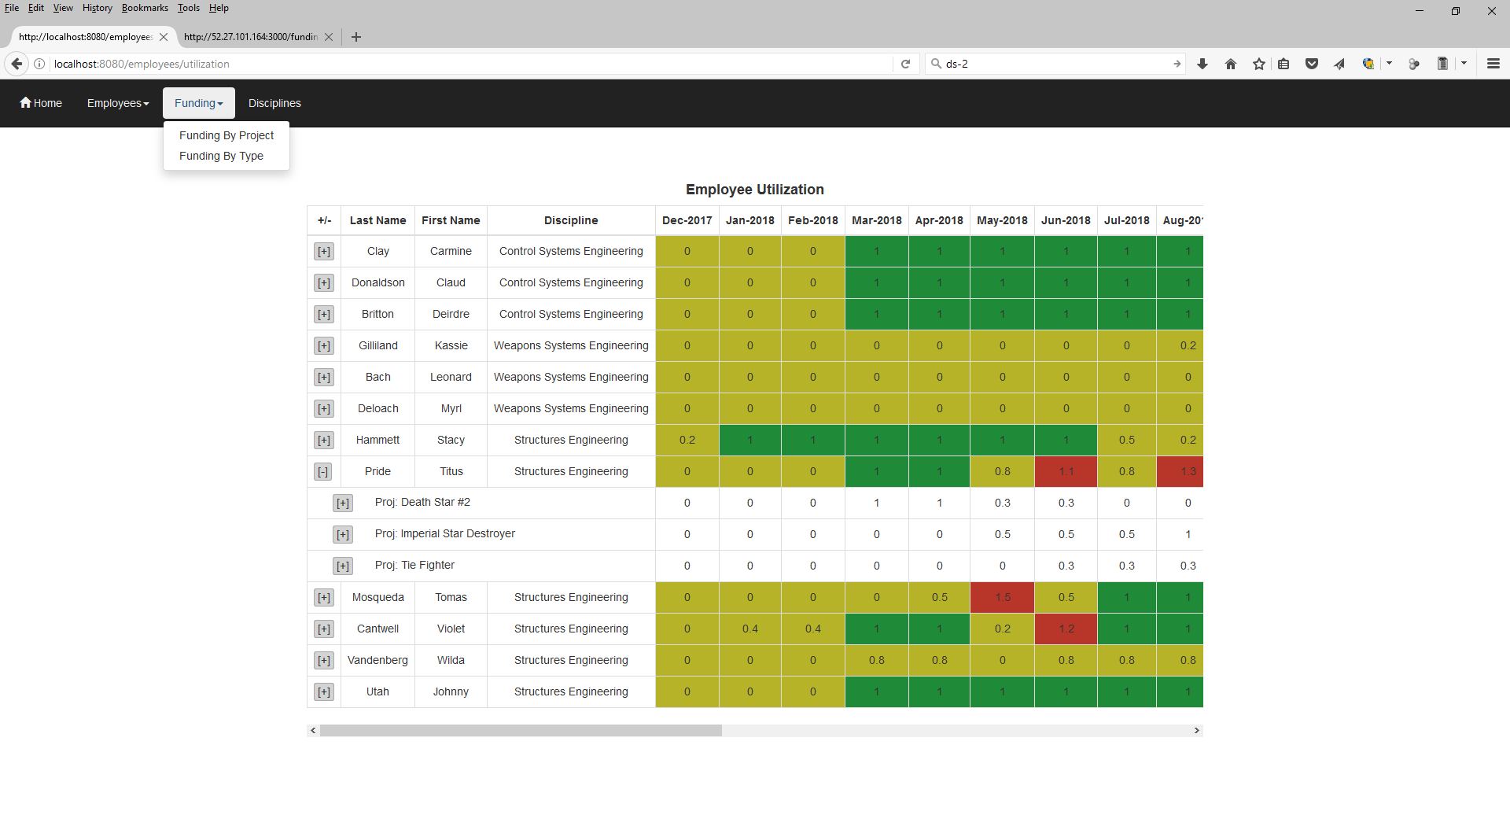
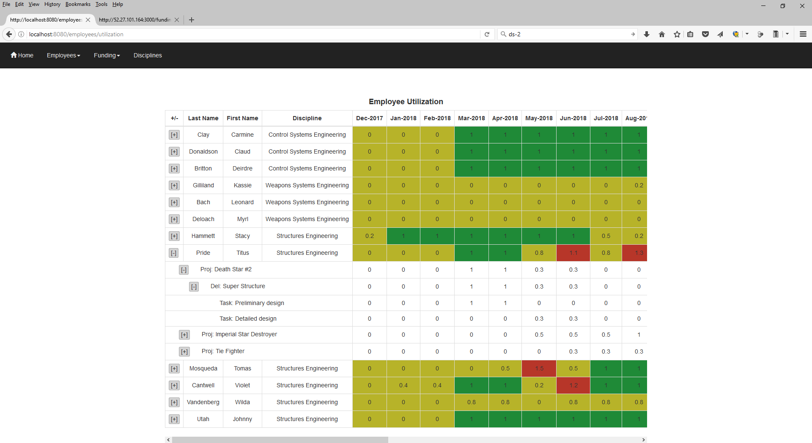
Employee Utilization Page
OSU / Spring 2017 / CS467 / Team Cassiopeia (Guthrie, Kuretski, Stramel) Page 6
Description
This is a maintenance page where users can see the employees that have been assigned work over time. This is a view only page designed to help managers understand if their employees are over or under allocated.
Months where employees have assignments totaling less than 100% of their time (underallocated) are highlighted in yellow. Similarly, months where employees have assignments totaling more than 100% of their time (overallocated) are highlight in red. Green is used to highlight months with balanced allocation. In an ideal world the entire table would be green.
Demonstration Steps
Note that in June of 2018, employee Titus Pride appears to be overallocated. He’s been assigned 1.1 man-months worth of work.
Click the “[+]” button next to Title Pride’s name to view which projects he’s assigned to work on.
Note that he’s been assigned 0.3, 0.5, and 0.3 man-months worth of work to projects “Death Star #2”, “Imperial Star Destroyer”, and “Tie Fighter” in June of 2018.
Click the “[+]” button next to “Proj: Death Star #2” to view which deliverables he’s assigned to in support of that project. Further click the “[+]” button next to “Del: Super Structure” under that project to view which tasks he’s assigned to in support of that deliverable.
Note that the 0.3 man-months of June 2018 Death Star work is solely in support of Detailed Design of the Super Structure.
Click the various “[-]” buttons to collapse the table as desired.
On the upper left of the screen, click on the “Funding” drop-down and then click “Funding By Project”.
Proceed to page 7 of this demonstration.
1
2
3
4
1
4
2
3

Slide 7
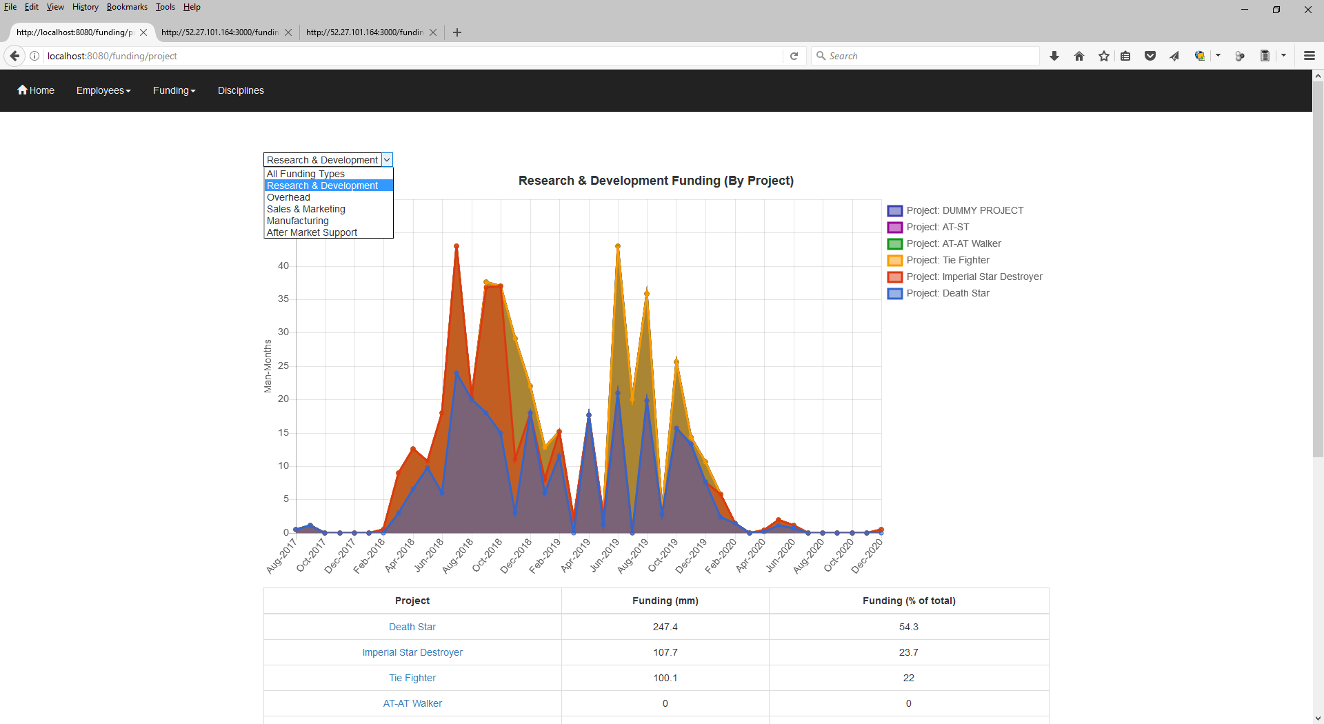
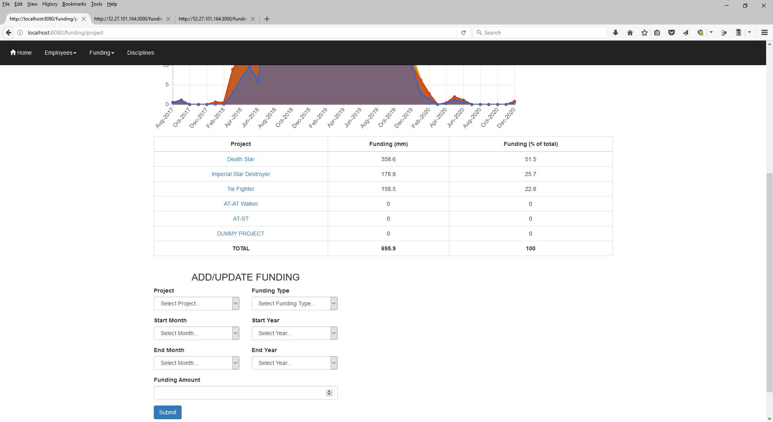
Funding By Project Page
OSU / Spring 2017 / CS467 / Team Cassiopeia (Guthrie, Kuretski, Stramel) Page 7
Description
This is one of two pages where users can view summaries of available funding for the organization and can make updates to the available funding. The user may also use this form to add, update, or delete funding.
This page allows users to see summaries of funding broken out my project. The chart provides a visual summary and the table provides project specific funding on both total and percentage bases. This view is provided at an overall basis or (using the drop down on the upper left) on a funding type basis.
Demonstration Steps
You may optionally note similar functionality to other pages already presented in prior pages.
Mouse hover over any data point on any curve.
In the chart legend, click on “Project: Death Star” several times.
The total area under all of the shaded curves represents the total funding for all projects.
The area under any one shaded curve represents the funding available for an individual project.
Perhaps we are only interested in the distribution of R&D funding by project. Click on the dropdown and change the selection from “All Funding Types” to “Research and Development”.
Note that the chart and the table are update with a new funding breakdown by project that specifically only includes R&D spending.
Under “ADD/UPDATE FUNDING”, fill in each field and click submit. This will assign funding of a particular type to a particular project for a period of time.
Project: “AT-ST”
Funding Type: “Sales & Marketing”
Start: April/2018
End: March/2019
Funding Amount: 10
You should see that both the chart and the table are updated when you select “All Funding Types” or “Sales and Marketing” in the dropdown.
Under “ADD/UPDATE FUNDING”, fill in each field and click submit. This will assign funding of a particular type to a particular project for a period of time.
Project: “AT-ST”
Funding Type: “Sales & Marketing”
Start: April/2018
End: March/2019
Funding Amount: 0 (Using a value of zero indicates deletion of funding).
You should see that both the chart and the table are updated when you select “All Funding Types” or “Sales and Marketing” in the dropdown.
On the upper left of the screen, click on the “Funding” drop-down and then click “Funding By Type”.
Proceed to page 8 of this demonstration.
3
1
1
2
2
2
3

Slide 8
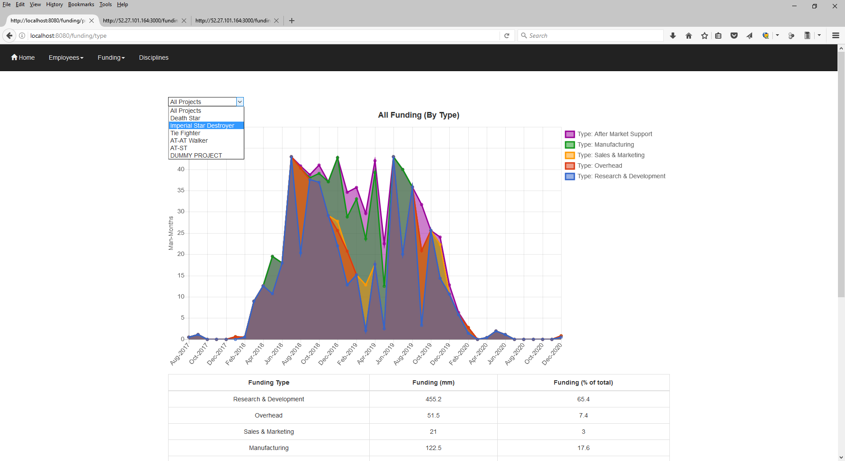
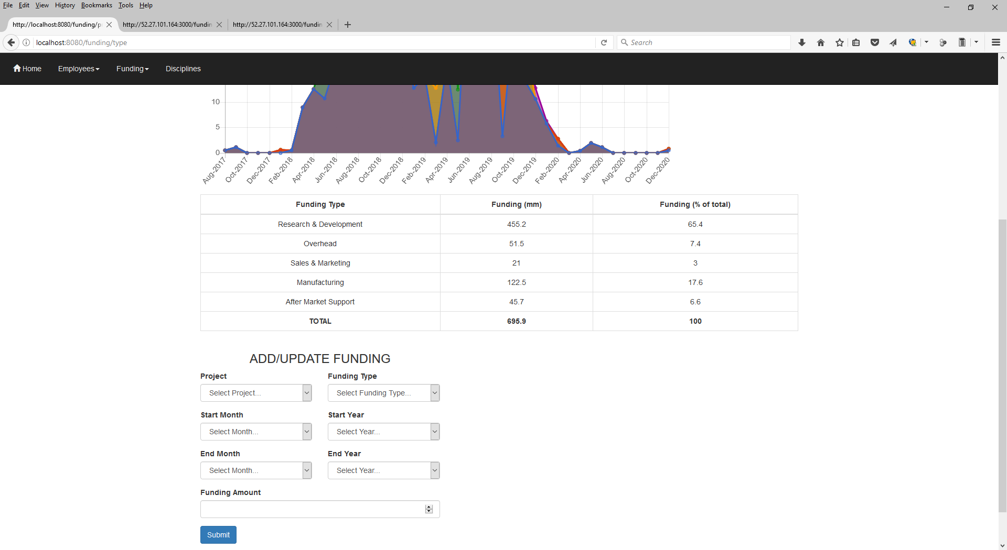
Funding By Type Page
OSU / Spring 2017 / CS467 / Team Cassiopeia (Guthrie, Kuretski, Stramel) Page 8
Description
This page displays the same information as the funding by project page but in a different organizational pattern. It transposes funding by type and by project to give the user an additional way to look at the same data.
This page allows users to see summaries of funding broken out my funding type. The chart provides a visual summary and the table provides type specific funding on both total and percentage bases. This view is provided at an overall basis or (using the drop down on the upper left) on a project basis.
Demonstration Steps
You may optionally note similar functionality to other pages already presented in prior pages.
Mouse hover over any data point on any curve.
In the chart legend, click on “Project: Death Star” several times.
The total area under all of the shaded curves represents the total funding for all projects.
The area under any one shaded curve represents the funding available for an individual project.
Perhaps we are only interested in the distribution of funding for the Imperial Star Destroyer project by funding by funding type. Click on the dropdown and change the selection from “All Projects” to “Imperial Star Destroyer”.
Note that the chart and the table are update with a new funding breakdown by type that specifically only includes the ISD project.
Under “ADD/UPDATE FUNDING”, fill in each field and click submit. This will assign funding of a particular type to a particular project for a period of time.
Project: “AT-ST”
Funding Type: “Sales & Marketing”
Start: April/2018
End: March/2019
Funding Amount: 10
You should see that both the chart and the table are updated when you select “All Project” or “AT-ST” in the dropdown.
Under “ADD/UPDATE FUNDING”, fill in each field and click submit. This will assign funding of a particular type to a particular project for a period of time.
Project: “AT-ST”
Funding Type: “Sales & Marketing”
Start: April/2018
End: March/2019
Funding Amount: 0 (Using a value of zero indicates deletion of funding).
You should see that both the chart and the table are updated when you select “All Project” or “AT-ST” in the dropdown.
On the upper left of the screen, click on the “Discipline” button.
Proceed to page 9 of this demonstration.
3
1
1
2
2
2
3

Slide 9
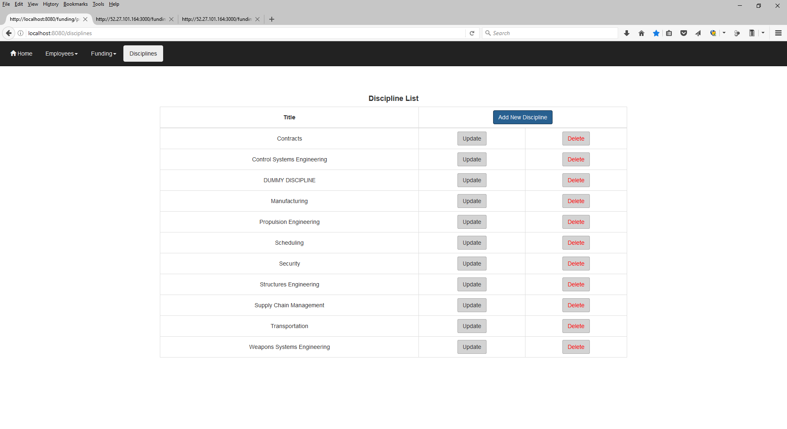
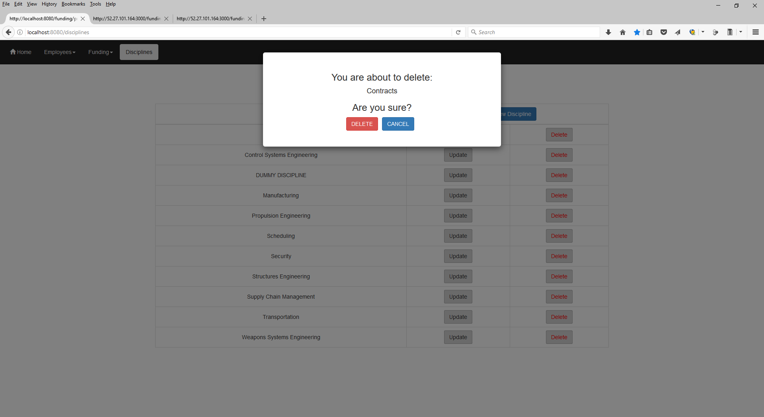
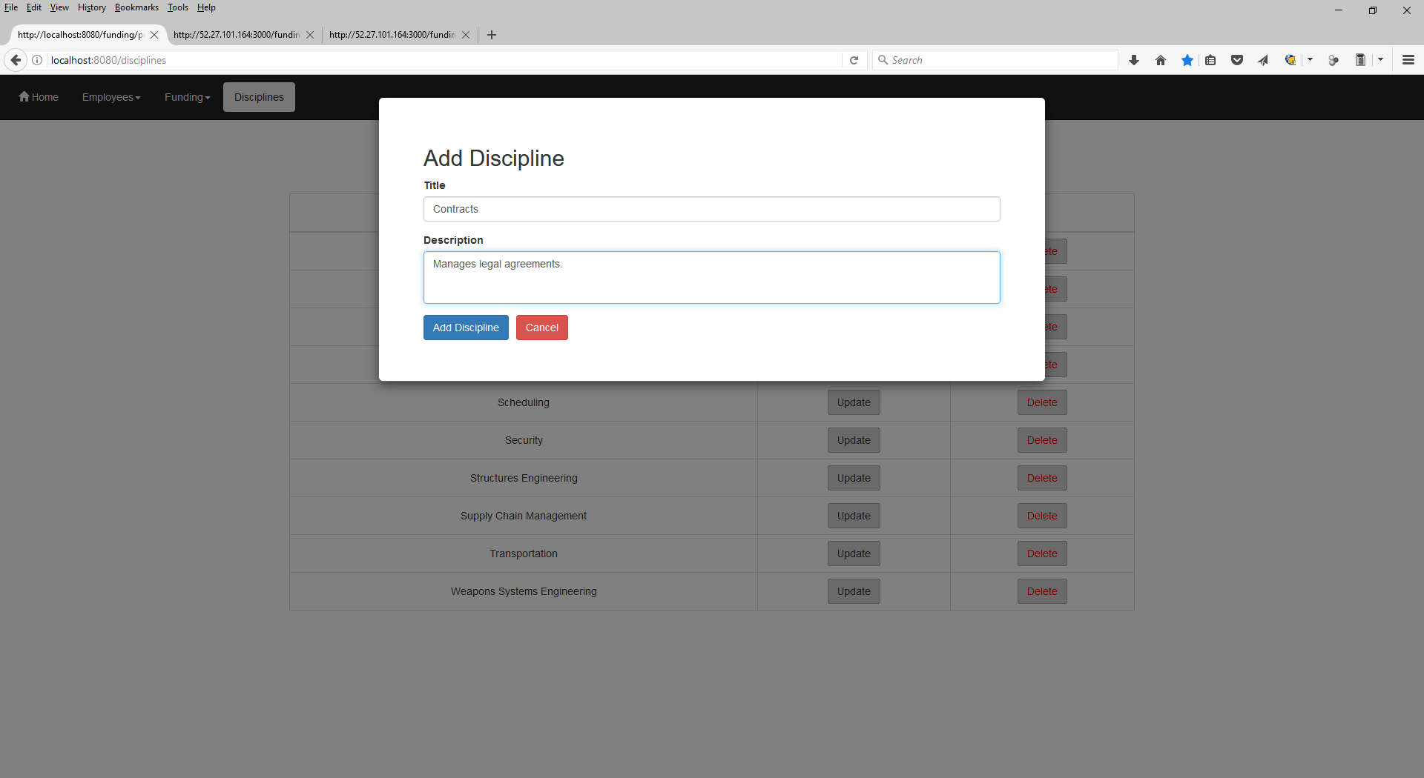
Discipline List Page
OSU / Spring 2017 / CS467 / Team Cassiopeia (Guthrie, Kuretski, Stramel) Page 9
Description
This is a maintenance page where users can see the disciplines (skill or work groups) as defined by the organization. Disciplines can also be added, updated, or deleted from this page.
Demonstration Steps
Click the “Add New Discipline” button, fill in each field and click submit.
Title: “Contracts”
Description: (enter any text of your choosing)
After clicking “Add Discipline” you should be able to find the new discipline in the list.
Click the “Delete” button next to “Contracts”.
You will get a warning.
Go ahead and click “Delete”.
The discipline “Contracts” will be removed from the list.
On the upper left of the screen, click on the “Home” button.
Proceed to page 1 of this demonstration.
1
3
2
2
1
3

