Slide 1
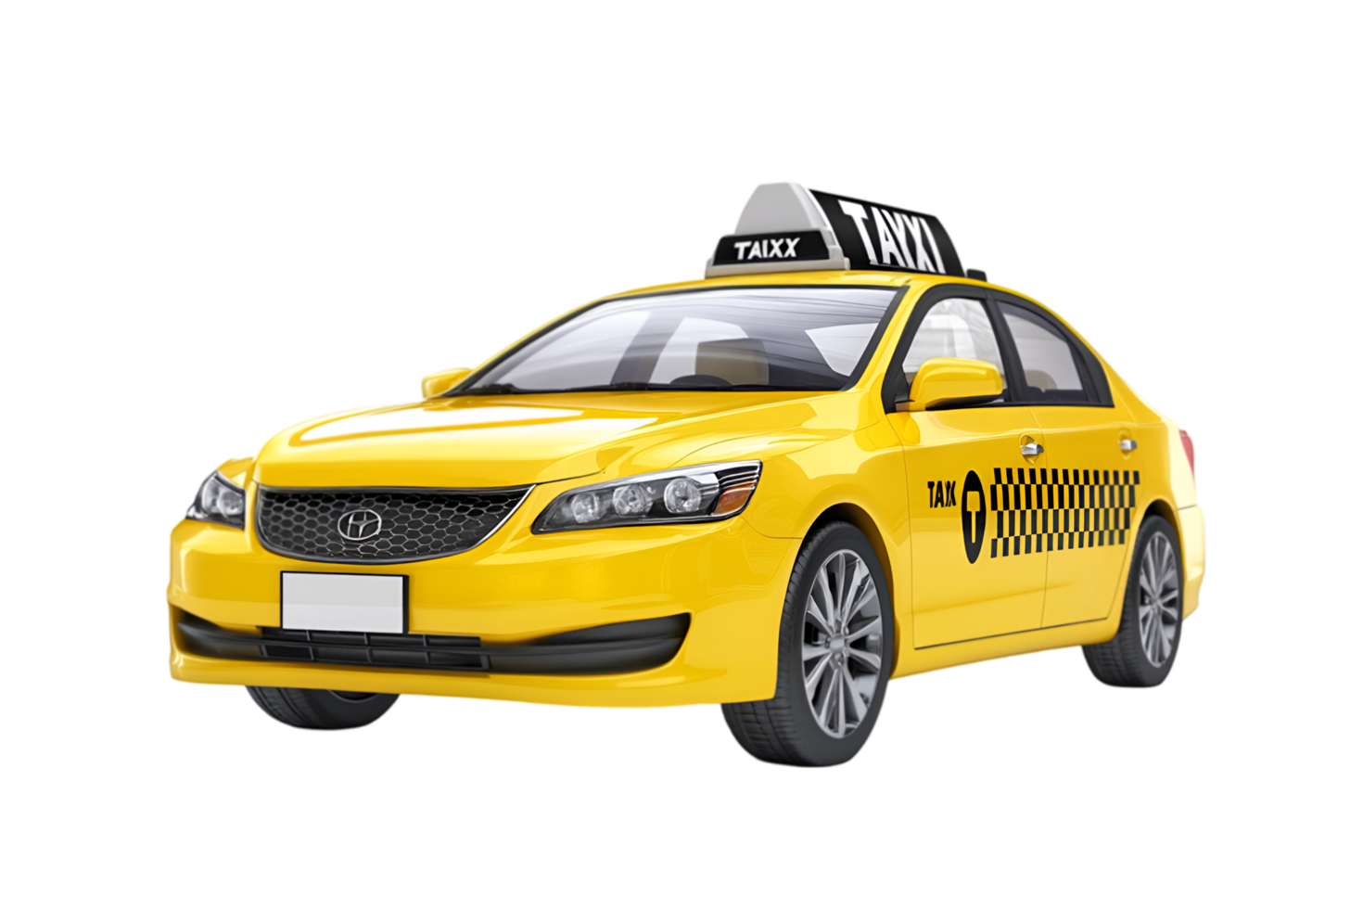
AKK TAXI
Rapid
Sigur
Confortabil
Razvan Taxi
Servicii de transport 24/7
Tel: 0720 064 963

