Slide 1
Predicting Apartment Prices in Helsinki
Notes:
1

Slide 2
Understanding the Context
Apartment prices have been constantly rising in Helsinki during the past 10 years¹
In 2019, the most expensive postal code areas (buildings built before 2018) by average price/m² in Helsinki were²:
00140 Kaivopuisto–Ullanlinna (8804 €/m²)
00120 Punavuori (7709 €/m²)
00150 Eira–Hernesaari (7695 €/m²)
00130 Kaartinkaupunki (7549 €/m²)
00100 Helsinki keskusta–Etu-Töölö (7345 €/m²)
… and the most cheapest:*
00910 Puotila
00930 Itäkeskus–Marjaniemi
00950 Vartioharju
00970 Mellunmäki
00990 Aurinkolahti
* Price info hidden from areas with less than 6 sold apartments or neighbour areas having less than 6 sold
apartments
Notes:
1

Slide 3
Business Problem
This study aims at predicting average sale prices of homes in apartment buildings in Helsinki and to gain a thorough and deep understanding on the factors that affect the prices in Helsinki
Hypotheses:
The most cheapest and expensive postal code areas in 2021 are the same as in 2019
The most significant factors in predicting apartment sale prices are subarea, apartment size and floor number
Notes:
1

Slide 4


Stakeholders
“We want to know where people pay the most/least for their apartments to be able to plan better city and to help avoid segregation”
“Which areas are worth investing?”
Real Estate investors
Private households
City
Optimizing business
Better understanding of the true values of properties and the factors influencing pricing
Urban planning
“I want to sell my apartment – I wonder what is the average price demand of this area and what factors affect it?"
Notes:
1

Slide 5
Data
Variable Name | Explanation | Variable Type | Action
Unnamed: 0 | empty | int64 | deleted
kohde_id | apartment ID | object | deleted
omistusmuoto | responsibility of owner | object | deleted
tyyppi | type of the house | object | deleted
huoneita | number of rooms | int64 | deleted
pinta_ala | size (m²) | float64 | -
kerros | floor number | float64 | -
velatonhinta | free of debt price | int64 | -
velkaosuus | debt | int64 | deleted
yhtiovastike | housing company loan payment + building service / maintenance fee | float64 | -
sauna | sauna | object | to dummy
tontti | land | object | to dummy
vuosi | building year | int64 | -
postinumero | postal code | object | to dummy
kaupunki | city | object | deleted
asuinalue | subarea | object | deleted
katuosoite | address | object | deleted
hoitovastike | building service / maintenance fee | float64 | deleted
rahoitusvastike | housing company loan payment | float64 | deleted
neliovastike | building service / maintenance fee per m² (hoitovastike/pinta_ala) | float64 | created
neliohinta | free of debt price per m² (velatonhinta/pinta_ala) | float64 | created for descr. analysis
Data was collected with a web scraper from Etuovi.com
Null variables and unimportant variables were removed
New variables neliovastike and neliohinta were created for descriptive analysis
Variables of type object (sauna, postinumero, tontti) were dummy coded
Extreme outliers were removed based on the following inclusion rules: 10m² < size < 500 m², 10000 € < free of debt price < 1M €, building service/maintenance fee > 0 € apartments in subarea > 10
1415 entries
Notes:
2

Slide 6
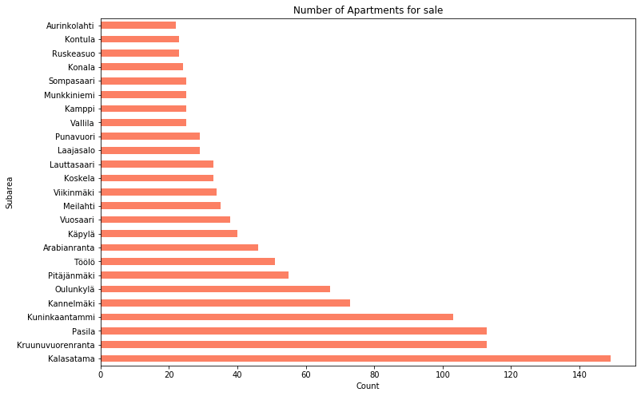
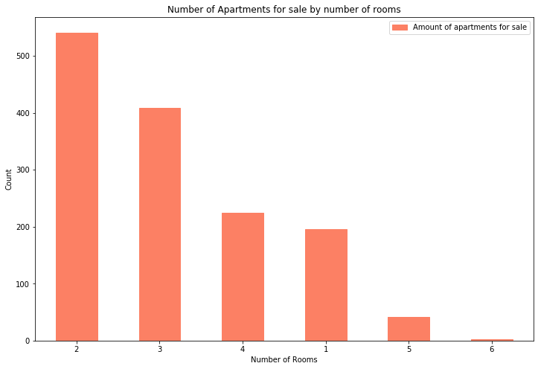
Explanatory Data Analysis
The largest amount of apartments for sale was in Kalasatama, least in Aurinkolahti
Apartments with two rooms were the most common
Notes:
2

Slide 7
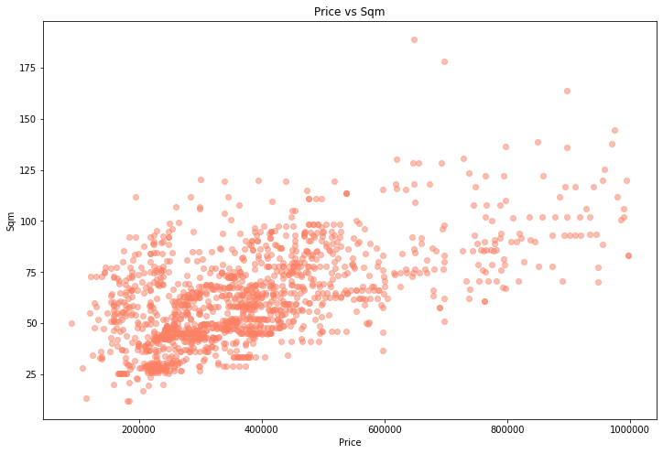
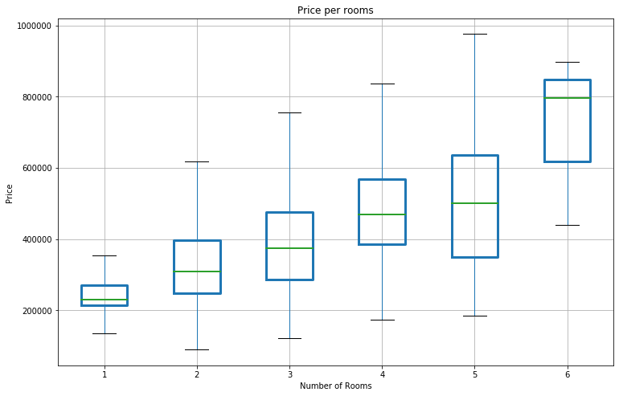
Explanatory Data Analysis
Distribution was large, but there was a trend with price and apartment size as well as price and number of rooms
Notes:
2

Slide 8
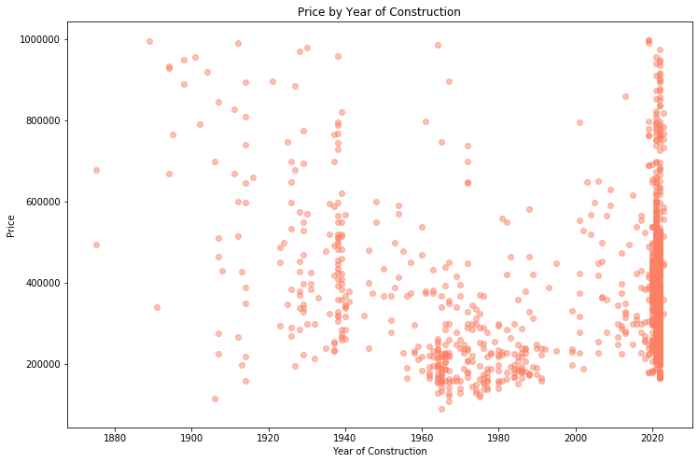
Explanatory Data Analysis
No clear linear correlation between year of construction and price
A lot of new apartments
Notes:
2

Slide 9

Differences in Prices/m² Between Subareas
All apartments
New apartments
(built 2018 or after)
Other apartments
(built before 2018)
subarea | mean | min | max
Sompasaari | 9495.06 | 7420.62 | 12113.43
Meilahti | 9490.10 | 4739.88 | 12882.76
Kamppi | 9296.00 | 5646.46 | 16383.56
Punavuori | 9250.19 | 7010.87 | 12840.58
Ruskeasuo | 9031.81 | 5950.63 | 15416.67
subarea | mean | min | max
Kamppi | 15034.92 | 13686.27 | 16383.56
Töölö | 11509.19 | 10692.91 | 12238.71
Punavuori | 11277.53 | 10400.00 | 12840.58
Meilahti | 10660.99 | 8473.33 | 12882.76
Sompasaari | 9495.06 | 7420.62 | 12113.43
subarea | mean | min | max
Katajanokka | 8883.45 | 5480.77 | 13542.86
Kamppi | 8796.96 | 5646.46 | 13142.86
Ullanlinna | 8665.91 | 6949.37 | 10337.50
Punavuori | 8605.13 | 7010.87 | 10828.57
Töölö | 7765.22 | 5586.21 | 12000.00
Myllypuro | 3245.06 | 2379.60 | 3920.79
Pihlajamäki | 2816.00 | 2119.57 | 3254.55
Malminkartano | 2797.05 | 2323.35 | 3928.57
Kontula | 2796.19 | 1671.23 | 5774.19
Mellunmäki | 2796.00 | 1741.07 | 4124.14
Mellunkylä | 4524.23 | 3798.56 | 5729.73
Konala | 4469.21 | 3958.44 | 4976.58
Mellunmäki | 4079.55 | 4079.55 | 4079.55
Malmi | 3881.74 | 3881.74 | 3881.74
Myllypuro | 3706.40 | 3703.39 | 3709.40
Pihlajamäki | 2816.00 | 2119.57 | 3254.55
Mellunmäki | 2728.45 | 1741.07 | 4124.14
Kontula | 2484.92 | 1671.23 | 3892.86
Mellunkylä | 2454.78 | 2046.78 | 2783.33
Koskela | 2374.43 | 2374.43 | 2374.43
Mean price/m² was highest in Sompasaari and lowest in Mellunmäki
Mean price/m² was highest in Kamppi and lowest in Myllypuro
Mean price/m² was highest in Katajanokka and lowest in Koskela
Notes:
2

Slide 10
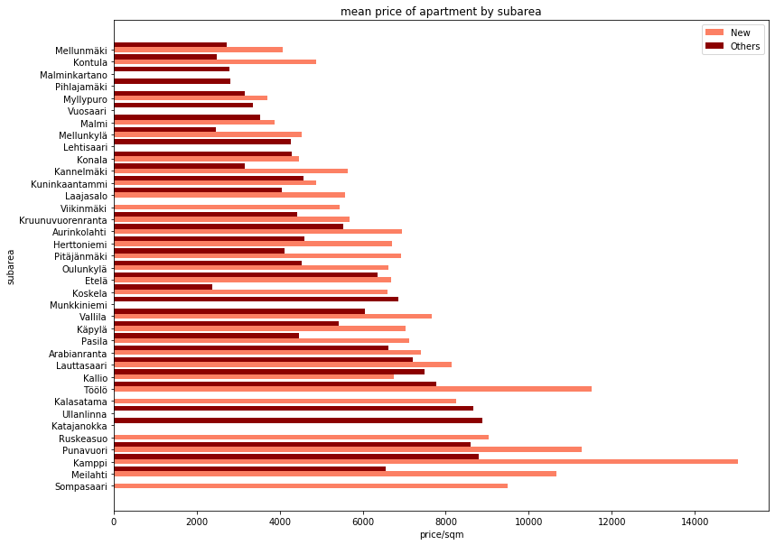
Differences in Prices/m² Between Subareas
Notes:
2

Slide 11
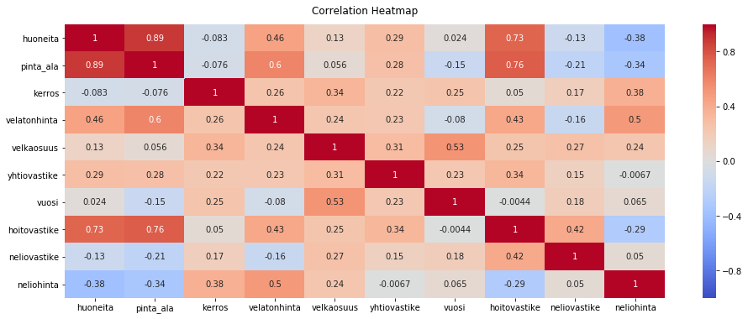
Data Preparation
Between-variable correlations were examined with heat map and to avoid multicollinearity, variables with no effect or negative effect to modelling (huoneita, neliohinta, asuinalue, velkaosuus) were excluded
Notes:
2

Slide 12
Modeling
To predict apartment prices, 3 x 2 regression models were formed using both XGB Regressor and Random Forest Regressor:
New apartments
(built 2018 or after)
All apartments
Other apartments
(built before 2018)
y = df2.velatonhinta
X = df2.drop('velatonhinta', axis=1)
X_train, X_test, y_train, y_test =
train_test_split(X, y, test_size = 0.3)
xg = xgb.XGBRegressor
rf = RandomForestRegressor
xg.fit(X_train, y_train)
rf.fit(X_train, y_train)
y_pred_xg = xg.predict(X_test)
y_pred_rf = rf.predict(X_test)
Notes:
3

Slide 13
Evaluating the Models
Models were evaluated by R², median absolute percentage error (MDAPE) and mean absolute percentage error (MAPE) values:
Random Forest model seemed to predict best the prices of all apartments
Examples of the model predictions:
Model | R2 | MDAPE | MAPE
New Apartments XGB | 0.945455 | 0.051426 | 0.061688
Random Forest | 0.945142 | 0.021571 | 0.040213
All Apartments Random Forest | 0.847020 | 0.050031 | 0.125968
XGB | 0.846442 | 0.092116 | 0.147658
Other Apartments XGB | 0.817836 | 0.131656 | 0.179809
Random Forest | 0.802896 | 0.140789 | 0.173225
Original | Prediction | Error %
280000 | 265947.38 | 5.018793
432200 | 410822.53 | 4.946199
188000 | 293639.22 | -56.191074
466500 | 463028.00 | 0.744266
165000 | 309819.20 | -87.769212
Notes:
3

Slide 14


Most Important Variables in the Random Forest Model
m²
1. Apartment Size
Importance in Random Forest Model: 0.386
2. Year of Construction
Importance in Random Forest Model: 0.135
3. Floor Number
Importance in Random Forest Model: 0.075
Next 5 variables in order of importance were
yhtiövastike (0.071), neliövastike (0.062), sauna asunnossa (0.007), sauna taloyhtiössä ja asunnossa (0.004), sauna taloyhtiössä mutta ei asunnossa (0.003)
Notes:
4

Slide 15
Results
“Looks like there might be potential in Katajanokka!”
“To avoid segregation, we should invest in city planning in Mellunmäki. And how about low-rent apartments in Katajanokka?”
The ranking of the subareas was different compared to 2019. Top 5 subareas had only one new subarea, Katajanokka, and Kaartinkaupunki was dropped. The cheapest areas were all changed except Mellunmäki.
The most important factors predicting the price of the apartment were apartment size, construction year and floor number, respectively
“Now I know what’s the price expectation of my apartment!”
Notes:
4

Slide 16
Evaluating the results
Data collected from several days (longitudinal study) and larger amount of data points could yield more reliable results
This data is about the apartments not yet sold – often the proposed price and the final price differ
What’s the role of COVID-19?
Notes:
4

Slide 17
Thank you!
References
Eerola, E., Lyytikäinen, T. and Vanhapelto, T., 2021. Asuntojen hintojen alueellinen eriytyminen Suomessa. Available at: https://www.doria.fi/handle/10024/180172 [Accessed 31 January 2021].
Tilastokeskus, 2020. Vanhojen osakeasuntojen keskihinnat ja kauppojen lukumäärät postinumeroalueittain, 2010Q4. Available at: http://pxnet2.stat.fi/PXWeb/pxweb/fi/StatFin/StatFin__asu__ashi__nj/statfin_ashi_pxt_112p.px/sortedtable/tableViewSorted/ [Accessed 31 January 2021].
Design edited from Slidesgo
Notes:
4

