Slide 1
EPAM PROJECT
WEATHER FORECAST APPLICATION
Developer:
Sergei Kuzmin
CONFIDENTIAL | © 2021 EPAM Systems, Inc.
Sep’2021

Slide 2
API
https://www.metaweather.com/api/
get data about weather in Moscow for current month and store it into your DB
TASK №7
Visualization
Statements
output the data by date (the date is set) in the form of a table and sort them by created in ascending order
id, weather_state_name, wind_direction_compass, created, applicable_date, min_temp, max_temp, the_temp

Slide 3

Repositories
REPO | LINK
with Infrastructure | https://github.com/skuzmin90/epam_project_terraform.git
with APP | https://github.com/skuzmin90/forecast-app.git
infrastructure
APPLICATION

Slide 4
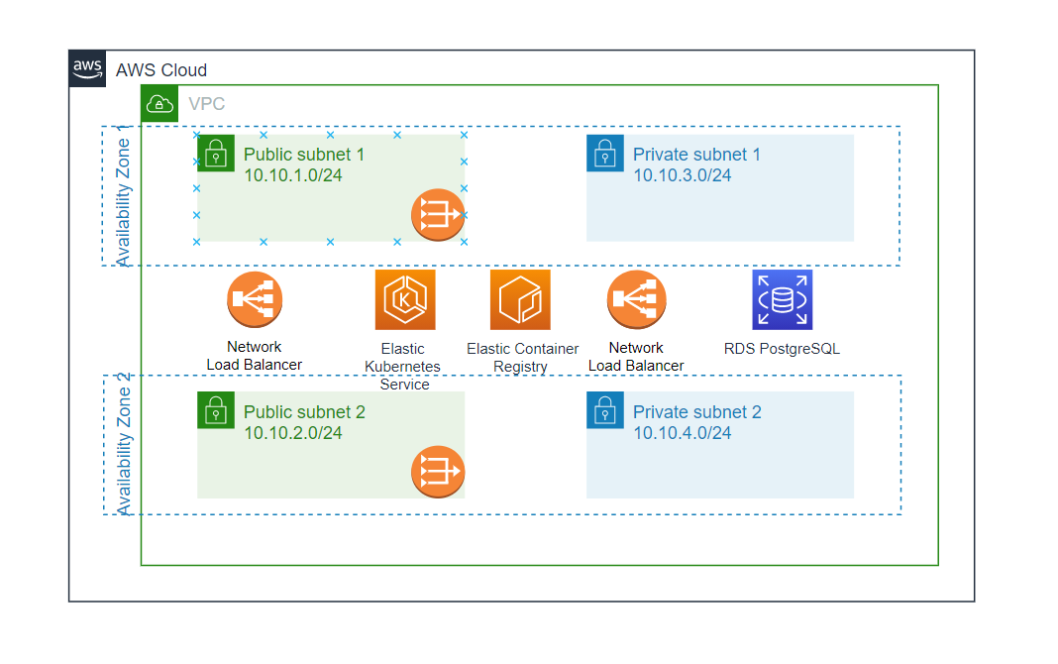
TECHNOLOGICAL STACK
Instruments
Frontend
HTML, Flask
Python Pytest, SonarCloud
RDS PostgreSQL
Terraform, AWS cloud, AWS ECR
GitHub Actions
AWS Cloudwatch, Grafana Cloud
Testing
Backend
Database
Infrastructure
CI/CD
Monitoring

Slide 5
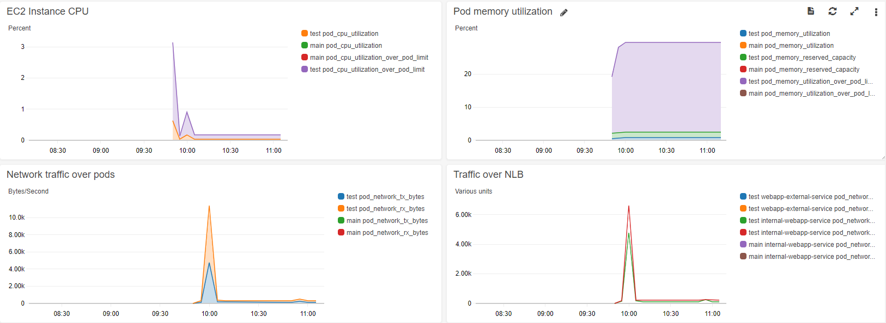
Monitoring AND LOGS
Monitoring and logging is based on the CloudWatch platform and gets metrics from the Metrics server

Slide 6
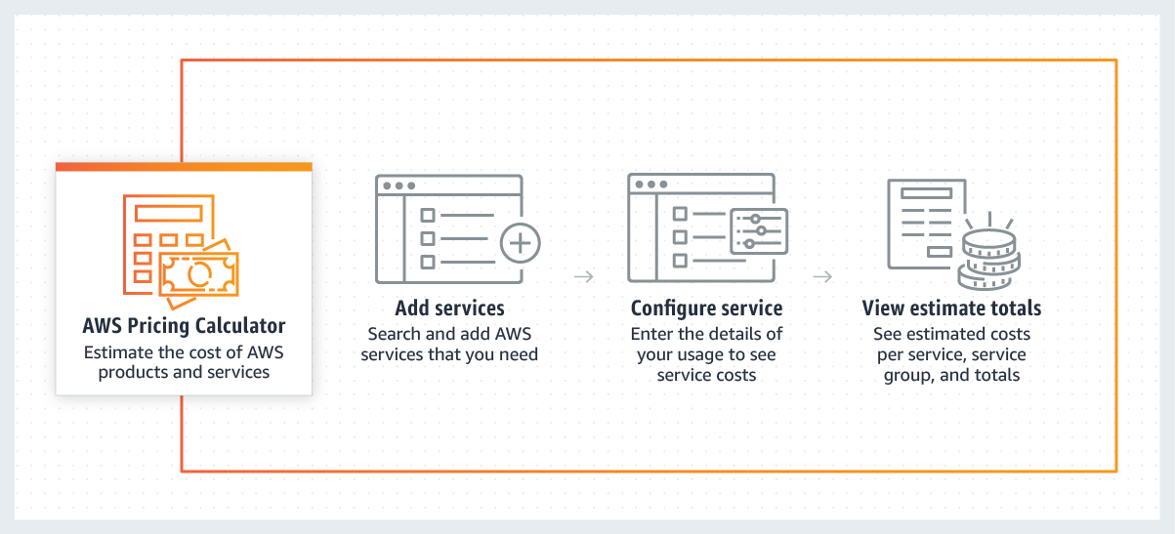
Forecasted year end costs
 | Count | Monthly cost | Total 12 months cost
EC2 instances | 2 | 62.91 USD | 754.92 USD
EKS cluster | 1 | 73.00 USD | 876.00 USD
RDS t2.micro | 1 | 39.68 USD | 476,16 USD
Amazon Elastic IP | 2 | 7.30 USD | 87.60 USD
Elastic Container Registry | 1 | 1.50 USD | 12 USD
Network Address Translation (NAT) Gateway | 4 | 65.70 USD | 788,4 USD
Elastic Load Balancing | 2 | 254.04 USD | 3,048.48 USD
 |  | 503.63 USD | 6,043.56 USD
Calculation created with AWS Pricing Calculator
https://calculator.aws/

Slide 7
Q&A
Developer:
Sergei Kuzmin
CONFIDENTIAL | © 2021 EPAM Systems, Inc.
Sep’2021

