Slide 1
Estimating Aqueous Solubility Directly From Molecular Structure
Group Members:
Sahil Kumar (22114083)
Yash Joshi (22114108)
Shubham Kr. Verma (22114092)
Mohammed Haaziq Jamal (22114055)

Slide 2
Introduction
Background:
Aqueous solubility is a critical property in fields such as drug discovery, environmental chemistry, and material science.
It determines how well a substance dissolves in water, impacting bioavailability in pharmaceuticals and contaminant behavior in the environment.
Problem Statement: Traditional methods for experimentally determining solubility are time-consuming and expensive.
Solution: Developing a machine learning model to predict solubility directly from molecular structure using molecular descriptors.
Objective: Use regression models to estimate the solubility of molecules (logS) from a dataset of molecular descriptors.

Slide 3
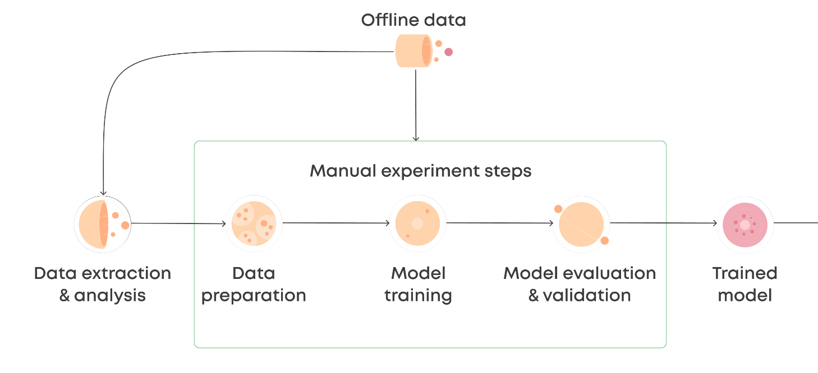
Followed Pipeline

Slide 4
Dataset Description
Dataset: delaney_solubility_with_descriptors.csv
Source:GitHub .
Size: 1,144 molecules, each with 4 molecular descriptors.
Target Variable:
logS: Logarithm of solubility in mol/L.
The target is continuous and used for regression analysis.
Descriptors:
Molecular descriptors include MolLogP (octanol-water partition coefficient), MolWt (Molecular Weight), NumRotatableBonds, AromaticProportion, etc.

Slide 5
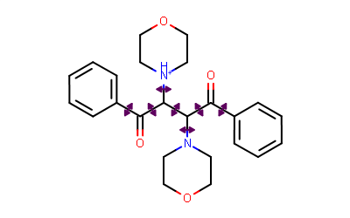
Rotable bonds and aromatic portion

Slide 6
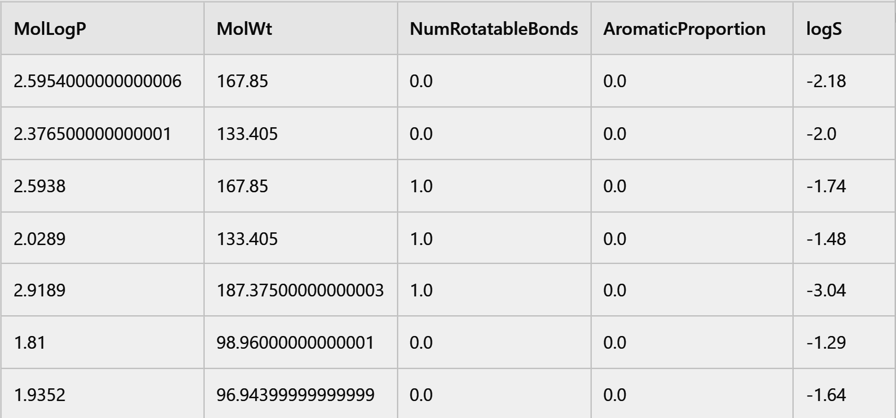
Sample rows from the dataset

Slide 7
Data Preprocessing
Preprocessing Steps:
1. Feature Scaling:
Applied StandardScaler to ensure all descriptors are on the same scale.
Scaling was important because models like SVR and Neural Networks are sensitive to feature magnitudes.
2. Train-Test Split:
Dataset split into 80% training (915 samples) and 20% testing (229 samples) for model evaluation.
Why Preprocessing Matters:
Standardization ensures no single feature dominates others during model training.
Proper train-test splitting avoids data leakage and ensures unbiased model performance.

Slide 8
Exploratory Data Analysis (EDA)
EDA Goals:
Understand relationships between molecular descriptors and solubility.
Identify patterns, correlations, and potential feature importance.
Key Observations:
Strong negative correlation between MolLogP and logS.
Moderate negative correlation between Molecular Weight (MolWt) and logS.
Weak correlations for other features, indicating that non-linear models may perform better.
Insights on Distributions:
Some features like MolWt are skewed, while others like Aromatic Proportion are binary.

Slide 9
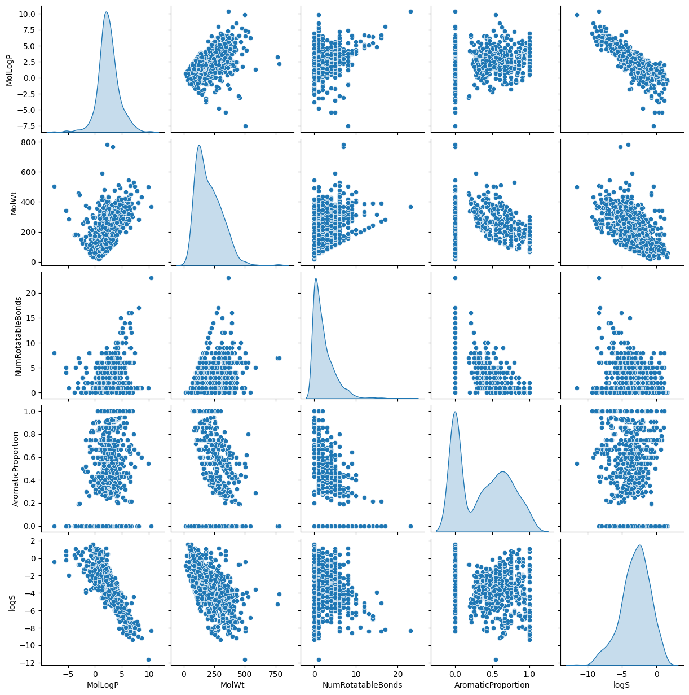
EDA Plots :

Slide 10
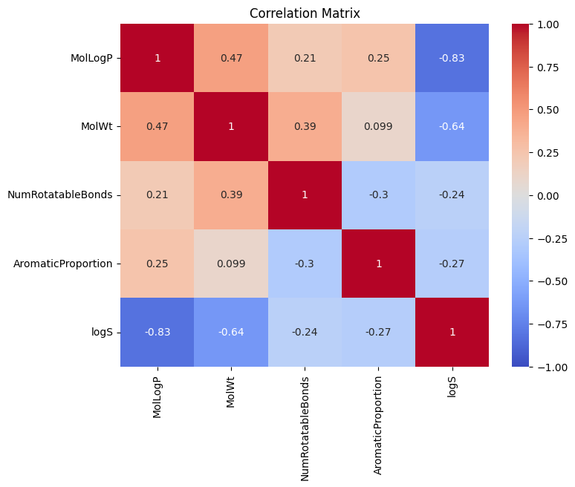
Correlation Matrix

Slide 11
Feature Insights – MolLogP vs logS
MolLogP (Partition Coefficient): A measure of a molecule’s hydrophobicity.
Observation:
Strong negative correlation (-0.828) between MolLogP and logS.
Hydrophobic molecules (higher MolLogP) tend to have lower solubility in water.
Key Takeaway:
MolLogP is a crucial predictor of solubility due to its large influence on the model.

Slide 12
Feature Insights – MolWt vs logS
Molecular Weight (MolWt): The sum of the atomic weights of all atoms in a molecule.
Observation:
Moderate negative correlation (-0.637) between MolWt and logS.
Larger molecules are generally less soluble.
Key Takeaway:
MolWt is another important feature, but the relationship is less strong than with MolLogP.

Slide 13
Feature Insights – NumRotatableBonds and AromaticProportion
NumRotatableBonds:
A weak negative correlation (-0.239) with logS.
Molecules with more rotatable bonds may have slightly lower solubility due to greater flexibility in structure.
AromaticProportion:
Weak binary correlation (-0.268) with logS.
Aromatic molecules (containing rings of atoms) do not show a clear linear relationship with solubility.

Slide 14
Data Distribution Insights
MolWt: Right-skewed distribution, with most molecules having a smaller weight but a few with very high molecular weights.
NumRotatableBonds: Discrete distribution due to the nature of the feature (whole numbers).

Slide 15
Model Selection
Models Used:
Neural Network: Best suited for capturing non-linear relationships.
Random Forest & Gradient Boosting: Excellent for feature importance and handling mixed feature types.
Support Vector Regression: Effective for smaller datasets but sensitive to feature scaling.
Linear Models (Ridge, Lasso): Act as baseline models to compare against more complex models.

Slide 16
Why These Models?
Neural Network
Captures Complex Non-linear Patterns: Suitable for the dataset's non-linear relationships in molecular descriptors using larger dataset.
Flexibility:The flexibility of neural networks allows for experimentation with architecture and hyperparameters,
Random Forest & Gradient Boosting
Handling Non-linear Relationships:Works on non-linear data and is less computationally expensive than Neural network.
Reduces Overfitting: Bagging in Random Forest and iterative boosting in Gradient Boosting improve generalization.
Feature importance:These models can be used providing insights on feature importance.

Slide 17
Contd…
Support Vector Regression (SVR)
Effective on Small/Medium Datasets: Works well with limited samples by focusing on critical points (support vectors).
Capture Non-linear relationship:By using different kernel function it provides flexibility in dimensions of data.
Linear Models (Ridge & Lasso)
Provide Baseline Comparison: Useful for establishing a reference for model performance.
Simplicity and Interpretability: Show linear relationships in data and help in understanding feature contributions.

Slide 18
Evaluation Metrics
RMSE (Root Mean Square Error): Measures the average error magnitude.
MAE (Mean Absolute Error): Measures the average absolute difference between predicted and actual values.
R² (Coefficient of Determination): Measures how well the model explains variance in the data.

Slide 19
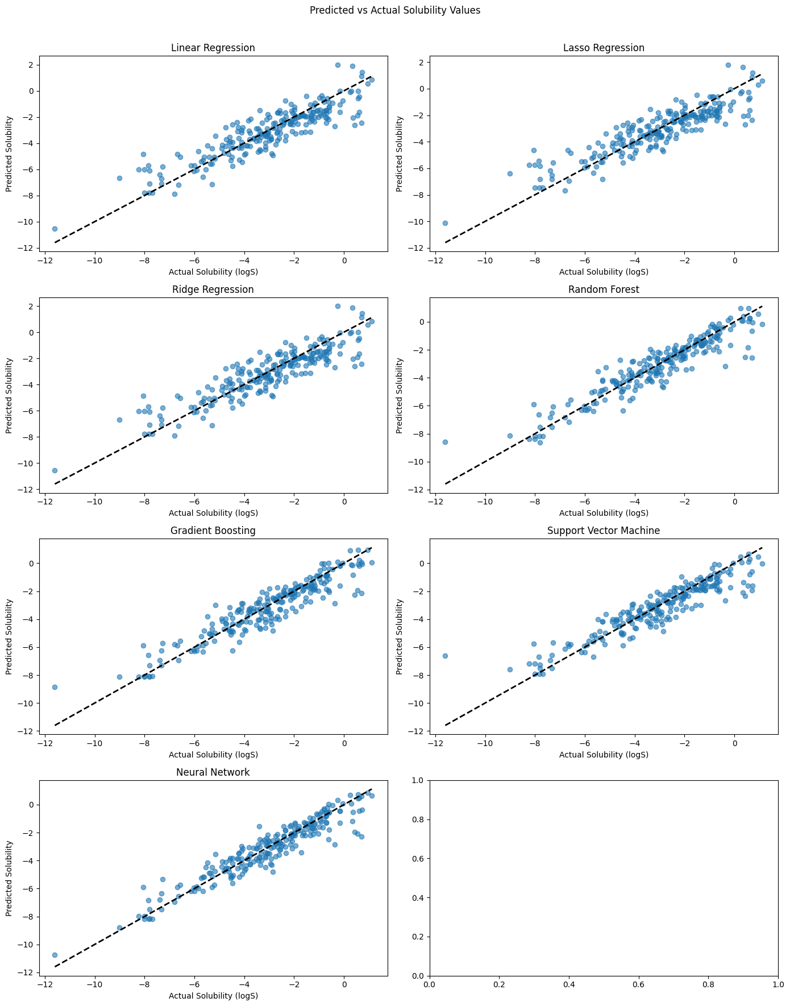
Model Performance – Neural Network
Neural Network Performance:
Best performance among all models with:
RMSE: Lowest (0.72)
MAE: Lowest (0.53)
R²: Highest (0.89)
Why Neural Network Performed Best:
Captures complex non-linear relationships between molecular descriptors and solubility.
Uses multiple layers of perceptrons, optimizing weights during training for accurate predictions.
Tuning: Manually tuned parameters like learning rate, batch size. and number of layers to find the best performing model .

Slide 20
Model Performance – Random Forest & Gradient Boosting
Random Forest Performance:
RMSE: 0.80
MAE: 0.58
R²: 0.86
Gradient Boosting Performance:
RMSE: 0.82
MAE: 0.60
R²: 0.86
Why Random Forest & Gradient Boosting Worked Well:
Its robust handling of non-linear patterns and minimal need for feature scaling made it work well.

Slide 21
Model Performance – Support Vector Regression(SVR) and Linear Models
SVR Performance:
RMSE: 0.88
MAE: 0.63
R²: 0.84
Linear Models (Ridge, Lasso):
Ridge:
RMSE: 1.01
MAE: 0.78
R²: 0.79
Lasso:
RMSE: 1.02
MAE: 0.80
R²: 0.78
Linear models couldn’t capture the complex relationships between molecular descriptors and logS, performing worse than non-linear models.

Slide 22
Hyperparameter Tuning
Purpose of Hyperparameter Tuning:
Optimize model performance by adjusting key parameters such as:
Number of trees in Random Forest and Gradient Boosting.
Regularization parameters in Ridge and Lasso.
Methods Used:
Grid Search and Randomized Search to find the optimal combination of hyperparameters.
Grid Search tested specific parameter combinations, while Randomized Search provided faster exploration of broader parameter spaces.
Key Tuned Hyperparameters:
Random Forest: Number of estimators, max depth.
Gradient Boosting: Learning rate, number of trees.
Results of Tuning:
Improvements in model metrics were modest. Each model showed comparable performance with RMSE values close to one another.

Slide 23
Outlier Detection
Why Detect Outliers:
Outliers can skew model performance, especially in sensitive models like Neural Networks.
Method:
Used Isolation Forest algorithm to detect outliers by isolating data points that differ significantly from the rest.
Impact on Dataset:
46 outliers removed from the original dataset.
Neural Network performance slightly decreased after outlier removal, suggesting a negative effect on overfitting.
Conclusion:
Outlier removal had a small but noticeable impact on model performance, indicating that most data points were consistent with expected solubility trends.

Slide 24
Output Visualization – Predicted vs Actual Solubility
Visualization Purpose:
Comparing the predicted solubility (logS) values against actual values for each model on the test set.
Best Model: Neural Network predictions closely matched actual solubility values, especially in the mid-range of solubility.
Other Models: Random Forest and Gradient Boosting also performed well but occasionally over- or under-predicted solubility for more extreme cases.

Slide 25
Learning Outcomes and Limitations
Learning Outcomes:
Successfully implemented regression models to predict aqueous solubility.
Neural Network proved most effective, highlighting the importance of non-linear modeling in chemical data.
Preprocessing and feature scaling were critical for SVR and Neural Network performance.
Limitations:
Dataset Size: Small dataset (1,144 samples) limits generalizability.
Feature Selection: Some molecular descriptors, like NumRotatableBonds, showed weak correlations, potentially adding noise to the model.
Synthetic Data Generation: Could not be applied due to the complexity of chemical structures.

Slide 26
Future Improvements
Expand Dataset for Better Generalization
Collect a larger, diverse set of molecules to improve model robustness and capture a broader range of chemical structures, leading to better generalization on new compounds.
Leverage Advanced Deep Learning Models
Graph Neural Networks (GNNs): Model complex molecular structures as graphs to capture atom-bond interactions effectively.
Transformer-based Models: Use ChemBERTa or similar for sequence-based representations, learning subtle molecular patterns.

Slide 27
Other Researches
https://ieeexplore.ieee.org/abstract/document/9640774
Feature - 8
Dataset - 2800 samples
R² - 0.77
Similarly, there are other papers but they are little off topic
https://jcheminf.biomedcentral.com/articles/10.1186/s13321-023-00752-6
https://jcheminf.biomedcentral.com/articles/10.1186/s13321-021-00575-3#Sec2

Slide 28
THANK YOU

