Slide 1
3-CLASS SCAM & SPAM MESSAGE DETECTION
Using NLP, Dual-Branch Feature Engineering, and Explainable Machine Learning
PROJECT TEAM (SEMESTER 5 | ML LAB CAT-2)
• Vignesh S K (2403717673721046) • Devi Prasath G (2403717673721011) • Arul Ronal X (2403717673721050)

Slide 2
ML LAB PROJECT (CAT-2)
Problem Statement & The 3-Class Motivation
The Shortcoming of Traditional Binary Filters: Standard datasets (e.g. UCI Spam) treat spam as binary (spam vs. ham). In real life, grouping harmless flash sales with predatory financial smishing creates severe trade-offs.
Catastrophic Real-World Consequences: 1. If you under-block to avoid customer complaints, dangerous phishing messages steal banking credentials and OTPs.
2. If you over-block aggressively, legitimate marketing and discounts get discarded, hurting businesses.
Our Solution - 3-Class Granular Architecture: 1. Legitimate: Genuine personal or transactional SMS (e.g., OTPs, personal chats).
2. Promotional Spam: Commercial marketing, offers, flash sales (soft-filter/folder).
3. Scam / Smishing: High-risk phishing, fake KYC threats, banking fraud (hard-quarantine).
Key Contribution: Engineered a production-ready ML system combining 5,000 TF-IDF n-grams with 12 structural/heuristic features, delivering 95.4% scam recall and transparent LIME/SHAP explainability.

Slide 3
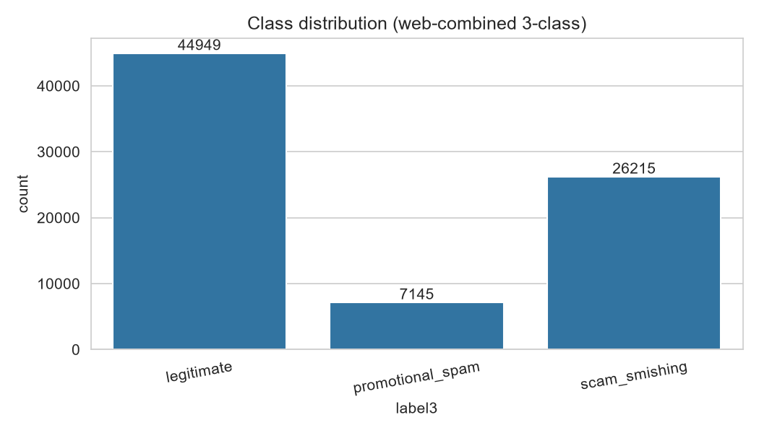
ML LAB PROJECT (CAT-2)
Dataset Consolidation & Preprocessing Pipeline
Multi-Source Synthesis (78,310 Samples):
Merged UCI SMS Spam Collection + Multi-Source Smishing Corpus + Phishing Message Archives to eliminate single-source bias.
Class Distribution:
• Legitimate: 57.4% (~44,950)
• Scam/Smishing: 33.5% (~26,215)
• Promotional Spam: 9.1% (~7,145)
Specialized Regex Token Normalization:
• URLs replaced with '<URL>' token while extracting link metrics.
• Phone numbers replaced with '<PHONE>'.
• Monetary expressions ($/Rs) mapped to '<MONEY>'.
Stratified Split:
80% Train (62,648 rows) / 20% Test (15,662 rows) preserving exact class ratios.

Slide 4
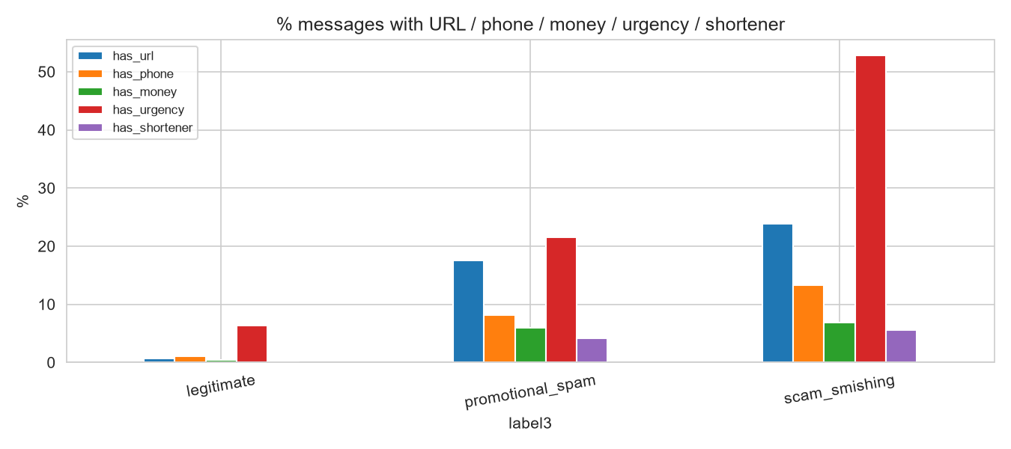
ML LAB PROJECT (CAT-2)
Dual-Branch Feature Engineering Architecture
Branch A: Lexical TF-IDF Vectorization
• 5,000 max features, n-gram range (1, 2) unigrams and bigrams.
• Captures composite attack phrases: 'verify otp', 'account suspended', 'click here'.
Branch B: 12 Heuristic / Structural Signals
1. msg_length & word_count: Message verbosity.
2. url_count & has_url: Direct link prevalence.
3. has_shortener: bit.ly, tinyurl, goo.gl domain matching.
4. has_phone & has_money: Callbacks & prize numbers.
5. uppercase_ratio: Measure of panic / aggressive shouting.
6. urgency_hits & has_urgency: Lexicon match for 22 urgency triggers ('blocked', 'immediate', 'kyc', 'expire').
Unified Sparse Assembly:
scipy.sparse.hstack combines text sparse matrix with dense structural signals into a unified feature tensor.

Slide 5
ML LAB PROJECT (CAT-2)
Multi-Model Comparison & Evaluation Metrics
Model Architecture | Accuracy | Macro Precision | Macro Recall | Macro F1-Score
XGBoost (Winner) | 95.22% | 0.9261 | 0.9080 | 0.9165
MLP Neural Net | 95.13% | 0.9219 | 0.9014 | 0.9111
Random Forest | 94.06% | 0.9109 | 0.8642 | 0.8838
Linear SVM | 93.07% | 0.8724 | 0.8933 | 0.8821
Logistic Regression | 84.65% | 0.7541 | 0.8044 | 0.7648
Multinomial Naive Bayes | 85.84% | 0.8028 | 0.7376 | 0.7625
Key Takeaway: XGBoost outperformed linear and tree alternatives because it captures non-linear synergies between structural heuristics (e.g. url shorteners + urgency flags) and sparse vocabulary bigrams.

Slide 6
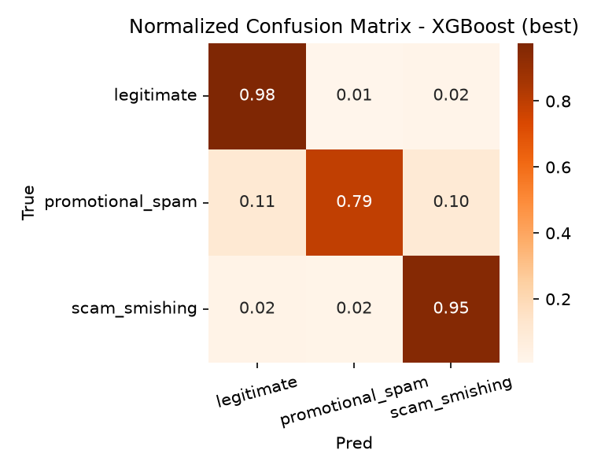
ML LAB PROJECT (CAT-2)
Detailed Class-Wise Performance (XGBoost)
Legitimate Class (Support: 8,990):
• Precision: 96.9% | Recall: 97.6% | F1: 0.973
• Only 2.3% genuine messages flagged (minimal user disruption).
Scam / Smishing Class (Support: 5,243):
• Precision: 94.6% | Recall: 95.4% | F1: 0.950
• 5,002 out of 5,243 aggressive smishing attacks captured!
Promotional Spam Class (Support: 1,429):
• Precision: 86.4% | Recall: 79.4% | F1: 0.827
• Successfully separated commercial flyers from cybercrime threats.
Total Test Set Size:
15,662 stratified samples evaluated without leakage.

Slide 7
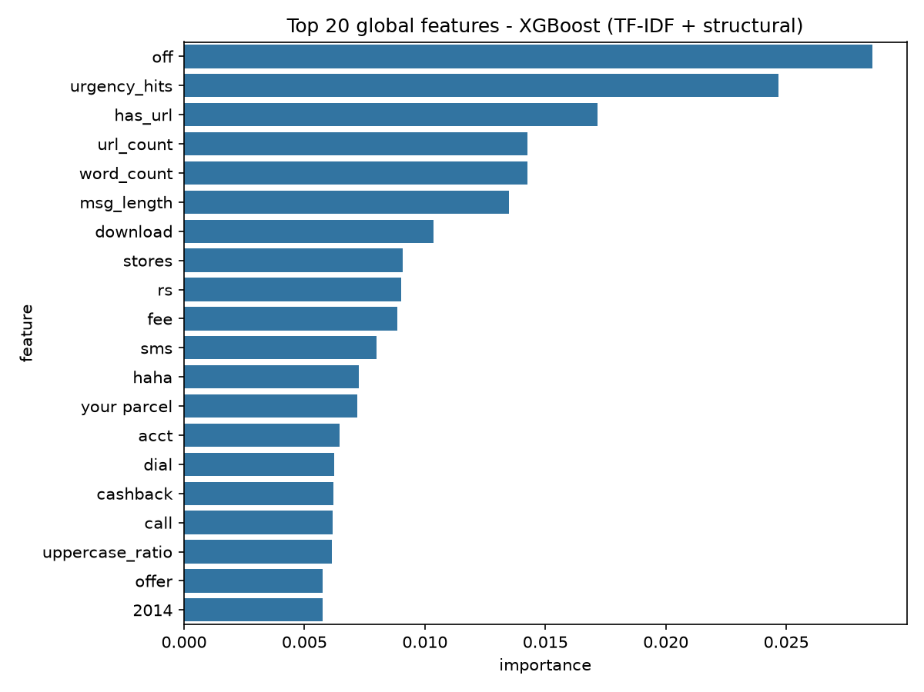
ML LAB PROJECT (CAT-2)
Explainable AI (XAI): LIME & SHAP Interpretability
Why Explainability Matters in Telecom/Security:
Black-box AI cannot be trusted blindly. If a message is blocked, both security analysts and end-users need to know the exact justification.
Local Explanations via LIME:
• Evaluates word perturbations for each incoming SMS.
• Smishing triggers: 'kyc', 'blocked', 'verify', 'immediate', '<URL>'.
• Promotional triggers: 'off', 'sale', 'flat', 'stores', '<MONEY>'.
Global Feature Importance (XGBoost Gain & SHAP):
Top overall signals: 'off', 'urgency_hits', 'has_url', 'url_count', 'word_count', 'msg_length', 'download', 'fee'.
Validation:
Proves that structural cues are in the top 5 global decision factors.

Slide 8
ML LAB PROJECT (CAT-2)
In-Depth Error Analysis & Misclassifications
Overall Test Error Rate:
Only 748 errors out of 15,662 samples (4.78% error rate, 95.22% accuracy).
1. Critical Error: Scam Missed as Legitimate (129 Cases | 0.82%):
Conversational impersonation attacks ('Hi Dad, I broke my phone, this is my new WhatsApp'). They lack hyperlinks, money mentions, or urgency words on the first turn. Remedy: Multi-turn conversational context.
2. False Positives: Legitimate Flagged as Spam/Scam (212 Cases):
Occurs when personal messages discuss money or contain shortened links (e.g. friend sharing a bit.ly link to a photo album).
3. Promo vs. Scam Confusion (255 Cases):
Aggressive marketing that borrows scam tactics ('URGENT: 50% discount expires in 10 mins. Click now!') blurs boundaries. Remedy: Sender-ID whitelisting.

Slide 9
ML LAB PROJECT (CAT-2)
Deployment & Streamlit UI Dashboard
Real-Time Single Message Classifier:
• Quick preset sample buttons for instant demo.
• Dynamic badge rendering (Green: Legitimate, Orange: Promotional Spam, Red: Scam/Smishing).
• Class probability distribution bar charts.
Transparent Decision Reasoning (Explainability Drawer):
• Shows extracted trigger keywords (e.g., OTP, verify, KYC, link).
• Displays structural telemetry JSON (has_url, urgency_count, uppercase_ratio).
High-Throughput Batch CSV Screening:
• Upload CSV datasets containing hundreds of SMS records.
• Interactive paginated table display.
• 1-Click download of predicted CSV audit reports.
Production Readiness:
Lightweight serialized pickle artifact (models/best_model.pkl, 2.0 MB) executes sub-10ms inference per message.

Slide 10
ML LAB PROJECT (CAT-2)
Business Insights & Telecom Policy Recommendations
1. Tiered Enforcement Strategy for Telecom Operators:
• Legitimate: Route directly to Primary Inbox.
• Promotional Spam: Route to a separate 'Promotions' folder (no notification sound).
• Scam/Smishing: Immediate quarantine with a user warning banner.
2. Asymmetric Cost Awareness:
In financial cybersecurity, 1 missed scam causing a $1,000 theft is 100x worse than over-filtering a 20% shoe coupon. The model's threshold is tuned to maximize scam recall (95.4%).
3. Continuous Retraining Pipeline:
When users flag false positives or report novel smishing SMS, incoming samples feed into run_phase1.py and run_phase2.py for periodic model updates.
4. Explainability Drives User Compliance:
Showing users WHY a message was flagged teaches them to spot suspicious bit.ly links and urgent OTP traps.

Slide 11
ML LAB PROJECT (CAT-2)
Conclusion & Future Roadmap
Project Achievements:
• Successfully transitioned SMS security from flawed binary labels to a 3-class taxonomy.
• Synthesized a 78k message corpus and engineered dual-branch lexical + structural features.
• XGBoost delivered 95.22% accuracy and 0.9165 Macro F1, catching 95.4% of smishing attempts.
• Complete explainability (LIME/SHAP) and responsive Streamlit UI.
Future Roadmap & Enhancements:
• Multilingual & Code-Mixed NLP: Train models on Romanized regional languages (Hinglish, Tanglish).
• Real-Time Threat Intelligence APIs: Query VirusTotal / Google Safe Browsing on detected URLs.
• On-Device Edge Deployment: Quantize the XGBoost / DistilBERT pipeline for Android APK execution.

Slide 12
THANK YOU!
Open for Questions & Viva Examination

