Slide 1

CHANNEL TRAILER • SOFTWARE ENGINEERING IN PUBLIC
FROM CONCEPT
TO COMMISSIONING
Build a real application — end to end —
and learn how to engineer software.
REAL PROBLEM → WORKING SYSTEM
01
Notes:
Most coding channels teach you a framework on a toy app. This channel does something different: we take a real, messy, real-world problem, and build the actual application — end to end — so you learn how to engineer software, not just how to type it.

Slide 2
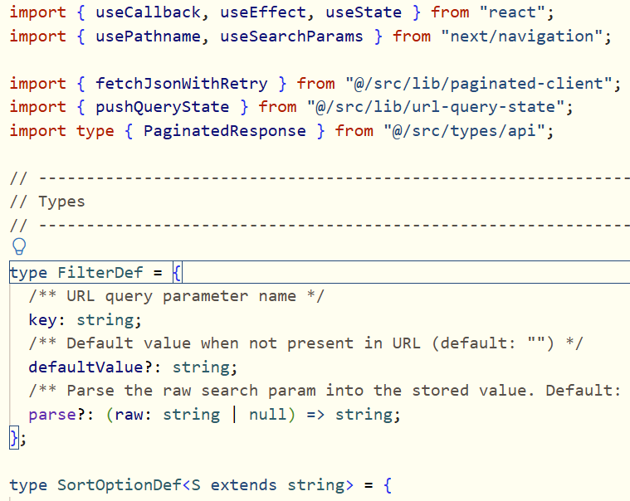
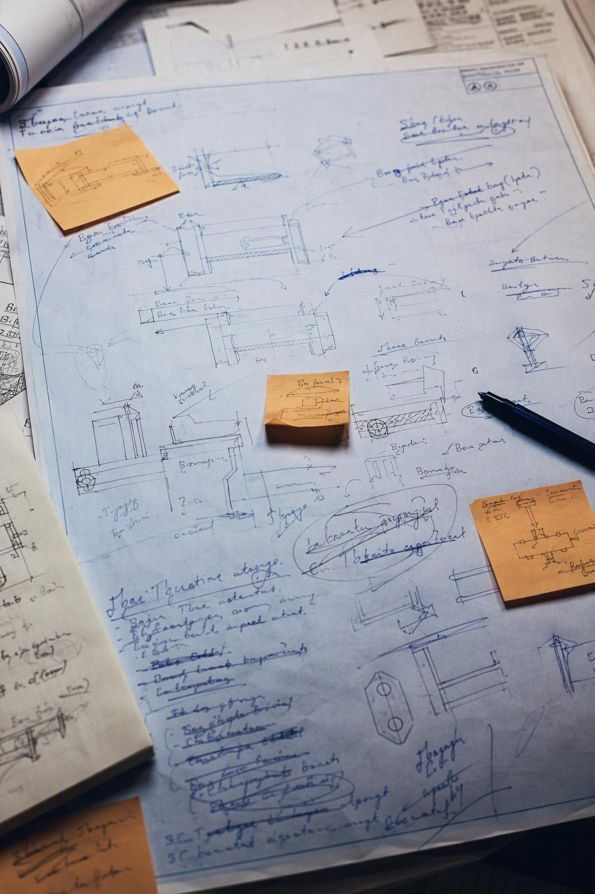
Tutorials teach syntax.
Real projects teach engineering.
THE MISSING WORK
01
INTERPRET
Find the business rule
inside a vague requirement.
02
DESIGN
Model data that survives
change and correction.
TOY TUTORIALS
Useful for syntax.
Too clean for reality.
03
PROVE
Test behavior — don’t
assume it works.
REAL REQUIREMENTS
MESSY BY DEFAULT
That’s engineering — and it’s what this channel is built around.
02
Notes:
Tutorials are great for learning syntax. They're not great at teaching you the things that actually make software projects succeed or fail: reading a vague requirement and finding the business rule hiding inside it. Designing data that won't fall apart when the real world gets messy — people move, ownerships change, payments get corrected. And proving, not assuming, that what you built actually behaves correctly. That's engineering. It's a different skill from writing code, and it's the one this channel is built around.

Slide 3

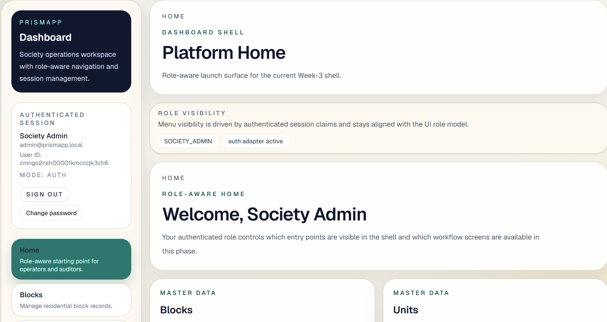
A real app has to survive
real life.
REAL SOCIETY CONTEXT
STRUCTURE
Blocks, units, owners, residents
HISTORY
Ownership changes over time
MONEY
Maintenance follows financial rules
WORKFLOW
Complaints move from open to resolved
REALISM IS THE FEATURE.
Relationships. History. Money. Rules that must hold up over time.
REAL APP • REAL RULES
03
Notes:
The project we're building together is a Society Management System — the kind of software that runs an apartment complex or gated community. Blocks, units, owners, residents. Monthly maintenance payments with real financial rules. Complaints that move through a real workflow from 'open' to 'resolved'. It's not glamorous, and that's exactly the point — it's realistic. It has relationships, history, money, and rules that have to hold up over time. That's what makes it worth building on camera instead of a toy app.

Slide 4
Problem first.
Syntax last.
EXAMPLE PROBLEM
“A unit needs exactly one owner at all times.”
01
02
03
04
05
PROBLEM
CONCEPT
TECHNOLOGY
IMPLEMENTATION
WORKING
FEATURE
What must always be true?
Which idea explains it?
What can enforce it?
How do we build it?
Can we show it working?
EVERY STEP EARNS THE NEXT.
That order is deliberate — it is how real engineering happens.
Done means demonstrated.
PROBLEM → PROOF
04
Notes:
Every topic on this channel follows the same pattern. We start with a real problem the application has — say, 'a unit needs exactly one owner at all times, even before it's ever sold.' Then we understand the concept behind it. Then we look at what technology helps us solve it — a database constraint, a transaction, a validation rule. Then we implement it. And only then do we call it done, because we can show it actually working. Problem first. Syntax last. That order is deliberate — it's the order real engineering happens in, and it's the opposite of how most tutorials are structured.

Slide 5


AI accelerates the work.
Judgment keeps it correct.
REVIEW
HUMAN
AI PARTNER
Understands the problem
Speeds up implementation
Reviews edge cases • catches what is wrong
Drafts code • explores options • compresses time
PARTNER, NOT PILOT
05
Notes:
AI is part of why this channel exists, but it's not the channel's identity. AI is making implementation faster than ever — which means the bottleneck is shifting. The valuable skill now is understanding the problem well enough to know what to build, and reviewing what gets built well enough to know if it's actually correct. So on this channel, AI shows up constantly — as a partner in the process — but it never replaces the engineering judgment. You'll see both sides: where AI genuinely speeds things up, and where a human has to catch what it gets wrong.

Slide 6
Different playlists.
One continuous story.
PLAYLIST A1
PLAYLIST F
START HERE
PrismApp: Building the App
AI-AUGMENTED
DEVELOPMENT
PLAYLIST B
Runs alongside every project, process, and technology playlist.
Architecture & SDLC
ENGINEERING PARTNER
TYPESCRIPT
POSTGRESQL
& PRISMA
NEXT.JS
A-series grows with each new case-study app.
REAL PROJECTS → DEEPER ENGINEERING
06
Notes:
Here's the shape of the channel. Playlist A1 tells the story of the first application, PrismApp — what we're building and why — with no deep technical detail yet, just the big picture. If a second real project joins the channel later, it gets its own A-series playlist alongside this one. After that, separate playlists go deep on the engineering itself: the process behind it, then TypeScript, PostgreSQL and Prisma, and Next.js — each one taught through problems these real applications ran into, not through generic examples. And running alongside all of it, a playlist on working with AI as part of the engineering process. Different playlists, one continuous story.

Slide 7
READY TO BUILD
REAL SOFTWARE?
Start with Episode 1.
Meet the application we’ll build
from the ground up.
EPISODE 1 • MEET THE APPLICATION
SUBSCRIBE
EPISODE 1
Then follow the project from concept to commissioning.
Problem first. Proof before “done.”
FROM CONCEPT → COMMISSIONING
07
Notes:
If you want to actually understand how real software gets built — not just memorize another framework — subscribe, and start with Episode 1, where I introduce the application we're building from the ground up.

