Slide 1

Airlines Sentiment Tweets - Text Mining
Sam Vuong
Raymond Huang
Kyle Murphy
Carmon Ho

Slide 2


Introduction
Twitter is most popular platform for people expressing their feelings and opinions.
For our project we will be analyzing the sentiments that were submitted to Twitter by various airline travellers in February 2015.
Goal: Be able to interpret the sentiments that were submitted to Twitter.
Be able to build a model to accurately predict the sentiment from tweet message text.
Use Text Mining techniques to analyze and process tweet messages.
Use Random Forest algorithm to model & predict tweet message sentiments.
Success Factor: How well we can analyze the sentiments submitted to Twitter.
How accurate is our prediction model.

Slide 3
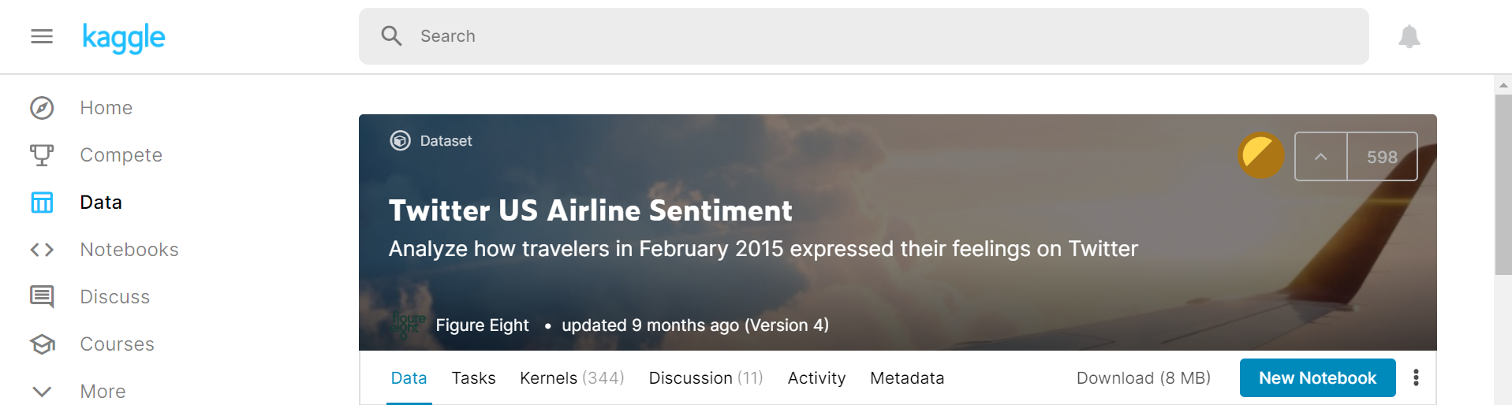
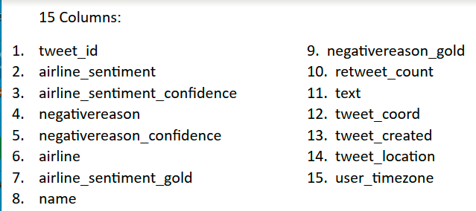
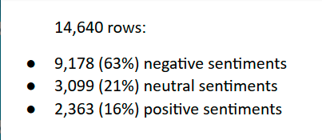
Website: https://www.kaggle.com/
Dataset Link: https://www.kaggle.com/crowdflower/twitter-airline-sentiment
Reference: Eight, Figure. “Twitter US Airline Sentiment.” Kaggle, Crowdflower’s Data for Everyone, 16 Oct. 2019, www.kaggle.com/crowdflower/twitter-airline-sentiment.

Slide 4

Ethical ML Framework
Conduct our research in an ethically responsible manner.
Eliminate discriminating factors like gender, religion, and region.
Remove all personal information to protect privacy.
The dataset we are using includes user names and Tweet_ID’s.
We have decided not to have any code to view or print out these information from the dataset in order to protect the privacy of the participants.

Slide 5

Assumptions
Contributors to this dataset are travellers who live in North America and have easier access to US airlines.
Contributors are at least teenagers who have access to a smartphone devices or laptops with internet service.

Slide 6
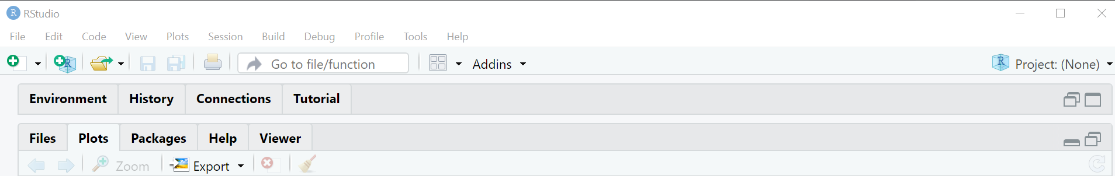
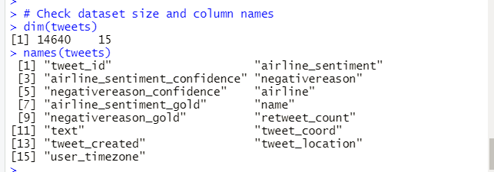


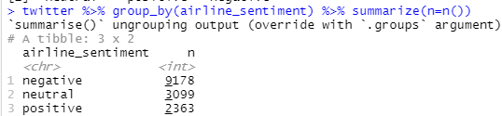
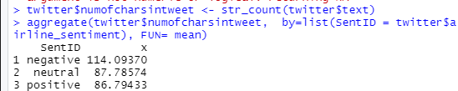

Data Exploration
Notes:
There are 14640 total tweets in this dataset
15 columns of data
14485 twitter users in the dataset
Average of 104 characters per tweet
Average of 17 words per tweet
Average characters and words per negative tweet is higher than both positive and neutral.

Slide 7
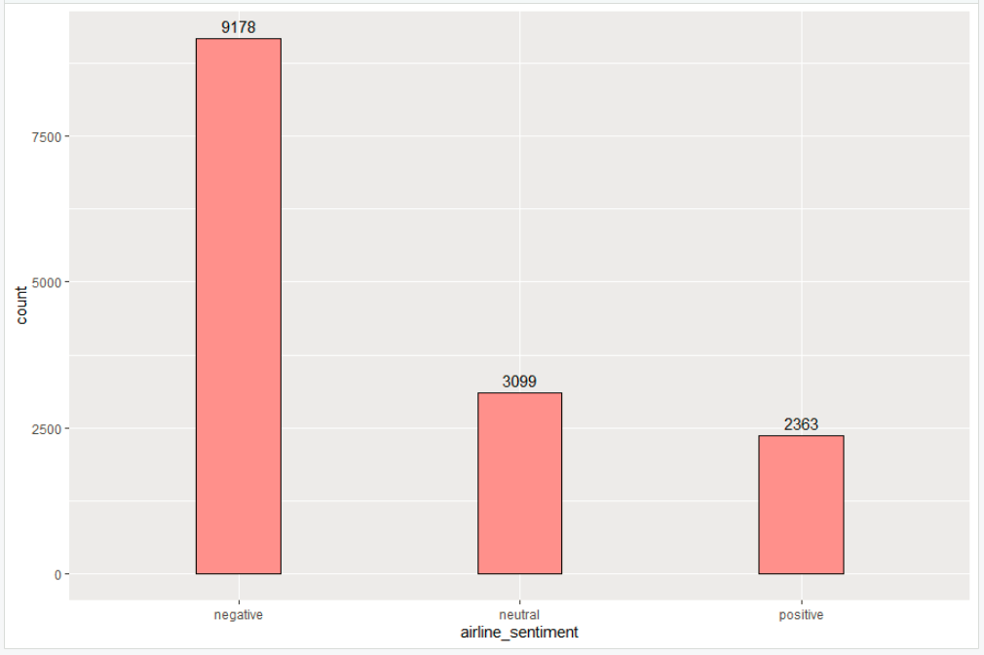
Data Visualization
Tweet Sentiment Distribution
Notes:
63% of tweets are negative
21% of tweets are neutral
16% of tweets are positive

Slide 8
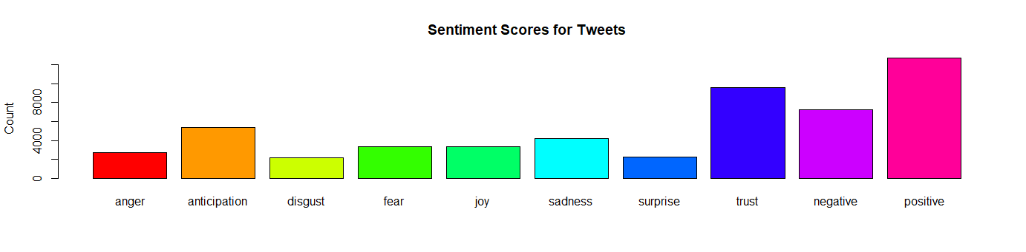
Data Visualization Cont.
Tweet Text Sentiment Scores
Notes:
package syuzhet was used to perform analysis that digs into the text
it seems that the positive sentiment score was the highest. The score in trust was second and negative follow behind.
This result looks to be the opposite of the chart in the previous slide. It is because the negative review was further broken down to anger, sadness, fear, disgust and surprise

Slide 9
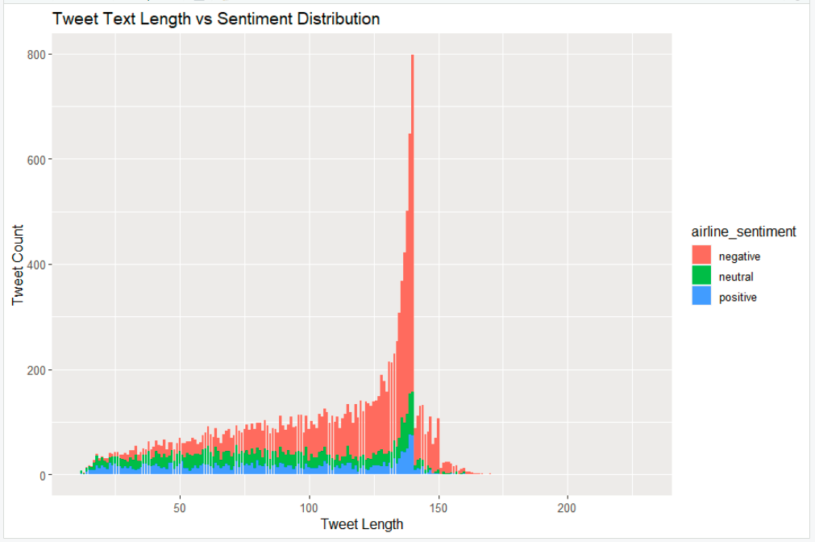
Data Visualization Cont.
Tweet Text Length vs Sentiment Distribution

Slide 10
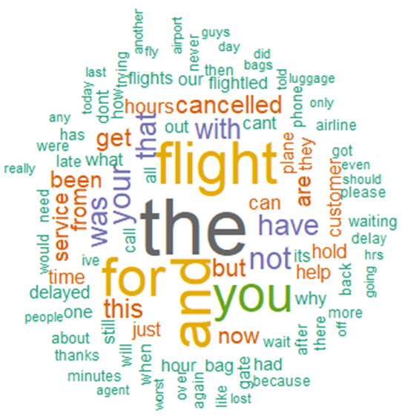
Data Visualization Cont.
Word-Cloud chart for Negative Sentiment Tweets (Top 100)
Notes:
The word cloud was used to investigate reasons why more negative Tweets were presented. The results show that customer service and late flight were the reason causing negative Tweets.

Slide 11
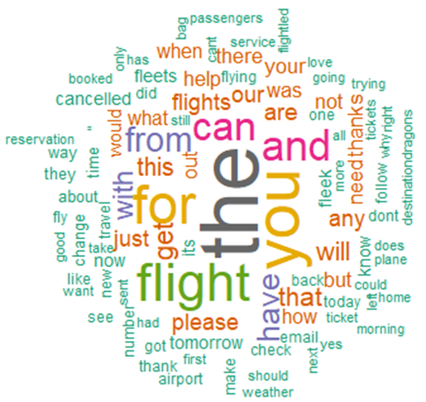
Data Visualization Cont.
Word-Cloud chart for Neutral Sentiment Tweets (Top 100)
Notes:
The word cloud was used to investigate reasons why more neutral Tweets were presented. The results do not show any obvious reasons causing neutral tweets. This is expected given that neutral tweets would not contain any negative or positive cogitations.

Slide 12
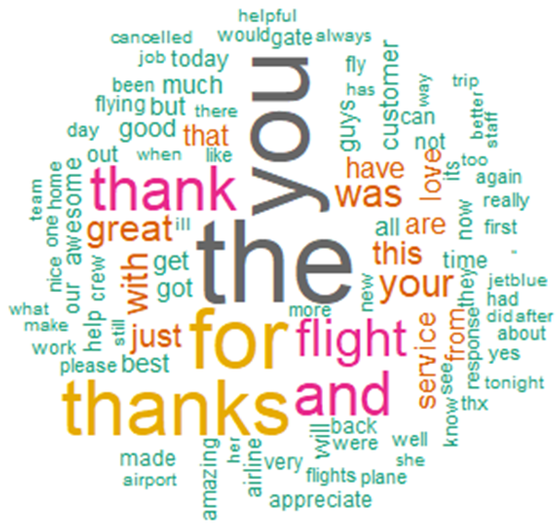
Data Visualization Cont.
Word-Cloud chart for Positive Sentiment Tweets (Top 100)
Notes:
The word cloud was used to investigate reasons why more positive Tweets were presented. The results show that customer gratitude was the reason causing positive Tweets. Words such as ‘thank you’, ‘thanks’, ‘great’, ‘love’, ‘appreciate’, and ‘amazing’ can be found in the top 100.

Slide 13
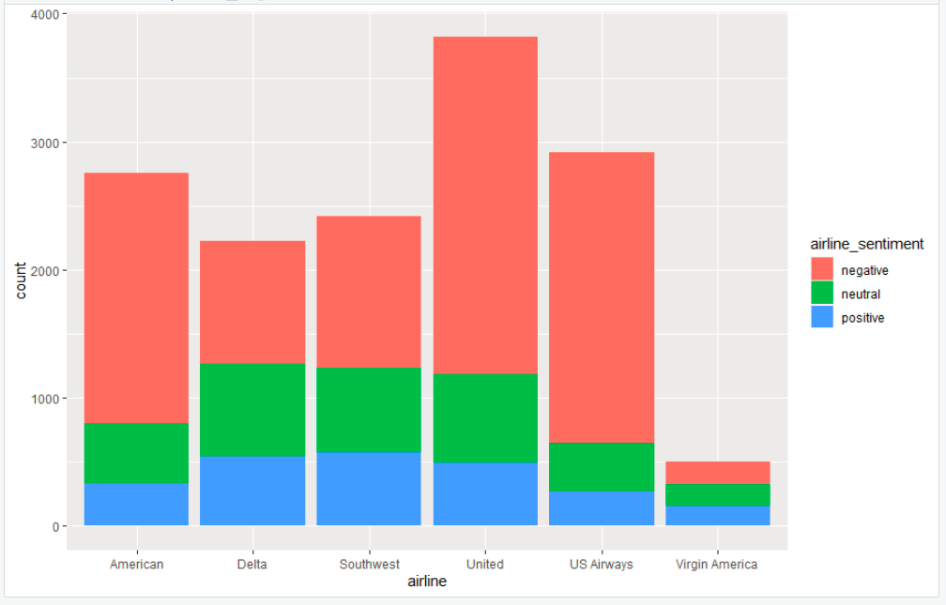
Data Visualization Cont.
Airlines Sentiment Distribution
Notes:
United airline has the greatest negative Tweets among all. Delta airline favored more positive Tweets percentages.

Slide 14
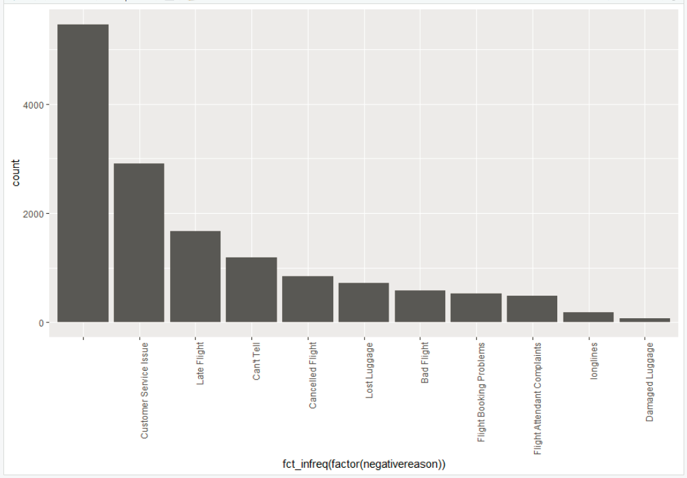
Data Visualization Cont.
Negative Tweet Reasons Distribution
Notes:
Based on the bar graph below, ‘Customer Service Issue’ appears to be the most common negative tweet reason and ‘Damaged Luggage’ appears to be the least common.

Slide 15
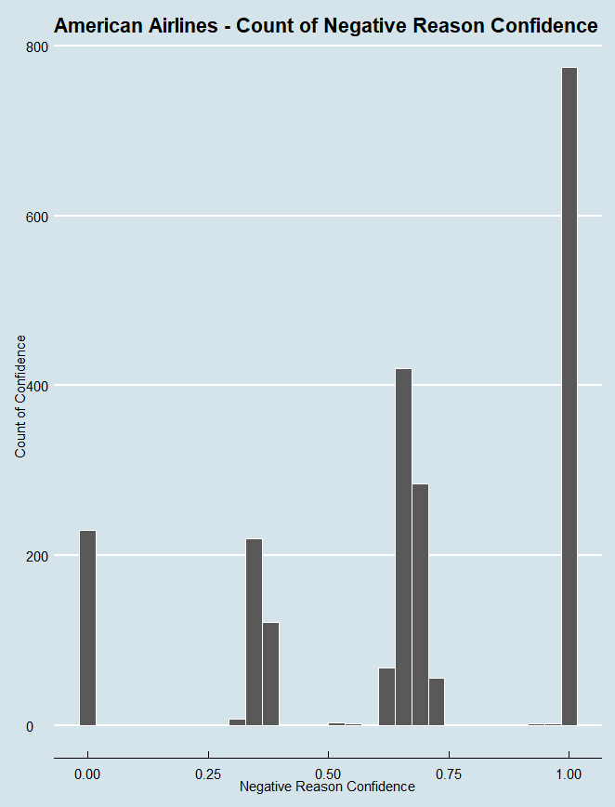
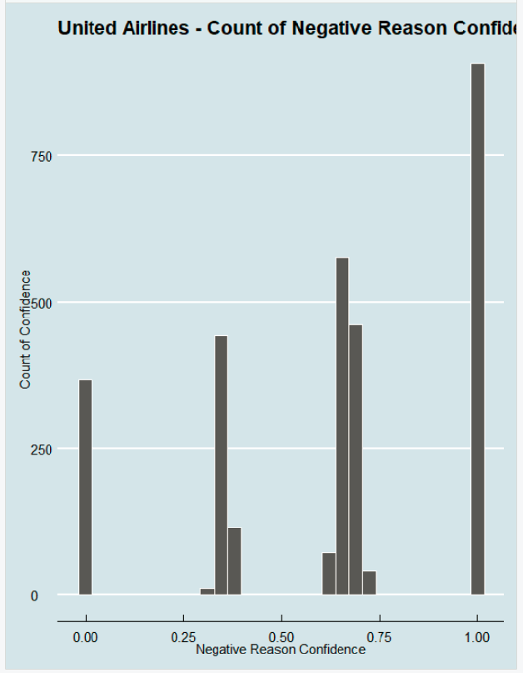
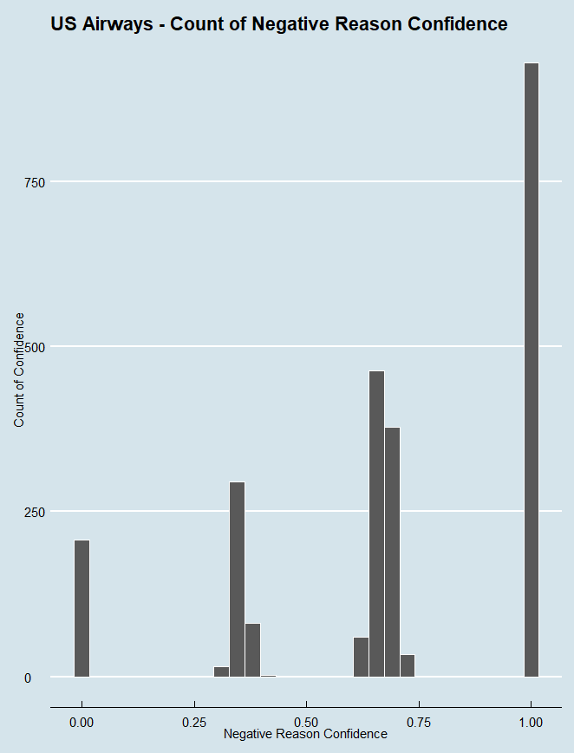
Data Visualization Cont.
Airlines Negative Reason Confident Distribution
Notes:
Based on the three ‘Count of Negative Confidence Distribution’ charts below, the data suggests that negative tweets tend to have a higher confidence level with American Airlines being the greatest.

Slide 16
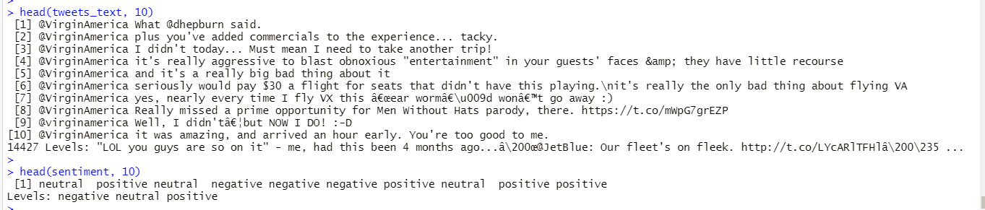
Data Preparation for Modelling
Step 1: Get the tweet text messages and the sentiment classification from tweets dataframe.
View first few lines of Tweet text messages and Sentiments:

Slide 17
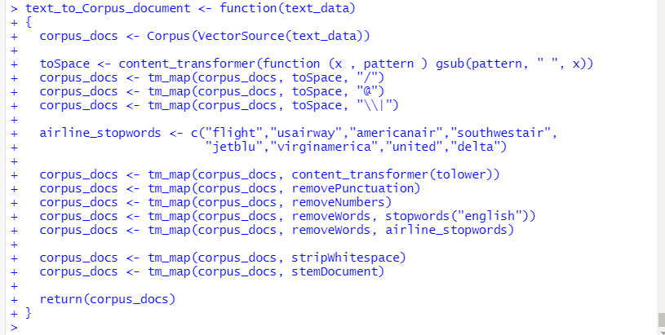
Data Preparation for Modelling Cont.
Step 2: We convert text messages to Corpus documents.
We create a function text_to_Corpus_document() to convert a text vector to a Corpus document object and perform common text tokenization, special characters/words removal and stemming.

Slide 18
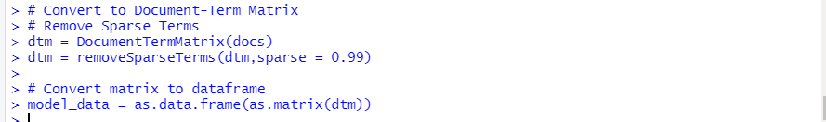
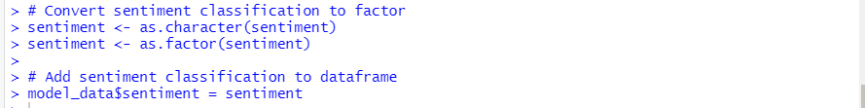
Data Preparation for Modeling Cont.
Step 3: We convert Corpus documents to Document-Term matrix, remove sparse terms and convert the matrix to Dataframe.
Step 4: We add Sentiment classification to the dataframe for modeling.

Slide 19
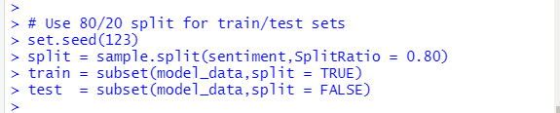

Modeling
Use a Random Forest model with Number of trees to grow (ntree) = 10.
Use 80/20 split for Train/Test sets.

Slide 20
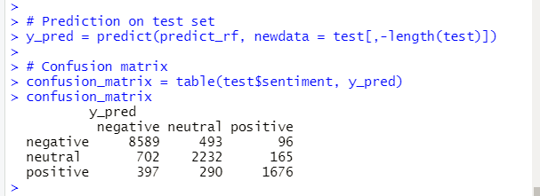
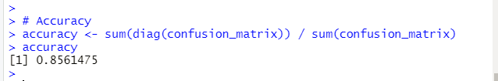
Modeling Evaluation
Predict the outcomes for test set.
Print out the Confusion matrix values.
Our model has an accuracy of 85%.

Slide 21
Deployment
We use ShinyApps website to deploy our application.
The deployment includes 2 parts:
User Interface
Server code
Our application can be accessed at: https://skvuong.shinyapps.io/project/

Slide 22
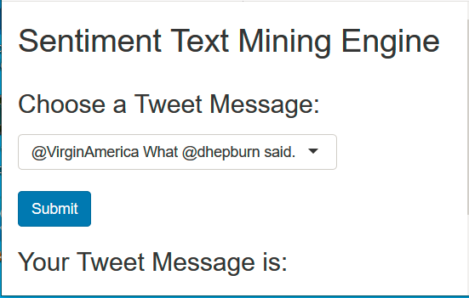
Deployment - User Interface
Presents a dropdown list of tweet text messages for user to select.
Calls the server code to predict sentiment for the input text.

Slide 23
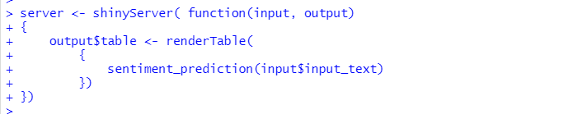
Deployment - Server Code
Received input text message.
Calls prediction function to execute prediction for related text message.
Returns Result.

Slide 24
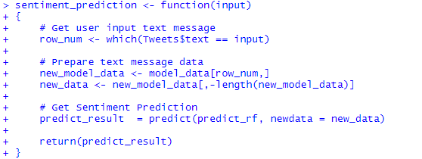
Sentiment_Prediction() function
Prepares model data for input test message.
Calls model code to predict sentiment for input text message.
Returns predicted result.

Slide 25
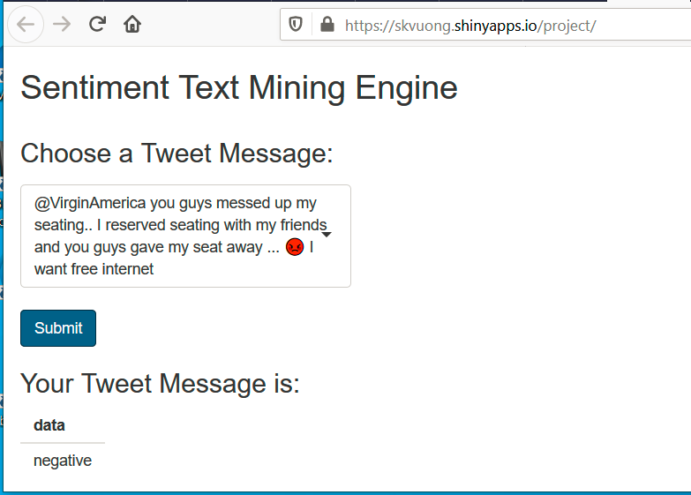
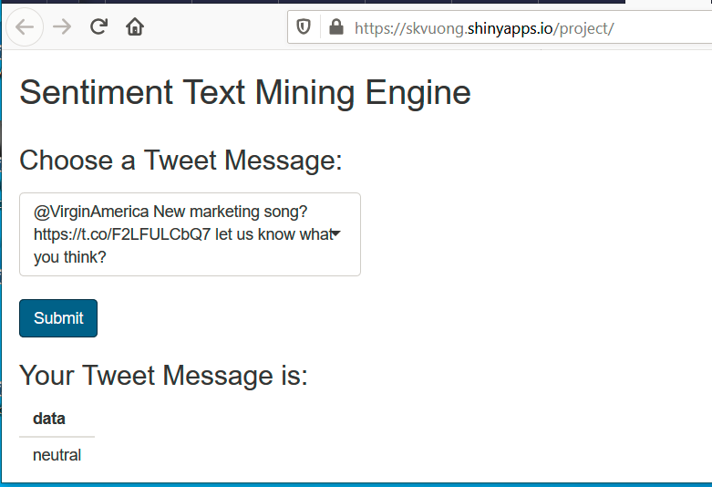
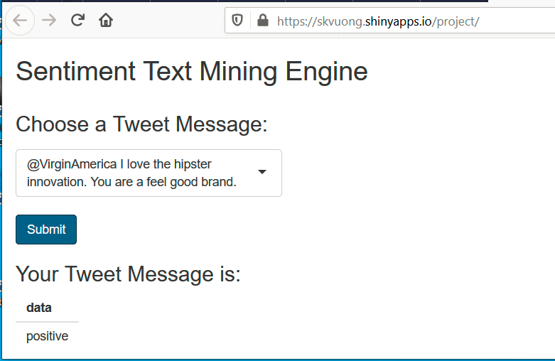
Deployment - Testing
3 possible outcomes for sentiment from tweet text messages:
Negative (approx. 63%)
Neutral (approx. 21%)
Positive (approx. 16%)
Negative Sentiment Test
Neutral Sentiment Test
Positive Sentiment Test

Slide 26
Conclusions
Our Data Analysis and Visualizations show that customers presented anticipations and things could be better off if customer service is improved and/or late flights are avoided.
United airline has the most negative tweets whereas Delta airline has a high positive tweet percentage.
Model accuracy of 85% was achieved using the Random Forest algorithm.
Further work on how to improve user interface will be of great interest. To further improve the user interface, the drop-down list can be replaced by input text typing by users.

Slide 27
Thank you.

Slide 28

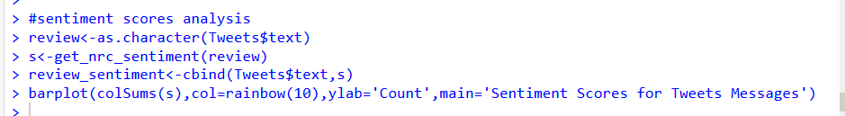
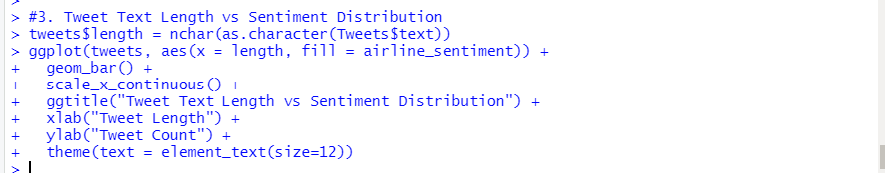
Data Visualization - R Code
Tweet Sentiment Distribution
Tweet Text Sentiment Scores
Tweet Text Length vs Sentiment Distribution

Slide 29
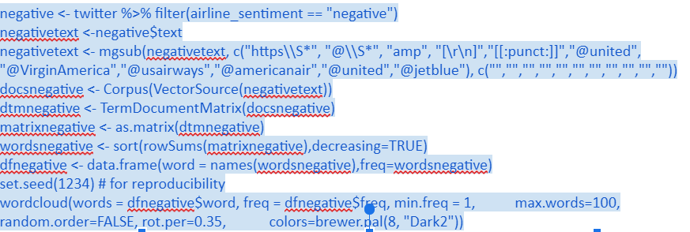
Data Visualization - R Code Cont.
Word-Cloud chart for Negative Sentiment Tweets (Top 100)

Slide 30
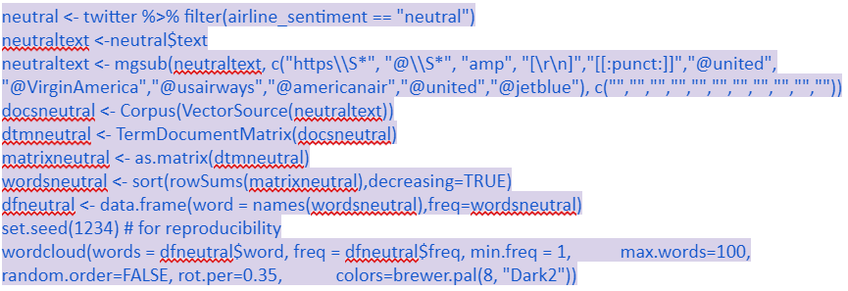
Data Visualization - R Code Cont.
Word-Cloud chart for Neutral Sentiment Tweets (Top 100)

Slide 31
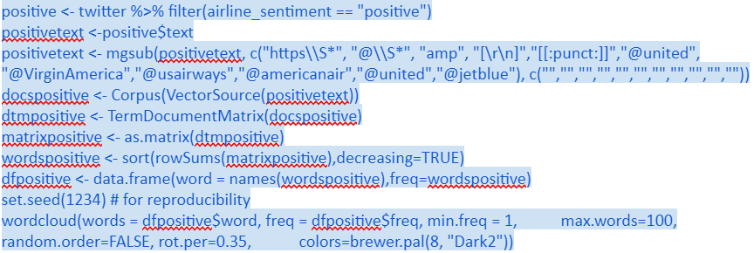
Data Visualization - R Code Cont.
Word-Cloud chart for Positive Sentiment Tweets (Top 100)

Slide 32

Data Visualization - R Code Cont.
Airlines Sentiment Distribution
Negative Tweet Reasons Distribution

Slide 33
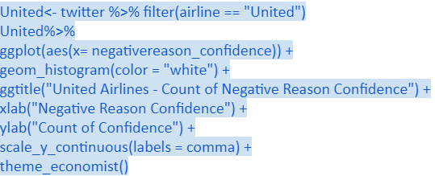
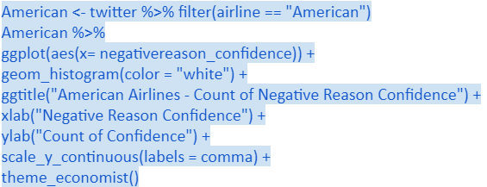
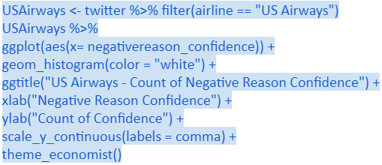
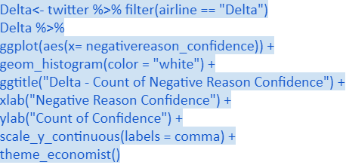
Data Visualization - R Code Cont.
United Airline - Negative Reason Confident Distribution
American Airline - Negative Reason Confident Distribution
US Airways - Negative Reason confident Distribution
Delta Airline - Negative Reason confident Distribution

