Slide 1

Housing Market - Time Series Analysis & Price Prediction using Deep Learning
Sam Vuong
Raymond Huang
Kyle Murphy
Carmon Ho

Slide 2
Introduction
Melbourne and Sydney are Australia's top house price cities much like Canada’s Toronto and Vancouver.
For our project we will be analyzing Melbourne’s Housing Market from January 2016.
Goal: Be able to analyze the house market trend in Melbourne.
Be able to build a model to accurately predict the trend of housing prices.
Use Time Series techniques to analyze our dataset.
Use Neural Network Deep Learning technique to model price prediction.
Success Factors: How well we can analyze the housing market dataset.
How accurate is our price prediction model.

Slide 3
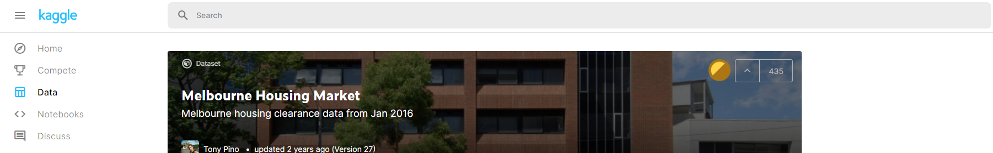
Website: https://www.kaggle.com/
Dataset Link: https://www.kaggle.com/anthonypino/melbourne-housing-market
Reference: Pino, T. (2016). “Melbourne Housing Market.” Melbourne, Victoria: Kaggle, 08 Jun. 2019, https://www.kaggle.com/anthonypino/melbourne-housing-market
Suburb
Address
Rooms
Type
Price
Method
SellerG
Date
Distance
Postcode
Bedroom2
Bathroom
Car
Landsize
BuildingArea
YearBuilt
CouncilArea
Latitude
Longitude
Regionname
Propertycount
34,857 rows
21 columns

Slide 4

Ethical ML Framework
Conduct our research in an ethically responsible manner
Eliminate discriminating factors like gender and religion
Remove all personal information like house address, postal code, latitude and longitude
We have decided not to have any code to view or print out these information from the dataset in order to protect the privacy of the participants.

Slide 5

Assumptions
Contributors to this dataset all reside in Melbourne
Although we cannot determine family size, but submitters would be in a relationship/married/common-law as affording a house is difficult

Slide 6
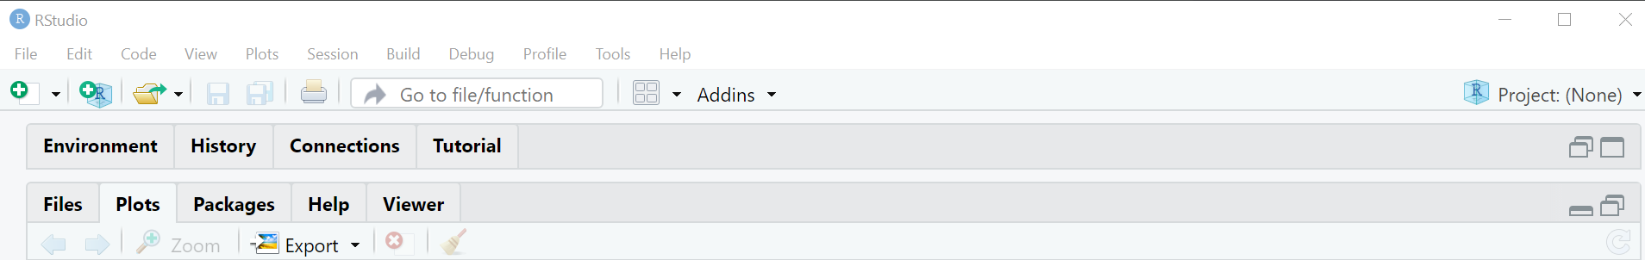
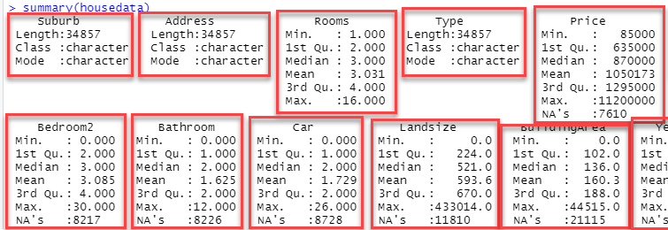



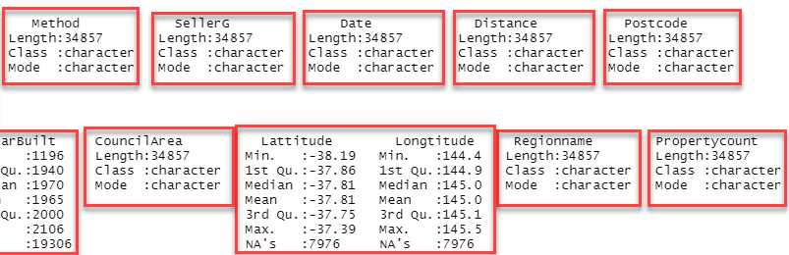
Data Exploration

Slide 7
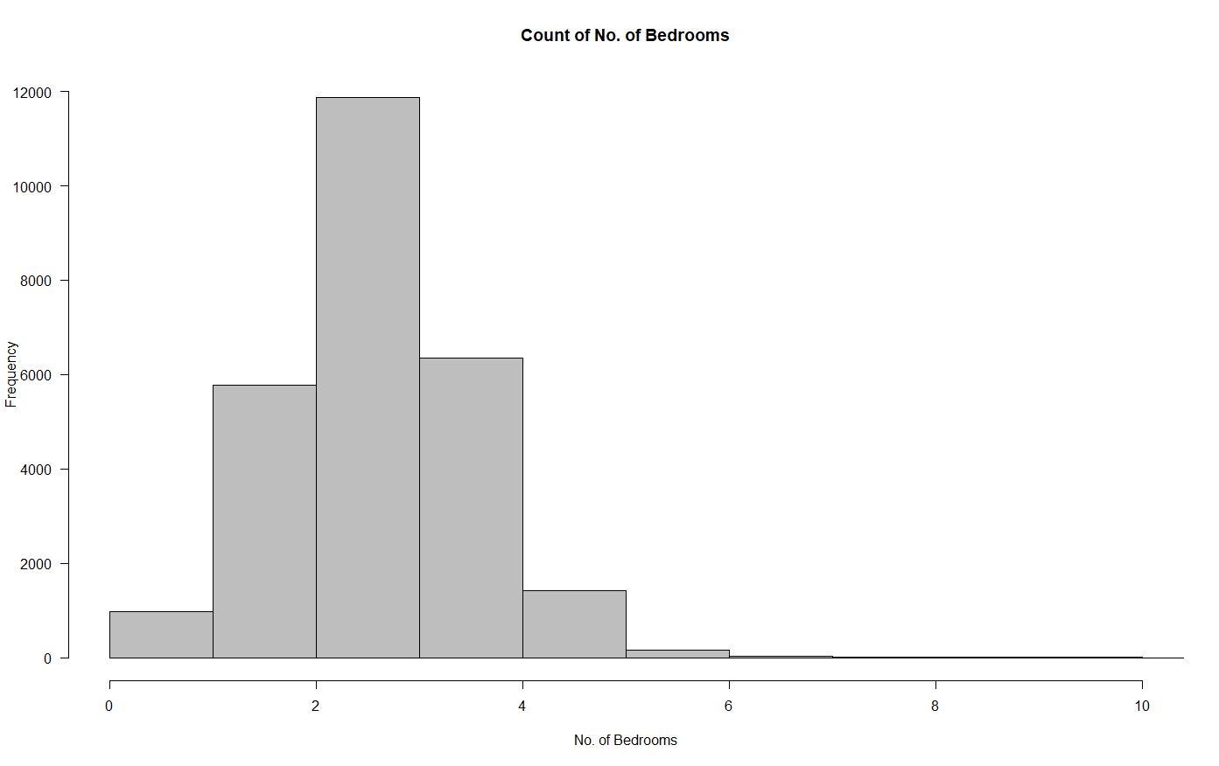
Data Visualization
Number of Bedrooms Per Home

Slide 8
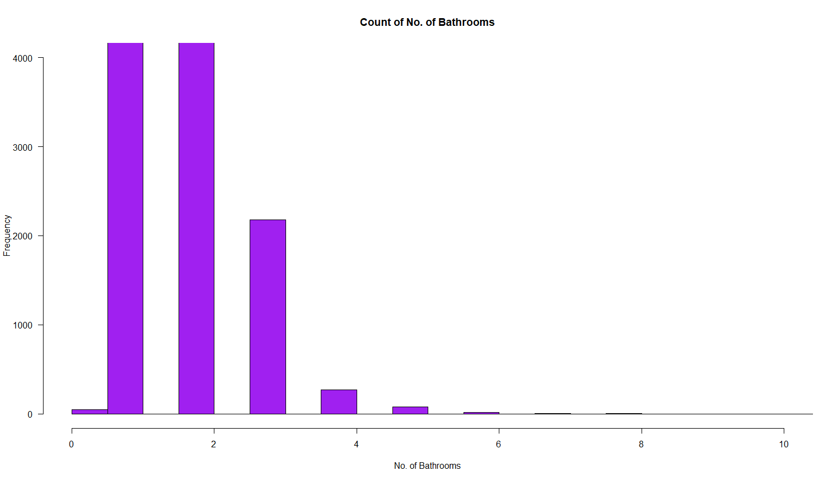
Data Visualization Cont.
Number of Bathrooms Per Home

Slide 9
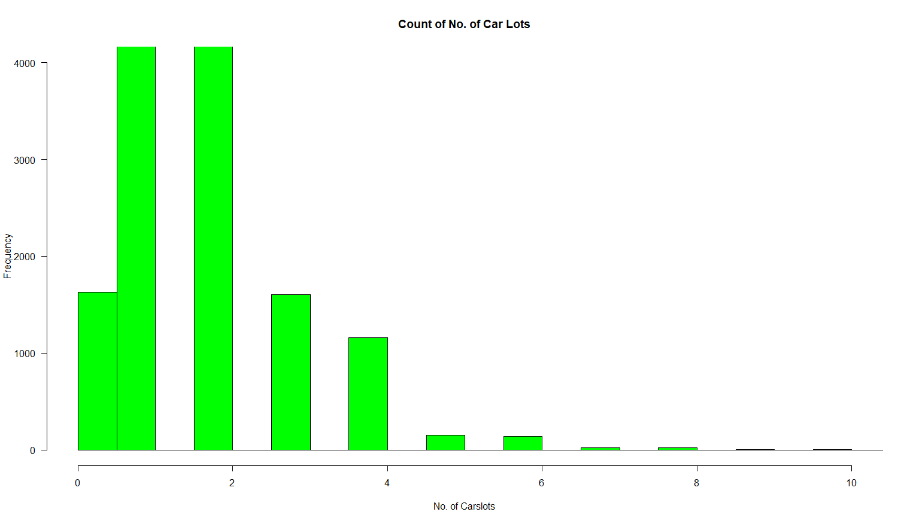
Data Visualization Cont.
Number of Car lots Per Home

Slide 10
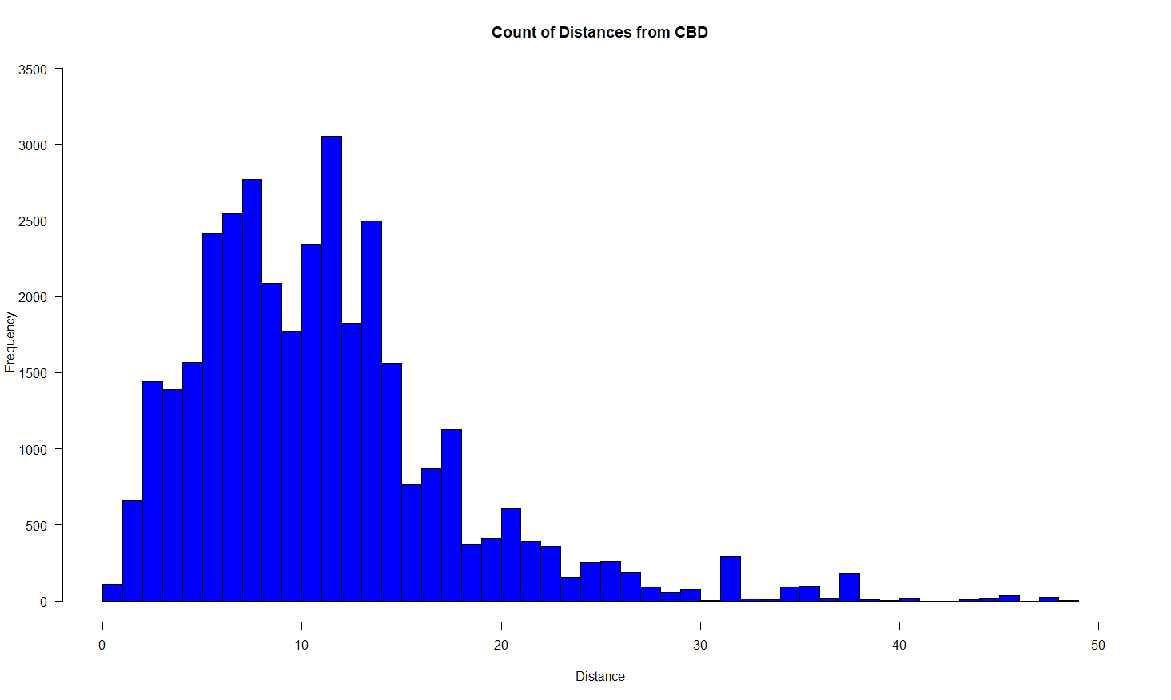
Data Visualization Cont.
Distance from Central Business District (CBD)

Slide 11
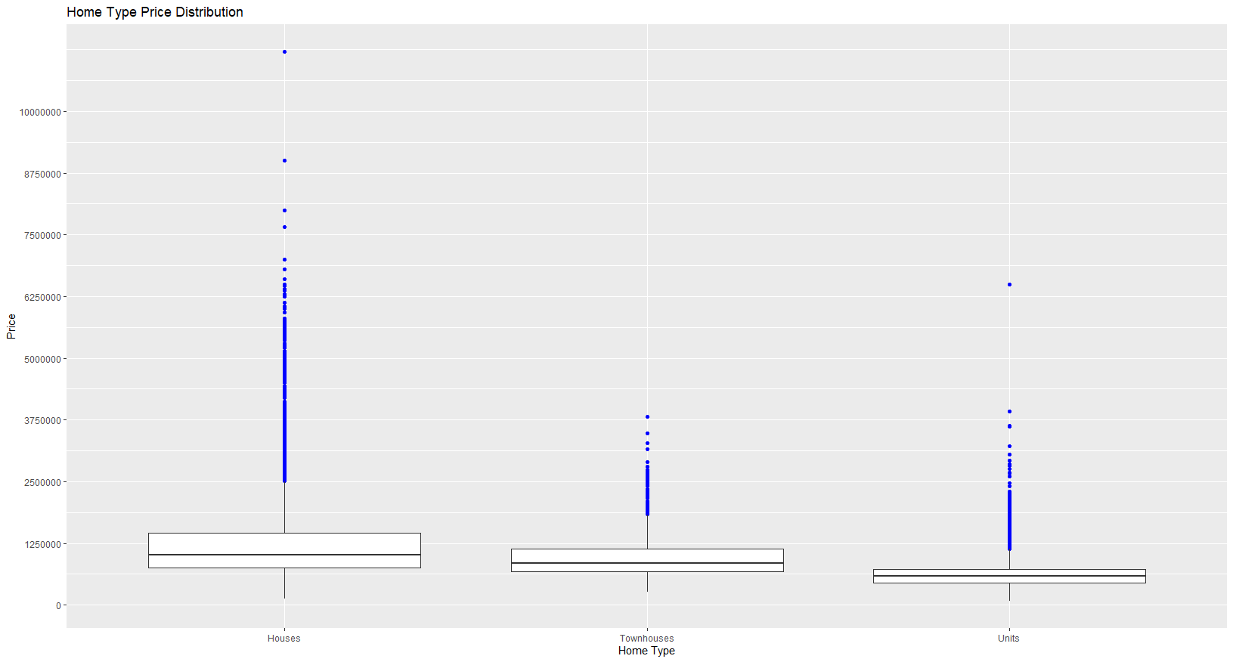
Data Visualization Cont.
Home Type Price Comparison

Slide 12
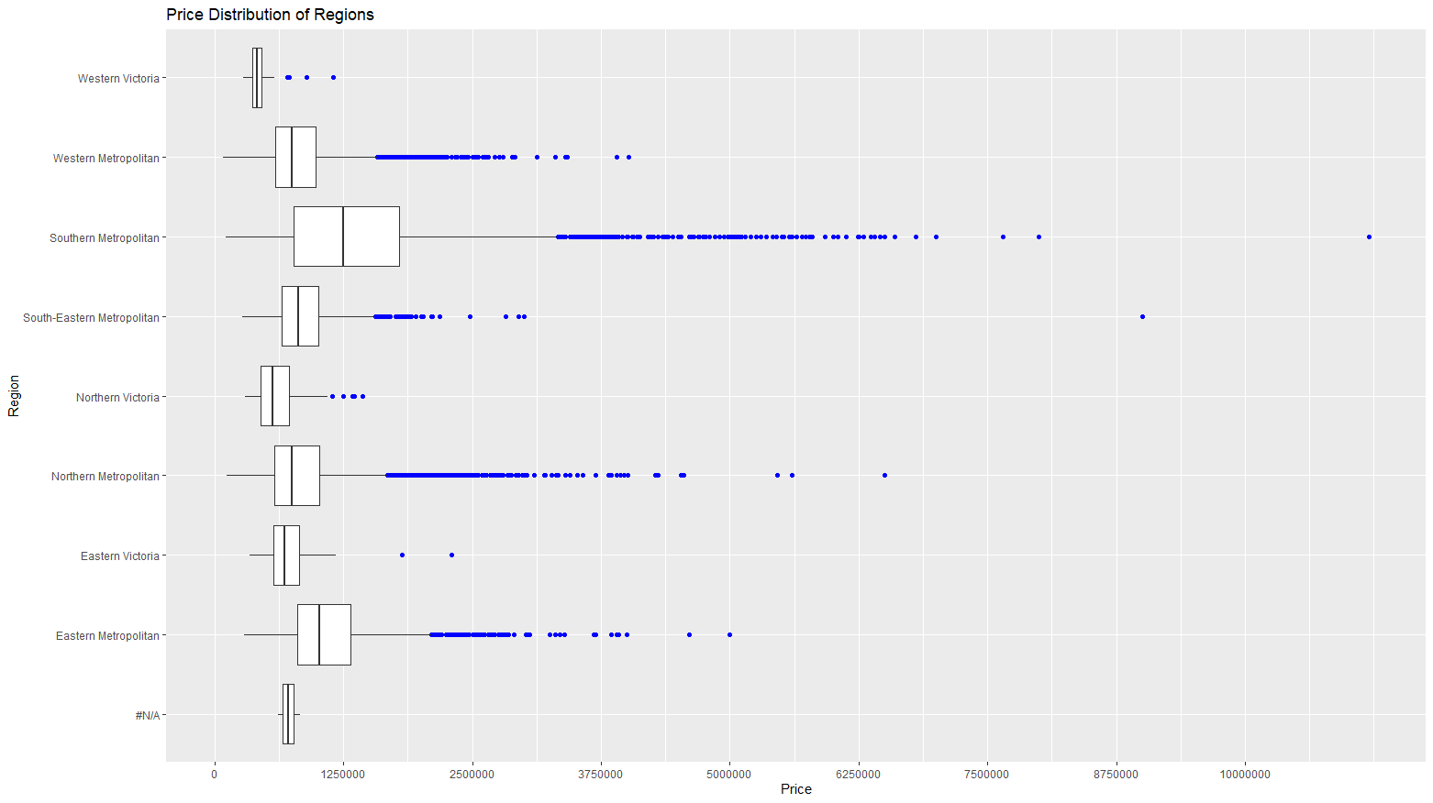
Data Visualization Cont.
Region Price Comparison

Slide 13
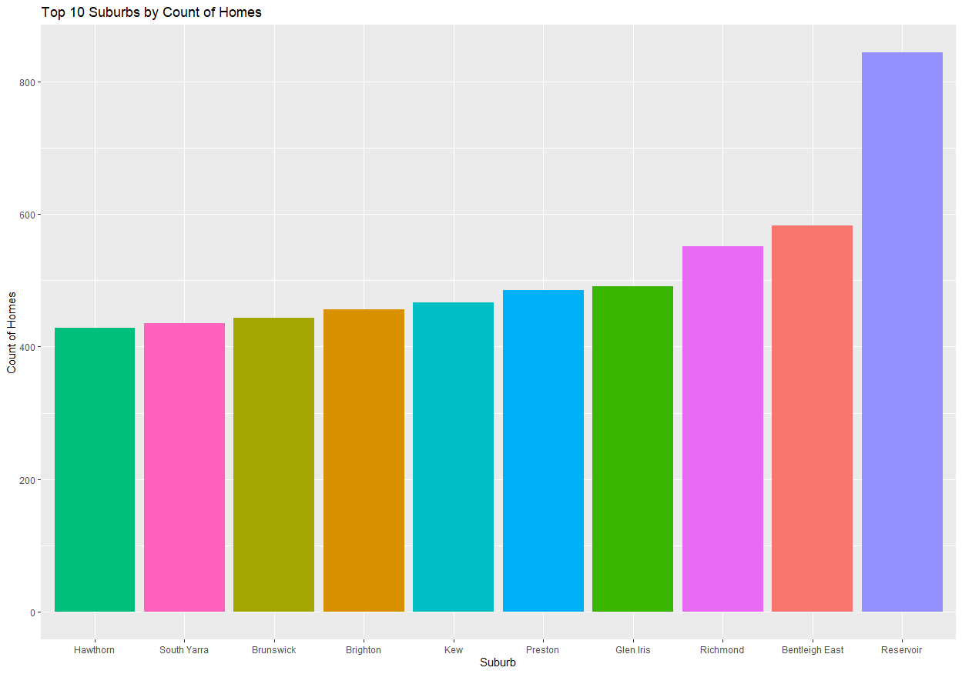
Data Visualization Cont.
Count of Homes Per Suburb

Slide 14
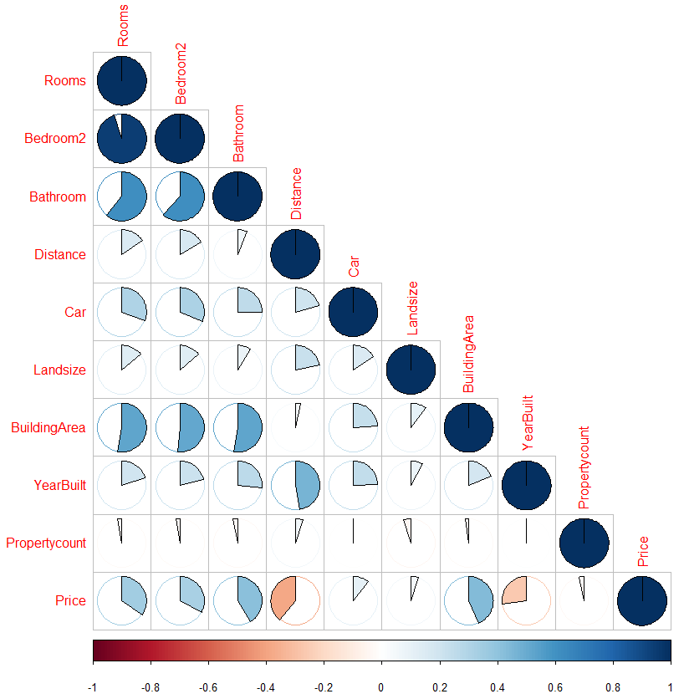
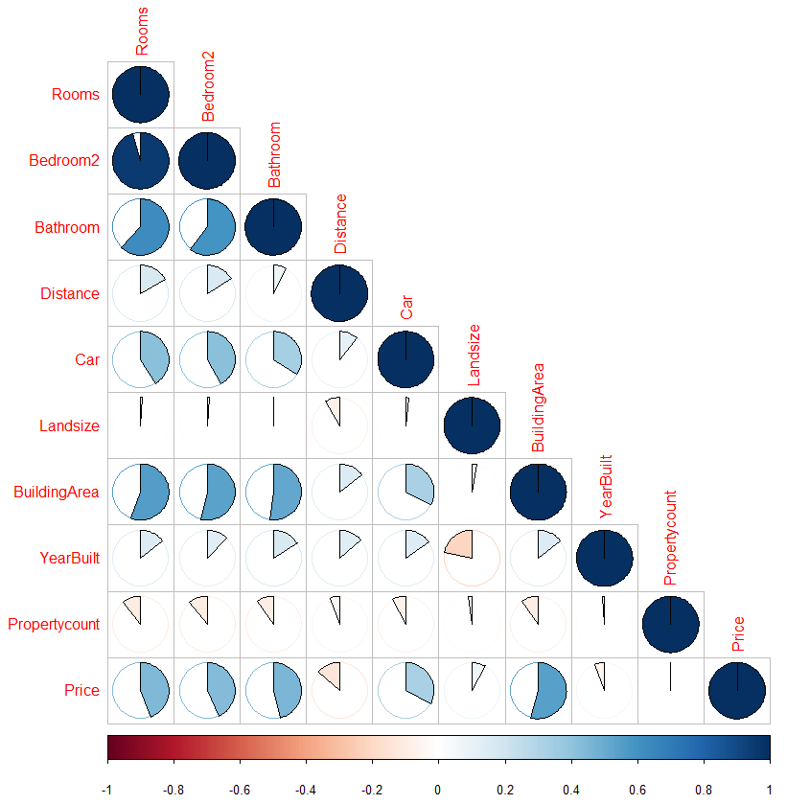
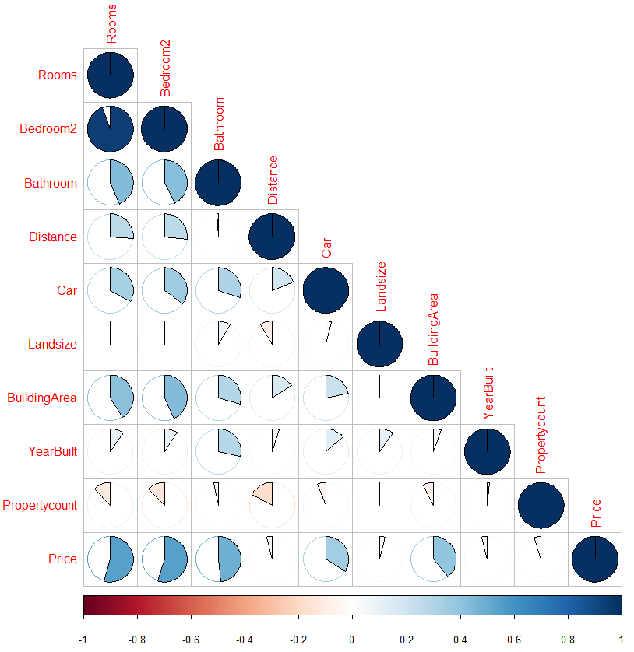
Data Visualization Cont.
Left Chart: Correlation Matrix of ‘House’ type homes
Centre Chart: Correlation Matrix of ‘Townhouse’ type homes
Right Chart: Correlation Matrix of ‘Unit’ type homes
Price Correlation Matrix

Slide 15
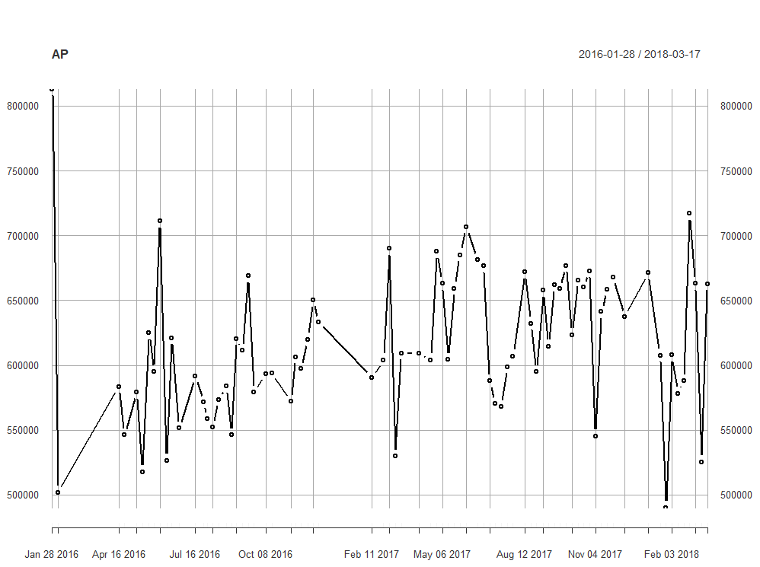
Time Series
First we plot and there are some changes with month but no clear trend.

Slide 16
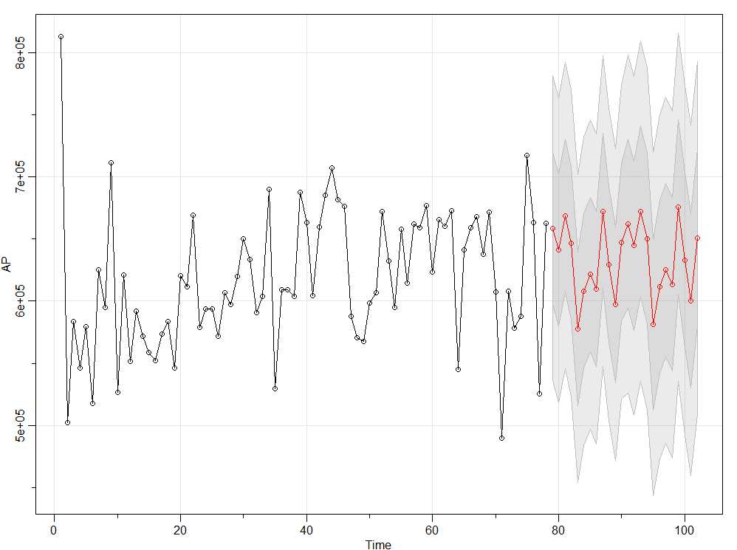
Time Series Cont.
Seasonal Arima model was found to be the best suited and with MAPE 6.75 which stands for 93.25 % accuracy regarding prediction.

Slide 17
Price Prediction Model - Data Preparation
Step-1 - Data Cleanup for Price attribute:
First we check for observations with missing Price values and outliers.
7,610 rows (approx. 21.8%) with null value.
208 rows (approx. 0.6%) with price values < 300,000.
58 rows (approx. 0.2%) with price values > 5,000,000.
We drop records with missing price values and outliers above.
The dataframe has 26,981 rows (approx. 77.4%) left.

Slide 18
Price Prediction Model - Data Preparation Cont.
Step-2 - Divide Data Buckets:
We divide the data into 10 buckets of equal sizes.
Assign bucket number for each group to a new variable - PriceRange.
Each bucket has about 10% of data (between 2,500 and 2,800 rows).
PriceRange column has integer values from 1 to 10.

Slide 19
Price Prediction Model - Data Preparation Cont.
Step-3 - Feature Selection:
Type - Property type - 3 different values: House, Townhouse, Unit.
Rooms - Number of rooms
Bedroom - Number of bedrooms
Bathroom - Number of bathrooms
Car - Number of car lots
Landsize - Land size
YearBuilt - Year property was built
BuildingArea - Build area
Distance - Distance from Central Business District (CBD)

Slide 20
Price Prediction Model - Data Preparation Cont.
Step-4 - Data Cleanup for Independent attributes:
Convert non-numeric columns with numeric data to numeric.
Fill null values in numeric columns with column mean values.
Step-5 - Create dummies for categorical attribute (Type):
We add categorical attribute (Type) to column selection and create dummies.

Slide 21
Price Prediction Model - Data Preparation Cont.
Step-6 - Prepare Model Data:
1. Create a dataframe with the selected features
2. Create a simple Neural Net with the selected features
3. Convert model data to matrix
4. Split data into 80/20 Train/Test sets
5. Normalize train and test data
6. Categorization train and test target vectors
This is called one-hot encoding in Keras (Deep Learning) -
Have multiple binary-outcomes, instead of one with multiple possible values.

Slide 22
Keras Deep Learning Model
Create a Keras sequential model - stacking the layers sequentially.
Our model has:
Three hidden layers, with 100, 50 and 20 neurons each.
Keras builds an implicit input layer using the input_shape parameter.
Last layer is the output layer.

Slide 23
Keras Deep Learning Model Cont.
We use the following options with our model:
Loss function = categorical_crossentropy
Optimizer function = optimizer_rmsprop()
Accuracy for our metrics

Slide 24
Keras Deep Learning Model Cont.
We fit the model with train dataset and with the following options:
# epochs = 100
Batch_size = 32
Validation_split=0.2

Slide 25
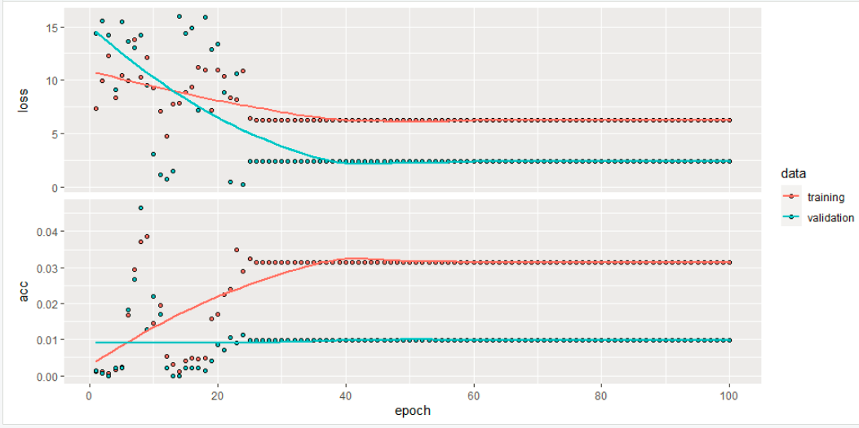
Keras Deep Learning Model Cont.
Chart of our model fitting history:

Slide 26
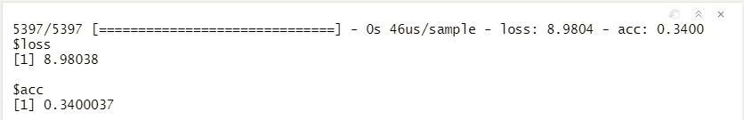
Model Evaluation
We evaluate our using the testset data.
The loss rate is 8.98, which is fairly good.
Accuracy is only about 34%, which is not very good.
Need more time to fine tune the model to improve the performance and accuracy.

Slide 27
Deployment
We used the ShinyApps website to deploy our application.
Our application on ShinyApps can be accessed at: https://skvuong.shinyapps.io/project/

Slide 28
Deployment Design
The App presents a drop-down list with options for the users to choose.
Our ShinyApp presents the following options to the users:
Top 10 Suburbs Bar Chart
Correlation Matrix Chart

Slide 29
Conclusions
1. The most favorable home was found to have 3 bedrooms, 2 bathrooms, 2 car spots and 11 km from the center. Western Victoria appears to have the lowest average price per home at $430,000 while Southern Metropolitan appears to have the highest average price per home.
2. Based on the correlation, the price of a Melbourne home is positively correlated with the number of rooms, number of bedrooms, number of bathrooms, number of car lots, land size, and building area but negative with the year built. The positive correlation of number of rooms, number of bedrooms, and number of bathrooms tends to be stronger for ‘unit’ type homes compared to ‘house’ and ‘townhouse’ type homes.

Slide 30
Conclusions cont.
3. From time series analysis, the Seasonal Arima model was found to be best suited with 6.75 for MPAE which means the model has 93.25% accuracy for prediction.
4. The result from our Price Prediction model using Keras Deep Learning shows that the model can achieve the loss rate of 8.98, which is fairly good. However the model accuracy is only about 34%, which is not very good.
5. We need more time to fine tune the performance of our model to have a better accuracy rate. Further analysis can be carried out to increase either units or layers for the models. What’s more, the effect of region or district could also be introduced into the model to see if accuracy could be increased.

Slide 31
Thank you.

Slide 32

Data Visualizations - R Code
Number of Bedrooms Per Home
Number of Bathrooms Per Home
Number of Car lots Per Home

Slide 33
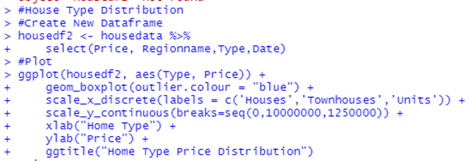
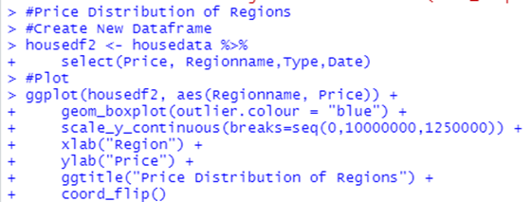
Data Visualization - R Code Cont.
Distance from Central Business District (CBD)
Home Type Price Comparison
Region Price Comparison

Slide 34
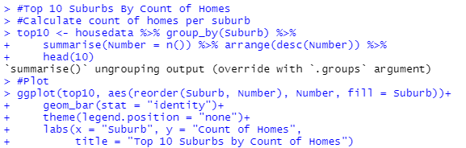
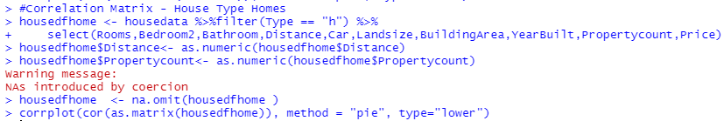
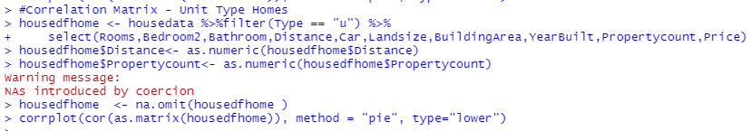
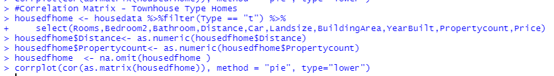
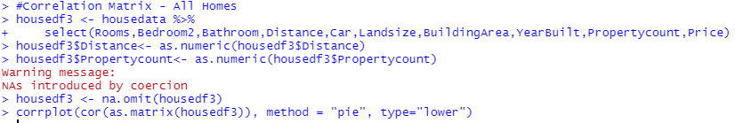
Data Visualization - R Code Cont.
Count of Homes Per Suburb
Price Correlation Matrix

