Slide 1
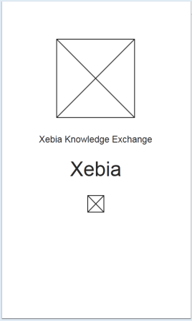
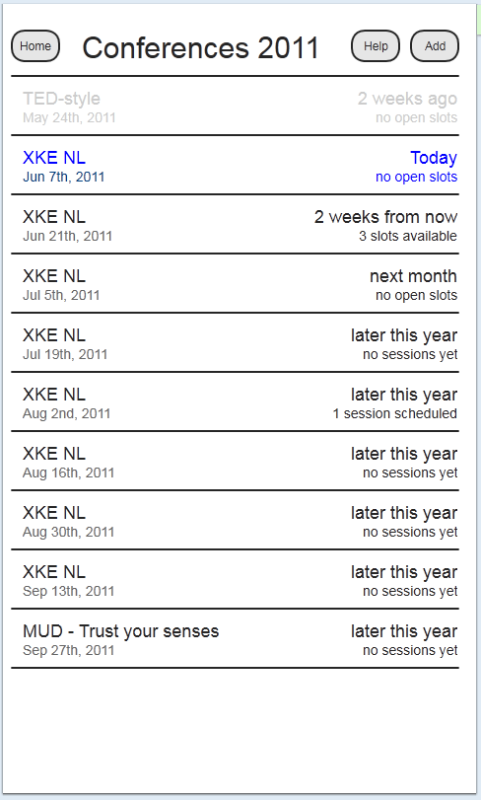
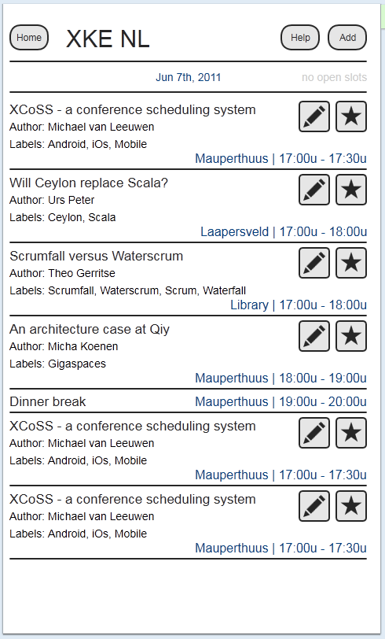
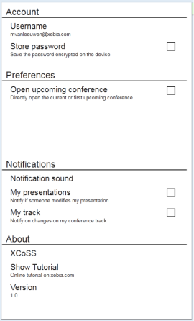
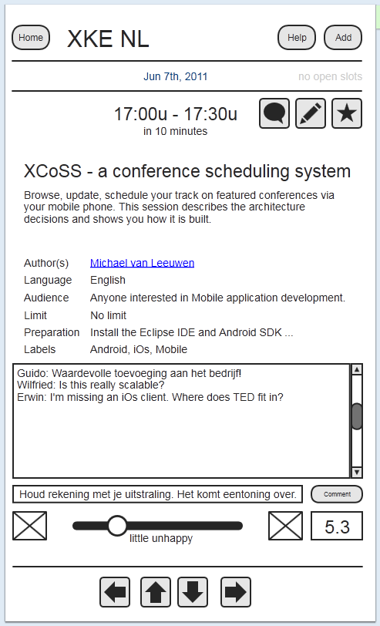
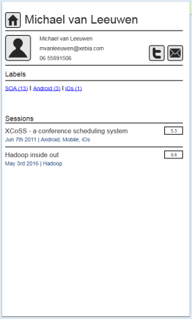
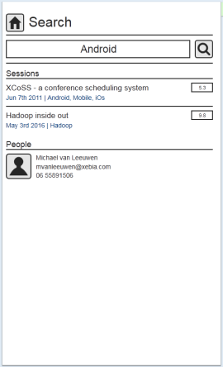
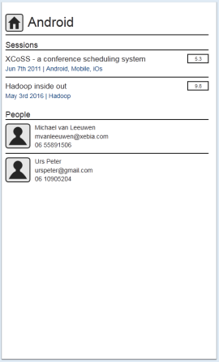
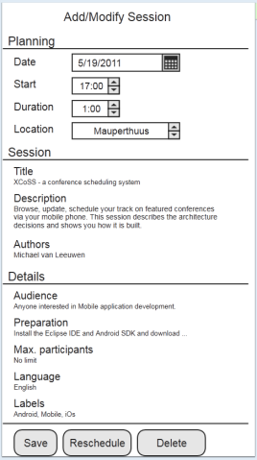
Startscreen
After loading, it will show the list of conferences of the current year. If selected, it will directly show the session view of the current or upcoming conference.
Conferences (+menu)
List all of one year. Current or upcoming is shown second (auto scroll). Select another year by clicking the title.
Conference list view
List all sessions of a conference. Star will mark your interest. Pencil will go to the modify screen of a session. Clicking a session will show the Conference session view with the selected session.
Preferences (via menu)
Accessible via every screen.
Session view
List a session in a conference. Sliding brings you on parallel sessions (horizontal) and chronologal sessions (vertical).
Author view
Allow to mail this author. All tags, with count, and all sessions in chronological order.
Search (via menu)
Searches all sessions with the text in the title, description, tags and all authors with the text in name or associated tags.
Tag (via link)
Searches all sessions and authors with this tags.
Click the session to view a session. Click the author to see the profile.
Add Session (modify)
Opens with specified (modify) or first available slot (add). Popups on fields to change. Reschedule finds the first available slot.

