Slide 1
Google Maps Clone
Skyler Favors

Slide 2
What I created
A map that uses a framework called MapBox
Lets you search your area for hotspots
You can narrow your search by drawing a polygon on the map
Gives you directions and estimated travel time

Slide 3
Why MapBox?
It’s Open Source! Mostly…
It’s much cheaper than Google Maps. Free for small projects
Fully Customizable
Much easier to use and understand

Slide 4
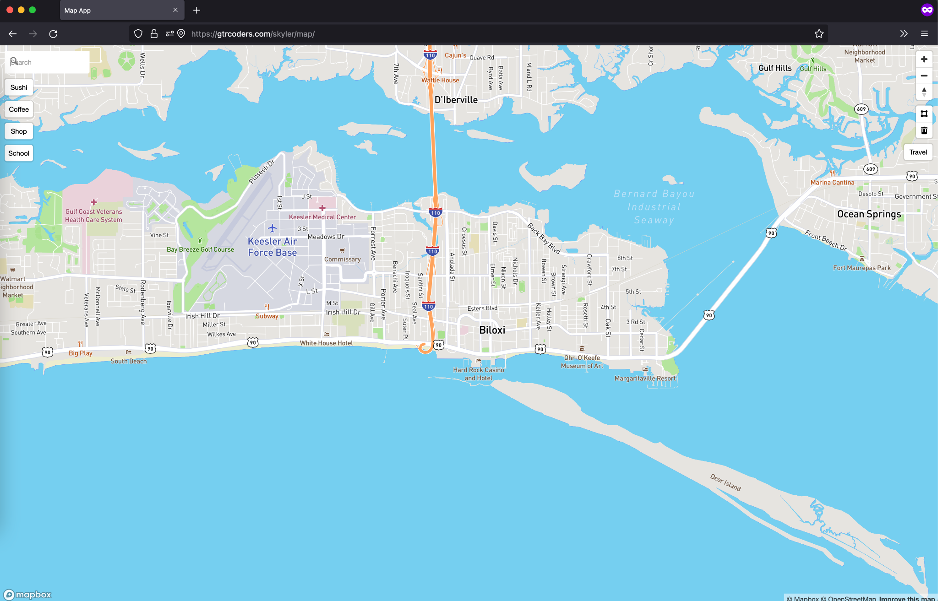

Slide 5
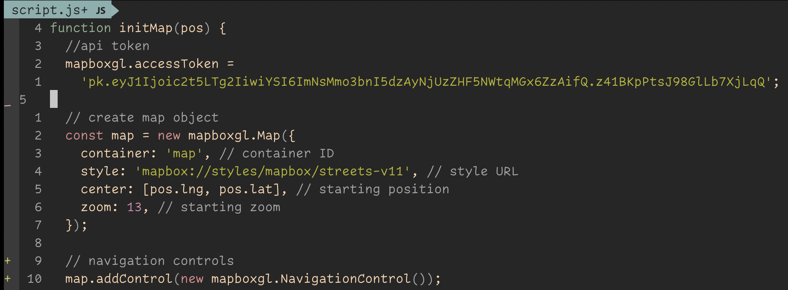
Drawing the map
Creates the map on our current position and zooms in

Slide 6
Map Blueprint
1234fakeapikey1234
Api key
Lat: -80, Lng: 30
Position
Zoom
15

Slide 7
Navigation Controls
Allows you to zoom in and out

Slide 8
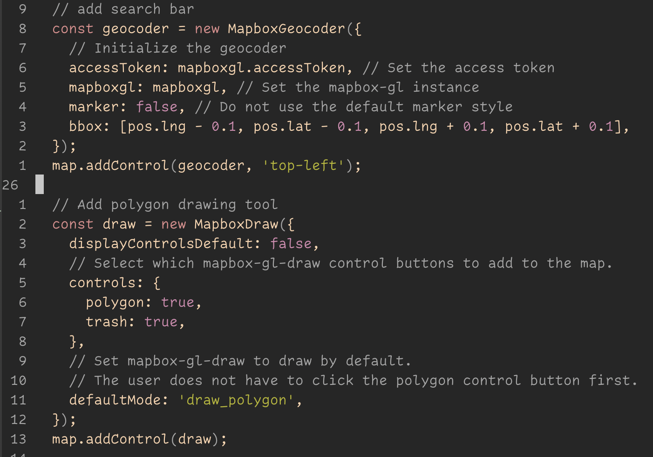
Search Function
Should only search the nearby area or inside of the drawn polygon

Slide 9
Polygon Function
Allow you to draw a polygon on the map

Slide 10
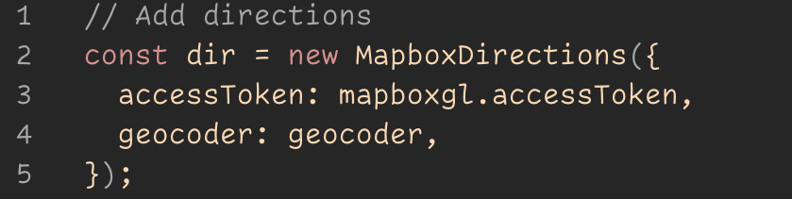
Directions Function
Lets you enter a destination and a mode of travel, returns the directions

Slide 11
Question??
http://gtrcoders.com/skyler/map/

