Slide 1
Steganography
By: Skyler Favors

Slide 2

What is Steganography?
Steganography is the practice of hiding a secret message inside of (or even on top of) something that is not secret.

Slide 3

What is a PPM
(Portable Pixel Format)
It’s basically an uncompressed, raw image
Very easy to manipulate
Can be very large, since they are uncompressed

Slide 4
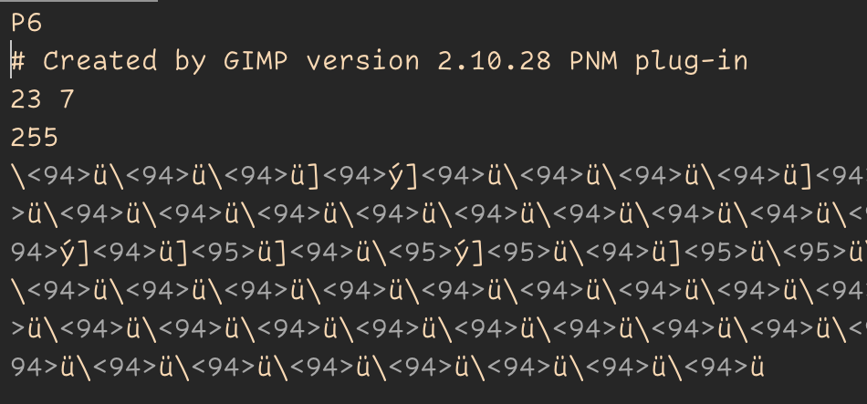
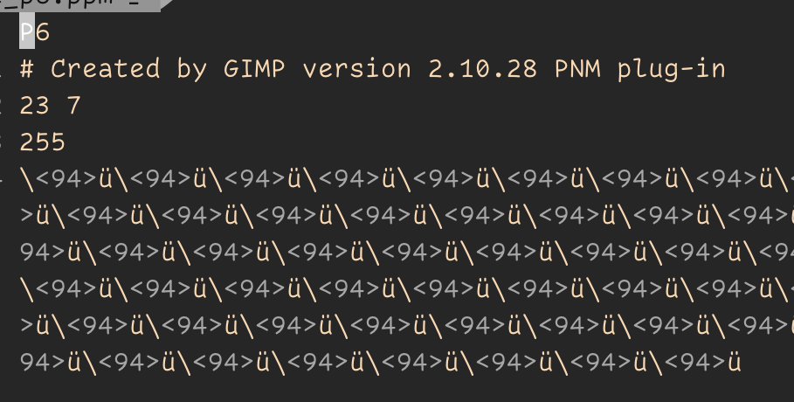
“Hello World”

Slide 5
The Steps I Take
Read bytes from ppm file
Sort out the header and rgb values
If Decoding
Decode the message from pixel data
Display Message
If Encoding the message
Encode message into pixel data
Save pixel data as a ppm file

Slide 6
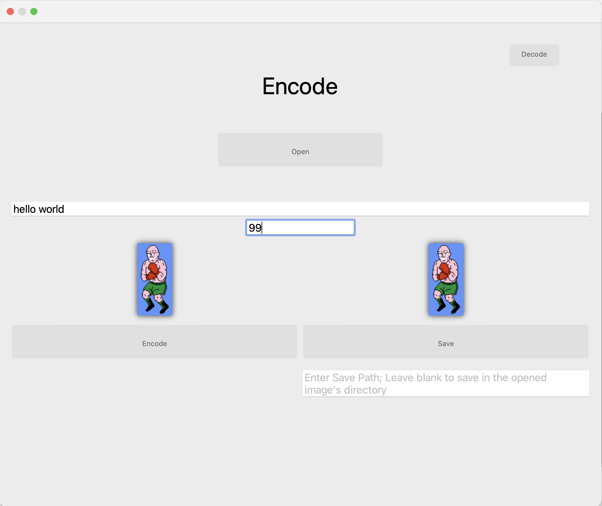

Slide 7
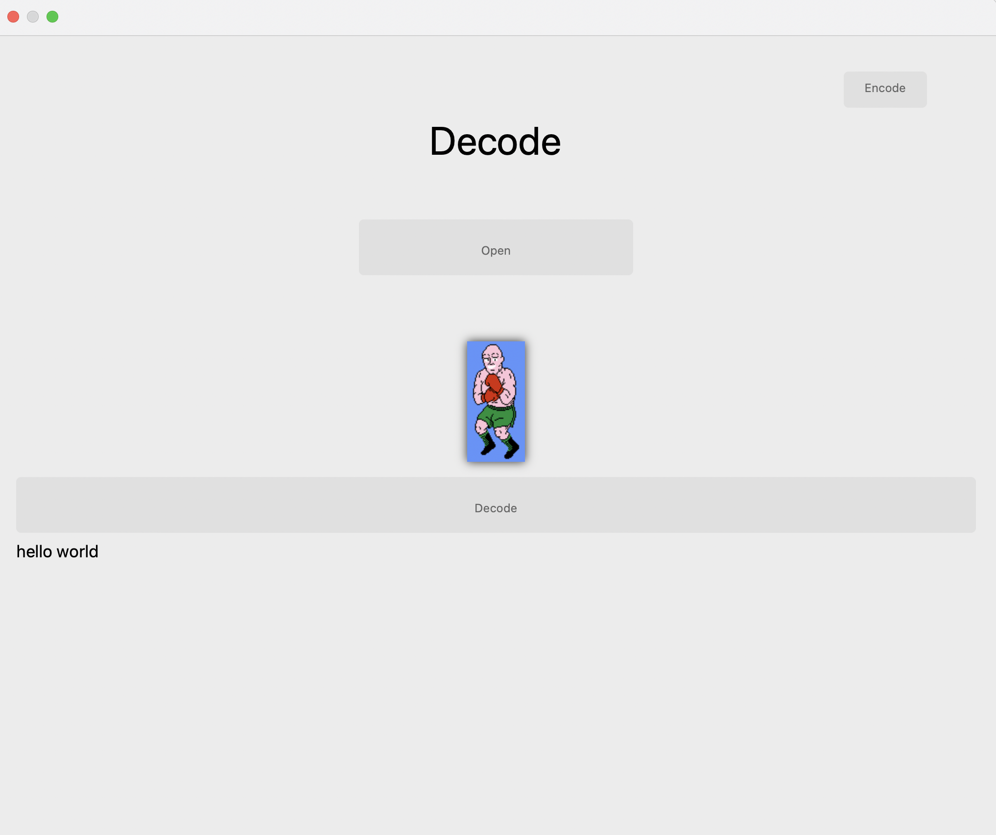

Slide 8

Getting Header and RGB Data
After the image is selected
Reads all the bytes of the image
Sort out which bytes are the header, and which are rgb values

Slide 9
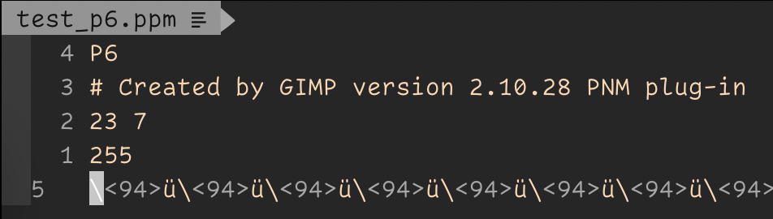
Enter / <CR> / 10
10
10
10

Slide 10
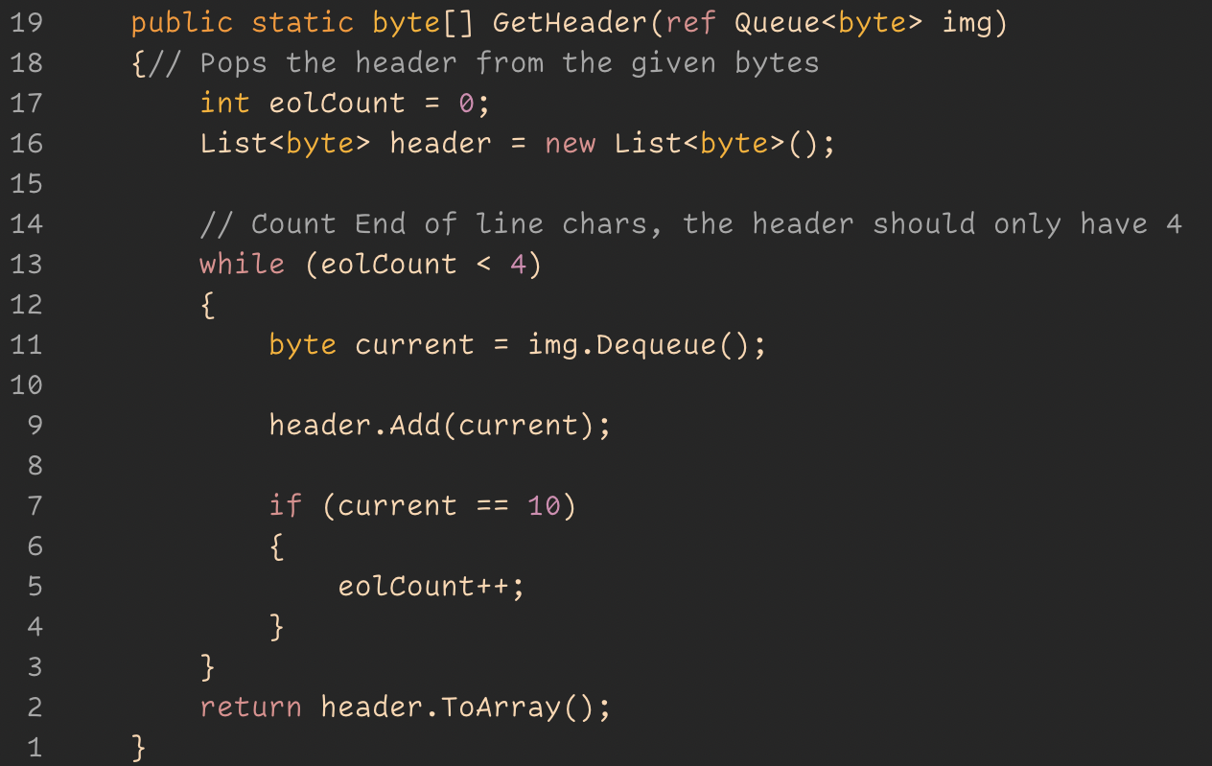

Slide 11
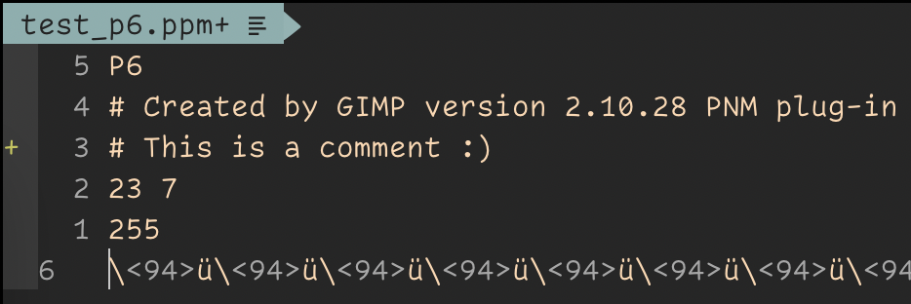

Slide 12
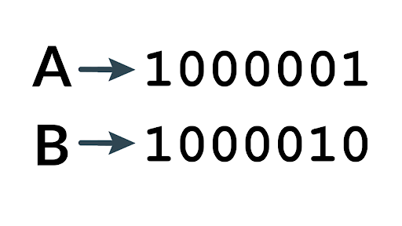
Encoding the message
Convert the users message into binary
Creates a header containing the length of the message and the starting location, also in binary
Inputs the header at the beginning, and the message at the specified location

Slide 13
My encoding process
Convert characters into binary
“Hello” == 01101000 01100101 01101100 01101100 01101111
Zero will be an even number, and One will be odd
Now change each color value based on the binary value
Original = [ [255,254,255], [179,170,160], [100,200,100] ]
Modified = [ [254,255,255], [180,171,160], [100,200,100] ]
0 1 1 0 1 0 0 0

Slide 14

Questions??

