Slide 1
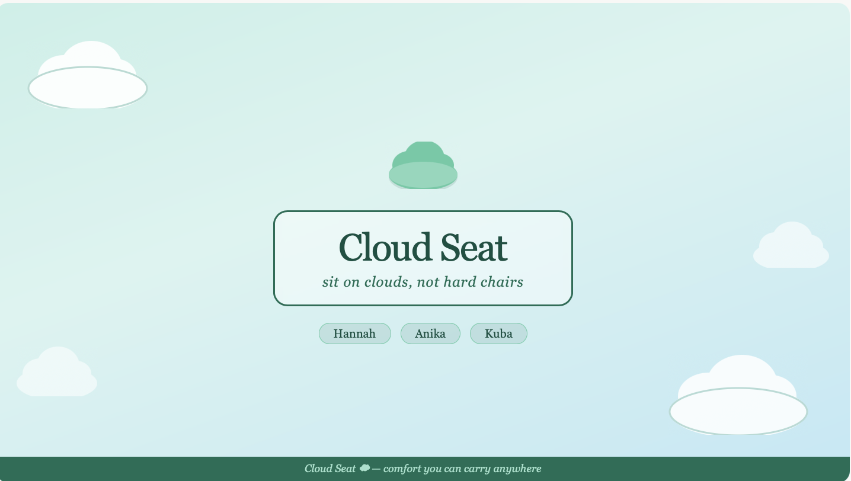

Cloud Comfort
Hannah, Anika, and Kuba

Slide 2
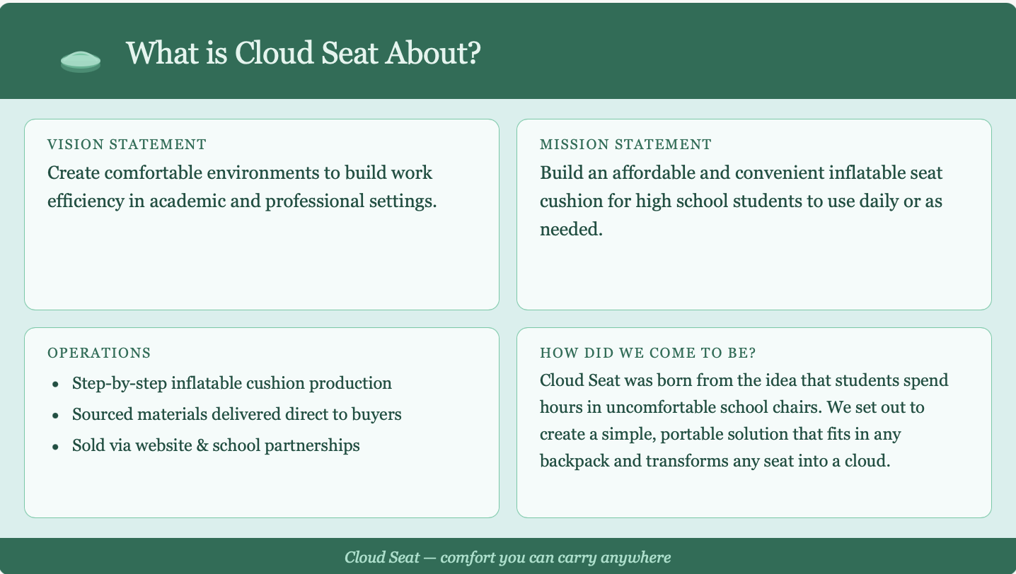
What is Our Company About?
Operations stuff here
Mission statement
Vision Statement
How did we come to be?

Slide 3
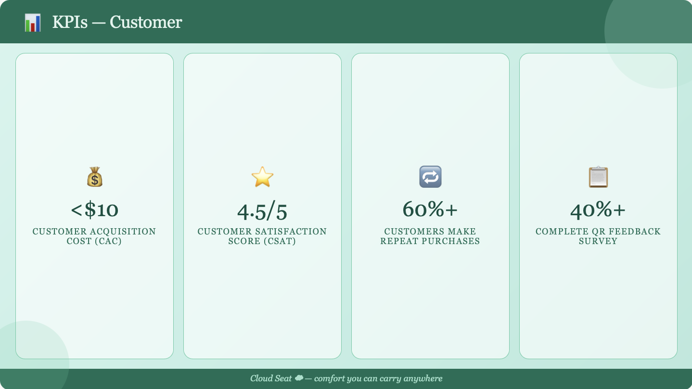
KPIs Customer
Customer Acquisition Cost (CAC) under $10
Customer satisfaction score (CSAT) of 4.5/5
At least 60% of customers make repeat purchases
40%+ of customers complete QR feedback survey

Slide 4
KPIs Operations
Employee satisfaction (surveys)
On time delivery schedule
How smooth products are made
Number of referrals

Slide 5
KPIs Market
Brand Awareness: Reach 50,000 impressions on student focused social media tags (#SchoolHacks)
Market Penetration: Secure “Official Comfort Partner” status with at least 3 regional student councils
Achieve 3-5% of viewers turning into customers
Gain 5,000+ followers across social media platforms

Slide 6
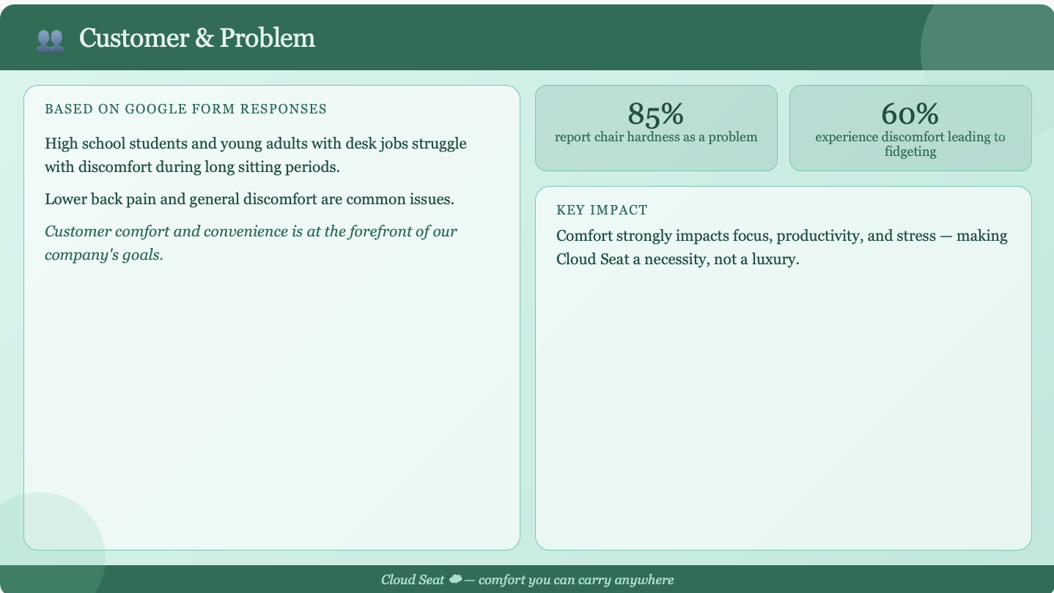
Customer & Problem
Based on Google Form responses:
High school students and young adults with desk jobs struggle with discomfort during long sitting periods
Lower back pain and general uncomfortability are common issues
85% report chair hardness as a problem
60% experience discomfort that leads to fidgeting
Comfort strongly impacts focus, productivity, and stress
Customer comfort and convenience is at the forefront of our company’s goals.

Slide 7
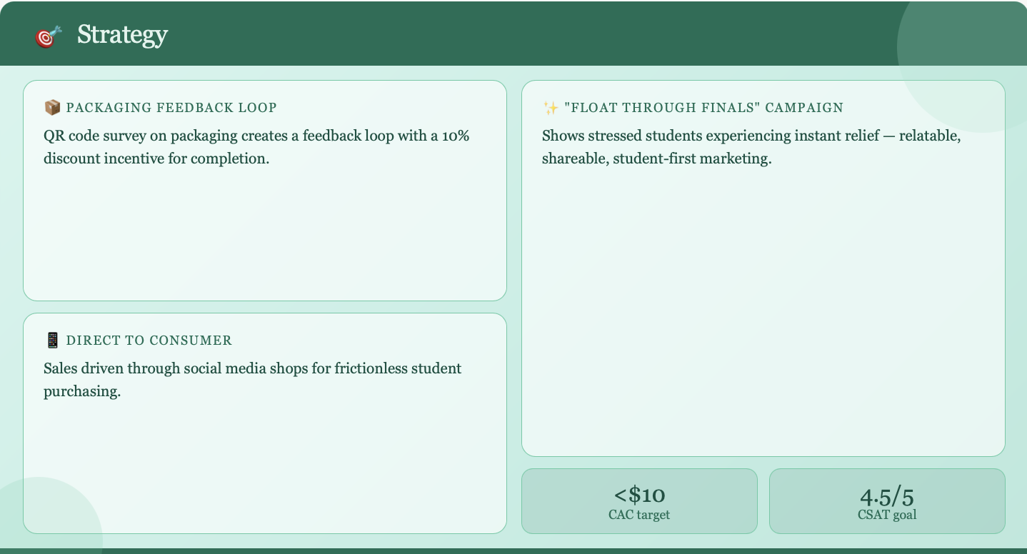
Strategy
-QR code survey on packaging creates a feedback loop (10% discount incentive)
–Direct to consumer sales through social media shops
-”Float Through Finals” campaign shows stressed students showing instant relief
-CAC target under $10
-cSAT goal of 4.5/5

Slide 8
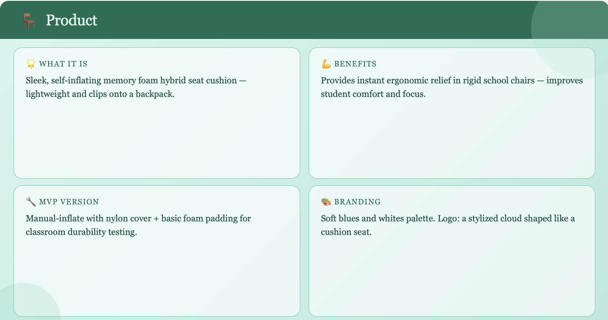
Product
-Sleek and self inflating memory foam hybrid seat cushion
-Lightweight and clips onto a backpack
-MVP:Manual- inflate version with nylon cover+ basic foam padding (for classroom durability testing)
-Provides instant ergonomic relief in ridgid school chairs
-Helps improve student comfort and focus
-Branding: Soft blues and whites
-Logo: Stylized cloud shaped like cushion seat

Slide 9
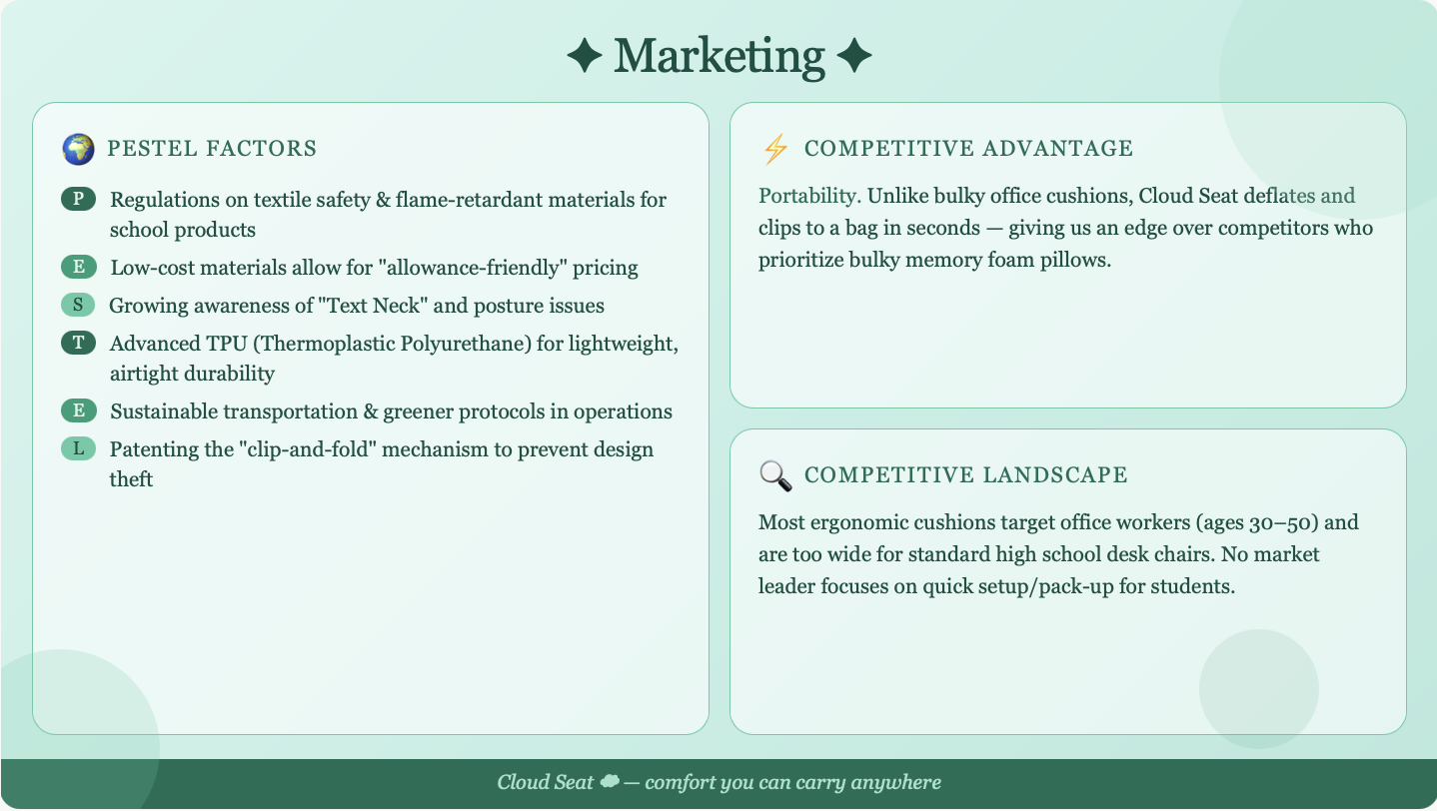
Marketing
PESTEL Factors
Political: Regulations on textile safety and flame-retardant materials for school-use products
Economic: Low-cost materials allow for "allowance-friendly" pricing.
Social: Growing awareness of "Text Neck" and posture issues.
Technological: Use of advanced TPU (Thermoplastic Polyurethane) for lightweight, airtight durability.
Environmental: Use sustainable transportation methods and “greener” protocols and regulations within the business’s operations
Legal: Patenting the specific "clip-and-fold" mechanism to prevent design theft.
Competitive Advantage
Portability. Unlike bulky office cushions, Cloud Seat is designed to be deflated and clipped to a bag in seconds. This provides an advantage over our competitors, as most of them sell and prioritize bulky memory foam pillows.
Competitive Landscape
Most ergonomic cushions are marketed toward office workers (ages 30–50) and are too wide for standard high school desk chairs. No current market leader focuses specifically on situations where quick setup/pack-up is required.

Slide 10
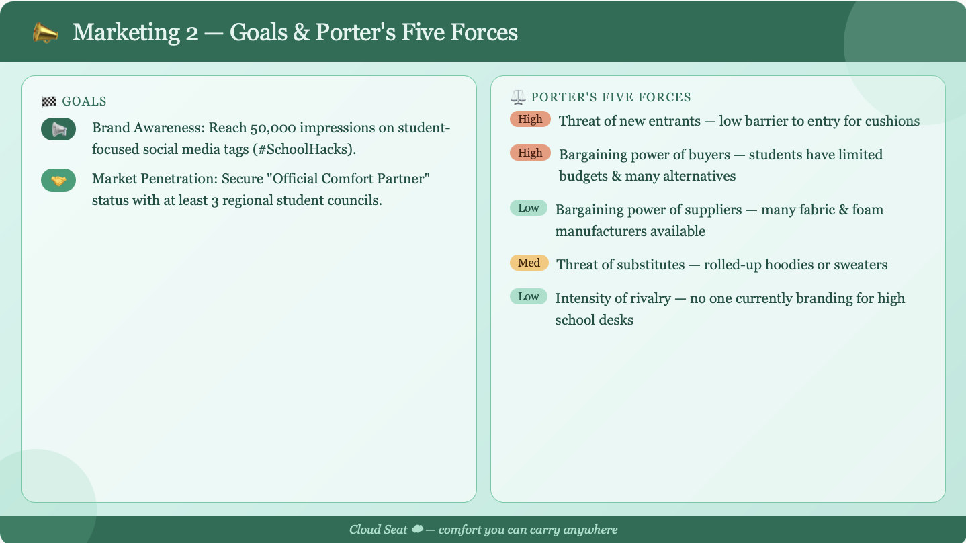
Marketing 2
Goals
Brand Awareness: Reach 50,000 impressions on student-focused social media tags (#SchoolHacks).
Market Penetration: Secure "Official Comfort Partner" status with at least 3 regional student councils.
Porter’s Five Forces
Threat of New Entrants: High (low barrier to entry for cushions).
Bargaining Power of Buyers: High (students have limited budgets and many alternatives).
Bargaining Power of Suppliers: Low (many fabric and foam manufacturers available).
Threat of Substitutes: Medium (rolled-up hoodies or sweaters).
Intensity of Rivalry: Low (no one is currently branding specifically for high school desks).

Slide 11
Marketing
SWOT Analysis
Strengths: Strong customer communication, reliable services
Weaknesses: Due to Cloud Comfort being a new brand there could be low awareness
Opportunities: Potential partnerships with schools,and corporations
Threats: Cheap competitors and alternatives, Copycat products, design theft

Slide 12
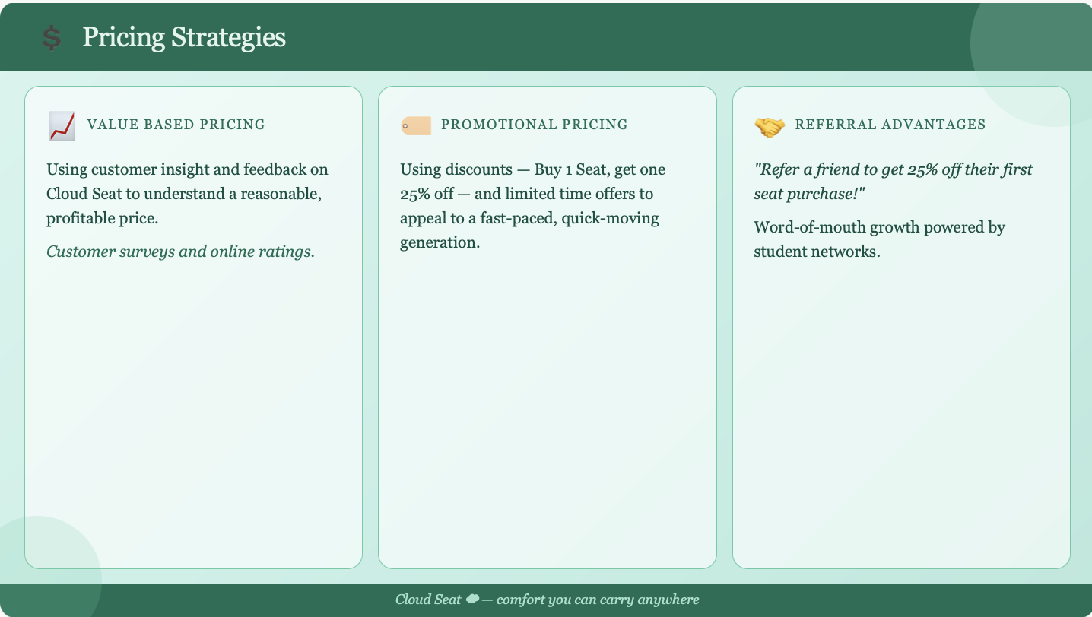
Pricing Strategies
Value Based Pricing
Using customer insight and feedback on Cloud Seat to understand a reasonable, profitable price.
(Customer surveys and online ratings)
Promotional Pricing
Using discounts (Buy 1 Seat get one 25%)
and limited time offers to appeal to a fast-paced, quick moving generation.
Referral Advantages
“Refer a friend to get 25% off their first seat purchase!”

Slide 13
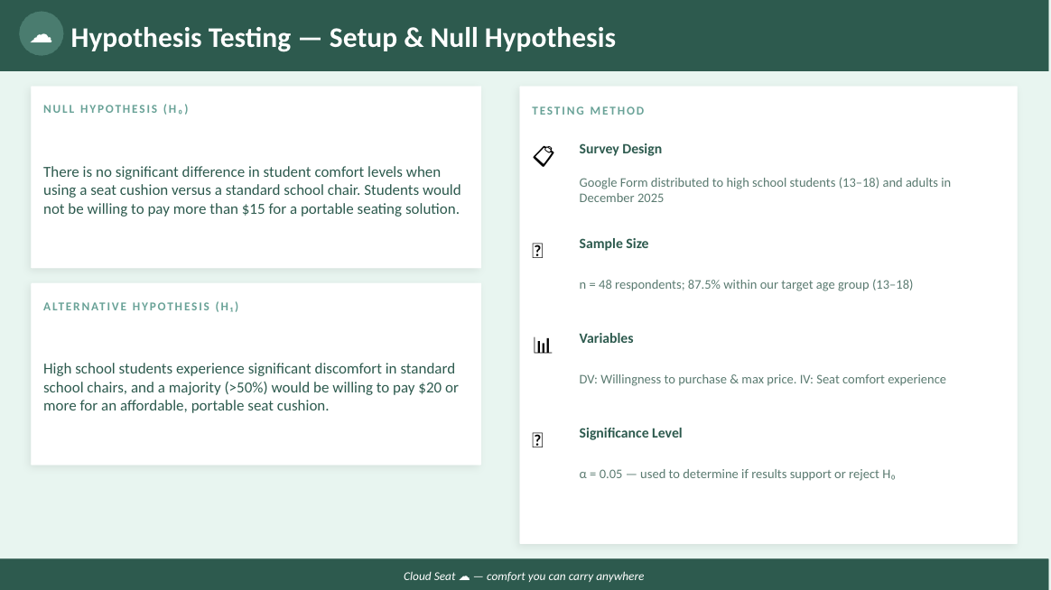

Slide 14
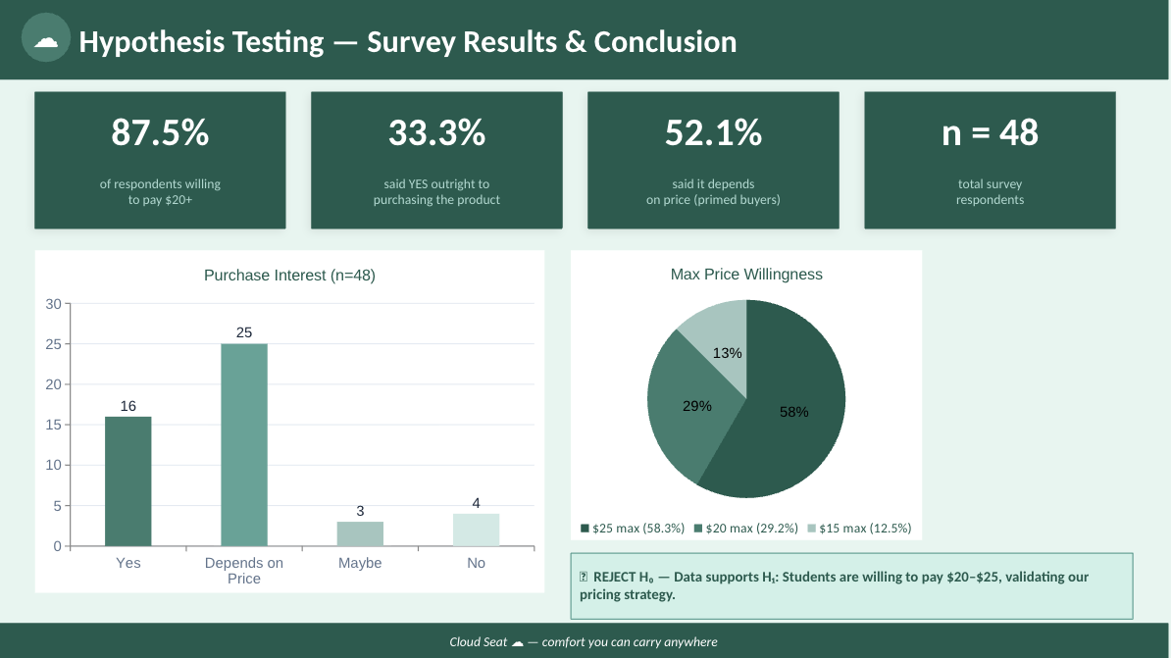

Slide 15
