Slide 1
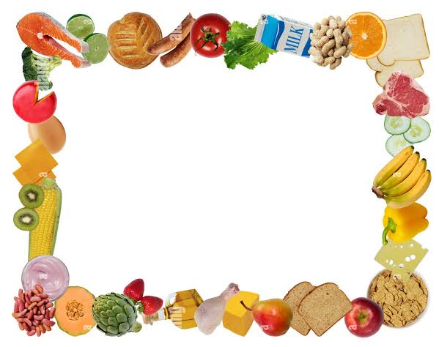
Cooking Story

Slide 2


Customer
The Problem:
People eat boring food
They don’t have enough options or knowledge to make their food better
Target Customer:
Teenager and adults who want to learn how to cook
Families and friends who want to experience new cultures
Plant to Build Customer Relations:
Create a website that includes booking systems and discounts
Email newsletters as a way for advertising

Slide 3

Customer cont.
Sales Tactics:
Discounts for bigger classes and first time customers
Monthly or yearly subscriptions
Research Findings:
People want to know how to cook to build independence
People want a variety on their life that they look forward to
Marketing:
Social media
Partnering with influencers

Slide 4
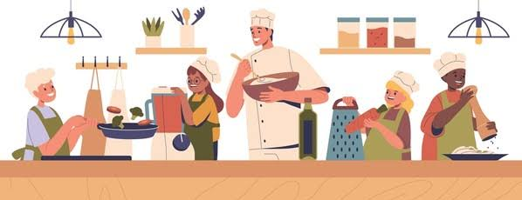
Customer KPIs
Class attendance
Customer satisfaction rate
# of review that are above four stars within six months
# of referrals to possible customer per thirty customers
# of customers that come from referrals per month
# of reoccurring customers per class

Slide 5
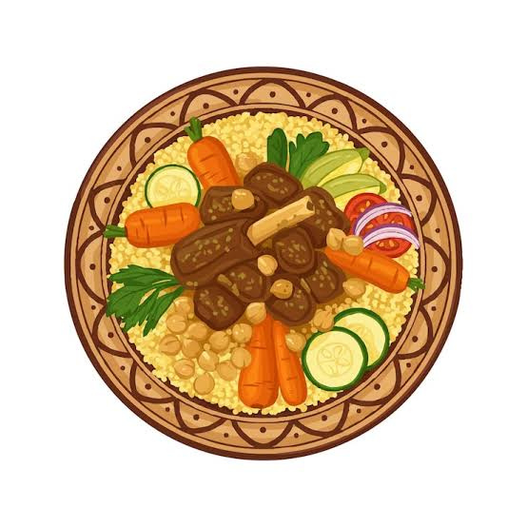
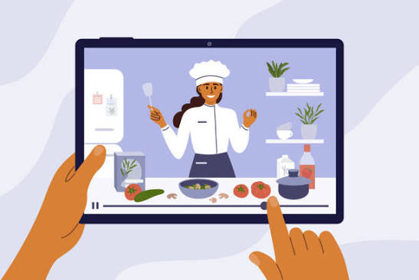
Product
A website and in-person service that provides cultural recipes to elevate foods
MVP:
Basic online cooking class
Short recorded lessons
Value Prep:
Affordable hands on cooking
Learn to cook quickly
Branding:
Cooking Story
Cook like your grandma

Slide 6
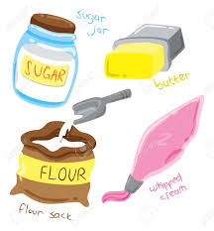
Market
PESTEL:
P - food safety regulations and health codes shape how we operate and handle ingredients
E - rising food prices shifts in disposable income and can affect class demand and supply costs
S - increasing interest in healthy eating, cultural food expectations, and cooking at home boosts demands for classes
T - online platforms and video tools are easy for virtual classes
E - sustainable sourcing and reducing food waste appeal to eco-friending learners
L - compliance with liability insurance, kitchen safety laws, and instructor certifications

Slide 7


Market Cont
Plan to seek competitive advantage:
Offer low prices and quality products
Research findings/ Hypothesis:
90% of people surveyed said that not knowing how to make food results in them eating unhealthy and costs a lot of money
78% of people surveyed have trouble learning how to cook without someone personally teaching them.
Porter’s Five Forces:
Competitive rivalry
Threat of new entrant
Bargaining power of customers
Threat of substitutes

Slide 8

Market KPIs and SWOT
KPIs:
# of likes on social media
# of followers on social media
At least three advertisements released per month
SWOT:
Hands on learning experience that online videos can’t replace
Personalized teaching and feedback
Builds a strong relationship with students

Slide 9
Hypothesis, Research and Skill assessment
Hypothesis and Research
If cooking instructors are skilled in both cooking and communication, students will report higher success and satisfaction rates and return to future classes.
Research through surveys, observations and customer return data.
Skill assessment- how will we choose our employees(cooking teachers):
Knife skills
Communication skills
Patience with students
Professionalism

Slide 10


Organization
Vision Statement:
To inspire a world where everyone feels confident, creative, and connected through the joy of cooking
Missions Statement:
To empower people to make food by teaching practice cooking skills, sharing culinary knowledge, and fostering a welcoming environment where learners of all levels and discover the joy of preparing meals
Skills assessment:
Cooking expertise
Ability to understand and teach basic techniques
Food safety
Cooking skills

Slide 11
Organization PACED
P - how can we efficiently teach cooking skills to beginners in a way that is affordable and easy to access
A - in person cooking classes, online video courses, one on one tutoring, subscription based cooking lessons
C - cost, ease of access, engagement, profit potential
E - in person classes (high engagement but limited reach), online video ( cheap and accessible but less interaction)
D - choose a hybrid model because it balances hands on learning with scalability

Slide 12
Operations
Production process:
We design and deliver hands-on cooking classes, workshops, and demonstrations where participants learn step-by-step techniques, recipes, and food preparation skills in a structured and engaging environment
Supply chain plan:
We source fresh ingredient, cooking tools, and class materials from trusted local suppliers to ensure quality while maintains flexibility to adapt to seasonal availability and participant needs
Marketing channel:
Instagram/tik tok
Advertisements/billboards

Slide 13

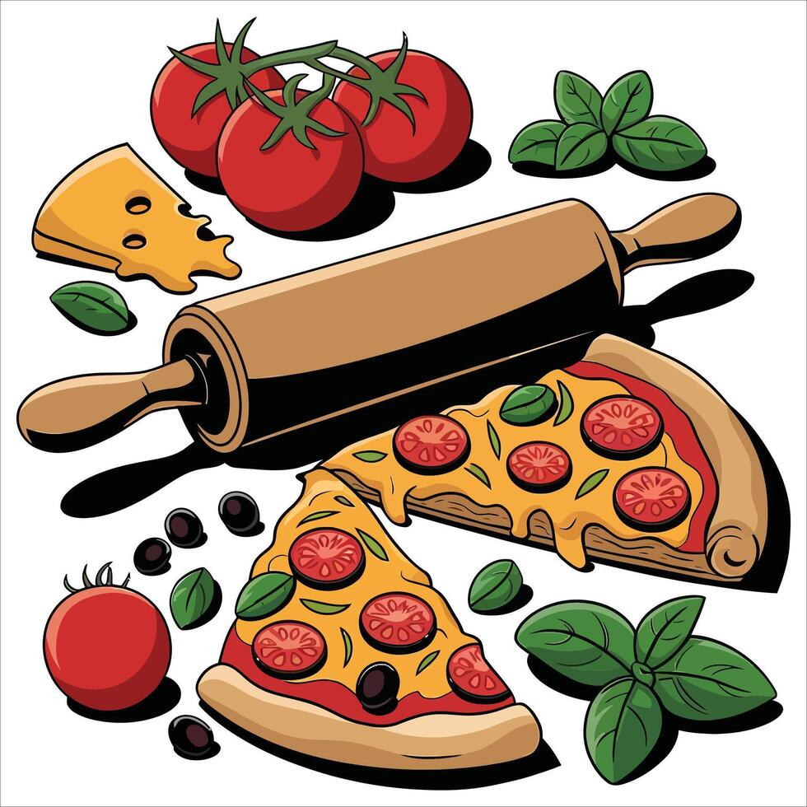
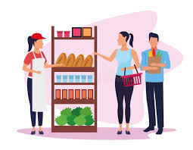
Operations KPIs
Amount of customers per class
Amount of customers satisfied per class
# of supplies used per class
# of ingredients used per class

Slide 14


Finance/Accounting
Pricing strategy
$40-60 per person per class - varies on the cuisine and materials required
An average of 12 students per class and 4 classes per week - revenue $10,000
Startup costs:
Kitchen equipment and tools - $8,000-12,000
Initial ingredient inventory and materials - $2,000-3,000
Marketing, website, and space rental - $3,000-5,000
Potential sources of funding:
Personal savings of family contributions
Small business loans/grants
Investors or crowdfunding platforms

Slide 15

Finance/Accounting Cont.
Investors pitch:
Our business offers a cultural experience, not just cooking, customers learn authentic recipes from around the world
Growing interest in experimental experience (people want experience, not just products) makes this highly marketable
With low overhead and repeat customers, we have strong potential for consistent profit and expansion to private events
Income statements:
Revenue $8,000 per month
Expenses $5,000 per month
Net profit $3,5000 per month

Slide 16

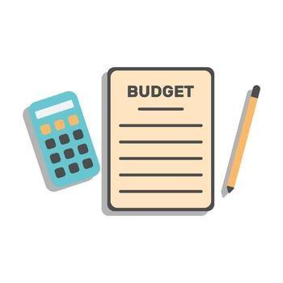

Finance/Accounting KPIs
Within 5% of the budget
At least 60% boost in revenue
$50,000 in investments
70% of loans paid off within 1 year

