Slide 1
Team Members:
Chaitanya Chakka, Astha Rastogi,
Gagan Singal, Satya Akhil Galla

Slide 2
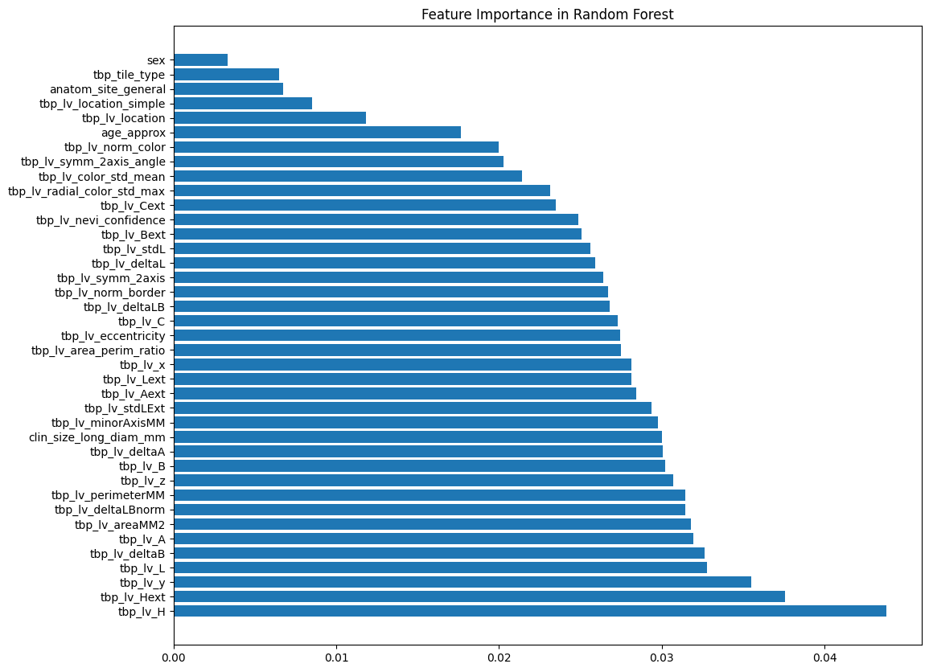
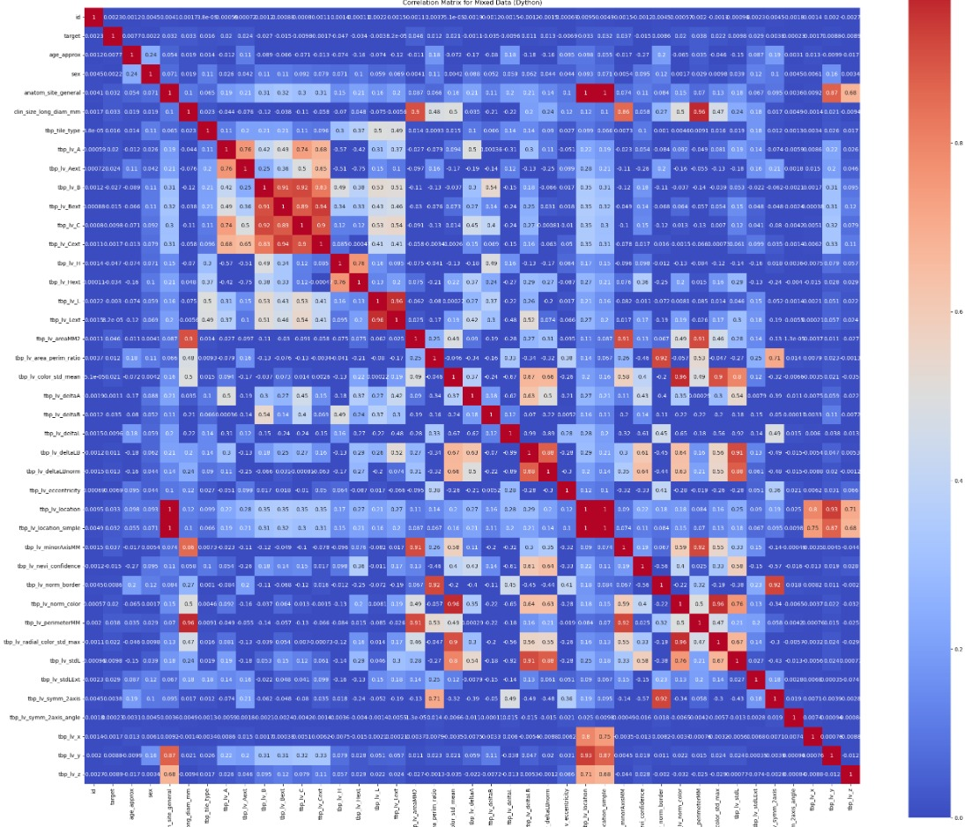
Data Analysis
314 positive and 320,533 are negative samples.
15,314 samples have at least one feature as NULL.
Calculated feature importance using Gini Entropy by fitting it to a Random Forest Classifier and discarded the 5 least important features.
High correlation observed between features corresponding to location.

Slide 3
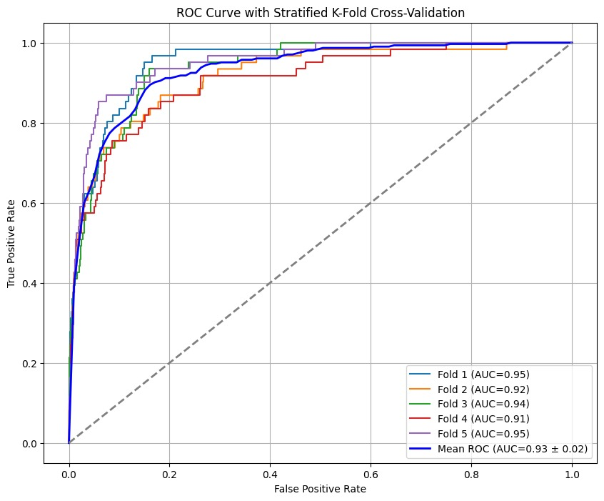
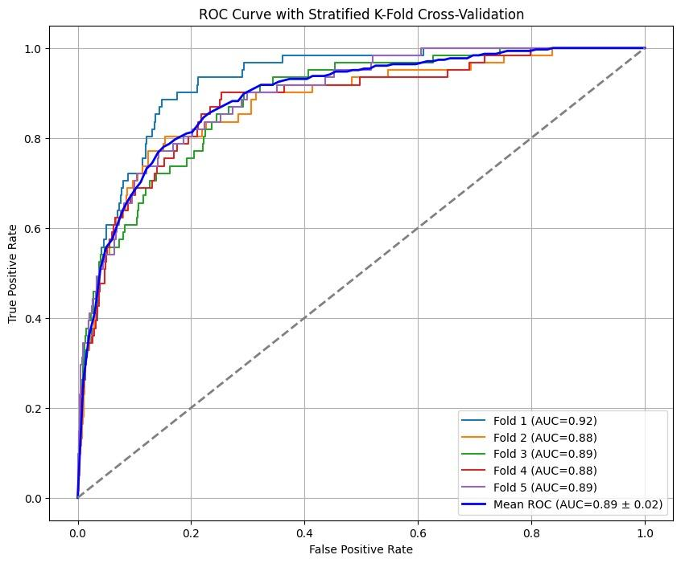
Method for Non-image Data
For data imbalance, we used SMOTE-EEN(SMOTE with Edited Nearest Neighbours) upto 30-70. Also used class-weights
Implemented with SVM with RBF kernel, Logistic Regression and XGBoost model. Tuned using Bayesian Optimization algorithm with Stratified 5-Fold Cross Validation.
Used AUC metric for evaluation.
Model | Validation AUC score
SVM | 0.87
LR | 0.89
XGBoost | 0.93

Slide 4
Experiments for Image Data
Model | Variant | Data points worked with | ROC-AUC | F1
VGG-19 With augmented minority class | Base | 50k with all minority data | 0.81 | 0.66
 | L2 Norm | 50k with all minority data | 0.77 | 0.63
 | Class weights | 50k with all minority data | 0.79 | 0.67
Inception-ResNet-v2 With augmented minority class | Base | 100k with all minority data | 0.64 | 0.47
 | L2 Norm + Class Weights | 100k with all minority data | 0.74 | 0.63
EfficientNet-v2-b1 | High Under- sampling of Minority Data | Whole Dataset | 0.96 | 0.79

Slide 5
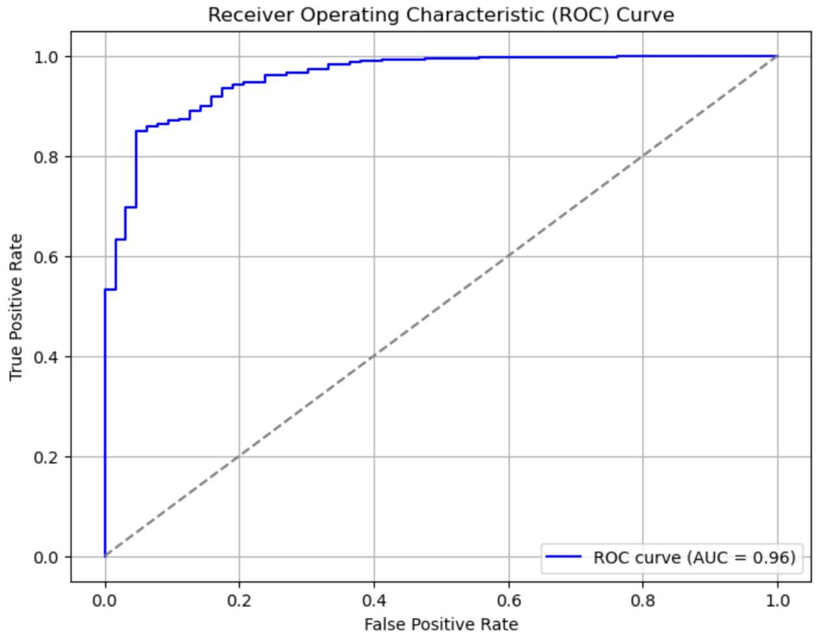
Method for Fusion
99% undersampling of negative samples. Data augmentation via Rotation, Flipping, Random Brightness Contrast, Resizing and Normalization.
Generated OOF predictions through CNN (EfficientNet_v2_b1) and merged them with tabular data.
Created new numerical features in the tabular data like lesion visibility score, position of lesion, etc. Passed this data into Voting Classifier - combination of XGBoost, LightGBM and CatBoost models.
Achieved an average AUC score of 96 (Stratified 5 fold cross validation).

Slide 6
Short Discussions
Image Model Observations:
EfficientNet_v2_b1 gave the best AUC Score.
When using VGG19 model, moving the decision boundaries achieved better scores. (ROC-AUC: 0.91; F1: 0.86 for boundary at 0.05).
Balancing the data was more of a key than training on different models and parameters.
Meta Data Model Observations:
SVM model took significantly longer time to converge when compared to XGBoost and Logistic Regression.
We removed only 5 features since removing more than that negatively affected the model prediction performance.
Undersampling the majority class while keeping the minority samples same did not vary the results significantly compared to using the complete dataset. This helped in faster fine-tuning.
Tabular data actually performed better than the image data and the fusion model even better.
Notes:
Squeeze and excitation blocks

