Slide 1

PyCrimes and Misdemeanors
UC Berkeley Data Science Bootcamp
Steve Bonillas
Laura Hickman
Kento Nakajima
Michelle Verger
Christian Corona
Notes:
Introduction
Hello everybody, my name is Kento, our team is PyCrimes and Misdemeanors.
As the name might suggest, the topic we will be discussing tonight is crime… specifically, Property crimes.
I am joined tonight by my team members, Steve, Laura, Michelle, and Christian. For the most part, I will be walking you through our project, but at certain points, I'll hand off to them.
Now, we have a lot to cover and not a lot of time to get to everything, so let's get started.

Slide 2
Agenda
01. Executive Summary
02. Tactics
Goals of the project
The questions we were looking to answer
Preview of our initial findings
Deciding on a Topic
Data Sources
How the sources were used
03. Challenges
04. Findings
05. Next Steps
What gave us trouble?
How were we heroes?
Factoids and Trivia (Fun!)
Charts!
Maps!
Numbers!
Blind Spots
Additional Research Avenues
Job Security
Notes:
Agenda
So, here's what we have on the menu for this evening. First, we are going to talk about the goals of our project, the questions we were looking to answer, and give a preview of our initial findings.
Then, we'll talk about our Tactics - how we went about deciding on our topic. What data sources we used, and how we utilized them.
After that, we will take a moment to acknowledge the challenges we ran into and how we heroically overcame them.
And then, the main event. We will go into our actual findings. That may sound like we're going to bore you with a bunch of charts…. well, yes, we are going to do that. But first we will wow you with some interesting trivia and factoids to hopefully keep you awake… THEN we'll bore you with our charts.
At the end, we'll tell you where you can send your grant money. We'll go over some of our blind spots, and where additional research could be useful. Michelle called this job security.

Slide 3
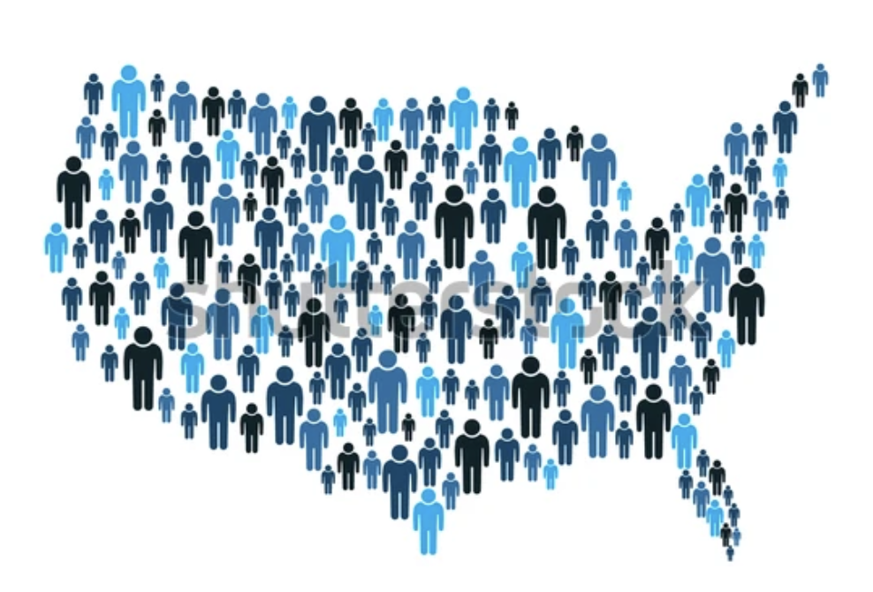

Executive Summary
Data Sources
Questions
Initial Findings
FBI Crime Data Explorer API
Property crime arrests by state
Number of law enforcement employees
Number of agencies reporting data
https://cde.ucr.cjis.gov/LATEST/webapp/#/pages/docApi
US Census Bureau
2020 and 2010 Census results used for per capita calculations
https://www.census.gov/programs-surveys/decennial-census/decade/2020/2020-census-results.html
Between 2010 and 2020, what was the overall trend when it came to property crimes?
Is there a correlation between population and arrest rates?
If those rates are adjusted per capita, does the picture change?
Is there a correlation between the number of law enforcement employees and arrest rates?
Historiography: Can we find any changes in the way the data was reported that might affect any trends that are seen?
Spoiler Alert
Property crime steadily declined between 2010 and 2020
Found correlation between population and raw arrest numbers.
When normalized for population, the arrest rates even out.
Found correlation between number of police and number of arrests to a point, but after a certain level, diminishing returns.
Reporting agencies and law enforcement numbers remained stable during the subject period.
Notes:
Executive Summary
Alright, so I've said a lot of words and very few of them have been the word 'Crime'.
- Our team spent a bit of the first night brainstorming topics, but we landed on something that Michelle had domain in. Crime. She's not a criminal (that we know of), she studied it.
- She directed us to the FBI's Crime Data Explorer. This is a database where over 18,000 law enforcement agencies across the country provide records of arrest….
- And that is an important distinction we should make right now. We may use the terms 'Crime', 'Offense' and 'Arrest' interchangeably in this discussion, but all our records are of arrests, not convictions.
- Think of this like the show cops, 'all suspects are innocent until proven guilty in a court of law.' The Crime Data Explorer also allowed us to pull records for an estimated number of Law Enforcement Employees and the number of Agencies providing the data we were using.
- Initially we wanted to see if we could measure the effect the pandemic had on crime rates.
- Well, the data from the time period is still being compiled and what has been compiled is incomplete, so we broadened our scope, and generalized our questions.
- In fact, we didn't form most of our questions until after we had our data. One thing we did decide on somewhat early was that we wanted to stick to Property and Non-Violent crimes, as they are easier to talk about.
To cut this short, the main thrust of our questions were this…
- Between 2010 and 2020, what was the overall trend when it came to Property crimes?
- Is there a correlation between population and arrest rates?
- If those rates are adjusted per capita, does the picture change?
- Is there a correlation between the number of law enforcement employees and arrest rates?
- Historiography: Can we find any changes in the way the data was reported that might affect any trends we see?
Spoiler Alert: We found answers to a lot of these questions, and we will show you the charts in a few minutes.
- Our numbers show a steady decline in property crime between 2010 and 2020.
- There does seem to be a correlation between population and raw arrest numbers.
- When corrected to per capita, arrest rates even out.
- There does seem to be a correlation between the number of police and the number of arrests, but only to a point. After a certain level, there are diminishing returns.
- With the data that was available to us, we were able to verify that the number of reporting agencies during our subject time period rose and the number of law enforcement officials employed nationwide remained relatively stable.

Slide 4




Tactics
01. Setting our Goals
02. Divide the Labor
Chose a project based on a team member’s domain.
Remain objective.
Let the data tell the story.
Work towards a thesis, not from one.
Team members pursued areas that interested them. APIs, visualization, analysis, etc.
Used regular communication to fill gaps as needed.
03. Find the Data
04. Clean the Data
05. Analyze and Polish
Arrest Data was procured from the from the FBI Crime Data Explorer using APIs.
Population data was pulled from the Census bureau and imported to the project via CSV.
API data was imported to Panda data frames and reviewed.
Identified and corrected gaps.
Clean data frames exported to CSVs to shorten later workflow and reduce API calls.
Comparison and Extrapolation
Found common denominators in population and law enforcement rosters.
Adjusting values per capita provided more context.
Visualizations were generated in Python, with line, bar, and scatter graphs. Hvplot maps were utilized as well.
Notes:
Tactics
We kind of already went over some of this in the summary, so I'll make this quick.
The first thing we did was set our goals.
We chose a topic that was in a team member's domain.
We wanted to do our best to remain objective.
We wanted the data to speak for itself
And we wanted to work TOWARDS a thesis rather than FROM one.
Then we divided the labor
Team members volunteered for portions that interested them, whether it was apis, visualizations, or analysis.
Gaps were filled as needed through regular communication.
We found the data
- Arrest Data, Law Enforcement Employee data, and reporting agency data was all pulled via API from the FBI's Crime Data Explorer
- Laura found the population data through the Census Bureau, she cleaned and normalized our arrest data from it,
- We were able to import her numbers via CSV to our workbooks.
Cleaning the data…
The API and CSV data was imported into Panda data frames, reviewed, and corrected.
We identified and corrected gaps in the data.
Clean data frames were exported to CSVs so they could be pulled later without calling the API again.
Analysis
We utilized comparison and extrapolation, pulling from the data what we could and comparing the variables that we had.
We found common denominators in population and law enforcement employment numbers.
Adjusting values per capita provided better context for our data.
Visualizations were generated in Python, with line, bar and scatter graphs. Hvplot maps were utilized as well.

Slide 5
Challenges
Things we heroically overcame
Blind Spot
Michelle’s broken arm.
Pandemic data was unreliable.
Example: Florida went from reporting tens of thousands of property crime in 2020 to under 200 in 2021
So, we switched our focus.
HvPlot had some formatting issues, which didn’t allow for suppressing scientific notation without sacrificing other, more important formatting settings.
Laws and definitions vary from state to state. This could leave some of our data open to interpretation.
Notes:
Challenges
We had a few.
Michelle is a big damn hero. She did her work nursing a broken arm. And she still made some of the nicest graphs any of us have seen.
Like we said earlier, we initially wanted to do something pandemic related, but found some of the data unreliable. Florida went from reporting tens of thousands of property crime in 2020 to under 200 in 2021. There were several instances like that in the more recent data that we just didn’t feel confident in.
Even with the data we have, it is based on what is voluntarily reported to the FBI from state and local law enforcement. It has been unified and codified, but laws and definitions vary from state to state, so some of our findings may be open to interpretation.
HvPlot was finicky with some of its formatting, so getting rid of scientific notation on our maps was not possible without harming the spirit of what the map was trying to convey.
There were some other minor issues, but now is not the time to dwell on the past… now is the time for Trivia!

Slide 6




Some Quick Factoids
For the years 2010 to 2020, here are the states with the most arrests for…
Arson
(Setting Fires)
Larceny
(Stealing Property)
Embezzlement
(Robbing Companies and Charities)
Fraud
(Stealing with Words)
California
Texas
Virginia
North Carolina
2,051 Arrests
11,5252 Arrests
1,676 Arrests
18,242 Arrests
Notes:
Here are the states with the most arrests for specific crimes… and remember, these are arrests, not convictions.
First, Arson…
The state with the most Arson Arrests…
California, with 2051 arrests
Next, Larceny, which is stealing property without breaking in
- Texas with 115,252 arrests
Next, Embezzlement (that’s robbing from Companies, Charities, or from people have your trust, so like a client)
- Virginia with 1,676 arrests
And one more… Fraud, which is stealing with words – lying to get people to give you money or stuff
- and the winner is, North Carolina with 18,242 arrests

Slide 7


Some More Trivia
For the years 2010 to 2020, what states had the…
Highest Rate of Arrest
(Per Capita)
Lowest Rate of Arrest
(Per Capita)
It is hard to find an icon that conveys “Being let go with a warning.”
Delaware
Illinois
Averaged 1031 arrests per capita.
Delaware also had the single year highest arrest per capita with 1214 in 2012.
Averaged 125 arrests per capita.
Single lowest year was Pennsylvania with 3.5 arrests per capita in 2020.
Notes:
And just a couple more…
First, the state with the Highest Rate of Arrest (per capita) was…
Delaware
- With an average of 1031 arrests per capita
- Also, in 2012, Delaware had the highest single year arrest rate, nationwide,, with 1214 arrests per capita.
And who had the lowest?
- Sorry, its hard to find an icon for ‘not getting arrested’
Illinois
- Averaged 125 arrests per capita
- In 2020, Pennsylvania had the single lowest reported arrest rate at 3.5 arrests per capita. That seems very low, and could be a function of the lockdowns, or an issue of reporting, but it wasn’t a massive outlier in the data.

Slide 8
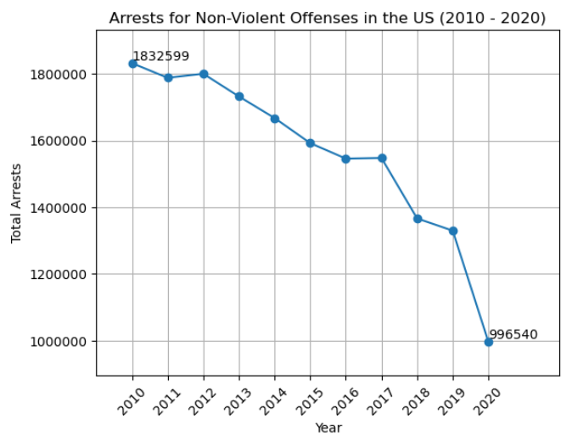
Total Arrests in the US (2010 – 2020)
One of our first findings was a significant and steady downward trend in reported property crime arrests.
The numbers shown here are an aggregate of arrests across all states, for all offenses classified by the FBI as Property Crimes, which are:
Arson
Larceny – Theft
Vehicle Theft
Burglary
Embezzlement
Forgery & Counterfeiting
Fraud
Vandalism
Dealing in Stolen Property
Notes:
Thank you Kento
One of the first findings that we… found… was a significant downward trend in reported property crime arrests for our time period.
The numbers we have here are an aggregate of arrests across all states, for all offenses classified by the FBI as Property Crimes, which are:
Arson
Larceny – Theft
Vehicle Theft
Burglary
Embezzlement
Forgery & Counterfeiting
Fraud
Vandalism
Dealing in Stolen Property
We see that we start here in 2010 with over 1 Million, 800 thousand arrests… To just under a million in 2020.
Michelle has some charts that might provide some explanations for some of these later numbers, but we wanted to see if we could find some answers in our data sources first…

Slide 9
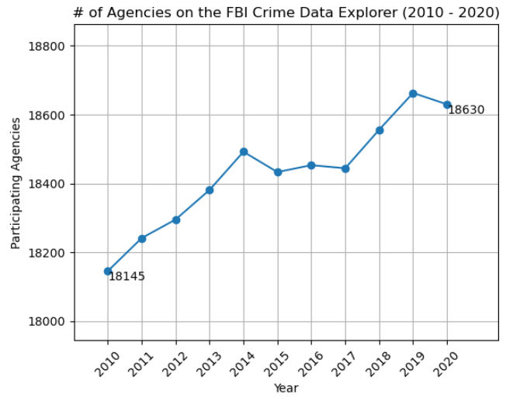
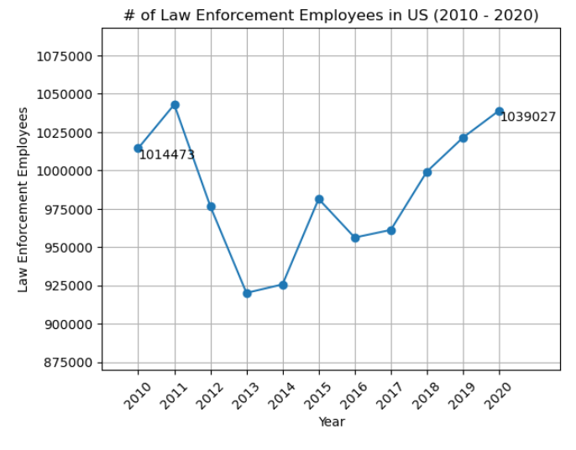
Double Checking Our Findings
These charts show that the number of agencies reporting to the Crime Data Explorer and the number of law enforcement personnel remained relatively stable throughout the subject period.
This provides added context to our overall arrest data, which shows a steady downward trend. If these charts showed drops in reporting agencies or in law enforcement officers, those could be possible outside factors that influenced the drop in reported arrests, but that does not appear to be the case.
Notes:
So, here’s how we checked those sources….
We have two charts here. The one on the left shows the number of Agencies reporting to the FBI’s Crime Data Explorer. The chart on the left shows the number of law enforcement employees who were on the books during our timeframe.
This provides added context to our overall arrest data which showed a steady downward trend.
If these charts showed a drop in Reporting Agencies or in the number of law enforcement officials, then then those could be possible outside factors that might influence a drop in reported arrests.
But that does not appear to be the case, we see that the dataset gained reporting agencies overtime and the number of law enforcement officers remained relatively stable and ended higher than it began.

Slide 10


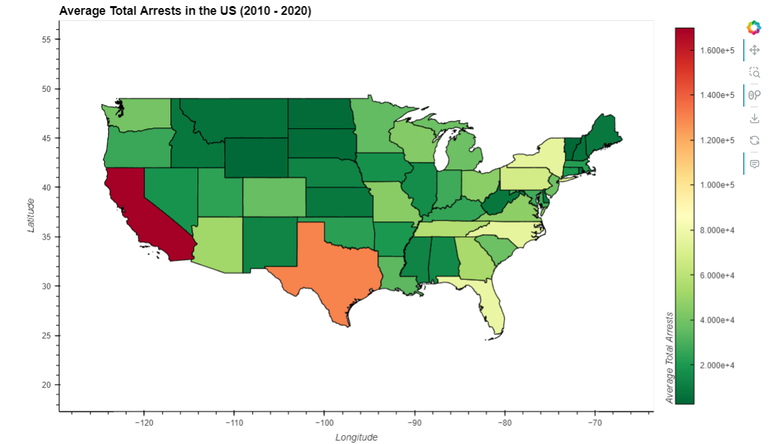

Average Total Arrests in the US
This is our heatmap of total arrests in the US between 2010 and 2020.
We took the average of each state’s arrests and used hvplot to give a color gauge to our map to illustrate the areas with the greatest concentration of arrets.
Notes:
This is our heatmap of the average total arrests in the US between 2010 and 2020.
We took the average of each state’s arrests and used hvplot to give a color gauge to our map to illustrate the areas with the greatest concentration of arrets.
Red is higher, Green is lower.
This is showing us that the greatest concentration of arrests are in the most populated areas.
California, Texas, Florida, and New York
However, that is not the whole story.

Slide 11
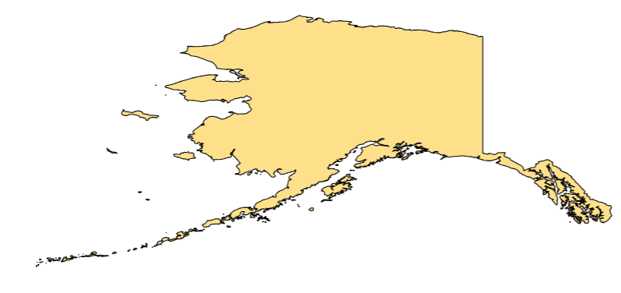
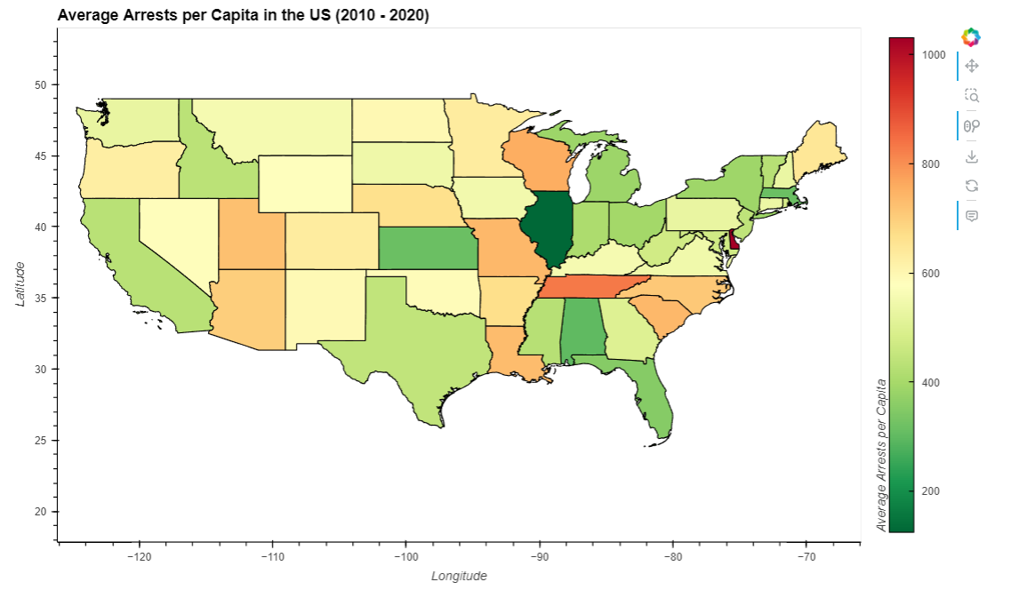

Average Arrests Per Capita
This map tells a different story.
We adjusted the arrest numbers per capita, to visualize the Arrest Rate.
What we see is arrest rates are more normalized and that the hot spots are no longer just the population centers.
Notes:
This map tells us another story….
This is what it looks like when we adjust our numbers per capita to show each state’s actual Arrest Rates.
We see now that arrest rates are more normalized throughout the country and that the hotspots are no longer just the population centers.
The outliers we see here are Delaware and Tennessee, but for most of the map, the data is trending towards the average.
We didn’t make this adjustment so that the higher population states look better. The two maps should be taken together to gain a fuller understanding of what our data is trying to tell us.
And for even more context, I’m going to kick it over to Michelle

Slide 12
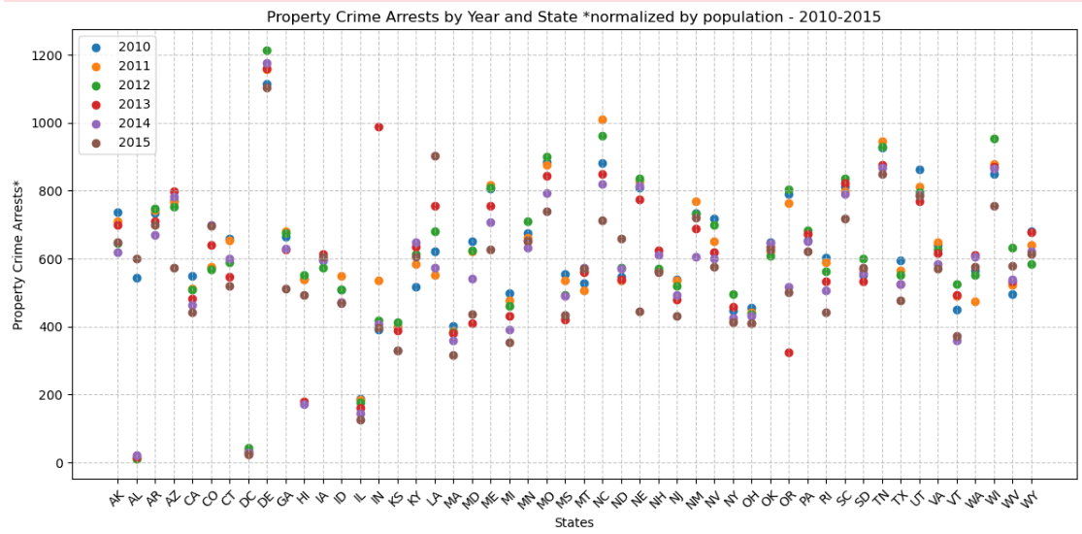
Arrests by Year & State (2010 - 2015)

Slide 13
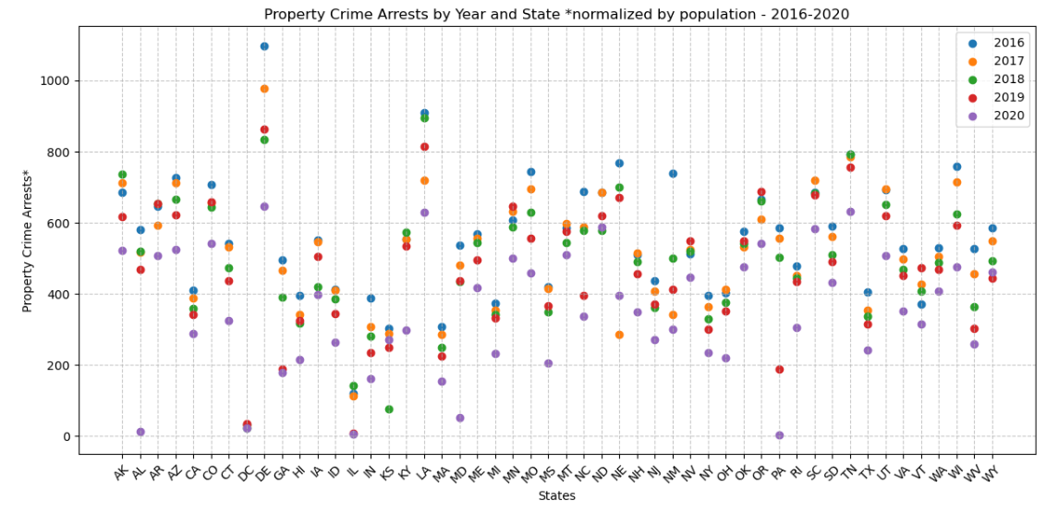
Arrests by Year & State (2016 - 2020)

Slide 14
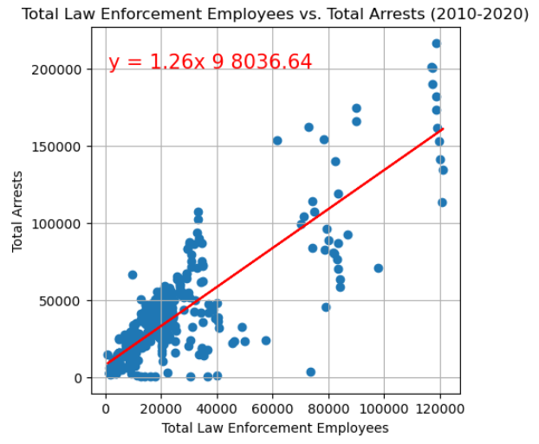
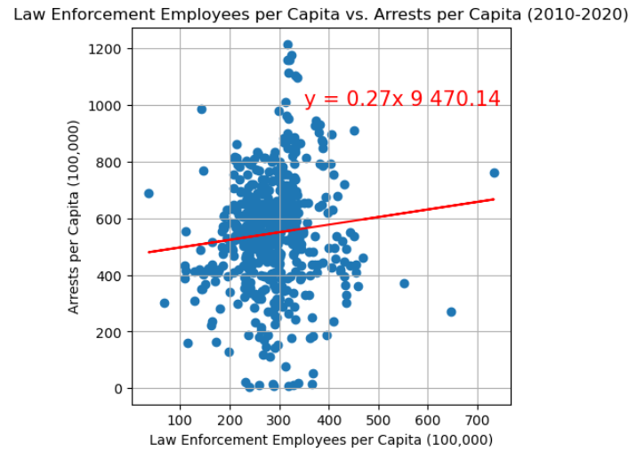
Law Enforcement and Arrests
The chart on the left illustrates the relationship between total number of law enforcement officers and total arrests in each state, each year. What it shows is that as the number of law enforcement officials grows, so do overall arrests. Since they are both linked to population, that make sense.
On the right, we have both values adjusted per capita. What this shows us is that there is a region of efficiency between 200 and 400 law enforcement employees per capita where arrest rates are clustered. This likely gives us an idea of each state’s budgeting considerations.
Notes:
Analysis 1:
Question: Is there a correlation between the number of arrests and law enforcement employees in aggregate?
Analysis: Compared number of arrests to number of the law enforcement employees at national level in scatter plot.
Finding: A linear relationship as the number of arrests follows the increase in the number of law enforcement employees.
Analysis 2: Question: Can we normalize Analysis 1 finding in a more comparable measurement?
Analysis: Compared the arrests per capita to the law enforcement employees per capita in the same method.
Finding: No material linear relationship identified in per capita analysis.

Slide 15
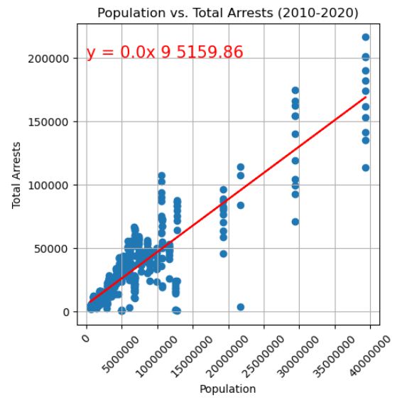
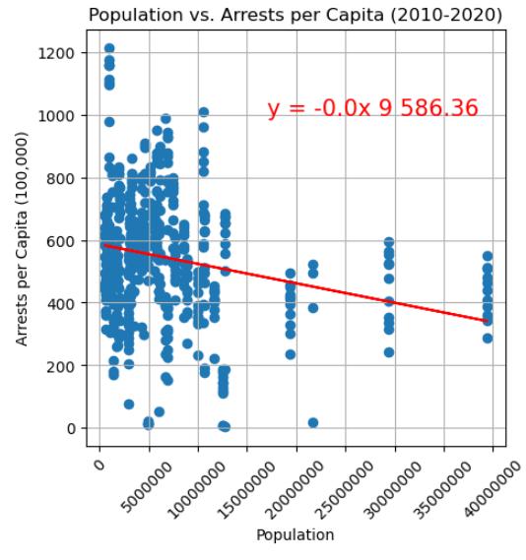
Population and Arrests
The chart on the left shows population vs total arrests. The trendline shows a strong relation between population and overall arrest numbers.
On the right, we see what happens when we adjust the population per capita. The trendline shows us that arrest rates shift downward slightly as population grows. This suggests an Arrest Rate which remains relatively steady, regardless of total population.
Notes:
The chart on the left shows population vs total arrests. The trendline shows a strong relation between population and overall arrest numbers.
On the right, we see what happens when we adjust the population per capita. The trendline shows us that arrest rates shift downward slightly as population grows. This suggests an Arrest Rate which remains relatively steady, regardless of total population.

Slide 16
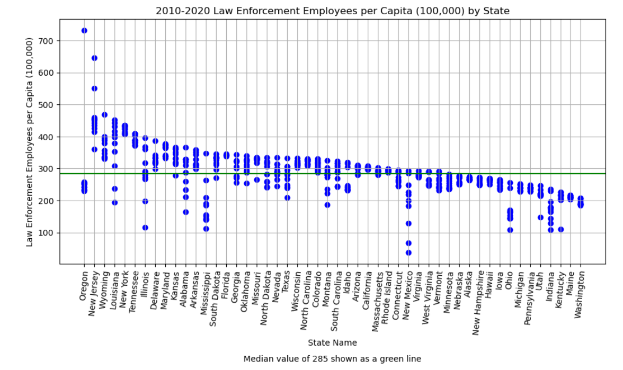
Police per Capita by State
Each dot on the vertical axis represents a year’s worth of data for that specific state.
Notes:
Analysis 3:
Question: What relation can we identify at each state at a more granular level?
Analysis: Visualize law enforcement employees per capita by state sorted in descending order in bar scatter chart providing with the median value. Visualize arrest per capita by keeping the same sorted order with the same method.
Finding: Identified the law enforcement labor force efficiency in the arrest counts.

Slide 17
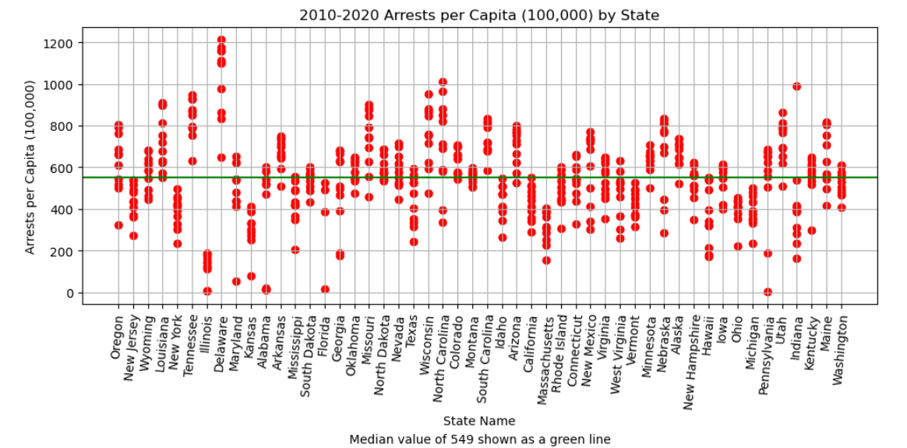
Arrests per Capita by State
Each dot on the vertical axis represents a year’s worth of data for that specific state.
Notes:
Analysis 3:
Question: What relation can we identify at each state at a more granular level?
Analysis: Visualize law enforcement employees per capita by state sorted in descending order in bar scatter chart providing with the median value. Visualize arrest per capita by keeping the same sorted order with the same method.
Finding: Identified the law enforcement labor force efficiency in the arrest counts.

Slide 18
Next steps
Additional data sources to consider
Violent Crime
Education and Economic Data
Conviction and Incarceration Rates
Notes:
There are plenty of other factors that would feed into a fuller understanding of the US crime rate. Some of those were either outside the scope or would require additional time, effort, and funding.
- We purposely omitted violent crime, but that data would be easily accessible using our methods.
- We were also interested in investigating education and economic drivers behind the numbers we were seeing.
- As our data is mostly based on Arrest records, following up, and comparing our data to conviction and incarceration rates would also tell us more.

Slide 19

Thank you
Steve Bonillas
Kento Nakajima
Michelle Verger
Laura Hickman
Christian Corona
PyCrimes and Misdemeanors
Notes:
Thank you all very much for your time.
And don’t do crime.
We have been PyCrimes and Misdemeanors

