Slide 1





Ace Security: A face recognition security system
180896615
Akash Premdhari Pandey
John Schormans

Slide 2
Project Overview
Major Aim of the project is to initiate the security system in a way that it provides the best possible results than any other security system
The accuracy with robustness, with being economically-friendly is another factor which will be achieved in this project
The problem I’m solving currently is that, in today’s market you could either get a quality product for high cost and an average product in low cost. Problem here is high accuracy with less price is merely available. The main aim is also to reduce the price with a robust system.

Slide 3
Introduction
Face Recognition is one of the most compelling biometric technique used for security purpose [1]. Although, there are other methods which are more reliable such as fingerprint scanner and iris recognition, but these measures are intruding and are highly dependent on human co-operation [2]. Due to this reason, face recognition is ubiquitous, convenient and non-intrusive method. It is an appropriate solution for mass scanning which can be difficult task in other measures. Moreover, the techniques in which multiple individual has to share the same equipment to conduct biometric recognition can be unhygienic and probably people are more exposed to germs transmission. However, this problem is absent in case of face recognition.
Face Recognition is an ability of computer or an equipment to recognise the user’s face and provide security. A face recognition system works by recognising an image or a video of human face with existing database. The structure, shape and different elements of face is been taken into account while recognising a face. In addition to these elements distance between eyes, nose, mouth and jaw, the sides of mouth etc are also compared

Slide 4
Requirements
Integrating the hardware and the software module of the system in an efficient way.
Implementing the face detection accurately and signaling the same to the Micro-controller and then the Servo-motor.
Android application built should be capable of listing all the required information. The system allows the user to input the image for processing.
The back-end system should compare the image precisely with previously analyzed image by using machine learning technique.
Entire system should be economical and robust in nature.

Slide 5
Swot Analysis
Strength Faster than any other comparative biometric indentifiers. Highest accuracy Open source libraries can be used easily. | Opportunities A Reliable security based system in stores Cheaper than any other proposed model in the market
Weakness Includes the accuracy in the real time video capturing and in-accurate facial recognition in it. Uses too many images taken in different angles for the training and testing of data. Use of external face covering masks could be the possible weakness of the system | Threats External cause of damage of the system Cloud server not being active. Other robust application built in competition. Authentication error while authenticating

Slide 6
Existing Technology
Facewatch UK:It is a user-friendly software which provides an automated turnkey mobile and video surveillance facial recognition system. It generates an alert whenever it recognises a face and check the image in its existing database. It is more realistic and practical to use because of low resolution feature.
2.4.2 Morpho Trak: It is leading biometric company and largest innovators in the field of face recognition and fingerprint identification system. It provides security equipment to broad range of market such as border restriction, driving license, law enforcement, IT security etc.
2.4.3 Cross Matching Technologies: It provides the biometric management system, applications and related technologies to government, law enforcement agencies and corporates. The services are capable of wireless, stationary or mobile use that includes facial recognition system and other security related systems.

Slide 7
Hardware system description
Micro-controller: Node MCU is the microcontroller which is been used in the Ace security system. An open source firmware which is used in Internet of things (IOT) based systems. The technical specification of the system includes; 32-bit Xtensa() Processor, 160MHZ clock frequency with RTOS enabled functionality.
Servo motor is been used to signal the output or the result after image processing in the application.

Slide 8

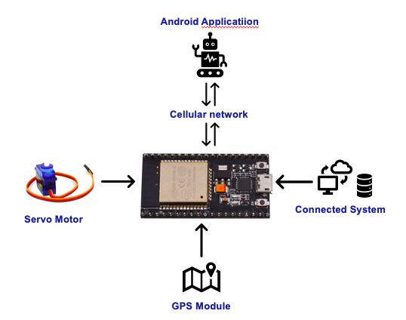
Basic Working

Slide 9
Software Description
Flutter is Google's mobile UI framework which is been used in the system as a framework to build an android application which also supports machine learning algorithms.
Flutter firebase is an opensource cross-platform tool for creating Android and IOS applications using a modern framework. The idea of Flutter Firebase revolves around DART, which is a simple object-oriented language. It works with the Widgets. The whole UI system of Firebase is a fusion of numerous widgets, different styles of the elements such as font scheme or the color scheme, OEM widgets() etc.

Slide 10
Working Methodology
Firstly, an image is trained and tested under the neural network algorithm of Machine learning which gets uploaded in the application’s database. This allows the system to analyze the image and store it for future comparison with another image which would be uploaded using the android application.
The next step is the setup of the Microcontroller NODE-MCU and the servomotor using a PC/Laptop. The NODE-MCU will be connected to the internet with the same network as the mobile android device.
If the face coordinates match, it rotates the servo motor and signals that, the uploaded image is similar to the previously trained image/images.

Slide 11
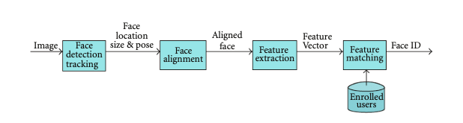
Machine Learning Algorithm
Validation of Neural Network is been used in the system.
With 99% accuracy, this is the best approach till date for the facial recognition, also becomes my reason to choose this approach over other available approaches.
Figure: Step by step depiction of neural network model

Slide 12
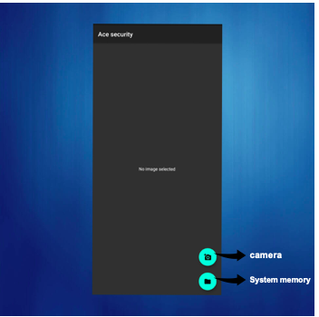
Insight of Android Application

Slide 13
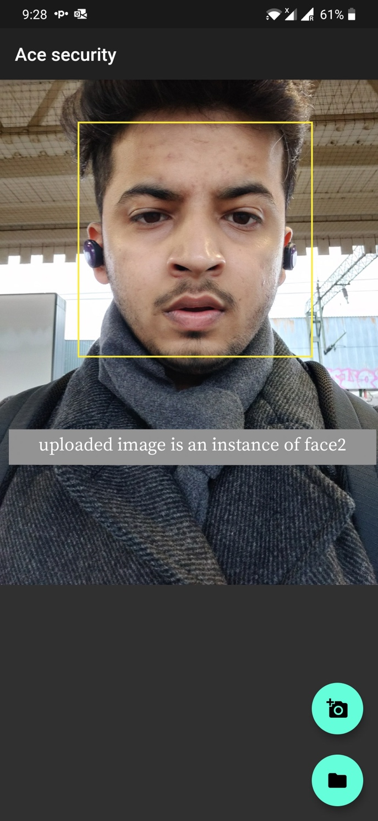
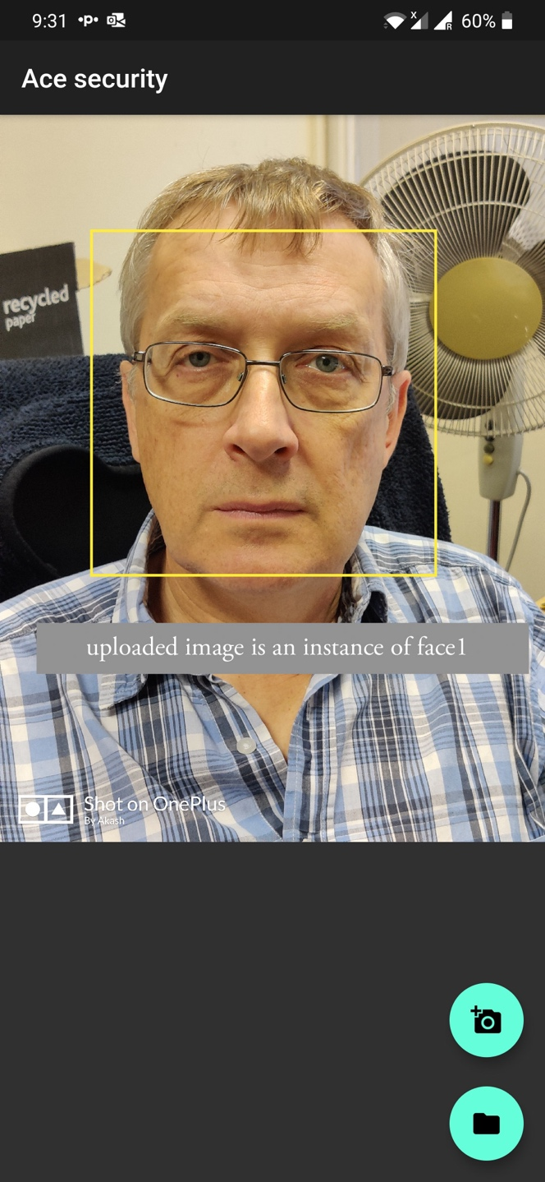
Result
The system contains facial data of two persons. Instance 1 and instance 2,
the system is been built in such a way that if the first person’s face data is been recognized then,
the servomotor rotates clockwise. If the second person’s facial data is been recognized,
the servomotor would rotate anti-clockwise. This signifies that the system opens for one person and closes for another. If, an image uploaded is not similar to either of the facial data, the servomotor doesn’t rotate but instead the application notifies the similarity percentage of the facial image uploaded based on its features.
Figure : Testing result and confirmation of Matching Image of Face1
Figure : Testing result and confirmation of Matching Image of Face2

Slide 14
Future Development
All the applications built; systems developed always has a scope of improvement in several areas. Thus, my system can also be improved in several ways to make it more robust in the coming future.
Firstly, A cross-platform system application can be built in the iPhone Operating System (IOS), making it available to all the mobile platforms.
Secondly, the CCTV camera could be used to take down the facial data which could then be connected directly to the database where the machine learning algorithm trains and tests the images.
Lastly, The micro-controller used can be updated according to the future need, to make it cop up with the future technologies.

Slide 15

Challenges Faced
Major challenge was to overcome the GDPR law, which states that the system was against taking down and saving the facial coordinates into the database. I overcame the challenge as; my system serves multiple purposes starting from personal security to the industrial security. The home door lock doesn’t come under the GDPR. The industrial usage of the system was a problem. But my system would only deal with the already identified theft. Also, to protect your business you have to make it secure. This challenge took me a month to overcome. The fact that you’re dealing with the already identified faces makes it overcome the GDPR.
the on-going pandemic has adversely affected the implementation of the project. I had almost finished my project a long time back. But, due to this pandemic I had a real hard time in implementing the final system and created a rush due to which I couldn’t complete and submit my report on time.

Slide 16
Conclusion
To conclude, I would say that the outcome of the system was positive. Starting from an idea which struck me while I was working part-time, to a swift delivery of the system with all the aspects included.
The sole purpose to build this system was to make it available for all.
The hurdles or the real time compilation error which I received made me highly experienced in building something which has the potential to change the way that a system works
I take pride to say that I applied all the theoretical as well as the practical knowledge gained from my coursework since year 1 and the result was a system which serves a cause.

Slide 17
Refrences
Waldemar Wojcik, Konrad Gromaszek and Muhtar Junisbekov (July 6th 2016). Face Recognition: Issues, Methods and Alternative Applications, Face Recognition - Semisupervised Classification, Subspace Projection and Evaluation Methods, S. Ramakrishnan, Intech Open,
DOI: 10.5772/62950. Available from: https://www.intechopen.com/books/face-recognition-semisupervised-classification-subspace-projection-and-evaluation-methods/face-recognition-issues-methods-and-alternative-applications
W. Hwang, X. Huang, S. Z. Li, and J. Kim, "Face recognition using Extended Curvature Gabor classifier bunch," Pattern Recognition, vol. 48, pp. 1247-1260, 2015.
J. Chen and Z. Yi, "Sparse representation for face recognition by discriminative low-rank matrix recovery," Journal of Visual Communication and Image Representation, vol. 25, pp. 763-773, 2014.
R. Sharma and M. Patterh, "A new pose invariant face recognition system using PCA and ANFIS," Optik-International Journal for Light and Electron Optics, vol. 126, pp. 3483-3487, 2015.
C. Zhou, L. Wang, Q. Zhang, and X. Wei, "Face recognition based on PCA image reconstruction and LDA," Optik-International Journal for Light and Electron Optics, vol. 124, pp. 5599-5603, 2013.
Y. Zhao, L. Li, and Z. Liu, "A novel algorithm using affine-invariant features for pose-variant face recognition," Computers & Electrical Engineering, vol. 46, pp. 217-230, 2015.
R. Khattree and D. N. Naik, Multivariate data reduction and discrimination with SAS software: Sas Institute, 2000.

