Slide 1
Apache Kafka
Sajan Kedia

Slide 2
Agenda
What is kafka?
Use cases
Key components
Kafka APIs
How kafka works?
Real world examples
Zookeeper
Install & get started
Live Demo - Getting Tweets in Real Time & pushing in a Kafka topic by Producer

Slide 3
What is Kafka?
Kafka is a distributed streaming platform:
publish-subscribe messaging system
A messaging system lets you send messages between processes, applications, and servers.
Store streams of records in a fault-tolerant durable way.
Process streams of records as they occur.
kafka is used for building real-time data pipelines and streaming apps
It is horizontally scalable, fault-tolerant, fast and runs in production in thousands of companies.
Originally started by LinkedIn, later open sourced Apache in 2011.

Slide 4
Use Case
Metrics − Kafka is often used for operational monitoring data. This involves aggregating statistics from distributed applications to produce centralized feeds of operational data.
Log Aggregation Solution − Kafka can be used across an organization to collect logs from multiple services and make them available in a standard format to multiple consumers.
Stream Processing − Popular frameworks such as Storm and Spark Streaming read data from a topic, processes it, and write processed data to a new topic where it becomes available for users and applications. Kafka’s strong durability is also very useful in the context of stream processing.

Slide 5
Key Components of Kafka
Broker
Producers
Consumers
Topic
Partitions
Offset
Consumer Group
Replication

Slide 6
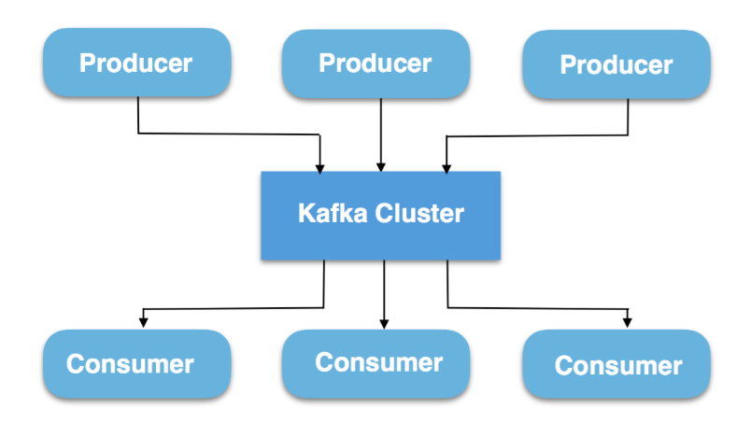
Broker
Kafka run as a cluster on one or more servers that can span multiple datacenters.
An instance of the cluster is broker.

Slide 7
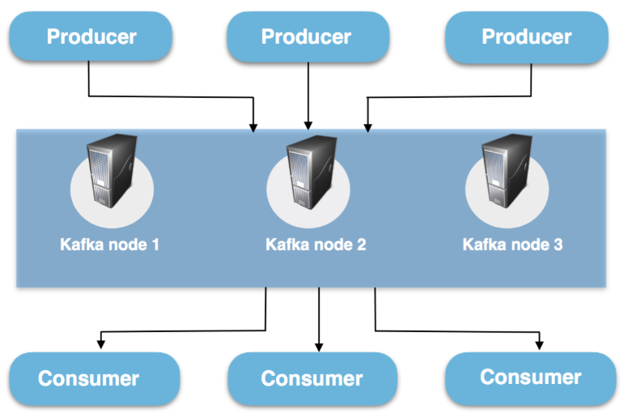
Producer & Consumer
Producer: It writes data to the brokers.
Consumer: It consumes data from brokers.
Kafka cluster can be running in multiple nodes.

Slide 8
Kafka Topic
A Topic is a category/feed name to which messages are stored and published.
If you wish to send a message you send it to a specific topic and if you wish to read a message you read it from a specific topic.
Why we need topic: In the same Kafka Cluster data from many different sources can be coming at the same time. Ex. logs, web activities, metrics etc. So Topics are useful to identify that this data is stored in a particular topic.
Producer applications write data to topics and consumer applications read from topics.

Slide 9
Partitions
Kafka topics are divided into a number of partitions, which contains messages in an unchangeable sequence(immutable).
Each message in a partition is assigned and identified by its unique offset.
A topic can also have multiple partition logs.This allows for multiple consumers to read from a topic in parallel.
Partitions allow you to parallelize a topic by splitting the data in a particular topic across multiple brokers.

Slide 10
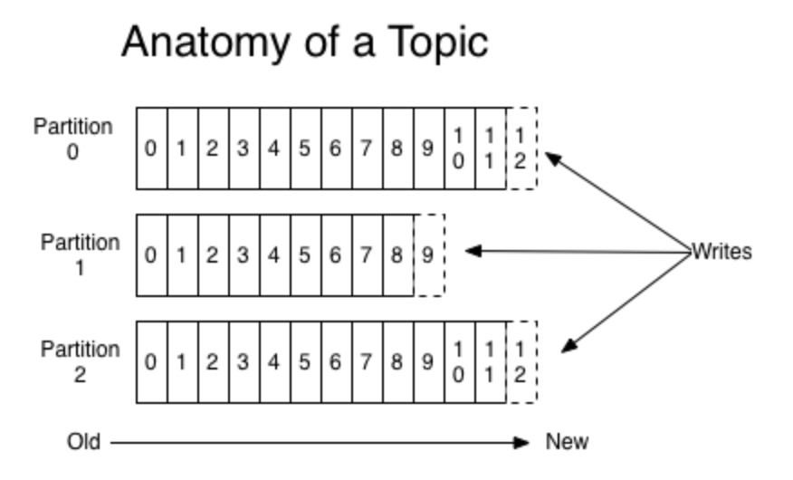

Slide 11
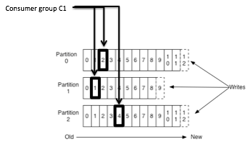
Partition Offset
Offset: Messages in the partitions are each assigned a unique (per partition) and sequential id called the offset
Consumers track their pointers via (offset, partition, topic) tuples

Slide 12
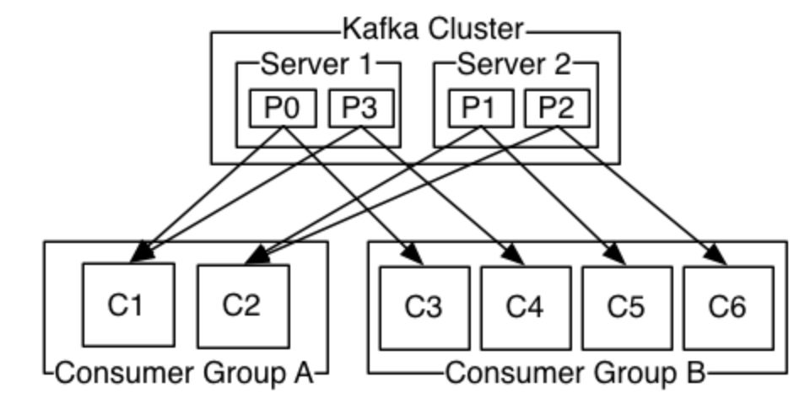
Consumer & Consumer Group
Consumers can read messages starting from a specific offset and are allowed to read from any offset point they choose.
This allows consumers to join the cluster at any point in time.
Consumers can join a group called a consumer group.
A consumer group includes the set of consumer processes that are subscribing to a specific topic.

Slide 13
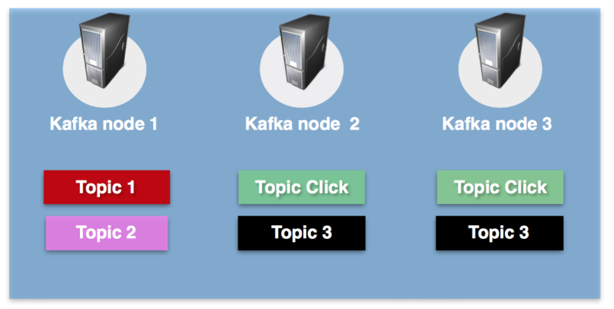
Replication
In Kafka, replication is implemented at the partition level. Helps to prevent data loss.
The redundant unit of a topic partition is called a replica.
Each partition usually has one or more replicas meaning that partitions contain messages that are replicated over a few Kafka brokers in the cluster. As we can see in the pictures - the click-topic is replicated to Kafka node 2 and Kafka node 3.

Slide 14
Kafka APIs
Kafka has four core APIs:
The Producer API allows an application to publish a stream of records to one or more Kafka topics.
The Consumer API allows an application to subscribe to one or more topics and process the stream of records.
The Streams API allows an application to act as a stream processor, consuming an input stream from one or more topics and producing an output stream to one or more output topics, effectively transforming the input streams to output streams.
The Connector API allows building and running reusable producers or consumers that connect Kafka topics to existing applications or data systems. For example, a connector to a relational database might capture every change to a table.

Slide 15
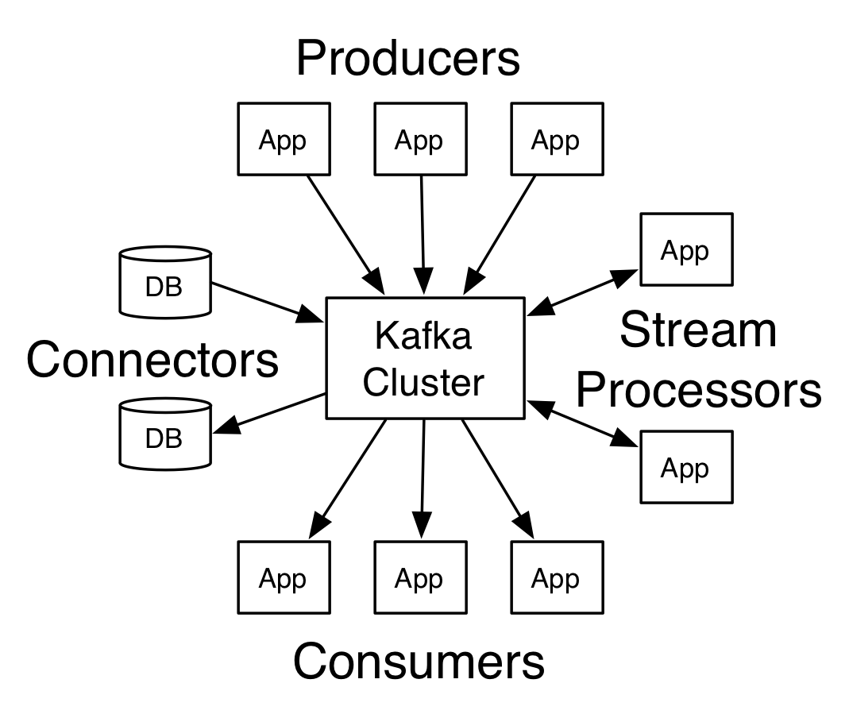

Slide 16
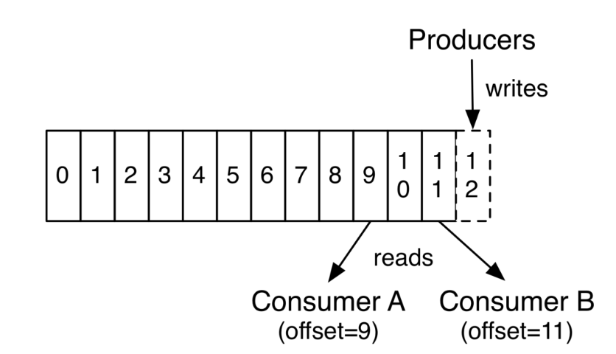
How Kafka Works?
Producers writes data to the topic
As a message record is written to a partition of the topic, it’s offset is increased by 1.
Consumers consume data from the topic. Each consumers read data based on the offset value.

Slide 17
Real World Example
Website activity tracking.
Let’s take example of Flipkart, when you visit flipkart & perform any action like search, login, click on a product etc all of these events are captured.
Tracking event will create a message stream for this based on the kind of event it’ll go to a specific topic by Kafka Producer.
This kind of activity tracking often require a very high volume of throughput, messages are generated for each action.

Slide 18
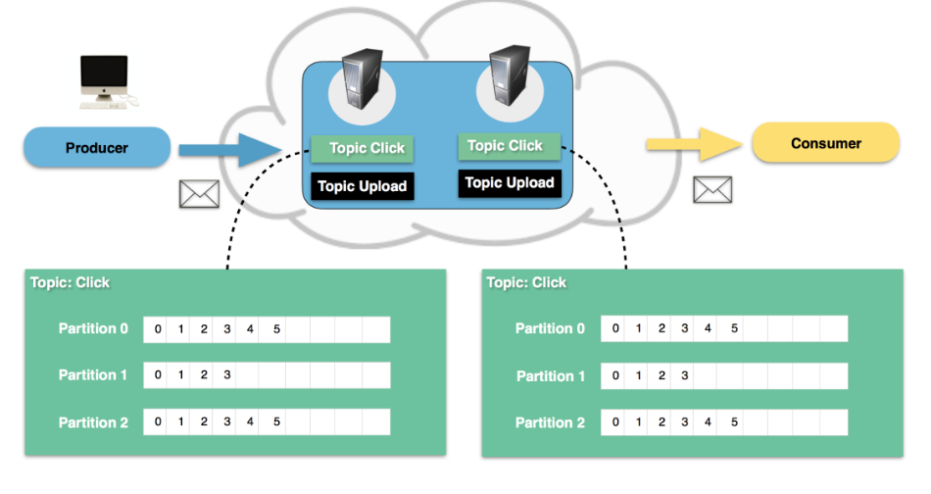
Steps
A user clicks on a button on website.
The web application publishes a message to partition 0 in topic "click".
The message is appended to its commit log and the message offset is incremented.
The consumer can pull messages from the click-topic and show monitoring usage in real-time or for any other use case.

Slide 19
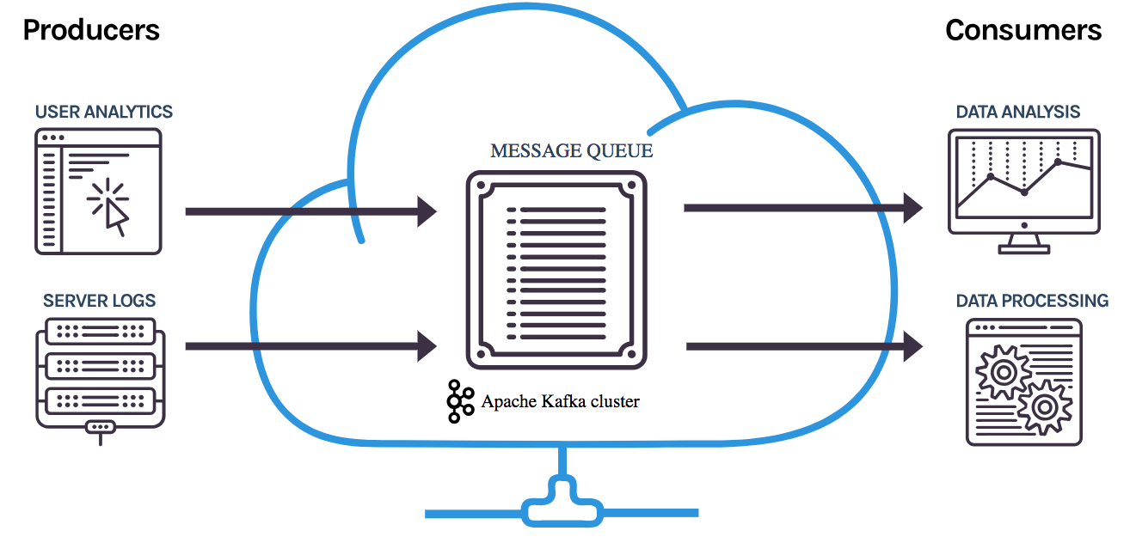
Another Example

Slide 20
Zookeeper
ZooKeeper is used for managing and coordinating Kafka broker.
ZooKeeper service is mainly used to notify producer and consumer about the presence of any new broker in the Kafka system or failure of the broker in the Kafka system.
As per the notification received by the Zookeeper regarding presence or failure of the broker then producer and consumer takes decision and starts coordinating their task with some other broker.
The ZooKeeper framework was originally built at Yahoo!

Slide 21
How to install & get started?
Download Apache kafka & zookeeper
Start Zookeeper server then kafka & run a single broker
> bin/zookeeper-server-start.sh config/zookeeper.properties
> bin/kafka-server-start.sh config/server.properties
Create a topic named test
> bin/kafka-topics.sh --create --zookeeper localhost:2181 --replication-factor 1 --partitions 1 --topic test
> bin/kafka-topics.sh --list --zookeeper localhost:2181
test
Run the producer & send some messages
> bin/kafka-console-producer.sh --broker-list localhost:9092 --topic test
This is a message
This is another message
Start a consumer
> bin/kafka-console-consumer.sh --bootstrap-server localhost:9092 --topic test --from-beginning
This is a message
This is another message

Slide 22
Live Demo
Live Demo of Getting Tweets in Real Time by Calling Twitter API
Pushing all the Tweets to a Kafka Topic by Creating Kafka Producer in Real Time
Code in Jupyter

Slide 23
Thanks :)
References Used:
Research Paper - “Kafka: a Distributed Messaging System for Log Processing” : http://notes.stephenholiday.com/Kafka.pdf
https://cwiki.apache.org/confluence/display/KAFKA/Kafka+papers+and+presentations
https://kafka.apache.org/
https://www.cloudkarafka.com

