Slide 1

SONY KDL 70X7000
Stockton Tsai / 2008.10.9
AUO Proprietary & Confidential

Slide 2
Mode
Parameter
 | Dynamic | Movie | Standard
Backlight(0-10) | 10 | 0 | 3
Contrast(0-100) | 100 | 80 | 100
Brightness(0-100) | 45 | 50 | 50
Saturation(0-100) | 60 | 50 | 55
Tint | Standard | Standard | Standard
Color Temperature | 高 | 低2 | 中
Sharpness(0-100) | 50 | 50 | 40

Slide 3
Measurement Item
Basic Property
  Purpose
    Gamma Curve
    Color Temperature
    Gray Smoothness
    Contrast
    Color Gamut
  Test Pattern
    WRGB 0 ~ 255
  Measurement
    xyY
    Color Temperature + △uv for W0 ~ W255

Slide 4
Measurement Item
Gamut Volume
  Purpose
    3D Gamut Volume
  Test Pattern
    1352 Surface Color
  Measurement
    xyY
729 Color
  Purpose
    Database for CM, 3D LUT Calculation
  Test Pattern
    729 Colors
  Measurement
    xyY

Slide 5
Measurement
General Property
 | Dynamic | Movie | Standard
W255 (nit) | 593 | 204 | 363
W0 (nit) | 0.377 | 0.183 | 0.207
Contrast | 1572 | 1113 | 1748
Color Temperature | 13832K △uv= +0.0122 | 7539K △uv= +0.018 | 10671K △uv= +0.0126
Color Gamut (NTSC %) | 108 | 81 | 109
For movie mode, reduce Gamut to get Nature image

Slide 6
Color Database Collection
729 colors for AUO Color Engine Parameter Calculate
  Color Matrix
  Hue/Sat
  3D LUT
RGB
AUO
Color Engine
R’G’B’
Target
Color
(XYZ)
XYZ
Color Database

Slide 7
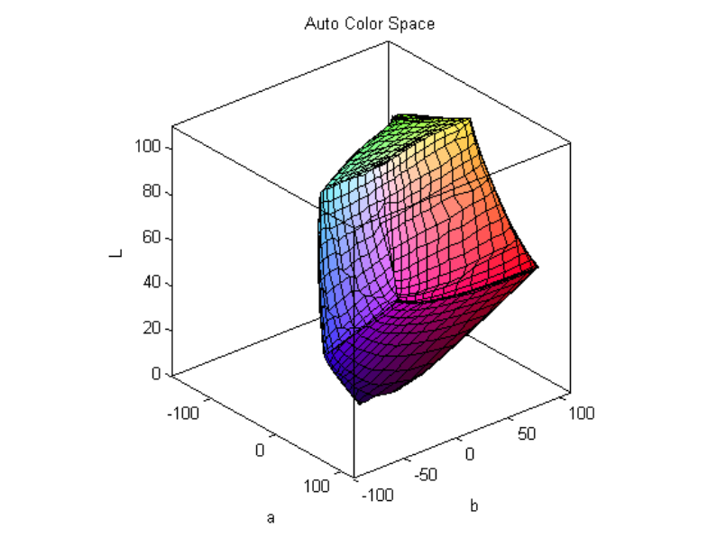
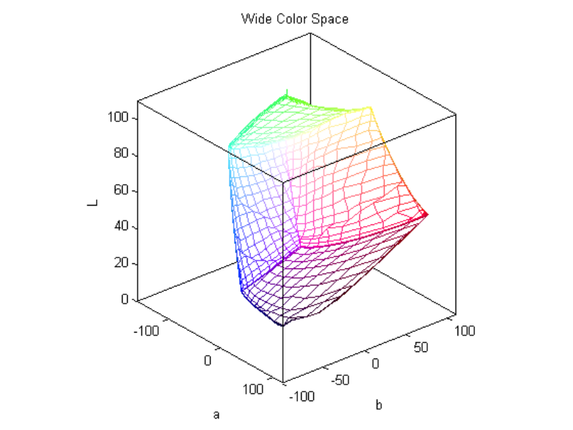
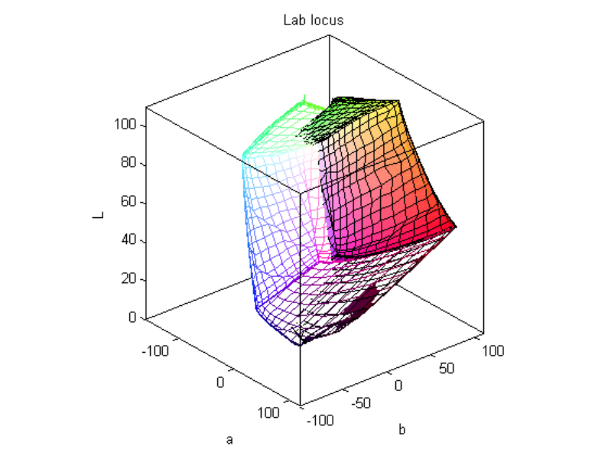
Gamut Volume
Panel A
Panel B
Comparison

Slide 8

729 Colors

Slide 9
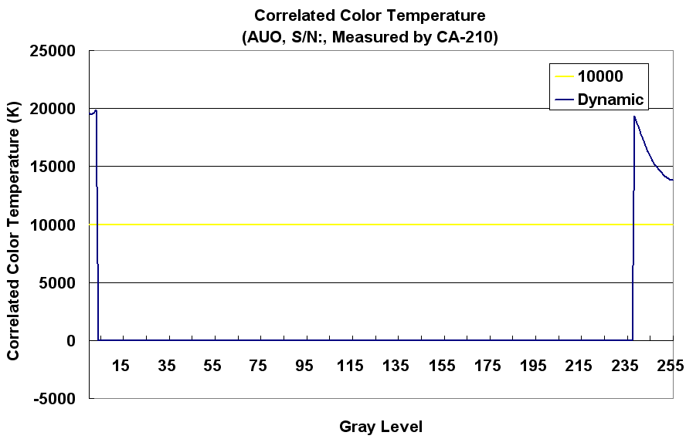
Color Temperature
Dynamic
CCT =-1 (Out of CA210 Measurement Range, >20000K)

Slide 10
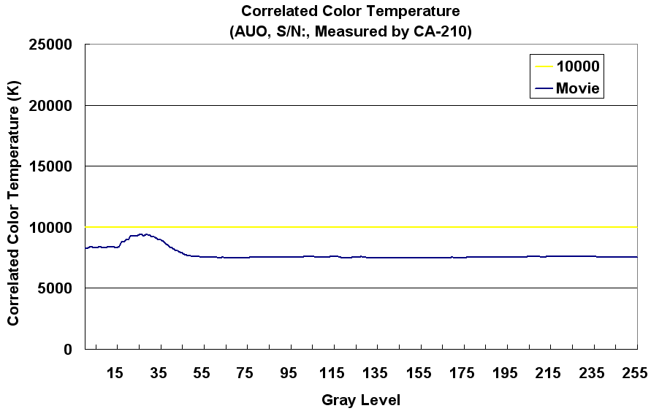
Color Temperature
Movie

Slide 11
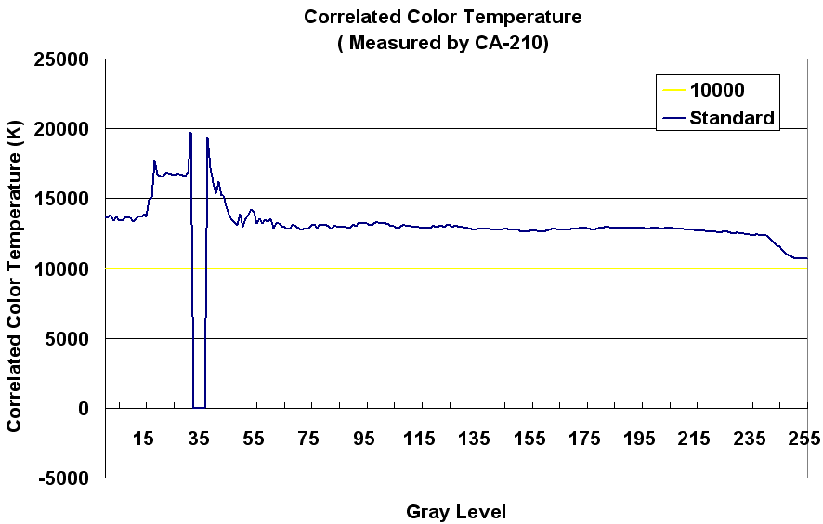
Color Temperature
Standard
CCT =-1 (Out of CA210 Measurement Range, >20000K)

Slide 12
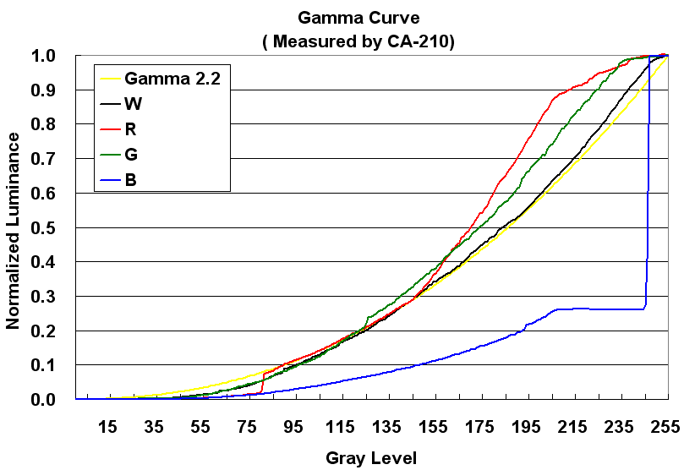
Gamma Curve
Dynamic

Slide 13
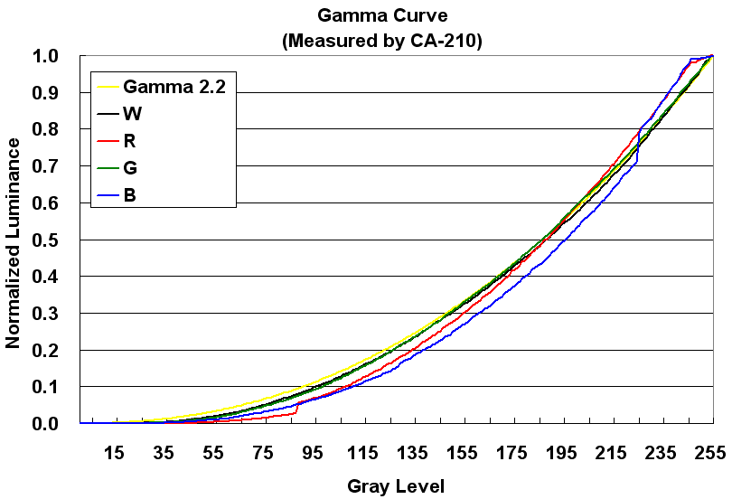
Gamma Curve
Movie

Slide 14
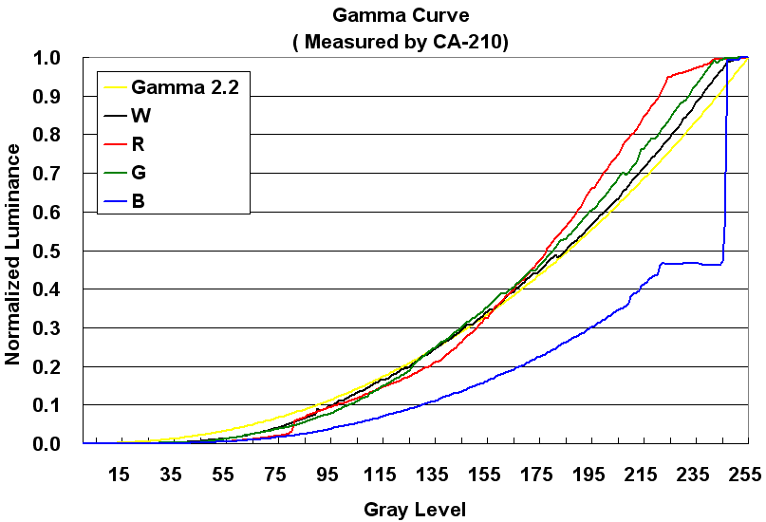
Gamma Curve
Standard

Slide 15

AUO Proprietary & Confidential

