Slide 1
Reinforcement Learning
on an example

Slide 2
Q-Learning

Slide 3
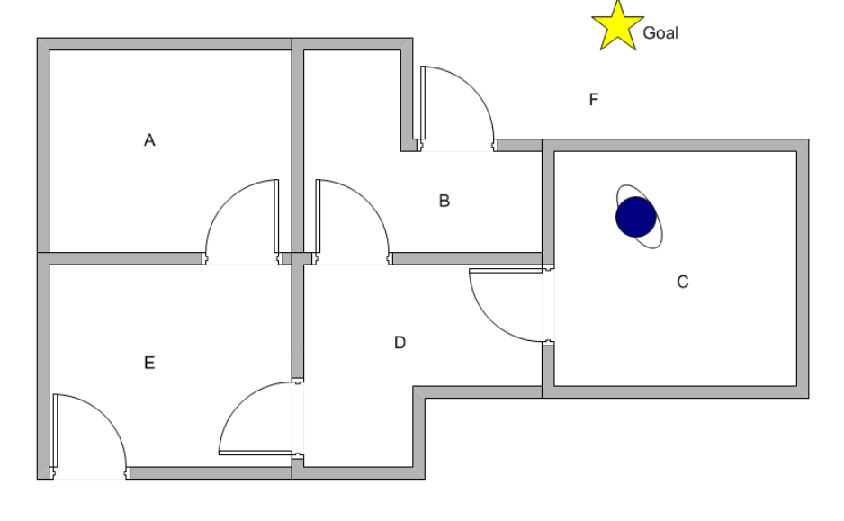
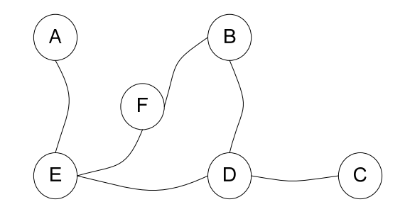

Slide 4
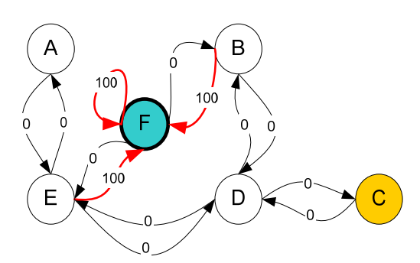
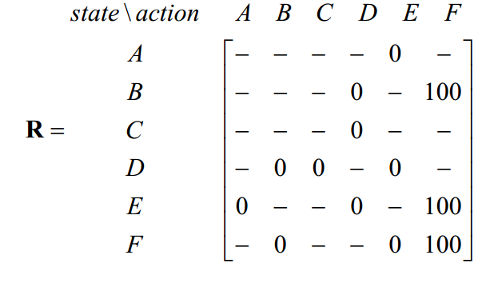

Slide 5
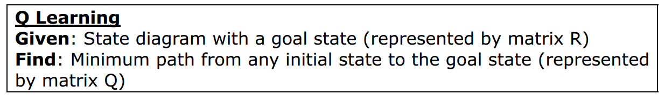
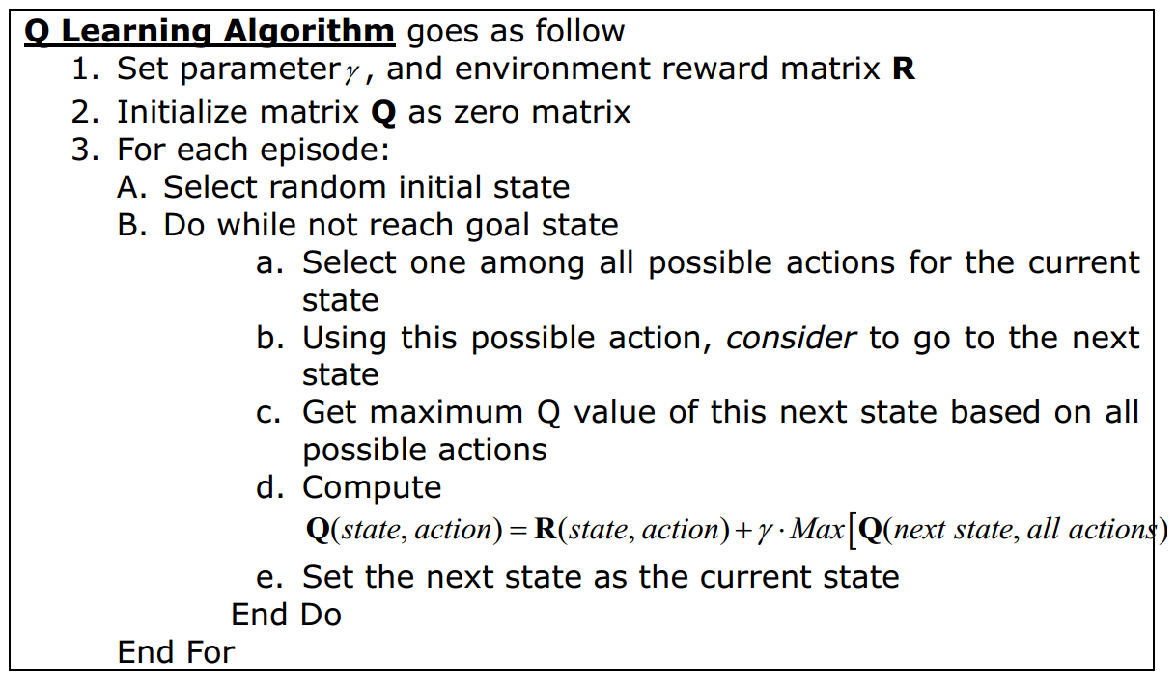

Slide 6
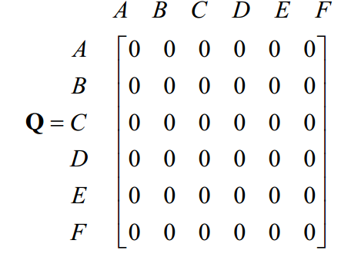
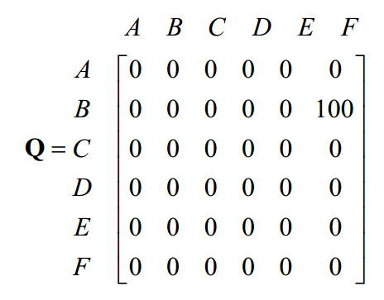
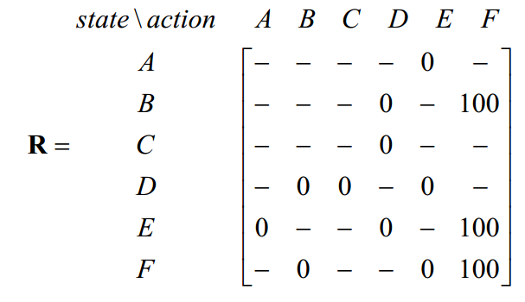
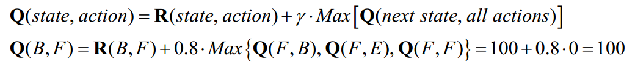

Slide 7
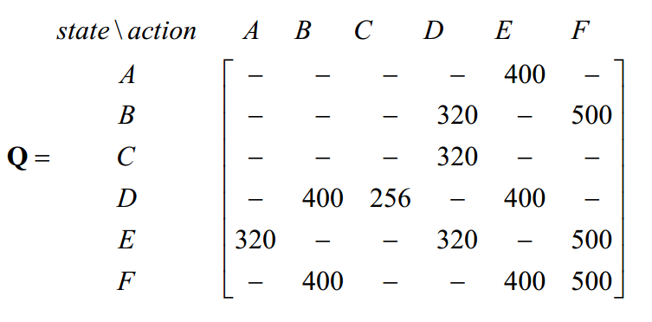
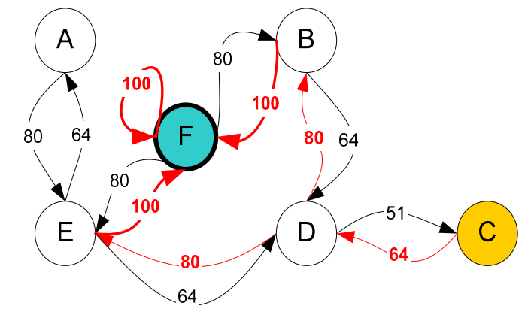

Slide 8
Towers of Hanoi

Slide 9
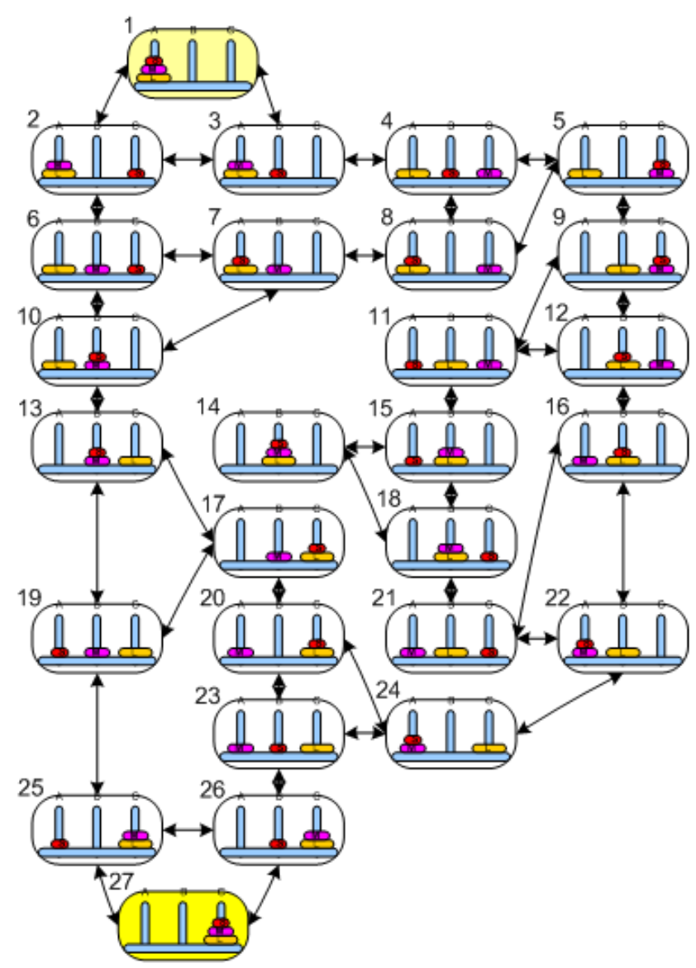

Slide 10
https://github.com/sky4walk/HanoiTowersSolver
- setRMatrix();
- hanoiGame.setLambda(lambda);
- for ( int i = 0; i < rounds; i++ ) {
String res = hanoiGame.learn();
System.out.print(".");
// System.out.print(res);
}
- System.out.print(hanoiGame.bestMoves());

